Slide 1

Music Genre Classification
Katrina Li, Cathy Guang

Slide 2
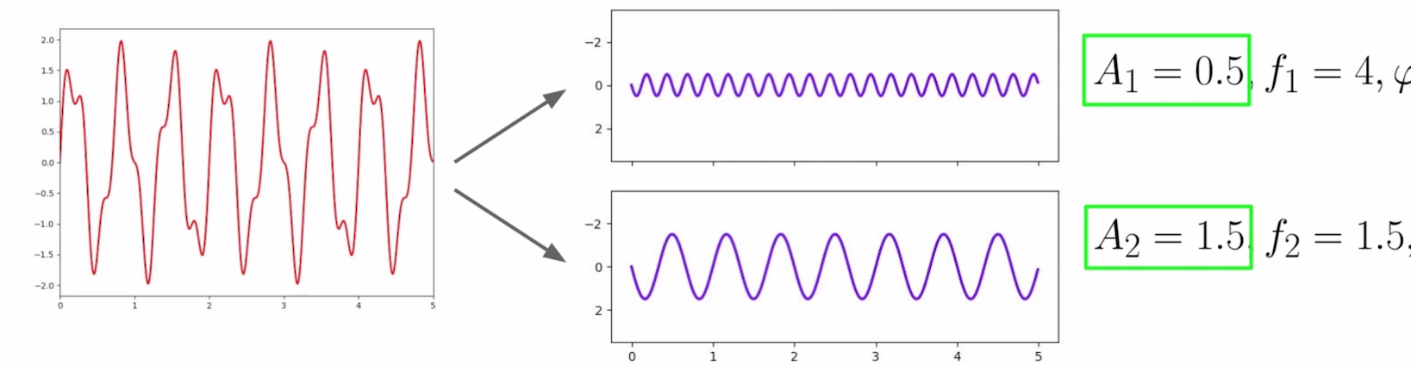
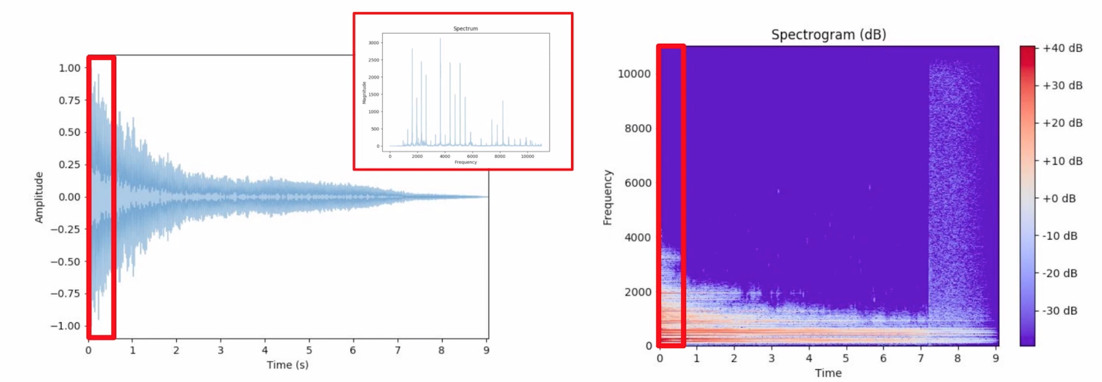
Audio Processing
Fourier transform
Short time Fourier transform
Notes:
Decompose complex periodic sound into sum of sine waves oscillating at different frequencies.
We are particularly interested in the amplitude. Because it tells us how much a particular frequency contributes to the complex sound.
We can see this 1.5 contributes more.

Slide 3
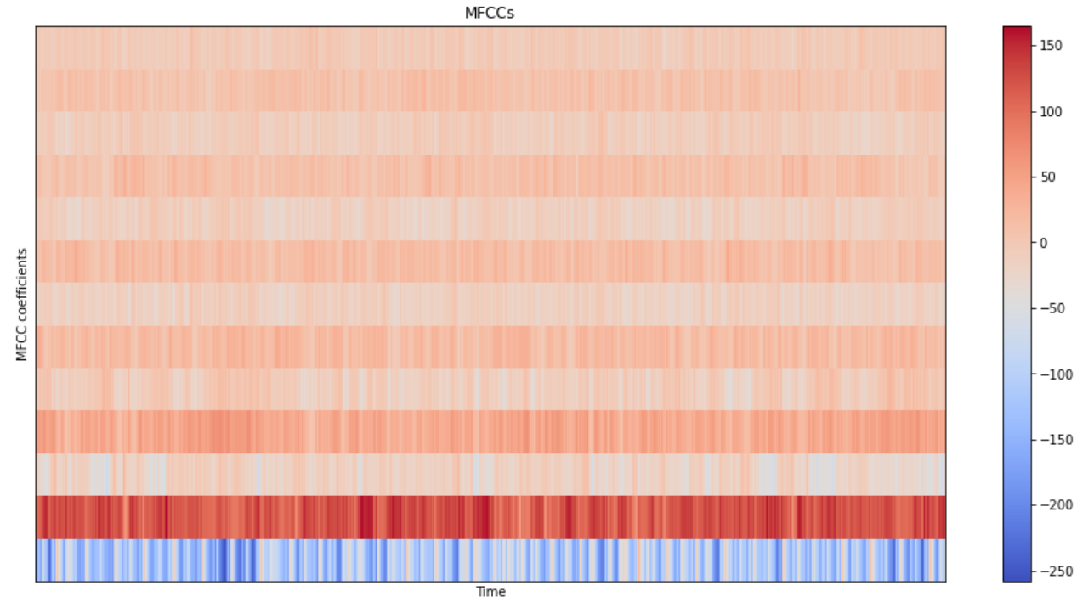
Mel Frequency Cepstral Coefficients (MFCCs)
Capture timbral/textural aspects of sound
Approximate human auditory system (advantage over spectrum)
13 to 40 coefficients (we used 13)
Calculated at each frame
Notes:
Whenever we meet an audio file, we convert it into a spectrum, representing magnitude as a function of frequency. It shows how different frequencies have different power. From time domain to frequency domain. X axis changed from time to frequency.
However, we also don’t want to lose information about time, like how music evolve with respect to time.
Short Time Fourier Transform, do FFT at different intervals. We gets a spectrogram with three axis, so that both time and magnitude are kept here.

Slide 4
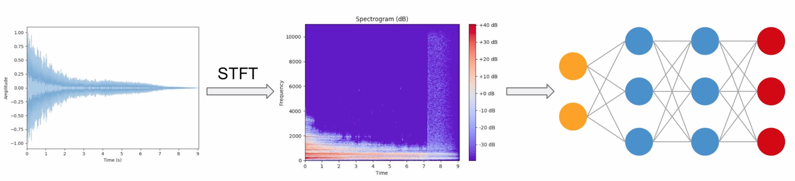
Why we chose CNN?
Notes:
CNN model is of high accuracy for image classification and recognition. Since we can transform audio into an image, CNN can help us recognize textures and timbre in our music files effectively.

Slide 5
Preprocessing Data
For each audio file
Create 10 segments (there are overlaps between each segment)
For each segment
Label their genre
Extract 13 MFCCs
Store only MFCC for segment if it has expected number of vectors
X.shape = (10000, 130, 13) Y.shape = (10000,)
Notes:
we splitted each audio file into 10 segments and extracted 13 MFCCs for each of those segments. For each segment, we distributed a label that represents the genre of the music. We created a three dimensional array to store the label and MFCCs and dumped the array to a json file to be used for training. I would like to give you a heads up that before storing each MFCC for segment, we would measure the length of the number of vector to make sure each of them is 130. Otherwise there will be a problem in the training process. After these preprocessing steps, our X would have 10000 samples, and for each samples 130 timesteps, and 13 mfcc features. For each sample, we assigned a Y value that represents the label of the segment, which became our Y. Then we did a train test split for our data, we put 60% of the data into training, 15% into validation and 25% into testing.

Slide 6
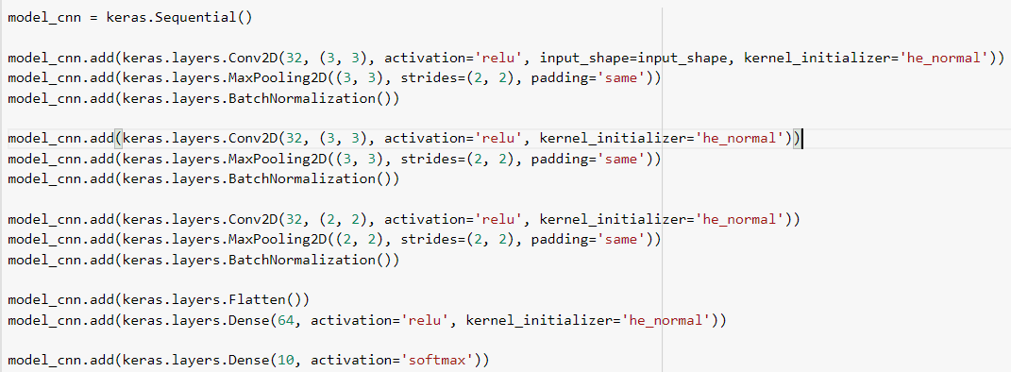
Model Structures
Hidden Layers: ReLU, he_normal
Output Layer: Softmax
Notes:
We set the three hidden layers to be Rectified Linear Unit activation functions (ReLU) because it is simple to implement and effective, and specifically, it is less susceptible to vanishing gradients that prevent deep models from being trained. We set our kernel size to be 32, For the output layer we use the softmax activation function because it is a multiple classification problem.

Slide 7
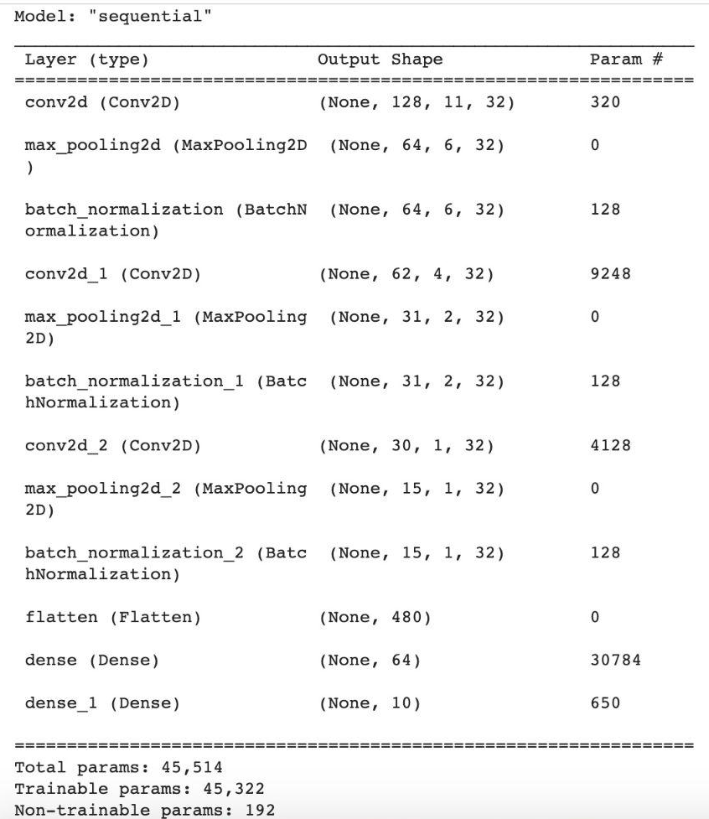
Model Structures
Notes:
This is the model summary. Then we do model.fit. The learning rate was 0.01, loss was ‘sparse_categorical_crossentropy’ and metrics was ‘accuracy’.

Slide 8
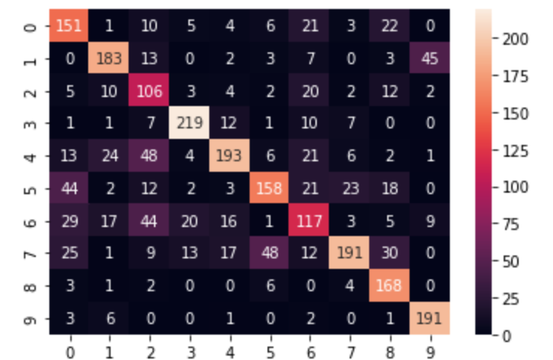
Results
Accuracy for the test data: 0.66
Notes:
Here’s the heat map of the result of our test data, as you can see it tends to classify the inputs to a type 4,5,6 or a 7 music, which are blues, reggae, rock and hiphop. We believed it was reasonable that our model confused more between these types, but recognized ‘pop’ (which is 8) and ‘classical’ (which is 9) quite well

Slide 9
Acknowledgement
Youtube channel-Valerio Velardo - The Sound of AI: https://www.youtube.com/channel/UCZPFjMe1uRSirmSpznqvJfQ
Why we choose ReLU for hidden layers: https://machinelearningmastery.com/choose-an-activation-function-for-deep-learning/
Why use he_normal for ReLU: https://machinelearningmastery.com/weight-initialization-for-deep-learning-neural-networks/

