Slide 1
Purpose: first trial
Experiment: 8-hour night measurement
Next conc:
1) Someone who has created a test to see how decision making and problem solving skills change with exposure to Carbon dioxide (or anything else that might impact these brain functions)
2) The biochemistry of why elevated carbon dioxide impacts brain function
Bring a printed copy of your articles to share with each of us ( 5 copies). We can talk about the articles and how you found them when we meet tomorrow.
Change parameter into variable(Cout and Q and S)
Does s change
During non-REM sleep (about 80% of an adult's sleeping time), you breathe slowly and regularly. But during REM sleep, your breathing rate goes up again. (https://www.webmd.com/sleep-disorders/what-happens-body-during-sleep) => short time model
A normal respiratory rate varies based on age and activity levels (https://www.medicalnewstoday.com/articles/324409)
The (human) respiratory rate at rest (https://www.ncbi.nlm.nih.gov/pmc/articles/PMC9596596/)
Respiration rate (https://www.cosinuss.com/en/measured-data/vital-signs/respiration-rate/)
Heart rate
How does c out change
Hard to model
Change data time used
Exponential equation
Data:
Observations:
Max at about 3h
Equilibrium at about 1000 ppm
Tested by temtop 6, on 6/3-6/4
Next:
add decay measurement
Test the decay time
Measure room size:
Mathias 214 18ft6 * 11ft5 * 8ft74= 5.6388 meters * 3.4798 meters * 2.66 meters = 52.194244 m3
Date: 6/4/2024
Data: IAQ24->#1. Jun3_8h_CX

Slide 2
Purpose: first trial
Experiment: 8-hour night measurement
Humidifier conc:
- Humidifier type
two main types: ultrasonic and evaporative humidifiers (https://learn.kaiterra.com/en/air-academy/humidifiers-cause-poor-air-quality)
Ultrasonic humidifiers work by submerging a thin metal plate vibrates at a sufficient frequency, the water can’t stick to it anymore, and the waves create a vacuum between the water and the plate. Then, this vacuum makes the water “explode” (at a very minuscule level), and the water droplets disperse into the air. From here, the water has a greater surface area to evaporate, and your air becomes humid more quickly.(droplet)
Evaporative: a wick inside absorbs water from a water basin. The humidifier then uses a fan to blow air across the wick, enabling evaporation at a faster rate.
Water droplets: If the water you put in the humidifier’s reservoir contains other minerals, these droplets will have the same minerals.
While ultrasonic humidifiers do release white dust, scientists still aren’t sure what to make of this material. In a study on mice, researchers discovered that inhaling the dust from ultrasonic purifiers produces a cellular response, but this response lacks the inflammation and damage associated with other forms of particulate matter. As of now, the results are inconclusive.
Humidifier used last summer is evaporative
Date: 6/4/2024
Data: IAQ24

Slide 3
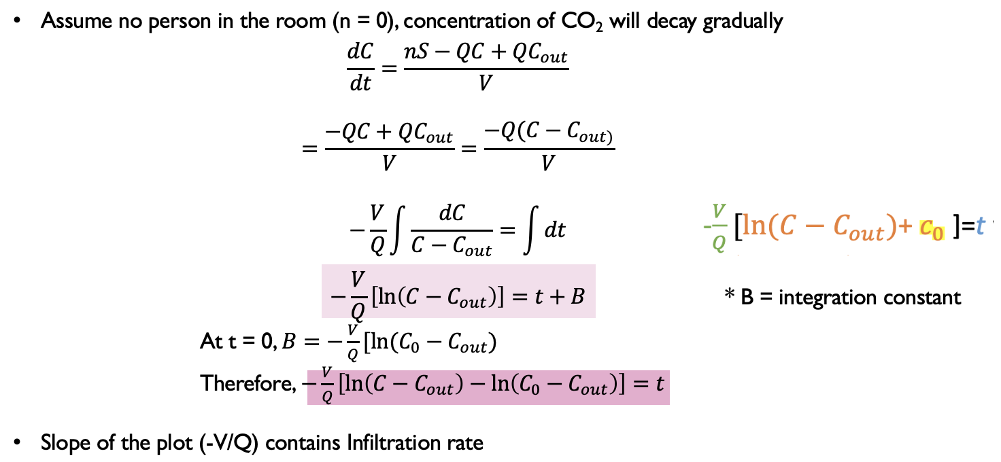
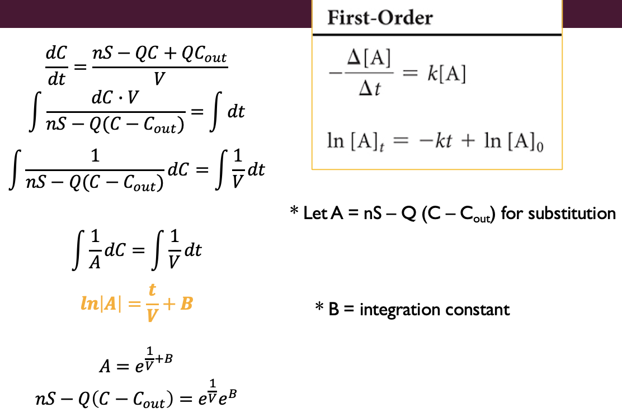
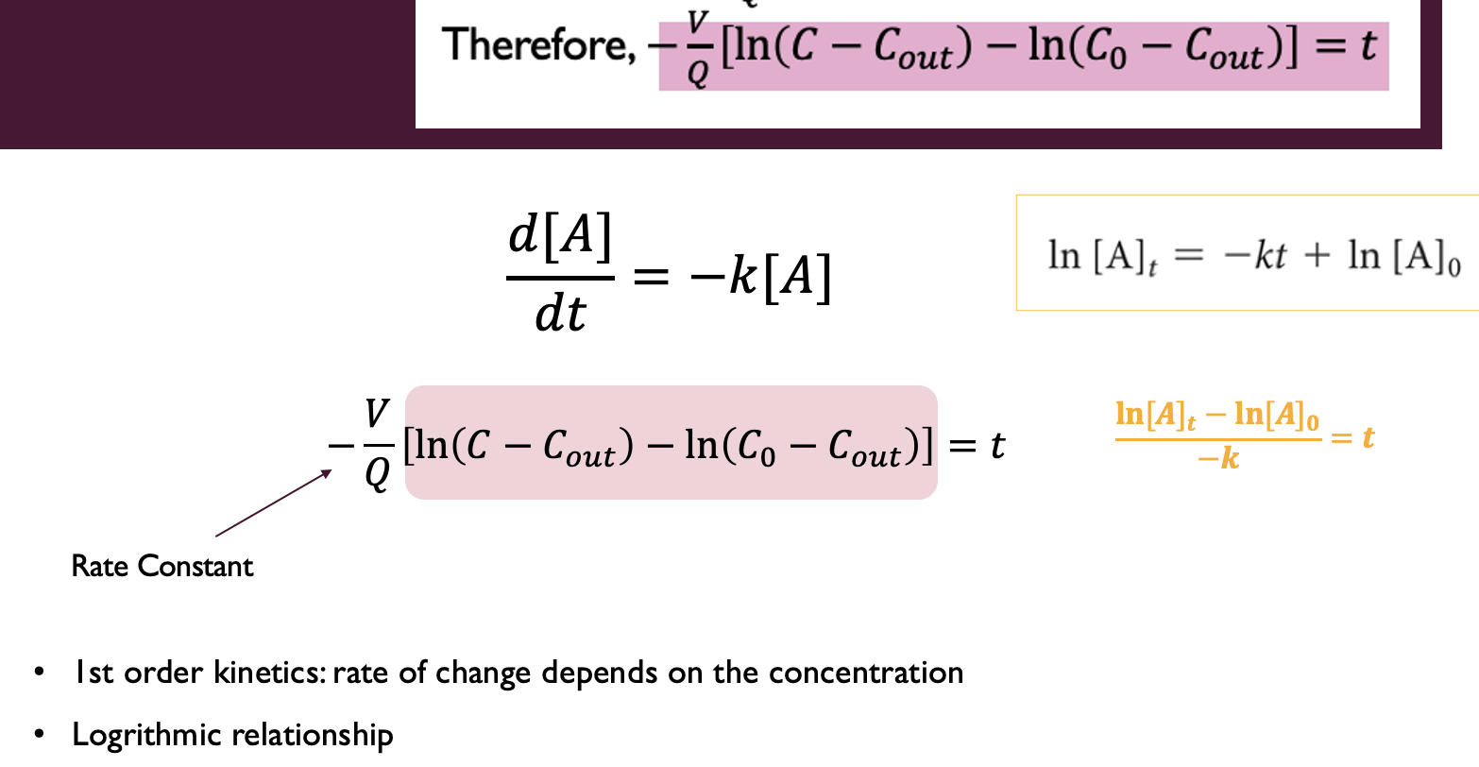
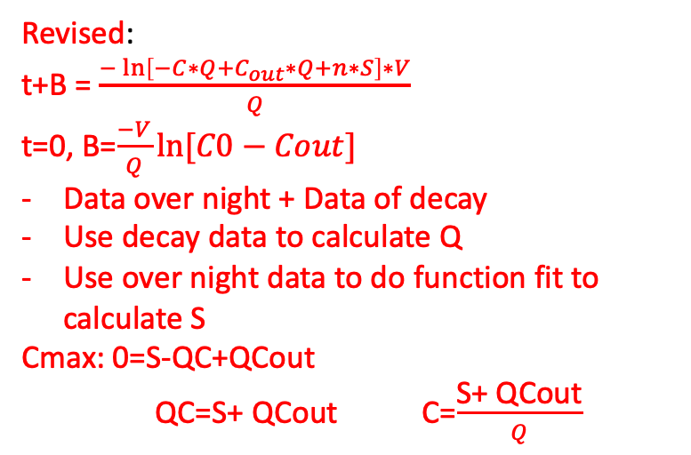
Find rate constant V/Q
Wrong: should be (lnA)/Q
Solve the deferential equation
Revised:
t+B = $\frac{−\ln\left[−C∗Q+C_{out}∗Q+n∗S\right]∗V}{Q}$
t=0, B=$\frac{−V}{Q}ln⁡[C0−Cout]$
Data over night + Data of decay
Use decay data to calculate Q
Use over night data to do function fit to calculate S
Cmax: 0=S-QC+QCout
QC=S+ QCout C=$\frac{\text{S}\text{+ }\text{QCout}}{Q}$
Find it is first order
Date: 6/4/2024
Data: Seminar Presentation Final, Mathematica IAQ24_1

Slide 4
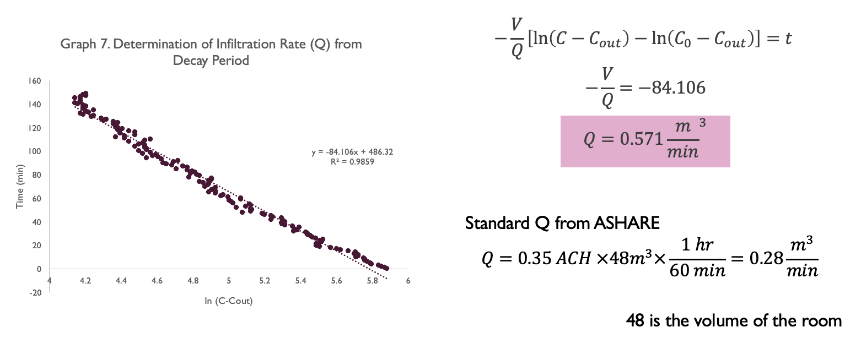
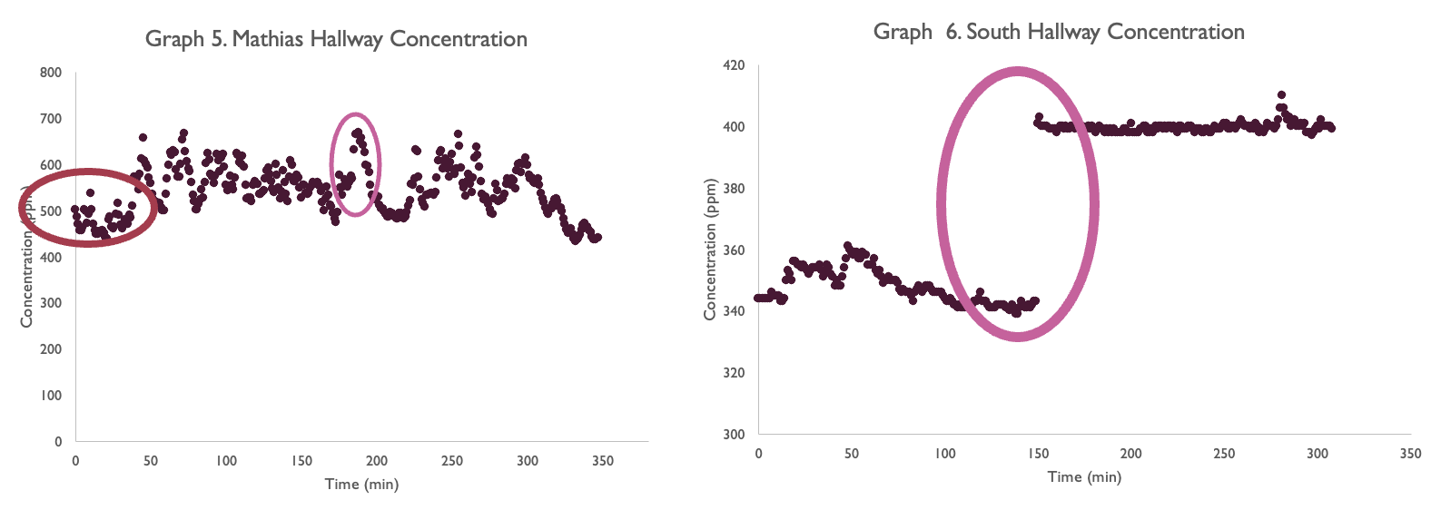
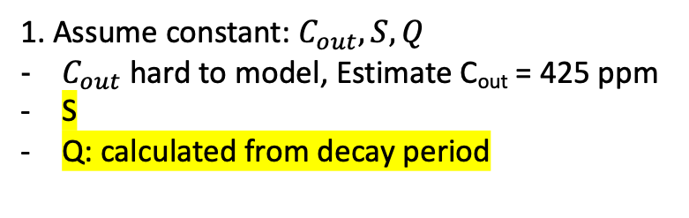

$$\frac{dC}{dt}=\frac{nS−QC+QC_{out}}{V}$$
1. Assume constant: $C_{out}, S, Q$
$C_{out}$ hard to model, Estimate C_{out} = 425 ppm
S
Q: calculated from decay period
2. Change data time used for function fit

Slide 5
Purpose: first trial with decay/ derive equation
Experiment: 8-hour night measurement
Next:
Mathematica graph function fit S
Check Q value should be ln(C-Cout)=x, t=y
Compare with esa’s Q
Difference between theorical data?
Fit with a shorter time
When can you publish paper (Q without blower door test)
Calculate ACH
Research model why
Calculation:
Decay rate-> Q
Function fit -> S
Use Q and S to see if Cmax is the same using 8h data and 3h data
Read 7 paper
Hallway plot
How to import data from excel to mathematica
Data of decay:
Observations:
Initial at 1023ppm, ending at 992ppm after 25 min
Over night data also collected
Tested by temtop 6, on 6/4-6/5
Q= 40346.19 m^3/min
V= 84.727 m^3, slop=-V/Q=-0.0021c
Date: 6/5/2024
Data: IAQ24->#2. Jun5_decay_CX

Slide 6
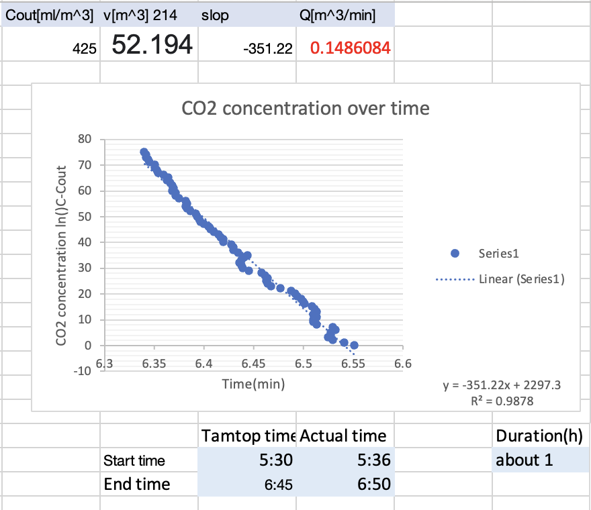
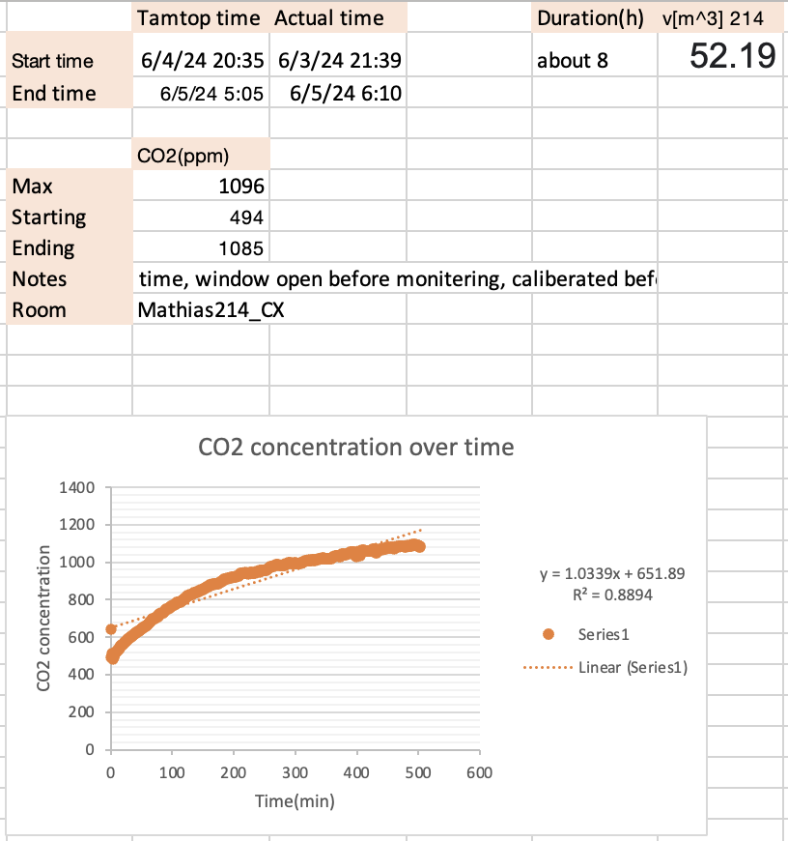
Purpose: second trial with decay/ derive equation
Experiment: 8-hour night measurement
Next:
Mathematica graph function fit S
Difference between theorical data?
Fit with a shorter time
When can you publish paper (Q without blower door test)
Calculate ACH
Are S/metabolism for me and You jung different? How much?
Data of decay and Observation:
Tested by temtop 6
You jung’s calculated = 0.24 (senior presentation)
Date: 6/6/2024
Data: IAQ24->#2. Jun5_decay_CXand #2. Jun4_8h_CX

Slide 7
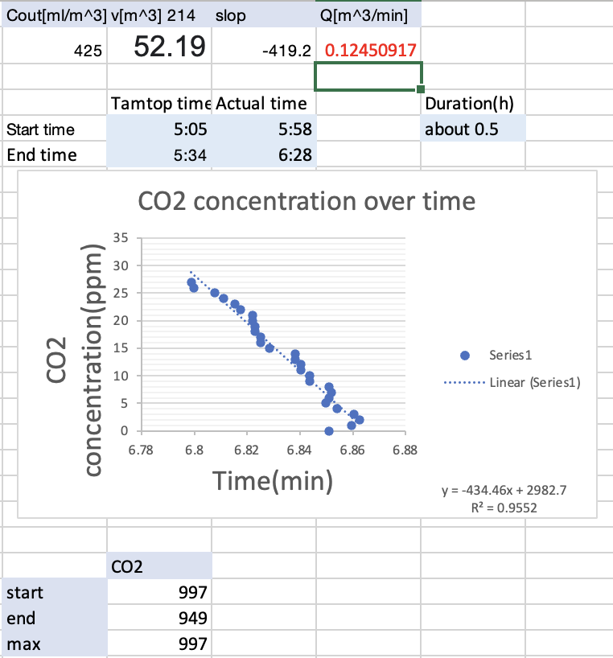
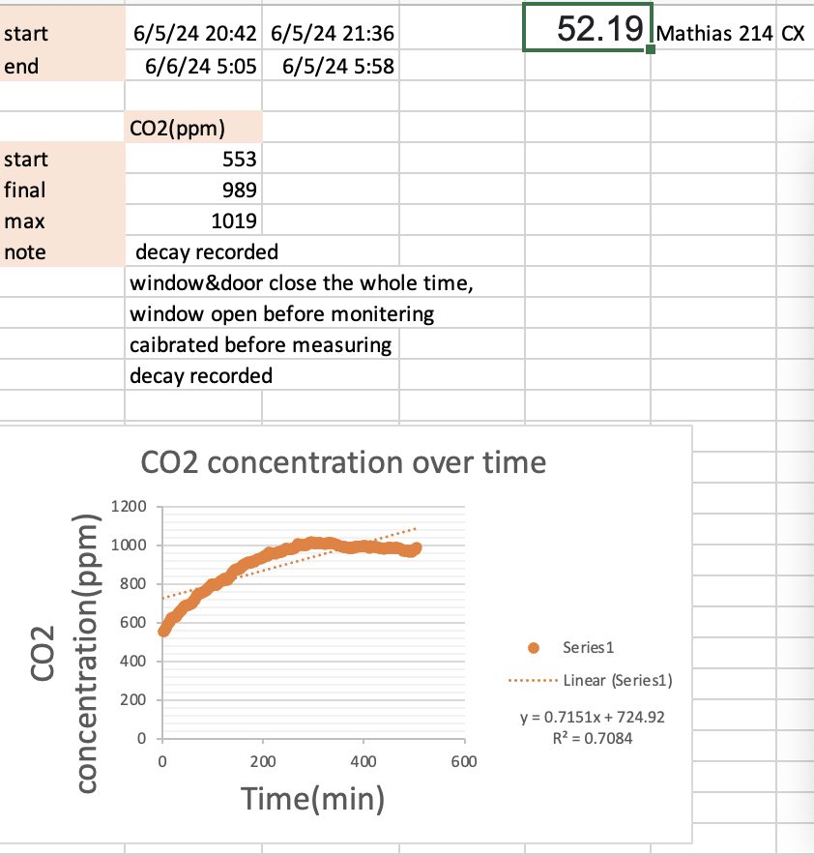
Purpose: second trial with dacay/ derive equation
Experiment: 8-hour night measurement
Data of decay and Observation:
Tested by temtop 6
Date: 6/6/2024
Data: IAQ24->#4. Jun6_decay_CX and #4. Jun5_8h_CX

Slide 8
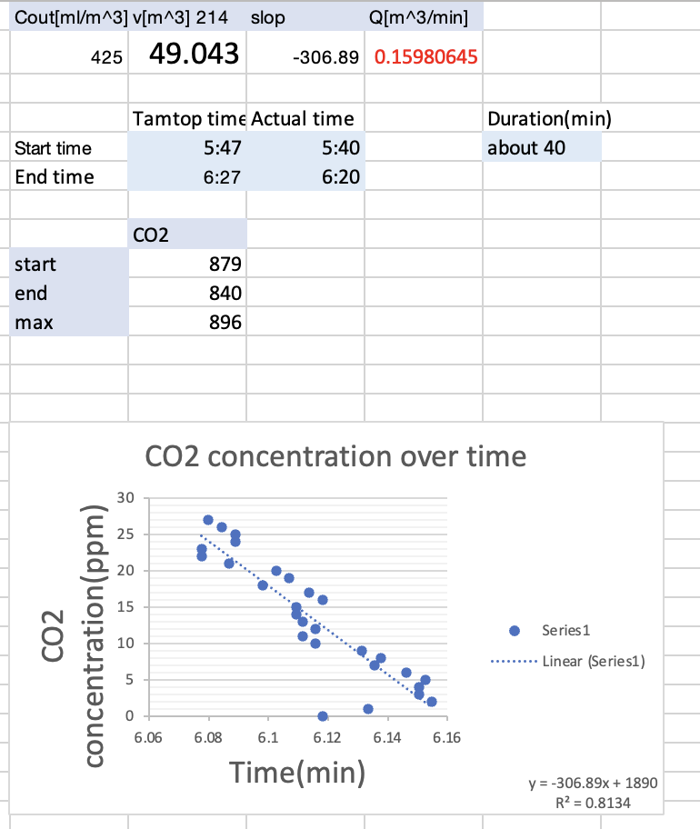
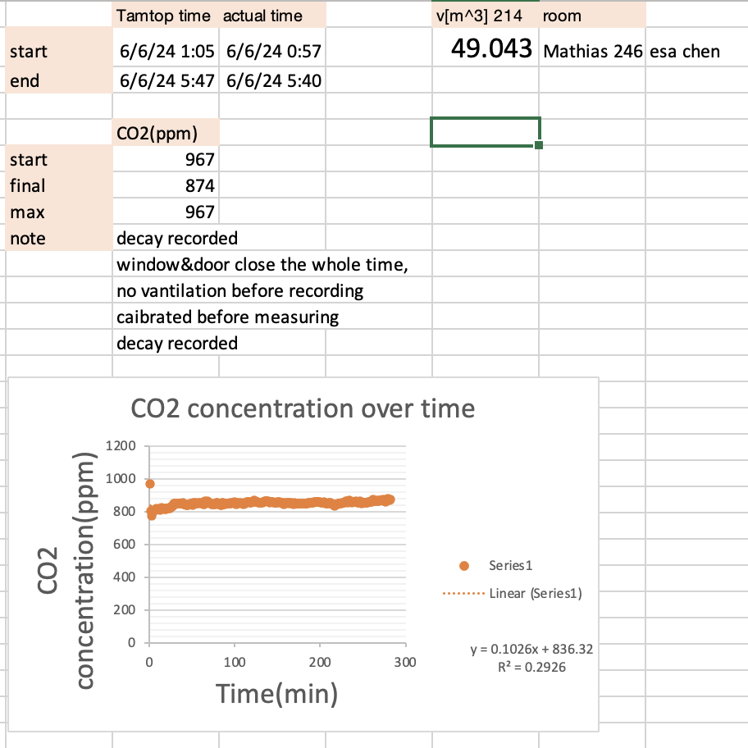
Purpose: third trial with decay ESA
Experiment: 8-hour night measurement
Data of decay and Observation: Tested by temtop 7
Date: 6/6/2024
Data: IAQ24-> #5. Jun6_decay_EC and #5. Jun6_6h_EC

Slide 9
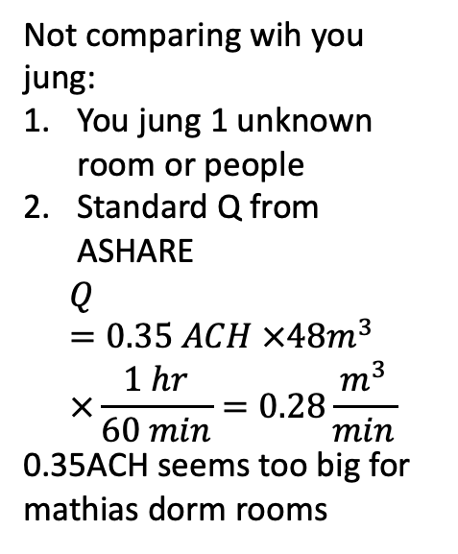
Purpose: Q value comparing
 | Q (m^3/min) calculated from decay (not rounding) | Data from | Tested location | Tested device
Cathy Xiao 1 | 0.148 | 6/4-6/5 decay (IAQ24) | Mathias 214 (52.194244 m3) | temtop 6
Cathy Xiao 2 | 0.124 | 6/5-6/6 decay (IAQ24) | Mathias 214 (52.194244 m3) | temtop 6
Esa Chen | 0.158 | 6/5-6/6 decay (IAQ24) | Mathias 246 (49.043m3) | temtop 7
You Jung 1 | 0.571 | Senior presentation calculated | ? | ?
You Jung 2 | 0.28 | Senior presentation from ACH | ? | ?
Not comparing wih you jung:
You jung 1 unknown room or people
Standard Q from ASHARE
$$Q=0.35 ACH ×48m^{3}×\frac{1 hr}{60 min}=0.28\frac{m^{3}}{min}$$
0.35ACH seems too big for mathias dorm rooms
Date: 6/7/2024
Data: previous slides

Slide 10
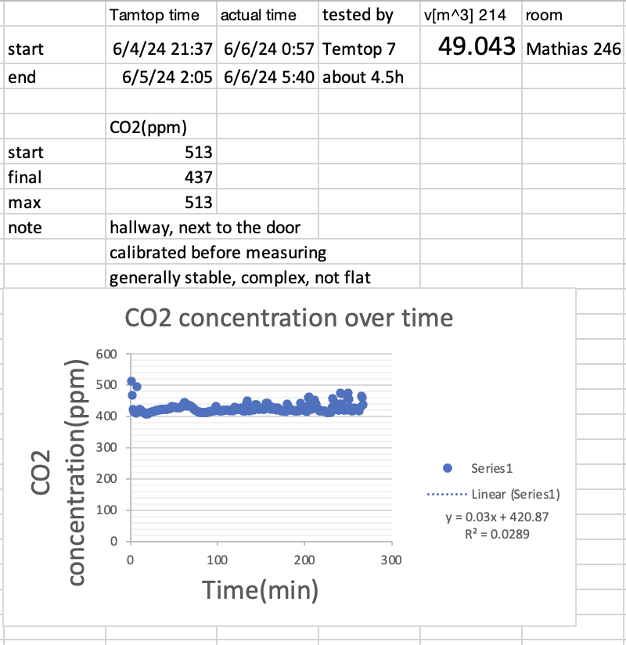
Purpose: 1. hallway; 2. room volume; 3. Q
Experiment: #3. hallway measured
Mathias Room volume:
Length * width * height
(1L=0.001m^3)
Mathias 214: 18ft6 * 11ft5 * 8ft7.4= 51 534.1634 liters
= 51. 534 m3 (V1)
Mathias 246: 18ft9.5 * 11ft8.75 * 8ft8 = 54 091.5516 liters
= 54.091 m3(V1)
Average height: of 8 feet 7.4 inches (2.626 m) and 8 feet 8 inches (2.6416 meters) = 8 feet 7.7 inches (8.6417 feet)
= 2.634 m
Using average height:
Mathias 214= 51.68 m3 (V2)
Mathias 246= 53.94 m3(V2)
For future slides:
Q1=infiltration rate calculate from V1 (by measured height)
Q2= infiltration rate calculate from V2 (by averaged height)
Data of decay and Observation:
Date: 6/9/2024
Data: IAQ24-> #3. Jun4-5_4.5h_hallway

Slide 11
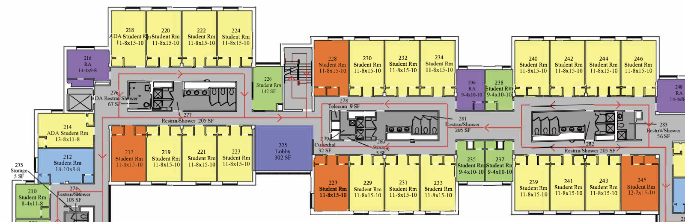
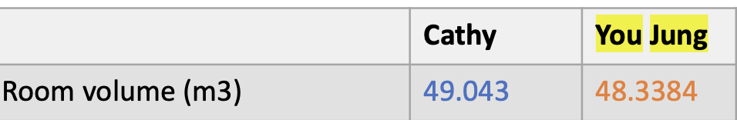
V=49.043
V1= 54.091 m3
V2=53.94 m3
V1= = 51. 534 m3 (V1)
V2= 51.68 m3
48.3384
Date: /2024
Data: IAQ24->

Slide 12
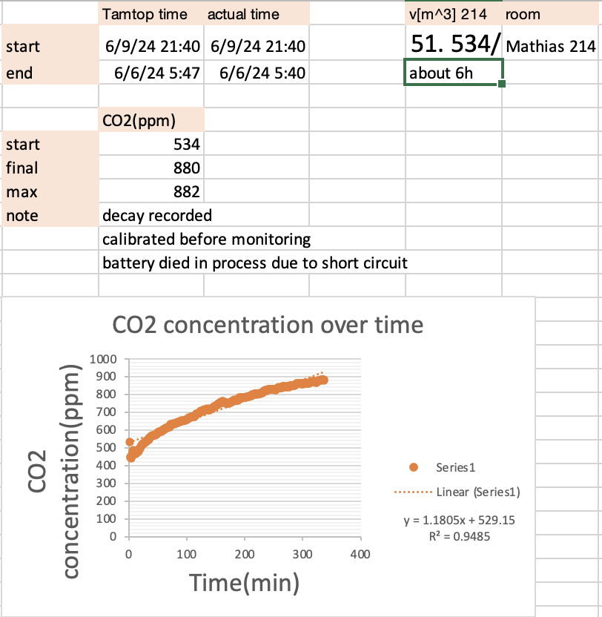
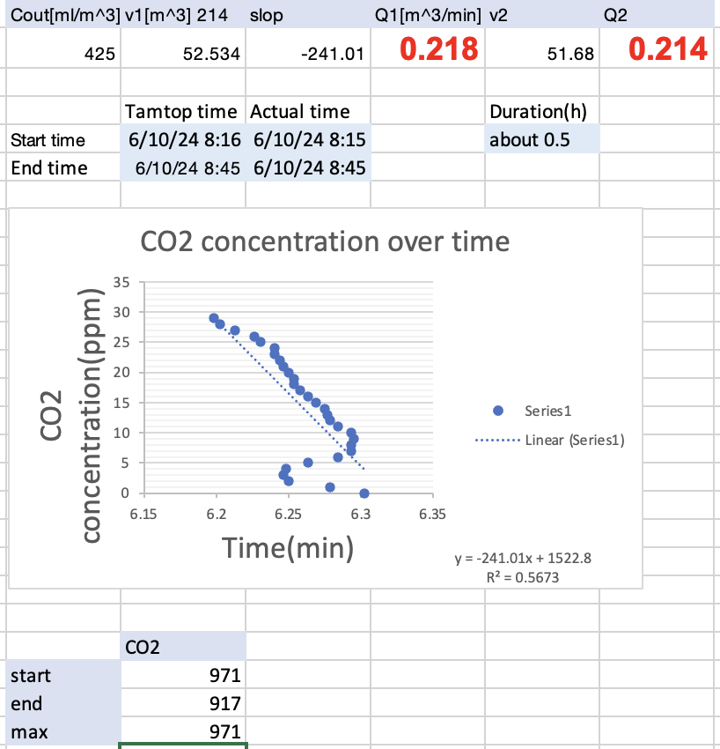
Purpose: test when humidify is high (CX and EC)
Experiment: overnight data collection and decay
6/9 is raining
The other tested days has max humidity around 30%
6/9 max humidity=62.9 (doubled)
6/10 max humidity=45.4
Data of decay and Observation:
Date: 6/10/2024
Data: IAQ24->#6. Jun9_6h_CX and #6. Jun10_decay_CX

Slide 13
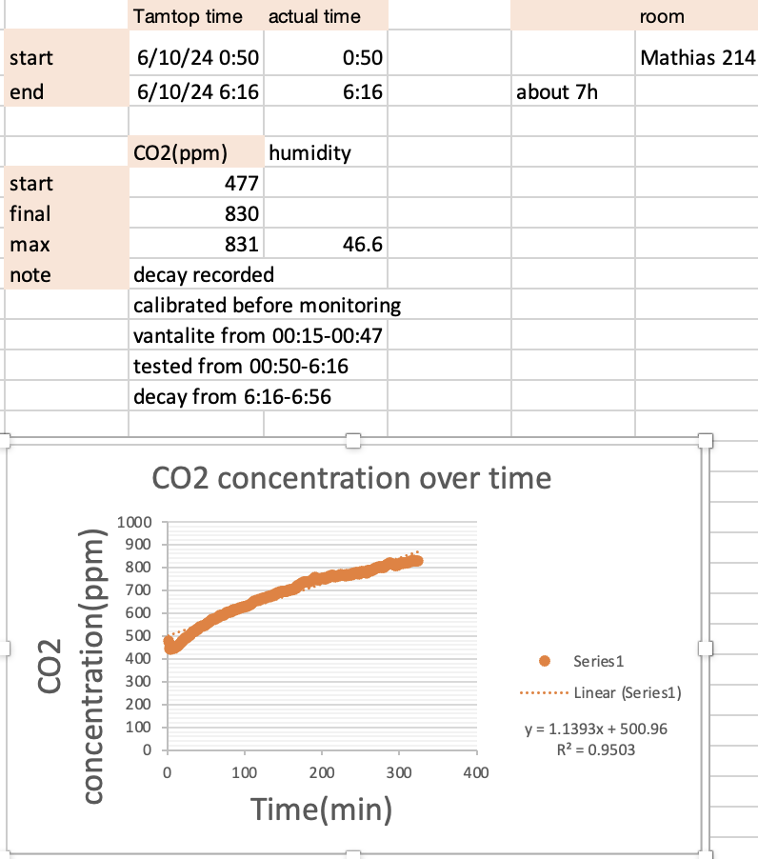
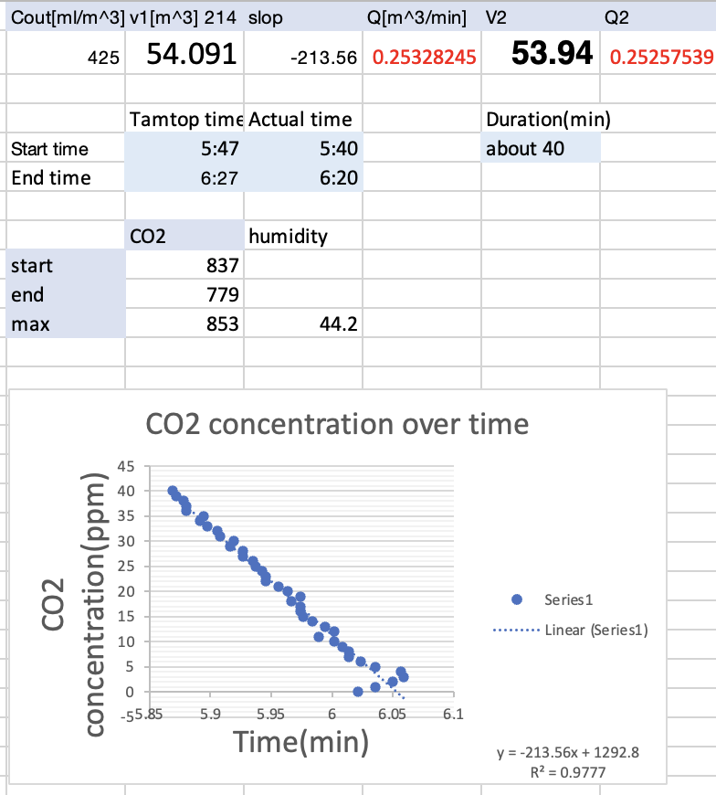
Compare normal days with high humidity days:
CX: usually Q around 0.16 (average of 0.14 and 0.19)
Q (#)
Usual | Humid
Q= 0.16 | Q=0.25
Mathias 218 | Mathias 218
Cmax=
Date: 6/11/2024
Data: IAQ24-> #7. Jun10_7h_EC and #7. Jun10_decay_EC

Slide 14
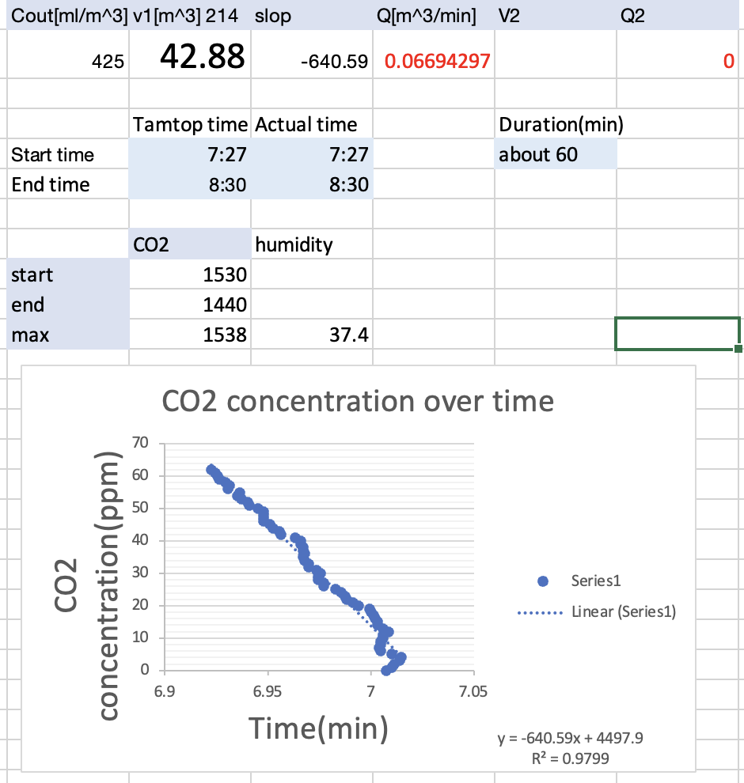
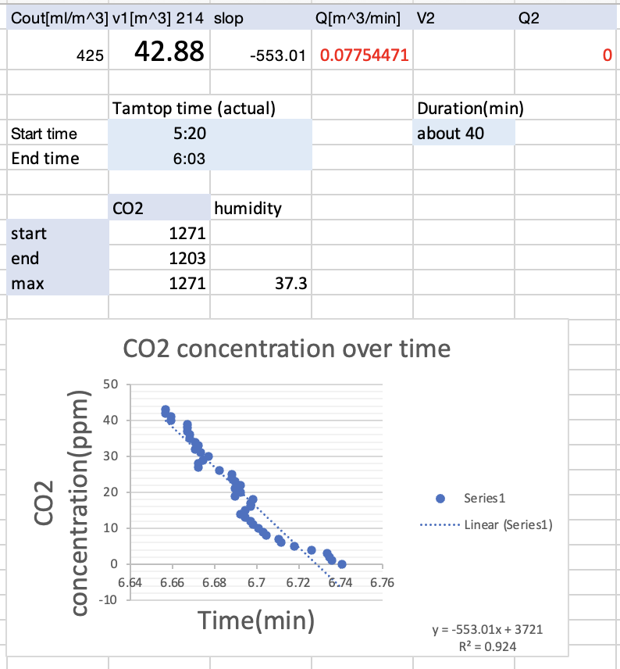
Purpose: test reproducibility at Baca
Experiment:
One person in 3-person bedrooms at A x3
One person in apartment bedroom x1
Overnight data with decay –calculate Q
All 4 people in 3-person bedrooms peak till about 2500 ppm (CO2) for 3 times –see if reproductivity
All 4 people in apartment bedrooms peak till about 2500 ppm (CO2) for 3 times –see if reproductivity
For #2 and #3, various activities were performed (singing, dancing, jumping, etc)
Data of decay and Observation:
4.75m*3.7m*2.44m = 42.883m3
All bedrooms identical
Date: 6/12/2024
Data: IAQ24->#8. Jun11_decay_CX and #10. Jun12_decay_CX

Slide 15
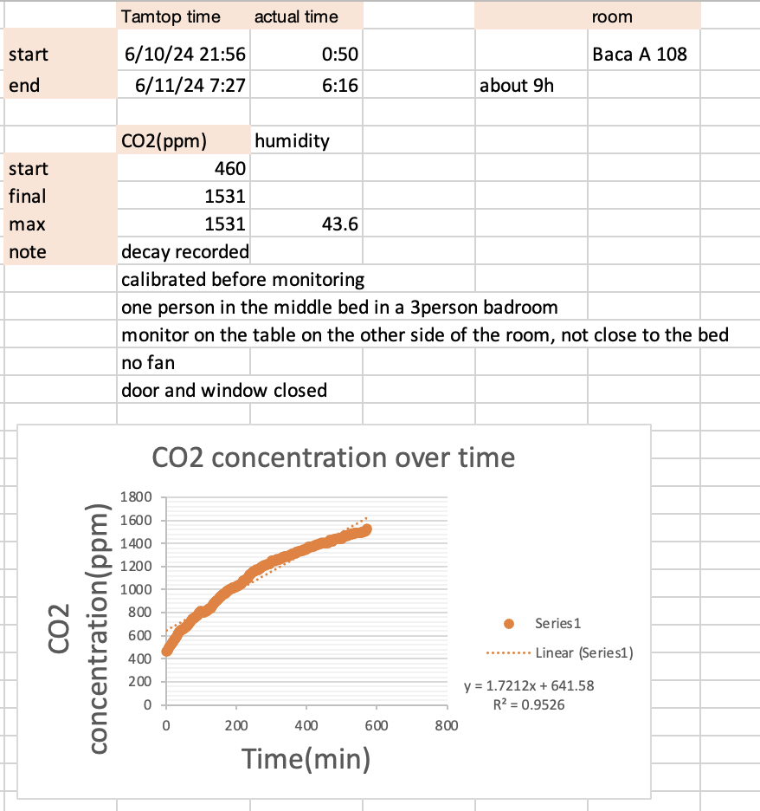
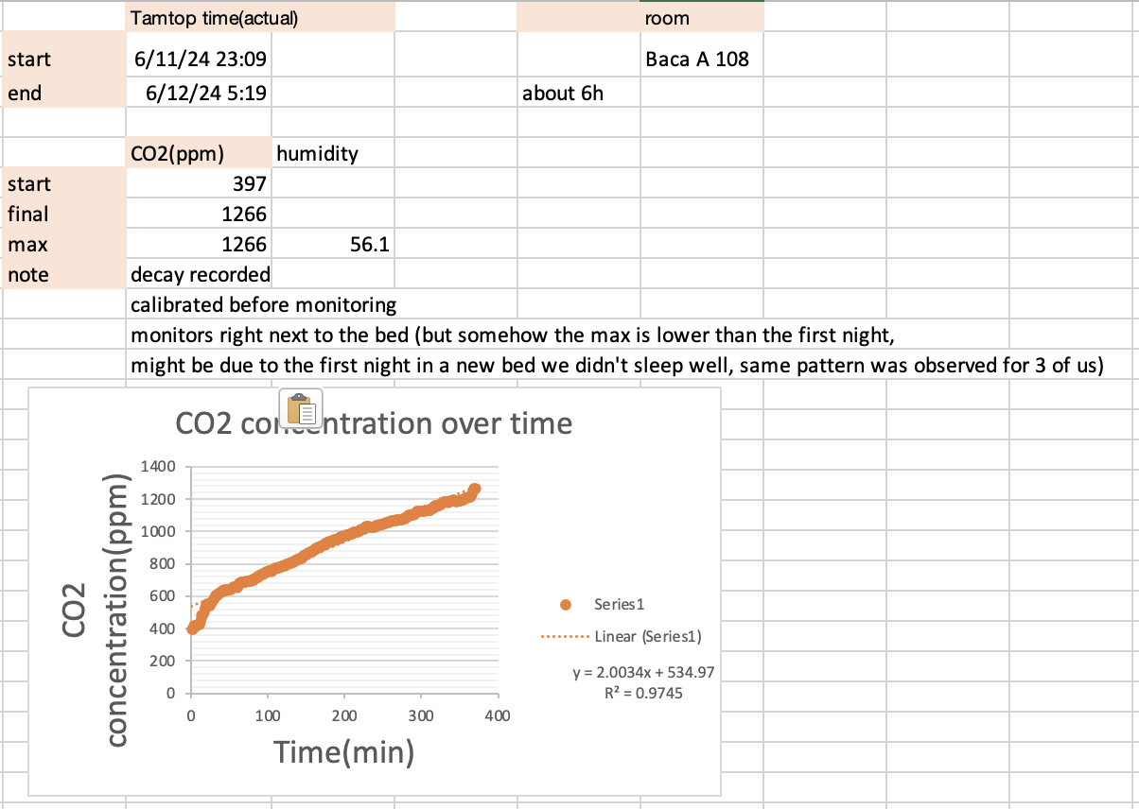
#8 and #10
Date: 6/13/2024
Data: IAQ24-> #8. Jun10_9h_CX and #10. Jun11_6h_CX

Slide 16
 | Q (m^3/min) calculated from decay (not rounding)excel | Data from | Tested location (m3) | Tested device | Q Mathematica | S Mathematica
Cathy Xiao 1 | Q1= 0.1486 Q2=0.1471 | 6/4-6/5 decay (IAQ24 #2) | Mathias 214 (V1=51. 534 V2=51.68) | temtop 6
Cathy Xiao 2 | Q1=0.19853 Q2=0.199 | 6/5-6/6 decay (IAQ24 #4) | Mathias 214 (V1=51. 534 V2=51.68) | temtop 6
Esa Chen | Q1= 0.1762 Q2=0.1757 | 6/5-6/6 decay (IAQ24 #5) | Mathias 246 (V1=54.091 V2=53.94) | temtop 7
Cathy Xiao 3 (doubled humidity) | Q1=0.218 Q2=0.214 (~doubled Q) | 6/9-6/10 decay (IAQ24 #6) | Mathias 214 (V1=51. 534 V2=51.68) | temtop 7
Esa Chen 2 (doubled humidity) | Q1=0.2532 Q2=0.2525 (~doubled Q) | 6/9-6/10 decay (IAQ24 #7) | Mathias 246 (V1=54.091 V2=53.94) | temtop 6
Cathy Xiao 4 (Baca) | 0.06694 | 6/10-6/11 decay (IAQ24)(#8) | Baca A 108 | Temtop 6
Cathy Xiao 5 | 0.07754 | 6/11-6/12 decay (IAQ24)(#10) | Baca A 108 | Temtop 6

Slide 17
Compare s with last summer
Mathematica
Maybe other language
High humidity day Q
Patric

