Slide 1
Chapter 3-hardware

Slide 2
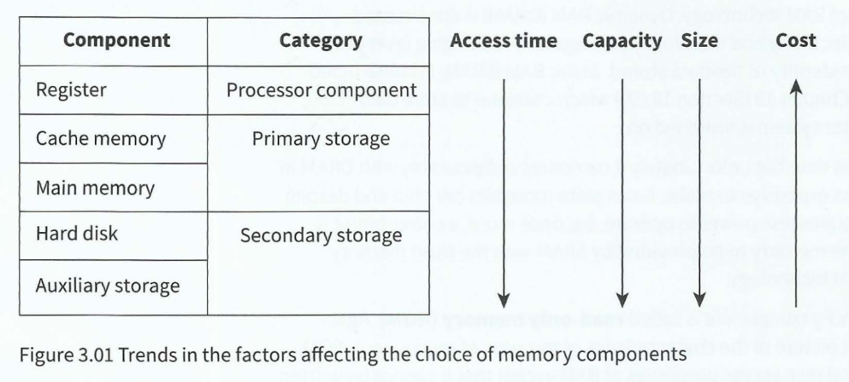
Computer system：
1）run programs *speed
2) store data * capacity and cost
—the memory system hierarchy

Slide 3
Memory components
cache memory +main memory→primary storage.
Random-access memory (RAM): volatile memory that can be read from or written to any number of times
1）can be repeatedly read from or written to
2）volatile
3）SRAM/DRAM
Read-only memory (ROM): non-volatile memory that cannot be written to but can be read from any number of times
1） cannot be written to
2） the data in ROM is not lost when the computer system is switched off

Slide 4
Secondary storage devices
Magnetic media
-sector → smallest unit of storage
-A hard drive is considered to be a direct-access read-write device
because any sector can be chosen for reading or writing.
However, the data in a sector has to be read sequentially.

Slide 5
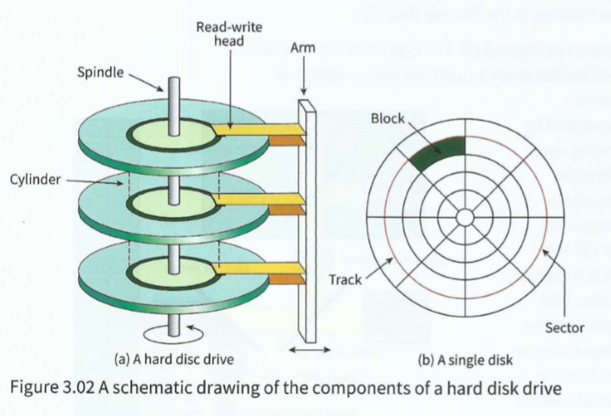
Points to note about the physical construction are that there is more than one platter (disk) and that each platter has a readwrite head for each side. The platters spin in unison. The read-write heads are attached to actuator arms which allow the heads to move over the surfaces of the platters. The motion of each actuator head is synchronised with the motion of the other heads. A cushion of air ensures that a head does not touch a platter surface.

Slide 6
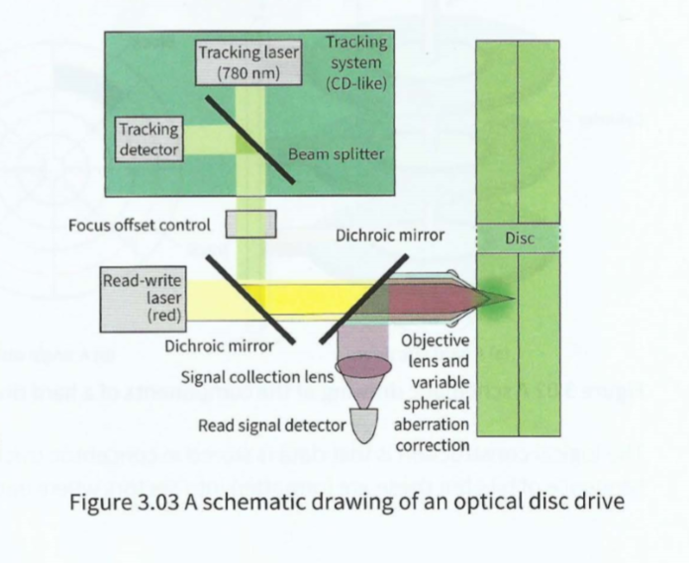
Optical media
The disc spins and the laser beam is reflected from a surface which is sandwiched between a substrate and a protective outer coating.
For a CD-ROM, the reflective surface is manufactured with indentations, called 'pits', separated by what are referred to as 'lands'. When the disc is being read, the travel of the laser beam to a pit causes a difference in phase compared to reflection from a land. This phase difference is recognised by the photodiode detector and attached circuitry and interpreted as a 1 or 0.

Slide 7
Solid-state media
The most frequently used technology is called 'NANO'
The special feature is that blocks of memory cells can have their contents erased all at once 'in a flash'. Furthermore, before data can be written to a block of cells in the memory the data in the block first has to be erased. When data is read, a whole block of data has to be read in one operation.

Slide 8
Computer graphics
Halftoning: approximated a grey tone by printing an array of black dots; varying the size of the dots changed the tone displayed.

Slide 9
Screens and associated technologies
The first is the behaviour instigated by a button click which needs no further discussion
the second is the operation of the mouse in controlling a screen cursor.

Slide 10
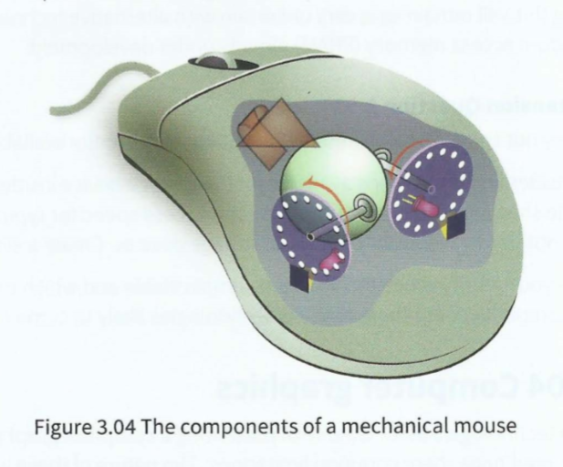
As the mouse moves the rubber ball rotates causing one or both rollers to rotate. Each roller is attached to a spindle on which there is a disc with holes arranged around the outer edge. A light beam and detector are arranged so that the intermittent transmission of the light through the holes in the disc is recorded as the disc rotates and the circuitry attached to the pair of detectors then sends the appropriate data to the
computer to activate movement of
the screen cursor.

Slide 11
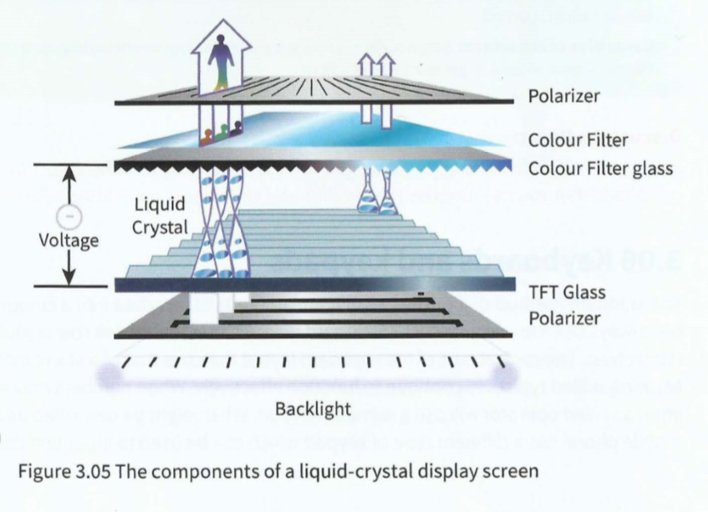
Screen display
Liquid-crystal display (LCD): a screen back-lit by light-emitting diodes and with liquid crystal cells sandwiched between polarisers
In the flat-screen technology that is most used at present, the pixel is not a light source. The liquid-crystal display (LCD) screen has individual cells containing a liquid crystal to create the pixel matrix but these do not emit light. The pixel matrix is illuminated by back-lighting and each pixel can affect the transmission of this light to cause the on-screen display

Slide 12
Touch screens
Resistive touch screen: a flexible surface which causes contact between electrically resistive layers beneath when touched
Capacitive touch screen: a rigid surface above a conductive layer which undergoes a change in electrical state when a finger touches the screen

Slide 13
Keyboards and keypads
The key press has to be converted to a character code which is transmitted to the processor.
The keys are positioned above a key matrix which consists of a set of rows of wires and another set of columns of wires. Pressing a key causes contact at a specific intersection. The microprocessor continuously tests to see if any electrical circuit involving a row wire and a column wire has become closed.

Slide 14
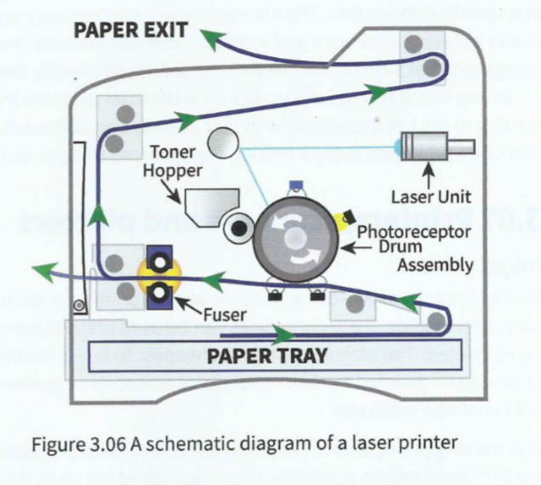
Printers, scanners and plotters
Inkjet printer
Laser printer
Graphics plotter and 3D printer

Slide 15
Input and output of sound
Input: microphone
Output: a loudspeaker or speaker

