Slide 1

AnCoWe Anime + Comics = Web Game

Slide 2




Arhitectura si Workflow
Page Request
Connect
Insert Data
Get Data
Update Data
Response
Users table | SaveData Table | Rank Table
ID – int, PrimaryKey | ID – int, PrimaryKey | ID – int, PrimaryKey
Username - text | User_id – int, ForeignKey | Score - text
Password – text | Save_data - text | User_id – int, ForeignKey
Name - text
Address - text
Email - text
Phone - text

Slide 3
Register workflow
Register in case of no account
Request register page
Insert data
Connect
Response
Send positive response if account created
Send negative response in case of account already exist

Slide 4
Login workflow
Enter username and password
Request loginpage
Check if user exist
Connect
Response
Get user resources
And building level
Inexistent account - Negative response and redirect to login page
Redirect user to game page
Load his progress in case of correct login data

Slide 5






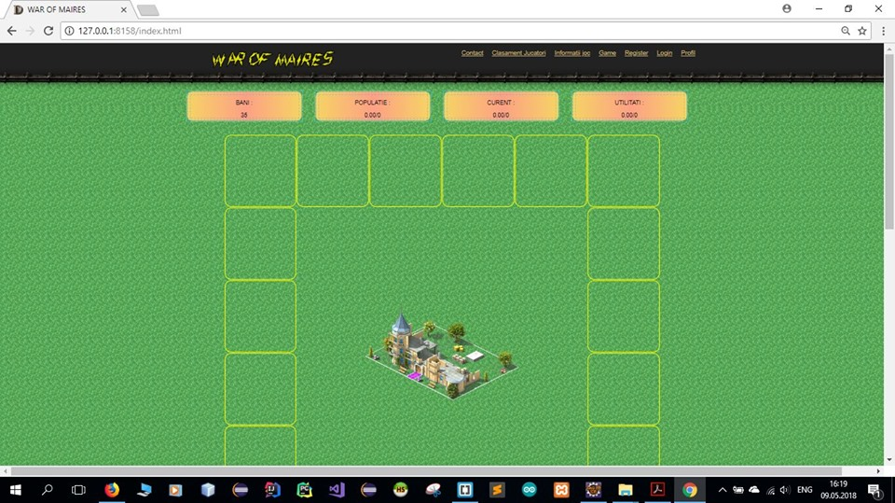



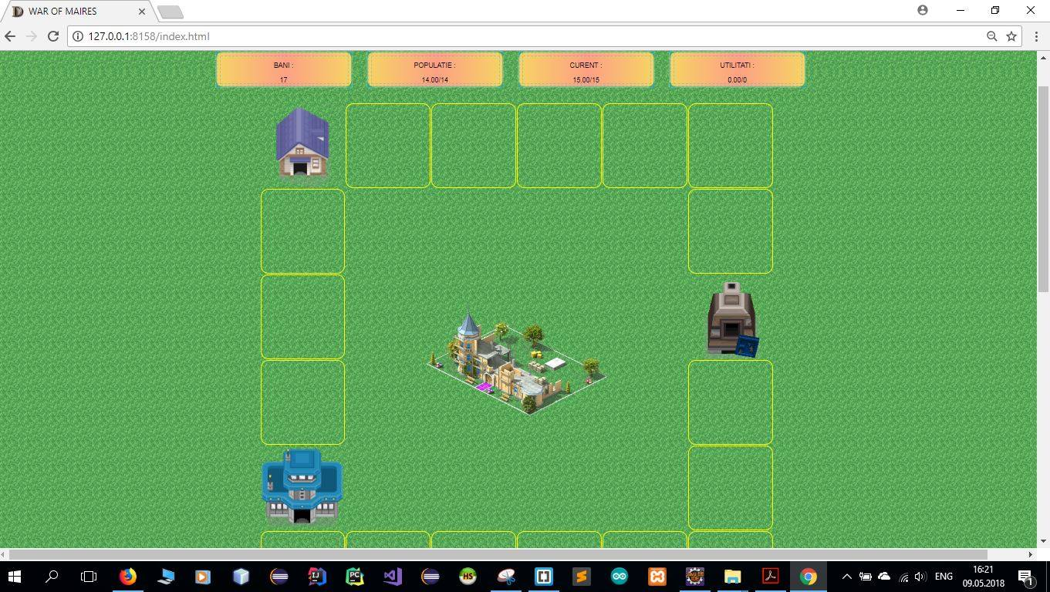
Connect
If positive response from login ,If user first time in game then player must pick a support character that will help player to grow
Update
database
Choose character
Send response
Send game page
After building some buildings

Slide 6


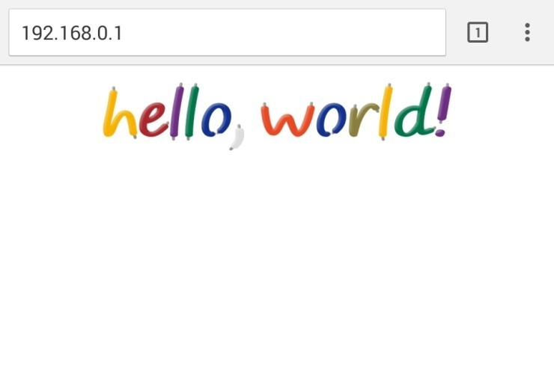
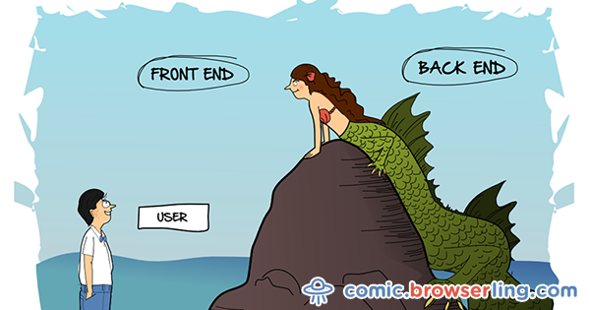
Etape Intermediare dezvoltare proiect
Mai apoi am inceput sa coloram, pictam si sa dam viata site-ului nostru
Am inceput cu o simpla pagina web
Si am format scheletul site-ului
Dupa ore de munca la design, am adaugat si putina functionalitate site-ului
Rezultatul acestei munci pana in momentul de fata arata cam asa :D

Slide 7
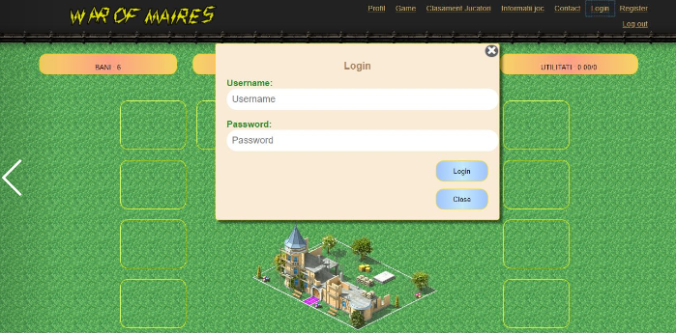
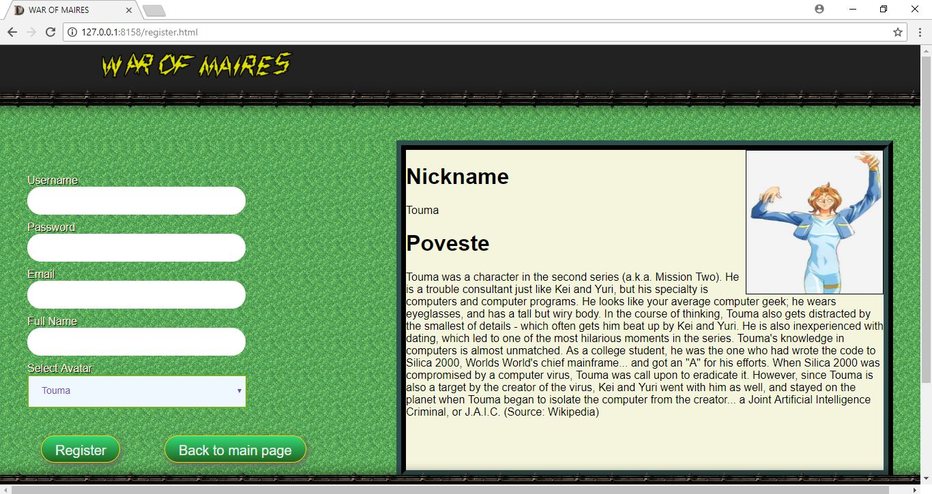
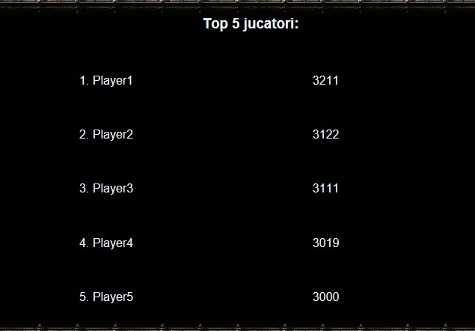
De fapt arata cam asa

Slide 8


Dorim ca site-ul sa prinda si mai multa viata, si sa functioneze in parametri normali, de aceea ne propunem sa terminam de implementat functionalitati precum:
-Register (In derulare)
-Login (In derulare)
-Rank (Momentan Hardcodat)
-Game functionality (In derulare)
Pentru a face totul posibil, vom recurge la :
- Java pentru functionalitatile aplicatiei web
- SQL pentru prelucrarea datelor din baza de date
- MySQL (HeidiSQL) pentru stocarea bazelor de date
Ce ne dorim
Ce nu ne dorim

Slide 9
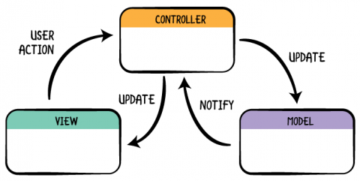
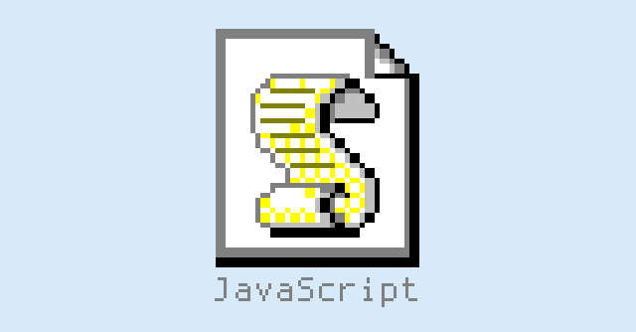
Modelarea datelor
Update data /
Check data
Get data / response
Java files
MODEL
Request data
Send data from view
Send data / response
Connect
Response
Request a page
Update building
Verify rank
Login / Register
VIEW
CONTROLLER

