Slide 1

Therapeutic Inertia based AI algorithms in Healthcare

Slide 2
Assumption
Examples
Potential concepts mentioned in clinical notes:
Comorbidities
compliance
patient reported adherence
symptoms
to identify such concepts we apply unsupervised algorithm
Notes:
Nowadays, discerning appropriate vs. inappropriate treatment inertia for hypertension is not possible without information on factors
that could alter appropriateness of BP lowering medication initiation or escalation.
using NLP to examine EHR could potentially provide contextual data that could be used to discern appropriate versus inappropriate treatment inertia. Patient information such as symptoms, self-reported adherence and home BP readings may be recorded by providers in the progress note but this information is not currently being utilized to assess hypertension management. We propose to utilize artificial intelligence tools to identify factors associated with inappropriate treatment inertia and explore whether these factors (demographics, comorbidities and contextual data) can be used to discern appropriate vs. inappropriate treatment inertia. Our long-term goal is to develop and implement real-time algorithms that improve hypertension management within health systems.

Slide 3
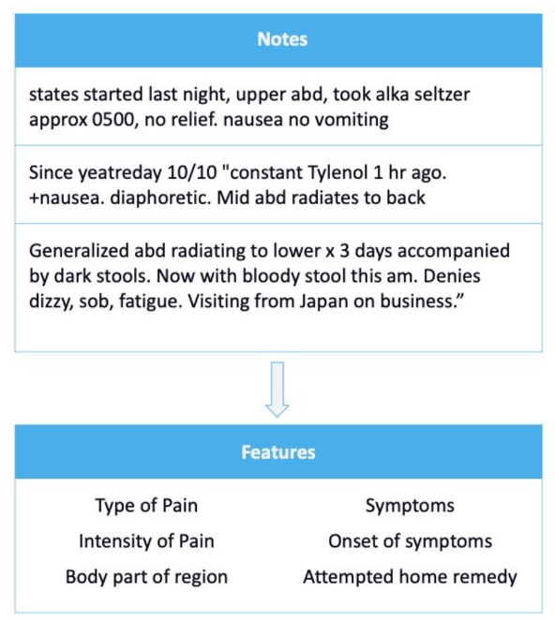
Introduction
How can use NLP to identify topics from unstructured data?
Human Language is:
Nuanced
Fuzzy
Contextual
Medium Specific
Domain Specific
healthcare specific needs:
Core Annotators : Part of speech, spell checking
Vocabulary: Ontologies, relationships, word embeddings
ML & DL Models: Named entity recognition, entity resolution

Slide 4
Application of Topic Modeling
Discovering hidden patterns
Efficient exploration
Topic Modeling
Topic modeling is particularly useful for analyzing unstructured clinical notes
Cohort identification
Clinical decision support
Notes:
Unstructured notes in clinical studies refer to textual data generated by healthcare professionals during patient care, such as progress notes. Topic modeling, like LDA, is particularly useful for analyzing unstructured clinical notes. Here's why:
Discovering hidden patterns: Clinical notes can be voluminous and complex. Topic modeling helps uncover hidden patterns or themes within these notes by identifying common topics discussed across different documents.
Efficient exploration: By applying topic modeling to clinical notes, researchers can quickly navigate and explore large volumes of unstructured data. It provides a way to summarize and organize the information, making it easier to extract relevant knowledge and insights efficiently.
Cohort identification: Topic modeling can assist in identifying patient cohorts or subgroups based on the topics discussed in the notes. By clustering patients who share similar topics or conditions, researchers can create cohorts for further analysis, such as studying disease progression, treatment effectiveness, or predicting outcomes.
Clinical decision support: Extracting information from unstructured clinical notes can aid clinical decision-making. By using topic modeling, healthcare professionals can identify relevant topics or trends related to a specific condition, treatment, or adverse event. This can help in personalized treatment planning, monitoring patient progress, and improving patient outcomes.
In summary, topic modeling is valuable for analyzing unstructured clinical notes because it enables the discovery of hidden patterns, facilitates efficient exploration of large datasets, aids cohort identification, and supports clinical decision-making by extracting relevant information from textual data.

Slide 5
Topic Modeling
Predicted topics
NLP
Predicted Topic 1
Note
Topic Modeling
…
Predicted Topic M
input data
Classification
Topic 1
…
Topic M
Note 1
0.3
0.5
Predicted inertia
…
…
…
…
0.6
0.7
Note N
Notes:
Topic modeling is a type of unsupervised machine learning that can be used to identify the topics that are present in a corpus of text. This can be useful for tasks such as organizing documents, clustering text, and generating summaries.

Slide 6
Models:
Latent Dirichlet Allocation (LDA)
1
BioBert
2
BerTopic
3

Slide 7
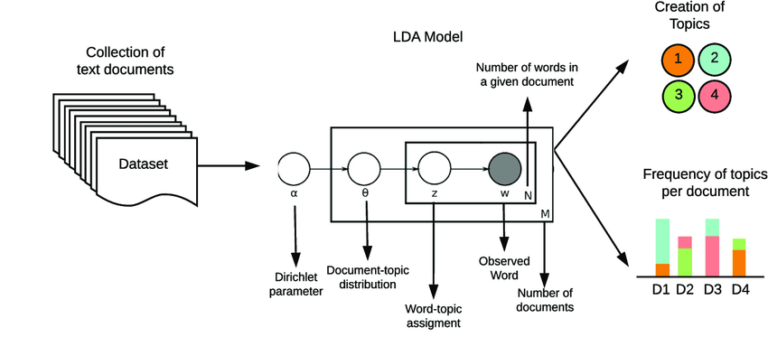
LDA
Notes:
LDA (Latent Dirichlet Allocation) is a statistical topic modeling technique that has been around for many years. LDA is a simple and effective technique that can be used to extract topics from a variety of text corpora. LDA works by assuming that each document in the corpus is a mixture of topics, and that each topic is a mixture of words. LDA then uses statistical techniques to estimate the number of topics in the corpus, the distribution of topics over documents, and the distribution of words over topics.

Slide 8
LLMs in Inertia
Large language models (LLMs) have the potential to be used to detect therapeutic inertia by extracting and analyzing clinical information from progress notes.
Using LLMs to detect therapeutic inertia in hypertension management and preprocesses the progress notes to extract clinical information.
The clinical information is then used as input to a pre-trained LLM to identify topics related to therapeutic inertia.
Notes:
are there any other features that might be important? - ask audience

Slide 9
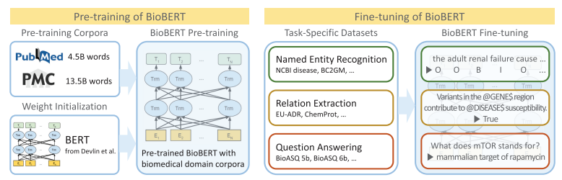
Model 1: BioBert
Overview of the pre-training and fine-tuning of BioBert
Progress note
Notes:
BERTopic is a topic modeling technique that uses BERT embeddings to generate topics. BERT is a large language model that has been trained on a massive dataset of text and code. This makes BERT very good at understanding the meaning of words and sentences. BERTopic can use BERT embeddings to generate topics that are more meaningful and interpretable than topics generated by other techniques.

Slide 10

Model 2: BerTopic
Topic modeling provides methods for automatically organizing, understanding, searching, and summarizing large electronic archives. It can help with the following.
● discovering the hidden themes in the collection
● Classifying the sentences into the discovered themes
● By annotating the document, based on the topics predicted by the modeling method, we are able to optimize our search process

Slide 11
Pre-Processing
Remove special characters
Tokenization
Lower Case
Contractions
Lemmatization
Normalizer and word embeddings
Notes:
lower case: Since we would expect to treat “Food” and “food” as the same word, without creating various predicting powers, I’ve down-cased each word.
Contractions: I’ve replaced contractions with their longer forms such as “isn’t”: “is not”, “can’t”: “cannot“. To do so, I’ve imported contractions
Remove special characters: I’ve cleaned the data from any special character such as double quotes, punctuation, and possessive pronouns.
Stopwords: I’ve removed stopwords since they add noise without bringing any information value in modeling. I’ve downloaded a list of English stopwords from the nltk package and deleted them from the text corpus.
Tokenization: to process text, we need to split it into smaller chunks. Here, I’ve split sentences into words using WordPunctTokenizer from the nltk library.
Lemmatization: To convert each word into its root word

Slide 12
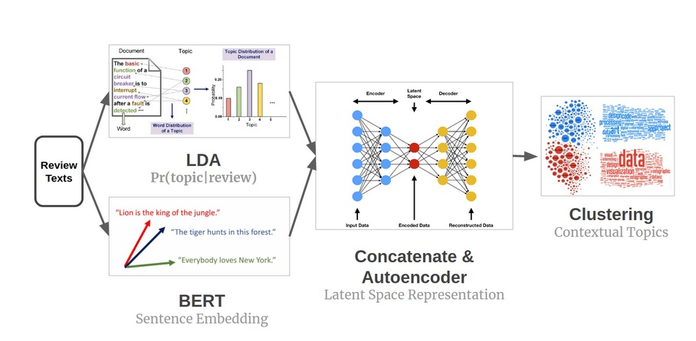
BerTopic
Notes:
BERTopic is a topic modeling technique that uses BERT embeddings to generate topics. BERT is a large language model that has been trained on a massive dataset of text and code. This makes BERT very good at understanding the meaning of words and sentences. BERTopic can use BERT embeddings to generate topics that are more meaningful and interpretable than topics generated by other techniques.

Slide 13
What is the different between LDA, berTopic and BioBert?
?
Biobert
Strength: connected with biomedical ontologies to better understand clinical concepts
weakness: need lots of hyperparameter tunings
BerTopic
Strength: Relatively easy to us
Weakness: Can be less accurate than BioBERT or LDA??????
LDA
Strength: More flexible
Weakness: Can be more difficult to use
Notes:
Biobert is a BERT model that has been fine-tuned on a corpus of biomedical text. This means that it is better at understanding the meaning of words and phrases in biomedical text than BERT. BioBERT can be used to extract topics from biomedical text, but it can also be used for other tasks, such as question answering and natural language inference
BerTopic is a topic modeling model that uses BERT embeddings. This means that it can take advantage of the semantic information that is captured in BERT embeddings to identify topics in text. BerTopic is relatively easy to use, and it can be used to extract topics from a variety of text formats.
LDA is a statistical topic modeling model. This means that it does not use any pre-trained language models. Instead, it learns the topics in a corpus from scratch. LDA is a more flexible model than BioBERT or berTopic, but it can be more difficult to use.

Slide 14
BerTopic
LDA for probabilistic topic assignment vector.
Bert for sentence embedding vector.
Concatenated both LDA and Bert vectors with a weight hyperparameter to balance the relative importance of information from each source.
Used autoencoder to learn a lower dimensional latent space representation of the concatenated vector.
The assumption is that the concatenate vector should have a manifold shap in the high dimensional space.
Used clustering on the latent space representations to get topics.

Slide 15
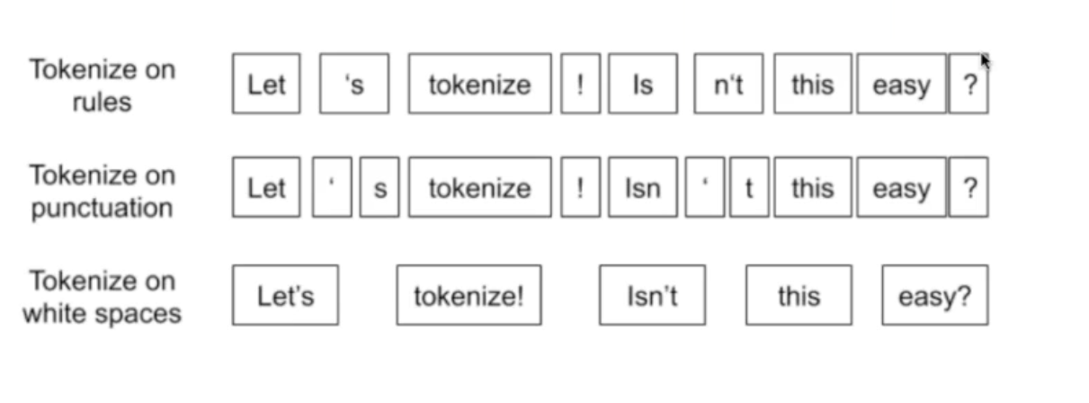
preprocessing
?
Notes:
Other factors that may influence provider prescribing behaviors include patient reported symptoms
and social determinants of health [4, 22], which aligns with special interest of AHRQ (NOT-HS-21-014) in
“advancement of the nation’s goal of achieving equity in the delivery of healthcare services”.
/ Further research is recommended to explore the reasons for inappropriate inertia, and to better
characterize treatment inertia to inform interventions [10].
/

Slide 16
Re-Structure
Lower case: Since we would expect to treat “Food” and “food” as the same word, without creating various predicting powers, I’ve down-cased each word.
Contractions: I’ve replaced contractions with their longer forms such as “isn’t”: “is not”, “can’t”: “cannot“. To do so, I’ve imported contractions
Remove special characters: I’ve cleaned the data from any special character such as double quotes, punctuation, and possessive pronouns.
Stopwords: I’ve removed stopwords since they add noise without bringing any information value in modeling. I’ve downloaded a list of English stopwords from the nltk package and deleted them from the text corpus.
Tokenization: to process text, we need to split it into smaller chunks. Here, I’ve split sentences into words using WordPunctTokenizer from the nltk library.
Lemmatization: To convert each word into its root word

Slide 17
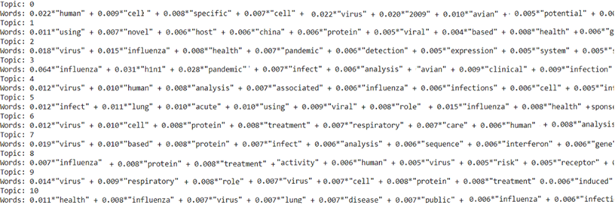
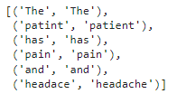
Initial Result
1

Slide 18
Pipline
Pipeline:
•Reducing embedding dimensionality
•Cluster reduce embeddings
•Tokenize documents

Slide 19
Data and model
embedding_model = SentenceTransformer('all-MiniLM-L6-v2')
umap_model = UMAP(n_components=3, n_neighbors=3, random_state=42, metric="cosine", verbose=True)
hdbscan_model = HDBSCAN(min_samples=20, gen_min_span_tree=True, prediction_data=False, min_cluster_size=20, verbose=True)
vectorizer_model = CountVectorizer(vocabulary=vocab, stop_words="english")
topic_model= BERTopic(
embedding_model=embedding_model,
umap_model=umap_model,
hdbscan_model=hdbscan_model,
vectorizer_model=vectorizer_model,
verbose=True
).fit(doc, embeddings=embeddings)
79320 Sample of notes

Slide 20
Result

Slide 21
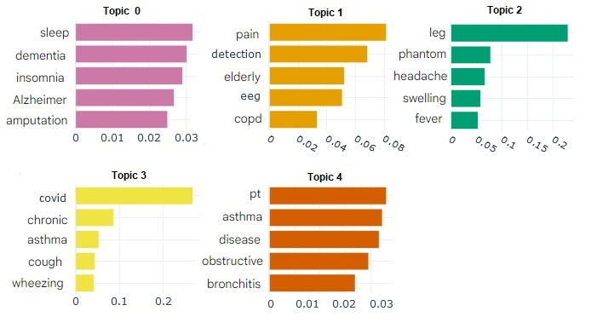
berTopic
To gain insights and facilitate comparisons between topic representations, we can create bar charts using the c-TF-IDF scores for each topic. This visualization allows us to observe the relative scores both within and between topics.

Slide 22
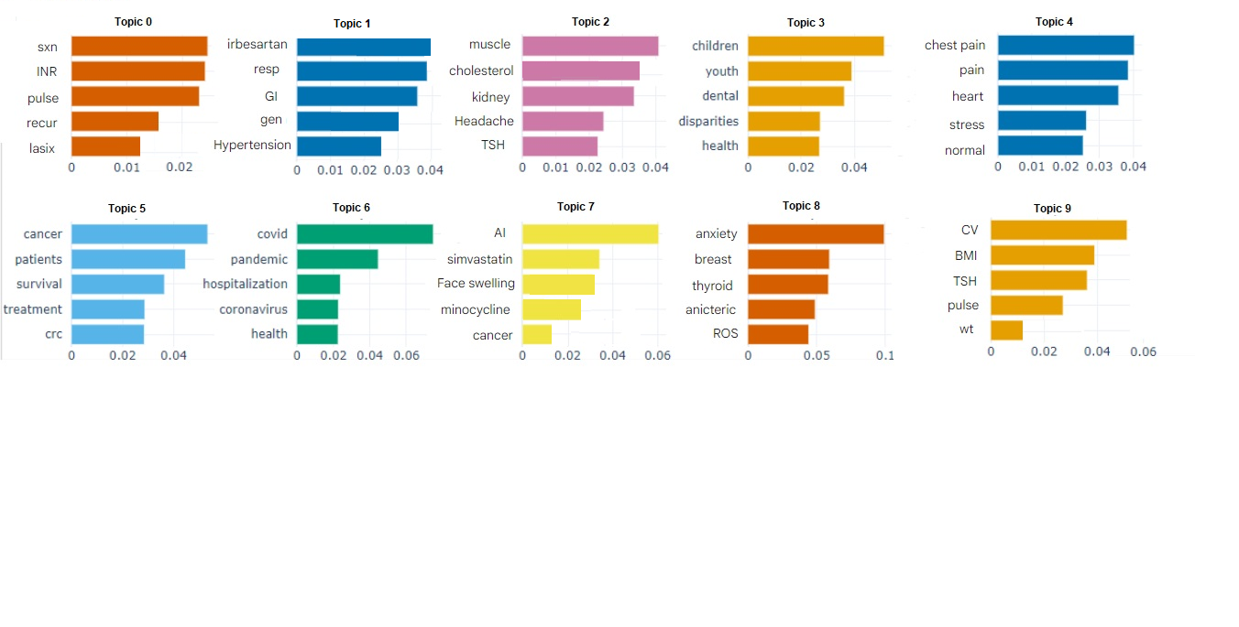
berTopic

Slide 23
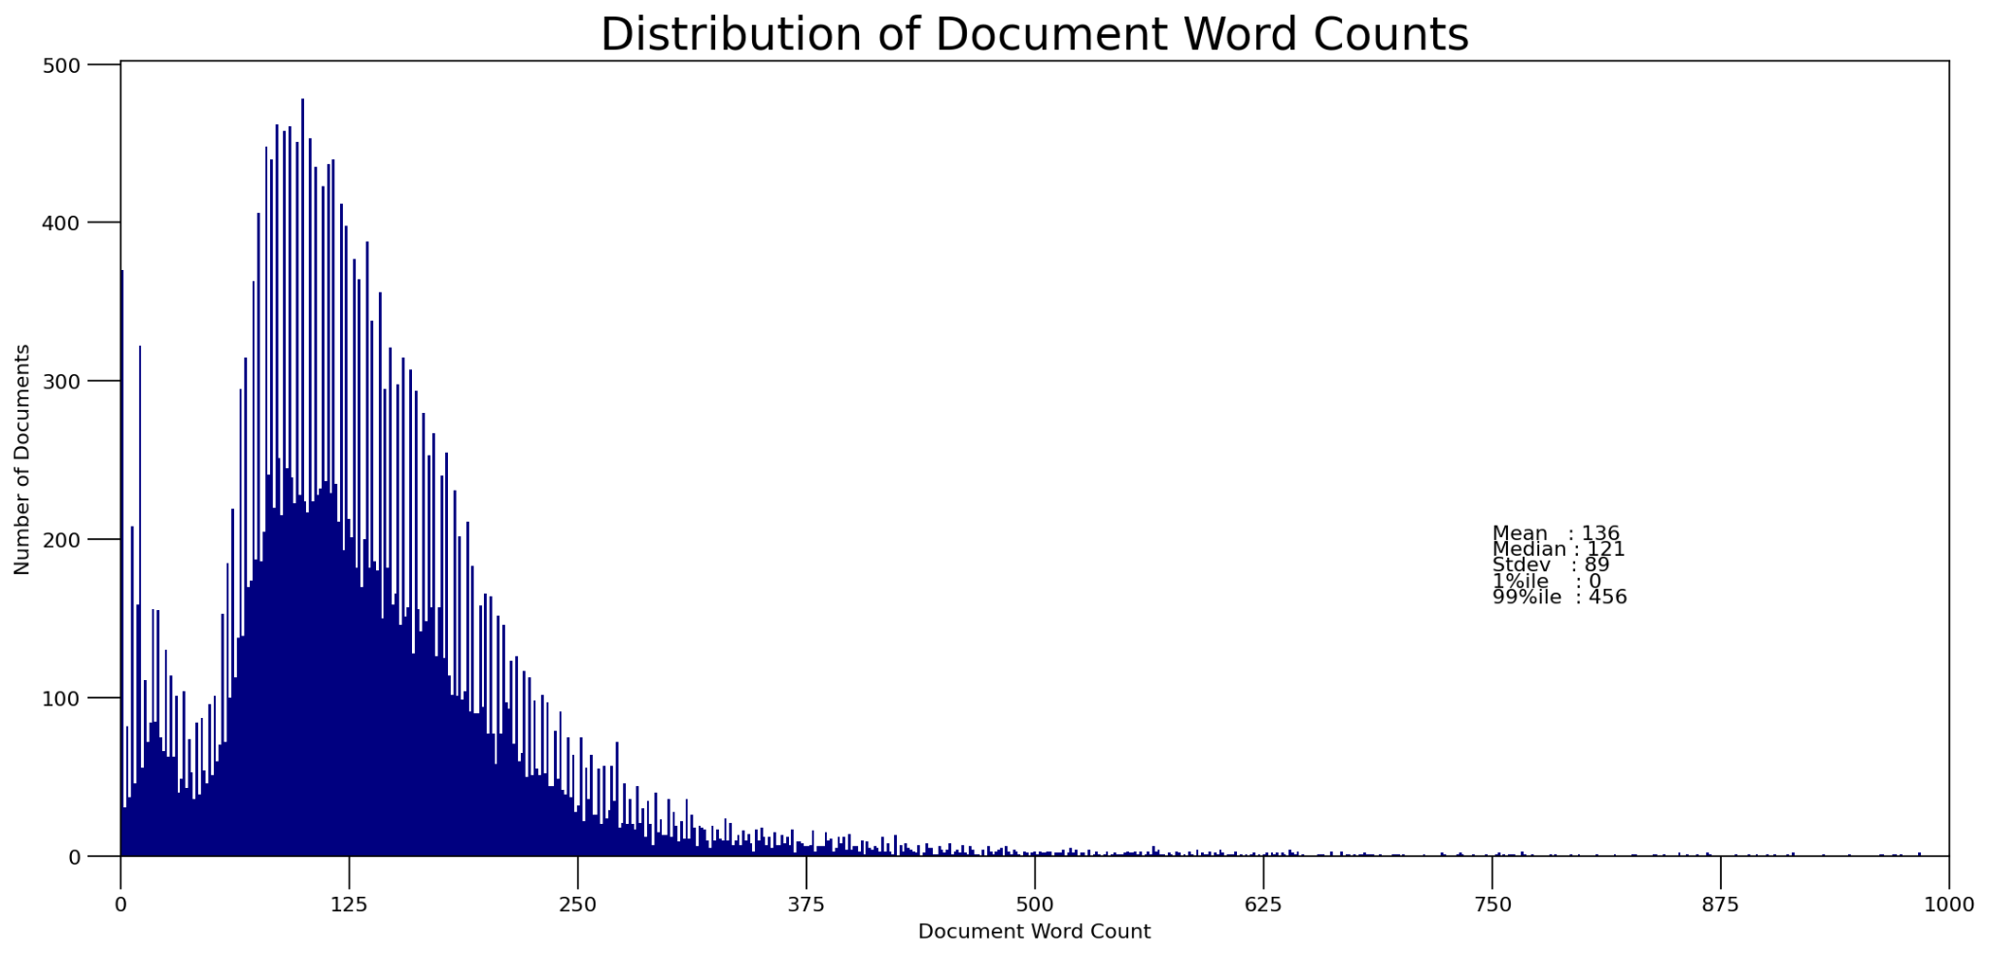

Slide 24
Data Collection
There were a total of 33,412 visits.
There were 6,757 patients.
The most number of visits by a patient was 35.
The least number of visits by a patient was 1.
There were 332 missing data points.
The longest note based on the number of characters was 32,607 characters long.
The shortest note based on the number of characters was 23 characters long.
The longest note based on the number of words was 5,132 words long.
The shortest note based on the number of words was 3 words long.

Slide 25
Future Work
4
NLP Models (Aim-1.2 and Aim-1.3): The extracted NLP concept-IDs from progress notes create a high dimensional space. Two NLP approaches, supervised ontology-based (Aim-1.2) and unsupervised topic model (Aim-1.3), are proposed to identify major clinical, contextual and socioeconomic factors that can potentially delineate appropriate vs. inappropriate inertia. We will randomly select 80% of our visits to (1) train our NLP and machine learning models (Aim-2), and leave the hold-out 20% visits for testing our machine learning performance. The supervised NLP Model will identify potential clinical and contextual subjects that they perceive to be associated with appropriate vs. inappropriate treatment inertia. The unsupervised model will train a specific type of unsupervised topic model, named Latent Dirichlet Allocation (LDA), on our progress note corpus, which generates a pre-specified number of topics and represents each note as a mixture of words with a probability of belonging to that topic. A consensus from the expert panel will identify the optimal model, which has the most interpretable outcome. We will test if any of the identified topics by the final

Slide 26
Future work
Tuning the berTopic model and perform sensitivity analysis to extract optimize topics
Apply LDA on progress notes
Apply BioBert to capture latent concept-IDs from the progress notes, we will use a clinical named-entity recognition NLP tool called Spark NLP.
Perform statistical analysis on identify topics
Therapeutic inertia, which may be influenced by geospatial features of patients' locations, will be added to the output of the LLMs Model based on the topics that have been gathered.

Slide 27
Module
Extract Entities from sentence embeddings and resolve them to unique oncology.
Set distance function: Value is String
what distance function used for word mover’s distance (WMD). It can be Euclidean or Cosine
Set neighbours : Value id int
number of neighbours to take into account in the KNN algorithm query to calculate WMD
Set Threshold: Value is float
it represent the max dis between the query and neighbours. neighbours with the distance greater that threshold will not be returned.
Set Use Aux label: value is Boolean
name of aux column which maps resolved entities to extra labels
5. Set Case Sensitive. Value is Boolean

Slide 28
Data preprocessing
Unstructured Vs Structured Data
Unstructured Data
Structured Data

Slide 29
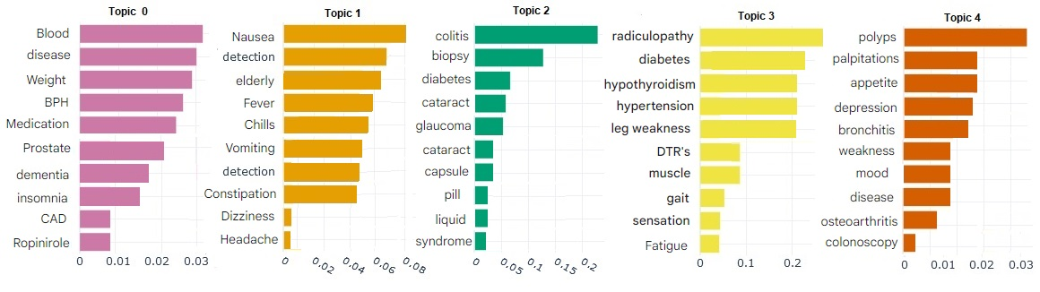
BerTopic
5

Slide 30
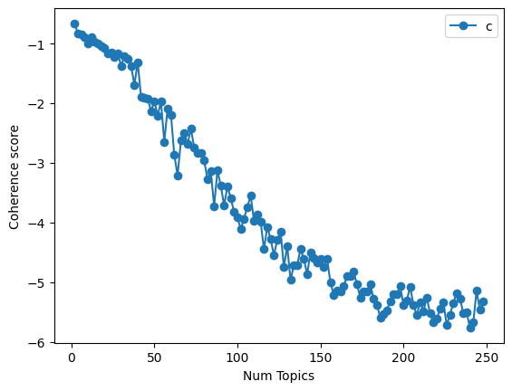
UMASS coherence in LDA
Evaluate the quality of a topic model
words appear together in a topic should be semantically related
how often two words would be expected to occur together by chance
This measure of the semantic coherence of a topic model

Slide 31
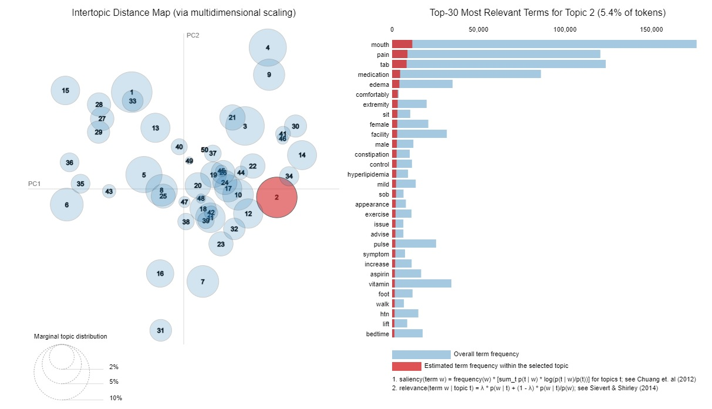
LDA

Slide 32
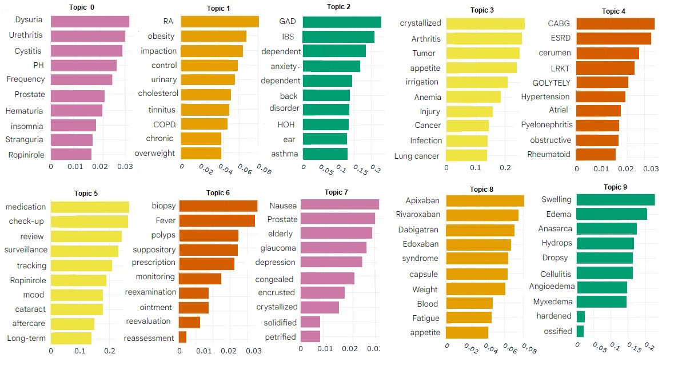
berTopic
10

Slide 33
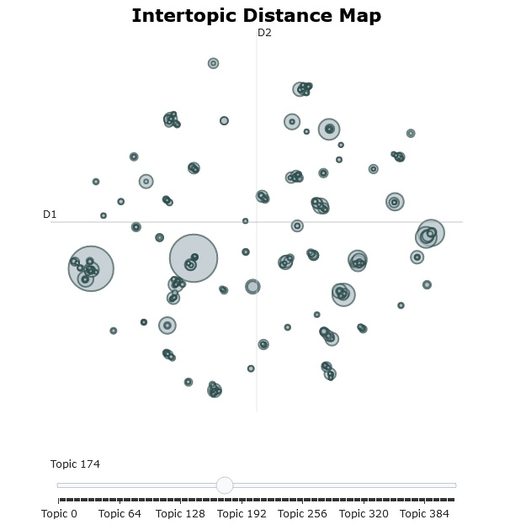

Slide 34
Topics from Hierarchical clustering
red | cirrhosis_eylea_genotype_abnormal_blidness
 | chemo_lip_afib_chf_humerus
 | locallycost_abnormal_vibratorysense_hypothyroidism_hole
 | ckd_abnormal_renal_hgbac_kit
 | abnormal_hgbac_maintenance_mark_breathe
 | abnormal_hgbac_maintenance_diabete_microalbumin
 | afib_abnormal_unspecheredit_nml_insulin
 | dci_abnormal_amyloidosis_breast_fibromylagia
 | sarcoidosis_pen_mtx_bblocker_refil
 | grandaunt_pump_casepump_pancreatic_endometriosis

Slide 35
Topics from Hierarchical clustering
green | estradiol_carpometacarpal_vaginitis_sharonwod_shrimp
 | .mariareye_myopiadetached_carolmartina_macularpucker_shirleypike
 | susankrn_anicteric_stool_mellitus_smartview
 | anictric_entheopathy_dyspnea_stool_nausea
 | afib_anicteric_card_dyspnea_tobacco
 | thyroid_anicteric_stool_dyspnea_hypothroidism
 | thyroid_anicteric_stool_comment_latestrngamp
 | anticteric_stool_latestrngamp_dyspnea_substance
 | anicteric_comment_stool_dyspnea_preventative
 | osteoporosis_sentile_homatropine_prevention_closedfracture
 | anicteric_bettymarin_lorrainehyzny_prevention_stool
 | adultpediatric_penicillin_sleepapnea_angioedema_pap
 | wellness_anicteric_stool_dyspnea_substance

Slide 36
Topics from Hierarchical clustering
red | dominicpastore_carotid_suppository_bradycardia_occlusion
 | eheumatology_dinafata_templeincision_prednisone_mineal
 | prednisone_repeat_vestibular_stable_score
 | corlisstaylor_investigator_anthonycole_chlorthalidone_belching
 | electricalburn_graft_charlesfield_charlesriale_thallassemia
 | josephcurtis_curtisgrace_curtisburnside_deny_situational
 | son_deny_pmi_negative_percussion
 | stable_care_primary_future_unremarkable
 | return_unchanged_amlodipine_care_answer
 | stable_wif_seizure_neurology_hemiparsis
 | olgabazzi_walker_donepezil_nitroglycerin_citrate
 | helenmillier_glimepride_glargine_endocrinology_toe
 | liver_malignant_robinreed_ureter_hydrocodone
 | maryreynold_ectropin_uncontrolled_vascepa_nephrology

Slide 37
Topics from Hierarchical clustering
red | congenital_embolism_corpulmonale_thocrystal_bovinerepaire
 | robertnergoski_embolism_denavicream_gelbrushpaste_rinse
 | extce_pedal_abdoman_tender_buncretinine
 | basaglar_avoidnsaid_antigenpsa_jamesbeatty_pole
 | pbc_cirrhosis_directly_polycystic_uncontrolled
 | sporstic_jaynejurkovich_unknowndarvon_propoxyphene_lightheade
 | roshangoel_retinaltoxity_fold_laxityeyelid_plaquenil
 | copyscanne_smokesxposure_coagulopathy_martini_tendinitis

Slide 38
Topics from Hierarchical clustering
purple | ovarian_fragmin_emergenpacket_eosinophilia_georgettadavi
 | brca_cancer_male_braintumor_aki
 | prostate_robertsansone_adult_male_annual
 | progress_male_robermarshall_resp_internal
 | adult_male_davidgordon_annual_anthonygraefe
 | janetbrousek_mariamankos_joshuaevan_progress_cancer
 | ricardogarcia_hypersomnolence_testicular_adenomatous_diabetes

Slide 39
Topics from Hierarchical clustering
green | willieandrew_dialysis_dialshunt_malyuginre_cmplxmayugin
 | robertropa_dialysis_timolol_orderspecific_caneamblulate
 | dialysis_renal_toe_retina_lysol
 | dialysis_jeanettekelley_codliveroil_tk_esrdhd

Slide 40
Topics from Hierarchical clustering
Red | Arlenefreitag_fluocinonide_neosporin_ext_topically
 | estheredmond_calcet_debroxotic_area_maximum
 | geraldsebesta_washshower_delaydrelease_area_smooth
 | _evelyndefiore_winter_probiotic_packet
 | lauramccaskil_adrenalcrisis_luerloksyrgx_dexamethasone_hydrocortisone
 | tedkuciaage_sex_differently_occational_cigar
 | thomaskraus_thomascooper_citrucel_complex_sex
 | servicecalle_servicereviewe_facemeete_personally_intervention
 | shirleypauss_citracal_slow_magnesium_tshfrt
 | joycecommiso_swallow_ployp_clare_blue
 | melvinrieve_ecotrin_melvinthoma_strength_deny
 | aredsmulti_mybetriq_tshfrt_blue_vit
 | marycarter_longsadultlow_blue_marymeyerhofer_deny
 | deny_blue_nourished_counsel_servicecalle
 | donaldgancer_donaldpickard_donalddelaney_blue_deny
 | blue_deny_nourished_fever_cough
 | cough_blue_deny_nourished_counsel
 | cough_blue_deny_nourished_counsel

Slide 41
Topics from Hierarchical clustering
yellow | rotationflap_iliac_nasal_hinessewe_harrycarson
 | hydrocodone_esiesi_synvisc_patch_elect
 | montelukast_socorroszubert_liver_stent_ranitidine
 | stagesarker_electecstay_cellpopulation_recurrent_dvt
 | recurrent_lillianrooney_bellpalsyface_lifelong_religious
Black | itp_ostomy_flectorpatch_spondylosis_ostomyrlq
 | centralvite_lumbar_stenosis_rush_redyeastrice
 | fibromyalia_norco_lumbar_imodium_stenosis
 | nancykennedy_fibromyalgia_husband_glargine_buck

Slide 42
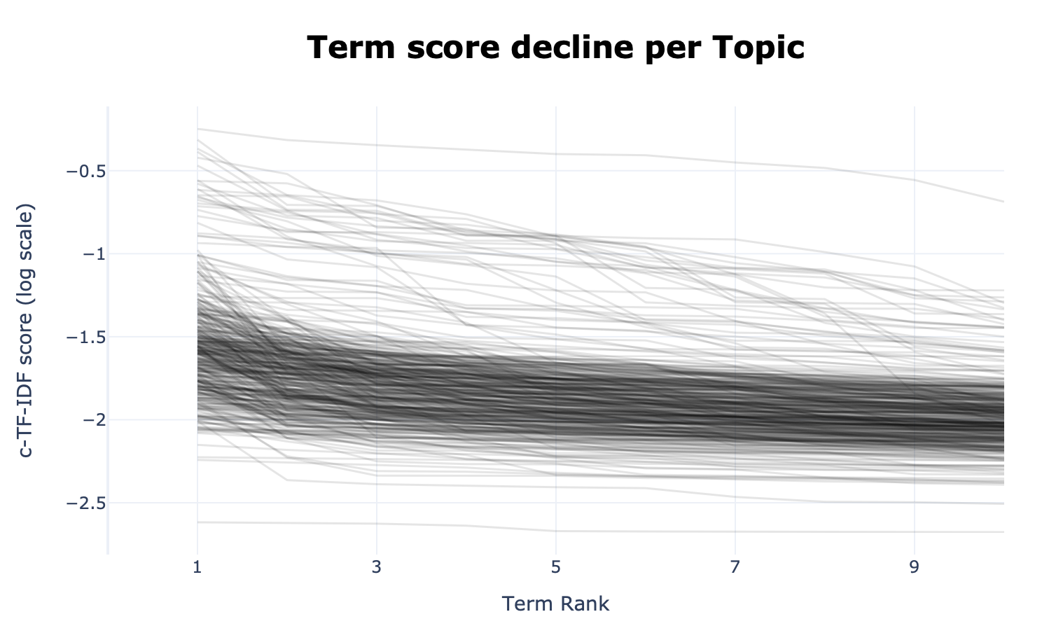
6
Topics are represented by a number of words starting
with the best representative word.
Each word is represented by a c-TF-IDF score.
The higher the score, the more representative a word to the topic is
Topic4:rmf_foll_delete_dictate_duplicate
Topic 69: case_attend_resident_agree_interna

Slide 43
Data Processing
Classification methods in this research
80%
0
0
Train data
1
1
0
1
0
0
1
Test data
0
20%
1
Encoded data
Encoded target

Slide 44
Data Acquisition
Initial Structured Data
2520 Long Stay
5484 Short Stay
8004 Sample of Data

Slide 45
Geospatial Feature Selection
Area Deprivation Index (ADI)
Based on ACS 5-yr estimates (2016-2020)
Census block level (possible to aggregate to tract level via population-weighted median values)
National percentile (1-100) with 100 being most disadvantaged
Factors
% over 25 w/ < 9 yr education
% over 25 w/ > HS diploma
% over 16 in white-collar jobs
Median family income
Income disparity
Median home value, gross rent, mortgage
Homeownership rate
% over 16 unemployed
% families below poverty level
% population below 150% poverty threshold
% single-parent households
% with no vehicle
% without phone
% without plumbing
% Households with overcrowding (>1 person per room)
PolicyMap Features Complementary to ADI
% Over 25 w/ < 9 yr education
% over 25 w/ > HS diploma
Median family income
Income disparity (Gini Index) (t)
Median home value
Median gross rent
Homeownership rate
% over 16 unemployed
% Families below poverty level
% Single-parent households
% Occupied homes with no vehicle
% Occupied homes without computer access
% Occupied homes without plumbing (t)
% Households with overcrowding (>1.5 people per room)
Other potentially important PolicyMap features
Distance to public transit (2010)
Low food access (t, 2010)
Notes:
Data from 2020 blocks unless denoted otherwise (such as tracts or 2010 data)

Slide 46
Thank you!

