Slide 1

BAST - Intrusion detection system
Your Guardian from the Underworld

Slide 2


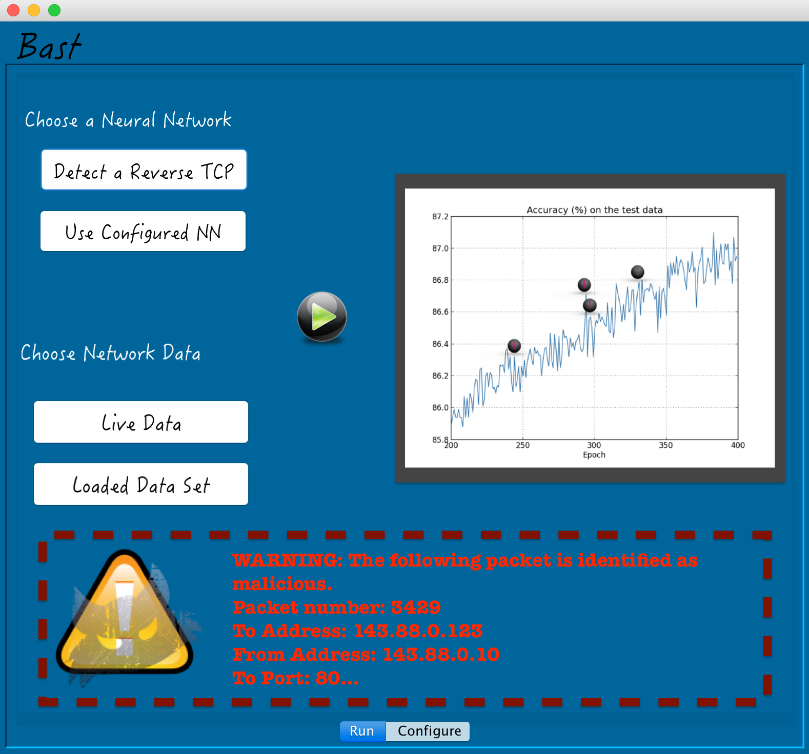

In action
Users can see the results here
Warnings are displayed with basic packet information for ease of identification

Slide 3

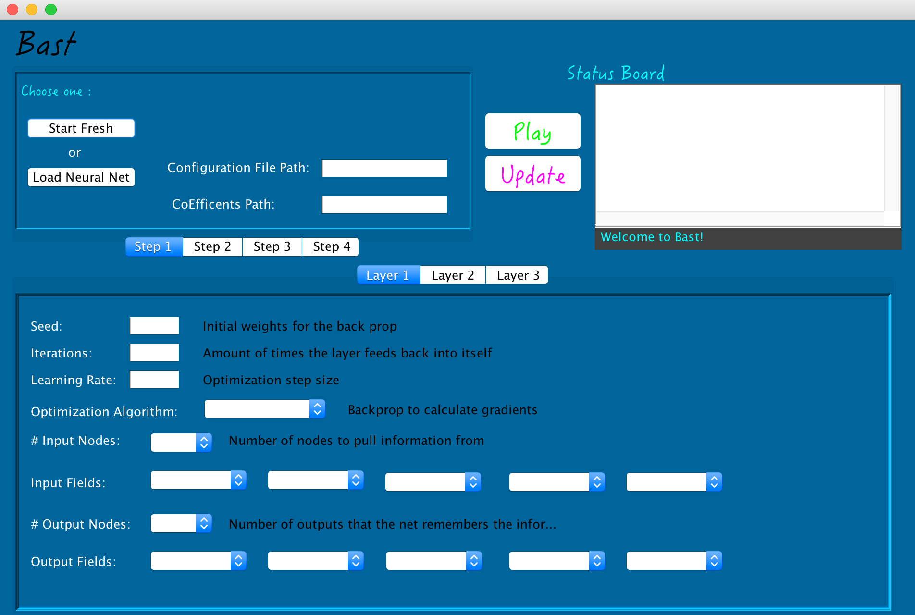

Parameterized Neural Network
Provides useful output while training, validating and final testing.
Students or developers can create individual hidden layers

Slide 4
What We Did
1.) We created a parameterized neural network.
2.) Generated generic network (pcap) files legally through simulations and controlled environments.
3.) Created a dataset with a reverse TCP attack in a controlled environment.
4.) Created a program that reads live data from a network.
5.) Trained our configured network on the data sets generated.
6.) Validated that the training worked.
7.) Tested the network against the malware data set.
8.) Celebrated being awesome.

Slide 5
the point
In an ideal world, one would create a completely secure, unhackable computer system; however, cyber security is like a bank’s vault, the time it takes to break into the system is the degree of security. This project focuses on using artificial intelligence to detect an intruder. Based on adaptability, we choose to use a neural network to detect a reverse TCP hack, a common hack known to penetrate firewalls. Because attacks on a system often happen with a voluntary or innocent inside actor, this project addresses several vulnerabilities that Cyber Security professionals face with an adaptable solution.

Slide 6

Configurable hidden layers
Bast is pre-loaded with a reverse TCP intrusion detection system.
However Users can configure a Neural Network and configure each hidden layer the network uses to learn.

Slide 7



Live results
In order to analyze the data quickly, Bast provides a graph displaying the accuracy rating while running. Users can see real-time threats occurring on their network.
warnings
When Bast identifies a threat, it alerts the user with the provided packet information.

Slide 8
Connecting Users
with networks for protection

