Slide 1
Possibilities of WebAssembly
Ologu Catinca-Ioana
&
Incze Zsolt-Tamás

Slide 2
What is coming up?
01
What is WebAssembly
02
Why WebAssembly
03
WebAssembly in our project
04
Limitations
05
Advantages and disadvantages
06
Conclusion

Slide 3

What is WebAssembly?

Slide 4
What is WebAssembly?
Low-level stack machine for executing binary code
Portable compilation target for programming languages
Enables deployment on the web for client and server applications
Supported by major browsers:
Google Chrome
Microsoft Edge
Mozilla Firefox
Apple Safari

Slide 5
Why WebAssembly?

Slide 6
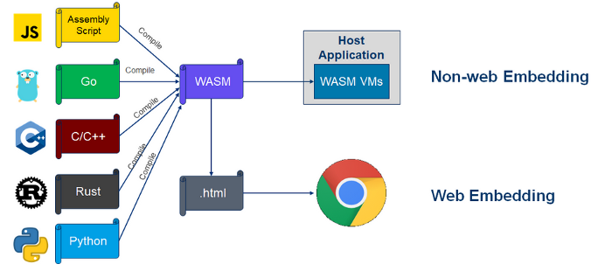
Why WebAssembly?
Enables high performance applications on web pages
E.g. video games, video editing, 3D rendering, or music production
Compilation target for 40 different programming languages
Open-source
Lightweight
Easy debugging

Slide 7
WebAssembly in our project

Slide 8
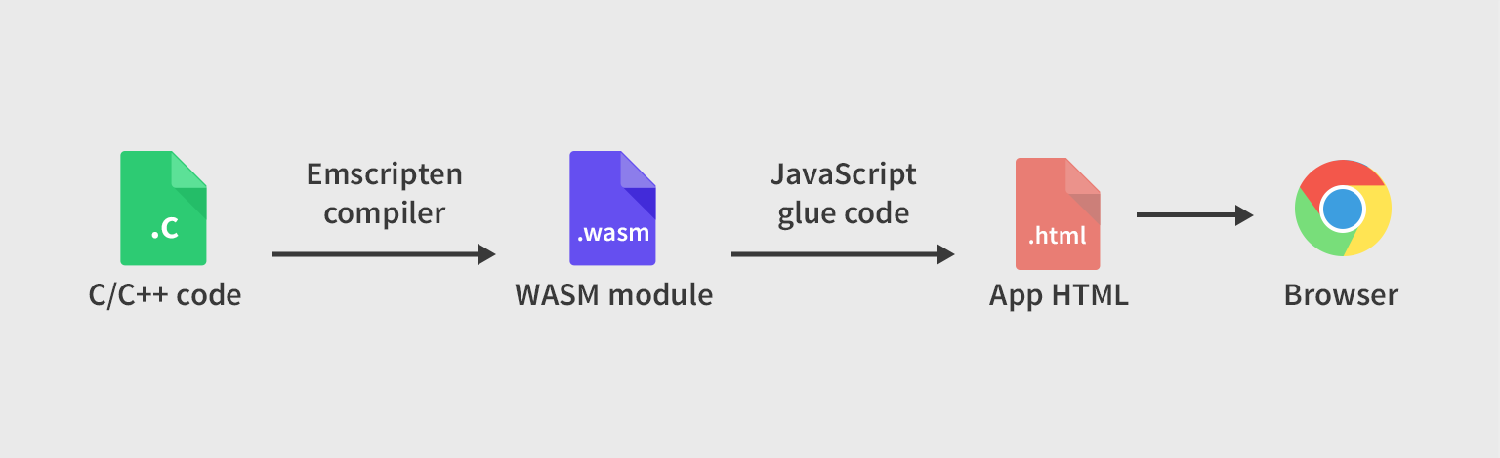
WebAssembly in our project
Code written in C
Compiled using Emscripten
Connected to Javascript and HTML

Slide 9
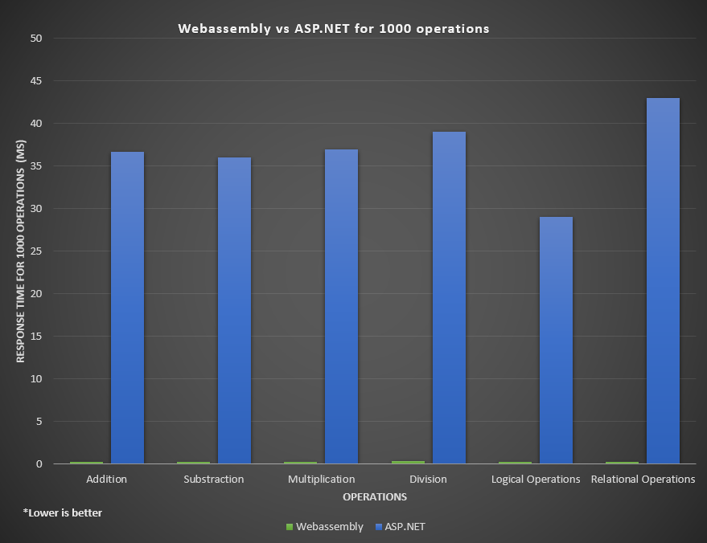

Slide 10
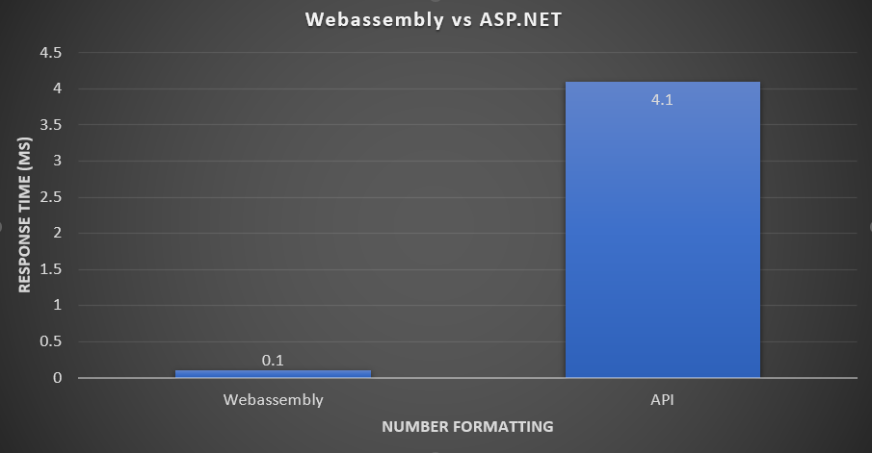
*Lower is better

Slide 11
40 X

Slide 12
Limitations

Slide 13
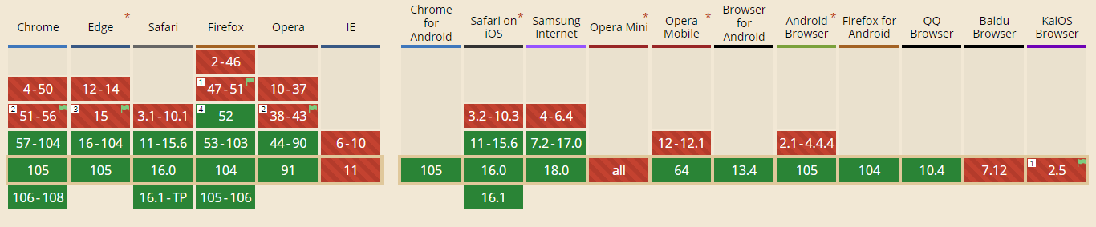
Limitations
WebAssembly does not allow direct interaction with the DOM
All interaction must flow through JavaScript interop
Absence of garbage collection
No support in older browsers

Slide 14
Advantages and disadvantages

Slide 15
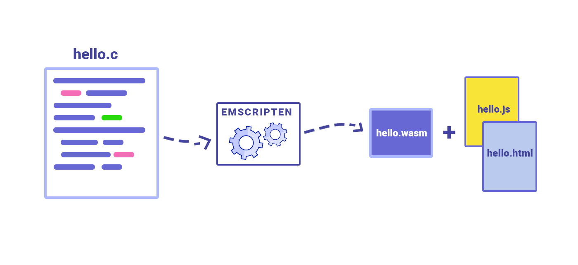
Advantages
Near-native performance
Hardware, language, and platform-independent
Can use the same web APIs accessed by JavaScript
Server-side ahead-of-time compiling
Can pass objects as parameters

Slide 16
Disadvantages
Potential security issues, difficult malware detection
Relatively new technology with little support
Not beginner friendly
Manual memory management

Slide 17
Conclusion

Slide 18
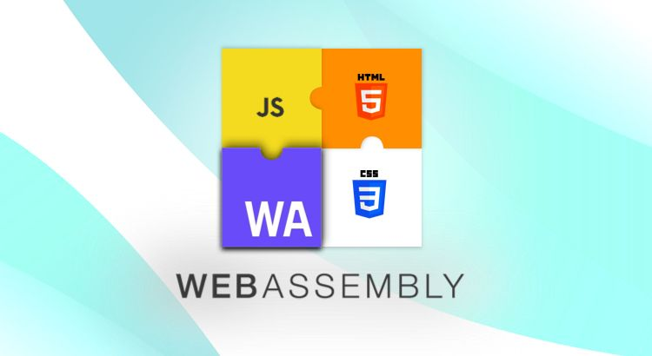

Slide 19
Thank You

