Slide 1

Autoencoder-based Visual RL in CarRacing-v3
Bachelor’s Degree Programme in Applied Computer Science and Artificial Intelligence
AI Lab: Computer Vision – Signal Processing – Natural Language Processing
Andrea Catino (catino.2154867@studenti.uniroma1.it)
A.Y. 2025/2026
1

Slide 2


Table of Contents
Context
Problem and Motivation
Related Work and Gap with Respect to the State of the Art
Proposed Solution and Our Contribution
Dataset and Experimental Protocol
Critical Discussion and Limitations
Conclusion and Future Work

Slide 3

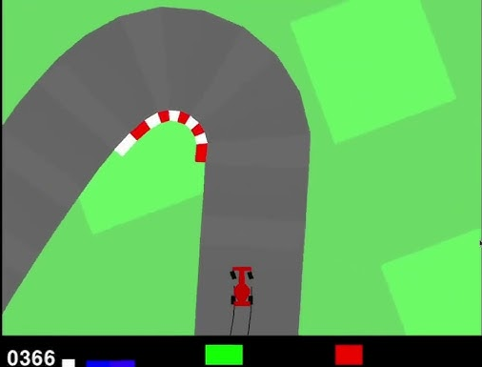
Context ●
Visual Reinforcement Learning in CarRacing-v3
CarRacing-v3
Observation
96 × 96 × 3 RGB image
Action
Continuous control: steering, throttle, brake
Goal
Learn to drive directly from visual observations
The agent receives no explicit information about road position, direction or track boundaries.
AI Lab: Computer Vision – Signal Processing – Natural Language Processing

Slide 4
Table of Contents
Context
Problem and Motivation
Related Work and Gap with Respect to the State of the Art
Proposed Solution and Our Contribution
Dataset and Experimental Protocol
Critical Discussion and Limitations
Conclusion and Future Work

Slide 5
Problem and Motivation ●
Learning Perception and Control Simultaneously
Raw-pixel learning
Main challenges
RGB observation
Visual features are learned only through reward
Visual feature learning
Perception and control are optimized simultaneously
Policy learning
Training can be sample-intensive and unstable
Continuous action
Can a pretrained visual representation simplify policy learning?
27,648 pixel values → 3 control values
AI Lab: Computer Vision – Signal Processing – Natural Language Processing

Slide 6
Table of Contents
Context
Problem and Motivation
Related Work and Gap with Respect to the State of the Art
Proposed Solution and Our Contribution
Dataset and Experimental Protocol
Critical Discussion and Limitations
Conclusion and Future Work

Slide 7
Related Work and Gap with Respect to the State of the Art ●
Related Work and Gap: Learning Control from Pixels
Approach | Main Idea | Limitations
End-to-end Deep RL DQN, PPO | A CNN learns visual features directly from the reward signal | Perception and control are learned simultaneously
Auxiliary Reconstruction During RL SAC+AE | Reconstruction loss helps the encoder learn compact visual features | Representation and policy are still trained jointly
Contrastive / Augmented RL CURL, DrQ | Contrastive learning or image augmentation improves visual representations | More specialized objectives and training strategies
Mnih et al., 2015 · Kostrikov et al., 2021 (DrQ) · Yarats et al., 2021 (SAC+AE) · Laskin et al., 2020 (CURL)
Limited evaluation of frozen autoencoder representations
AI Lab: Computer Vision – Signal Processing – Natural Language Processing

Slide 8
Table of Contents
Context
Problem and Motivation
Related Work and Gap with Respect to the State of the Art
Proposed Solution and Our Contribution
Dataset and Experimental Protocol
Critical Discussion and Limitations
Conclusion and Future Work

Slide 9
Proposed Solution and Our Contribution ●○
Offline Visual Pretraining
1. Environment
2. Frame Collection
3. Autoencoder
4. Representation
5. PPO Policy
6. Evaluation
CarRacing-v3
RGB observations
Continuous actions
18,293 RGB frames
Sampled (random intervals) during policy interaction
CNN Encoder
+
CNN Decoder
MSE reconstruction loss
Frozen Encoder
96x96x3 ->
Latent vector 128
MlpPolicy
Latent vector ->
Continuous action
Mean reward
Final reward
Learning curve
Stability
Phase 1: Representation learning
• Reconstruction objective
• No reward signal
Phase 2: Policy learning
• Frozen encoder
• PPO trained only on latent vectors
AI Lab: Computer Vision – Signal Processing – Natural Language Processing

Slide 10
Proposed Solution and Our Contribution ○●
Offline Visual Pretraining
Contribution
Complete Pipeline: Frame collection, autoencoder training, latent wrapper and PPO integration
Controlled Benchmark: Raw and latent PPO evaluated with the same experimental protocol
Reproducibility: Three training seeds, fixed evaluation seeds and saved configurations
Critical Analysis: Sample efficiency, stability, final performance and failure modes
The contribution is an interpretable and reproducible experimental comparison, not a new RL algorithm.
AI Lab: Computer Vision – Signal Processing – Natural Language Processing

Slide 11
Table of Contents
Context
Problem and Motivation
Related Work and Gap with Respect to the State of the Art
Proposed Solution and Our Contribution
Dataset and Experimental Protocol
Critical Discussion and Limitations
Conclusion and Future Work

Slide 12
Dataset and Experimental Protocol ●○○○○○
Dataset and Autoencoder Architecture
Frame dataset
18,293 PNG frames
96x96 RGB
90% train / 10% validation
Normalized to [0, 1]
Encoder
Decoder
Training
MSE loss
Adam
Batch 128
40 epochs
3.75M parameters
3 x 96 x 96
Latent 128
32 x 48 x 48
256 x 6 x 6
64 x 24 x 24
128 x 12 x 12
128 x 12 x 12
64 x 24 x 24
256 x 6 x 6
32 x 48 x 48
Latent 128
3 x 96 x 96
AI Lab: Computer Vision – Signal Processing – Natural Language Processing

Slide 13
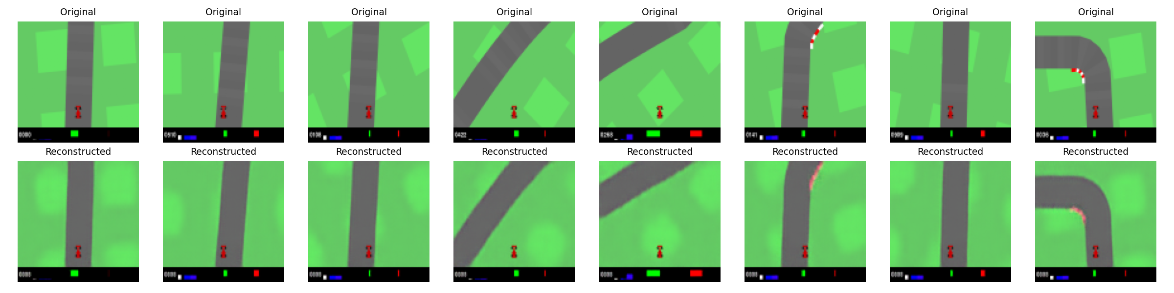
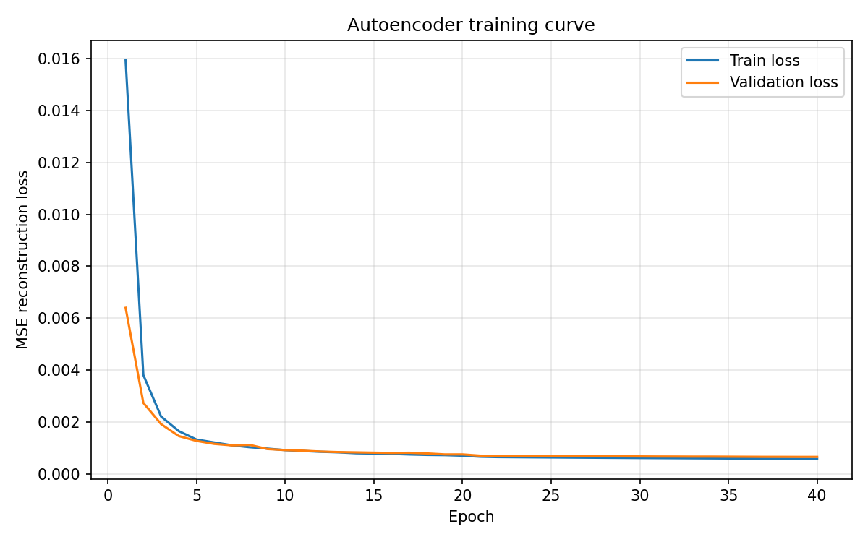
Dataset and Experimental Protocol ○●○○○○
Autoencoder Results
Final losses
Train: 0.000581
Validation: 0.000659
AI Lab: Computer Vision – Signal Processing – Natural Language Processing

Slide 14
Dataset and Experimental Protocol ○○●○○○
Controlled Experimental Protocol
RAW-PIXEL PPO
RGB frames
PPO CnnPolicy
Actions
LATENT PPO
RGB frames
Frozen Encoder
Latent 128
PPO MlpPolicy
Actions
Shared configuration
PPO algorithm
Learning rate: 1e-4
2 parallel environments
2,000,000 timesteps per run
Training seeds: 42, 123, 456
Evaluation seed: 10,000
5 deterministic evaluation episodes
Evaluation every 20,000 environment timesteps
AI Lab: Computer Vision – Signal Processing – Natural Language Processing

Slide 15
Dataset and Experimental Protocol ○○○●○○
Evaluation Metrics
Best Evaluation Reward: Highest mean reward during training
Final-Window Reward: Mean of the final 5 evaluations
Normalized AUC: Overall performance across the learning curve
Steps to Reward 700: Sample-efficiency threshold
Across-Seed Variability: Mean and standard deviation over 3 training seeds
AI Lab: Computer Vision – Signal Processing – Natural Language Processing

Slide 16
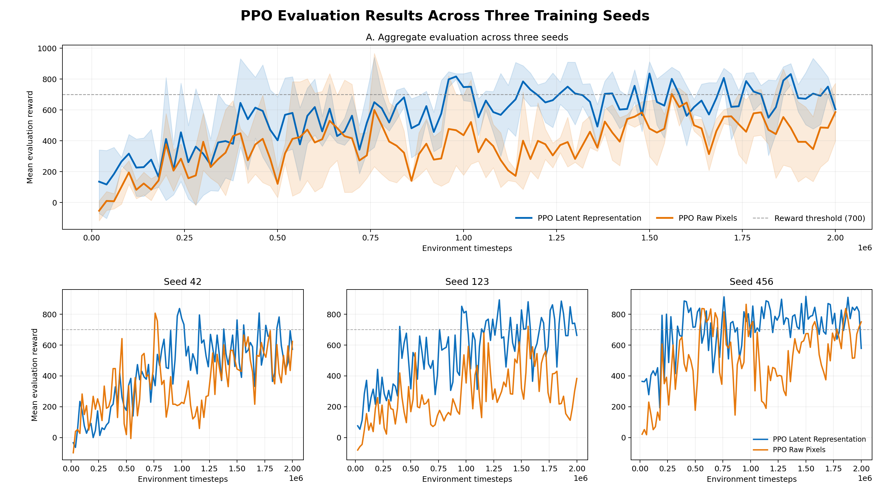
Dataset and Experimental Protocol ○○○○●○
PPO Learning Curves
Latent PPO achieves higher reward across most of training
The reward-700 threshold is reached earlier
Both methods remain variable across seeds
AI Lab: Computer Vision – Signal Processing – Natural Language Processing

Slide 17
Dataset and Experimental Protocol ○○○○○●
PPO Results Summary
Metric | Raw PPO | Latent PPO | Difference
Best evaluation reward | 798.1 ± 71.7 | 882.4 ± 40.5 | +10.6%
Final 5-eval mean | 459.2 ± 211.3 | 685.1 ± 127.4 | +49.2%
Normalized AUC | 377.8 ± 120.0 | 567.5 ± 134.5 | +50.2%
Steps to reward 700 | 960k ± 529k | 520k ± 394k | −45.8%
Mean ± standard deviation across 3 training seeds
Latent PPO outperformed raw-pixel PPO on all predefined aggregate metrics.
AI Lab: Computer Vision – Signal Processing – Natural Language Processing

Slide 18
Table of Contents
Context
Problem and Motivation
Related Work and Gap with Respect to the State of the Art
Proposed Solution and Our Contribution
Dataset and Experimental Protocol
Critical Discussion and Limitations
Conclusion and Future Work

Slide 19
Critical Discussion and Limitations ●○
Critical Discussion
What Worked
Latent PPO outperformed raw PPO on all aggregate metrics
Reward 700 was reached with 46% fewer timesteps
Final-window reward improved by 49%
The advantage appeared across all three seeds for AUC and best reward
What The Results Mean
The results suggest that reconstruction pretraining captured useful driving information
Dimensionality was reduced from 27,648 values to 128
The frozen representation appears to have simplified policy learning
Separating perception and control was beneficial in this experiment
The frozen autoencoder improved learning, but it did not eliminate PPO variability.
AI Lab: Computer Vision – Signal Processing – Natural Language Processing

Slide 20
Critical Discussion and Limitations ○●
Limitations
Limited Statistical Evidence: Only three training seeds were evaluated
Dataset Bias: Frames were collected from states visited by previous PPO policies
Reconstruction Objective: MSE optimizes pixel similarity, not control-relevant information
Visual Input: CarRacing observations include the simulator HUD
Experimental Scope: One environment, one latent dimension and one main learning rate
Frozen Encoder: The representation cannot adapt during policy learning
AI Lab: Computer Vision – Signal Processing – Natural Language Processing

Slide 21
Table of Contents
Context
Problem and Motivation
Related Work and Gap with Respect to the State of the Art
Proposed Solution and Our Contribution
Dataset and Experimental Protocol
Critical Discussion and Limitations
Conclusion and Future Work

Slide 22
Conclusion and Future Work ●○
Conclusion
Does a frozen autoencoder representation improve PPO training from visual observations?
Yes, within the tested CarRacing-v3 setting and experimental budget.
+10.6%
Best evaluation reward
+49.2%
Final-window reward
−45.8%
Timesteps required to reach reward 700
+50.2%
Normalized learning-curve AUC
A compact frozen representation improved sample efficiency and overall performance, but PPO remained variable across training seeds.
AI Lab: Computer Vision – Signal Processing – Natural Language Processing

Slide 23
Conclusion and Future Work ○●
Future Work
Task-Aware Representation Learning: Fine-tune the encoder during PPO or combine reconstruction and RL losses
Better Visual Objectives: Contrastive learning, augmentation or sharper reconstruction losses
Broader Evaluation: More seeds, different latent dimensions and additional visual-control environments
Robustness: Noise, blur, brightness changes, occlusions and domain randomization
Observation Preprocessing: Remove the HUD and focus the encoder on the road scene
AI Lab: Computer Vision – Signal Processing – Natural Language Processing

Slide 24

THANK YOU FOR LISTENING!
ANY QUESTIONS?

