Slide 1
ASL Fingerspelling Interpretation
Sbera Catalin

Slide 2
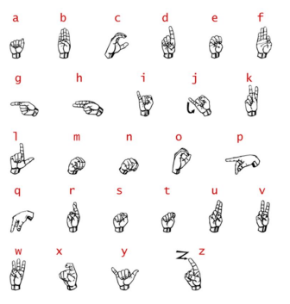
Introduction
ASL is one of many forms of sign language.
There is a specific sign for each letter/number
For the purpose of this project letters J and Z are omitted alongside the numbers
This Program will work on images, not on live footage

Slide 3
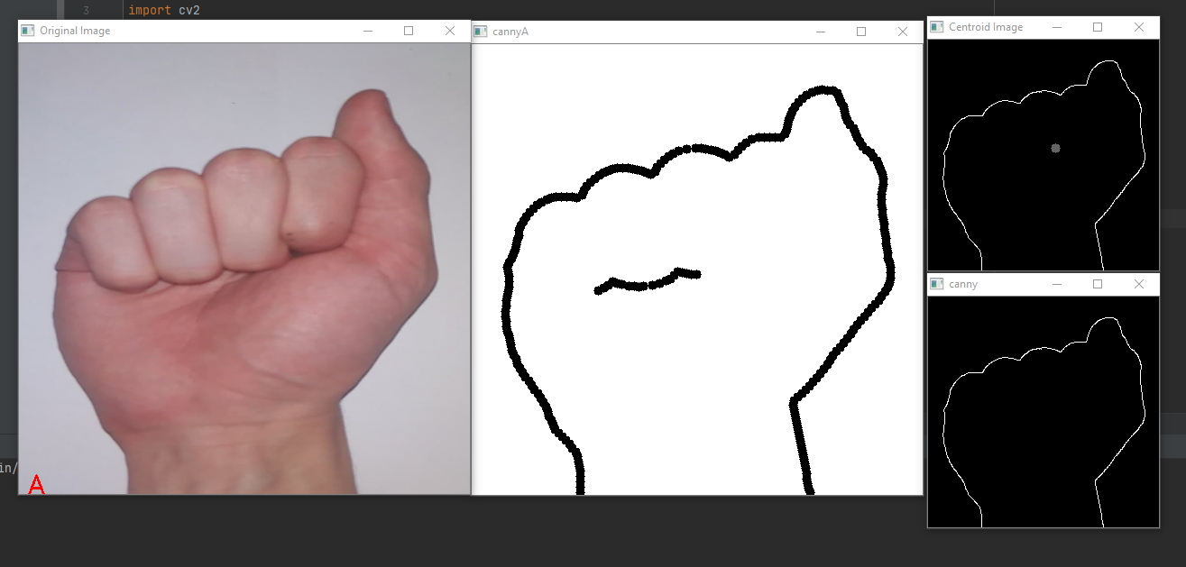
Example

Slide 4
Explanation of the algorithm
The algorithm is split into multiple parts
First we take the image and resize it to a smaller size in order to decrease the calculations
Using Canny edge detection we detect the edges of the objects in the image.
We then thicken the edges in order to compensate for missing pixels and have a complete image (cannyA)
We then fill the center of the image in order to remove inner edges that have been detected then invert the image (canny)
We then compute the centroid point of the image and calculate the distances to all the edge pixels (Centroid image)
These distances are then normalized and used to create a histogram of 100 bins
The histogram is then compared to a dataset of histograms that correspond to the letters
The resulting letter is then added to the bottom-left point of the original image (Original Image)

Slide 5
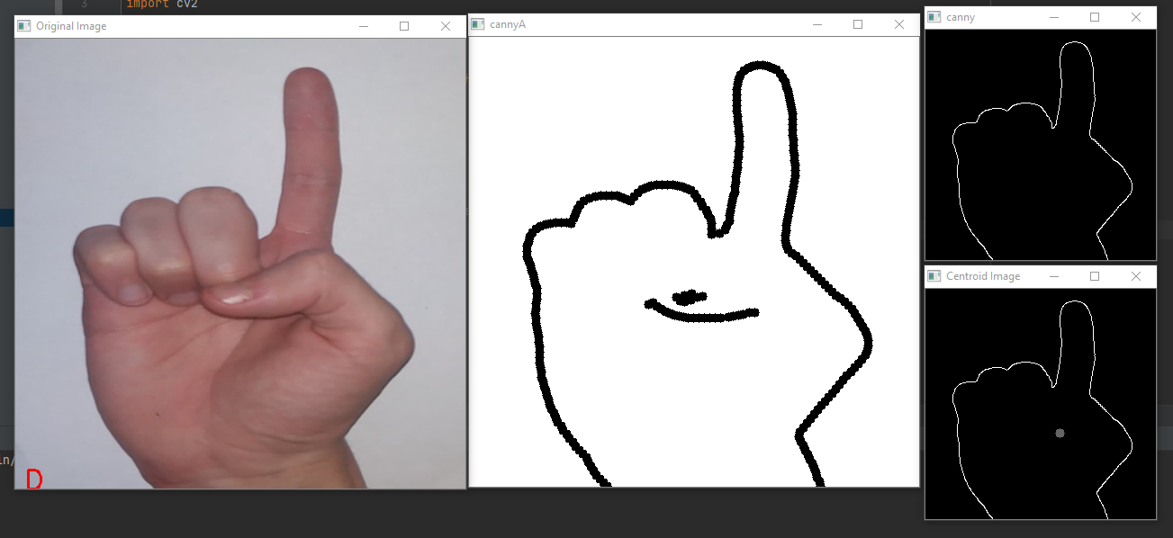
More Examples

Slide 6
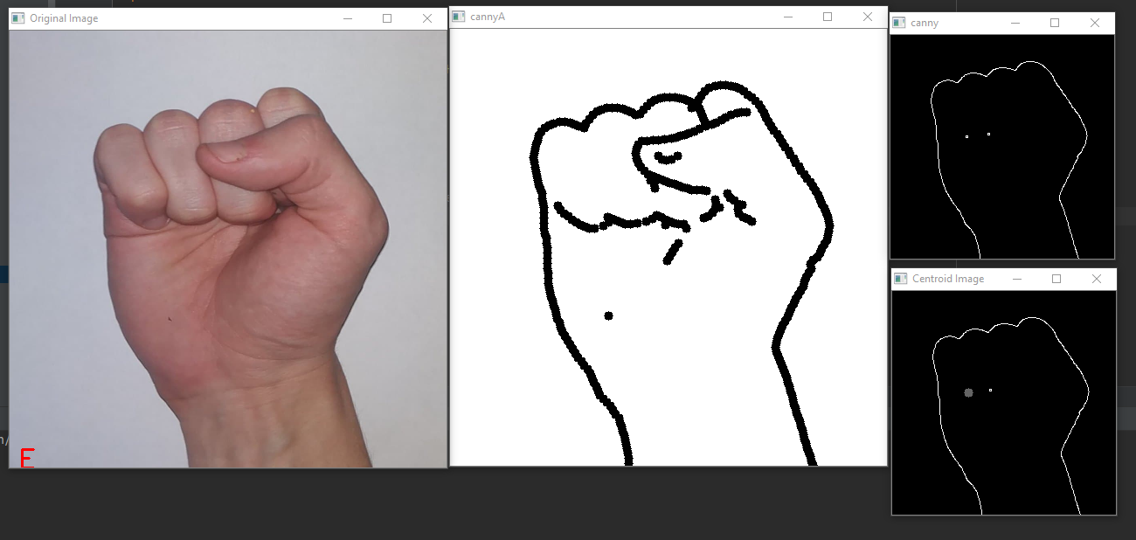

Slide 7
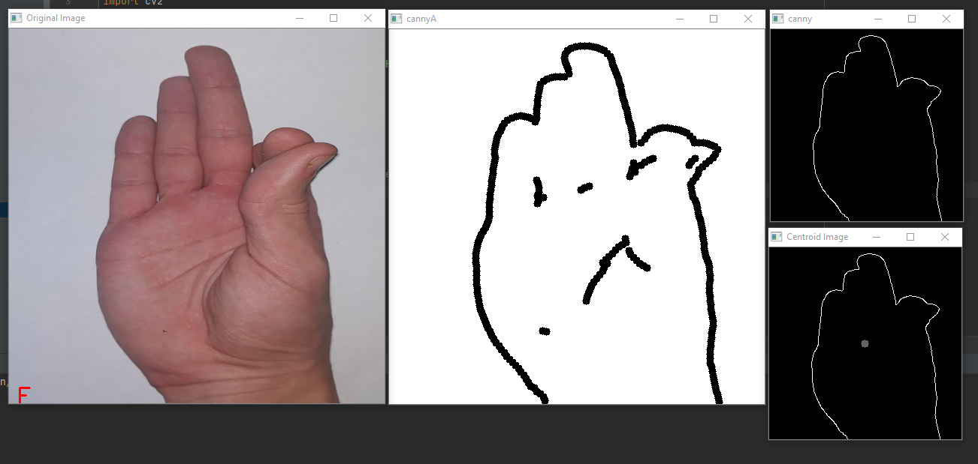

Slide 8
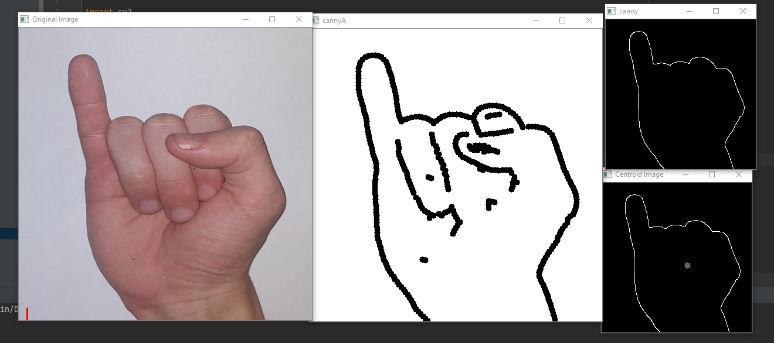

Slide 9
