Slide 1
Application
How can we make and promote an app successfully？
_{FENG Yujin 18413188}
_{CHEN Ye 18428665}
_{GU Minyi 18445276}
_{DU Jiawei 18420990}

Slide 2
Introduction
MAKE AND PROMOTE AN APP
Introduction
· Global mobile internet penetration has exceeded half the world’s population.
· The average daily time spent accessing online content from a mobile device
has reached 185 minutes daily among Millennials.
· The two largest global platforms : Apple’s App Store and Google Play.
· As of March 2018, there were some 3.6 million apps in Google Play alone.

Slide 3
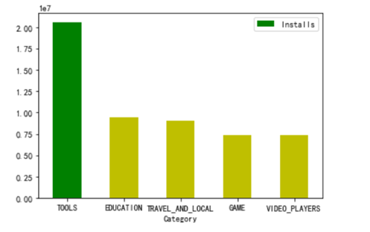

Category
MAKE AND PROMOTE AN APP
Category
· What the quantities are most is the apps related to Family, Game, Medical, Tools and Lifestyle.
· Tools, Education, Travel, Game and Video Players are the five kinds of applications downloaded most.

Slide 4
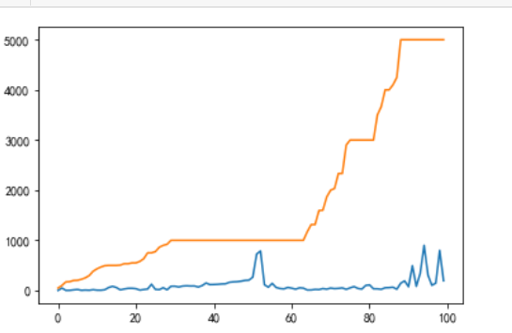
Promotion Strategy
MAKE AND PROMOTE AN APP
Promotion Strategy
Reviews
Installs
· No matter how much the installs
increase, the reviews keep relatively
stable with no more than 1k users
willing to review.
· Users' willingness to comment
needs to be stimulated by something.

Slide 5
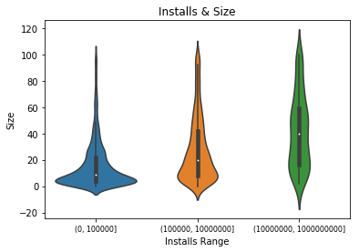
Apps’ Sizes
MAKE AND PROMOTE AN APP
Apps’ Sizes
· When the sizes are in the range
of 15~60 M, users are more likely
to install the apps.
· Solution for apps with big size:
dividing the process of download
by many times or updating them
step by step .

Slide 6
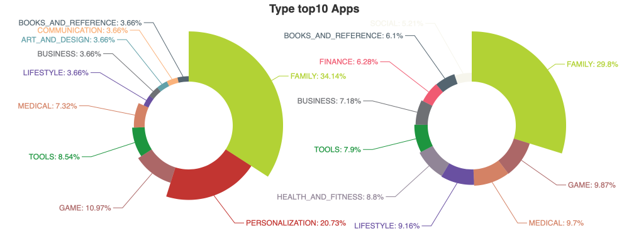
Pricing Strategy
MAKE AND PROMOTE AN APP
Pricing Strategy

Slide 7
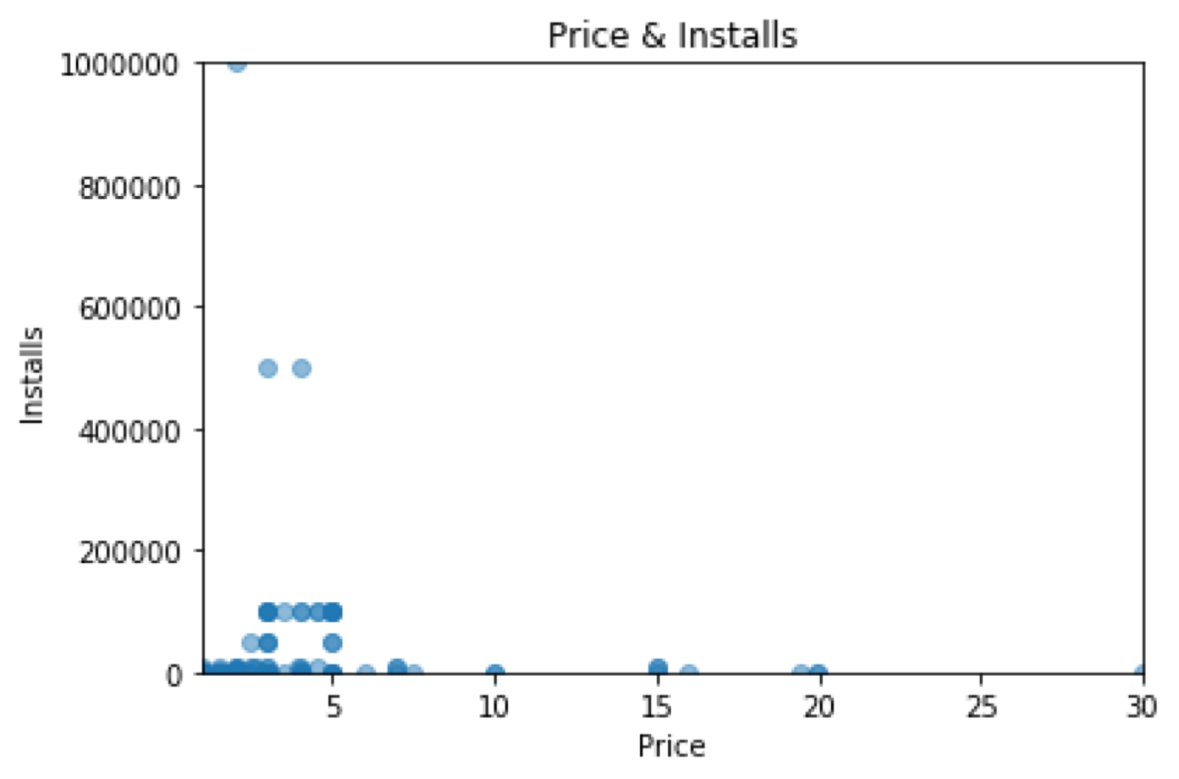
Pricing Strategy
MAKE AND PROMOTE AN APP
Pricing Strategy
· The apps costing less than $5 are
more popular.
· Apps which cost more may need
to provide a free trail to increase
consuming willingness or offer
purchasing options within the app.

Slide 8
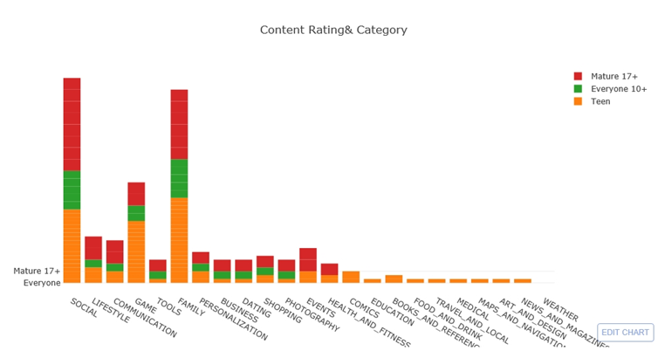
Content Rating and Potential Market
MAKE AND PROMOTE AN APP
Content Rating and Potential Market

Slide 9
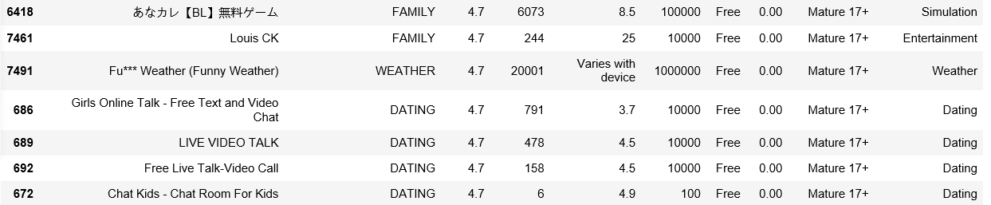
Content Rating and Potential Market
MAKE AND PROMOTE AN APP
Content Rating and Potential Market

Slide 10
Future Work
MAKE AND PROMOTE AN APP
Future Work
· Scraping original data
· Comparing the data scraping from Apple’s app store
· Analyzing more category and content rating mistakes to find whether it is a strategy
· Do the content analysis of reviews

Slide 11
Conclusion
MAKE AND PROMOTE AN APP
Conclusion
· Category: focus on the categories with less competitors like Education, Travel and Video Players.
· Pricing Strategy: adjust pricing so as to offer attractive products at a bearable margin, and it is
better to provide a free trail or insider access for purchasing value-added services.
· Sizes: control the sizes of apps under 50 M, otherwise divide the process of download by times or
updating them step by step.
· Promotion Strategy: inspire users to make reviews, especially positive reviews.
· Content Rating and Potential Market: there is a choice for apps’ operators that take advantage of
content rating for advertising. What’s more, there are still gaps in the market for teen and adults.

Slide 12
Thank You
Thank You

