Slide 1
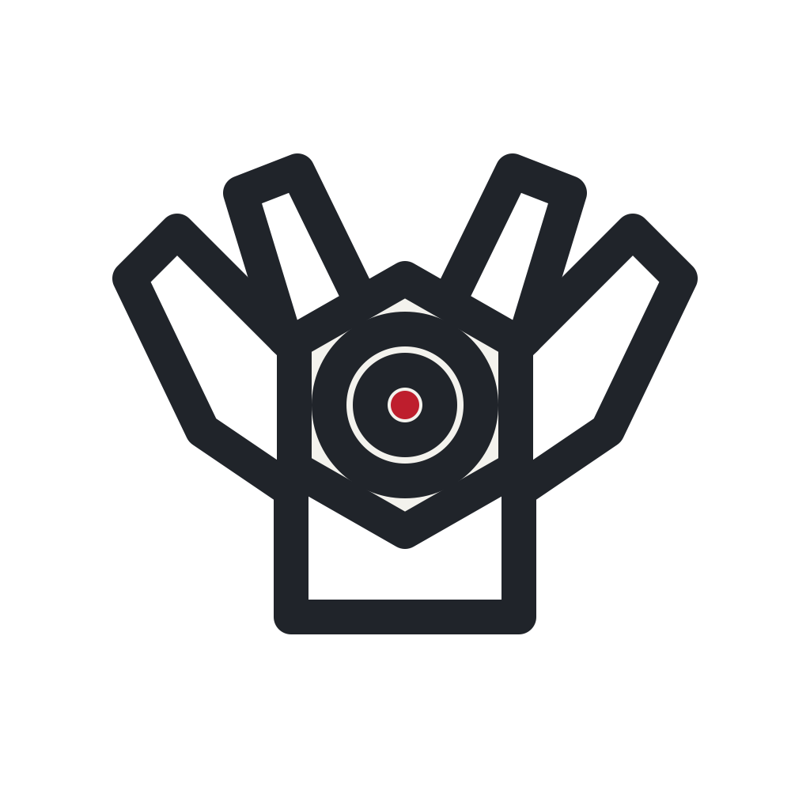
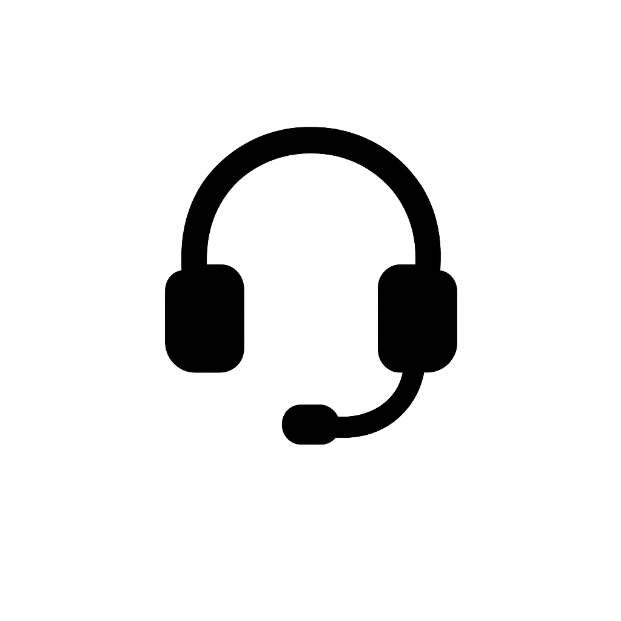

Team JQK
No Cloud Needed
Private by Design
Protocols
Internet: none — local Wi-Fi only (HTTP/WS phone→board, UDP heartbeat, UART→MCU)
All compute on-device
Zero-connectivity demo
No video leaves the device
Phone joins the board’s Wi-Fi
Mira is a robotic camera-inspection assistant built entirely on the Arduino UNO Q. An SO-101 arm carries a camera that scans and inspects objects, teleoperated from a phone in XR over the board’s own Wi-Fi — no cloud, no GPU, nothing leaves the device.
Camera
Headset
Mira App (MPU · Debian)
Camera capture
Comm (MPU)
Wi-Fi: phone XR UI (WebXR)
USB serial 1 Mbaud → SO-101
UART → MCU heartbeat bridge
100 Hz servo control loop
Replay · 3D recon (planned)
Interlock (MCU · STM32)
Gates the 12 V servo relay
Heartbeat + E-stop watchdog
Faults latch → arm de-energises
GPIO
WiFi
Int
BT
ADC
Working now: 100 Hz servo control · camera capture · trajectory replay
In progress: XR teleoperation from an Android phone (WebXR)
Planned: on-device 3D reconstruction (visual hull)
Hardware-enforced safety: MCU interlock gates the 12 V servo rail
Values: private, offline, low-cost — inspection that works anywhere
Camera
SO-101 Arm
DAC
PWM
⚠ E-stop = cut 12 V servo rail. Board power-off does NOT stop the arm.
OpAmp
UART
USB-C Multiport Hub + PD
I2C
SPI
Speaker
Mic
CAN
SAI
USB-C
PSSI
UNO Q (QRB2210 Linux + STM32U585 MCU) · SO-101 6-servo arm on 12 V · USB-C hub + PD · wrist & overhead cameras · speaker · wireless mic
⚠ Board power-off does NOT stop the arm — the E-stop cuts the 12 V servo rail via a fail-safe MCU relay interlock (heartbeat-gated, faults latch)
USB host role depends on boot order (known UNO Q bug) — scripted workaround
Demo phone must support ARCore for XR tracking
On Board
Peripherals
Mouse
Keyboard
RGB
LED
LED
MATRIX
Storage

