Slide 1
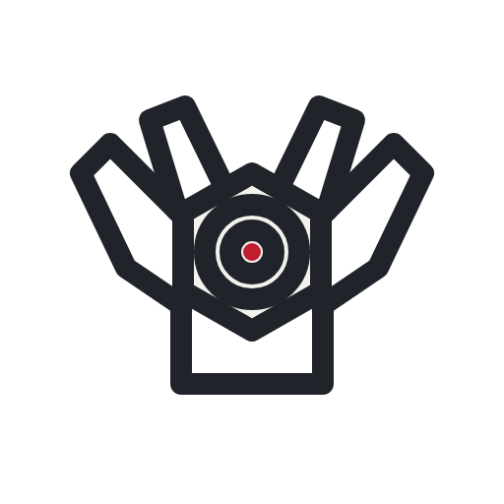
J
♥
MIRA
a robotic camera-inspection assistant on the Arduino UNO Q
TEAM JQK · QUALCOMM HACK CHALLENGE 2026 · OFFLINE — PRIVATE — HARDWARE-SAFE
K
♠

Slide 2
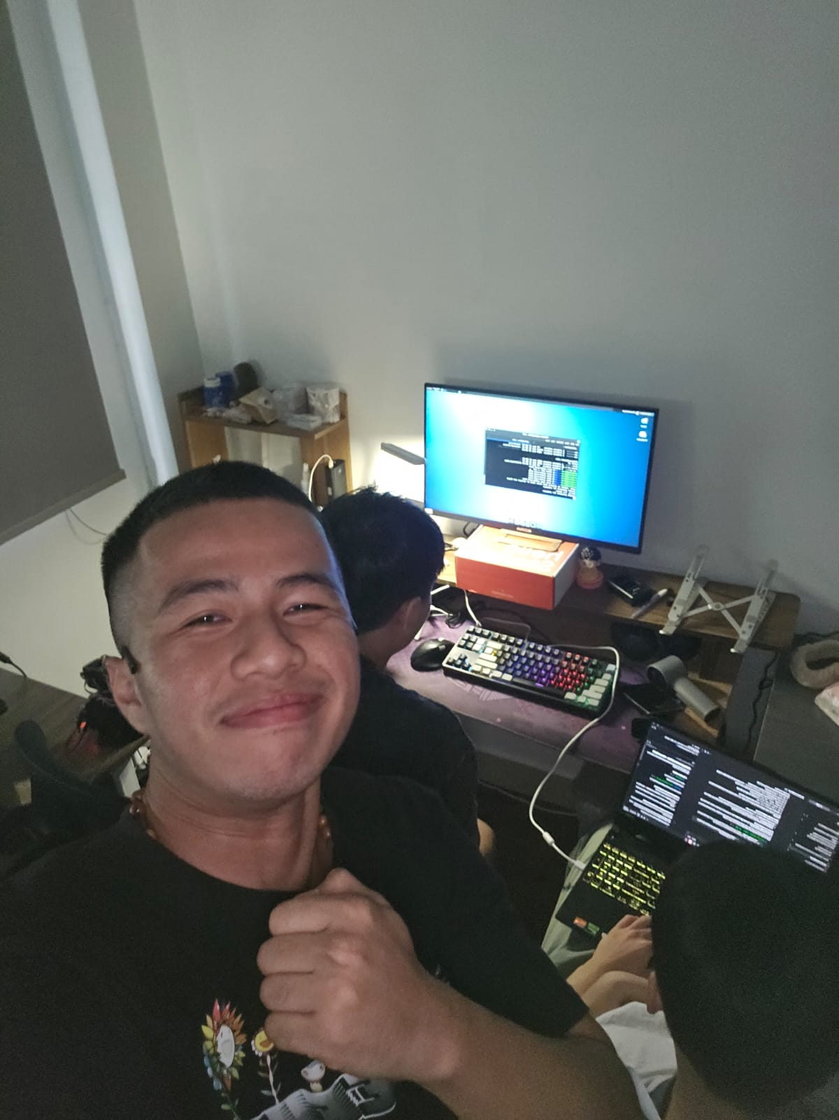
J
♥
01 · WHO WE ARE
Team JQK
FIVE STUDENTS, ONE ARM.
We wanted a robot arm to do something real — not just wave at the camera.
ROLES.
Firmware & safety interlock · servo control & drivers · XR teleoperation · computer vision & ML · product & demo.
ONE RULE WE BUILD BY.
Every feature must run with the Wi-Fi router unplugged.
the hacker house, shipping
K
♠
TEAM JQK — MIRA ON UNO Q
2 / 6

Slide 3
J
♥
02 · PROBLEM → PRODUCT
Close-up inspection is manual, hazardous, or cloud-bound
PROBLEM.
Inspecting objects up close means hands, ladders or expensive rigs — and the smart-camera products that exist stream your video to someone else’s cloud.
FIG. 2 — THE LOOP
PHONE — WebXR UI
Wi-Fi · the board is the access point
PRODUCT.
UNO Q — QRB2210 · DEBIAN
capture · 100 Hz control · web server
Mira: an SO-101 arm carries a camera you steer from a phone in XR. It scans, inspects, records and replays trajectories.
USB serial · 1 Mbaud
SO-101 ARM + WRIST CAM
THE TWIST.
12 V rail — relay-gated
Control, capture and the UI itself run on one 2 GB UNO Q. No GPU, no cloud — nothing leaves the device.
STM32 SAFETY INTERLOCK
K
♠
TEAM JQK — MIRA ON UNO Q
3 / 6

Slide 4
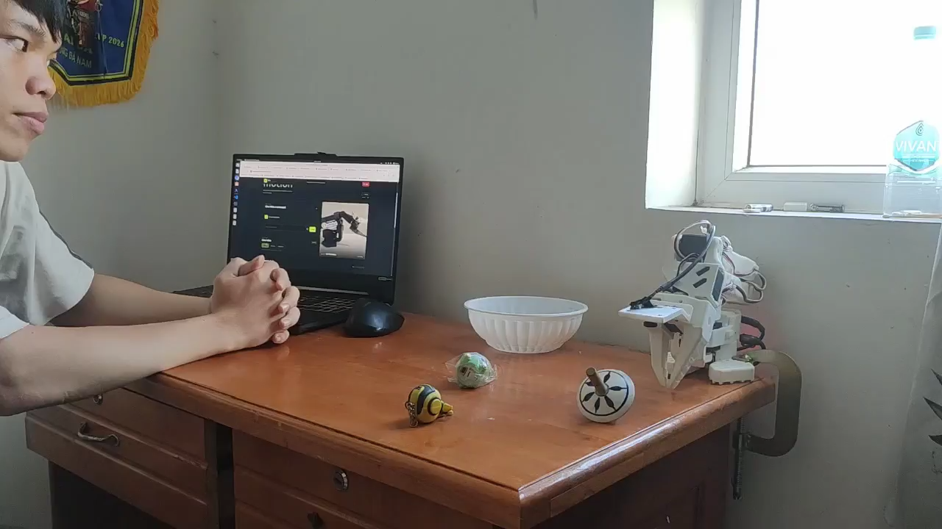
J
♥
03 · FEATURES & DEMO
What you will see today
WORKING.
100 Hz servo control · camera capture · trajectory record & replay · fail-safe servo-power interlock.
NOTICE — SAFETY IS A FEATURE
Board power-off does not stop the arm — servos freeze rigid. So the MCU alone gates the 12 V rail:
IN PROGRESS.
XR teleoperation from an Android phone (WebXR + ARCore).
heartbeat stale → rail drops
E-stop opens → rail drops
corrupt frame → rail drops
faults latch → a human resets
DEMO FLOW.
Arm the interlock → steer from the phone → replay the scan → pull the heartbeat, watch the rail drop.
Linux cannot override it. We demo this live.
DEMO VIDEO
K
♠
TEAM JQK — MIRA ON UNO Q
4 / 6

Slide 5
J
♥
04 · WHAT’S NEXT
From teleop to autonomy — still offline
NOW → HACK DAY.
Finish XR teleop · capture demo footage · harden the USB boot-order workaround.
NEXT MONTH.
On-device 3D reconstruction (visual hull) from arm-swept captures · voice control with on-device speech-to-text.
AFTER.
LeRobot-format datasets from replayed trajectories → train small imitation policies that run on the QRB2210. The arm learns the inspection, then does it alone.
K
♠
TEAM JQK — MIRA ON UNO Q
5 / 6

Slide 6
J
♥
Mira — inspection that works anywhere.
Because it never needed anywhere else.
github.com/Catnip-harvest/Mira-on-Uno-Q · TEAM JQK · QUESTIONS WELCOME
K
♠

