Slide 1
Exponential and Logarithmic Equations

Slide 2
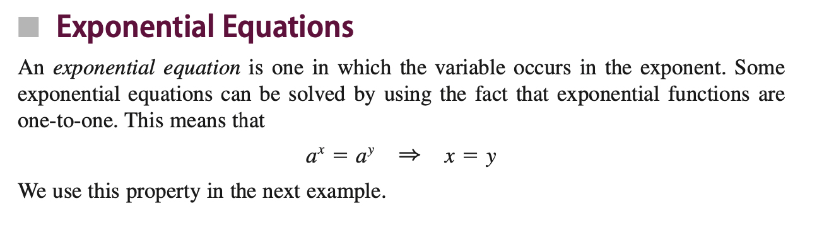
Definition

Slide 3
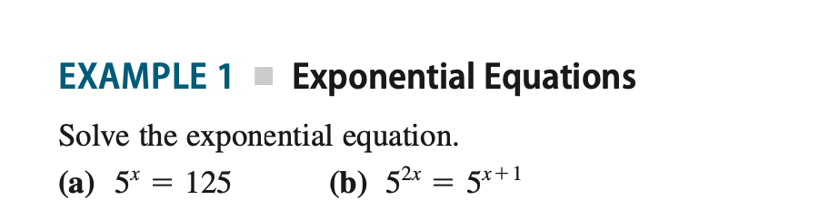
Example

Slide 4
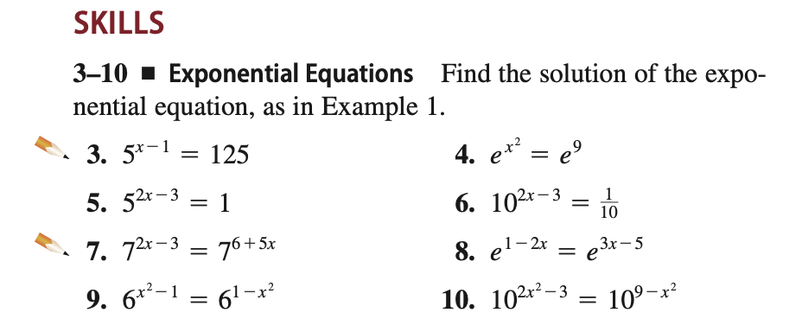
Problems

Slide 5
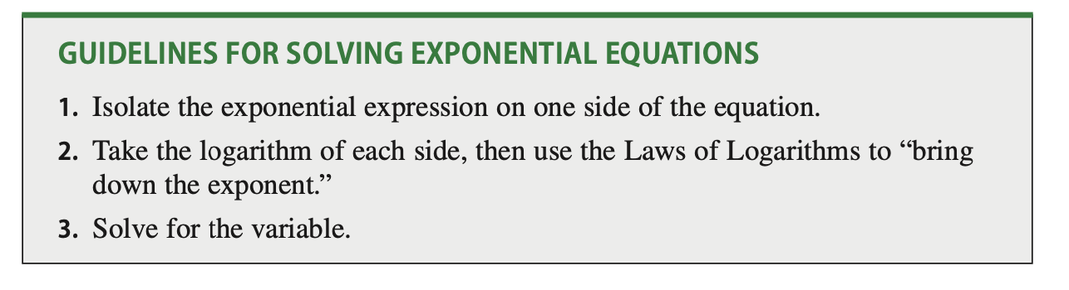
How to solve Exponential Equations?

Slide 6
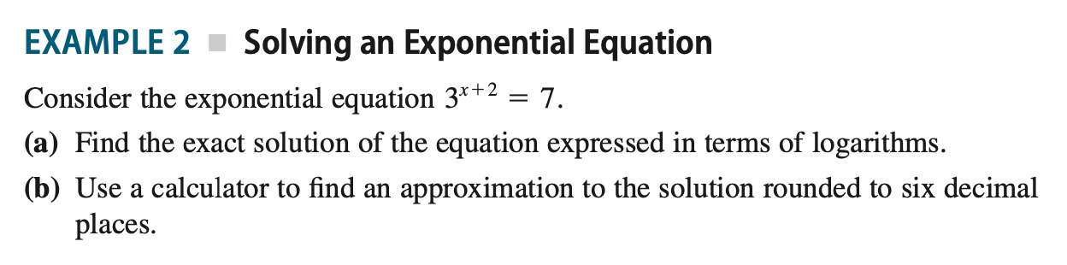
Example

Slide 7
Problems to Solve

Slide 8
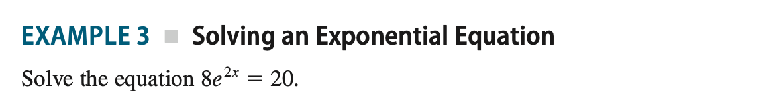
Example

Slide 9
Problems to Solve

Slide 10
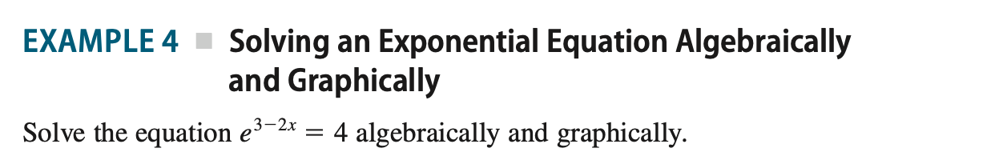
Algebraic

Slide 11
Problems to Solve

Slide 12
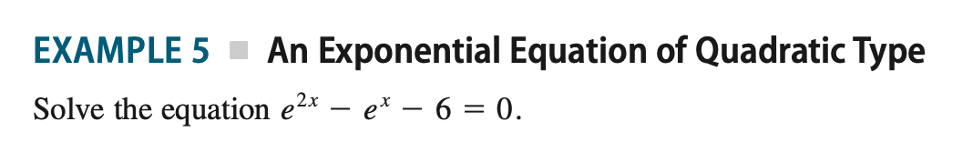
Quadratic Type

Slide 13
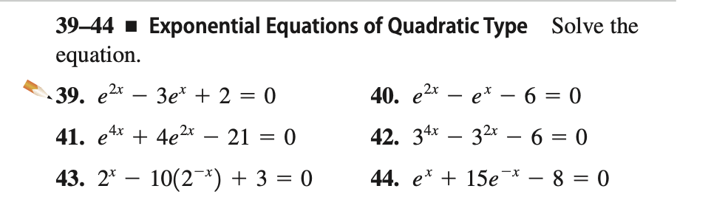
Problems to Solve

Slide 14
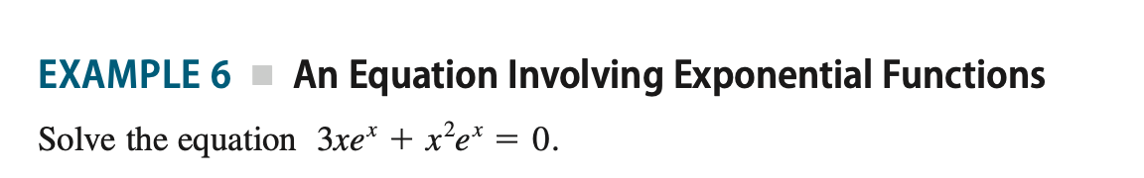
Example

Slide 15
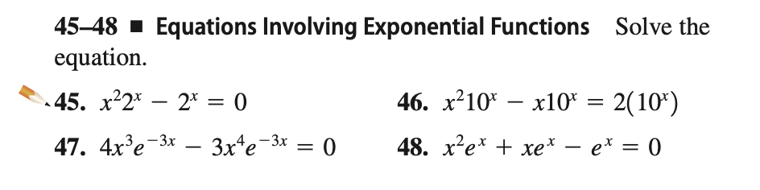
Problems to Solve

Slide 16
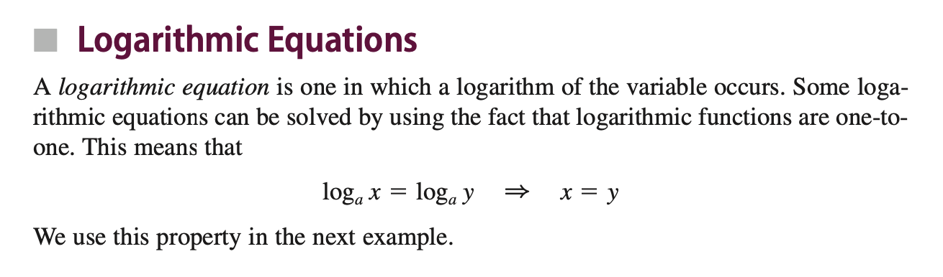
Definition

Slide 17
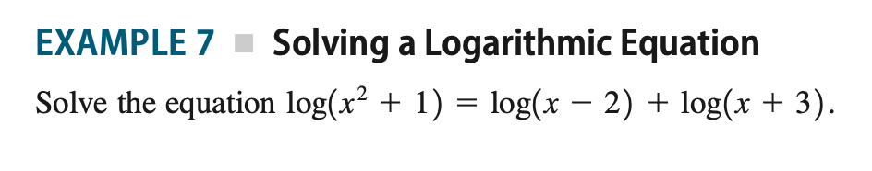
Example

Slide 18
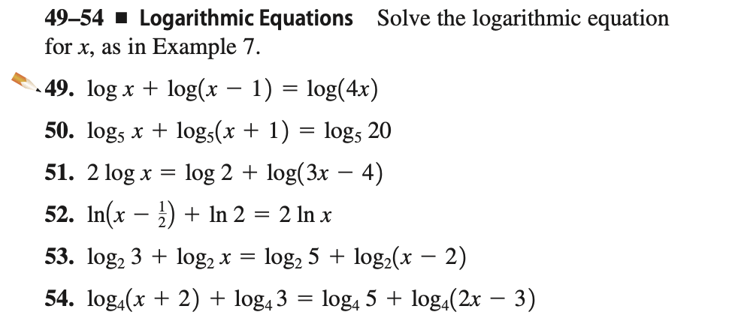
Problems to Solve

Slide 19
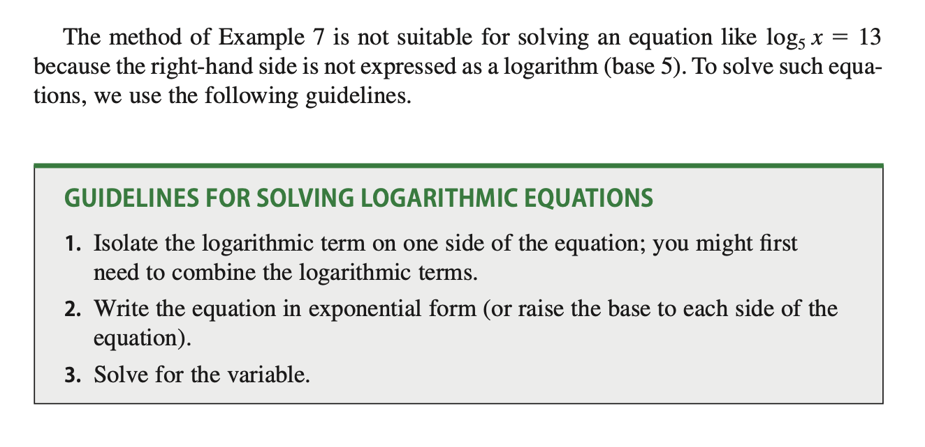
How to Solve Logarithmic Equations?

Slide 20
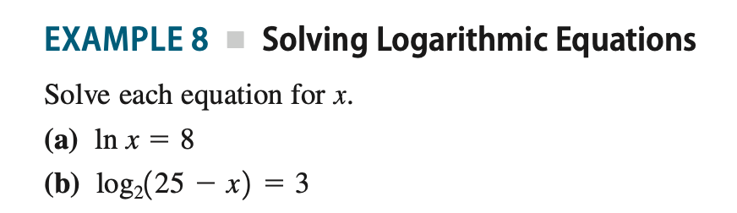
Example

Slide 21
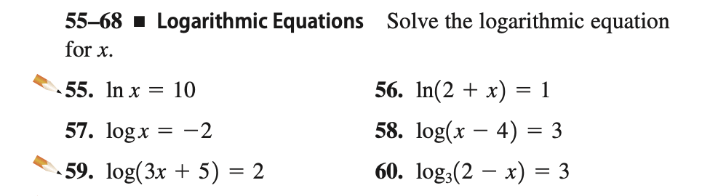
Problems to Solve

Slide 22
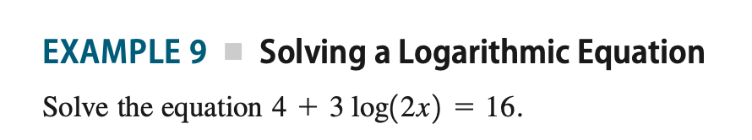
Example

Slide 23
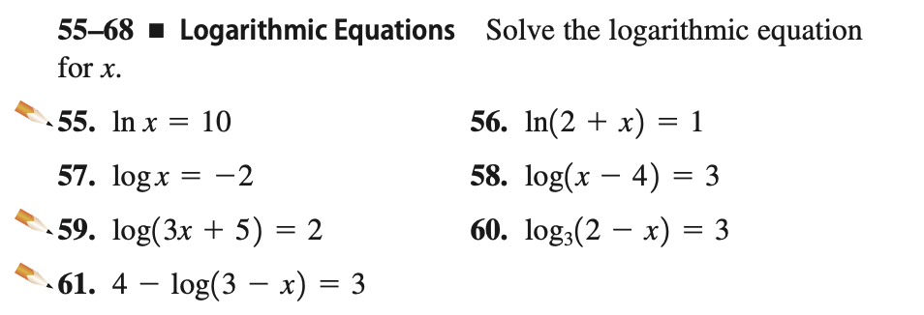
Problems to Solve

Slide 24
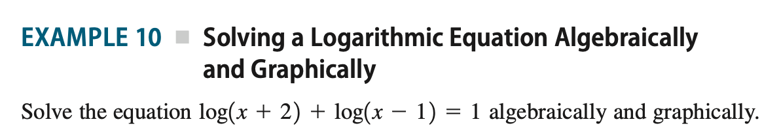
Example

Slide 25
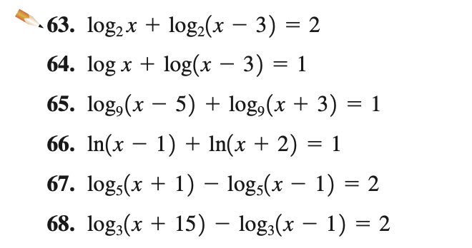
Problems to Solve

