Slide 1
Counting theory:addition and multiplication

Slide 2

Addition principle

Slide 3
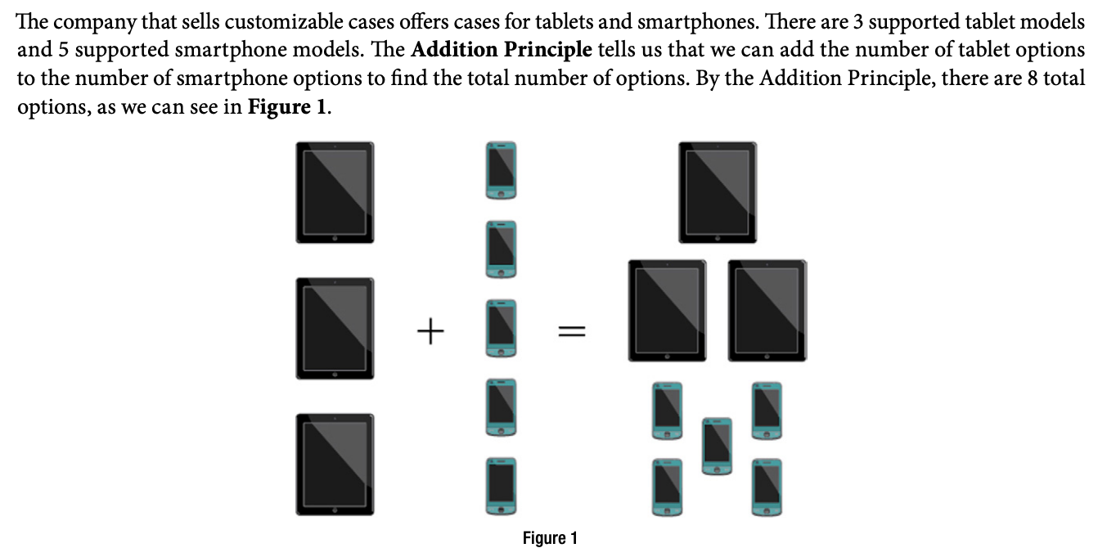
example

Slide 4


example

Slide 5

problem

Slide 6

Multiplication principle

Slide 7
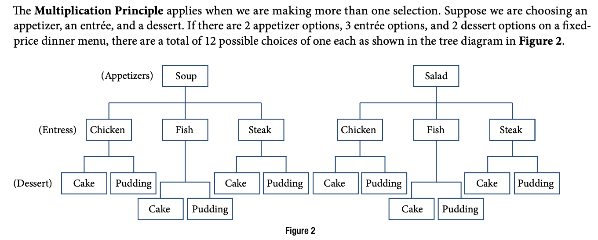
example

Slide 8
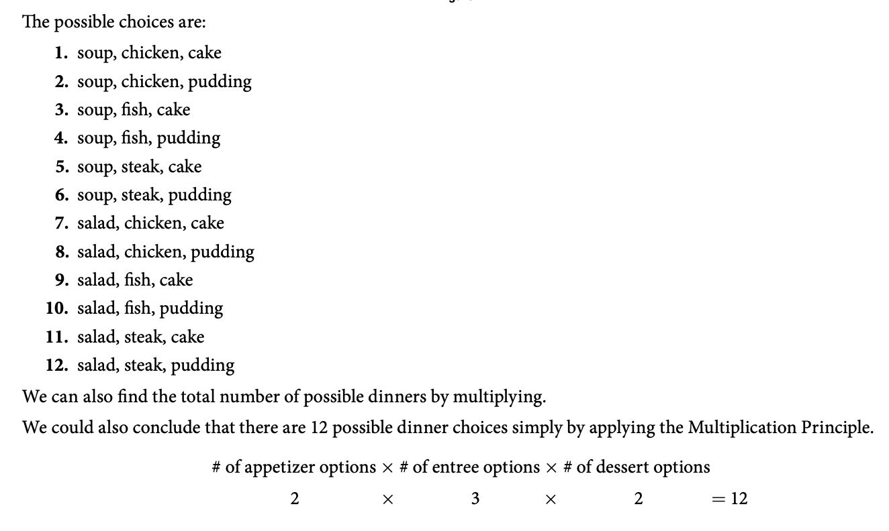
solution

Slide 9

example

Slide 10

problem

Slide 11
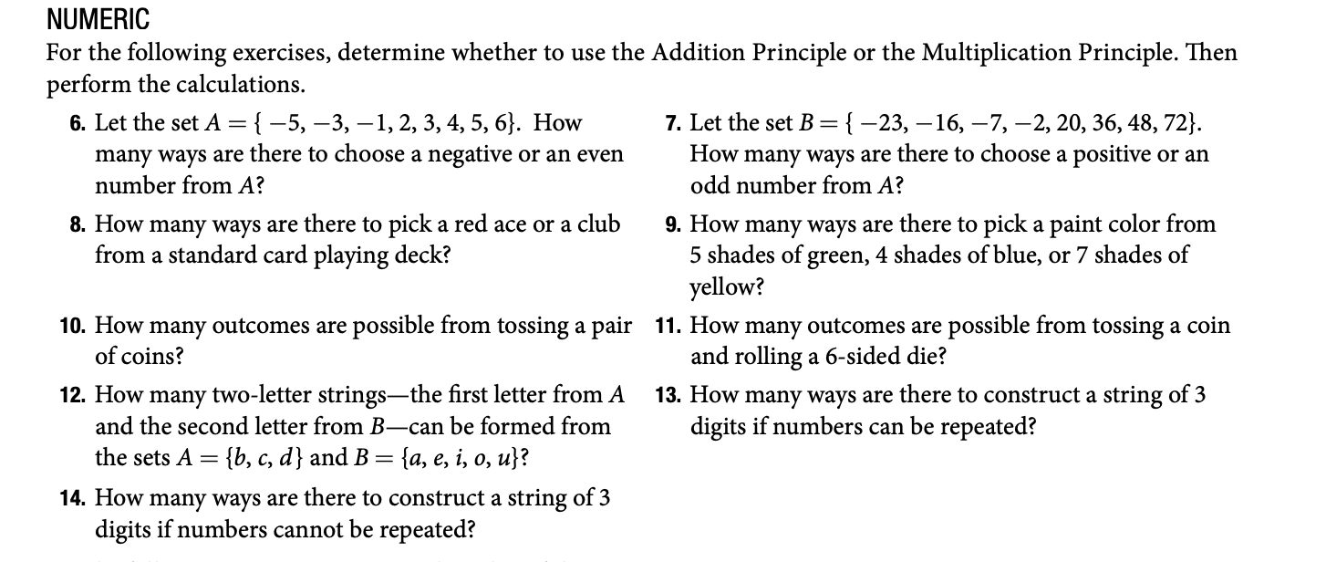
Problems

