Slide 1
A Monte Carlo simulation of the 2D Ising Model
By Matteo Littardi and Pietro Firpo

Slide 2
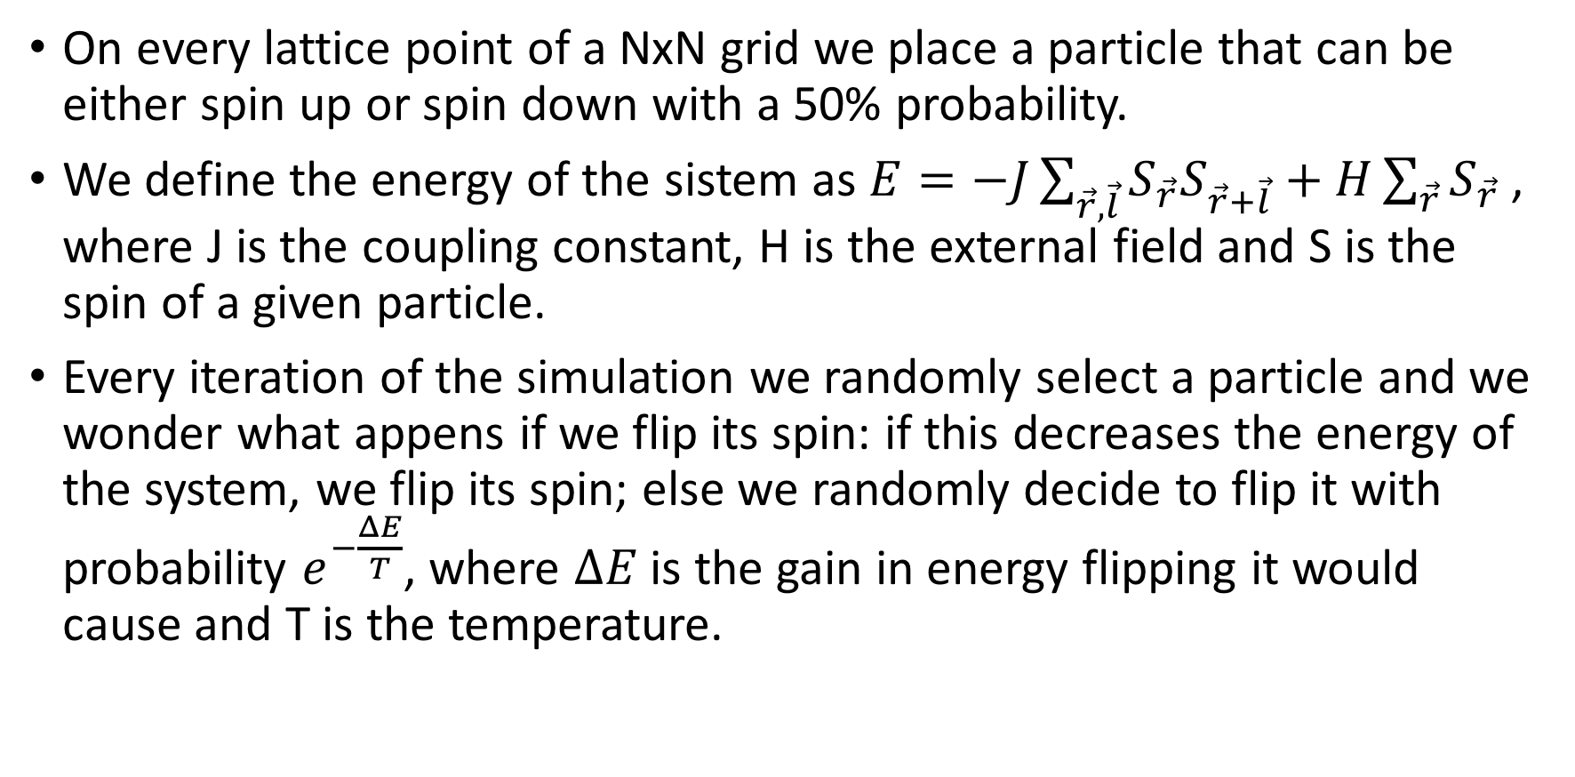
The Ising Model
On every lattice point of a NxN grid we place a particle that can be either spin up or spin down with a 50% probability.
We define the energy of the sistem as $E=−J\sum_{\vec{r}, \vec{l}}{S_{\vec{r}}S_{\vec{r}+\vec{l}}}+H\sum_{\vec{r}}{S_{\vec{r}} }$, where J is the coupling constant, H is the external field and S is the spin of a given particle.
Every iteration of the simulation we randomly select a particle and we wonder what appens if we flip its spin: if this decreases the energy of the system, we flip its spin; else we randomly decide to flip it with probability $e^{−\frac{ΔE}{T}}$, where $ΔE$ is the gain in energy flipping it would cause and T is the temperature.

Slide 3
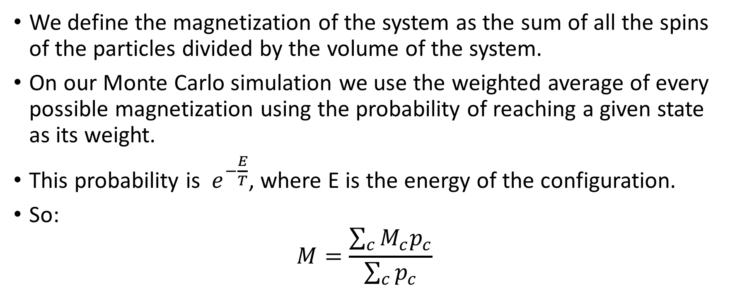
Magnetization
We define the magnetization of the system as the sum of all the spins of the particles divided by the volume of the system.
On our Monte Carlo simulation we use the weighted average of every possible magnetization using the probability of reaching a given state as its weight.
This probability is $e^{−\frac{E}{T}}$, where E is the energy of the configuration.
So:
$$M=\frac{\sum_{c}{M_{c}p_{c}}}{\sum_{c}{p_{c}}}$$

Slide 4
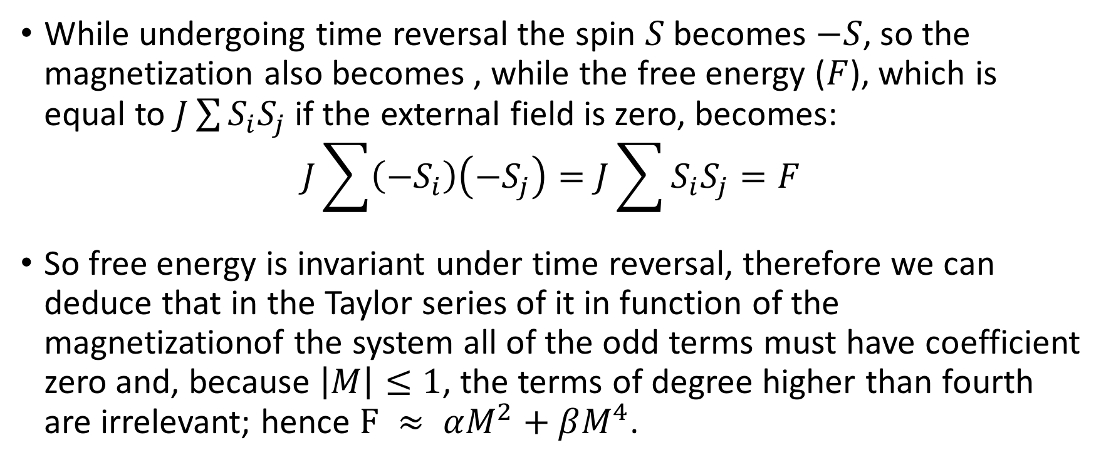
Magnetization: time simmetry
While undergoing time reversal the spin $S$ becomes $−S$, so the magnetization also becomes , while the free energy ($F$), which is equal to $J\sum{S_{i}S_{j}}$ if the external field is zero, becomes:
$$J\sum{\left({−S}_{i}\right)\left({−S}_{j}\right)=J\sum{S_{i}S_{j}=F}}$$
So free energy is invariant under time reversal, therefore we can deduce that in the Taylor series of it in function of the magnetizationof the system all of the odd terms must have coefficient zero and, because $\left|M\right|≤1$, the terms of degree higher than fourth are irrelevant; hence $F ≈ αM^{2}+βM^{4}$.

Slide 5
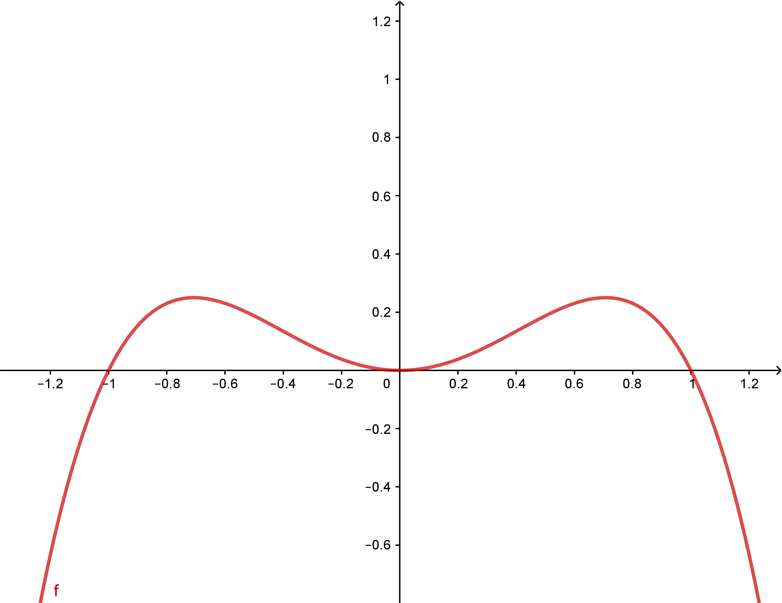
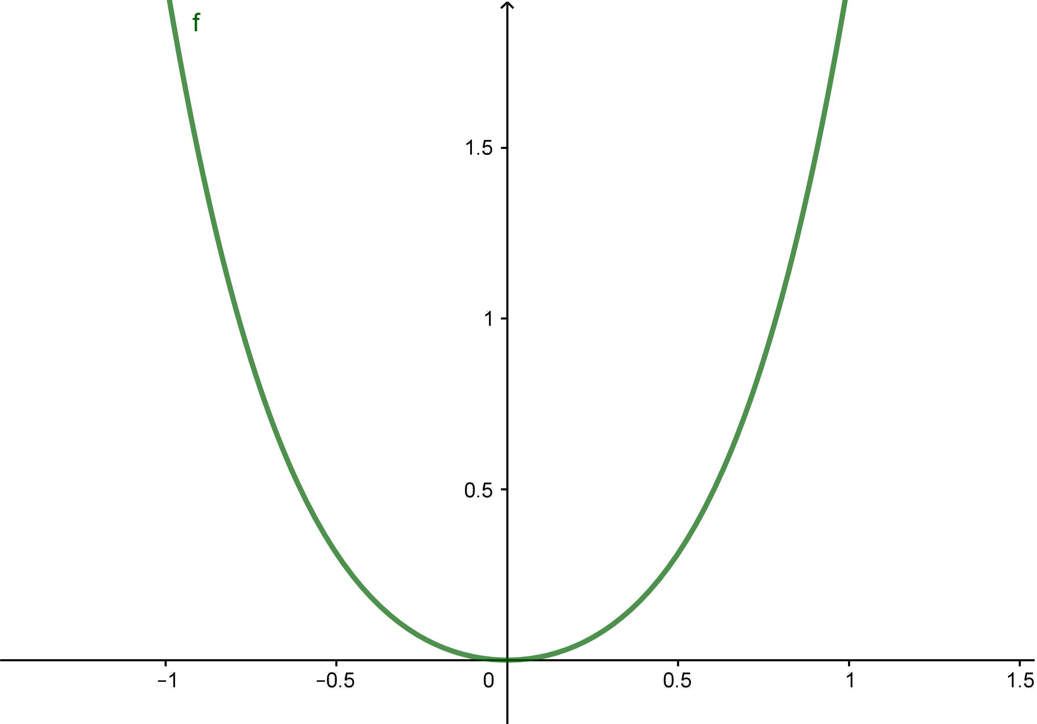
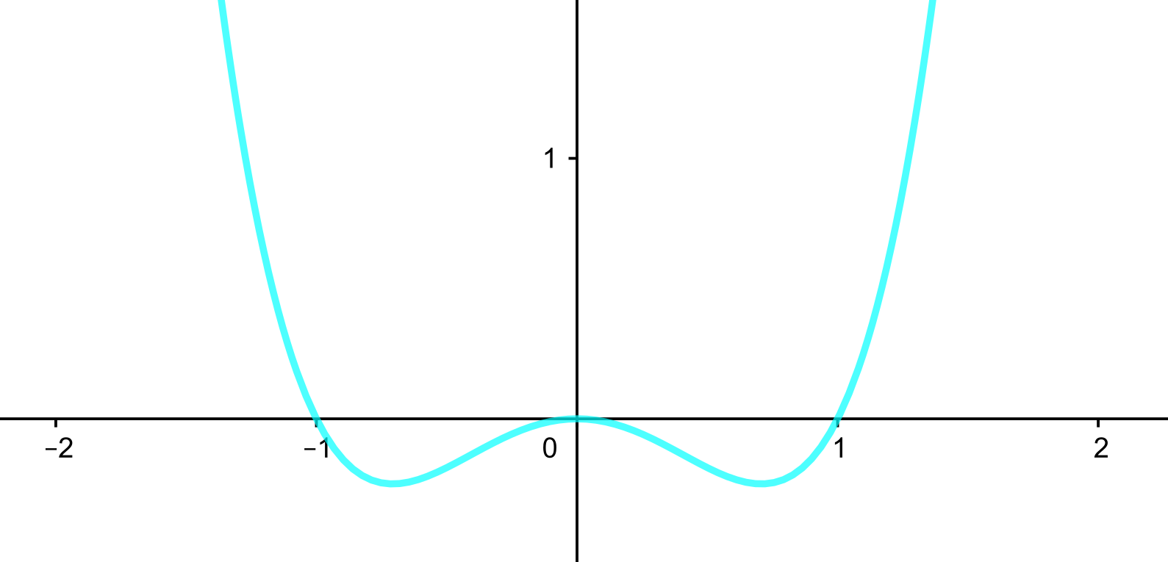
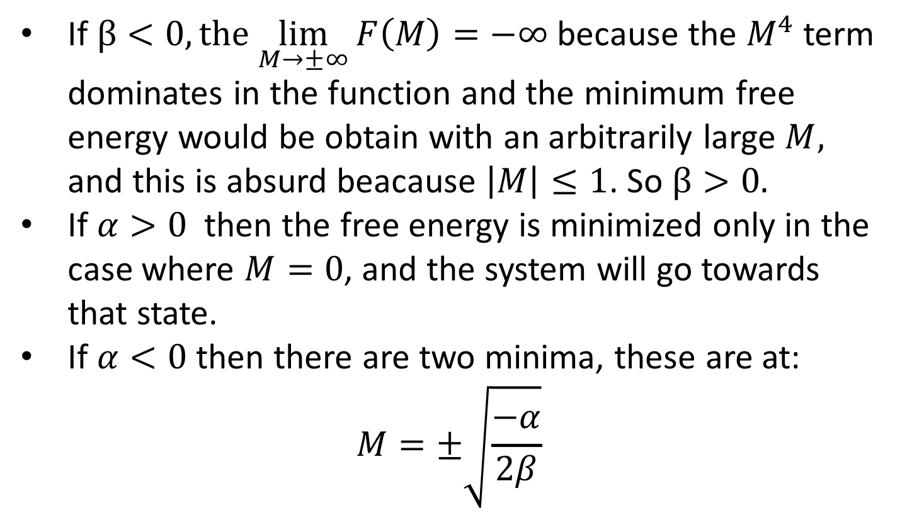



Magnetization: considerations on the series
$$x^{2}−x^{4}$$
If $β<0, the$ $\lim_{M→±∞}{F\left(M\right)=−∞}$ because the $M^{4}$ term dominates in the function and the minimum free energy would be obtain with an arbitrarily large $M,$ and this is absurd beacause $\left|M\right|≤1$. So $β>0.$
If $α>0$ then the free energy is minimized only in the case where $M=0$, and the system will go towards that state.
If $α<0$ then there are two minima, these are at:
$$M=±\sqrt{\frac{−α}{2β}}$$
$$x^{2}+x^{4}$$
$$x^{4}−x^{2}$$

Slide 6
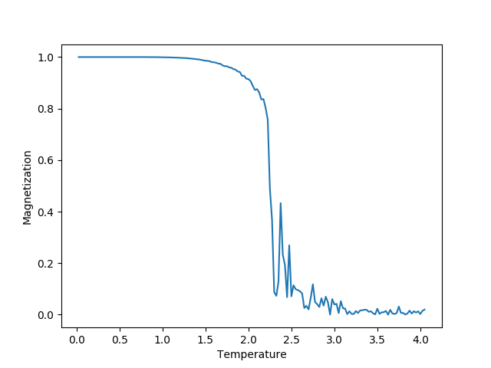
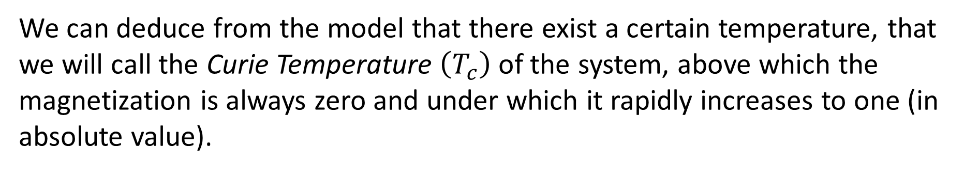
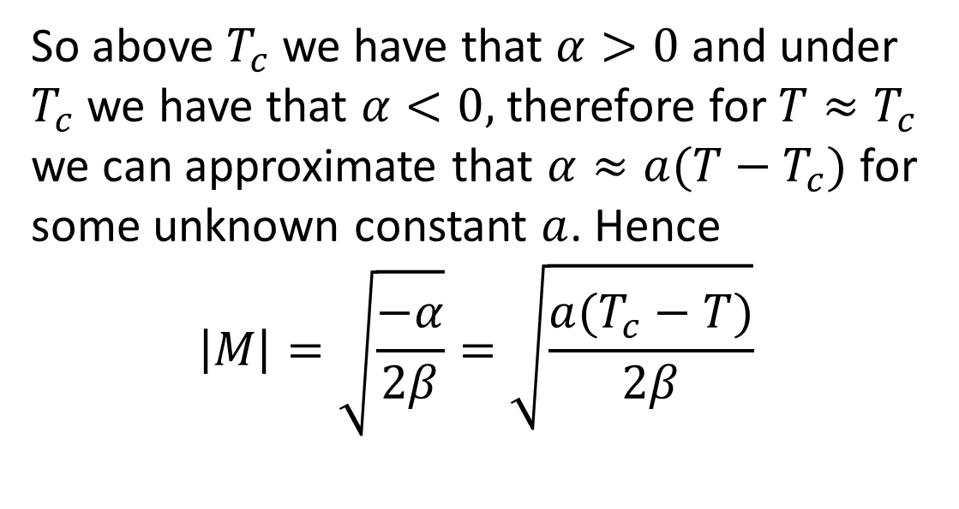
Magnetization: numerical results
We can deduce from the model that there exist a certain temperature, that we will call the Curie Temperature $\left(T_{c}\right)$ of the system, above which the magnetization is always zero and under which it rapidly increases to one (in absolute value).
So above $T_{c}$ we have that $α>0$ and under $T_{c}$ we have that $α<0,$ therefore for $T≈T_{c}$ we can approximate that $α≈a(T−T_{c})$ for some unknown constant $a$. Hence
$$\left|M\right|=\sqrt{\frac{−α}{2β}}=\sqrt{\frac{a(T_{c}−T)}{2β}}$$

Slide 7
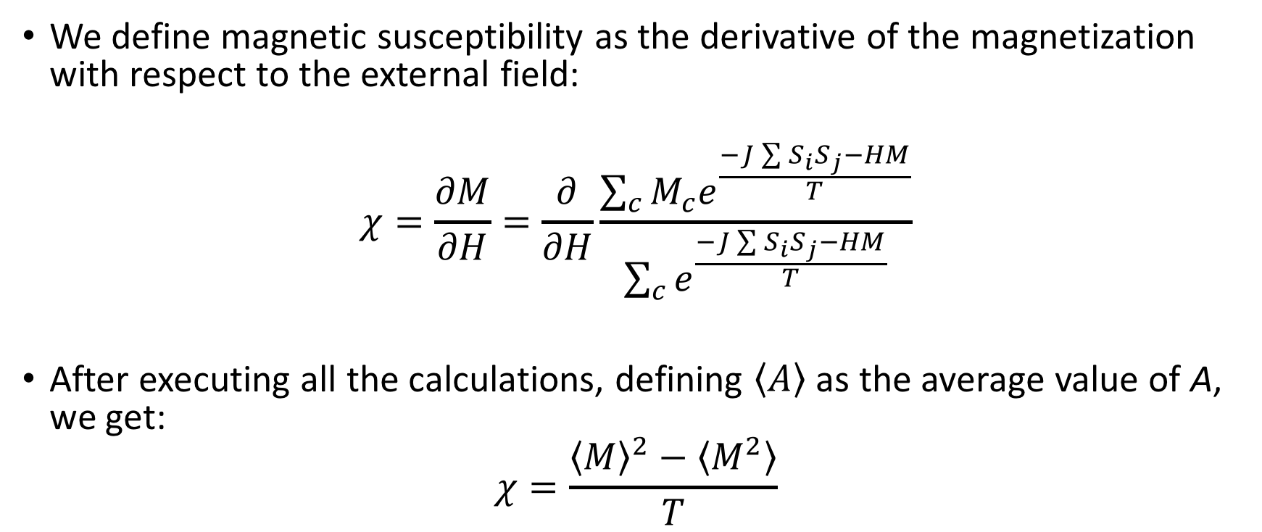
Magnetic susceptibility
We define magnetic susceptibility as the derivative of the magnetization with respect to the external field:
$$χ=\frac{∂M}{∂H}=\frac{∂}{∂H}\frac{\sum_{c}{M_{c}e^{\frac{−J\sum{S_{i}S_{j}}−HM}{T}}}}{\sum_{c}{e^{\frac{−J\sum{S_{i}S_{j}}−HM}{T}}}}$$
After executing all the calculations, defining $\left\langle A\right\rangle$ as the average value of A, we get:
$$χ=\frac{{\left\langle M\right\rangle }^{2}−\left\langle M^{2}\right\rangle }{T}$$

Slide 8
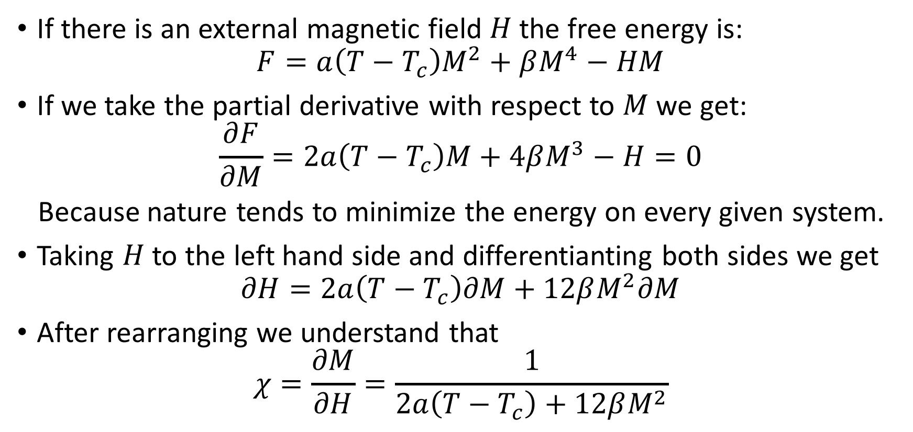
Magnetic susceptibility: analytical approach
If there is an external magnetic field $H$ the free energy is:
$$F=a\left(T−T_{c}\right)M^{2}+βM^{4}−HM$$
If we take the partial derivative with respect to $M$ we get:
$$\frac{∂F}{∂M}=2a\left(T−T_{c}\right)M+4βM^{3}−H=0$$
Because nature tends to minimize the energy on every given system.
Taking $H$ to the left hand side and differentianting both sides we get
$$∂H=2a\left(T−T_{c}\right)∂M+12βM^{2}∂M$$
After rearranging we understand that
$$χ=\frac{∂M}{∂H}=\frac{1}{2a\left(T−T_{c}\right)+12βM^{2}}$$

Slide 9
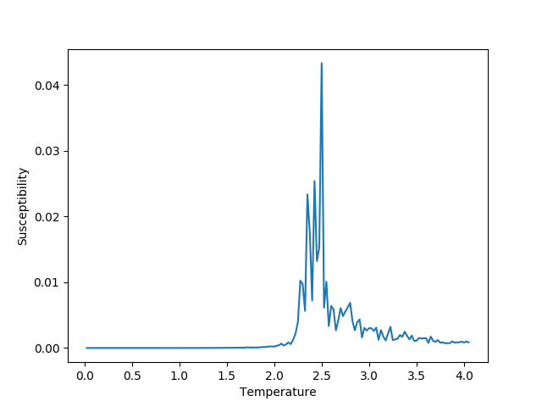
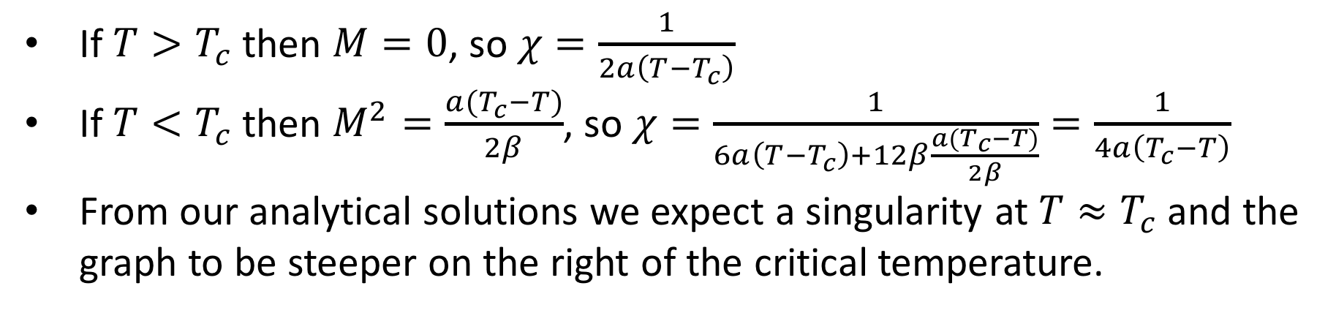
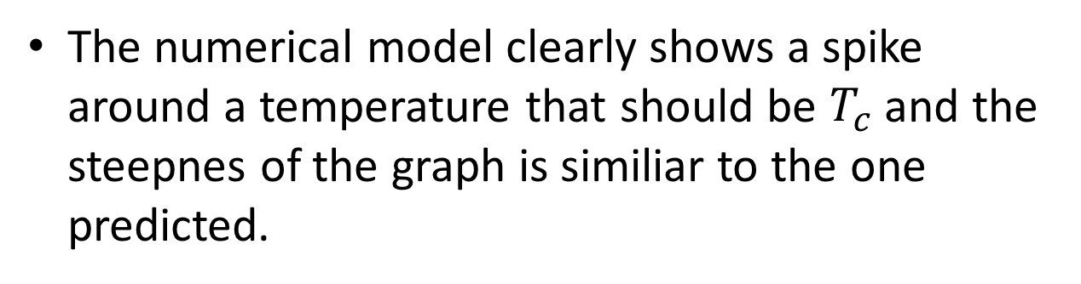
Magnetic susceptibility: numerical results
If$T>T_{c}$ then $M=0$, so $χ=\frac{1}{2a\left(T−T_{c}\right)}$
If $T<T_{c}$ then $M^{2}=\frac{a(T_{c}−T)}{2β}$, so $χ=\frac{1}{6a\left(T−T_{c}\right)+12β\frac{a(T_{c}−T)}{2β}}=\frac{1}{4a\left(T_{c}−T\right)}$
From our analytical solutions we expect a singularity at $T≈T_{c}$ and the graph to be steeper on the right of the critical temperature.
The numerical model clearly shows a spike around a temperature that should be $T_{c}$ and the steepnes of the graph is similiar to the one predicted.

Slide 10
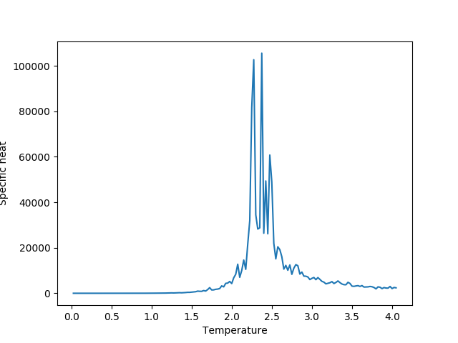
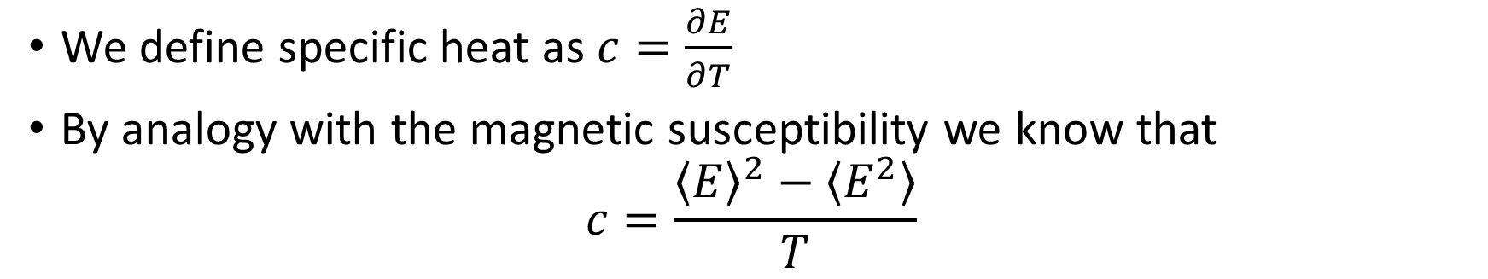
Specific Heat
We define specific heat as $c=\frac{∂E}{∂T}$
By analogy with the magnetic susceptibility we know that
$$c=\frac{{\left\langle E\right\rangle }^{2}−\left\langle E^{2}\right\rangle }{T}$$
The graph obtained numerically shows a similiar peak arount the Curie temperature.

Slide 11
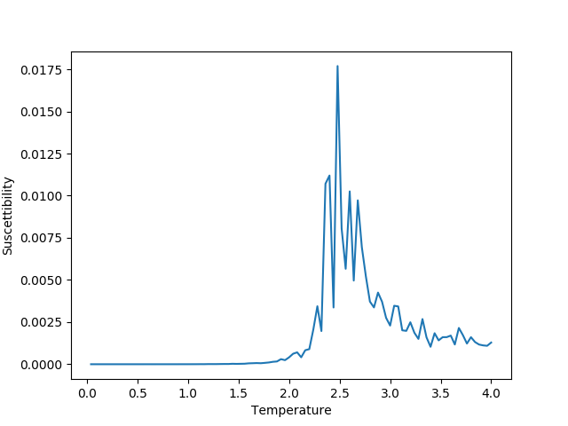
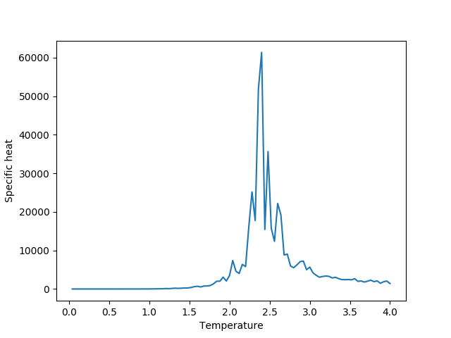
Comparing different sized systems
30x30 grid
35x35 grid

