Slide 1
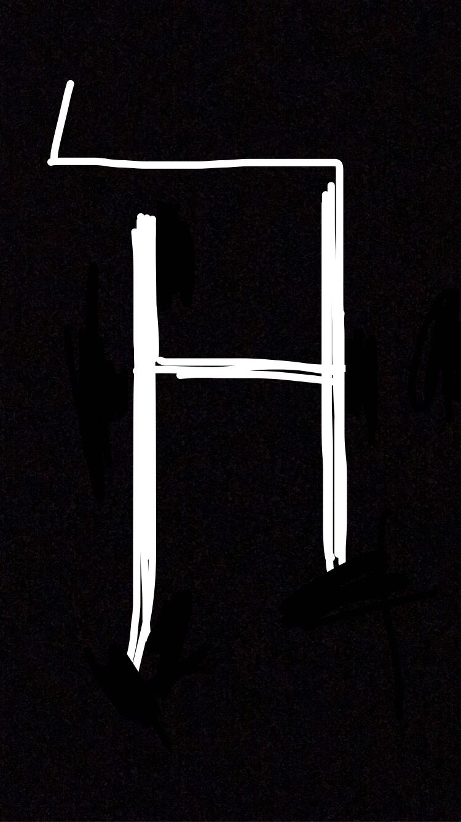
Haze of Hodur

Slide 2
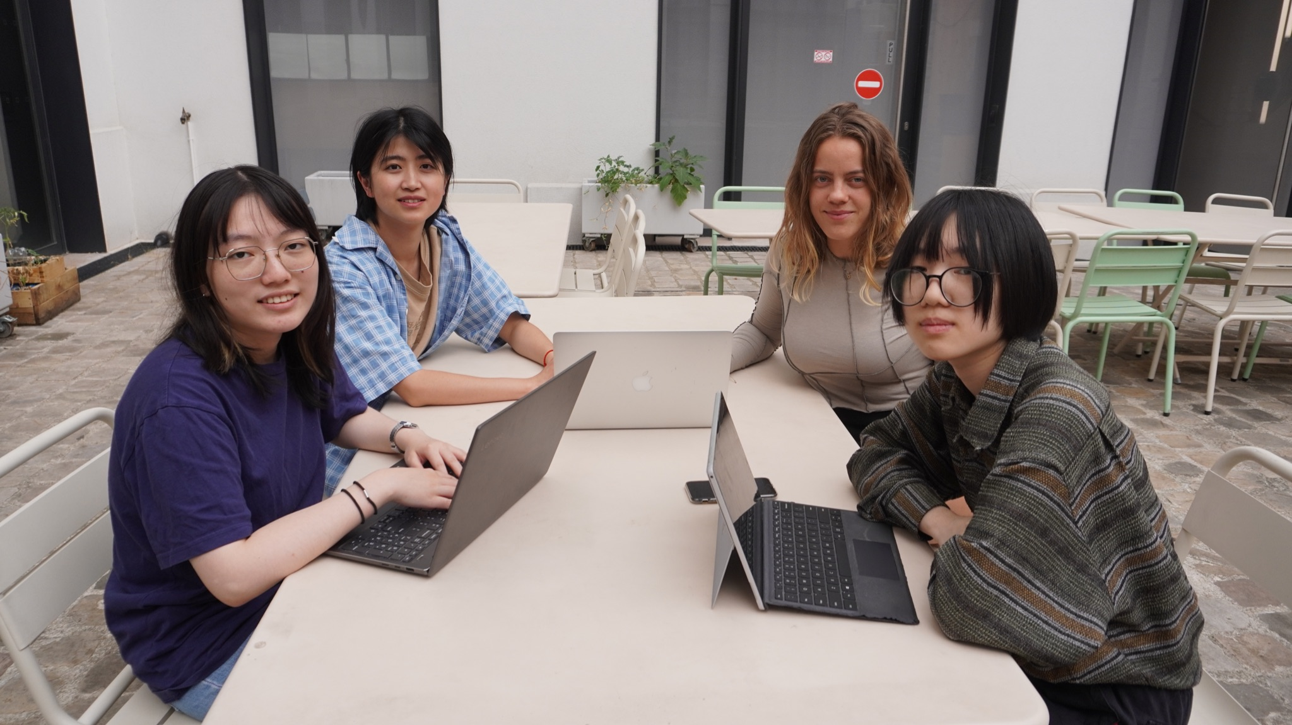
Wenyu, Hanfang, Nica, Yuxin

Slide 3
The Problem we want to address and tackle:
People with visual impairment are often excluded from ´video´ games
-tiny amount of mobile games available
-little awareness of sighted people
-online games are often not inclusive enough for people with different abilities
So what we did:
-make it possible to experience a demo of a game without the need of eyesight
-let people with visual impairment give us feedback

Slide 4
Proposed Solution
A game only with sounds that can be interacted with different gestures.
Web-based, cross-platform, free
https://agile-peak-94217.herokuapp.com/

Slide 5
Customers & Users
Pain
Although many game makers are trying to introduce accessibility modes for their games, there are not enough video games which are especially designed for visually impaired people.
There is a need for inclusive games.
Gain
Visually impaired people/gamers can also enjoy the entertainment of video games.
Able people can also experience a different way of playing video games.

Slide 6
A promising market
New game opportunity - a mix of a podcast, audiobook, game
This project is open source but the market of games and new views is large
Can be implemented as a healthier game due to less screen time

Slide 7
Competition ——What’s unique about our game?
Existing games made especially for visually impaired players, such as A Blind Legend, Lost and Hound, Blind Escape and so on, are mostly simulation games related to searching for things.
We want to broaden the variety of audio games, so we try to design a role-playing adventure game with audio guides.
Our game is completely free, cross-platform and open source, so anyone can easily play it online.

Slide 8
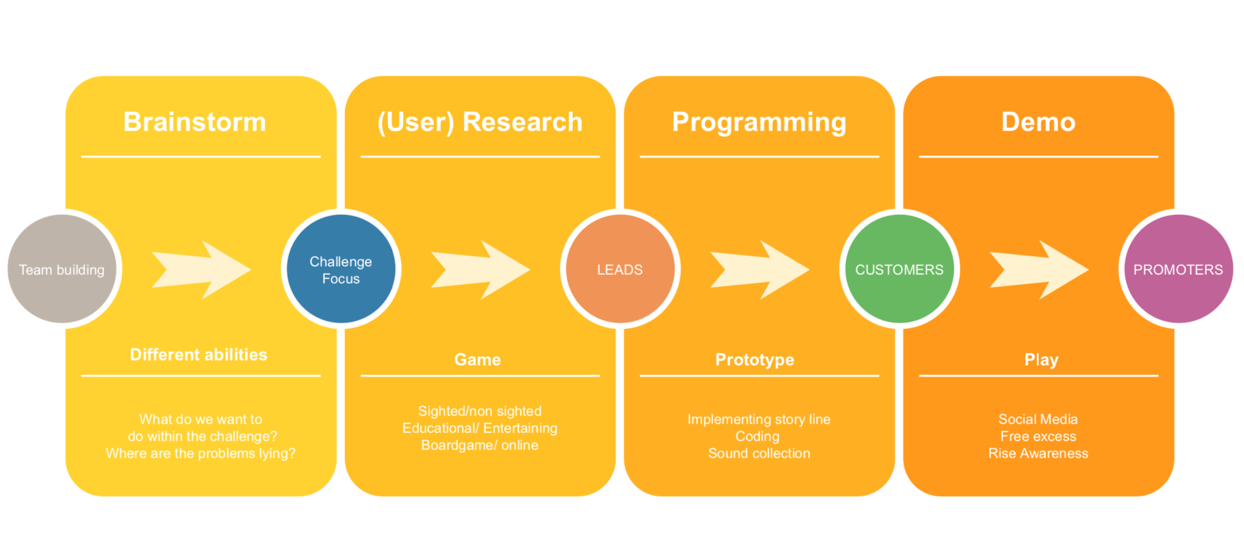

Slide 9
What we have done?
Finished the soundtracks recording and editing
Finished the level design/coding/debugging
Filmed the demo to show the gameplay
Let people play our game
Provide a demo on YouTube

Slide 10
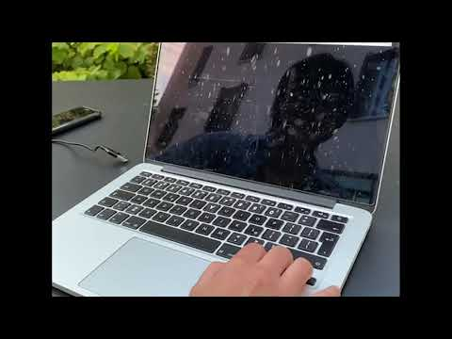
DEMO

Slide 11
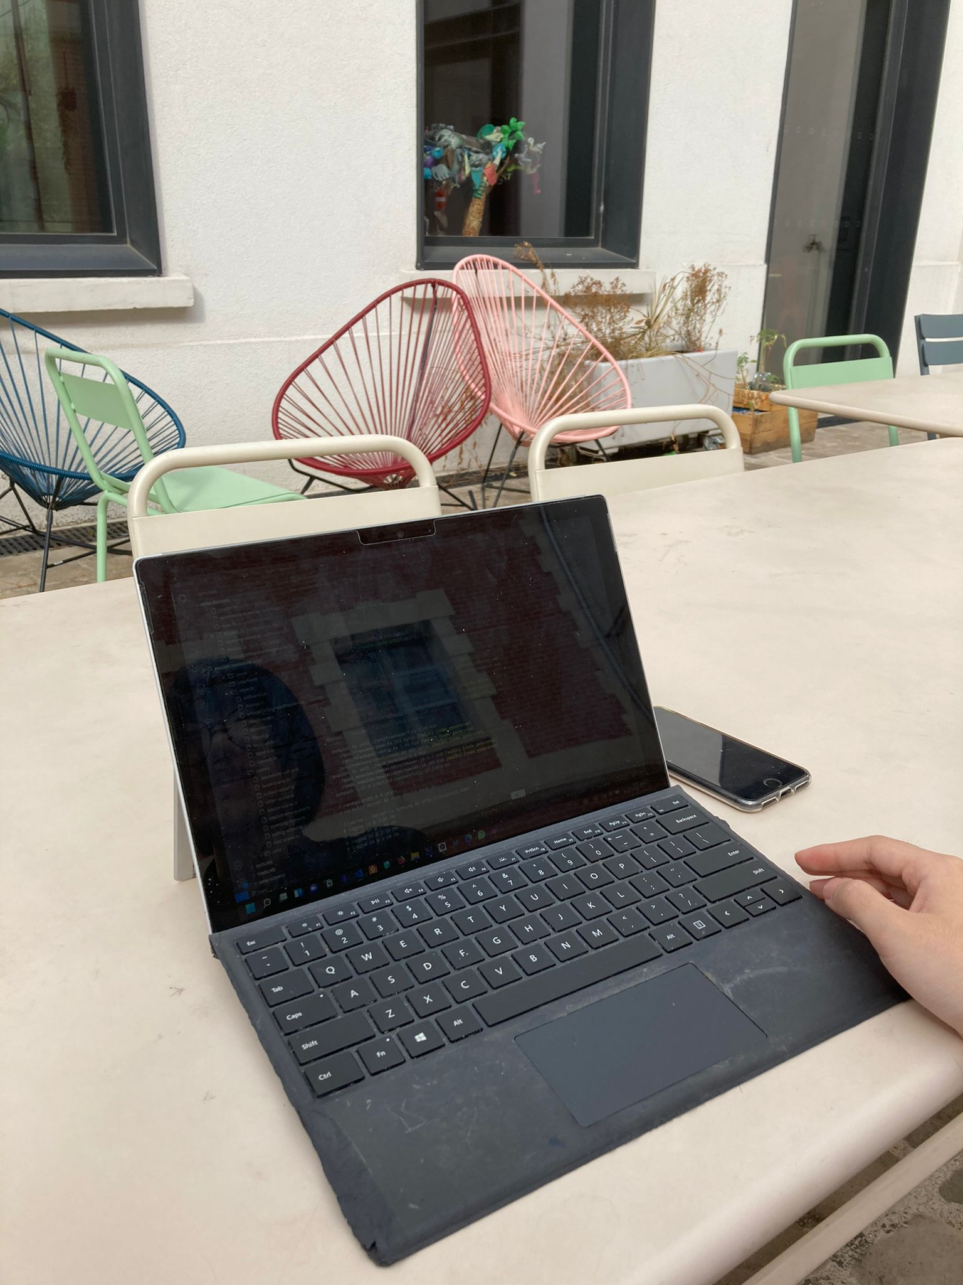
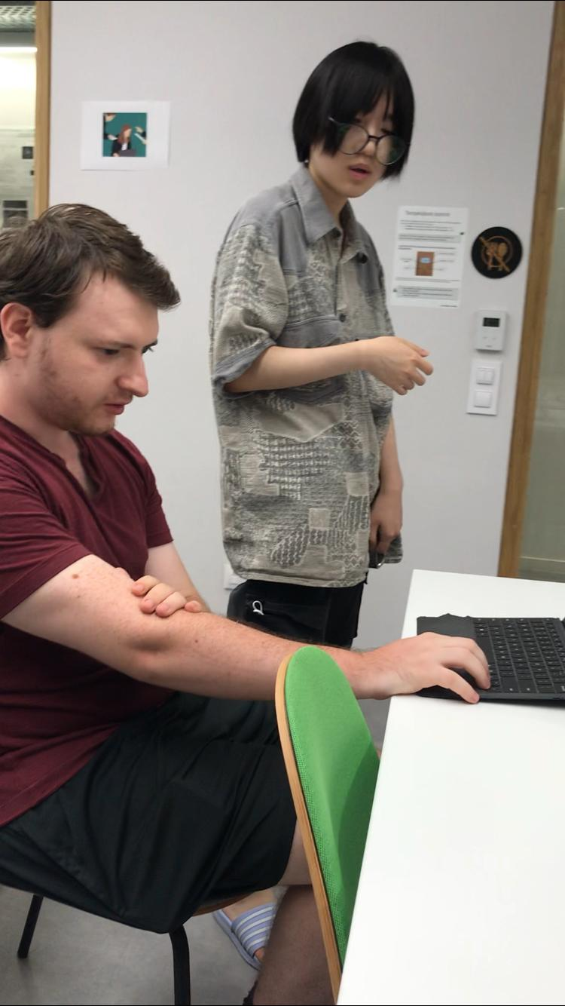
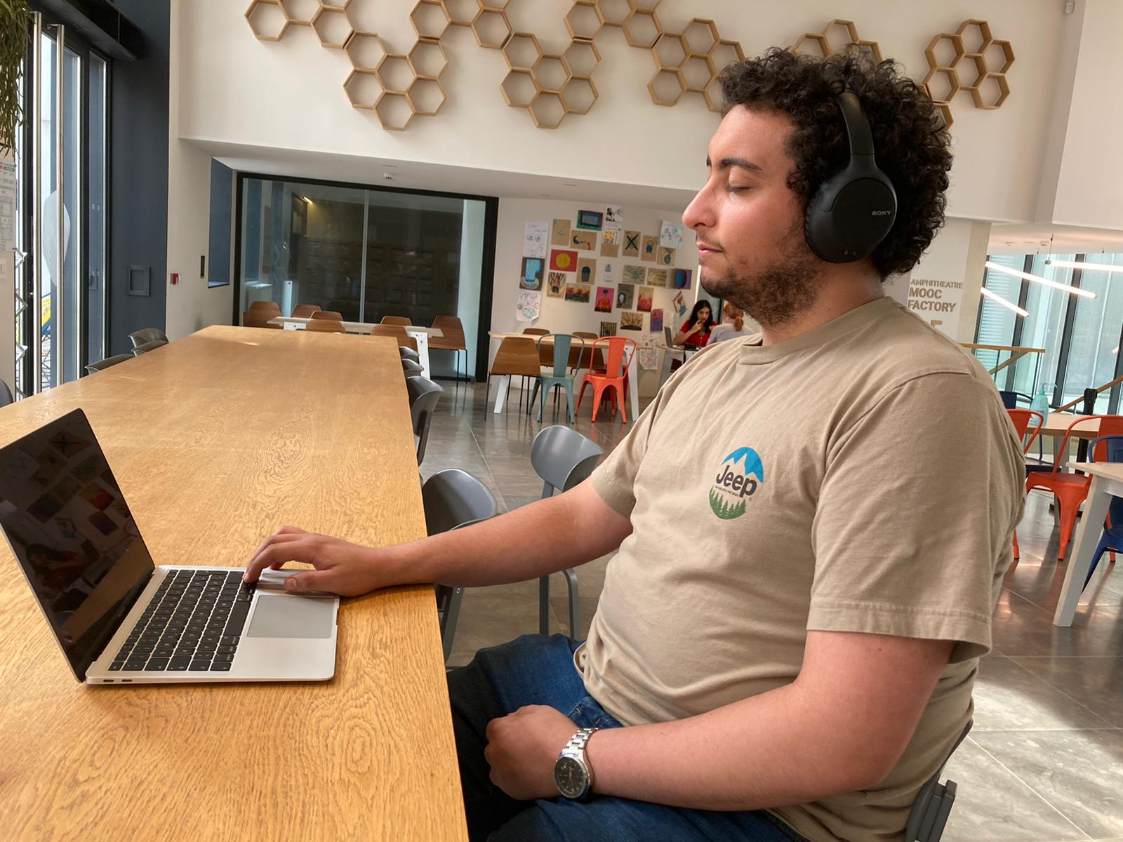
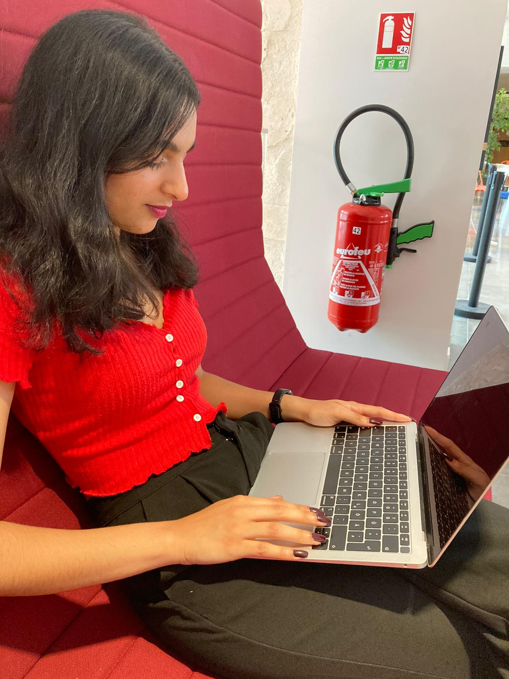
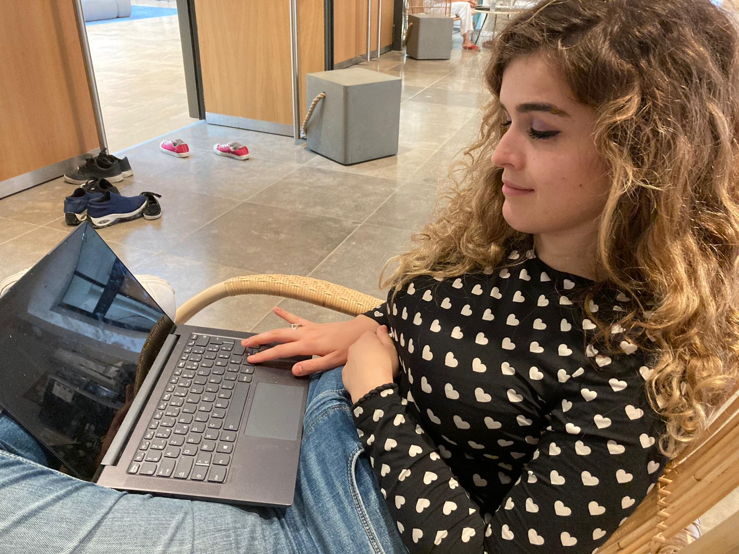

Slide 12
Next steps
Post our game on websites on facebook, so that we can raise people’s awareness, to create more games for visually impaired people.
Contact different game companies and pitch our game idea to them
Let people play our 30 minutes long game and keep working on it

Slide 13
Where we documented everything
Notion and the Learning Planet Institute Website
We use a Website to create a public access to our 30 minutes long game
We worked together by using Google Docs & Atlassian

Slide 14
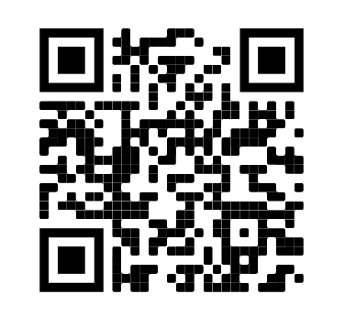
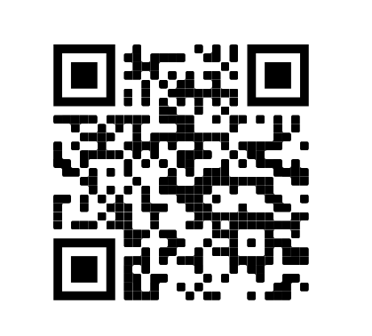
Link to the game:
github page:
https://agile-peak-94217.herokuapp.com/
currently only work on PC (with keyboard control)

Slide 15
Thank you for your attention!

