Slide 1
SDM Vision Reliability
Presentation 2: preliminary research findings
Randell Smith · Yiwen Hou · Karim Mattar
UC Berkeley MIDS Capstone · October 29, 2026
Six completed classifiers · one seed per task · shift evaluation unfinished
Notes:
Suggested speaker: Karim. Rehearsal target: 0:10.
Our project asks when a vision classifier should answer and when it should abstain. We will explain the research deliverable, the experiment design, our completed clean-data results and the evidence still needed before broader reliability claims.
Sources: docs/assets/clean-analysis-2026-10-29/evidence.json (SHA256 b90dc4b3c7c64bd6dd8fe37307f7d9f1f9df264eb480d5e86703fc76efe74a44); docs/research-writeup.md; docs/experiment-design.md. Presentation 2 guidance supplied by the team, pages 1–5. Speaking assignments and timings are suggestions based on the chat, not confirmed team decisions.

Slide 2
A review policy for confident vision errors
Target user
Why coverage matters
Vision practitioners deciding which model outputs can be accepted and which need human review.
A rule that rejects everything has no practical utility. A rule that accepts everything inherits the model’s errors.
CIFAR-100 example: 85.09% accepted, 14.91% deferred, 95.06% accuracy among accepted predictions.
Notes:
Suggested speaker: Karim. Rehearsal target: 1:50.
The target audience is a vision practitioner choosing an acceptance and review policy. Classification accuracy averages across all examples. It does not tell us whether a particular confidence rule can identify a useful subset of reliable predictions. Accepting every example preserves the original error rate. Rejecting every example avoids accepted errors but also provides no classification utility. We therefore report accepted accuracy and coverage together. In our completed CIFAR-100 ConvNeXt test, the standard-track temperature rule accepts 8,509 of 10,000 images, or 85.09%, at 95.06% accepted accuracy. The remaining 1,491 images would form a potential review pool in a hypothetical workflow. We have not measured a real inspection process, human accuracy, operational savings or deployment safety. Our benchmark is a way to compare policies before making those claims.
Sources: docs/assets/clean-analysis-2026-10-29/evidence.json (SHA256 b90dc4b3c7c64bd6dd8fe37307f7d9f1f9df264eb480d5e86703fc76efe74a44); docs/research-writeup.md; docs/experiment-design.md. Presentation 2 guidance supplied by the team, pages 1–5. Speaking assignments and timings are suggestions based on the chat, not confirmed team decisions.

Slide 3
A reproducible benchmark and paper
Research deliverable
Practitioner questions
Matched-checkpoint comparisons
Runnable evaluation notebooks
Coverage and error-analysis tables
A paper reporting positive and negative results
What coverage is attainable at a target accepted accuracy?
When does SDM add value beyond calibrated softmax?
Practitioner and expert validation remains a task unless the team confirms completed feedback.
Notes:
Suggested speaker: Karim. Rehearsal target: 2:45.
Our deliverable is a research paper supported by reproducible experiments. It serves practitioners by answering two questions: what coverage is attainable at a chosen empirical reliability target, and whether SDM adds value beyond cheap raw-softmax and temperature-scaled baselines. We preserve the same checkpoint, label space and evaluation images within a comparison, record calibration support, and retain negative results. The supporting notebooks export configurations, identities, per-image decisions and aggregate metrics. The paper connects those outputs to accepted accuracy, coverage, probability calibration, error ranking, confusions and limitations. The project does not claim a production inspection product or a general safety guarantee. We considered several distinct confidence measurements because calibration quality, ranking quality and admission feasibility can disagree. A useful final contribution can be a carefully evidenced limitation of SDM transfer, not only a positive result. The full corrupted/OOD comparison remains unfinished, so today’s conclusion is deliberately restricted to completed clean tasks. The repository does not establish that the planned expert meeting occurred. Do not claim an interview, quote, or user validation unless the team confirms it. Questions for expert feedback include why a qualifying region can fail despite useful error ranking, and how to compare global empirical thresholds with SDM’s class-conditional construction.
Sources: docs/assets/clean-analysis-2026-10-29/evidence.json (SHA256 b90dc4b3c7c64bd6dd8fe37307f7d9f1f9df264eb480d5e86703fc76efe74a44); docs/research-writeup.md; docs/experiment-design.md. Presentation 2 guidance supplied by the team, pages 1–5. Speaking assignments and timings are suggestions based on the chat, not confirmed team decisions.

Slide 4
Similarity, distance and magnitude in SDM
Similarity
Distance
Magnitude
Agreement with nearby training examples in representation space
Proximity to the training distribution
Decision-boundary information from the model’s logits
Calibration constructs a selective region. A region can be empty when its empirical conditions cannot be met.
Notes:
Suggested speaker: Yiwen. Rehearsal target: 1:15.
SDM uses representation-based signals rather than softmax confidence alone. Similarity reflects correctly predicted depth matches to training examples; distance reflects proximity to the training distribution; magnitude uses decision-boundary information. Calibration combines these signals into a selective admission region. Our implementation tracks must remain distinct: ResNet uses a learned adaptor through reexpress-sdm, whereas the completed ConvNeXt comparisons use the identity-adaptor formulation. Those variants are not a controlled architecture ablation. A region may be empty. That means zero coverage and undefined accepted accuracy, not a successful 95% guarantee. Source for the method terminology: docs/allen-schmaltz-sdm.md and the pinned upstream implementation.
Sources: docs/assets/clean-analysis-2026-10-29/evidence.json (SHA256 b90dc4b3c7c64bd6dd8fe37307f7d9f1f9df264eb480d5e86703fc76efe74a44); docs/research-writeup.md; docs/experiment-design.md. Presentation 2 guidance supplied by the team, pages 1–5. Speaking assignments and timings are suggestions based on the chat, not confirmed team decisions.

Slide 5
Compare methods within a fixed classifier and population
EMNIST Balanced protocol
Training
Validation
Calibration
Official test
→
→
→
106,925 images
1,175 images
1,175 / 4,700
18,800 images
Validation selects the checkpoint; calibration selects the confidence rule.
The standard calibration set is nested inside the enlarged set.
Compute: local MPS with CPU/CUDA support. No cloud deployment is claimed.
Notes:
Suggested speaker: Yiwen. Rehearsal target: 1:00.
The diagram shows the EMNIST population. Training has 106,925 examples, validation 1,175, enlarged calibration 4,700 and official test 18,800. Standard calibration contains 1,175 examples nested inside the enlarged set. Validation selects the ConvNeXt checkpoint. Calibration fits the temperatures and admission rules. Each comparison keeps the checkpoint, classes and evaluation population fixed. The ConvNeXt models use ImageNet-pretrained ConvNeXt-Tiny, seed 42, 20 epochs and validation-best checkpoint selection. Compute uses local Apple MPS and saved artifacts; the pipeline supports CPU and CUDA. Cloud CUDA is an alternative for later runs, not an existing deployed service. Local execution makes current cached artifacts available but limits throughput. No new compute run is launched here. The from-scratch ResNet uses its own recipe and reports validation, so we do not pool its results with ConvNeXt official-test results. Current analysis follows historical test exploration and is not a blind preregistration.
Sources: docs/assets/clean-analysis-2026-10-29/evidence.json (SHA256 b90dc4b3c7c64bd6dd8fe37307f7d9f1f9df264eb480d5e86703fc76efe74a44); docs/research-writeup.md; docs/experiment-design.md. Presentation 2 guidance supplied by the team, pages 1–5. Speaking assignments and timings are suggestions based on the chat, not confirmed team decisions.

Slide 6
Temperature scaling lowers clean calibration error
15-bin ECE (%) · same checkpoint and class predictions within each task
Notes:
Suggested speaker: Karim. Rehearsal target: 0:50.
Positive scalar temperature scaling changes probabilities without changing the predicted class. It improves ECE on all five completed ConvNeXt tasks shown here, using 25 calibration images per class. ECE is shown as a percentage with 15 bins. CIFAR-100 changes from 5.96% to 3.36%; EMNIST from 6.29% to 2.94%. Lower clean ECE is useful, but it does not imply that every other probability metric improves or that behavior remains reliable under distribution shift. We retain raw softmax because it is the simplest baseline and use calibration-only temperature fitting rather than fitting against test labels.
Sources: docs/assets/clean-analysis-2026-10-29/evidence.json (SHA256 b90dc4b3c7c64bd6dd8fe37307f7d9f1f9df264eb480d5e86703fc76efe74a44); docs/research-writeup.md; docs/experiment-design.md. Presentation 2 guidance supplied by the team, pages 1–5. Speaking assignments and timings are suggestions based on the chat, not confirmed team decisions.

Slide 7
Five completed ConvNeXt tasks show mixed SDM coverage
Dataset | Classes | Test images | Accuracy | SDM coverage 25 / 100 per class
CIFAR-100 | 100 | 10,000 | 88.45% | 0.00% / 0.00%
MNIST | 10 | 10,000 | 99.65% | 60.69% / 49.81%
Fashion-MNIST | 10 | 10,000 | 95.02% | 0.00% / 0.00%
KMNIST | 10 | 10,000 | 98.45% | 33.14% / 39.92%
EMNIST Balanced | 47 | 18,800 | 90.38% | 0.00% / 0.00%
ResNet is reported separately on validation; its results are not pooled with these test populations.
Notes:
Suggested speaker: Randell. Rehearsal target: 1:10.
These are five distinct official-test tasks and checkpoints, not one pooled model comparison. CIFAR-100 has 88.45% classification accuracy; Fashion-MNIST 95.02%; EMNIST 90.38%. Neither calibration budget produces a qualifying SDM region on those three tasks. MNIST admits 60.69% and 49.81% of its test set with no observed admitted errors. KMNIST admits 33.14% and 39.92%, with zero and two admitted errors respectively. More calibration support does not monotonically increase coverage. Full-coverage classification accuracy alone also does not determine whether a region forms: Fashion-MNIST exceeds 95% accuracy but has no region. These observations are descriptive; they do not isolate class count, resolution, or another mechanism. We should distinguish these verified ConvNeXt results from older teammate ResNet/Imagenette experiments whose numerical reconciliation remains pending.
Sources: docs/assets/clean-analysis-2026-10-29/evidence.json (SHA256 b90dc4b3c7c64bd6dd8fe37307f7d9f1f9df264eb480d5e86703fc76efe74a44); docs/research-writeup.md; docs/experiment-design.md. Presentation 2 guidance supplied by the team, pages 1–5. Speaking assignments and timings are suggestions based on the chat, not confirmed team decisions.

Slide 8
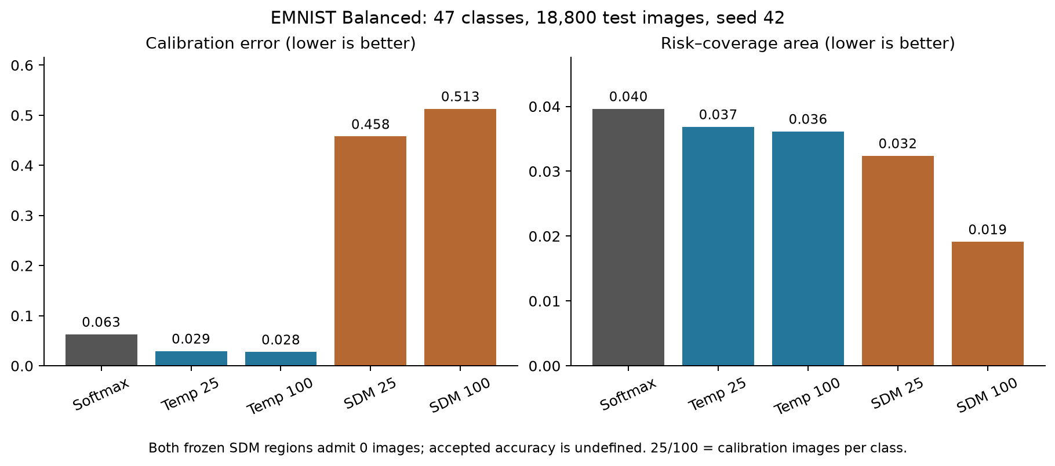
EMNIST ranking improves while both SDM regions stay empty
Notes:
Suggested speaker: Randell. Rehearsal target: 0:50.
EMNIST separates the three measurement questions. Its enlarged SDM track has AURC 0.01912, lower than raw softmax’s 0.03964, so its retrospective error ranking is better under that metric. Yet its native exported ECE is 51.30%, compared with 6.29% for raw softmax, and neither SDM track yields a qualifying admission region. A ranking improvement cannot stand in for a usable frozen policy. The SDM probability-matrix metrics are reconciled native exports; ranking and admissions were recomputed from saved per-image scores. One seed and one nested calibration comparison do not establish a general architecture or class-count effect.
Sources: docs/assets/clean-analysis-2026-10-29/evidence.json (SHA256 b90dc4b3c7c64bd6dd8fe37307f7d9f1f9df264eb480d5e86703fc76efe74a44); docs/research-writeup.md; docs/experiment-design.md. Presentation 2 guidance supplied by the team, pages 1–5. Speaking assignments and timings are suggestions based on the chat, not confirmed team decisions.

Slide 9
A 95% calibration target can miss on held-out data
Dataset | Coverage 25/class | Accuracy 25/class | Coverage 100/class | Accuracy 100/class
CIFAR-100 | 85.09% | 95.06% | 84.88% | 95.11%
MNIST | 99.81% | 99.70% | 99.97% | 99.66%
Fashion-MNIST | 99.60% | 95.24% | 98.05% | 96.03%
KMNIST | 99.48% | 98.73% | 99.85% | 98.57%
EMNIST Balanced | 84.63% | 96.17% | 89.81% | 94.56%
Temperature-scaled softmax rules; exact counts and Wilson intervals are in the write-up.
Notes:
Suggested speaker: Karim. Rehearsal target: 0:45.
Here the thresholds come from calibration only, with at least 100 admitted calibration examples and whole tied-confidence groups. The displayed values apply to saved official-test predictions. EMNIST’s 25/class temperature rule admits 84.63% at 96.17% accepted accuracy, while its 100/class rule admits 89.81% at 94.56%. The latter misses the 95% target. This is evidence of the behavior of these empirical policies, not evidence that more calibration data causes lower reliability. Exact counts and Wilson intervals are in the paper. A global empirical accuracy threshold also differs from SDM’s class-conditional region construction.
Sources: docs/assets/clean-analysis-2026-10-29/evidence.json (SHA256 b90dc4b3c7c64bd6dd8fe37307f7d9f1f9df264eb480d5e86703fc76efe74a44); docs/research-writeup.md; docs/experiment-design.md. Presentation 2 guidance supplied by the team, pages 1–5. Speaking assignments and timings are suggestions based on the chat, not confirmed team decisions.

Slide 10
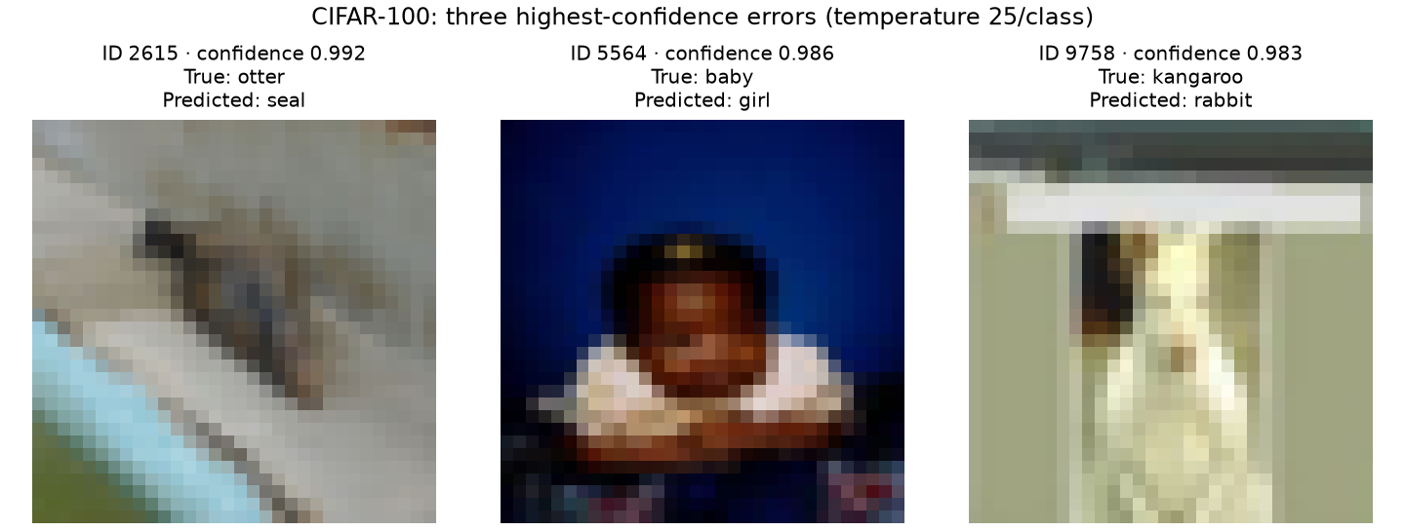
High-confidence CIFAR errors remain after temperature scaling
Notes:
Suggested speaker: Karim. Rehearsal target: 0:40.
These are the three highest standard-track temperature-confidence errors in CIFAR-100, selected deterministically with test ID as the tie-breaker. They illustrate remaining confident mistakes even after aggregate calibration improves. The otter is predicted as seal at approximately 0.992 confidence, the baby as girl at 0.986, and the kangaroo as rabbit at 0.983. We checked the IDs and labels against the cached dataset. These selected cases are not an estimate of overall error frequency or proof of label noise.
Sources: docs/assets/clean-analysis-2026-10-29/evidence.json (SHA256 b90dc4b3c7c64bd6dd8fe37307f7d9f1f9df264eb480d5e86703fc76efe74a44); docs/research-writeup.md; docs/experiment-design.md. Presentation 2 guidance supplied by the team, pages 1–5. Speaking assignments and timings are suggestions based on the chat, not confirmed team decisions.

Slide 11
The audit changed how the evidence can be used
Corrected
Still limited
Whole-score-group thresholds and risk curves
Calibration-only matched coverage
Cached calibration identity checks
Empty regions and small galleries
One seed per completed task
Different ResNet / ConvNeXt populations
Historical test exploration
No completed matched shift benchmark
Notes:
Suggested speaker: Karim. Rehearsal target: 0:45.
The audit keeps the comparison interpretable: equal confidence scores enter together; calibration-only matching does not use validation coverage; saved SDM fits must match the calibration population. Historical source repairs do not by themselves validate old numerical results. The main scientific limitations remain one seed, different backbone recipes and reporting populations, historical test exploration, and unfinished matched corruption/OOD evaluation. We can describe the clean findings today without claiming that they establish deployment safety or robustness.
Sources: docs/assets/clean-analysis-2026-10-29/evidence.json (SHA256 b90dc4b3c7c64bd6dd8fe37307f7d9f1f9df264eb480d5e86703fc76efe74a44); docs/research-writeup.md; docs/experiment-design.md. Presentation 2 guidance supplied by the team, pages 1–5. Speaking assignments and timings are suggestions based on the chat, not confirmed team decisions.

Slide 12
Remaining work and proposed owners
Workstream | Proposed owner | Next deliverable
SDM and protocol | Yiwen | Freeze choices and explain region diagnostics
Dataset comparisons | Randell | Reconcile run artifacts and coverage results
Baselines and paper | Karim | Integrate comparisons, figures and limitations
Priority: matched CIFAR corruption/OOD evaluation, then unfinished dataset checks. Full runs remain paused.
Notes:
Suggested speaker: Karim. Rehearsal target: 0:30.
This is a proposed workstream plan based on our current contributions and speaking topics, not a claim that new assignments were already agreed. Yiwen leads the SDM/protocol explanation; Randell the dataset coverage comparisons; Karim the baselines, evidence reporting and paper integration. The immediate deliverables are reconciled run artifacts and frozen evaluation choices. The remaining experiment priority is matched CIFAR-100-C and SVHN-OOD evaluation, followed by unfinished in-distribution checks. Full runs remain paused and this slide does not restart them. Confirm ownership and execution timing as a team.
Sources: docs/assets/clean-analysis-2026-10-29/evidence.json (SHA256 b90dc4b3c7c64bd6dd8fe37307f7d9f1f9df264eb480d5e86703fc76efe74a44); docs/research-writeup.md; docs/experiment-design.md. Presentation 2 guidance supplied by the team, pages 1–5. Speaking assignments and timings are suggestions based on the chat, not confirmed team decisions.

Slide 13
Our mission
Give vision practitioners reproducible evidence for when a classifier should answer, abstain, or defer to human review.
Reliable accepted predictions at useful coverage
Notes:
Suggested speaker: Karim. Rehearsal target: 0:30.
Our mission is to give vision practitioners reproducible evidence for when a classifier should answer, abstain or defer to review. Useful coverage and reliable accepted predictions must occur together. Our completed clean experiments show mixed SDM transfer behavior, including empty regions, and a clear role for calibrated baselines. The final paper will report those findings and the remaining evaluation honestly. Invite questions without adding a thank-you slide.
Sources: docs/assets/clean-analysis-2026-10-29/evidence.json (SHA256 b90dc4b3c7c64bd6dd8fe37307f7d9f1f9df264eb480d5e86703fc76efe74a44); docs/research-writeup.md; docs/experiment-design.md. Presentation 2 guidance supplied by the team, pages 1–5. Speaking assignments and timings are suggestions based on the chat, not confirmed team decisions.

