Slide 1
A reproducible benchmark and paper
Research deliverable
Practitioner questions
Matched-checkpoint comparisons
Runnable evaluation notebooks
Coverage and error-analysis tables
A paper reporting positive and negative results
What coverage is attainable at a target accepted accuracy?
When does SDM add value beyond calibrated softmax?
Allen Schmaltz feedback: [add key advice and resulting changes].
Notes:
Suggested speaker: Karim. Rehearsal target: 0:55.
Our deliverable is a reproducible benchmark and research paper for vision practitioners deciding which predictions to accept or send for review. We ask what coverage is attainable at a target accepted accuracy, and when SDM adds value beyond calibrated softmax. We compare policies on the same checkpoint and evaluation images within each task, and report negative results alongside positive ones. Calibration quality, error ranking and useful admission coverage can disagree. Today’s conclusions cover completed clean tasks; matched corruption and OOD evaluation remains unfinished.
Allen Schmaltz feedback: [TEAM: add his key advice and the changes made in response. Feedback was confirmed by Karim; do not infer endorsement.]
Sources: docs/research-writeup.md; docs/experiment-design.md; docs/assets/clean-analysis-2026-10-29/evidence.json.

Slide 2
Temperature scaling lowers clean calibration error
ConvNeXt-Tiny · clean official tests · seed 42 · 15-bin ECE (%)
Notes:
Suggested speaker: Karim. Rehearsal target: 0:50.
Positive scalar temperature scaling changes probabilities without changing the predicted class. It improves ECE on all five completed ConvNeXt tasks shown here, using 25 calibration images per class. ECE is shown as a percentage with 15 bins. CIFAR-100 changes from 5.96% to 3.36%; EMNIST from 6.29% to 2.94%. Lower clean ECE is useful, but it does not imply that every other probability metric improves or that behavior remains reliable under distribution shift. We retain raw softmax because it is the simplest baseline and use calibration-only temperature fitting rather than fitting against test labels.
Sources: docs/assets/clean-analysis-2026-10-29/evidence.json (SHA256 b90dc4b3c7c64bd6dd8fe37307f7d9f1f9df264eb480d5e86703fc76efe74a44); docs/research-writeup.md; docs/experiment-design.md. Presentation 2 guidance supplied by the team, pages 1–5. Speaking assignments and timings are suggestions based on the chat, not confirmed team decisions.

Slide 3
A 95% calibration target can miss on held-out data
Dataset | Coverage 25/class | Accuracy 25/class | Coverage 100/class | Accuracy 100/class
CIFAR-100 | 85.09% | 95.06% | 84.88% | 95.11%
MNIST | 99.81% | 99.70% | 99.97% | 99.66%
Fashion-MNIST | 99.60% | 95.24% | 98.05% | 96.03%
KMNIST | 99.48% | 98.73% | 99.85% | 98.57%
EMNIST Balanced | 84.63% | 96.17% | 89.81% | 94.56%
ConvNeXt official tests · accuracy among accepted predictions · calibration-only thresholds
Notes:
Suggested speaker: Karim. Rehearsal target: 0:45.
Here the thresholds come from calibration only, with at least 100 admitted calibration examples and whole tied-confidence groups. The displayed values apply to saved official-test predictions. EMNIST’s 25/class temperature rule admits 84.63% at 96.17% accepted accuracy, while its 100/class rule admits 89.81% at 94.56%. The latter misses the 95% target. This is evidence of the behavior of these empirical policies, not evidence that more calibration data causes lower reliability. Exact counts and Wilson intervals are in the paper. A global empirical accuracy threshold also differs from SDM’s class-conditional region construction.
Sources: docs/assets/clean-analysis-2026-10-29/evidence.json (SHA256 b90dc4b3c7c64bd6dd8fe37307f7d9f1f9df264eb480d5e86703fc76efe74a44); docs/research-writeup.md; docs/experiment-design.md. Presentation 2 guidance supplied by the team, pages 1–5. Speaking assignments and timings are suggestions based on the chat, not confirmed team decisions.

Slide 4
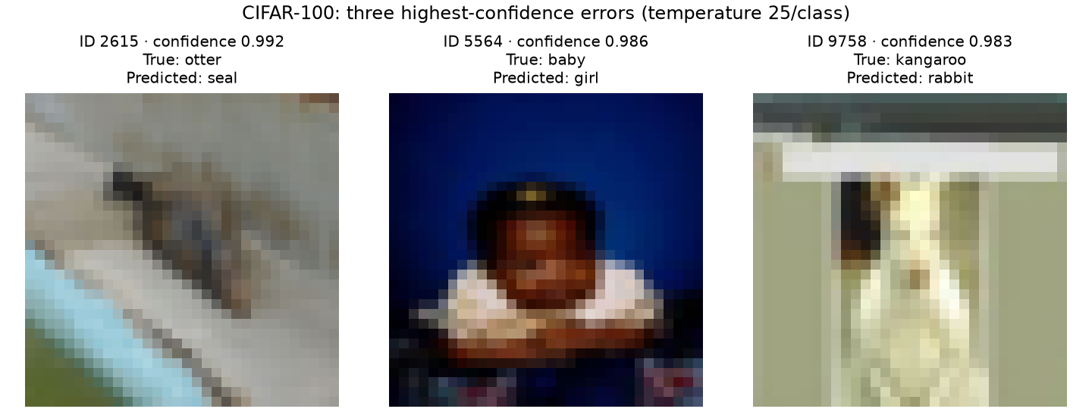
High-confidence CIFAR errors remain after temperature scaling
Notes:
Suggested speaker: Karim. Rehearsal target: 0:40.
These are the three highest standard-track temperature-confidence errors in CIFAR-100, selected deterministically with test ID as the tie-breaker. They illustrate remaining confident mistakes even after aggregate calibration improves. The otter is predicted as seal at approximately 0.992 confidence, the baby as girl at 0.986, and the kangaroo as rabbit at 0.983. We checked the IDs and labels against the cached dataset. These selected cases are not an estimate of overall error frequency or proof of label noise.
Sources: docs/assets/clean-analysis-2026-10-29/evidence.json (SHA256 b90dc4b3c7c64bd6dd8fe37307f7d9f1f9df264eb480d5e86703fc76efe74a44); docs/research-writeup.md; docs/experiment-design.md. Presentation 2 guidance supplied by the team, pages 1–5. Speaking assignments and timings are suggestions based on the chat, not confirmed team decisions.

Slide 5
The audit changed how the evidence can be used
Corrected
Still limited
Whole-score-group thresholds and risk curves
Calibration-only matched coverage
Cached calibration identity checks
Empty regions and small galleries
One seed per completed task
Different ResNet / ConvNeXt populations
Historical test exploration
No completed matched shift benchmark
Notes:
Suggested speaker: Karim. Rehearsal target: 0:45.
The audit keeps the comparison interpretable: equal confidence scores enter together; calibration-only matching does not use validation coverage; saved SDM fits must match the calibration population. Historical source repairs do not by themselves validate old numerical results. The main scientific limitations remain one seed, different backbone recipes and reporting populations, historical test exploration, and unfinished matched corruption/OOD evaluation. We can describe the clean findings today without claiming that they establish deployment safety or robustness.
Sources: docs/assets/clean-analysis-2026-10-29/evidence.json (SHA256 b90dc4b3c7c64bd6dd8fe37307f7d9f1f9df264eb480d5e86703fc76efe74a44); docs/research-writeup.md; docs/experiment-design.md. Presentation 2 guidance supplied by the team, pages 1–5. Speaking assignments and timings are suggestions based on the chat, not confirmed team decisions.

Slide 6
Baselines and paper: remaining work
Workstream | Owner | Next deliverable
Evidence | Karim | Reconcile source artifacts and exact counts
Baselines | Karim | Freeze comparison populations and policies
Paper | Karim | Integrate figures, limitations and expert notes
Next: matched corruption/OOD evaluation. Heavy experiments remain paused.
Notes:
Suggested speaker: Karim. Rehearsal target: 0:30.
My remaining work is to reconcile source artifacts and exact counts, freeze baseline comparison populations and policies, and integrate the figures, limitations and Allen feedback notes into the paper. The matched corruption/OOD evaluation remains future work. Full experiments remain paused. Other team members retain their existing work and speaking sections.

Slide 7
Our mission
Give vision practitioners reproducible evidence for when a classifier should answer, abstain, or defer to human review.
Reliable accepted predictions at useful coverage
Notes:
Suggested speaker: Karim. Rehearsal target: 0:30.
Our mission is to give vision practitioners reproducible evidence for when a classifier should answer, abstain or defer to review. Useful coverage and reliable accepted predictions must occur together. Our completed clean experiments show mixed SDM transfer behavior, including empty regions, and a clear role for calibrated baselines. The final paper will report those findings and the remaining evaluation honestly. Invite questions without adding a thank-you slide.
Sources: docs/assets/clean-analysis-2026-10-29/evidence.json (SHA256 b90dc4b3c7c64bd6dd8fe37307f7d9f1f9df264eb480d5e86703fc76efe74a44); docs/research-writeup.md; docs/experiment-design.md. Presentation 2 guidance supplied by the team, pages 1–5. Speaking assignments and timings are suggestions based on the chat, not confirmed team decisions.

