Slide 1
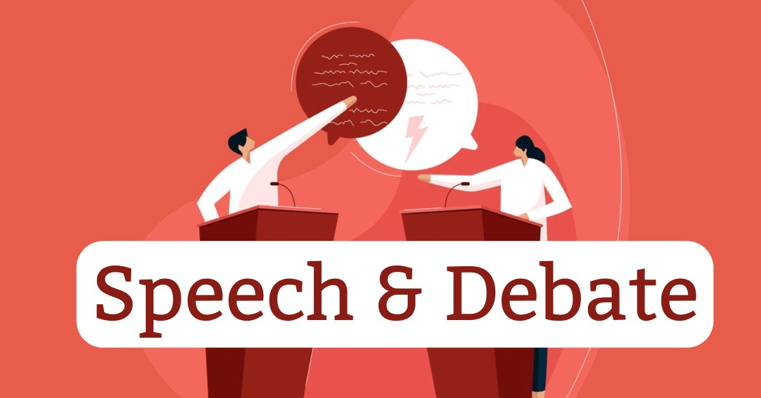

Slide 2
By: Emmett Pierson, Bret Haux, Cooper Haddick, Cameron Flinders, and Cali Crouse

Slide 3

Overview
Speech and debate is a competitive activity where participants engage in public speaking and structured arguments. They currently use a platform known as Tabroom to run these competitions in Montana, but there are many flaws in the system. The system currently only has functionality for inputting scoring, judges and students while scheduling and all other things are all done manually by staff at each tournament. This staff usually consists of the coaches and a few volunteers.

Slide 4
Current System
There are 7 different kinds of events: 3 speech and 4 debate
Students are put into Tabroom with a Unique Identifier called their speaker code and what competition they are competing in
Judges sign up for each tournament via email and then are put onto a list in Tabroom
There is a judge check-in desk where each judge must sign in. Their name is then put into a spreadsheet.
The staff then takes the judges that have checked in and manually assigns them to a room with students to compete
Judges receive paper ballots after they are assigned and then fill them out and return them to another desk.
Ballot scores are manually entered into Tabroom and Tabroom then ranks the students for each competition by their scores

Slide 5
System Concerns
The current system Tabroom, automates almost no part of the tournament process. It is mostly used to have a place to track each competitors score and assign judges to students
The judging assignments regularly fail and assign judges to students who they have already judged.
Uses a combination of spreadsheets and Tabroom to check judges into the tournament
All scheduling and room placement is done manually
Regularly falls hours behind due to scheduling errors
Ballots are on paper, and scoring is input manually
Coaches regularly spend more time helping with the event itself than they do coaching the students

Slide 6

System Requirements
Web-based platform
Mobile compatibility
All-in-one solution
User-Friendly
Reliability

Slide 7

System Users
Students – Students currently do not have access to Tabroom. But with a new system it would be beneficial for them to see their scores and their schedule, so they know where to be and when to be there
Judges – Judges currently do not have access to Tabroom. They check-in at a desk and then wait to receive their paper ballots with the room on them. The new system would preferably allow them to get a digital ballot with when and where to be.
Coaches – Coaches currently have access to Tabroom to see scoring and rankings of students in each event. Coaches would be able to view the full tournament schedule and the scoring/rankings for their students.
Staff – Staff usually consists of coaches, and they use Tabroom to double check that judges who have signed up have checked in, then manually assign ballots to the judges and they also use it to find the winners at the end of each tournament. The new system would allow them to automate most processes and focus on more of a directive role.

Slide 8

Project Purpose and Scope
Make the Speech and Debate tournament process more efficient and easier to use
Focus is on Montana Speech and Debate
User-friendly and automate as many processes as possible

Slide 9
Proposed 3rd Party Solutions

Slide 10

Arbiter Sports
Arbiter sports provides a web application that can also work on a mobile app allowing event organizers to seamlessly assign judges or refs, create a schedule for each competition, and allow you to receive scheduling notifications
This solution would help with the assigning part of each tournament, creating a schedule that follows all rules and assigning judges. Tabroom would still be used to track scoring and participants for each tournament

Slide 11

Benefits of System
Stop Delays
Increase tournament efficiency
User Friendly
Easy-to-use

Slide 12

Cost Estimate of Proposed System
Implementing ArbiterSports for event scheduling costs vary, but most sports league management software products on the market are priced on a "per month" basis, with entry-level pricing plans ranging from $24 to $240. ArbiterSports offers all-in-one event management solutions, including secure online and mobile-friendly registration and payment processing, centralized data and reporting, built-in emails and participant communications, and dedicated customer support.

Slide 13

Speechwire
SpeechWire is a comprehensive tournament management platform designed for speech, debate, and congress events at various levels, including high school, college, middle school, and even elementary levels.

Slide 14
Benefits of System
Developed for Speech and Debate
Increase efficiency
Easy to use on any browser
User Friendly
Customizable to meet unique tournaments requests/needs

Slide 15
Cost Estimate of Proposed System
Pricing scales based on the tournament size, with most events costing between $200 and $250. Discounts are available for early adopters in specific regions

Slide 16
Proposed Mock-Up Solution

Slide 17
New Web-Application/Mobile Application
In a perfect world this system could use an entirely new software where all functionality is in one place and made specifically for speech and debate. This is because speech and debate is a somewhat niche competition style.
Functionality could include – Student, Coach, Judge, Event Organizer portals that give different access. Students would be able to see their schedule and scores. Coaches would be able to see the entire tournament schedule, scorings, and rankings. Judges would be able to sign in online and see their schedule with an attached ballot. Organizers would be able to create a schedule by simply inputting which students and judges are signed up for the event.
This would also allow coaches and students to see a history of competitions and their placements

Slide 18
Benefits of System
Increase tournament efficiency
Stop delays
Allow coaches to be coaches
Automate systems that are done manually

Slide 19
Cost Estimate of Proposed Solution
The cost to develop an app varies depending on complexity and region of development. Average app development costs:
Simple app: $12,960 to $30,240
Complex app: $34,560 to $60,480
Advanced app: $56,160 to $82,080
This system would most likely fall under a complex app as its an almost entirely new system and would take quite a number of hours and a lot of testing. Our research suggests that it would be in the $35,000 - $45,000 range to develop a full and running application.

Slide 20
Conclusion
Current system works, but has many flaws and causes a lot of stress and hard ache for event organizers, students, coaches, and judges
There are services out there that could improve the current system
Our choice is ArbiterSports
Speech and debate is a niche sport, that to be fixed entirely would need its own sole application

Slide 21
Work Cited
“978 Clipart Person Who Royalty-Free Photos and Stock Images.” Shutterstock, www.shutterstock.com/search/clipart-person-who?cr=bc&ds_ag=&ds_agid=&ds_cid=71700000119502997&ds_eid=700000001393952&gclid=2a204b9a3fee18e3a1b22cc0312b8447&gclsrc=3p.ds&kw=www.shutterstock.com&msclkid=2a204b9a3fee18e3a1b22cc0312b8447&pl=PPC_BNG_US_PM-&utm_campaign=CO%3DUS_LG%3DEN_BU%3DIMG_AD%3DPM_TS%3Dlggeneric_RG%3DAMER_AB%3DACQ_CH%3DSEM_OG%3DCONV_PB%3DMicrosoft&utm_content=FF%3DPMAX-All_AU%3DProspecting&utm_medium=cpc&utm_source=bing&utm_term=www.shutterstock.com. Accessed 12 Dec. 2024.
“ArbiterSports -.” Truth in Advertising, 11 Dec. 2021, truthinadvertising.org/class-action/arbitersports/.
“Brunei Compensation & Benefits Outsourcing: Global PEO Benefits Services.” GP RSS, www.globalization-partners.com/globalpedia/brunei/compensation-benefits/?utm_keyword=brunei+employee+benefits&utm_device=c&utm_source=bing&utm_medium=cpc&utm_campaign=usa__search__benefits_countries__%5Ben%5D&utm_content=benefits_brunei&utm_term=brunei+employee+benefits&hsa_acc=2637010124&hsa_cam=11406119934&hsa_grp=1357897742744313&hsa_ad=&hsa_src=o&hsa_tgt=kwd-84869384341332%3Aloc-190&hsa_kw=brunei+employee+benefits&hsa_mt=p&hsa_net=adwords&hsa_ver=3&msclkid=2794f019fcf712f4a2fa9743f381b569. Accessed 12 Dec. 2024.
“Corporate Strategy | Bloomberg Professional Services.” Bloomberg.Com, Bloomberg, www.bloomberg.com/professional/solutions/corporations/corporate-strategy/?utm_medium=cpc&utm_source=bing&utm_content=nonbranded_corporate_strategy_performance_ph&utm_campaign=AMER+%7C+Corporations+%7C+Corporations+Awareness+%7C+Search+%7C+871039+%7C+FY+2024&tactic=871039&&msclkid=370ec22788e7172088e2a57d8770c09d&utm_term=company+strategy&gclid=370ec22788e7172088e2a57d8770c09d&gclsrc=3p.ds. Accessed 12 Dec. 2024.
“ITSM Software on Cloud: Freshservice.” Freshworks, www.freshworks.com/freshservice/lp/online-itsm-software/?utm_campaign=Grsmo&utm_medium=semanticlabs&utm_source=Grsmo&utm_tactic_id=3564353&pscd=affiliatepartner-freshservice.freshworks.com&ps_partner_key=c2VtYW50aWNsYWJz&sid=1-b-98a21e0d55801fde380179575b19a07f&ps_xid=P3RGZdEq6nbTPc&gsxid=P3RGZdEq6nbTPc&gspk=c2VtYW50aWNsYWJz. Accessed 12 Dec. 2024.
Name *. “Speech & Debate.” Aim Academy Online, 11 Dec. 2024, www.aimacademy.online/onlineclasses/speech-debate/.

Slide 22
Work Cited Continued
““Purpose and Scope.” Basic Safety and Training Solutions, 22 Sept. 2020, basicsafetyandtraining.solutions/topic/purpose/.
SpeechWire Tournament Services - Forensics Tournament Software - Speech, Debate, Congress, www.speechwire.com/p-features.php. Accessed 12 Dec. 2024.
SpeechWire, speechwirefour.com/. Accessed 12 Dec. 2024.
“Sports Event Management Tool: School Event Management Tool.” ArbiterSports, www.arbitersports.com/. Accessed 12 Dec. 2024.
“Stock Photos, Pictures & Royalty Free Videos.” Shutterstock, www.shutterstock.com/discover/image-packs-0224?&cr=pc&ds_ag=FF%3DStock%2BImage_AU%3DProspecting&ds_agid=58700003551364511&ds_cid=71700000014894855&ds_eid=700000001393952&gclid=76ffff6e6f5218b5c3909834610be819&gclsrc=3p.ds&kw=stock+images&msclkid=76ffff6e6f5218b5c3909834610be819&pl=PPC_BNG_US_IG-&utm_campaign=CO%3DUS_LG%3DEN_BU%3DIMG_AD%3DGENERIC_TS%3Dlggeneric_RG%3DAMER_AB%3DACQ_CH%3DSEM_OG%3DCONV_PB%3DMicrosoft-Ads&utm_content=FF%3DStock+Image_AU%3DProspecting&utm_medium=cpc&utm_source=bing&utm_term=stock+images. Accessed 12 Dec. 2024.
Tabroom.Com, www.Tabroom.com/index/about.mhtml. Accessed 12 Dec. 2024.

