Slide 1
UNIT-III Financial Intermediaries: Meaning of Financial Intermediation; Functions of Financial Intermediaries; Major Financial Intermediaries and Their Roles, Banking Financial Institutions: Commercial Banking, The public and private sector Bank, Role of Banks, Banks Financial Statements, Banks Computation, International Banking, NPA, Risk Management in Banking and Banking Innovations, NBFCs: Concept, guidelines, growth and prospects, IFCI, SFCs, IRBI, SIDC ,SIDBI– Introduction and operational policies

Slide 2
FINANCIAL INSTITUTIONS
Banks are the financial institutions which are empowered by the government to do financial activities like to accept a deposit, Grant credit, to manage withdrawals, to clear cheques, to provide general services.
Banks are the top organization which controls the whole financial system of the country.
Banks act as a financial mediator between the depositors and the borrowers.
Banks are responsible for the creating credit, mobilization of funds, safe and time bound transfer of finance.
Banks help in smooth functioning of the economy.
Accept, withdraw, clear cheque, service, payment, loan credit, finace lans

Slide 3
TYPES OF FINANCIAL INSTITUTIONS:
1. Commercial Banks
2. Regional Rural Banks(RRB)
3. Non-banking Financial Companies(NBFC)
4. Co-operative Societies/Banks

Slide 4
Commercial banks
Receiving deposits from the public.
Making various loans and advances.
Use of the cheque system.
Transfer of funds.
Safety lockers to keep valuable articles of customers in safe custody.
Savings accounts to individuals and small businesses.

Slide 5
COMMERCIAL BANKS
Commercial banks are regulated under the banking Regulation Act 1949. and their business model is designed to make profits.
Public Sector Banks
State Bank of India, Bank of India, Union Bank of India, Oriental Bank of Commerce.
Private Sector Banks
ICICI Bank, HDFC Bank, Axis Bank, KaurVysya Bank etc.

Slide 6
Regional Rural Banks (RRBs)
The Government of India set up RRBs on October 2, 1975.
-The banks provide credit to the weaker sections of the rural areas, particularly the small and marginal farmers, agricultural labourer’s and small entrepreneurs.
-Initially, five RRBs were set up which were sponsored by Syndicate Bank, State Bank of India, Punjab National Bank, United Commercial Bank and United Bank of India. Presently the number of the RRBs stands at 95.
Usually operate at regional levels in different states of India and may have branches in selected urban areas as well.
Providing banking to rural and semi-urban area.

Slide 7
Co-operative Societies/ banks:
A cooperative society is a voluntary association that started with the aim of the service of its members. It is a form of business where individuals belonging to the same class join their hands for the promotion of their common goals.
to provide timely and adequate credit to farmers for increasing agricultural production and productivity.
These are the Urban and Rural financial societies that provides loans to members at low interest.
It aims at providing better access to institutional credit for the small and marginal farmers and other weaker sections to enable them to adopt modern technology and improved agricultural practices has been a major concern of the policy.

Slide 8
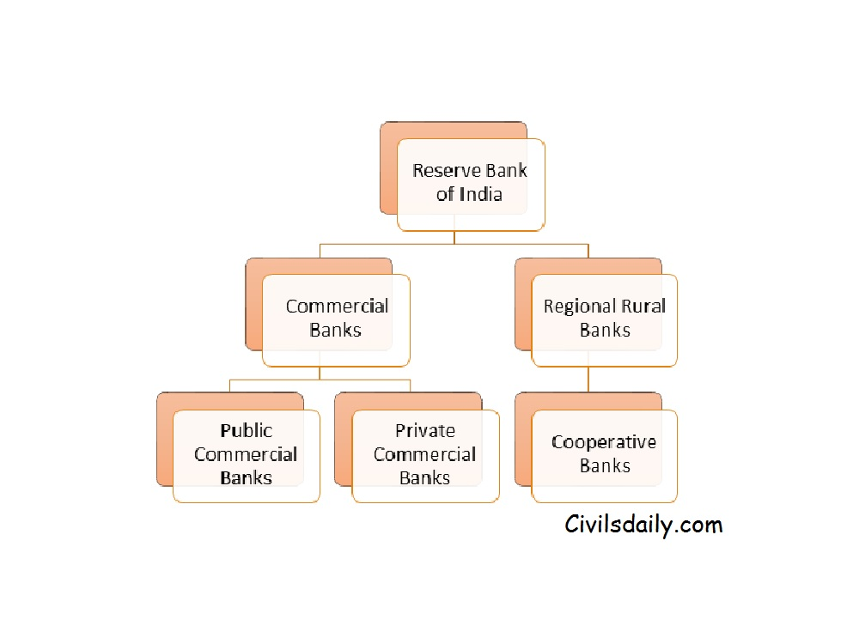
Types/Structure of Banks in India

Slide 9
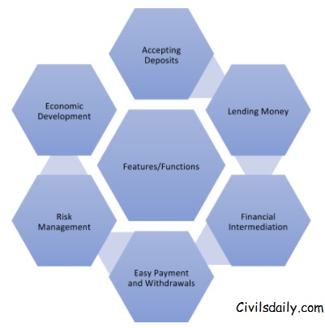
Features and functions of bank

Slide 10
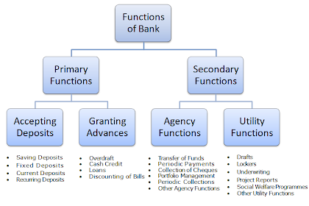
Functions of banks

Slide 11
Savings Deposit
Rate of interest will be low
Withdrawals and deposits are allowed
Salary and wage earners
Single and joint account
Restrictions

Slide 12
Fixed deposits
Lumpsum amount is deposited at one time for specific period
High rate of interest varies from deposit to deposit
Withdrawals are not allowed before expiry date
Current deposit
Business man
Withdrawals are freely allowed
No interest
Service facility and overdraft facility

Slide 13
Recurring deposit
Operate by salaried person
Petty traders
Periodic deposits
Withdrawal's permitted only of certain period. High rate of interest paid

Slide 14
Overdraft
This type of advances are given to current account holders. No separate account is maintained. All entries are made in the current account. A certain amount is sanctioned as overdraft which can be withdrawn within a certain period of time say three months or so. Interest is charged on actual amount withdrawn. It is sanctioned to businessman and firms.

Slide 15
Cash credit
The client is allowed cash credit upto a specific limit fixed in advance. It can be given to current account holders as well as to others who do not have an account with bank. Separate cash credit account is maintained. Interest is charged on the amount withdrawn in excess of limit. The cash credit is given against the security of tangible assets and / or guarantees. The advance is given for a longer period and a larger amount of loan is sanctioned than that of overdraft.
Short term loans, working capital

Slide 16
Loans
It is normally for short term say a period of one year or medium term say a period of five years. Now-a-days, banks do lend money for long term. Repayment of money can be in the form of installments spread over a period of time or in a lumpsum amount. Interest is charged on the actual amount sanctioned, whether withdrawn or not. The rate of interest may be slightly lower than what is charged on overdrafts and cash credits. Loans are normally secured against tangible assets of the company.

Slide 17
Discounting of Bill of Exchange
The bank can advance money by discounting or by purchasing bills of exchange both domestic and foreign bills. The bank pays the bill amount to the drawer or the beneficiary of the bill by deducting usual discount charges. On maturity, the bill is presented to the drawee or acceptor of the bill and the amount is collected.

Slide 18
Banks Financial Statements, Banks Computation,
Financial statements (or financial reports) are formal records of the financial activities and position of a business, person, or other entity.
Relevant financial information is presented in a structured manner and in a form which is easy to understand. They typically include four basic financial statements accompanied by a management discussion and analysis:
A balance sheet or statement of financial position, reports on a company's assets, liabilities, and owners equity at a given point in time.
An income statement—or profit and loss report (P&L report), or statement of comprehensive income, or statement of revenue & expense—reports on a company's income, expenses, and profits over a stated period. A profit and loss statement provides information on the operation of the enterprise. These include sales and the various expenses incurred during the stated period.
A statement of changes in equity or statement of equity, or statement of retained earnings, reports on the changes in equity of the company over a stated period.
A cash flow statement reports on a company's cash flow activities, particularly its operating, investing and financing activities over a stated period.
5.A comprehensive income statement involves those other comprehensive income items which are not included while determining net income.

Slide 19
International banking
Meaning of International Banking
International banking is just like any other banking service, but it takes place across different nations or internationally. To put in another way, international banking is an arrangement of financial service by a residential bank of one country to the residents of another country. Mostly multinational companies and individuals use this banking facility for transacting.
Example of International Banking
Suppose Microsoft, an American company is functioning in London. It is in need of funds to meet its working capital requirements. In such scenario, Microsoft can avail the banking services in form of loans, overdraft or any other financial service through banks in London. Here, the residential bank of London shall be giving its services to an American company. Therefore, the transaction between them can be said to be part of international banking facility.

Slide 20
International Transactions
International banking allows the business to make international bill payments. The currency conversion facility allows the companies to pay and receive money easily. Also, the benefits like overdraft facility, loans, deposits, etc. are available every time for overseas transactions.
Accounts Maintenance
A multinational company can maintain the records of global accounts in a fair manner with the help of international banking. All the transactions of the company are recorded in the books of the banks across the globe. By compiling the data and figures, the accounts of the company can be maintained.

Slide 21
Flexibility
International banking facility provides flexibility to the multinational companies to deal in multiple currencies. The major currencies that multinational companies or individuals can deal with include euro, dollar, pounds, sterling, and rupee. The companies having headquarters in other countries can manage their bank accounts and avail financial services in other countries through international banking without any hassle.
Accessibility
International banking provides accessibility and ease of doing business to the companies from different countries. An individual or MNC can use their money anywhere around the world. This gives them a freedom to transact and use their money to meet any requirement of funds in any part of the world.

Slide 22
Non-performing asset (NPA)
A nonperforming asset (NPA) refers to a classification for Loans or Advances that are in Default
Nonperforming assets (NPAs) are recorded on a bank's balance sheet after a prolonged period of non-payment by the borrower.
Overdraft and cash credit(OD/CC) accounts left out-of-order for more than 90 days
Agricultural advances whose interest or principal installment payments remain Expected payment on any other type of account is overdue for more than 90 days

Slide 23
For example, assume a company with a $10 million loan with interest-only payments of $50,000 per month fails to make a payment for three consecutive months. The lender may be required to categorize the loan as nonperforming to meet regulatory requirements.

Slide 24
Recording Non-Performing Assets (NPA)
Banks are required to classify nonperforming assets into one of three categories according to how long the asset has been non-performing: 1.sub-standard assets,
2. doubtful assets, and 3. loss assets.
A sub-standard asset is an asset classified as an NPA for less than 12 months.
A doubtful asset is an asset that has been non-performing for more than 12 months.
Loss assets are loans with losses identified by the bank, auditor, or inspector that need to be fully written off. They typically have an extended period of non-payment, and it can be reasonably assumed that it will not be repaid.

Slide 25
RISK MANAGEMENT
Risk – Definition
Risk takes on many forms but is broadly categorized as a chance wherein an outcome or investment’s actual return will differ from the expected outcome or return.
Risk includes the possibility of losing some or all of the original investment.
Different versions of risks are usually measured by calculating the standard deviation of the historical returns or average returns of a specific investment.
A fundamental idea in finance is the relationship between risk and return.
As risk is directly proportional to return, the more risk a bank takes, it can expect to make more money.

Slide 26
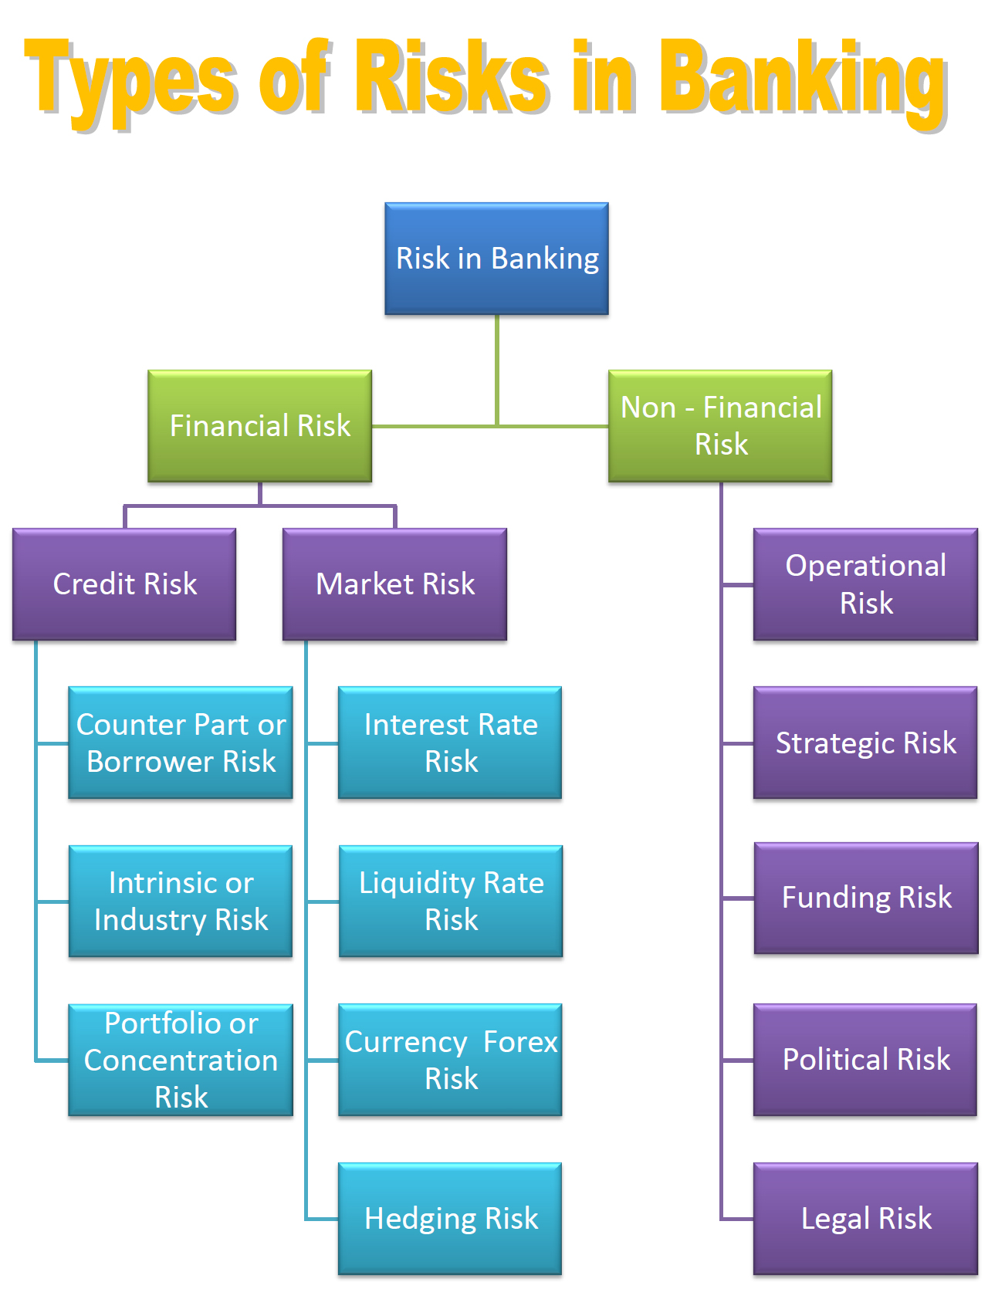

Slide 27
Liquidity Risk
It is the risk when a bank fails in honouring the commitment of payment of deposits to the customers due to inability to meet cash flow obligations. This may be due to rumours like the closing of bank or assets turning into NPA’s.
Interest Rate Risk
The interest rate risk refers to the chance that investments in bonds will suffer as the result of unexpected interest rate changes.
The interest rate is one of the primary drivers of a bond’s price.
The current interest rate and the price of a bond demonstrates an inverse relationship. In other words, when the interest rate increases, the price of a bond decreases.
This is associated with the opportunity cost of holding Bonds at a fixed rate interest.
Mitigation can be done by Hedging or diversification of Portfolio.

Slide 28
Market Risk
Market risk is the risk that the value of an investment will decrease due to changes in market factors.
These factors will have an impact on the overall performance on the financial markets and can only be reduced by diversification into assets that are not correlated with the market such as certain alternative asset classes.
Market risk is sometimes called “systematic risk” because it relates to factors, such as a recession, that impact the entire market.
Banks generally invest in products which are related to the price of Commodities, Shares, Currency movement and this can lead to market risk.

Slide 29
Default or Credit Risk
It is the risk of loss that may occur from the failure of any party to abide by the terms and conditions of any financial contract, principally the failure to make required payments on loans due to an entity.
There are two risks associated with it – Counterpart risk and Country Risk.
The major goal of a project finance firm in risk management is to ensure that it understands, measures, and monitors the various risks that arise, and that the organization adheres strictly to the policies and procedures established to address these risks.
After analyzing the specific borrower’s risk, the credit risk management group assigns a credit rating to the borrower.

Slide 30
Operational Risk
Operational risk is the risk not inherent in financial, systematic or market-wide risk. It is the risk remaining after determining financing and systematic risk and includes risks resulting from breakdowns in internal procedures, people and systems.
Operational loss has mainly three exposure classes namely people, processes and systems.
It has two sub-components. Transaction Risk & Compliance Risk.
Transaction risk is the risk arising from fraud, both internal and external, failed business processes and the inability to maintain business continuity and manage information.
Compliance risk is the risk of legal or regulatory sanction, financial loss or reputation loss that a bank may suffer as a result of its failure to comply with any or all of the applicable laws, regulations.

Slide 31
NBFC- Non banking financial companies
Nonbank financial companies (NBFCs), also known as nonbank financial institutions (NBFIs) are entities that provide certain bank-like and financial services but do not hold a banking license.
Investment banks, mortgage lenders, money market funds, insurance companies, hedge funds, private equity funds are all examples of NBFCs.
A non-banking financial company is that financial institution which provides the banking services to the customers without having a banking license. An NBFC needs to be compulsorily registered under the Companies Act 1956 however, it can be owned privately or by the government.

Slide 32
Bajaj Finserv Ltd. is the NBFC belonging to Bajaj Finance Limited. It provides different types of loans, such as capital for small and medium enterprises, corporate finance, vehicle loan, insurance, home loan, wealth management,
NBFC is a company which is registered under the companies act, 1956 and it is under the control of central bank (Reserve bank of India).

Slide 33
NBFC is a company which is registered under the companies act, 1956 and it is under the control of central bank (Reserve bank of India).
NBFC is not a bank but it is engaged in a lending fund as well as many other activities which are similar to banking like to provide loans and advances, credit facility, saving and various schemes etc.
NBFC also provides services to the business corporation like an acquisition of shares, stocks, debentures, bonds, and securities issued by the government.
It also facilitates services like hire purchase, leasing, venture capital finance, housing finance, and insurance

Slide 34
NBFIs: Non-Bank Financial Intermediaries!
Non-Bank Financial Intermediaries (NBFIs) is a heterogeneous group of financial institutions other than commercial and co-operative banks. They include a wide variety of financial institutions, which raise funds from the public, directly or indirectly, to lend them to ultimate spenders.
The development banks (such as the IDBI, IFCI, IGICI, SFCs, land development banks, etc.). They specialise in making term loans to their borrowers. Three other all-India big term-lending institutions are the LIC, the GIC and its subsidiaries, and the UTI. Of these, only the UTI is a pure NBFI, the others raise funds as premia from the sale of insurance. Then, there are provident funds and post offices that mobilise public savings in a big way for onward transmission to ulti­mate spenders.

Slide 35
NBFCS
IFCI- Industrial Finance Corporation of India
SFC- State Finance Corporations
IRBI- Industrial Reconstruction Bank of India
SIDC - is State Industrial Development Corporations
SIDBI-Small Industries Development Bank of India (SIDBI)

Slide 36
IFCI- Industrial Finance Corporation of India
Government of India set up the Industrial Finance Corporation of India (IFCI) in July 1948 under a special Act. This is the first financial institution set up in India with the main object of making medium and long term credit to industrial needs.

Slide 37
The functions of the IFCI base as follows:
The corporation grants loans and advances to industrial concerns.
(ii) Granting of loans both in rupees and foreign currencies.
(iii) The corporation underwrites the issue of stocks, bonds, shares etc.:
(iv) The corporation can grant loans only to public limited companies and co-operatives but not to private limited companies or partnership firms.

Slide 38
SFC- State Finance Corporations
The main objectives of the S.F.C are to provide financial assistance to medium and small scale industries which are outside the scope of I.F.C.I. The main function of S.F.C. is limited within its states. It covers not only public limited companies but also private limited companies, partnership firms and proprietary concerns.
Functions Of SFC:
The main functions of S.F.C. are as follows:
It grants loan and advances to industrial concerns that are repayable within the maximum period of 20 years.
It subscribes the shares and debentures of industrial concerns.
It underwrites the shares and debentures of the industrial concerns.
It guarantees loans raised by the industrial concerns repayable within 20 years.
Guarantees deferred payments for purchase of capital goods with India.
It acts as an agent of the State and central Government.

Slide 39
Industrial Reconstruction Bank of India. IRBI
The Government of India set up the Industrial Reconstruction Corporation of India (IRCI) in 1971 under the Indian Companies Act particularly to look into the problems of the sick units and provide assistance for their, speedy reconstruction and rehabilitation. In August 1984, the Government passed an act converting the IRCI into the Industrial Reconstruction Bank of India. IRBI has been set up with a view of enabling it to function as the principal credit and reconstruction agency for industrial revival by undertaking modernisation, expansion, reorganisation, diversification or rationalisation of industry and to coordinate similar work of the other institutions engaged therein and to assist and rehabilitate industrial concerns.

Slide 40
Functions of Industrial Reconstruction Bank of India
IRBI is empowered to grant loans and advances to industrial concerns.
(ii) To undertake stock, shares, bonds and debentures.
(iii) To guarantee loans/deferred payments and performance obligations of any contract undertaken by industrial concerns.
(iv) To act as an agent of Central and State Governments, Reserve Bank of India, State Bank of India, Scheduled commercial and
cooperative Banks, Public financial institutions, State financial corporations and such other persons as Central Governments may authorise.
(v) To engage in development activities such as providing infrastructural facilities, raw materials, consultancy, managerial and merchant banking services for reconstruction and development of industrial concerns and providing machinery and other equipment on lease or hire purchase basis etc.
Through its consultancy services, IRBI attempts to help banks and financial institutions to assess intrinsic worth of sick units which are seeking assistance for revival. Through its merchant banking services, IRBI helps the units in the process of (amalgamation, merger) and reconstruction/ Equipment leasing is, in fact, an extension of the IRBI hire purchase scheme.

Slide 41
SIDC - is State Industrial Development Corporations
Objectives of SIDC
The main objectives of SIDC are as follows:-
SIDC aims to promote micro, small and medium enterprises.
It aids in the establishment of entrepreneurship and skill development.
It helps in facilitating industrial infrastructure development.
It aims in providing publicity and marketing support to industries.

Slide 42
Functions of SIDC are:-
SIDCs procure scarce raw materials from the domestic market and international market and make it available to the needy small scale industries as per their requirements.
SIDCs take up various schemes to provide the various industrial units with efficient marketing assistance. SIDCs participate in tenders floated by the state government departments.
To obtain orders and distribute them among various small scale units, SIDCs make advance payments.
It helps in solving working capital problems of the various industrial units.
SIDCs have developed websites so that the products manufactured by the industrial units are displayed in the foreign markets. It provides export marketing assistance and helps in procuring export orders.
SIDCs also promote industrial units run by women entrepreneurs.
SIDCs help in setting up skill development centres where workers are trained in various skills and industrial activities. This is to ensure the supply of skilled labourers to various small scale industries.

Slide 43
SIDBI-Small Industries Development Bank of India (SIDBI)
Objectives of SIDBI
To promote marketing of products of small scale sector.
To upgrade technology and also undertaking modernization of small scale units.
To provide more financial assistance to small scale ancillary and tiny sector.
To encourage employment oriented industries.
To coordinate all the other institutions involved in the promotion of small scale industries.

Slide 44
Functions of SIDBI
Refinance to SSI
Discounting the bills of SSIs
SIDBI offers assistance to exports
Seed capital and also soft loan Assistance
Factoring, Leasing and HP finance
Venture capital

