Slide 1
UNIT-4
INDIAN FINANCIAL MRKETS

Slide 2
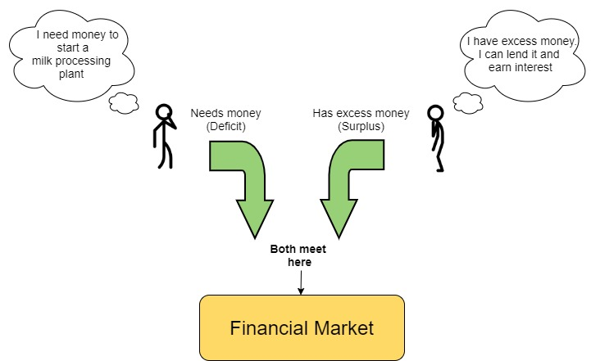
INTRODUCTION:
Business units have to raise short-term as well as long-term funds to meet their working and fixed capital requirements from time to time. From where would they get funds from?
Ans : From investors or lenders. Surplus money flows from the investors or lenders to the businessmen for the purpose of production or sale of goods and services. So, we find two different groups, one who invest money or lend money and the others, who borrow or use the money.
Financial Market
Financial market is the market that facilitates transfer of funds between investors/ lenders and borrowers/ users. Financial market may be defined as ‘a transmission mechanism between investors (or lenders) and the borrowers (or users) through which transfer of funds is facilitated’. It consists of individual investors, financial institutions and other intermediaries who are linked by a formal trading rules and communication network for trading the various financial assets and credit instruments. It deals in financial instruments (like bills of exchange, shares, debentures, bonds, etc)
Main functions of financial market
Let us now see the main functions of financial market. (a) It provides facilities for interaction between the investors and the borrowers. (b) It provides pricing information resulting from the interaction between buyers and sellers in the market when they trade the financial assets. (c) It provides security to dealings in financial assets. (d) It ensures liquidity by providing a mechanism for an investor to sell the financial assets. (e) It ensures low cost of transactions and information.
Classification of Financial Market
A financial market consists of two major segments: (a) Money Market; and (b) Capital Market. While the money market deals in short-term credit, the capital market handles the medium term and long-term credit
Money Market
The money market is a market for short-term funds, which deals in financial assets whose period of maturity is upto one year. It should be noted that money market does not deal in cash or money as such but simply provides a market for credit instruments such as bills of exchange, promissory notes, commercial paper, treasury bills, etc. These financial instruments are close substitute of money. These instruments help the business units, other organisations and the Government to borrow the funds to meet their short-term requirement.
The Indian money market consists of Reserve Bank of India, Commercial banks, Co-operative banks, and other specialised financial institutions. The Reserve Bank of India is the leader of the money market in India. Some Non-Banking Financial Companies (NBFCs) and financial institutions like LIC, GIC, UTI, etc. also operate in the Indian money market.

Slide 3
Capital Market
Capital Market is an institutional arrangement for borrowing medium and long-term funds and which provides facilities for marketing and trading of securities. So it constitutes all long-term borrowings from banks and financial institutions, borrowings from foreign markets and raising of capital by issue various securities such as shares, debentures, bonds, etc. The securities market has two different segments namely primary and secondary market.
Primary Market vs Secondary Market : The primary market consists of arrangements for procurement of long-term funds by companies by fresh issue of shares and debentures. The secondary market or stock exchange provides a ready market for existing long term securities. Stock exchange is the secondary market, which provides a place for regular sale and purchase of different types of securities like shares, debentures, bonds & government securities. It is an organised market where all transactions are regulated by the rules and laws of the concerned stock exchanges.
Secondary Markets or Stock Exchanges : The functions of a stock exchanges are to provide ready and continuous market for securities, information about prices and sales, safety to dealings and investment, helps mobilisation of savings and capital formation. It acts as a barometer of economic and business conditions and helps in better allocation of funds. Stock exchanges provide many benefits to companies, investors and the society as a whole. But they also suffer from limitations like exclusive speculation and fluctuation in prices due to rumours and unpredictable events. There are 21 stock exchanges in India presently, including BSE, NSE and OTCEI. Stock Exchanges are regulated by the Securities Contracts (Regulation) Act and by SEBI. SEBI has initiated a number of reforms in the primary and secondary market to regulate the stock market. Documentary and procedural requirements for listing and trading have been made stricter and foolproof to protect investors’ interest.
The secondary market has further two components. First, the spot market where securities are traded for immediate delivery and payment. The other is forward market where the securities are traded for future delivery and payment. This forward market is further divided into Futures and Options Market (Derivatives Markets). In futures Market the securities are traded for conditional future delivery whereas in option market, two types of options are traded. A put option gives right but not an obligation to the owner to sell a security to the writer of the option at a predetermined price before a certain date, while a call option gives right but not an obligation to the buyer to purchase a security from the writer of the option at a particular price before a certain date.

Slide 4
Financial Economics
It is the study of the use and distribution of resources (money instead of goods and services) in the financial markets.
Financial system
The entire financial system is made up of the following three elements:
Financial Markets
Financial Instruments
Financial Institutions
In this CHAPTER, we shall focus on financial markets and financial market instruments.
Financial markets
In an economy, some will have a surplus while others will be suffering from a deficit. This surplus & deficit can be of any kind but in financial economics, we shall assume this to be related to money.
Example:
Consider a person Mr A who wants to open a factory. He needs Rs 10 Crore for it. But has only 5 Crore with him. So, what does he do?
Should he go door to door asking for money? That’s just not feasible. So, he decides to borrow.
Now, consider another person Mr B. He has surplus money of Rs 1 Cr with him. Similarly, like him there are thousands of other people who have surplus money with them.
Mr A wants to borrow money and people like Mr B have that kind of money to lend. All good, but how does Mr A find out about such people who would be willing to lend him money!
This function is performed by a market where borrowers and lenders meet each other. It is like a supermarket but not for goods and services but for money.
In this market, surplus money is channeled from those who have it i.e., lenders to those who need it i.e., borrowers.
Following five types of lenders and borrowers exist,
Government of India
Banks
NBFC
Big businesses
Individuals
Thus, financial market, like all other markets is a place where buying and selling take place, but instead of the usual things like goods, merchandise, etc, money and other financial assets are traded.

Slide 5
Money Market and Capital Market : A comparison
Point of Distinction | Money Market | Capital Market
1. Time period / Term | Deals in short-term funds. | Long term funds.
2. Instrument Dealt In | Deals in securities like treasury bills, commercial paper, bills of exchange, certificate of deposits etc. | Deals in securities like shares, debentures, bonds and government securities.
3. Participants | Commercial banks, NBFS, chit funds etc. | Stock brokers, under writers, mutual funds, individual investors, financial institutions
4. Regulatory body | RBI | SEBI

Slide 6
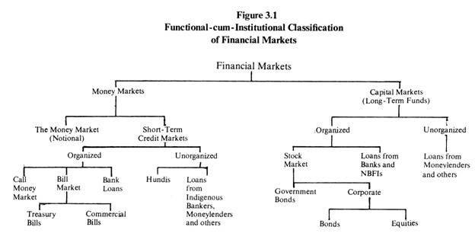

Slide 7
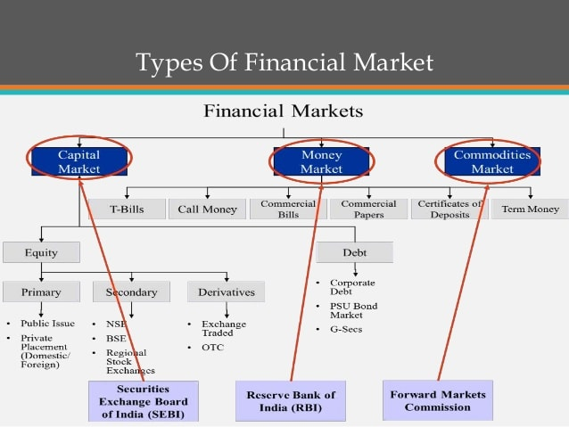

Slide 8
Organized financial market – regulated and controlled by any regulatory body like RBI. This organized market can be further divided into the following two categories:
Money Market
Capital Market
Unorganized financial market – unregulated and not governed by any laws. Private moneylenders etc come under this category

Slide 9
Following are some of the important money market instruments or securities.
(a) Call Money: Call money is mainly used by the banks to meet their temporary requirement of cash. They borrow and lend money from each other normally on a daily basis. It is repayable on demand and its maturity period varies in between one day to a fortnight. The rate of interest paid on call money loan is known as call rate.
(b) Treasury Bill: A treasury bill is a promissory note issued by the RBI to meet the short-term requirement of funds. Treasury bills are highly liquid instruments, that means, at any time the holder of treasury bills can transfer of or get it discounted from RBI. These bills are normally issued at a price less than their face value; and redeemed at face value. So the difference between the issue price and the face value of the treasury bill represents the interest on the investment. These bills are secured instruments and are issued for a period of not exceeding 364 days. Banks, Financial institutions and corporations normally play major role in the Treasury bill market.
Commercial Paper: Commercial paper (CP) is a popular instrument for financing working capital requirements of companies. The CP is an unsecured instrument issued in the form of promissory note. This instrument was introduced in 1990 to enable the corporate borrowers to raise short-term funds. It can be issued for period ranging from 15 days to one year. Commercial papers are transferable by endorsement and delivery. The highly reputed companies (Blue Chip companies) are the major player of commercial paper market.
(d) Certificate of Deposit: Certificate of Deposit (CDs) are short-term instruments issued by Commercial Banks and Special Financial Institutions (SFIs), which are freely transferable from one party to another. The maturity period of CDs ranges from 91 days to one year. These can be issued to individuals, co-operatives and companies.
(e) Commercial Bill/Trade Bill: Normally the traders buy goods from the wholesalers or manufactures on credit. The sellers get payment after the end of the credit period. But if any seller does not want to wait or in immediate need of money he/she can draw a bill of exchange in favour of the buyer. When buyer accepts the bill it becomes a negotiable instrument and is termed as bill of exchange or trade bill. This trade bill can now be discounted with a bank before its maturity. On maturity the bank gets the payment from the drawee i.e., the buyer of goods. When trade bills are accepted by Commercial Banks it is known as Commercial Bills. So trade bill is an instrument, which enables the drawer of the bill to get funds for short period to meet the working capital needs

Slide 10
STOCK EXCHANGE
As indicated above, stock exchange is the term commonly used for a secondary market, which provide a place where different types of existing securities such as shares, debentures and bonds, government securities can be bought and sold on a regular basis. A stock exchange is generally organised as an association, a society or a company with a limited number of members. It is open only to these members who act as brokers for the buyers and sellers. The Securities Contract (Regulation) Act has defined stock exchange as an “ association, organization or body of individuals, whether incorporated or not, established for the purpose of assisting, regulating and controlling business of buying, selling and dealing in securities”.
The main characteristics of a stock exchange are:
1. It is an organized market.
2. It provides a place where existing and approved securities can be bought and sold easily.
3. In a stock exchange, transactions take place between its members or their authorized agents.
4. All transactions are regulated by rules and by laws of the concerned stock exchange.
5. It makes complete information available to public in regard to prices and volume of transactions taking place every day.
It may be noted that all securities are not permitted to be traded on a recognized stock exchange. It is allowed only in those securities (called listed securities) that have been duly approved for the purpose by the stock exchange authorities. The method of trading now a-days, however, is quite simple on account of the availability of on-line trading facility with the help of computers. It is also quite fast as it takes just a few minutes to strike a deal through the brokers who may be available close by. Similarly, on account of the system of scrip-less trading and rolling settlement, the delivery of securities and the payment of amount involved also take very little time, say, 2 days.
STOCK EXCHANGES IN INDIA
The first organised stock exchange in India was started in Mumbai known as Bombay Stock Exchange (BSE). It was followed by Ahmedabad Stock Exchange in 1894 and Kolkata Stock Exchange in 1908. The number of stock exchanges in India went upto 7 by 1939 and it increased to 21 by 1945 on account of heavy speculation activity during Second World War. A number of unorganised stock exchanges also functioned in the country without any formal set-up and were known as kerb market. The Security Contracts (Regulation) Act was passed in 1956 for recognition and regulation of Stock Exchanges in India. At present we have 23 stock exchanges in the country. Of these, the most prominent stock exchange that came up is National Stock Exchange (NSE). It is also based in Mumbai and was promoted by the leading financial institutions in India. It was incorporated in 1992 and commenced operations in 1994. This stock exchange has a corporate structure, fully automated screen-based trading and nation-wide coverage

Slide 11
FUNCTIONS OF A STOCK EXCHANGE The functions of stock exchange can be enumerated as follows:
Provides ready and continuous market: By providing a place where listed securities can be bought and sold regularly and conveniently, a stock exchange ensures a ready and continuous market for various shares, debentures, bonds and government securities. This lends a high degree of liquidity to holdings in these securities as the investor can encash their holdings as and when they want.
Provides information about prices and sales: A stock exchange maintains complete record of all transactions taking place in different securities every day and supplies regular information on their prices and sales volumes to press and other media. In fact, now-a-days, you can get information about minute to minute movement in prices of selected shares on TV channels like CNBC, Zee News, NDTV and Senior Secondary Notes 74 MODULE -4 Business Finance Headlines Today. This enables the investors in taking quick decisions on purchase and sale of securities in which they are interested. Not only that, such information helps them in ascertaining the trend in prices and the worth of their holdings. This enables them to seek bank loans, if required.
Provides safety to dealings and investment: Transactions on the stock exchange are conducted only amongst its members with adequate transparency and in strict conformity to its rules and regulations which include the procedure and timings of delivery and payment to be followed. This provides a high degree of safety to dealings at the stock exchange. There is little risk of loss on account of non-payment or nondelivery. Securities and Exchange Board of India (SEBI) also regulates the business in stock exchanges in India and the working of the stock brokers. Not only that, a stock exchange allows trading only in securities that have been listed with it; and for listing any security, it satisfies itself about the genuineness and soundness of the company and provides for disclosure of certain information on regular basis. Though this may not guarantee the soundness and profitability of the company, it does provide some assurance on their genuineness and enables them to keep track of their progress.
Helps in mobilisation of savings and capital formation: Efficient functioning of stock market creates a conducive climate for an active and growing primary market. Good performance and outlook for shares in the stock exchanges imparts buoyancy to the new issue market, which helps in mobilising savings for investment in industrial and commercial establishments. Not only that, the stock exchanges provide liquidity and profitability to dealings and investments in shares and debentures. It also educates people on where and how to invest their savings to get a fair return. This encourages the habit of saving, investment and risk-taking among the common people. Thus it helps mobilising surplus savings for investment in corporate and government securities and contributes to capital formation.
Barometer of economic and business conditions: Stock exchanges reflect the changing conditions of economic health of a country, as the shares prices are highly sensitive to changing economic, social and political conditions. It is observed that during the periods of economic prosperity, the share prices tend to rise. Conversely, prices tend to fall when there is economic stagnation and the business activities slow down as a result of depressions. Thus, the intensity of trading at stock exchanges and the corresponding rise on fall in the prices of securities reflects the investors’ assessment of the economic and business conditions in a country, and acts as the barometer which indicates the general conditions of the atmosphere of business.
Better Allocation of funds: As a result of stock market transactions, funds flow from the less profitable to more profitable enterprises and they avail of the greater potential for growth. Financial resources of the economy are thus better allocated.

Slide 12
What Is the Bombay Stock Exchange (BSE)?
The Bombay Stock Exchange (BSE) is the first and largest securities market in India and was established in 1875 as the Native Share and Stock Brokers' Association. Based in Mumbai, India, the BSE lists close to 6,000 companies and is one of the largest exchanges in the world, along with the New York Stock Exchange (NYSE), Nasdaq, London Stock Exchange Group, Japan Exchange Group, and Shanghai Stock Exchange.
The BSE has helped develop India's capital markets, including the retail debt market, and has helped grow the Indian corporate sector. The BSE is Asia's first stock exchange and also includes an equities trading platform for small-and-medium enterprises (SME). BSE has diversified into providing other capital market services including clearing, settlement, and risk management.
In 1995, the BSE switched from an open-floor to an electronic trading system. There are more than a dozen electronic exchanges in the U.S. alone with the New York Stock Exchange (NYSE) and Nasdaq being the most widely known.
Today, electronic trading systems dominate the financial industry overall, offering fewer errors, faster execution, and better efficiency than traditional open-outcry trading systems. Securities that the BSE lists include stocks, stock futures, stock options, index futures, index options, and weekly options.
The BSE's overall performance is measured by the Sensex, a benchmark index of 30 of the BSE's largest and most actively traded stocks covering 12 sectors. Debuting in 1986, the Sensex is India's oldest stock index. Also called the "BSE 30," the index broadly represents the composition of India's entire market.
The Bombay Stock Exchange is located on Dalal Street in downtown Mumbai, India. In the 1850s, stockbrokers would conduct business under a banyan tree in front of the Mumbai town hall. After a few decades of various meeting locations, Dalal Street was formally selected in 1874 as the location for the Native Share and Stock Brokers' Association, the forerunner organization that would eventually become the BSE.
Mumbai is now a major financial center in India and Dalal Street is home to a large number of banks, investment firms, and related financial service companies. The importance of Dalal Street to India is similar to that of Wall Street in the United States. Indian investors and the press will cite the investment activity of Dalal Street and will use it as a figure of speech to represent the Indian financial industry.
BSE stock exchange was founded by Premchand Roychand in 1875 and is currently managed by Sethurathnam Ravi, serving as the chairman.
Securities and Exchange Board of India (SEBI) is responsible for the regulation of this stock exchange, continuously updating rules for its smooth operation.

Slide 13
What Is the National Stock Exchange of India Limited (NSE)?
The National Stock Exchange of India Limited (NSE) is India's largest financial market. Incorporated in 1992, the NSE has developed into a sophisticated, electronic market, which ranked fourth in the world by equity trading volume. Trading commenced in 1994 with the launch of the wholesale debt market and a cash market segment shortly thereafter.
Today, the National Stock Exchange of India Limited (NSE) conducts transactions in the wholesale debt, equity, and derivative markets. One of the more popular offerings is the NIFTY 50 Index, which tracks the largest assets in the Indian equity market. US investors can access the index with exchange-traded funds (ETF), such as the iShares India 50 ETF (INDY).
The National Stock Exchange of India Limited was the first exchange in India to provide modern, fully automated electronic trading. It was set up by a group of Indian financial institutions with the goal of bringing greater transparency to the Indian capital market.
Following are the objectives of NSE:
Establishing a nationwide trading facility for all types of securities.
Ensuring equal access to investors all over the country through an appropriate communication network.
Providing a fair, efficient, and transparent securities market using an electronic trading system.
Founded | 1992
Owner | Various domestic and global financial institutions, public and privately owned entities and individuals
Key people | Girish Chandra Chaturvedi (Chairperson) Vikram Limaye (MD & CEO)
Currency | Indian rupee (₹)

Slide 14
ROLE OF SEBI
As part of economic reforms programme started in June 1991, the Government of India initiated several capital market reforms, which included the abolition of the office of the Controller of Capital Issues (CCI) and granting statutory recognition to Securities Exchange Board of India (SEBI) in 1992 for:
protecting the interest of investors in securities;
promoting the development of securities market;
regulating the securities market; and
matters connected there with or incidental thereto. SEBI has been vested with necessary powers concerning various aspects of capital market such as:
(i) regulating the business in stock exchanges and any other securities market; Senior Secondary Notes 80 MODULE -4 Business Finance
(ii) registering and regulating the working of various intermediaries and mutual funds;
(iii) promoting and regulating self regulatory organisations;
(iv) promoting investors education and training of intermediaries;
(v) prohibiting insider trading and unfair trade practices;
(vi) regulating substantial acquisition of shares and take over of companies;
(vii) calling for information, undertaking inspection, conducting inquiries and audit of stock exchanges, and intermediaries and self regulation organisations in the stock market; and
(viii) performing such functions and exercising such powers under the provisions of the Capital Issues (Control) Act, 1947 and the Securities Contracts (Regulation) Act, 1956 as may be delegated to it by the Central Government.

Slide 15
S.E.B.I – Securities and Exchange board of India
Established in 1988 as a body for promoting orderly and healthy growth of securities market and for investor protection. It was given a statutory status in 1992
1. The expanding investor population and the market capitalization led to malpractices by the companies, traders, brokers, consultants.
2. These malpractices included self styled merchant bankers, price rigging, unofficial private placements, insider trading, non adherence to provisions of companies act, violation of rules and regulations of stock exchange, delay in delivery of shares.
3. The investor confidence was eroded and investor grievance was multiplied. To counter this government set up a regulatory body.
Objectives of the SEBI:
1. Regulate stock exchange and securities industry to promote their orderly functioning.
2. Protect rights and interests of investors
3. Prevent malpractices and promote balance between self regulation by the industry and statutory regulations
4. To make the intermediaries more professional and competitive by making a code of conduct and fair practices.
Functions of SEBI:
1. Registration of brokers, sub brokers
2. Registration of investment schemes and mutual funds
3. Prohibiting unfair and prohibitory practices.
4. Enforcing the act and penalizing defaulters.
5. Levying charges and fees for enforcing the act
6. Exercising functions as delegated to it by the central government under the securities contracts act.
7. Investor education, training of intermediaries, conducting research and promoting code of conduct.

Slide 16
Primary Market Reforms In India
Abolition of Controller of Capital Issues: The Capital Issues (Control) Act, 1947 governed capital issues in India. The capital issues control was administered by the Controller of Capital Issues (CCI).
The Narasimham Committee (1991) had recommended the abolition of CCI and wanted SEBI to protect investors and take over the regulatory function of CCI.
As a result, the government replaced the Capital Issues (Control) Act and abolished the post of CCI.
Companies are allowed to approach the capital market without prior government permission subject to getting their offer documents cleared by SEBI.
Securities and Exchange Board of India (SEBI)
SEBI was set up as a non-statutory body in 1988 and was made a statutory body in January 1992.
SEBI has introduced various guidelines for capital issues in the primary market. They are explained below
Companies are required to disclose all material facts and specific risk factors associated with their projects
SEBI has also introduced a code of advertisement for public issues for ensuring fair and truthful disclosures
SEBI has allowed the companies to determine the par value of shares issued by them.
SEBI has allowed issues of IPOs through “book building” process
FIIs Permitted to Operate in the Indian Market
Foreign institutional investors such as mutual funds and pension funds are allowed to invest in equity shares as well as in debt market, including dated government securities and treasury bills
Accessing Global Funds Market:
Indian companies are allowed to access global finance market and benefit from the lower cost of funds. They have been permitted to raise resources through issue of American Depository Receipts (ADRs), Global Depository Receipts (GDRs), Foreign Currency Convertible Bonds (FCCBs) and External Commercial Borrowings (ECBs).
Also, Indian companies can list their securities on foreign stock exchanges through ADR/GDR issues
Intermediaries under the Purview of SEBI
Merchant bankers, and other intermediaries such as mutual funds including UTI, portfolio managers, registrars to an issue, share transfer agents, underwriters, debenture trustees, bankers to an issue, custodian of securities, and venture capital funds – have been brought under the purview of SEBI
Credit Rating Agencies
Various credit rating agencies such as Credit Rating Information Services of India Ltd. (CRISIL – 1988), Investment Information and Credit Rating Agency of India Ltd. (ICRA – 1991), Cost Analysis and Research Ltd. (CARE – 1993) and so on were set up to meet the emerging needs of capital market.

Slide 17
Secondary Market Reforms
Setting up of National Stock Exchange (NSE):
NSE was set up in November 1992 and started its operations in 1994; which has now developed into a sophisticated, electronic market, which ranked fourth in the world by equity trading volume
Over the Counter Exchange of India (OTCEI)
It was set in 1992. It was promoted by a consortium of leading financial institutions of India including UTI, ICICI, IDBI, IFCI, LIC and others.
It is an electronic national stock exchange listing an entirely new set of companies which will not be listed on other stock exchanges
Disclosure and Investor Protection (DIP) Guidelines for New Issues
In order to remove inadequacies and systematic deficiencies, to protect the interests of investors and for the orderly growth and development of the securities market, the SEBI has put in place DIP guidelines to govern the new issue activities.
Companies issuing capital in the primary market are now required to disclose all material facts and specify risk factors with their projects
Depository System
A major reform in the Indian Stock Market has been the introduction of depository system and scrip less trading mechanism since 1996.
Before this, the trading system was based on physical transfer of securities.
A depository is an organization which holds the securities of shareholders in electronic form, transfers securities between account holders, facilitates transfer of ownership without handling securities and facilitates their safekeeping
The National Securities Clearing Corporation Ltd. (NSCL)
The NSCL was set up in 1996. It has started guaranteeing all trades in NSE since July 1996.
The NSCL is responsible for post-trade activities of the NSE. Clearing and settlement of trades and risk management are its central functions
Trading in Central Government Securities
In order to encourage wider participation of all classes of investors, including retail investors, across the country, trading in government securities has been introduced from January 2003.
Trading in government securities can be carried out through a nationwide, anonymous, order-driver, screen-based trading system of stock exchanges in the same way in which trading takes place in equities
Mutual Funds
Emergence of diversified mutual funds is one of the most important development of Indian capital market.
Their main function is to mobilize the savings of general public and invest them in stock market securities.
Mutual funds are an important avenue through which households participate in the securities market.

