Slide 1
BME 303: Final Project:
A Cellular Simulation of Immune-Mediated Bone Repair

Slide 2
The Problem
Rising viral infections are attacking bone receptors and preventing fractures from healing properly, leaving patients with long-term complications and no available medical treatment
The Global Burden
Scale: Over 3.68 million diagnoses
Trend: 19% increase since 2024
Severity: 40% of patients fail to recover completely
Duration: Average symptoms persist for over 3 months
The Viral Mechanism
Target: Viruses attack the bone via the MXRA8 receptor
Action: Triggers intracellular replication and a hyperinflammatory cytokine cascade
Treatment Gap: Currently no approved drug exists to stop this process

Slide 3
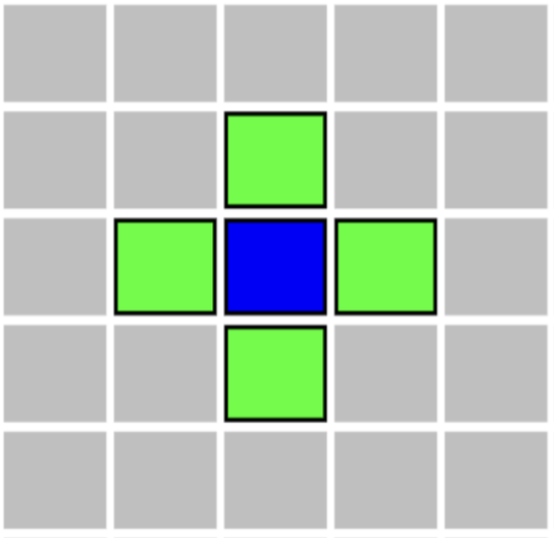
The Von Neumann Neighborhood
The simulation reads the grid using a Von Neumann neighborhood meaning cells only interact with the 4 directly adjacent squares (Up, Down, Left, Right)
1. Defining Bone Edges: If a bone cell touches an empty space in any of its 4 directions, it is painted black to create the outer wall
2. Building the Flow Field: Starting from the fracture (Value = 0), the algorithm scans outward, assigning each safe adjacent cell a distance value of +1
3. Enemy Movement: Enemies don't need complex AI. They simply scan their 4 neighbors and step onto the cell with the lowest distance value

Slide 4
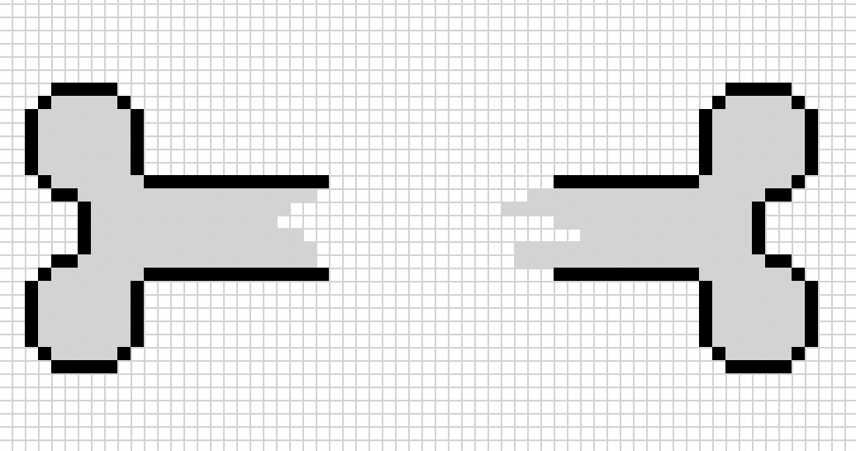
The Environment
The Grid: 100 x 100 space where three phases are simulated simultaneously: bone healing, infection spawning, and immune defense
The Bone: Located in the center, with grey representing the bone and black representing the edge. It heals progressively over time

Slide 5
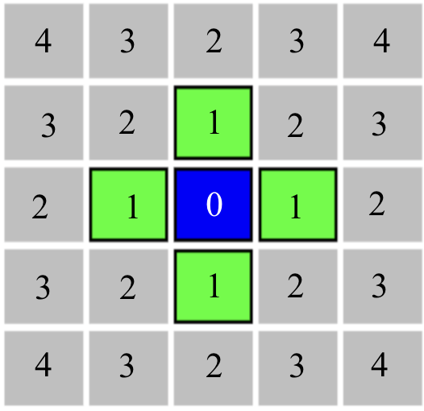
The logic: Flow-field
The Target: The center of the bone fracture is designated as the goal (Value = 0)
The Gradient: The algorithm scans outward, assigning each safe adjacent cell a distance value of +1
Smart Movement: Enemies do not need complex AI. They simply read the grid and continuously step onto the neighboring cell with the lowest value.
A continuous 3x3 clearance check ensures the 2x2 enemies safely bypass walls without clipping

Slide 6
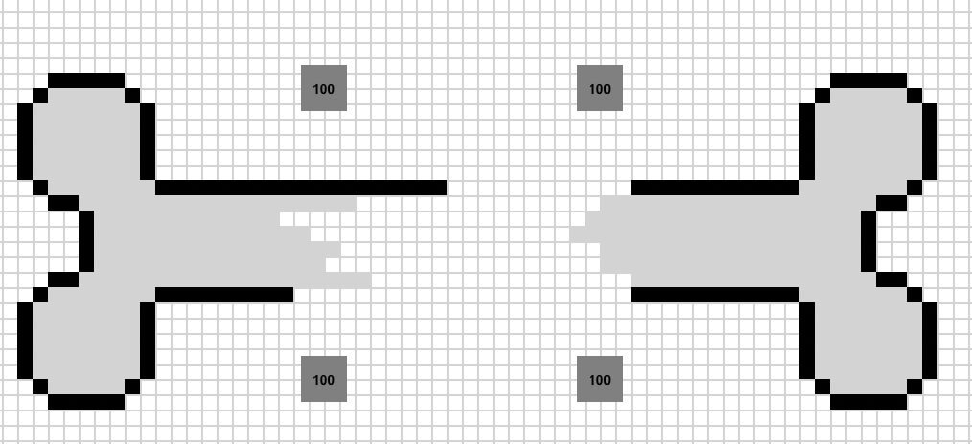
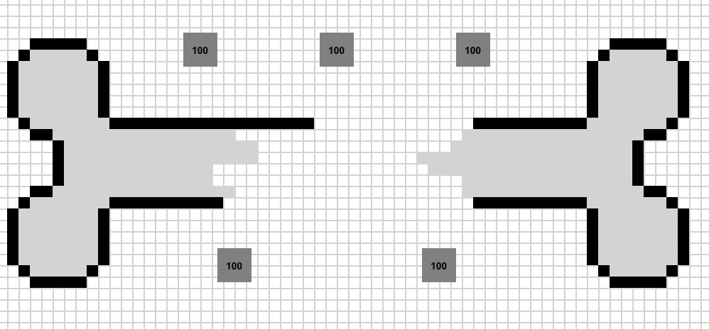
The logic: Defense
The Bone:
Placed directly in the center of the screen
Grey interior with black edges
Heals progressively over time
The Immune System (Towers):
Represented as 3x3 grey boxes
Constantly scan their radius. If an enemy steps in range, they deal damage instantly.
Distributed evenly above and below the bone shaft
If a tower dies, the towers automatically reorganize to maintain a balanced defense

Slide 7
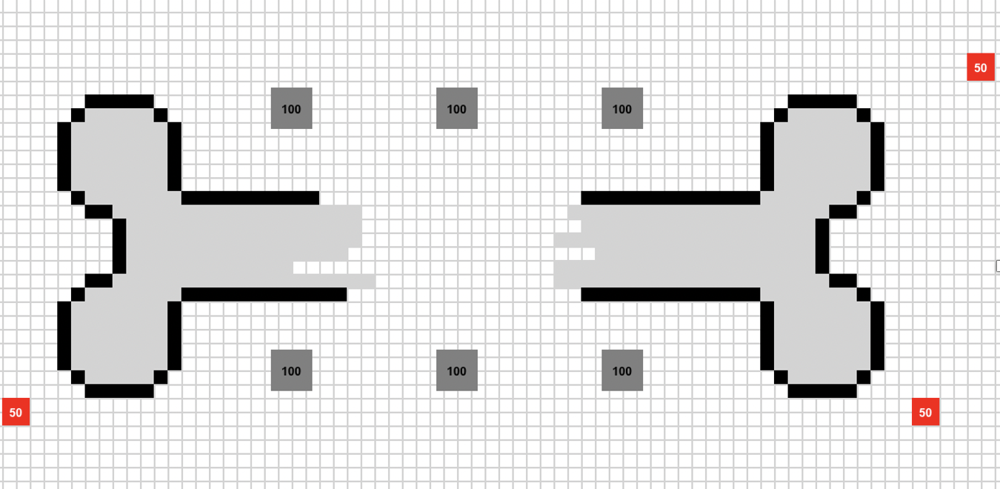
The logic: Threat
The Infection (Enemies):
Represented as 2x2 red boxes
Spawn randomly at the edges of the grid
Spawns in waves, with the spawn rate increasing over time
They must choose an action: they can either attack or move, but not both
The Infection Penalty:
If enough enemies get within a certain radius of the fracture, the bone suffers a penalty, slowing down its recovery speed

Slide 8
The logic: Spawn rate & Vaccine
Spawning (The Baseline)
Enemies don't just spawn once; they trickle in continuously, distributed evenly over a set number of ticks
To simulate a multiplying infection, the spawn rate automatically increases by a set amount after every cycle finishes
The Vaccine (The Variable)
We want to observe the effects a vaccine has on the survival and healing rate of the bone
The vaccine acts as a preemptive intervention that instantly cuts the enemy spawn rate in half

Slide 9
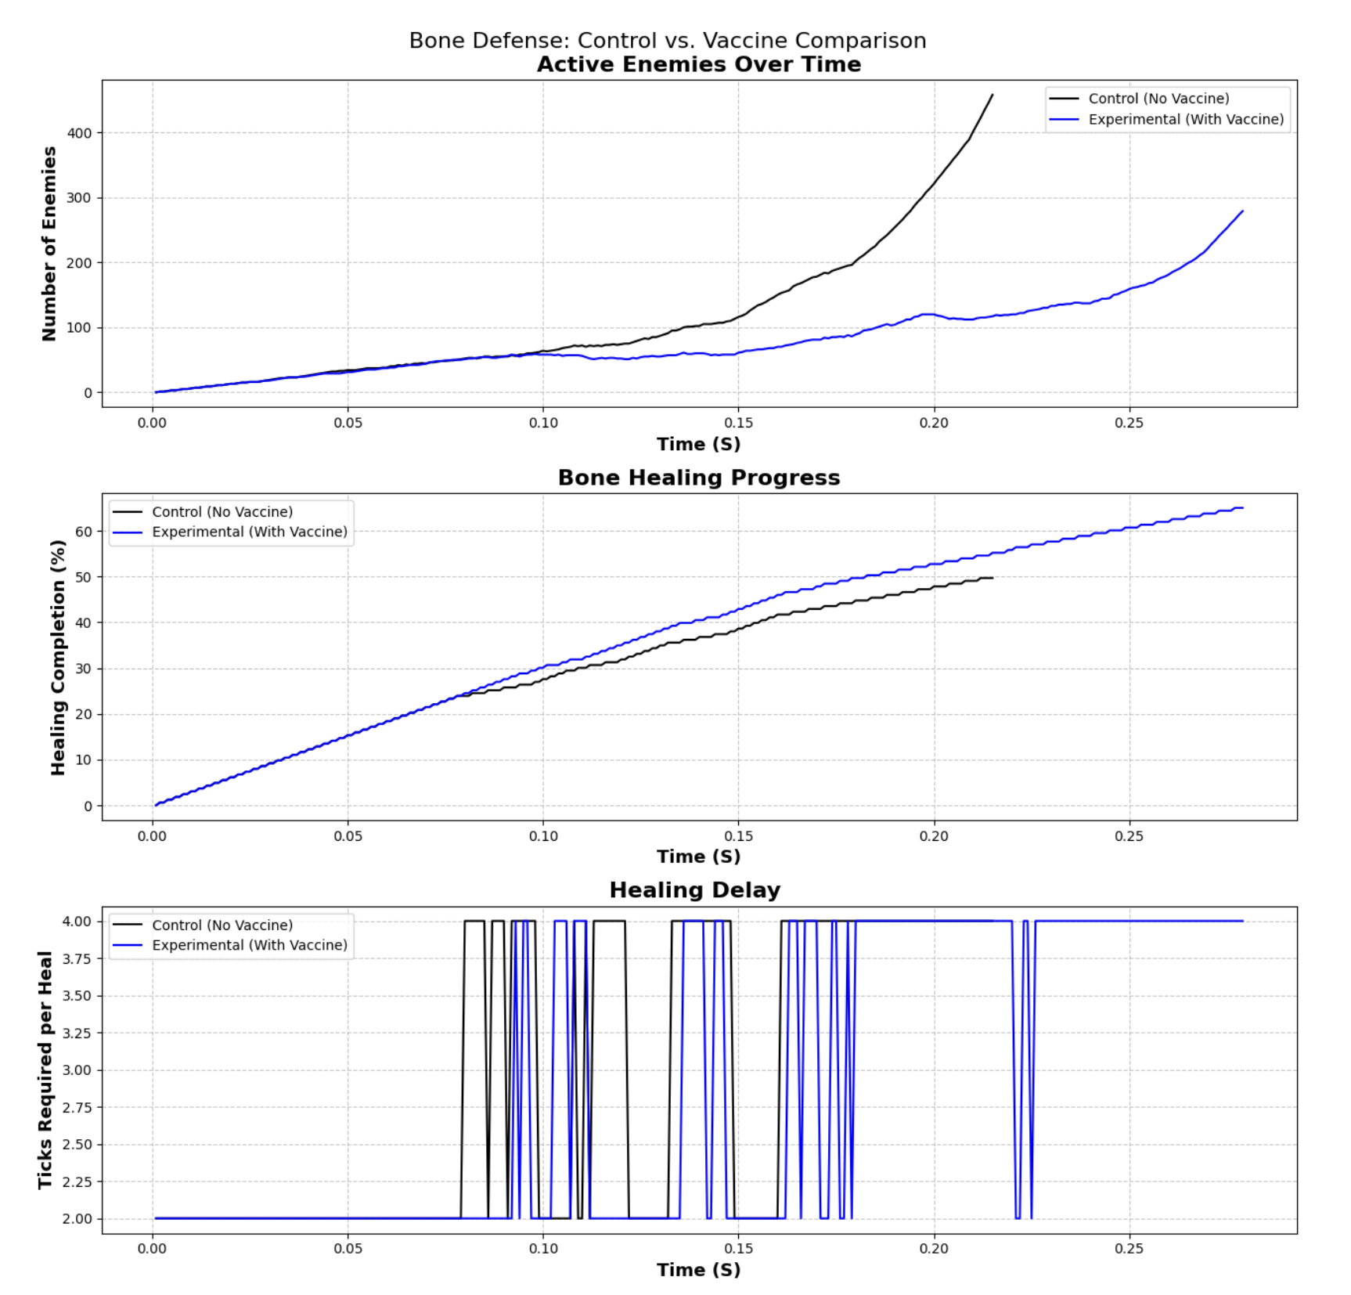
The Data

Slide 10
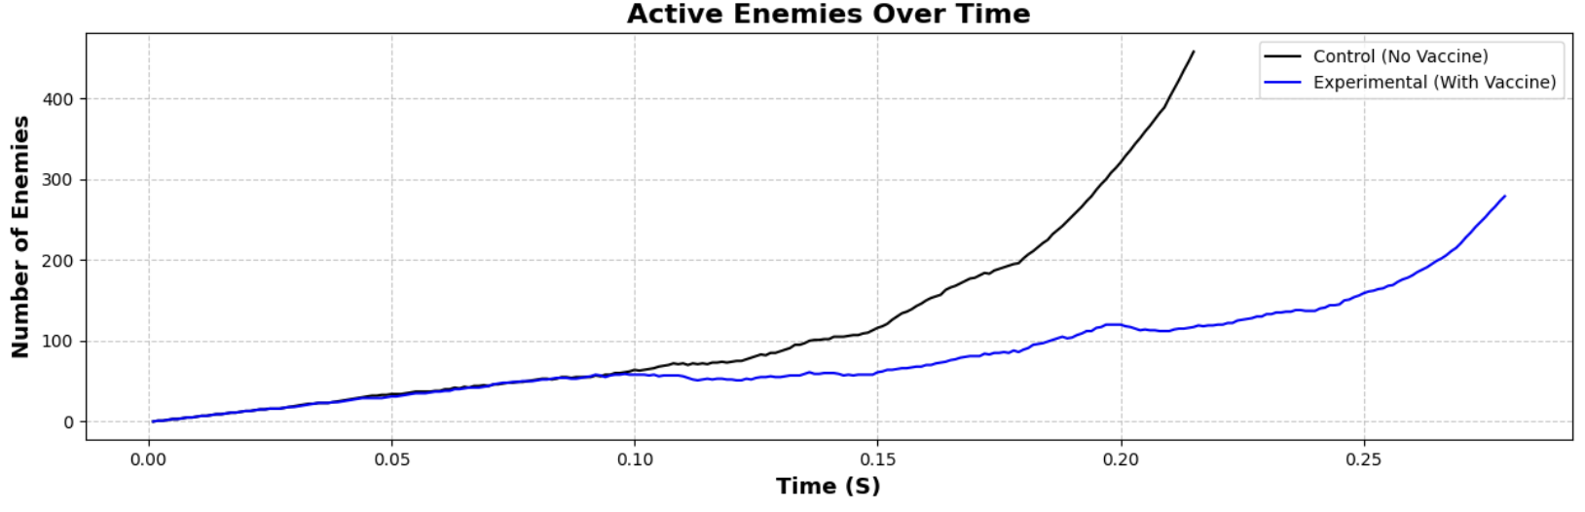

Slide 11
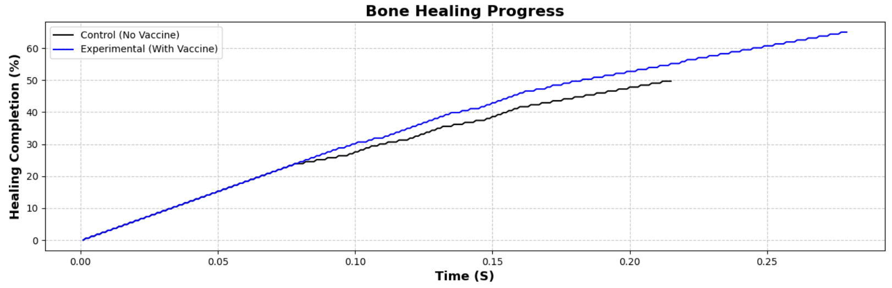

Slide 12
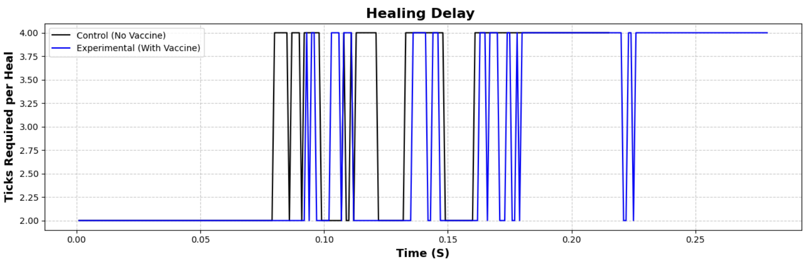

Slide 13
Limitations & Improvements
2D Environment: The current 100x100 grid simulates bone repair in two dimensions, whereas biological bone healing is a 3D process
Simplified Pathfinding: Enemies rely on a basic flow field and Von Neumann neighborhood, which may not capture complex biological movement
Linear Spawning: While wave-based, the spawn logic relies on set increments that may oversimplify the unpredictable nature of viral replication
Improved Pathfinding: Implement a changing goal state that changes as the fracture heals, rather than being a static box
Vaccine Mechanics: Change from a permanent spawn reduction to a temporary decrease that better simulates real-world function
Advanced Cell Behavior: Adding different immune cell types with unique behaviors, such as patrolling units rather than static towers

Slide 14
Thank You! Questions? Code: https://github.com/Catstrophi/BME303-Bone-Fracture-Simulation

