Slide 1



Trường Đại Học Công Nghệ Thông Tin - Khoa khoa học và kỹ thuật thông tin
ARTIFICIAL INTELLIGENCE TECHNOLOGY IN IMAGE GENERATION AND MANIPULATION
Giảng viên hướng dẫn: TS. Nguyễn Văn Kiệt
Nhóm 6
20521307 - Nguyễn Đức Hiển
21521967 - Thái Nguyễn Gia Đức
21522665 - Nguyễn Hồng Cát Thy

Slide 2
01
Introduction
Deepfake Technology: Combines "deep learning" and "fake" to create synthetic media (images, videos, audio) that appear highly realistic. Uses advanced neural networks, raising concerns about misinformation, privacy, and digital security.
Generative Models:
Generative Adversarial Networks (GANs)
Autoencoder

Slide 3
02
Related Work
Current Trends in Deepfake Technology:
GAN Architectures: StyleGAN and CycleGAN are popular but lack control over generated images. This can be addressed with conditional GANs.
Diffusion Models: Newer approach that generates images by reversing a Gaussian noise process. While effective, it is slow and resource-intensive.
Forensic Systems for Deepfake Detection:
Ensembling Systems: Combine state-of-the-art CNN architectures like EfficientNet and XceptionNet for detailed insights and improved detection accuracy. Uses two training strategies: end-to-end and siamese.

Slide 4
03
Method
Deepfake Generation:
Deepfake Detection:
Models Used: Diffusion, GAN, and DALL-E.
Datasets: LFW-Digiface-1M and Coco-captions.
Objective: Prove efficiency on Digiface-1M benchmark (Bae et al., 2022).
CNN Models: EfficientNetB4, EfficientNetB4ST, EfficientNetB4Att, EfficientNetB4AttST.
Approach: Analyze video frames individually for deepfake detection.
Goal: Improve each network's accuracy without combining networks (Bonettini et al., 2020).

Slide 5
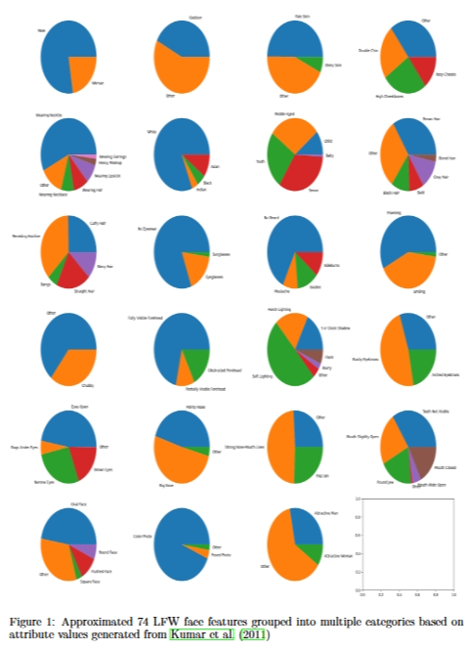
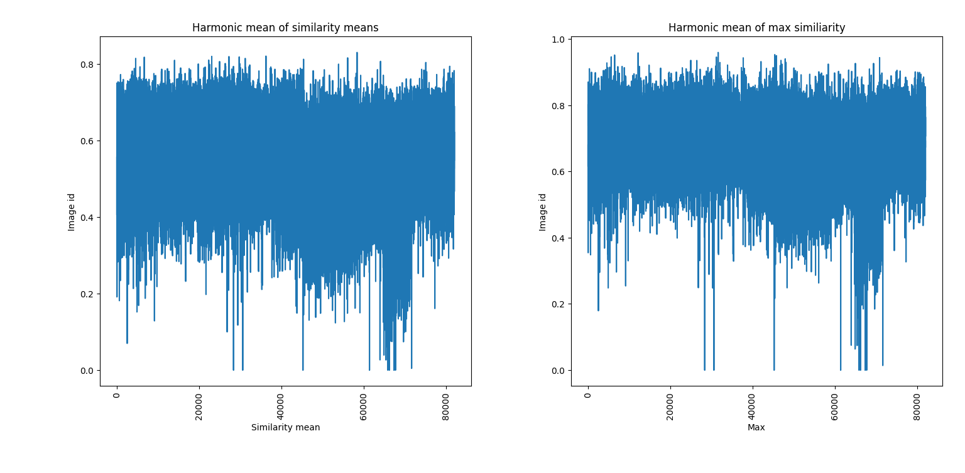
Dataset
04

Slide 6
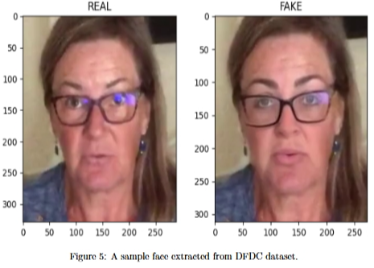
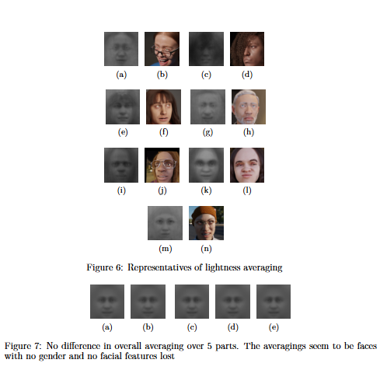
Dataset
04

Slide 7
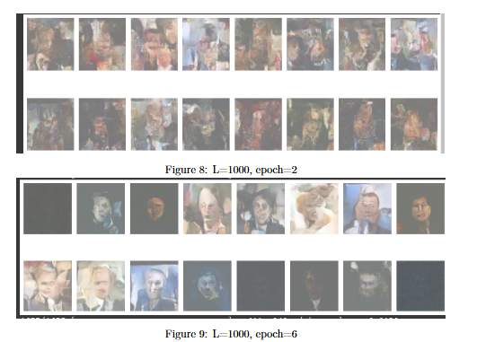
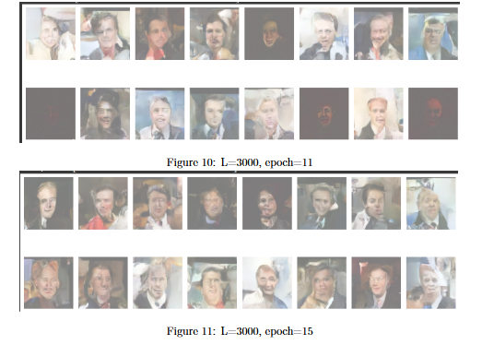
Experiments
05

Slide 8
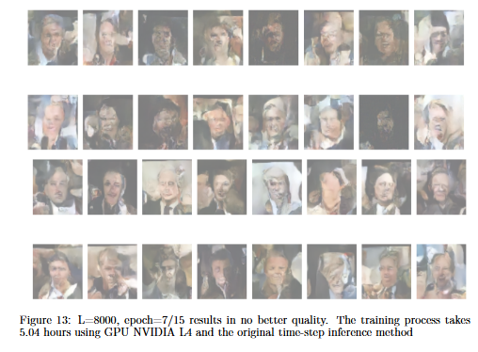
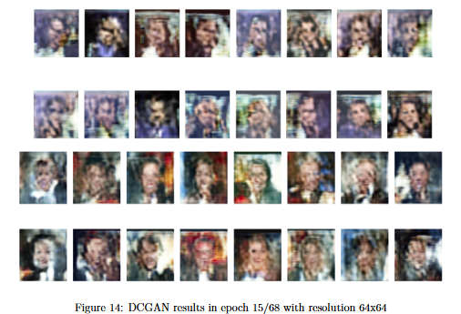
Experiments
05

Slide 9
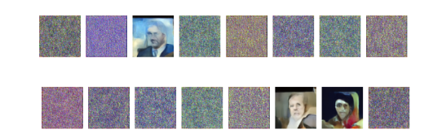
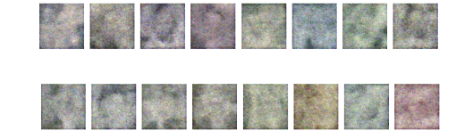
Experiments
05

Slide 10
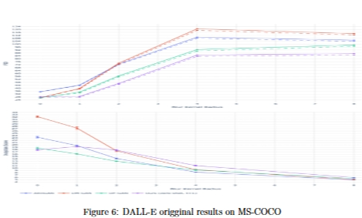
Experiments
05
-
All metrics are calculated in different blur levels
The purple curve shows improved FID of DALL-E(slightly smaller)
The purple curve also shows improved IS of DALL-E(slightly higher)

Slide 11
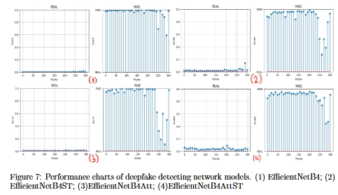
Experiments
05

Slide 12
06
Conclusion
With deepfake technology advancing rapidly, it's crucial to understand the current state of generative AI and its forensic counter-measures. This paper examines image-generating models like Diffusion, GAN, and DALL-E for deepfakes, as well as face-detecting forensic techniques in videos.
Our goal is to showcase the capabilities of both generating and detecting technologies and highlight the progress of this "arms race." Future research will focus on state-of-the-art generative AI models to improve forensic techniques, addressing the growing threat of deepfakes and generative AI misuse

Slide 13
Trường Đại Học Công Nghệ Thông Tin - Khoa khoa học và kỹ thuật thông tin
Thank You

