Slide 1
Dielectric Function
Dongying 2015/10/12

Slide 2
What is Dielectric Function
The dielectric function of a material describes the electrical and optical properties versus frequency, wavelength, or energy.
It describes the polarization and absorption properties of the material.

Slide 3

From J.A. Woollam Co. Ellipsometry Solutions

Slide 4
Classical model of Dielectric Function
Lorentz model

Slide 5
Quantum Theory of Dielectric Function

Slide 6
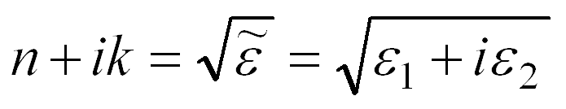
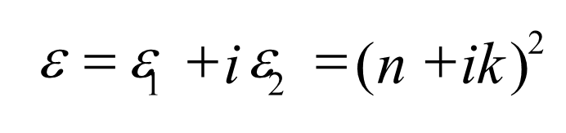
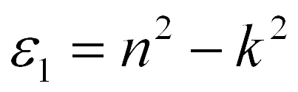
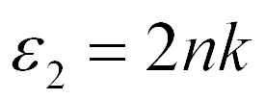
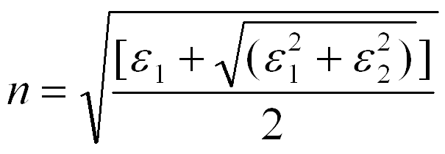
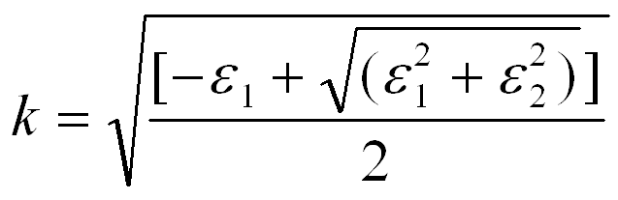
Dielectric Constant and Refractive Index

