Slide 1
Memory Virtualization Address Spaces
T07
Ch.13 of Operating Systems: Three Easy Pieces by Remzi and Andrea Arpaci-Dusseau (pages.cs.wisc.edu/~remzi/OSTEP/)
22 de agosto de 2018

Slide 2
Memory Virtualization
What is memory virtualization?
OS virtualizes the physical memory.
OS provides an illusory (aka virtual) memory space to each process.
To the process, it looks like having the whole memory (or more!) at its disposal.

Slide 3
Benefits of Memory Virtualization
Ease of use in programming
Memory efficiency in terms of time and space
A guarantee of isolation for processes as well as the OS
Protection from errant accesses of other processes

Slide 4
OS in early systems
0KB
Only one process loaded in memory each time.
Poor utilization and efficiency
Operating System
(code, data, etc.)
64KB
Current
Program
(code, data, etc.)
max
Physical Memory

Slide 5
Multiprogramming and Time Sharing
0KB
Several processes are loaded in memory at the same time.
A process is executed for a short while.
System switches cyclically among ready processes in memory.
Utilization and efficiency are increased.
An important protection issue is caused:
Errant memory accesses from other processes
Operating System
(code, data, etc.)
64KB
Free
128KB
Process C
(code, data, etc.)
192KB
Process B
(code, data, etc.)
256KB
Free
320KB
Process A
(code, data, etc.)
384KB
Free
448KB
Free
512KB
Physical Memory

Slide 6
Address Space
OS creates an abstraction of physical memory.
The address space contains all about a running process.
That consists of program code, heap, stack and etc.
0KB
Program Code
1KB
Heap
2KB
(free)
15KB
Stack
16KB
Address Space

Slide 7
Address Space (cont.)
Code
Is the area where instructions live
Heap
Dynamically allocated memory.
malloc in C language
new in object-oriented language
Stack
Keeps return addresses or values.
Contains local variables and arguments to routines.
0KB
Program Code
1KB
Heap
2KB
(free)
15KB
Stack
16KB
Address Space

Slide 8
Virtual Address Translation
Every address in a running program is virtual.
OS translates the virtual address to a physical address
Processor
Translation
Virtual Address
Raise Exception
Invalid
Valid
Physical Memory
Physical Address
Data
Data

Slide 9
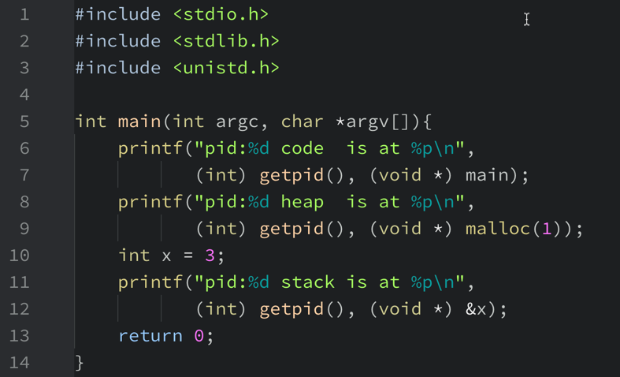
Example: a small C program that prints out addresses

Slide 10
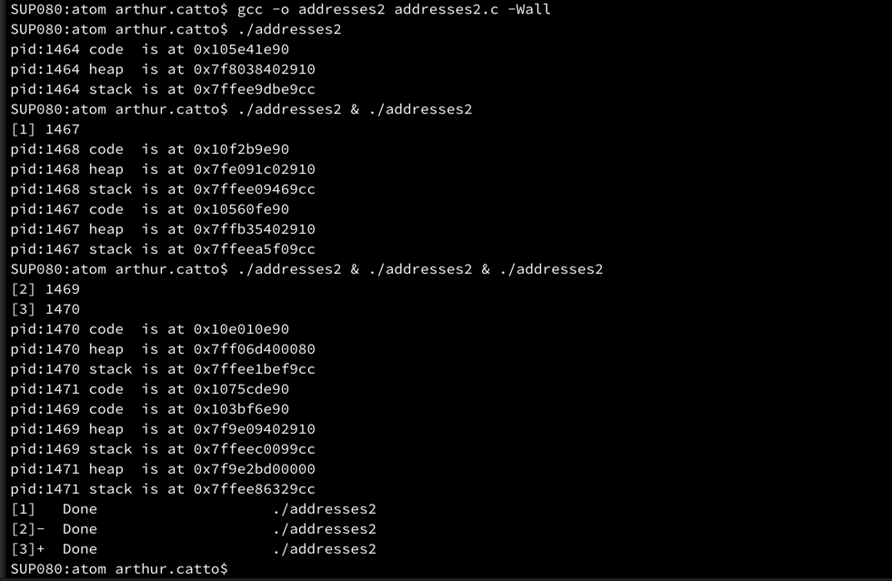
Example: a small C program that prints out addresses

Slide 11
Example: a small C program that prints out addresses

