Slide 1
Memory Virtualization Memory API
T08
Ch.14 of Operating Systems: Three Easy Pieces by Remzi and Andrea Arpaci-Dusseau (pages.cs.wisc.edu/~remzi/OSTEP/)

Slide 2
malloc()
Memory API
Allocate a memory region on the heap.
Argument
size_t size: size of the memory block(in bytes)
size_t is an unsigned integer type.
Return
Success: a void type pointer to the memory block allocated by malloc
Fail: a null pointer
#include <stdlib.h>
void* malloc(size_t size)

Slide 3
sizeof()
Memory API
Functions and macros are used to provide the size parameter in malloc instead typing in a number directly.
You may get different sizeof results even with similar variables, e.g.
The area is in the heap and its actual size is defined at run-time.
The area is in the stack and its actual size is defined at compile-time.
int *x = malloc(10 * sizeof(int));
printf(“%d %p\n”, sizeof(x), x);
8
int x[10];
printf(“%d %p\n”, sizeof(x), x);
40

Slide 4
free()
Memory API
#include <stdlib.h>
void free(void* ptr)
Free a memory region allocated by a call to malloc.
Argument
void *ptr: a pointer to a memory block allocated by malloc
Return
none

Slide 5
Memory Allocation
2K
(free)
points to
heap
Is here
stack
int *pi; // local variable
16K
pi
Address Space
2K
2K + 4
allocated
2K + 8
allocated
2K + 12
allocated
allocated
pi = (int *) malloc(sizeof(int) * 4);
(free)
2K
*pi
16KB
Address Space

Slide 6
Memory allocation on a very small machine
Example
int *pi; // local variable
pi = (int *) malloc(sizeof(int) * 4);
 | 0x1000
pi | 0x3FF8
 | 0x4000
 | Address Space
 | 0x1000
 | 0x1004
 | 0x1008
 | 0x100C
pi | 0x3FF8
 | 0x4000
 | Address Space
heap
allocated
stack
heap
stack
0x1000

Slide 7
Freeing dynamically allocated memory
Example
free(pi);
The value of pi is now invalid but is still there!
 | 0x1000
pi | 0x3FF8
 | 0x4000
 | Address Space
heap
stack
0x1000

Slide 8
Freeing dynamically allocated memory
Example
The process will be aborted if you try to free a dynamically allocated area twice.
free(pi);
free(pi);
SUP080:atom arthur.catto$ gcc free2.c -o free2
SUP080:atom arthur.catto$ ./free2
pid:28570 main is at 0x108cdce40
pid:28570 pi is at 0x7ffee6f239a8
pid:28570 size of pi is 8
pid:28570 area is at 0x7febd14028f0
free2(28570,0x1113ca580) malloc: *** error for object 0x7febd14028f0: pointer being freed was not allocated
free2(28570,0x1113ca580) malloc: *** set a breakpoint in malloc_error_break to debug
Abort trap: 6

Slide 9
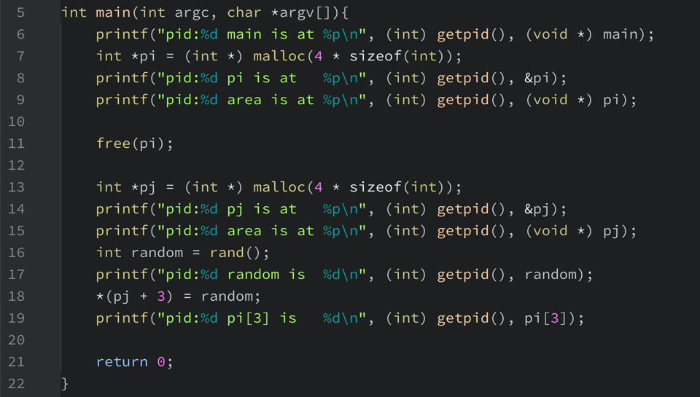
Freeing dynamically allocated memory
Example
What happens when you reuse a pointer that has been freed?

Slide 10
Freeing dynamically allocated memory
Example
What happens when you reuse a pointer that has been freed?
The system may be quite willing to do it!
SUP080:atom arthur.catto$ gcc free3.c -o free3
SUP080:atom arthur.catto$ ./free3
pid:28753 main is at 0x10e5e1da0
pid:28753 pi is at 0x7ffee161e9a8
pid:28753 area is at 0x7f9b464028f0
pid:28753 pj is at 0x7ffee161e9a0
pid:28753 area is at 0x7f9b464028f0
pid:28753 random is 16807
pid:28753 pi[3] is 16807

Slide 11
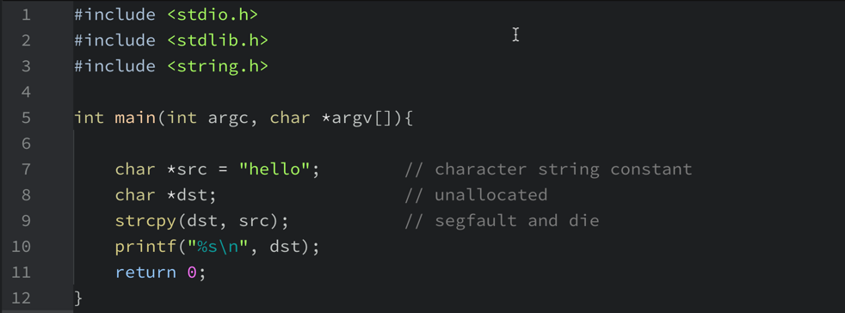

Forgetting to Allocate Memory
Incorrect code
Common mistakes

Slide 12
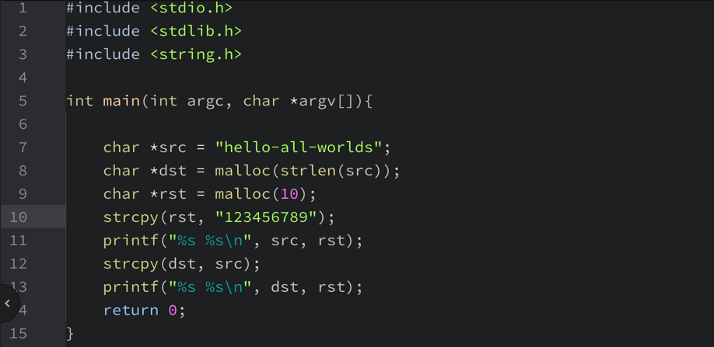
Not Allocating Enough Memory
Incorrect code, but work properly
Common mistakes
What’s the output of this program?

Slide 13
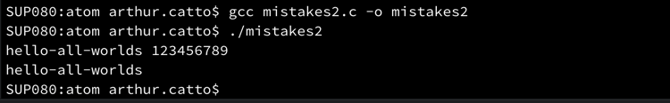
Not Allocating Enough Memory
Incorrect code, but work properly
Common mistakes
Where has rst gone?

Slide 14
Forgetting to Initialize
Encounter an uninitialized read
int *x = (int *)malloc(sizeof(int)); // allocated
printf(“*x = %d\n”, *x); // uninitialized memory access
value used before
(free)
allocated
with value used before
(free)
(free)
heap
heap
stack
stack
*x
*x
Address Space
Address Space

Slide 15
Memory Leak
A program runs out of memory and eventually dies.
unused
: unused, but not freed
allocated
unused
unused
(free)
allocated
unused
(free)
unused
heap
heap
heap
allocated
stack
(free)
stack
*d
*c
*b
*b
*a
*a
*a
Address Space
Address Space
Address Space

Slide 16
Dangling Pointer
Freeing memory that is still needed
A program accesses memory with an invalid pointer
*b
*b
free()
unreachable
*a
*a
dangling pointer
2KB
3KB
2KB
3KB
3KB
4KB
3KB
free(b)
freed
4KB
4KB
NULL
NULL
(free)
Heap
Heap
(free)
Stack
Stack
*b
3KB
*b
3KB
*a
2KB
*a
2KB
Address Space
Address Space

Slide 17
calloc()
Other Memory APIs
#include <stdlib.h>
void *calloc(size_t num, size_t size)
Allocate memory on the heap and zeroes it before returning.
Argument
size_t num : number of blocks to allocate
size_t size : size of each block(in bytes)
Return
Success: a void type pointer to the memory block allocated by calloc
Fail: a null pointer

Slide 18
Double Free
Free memory that was freed already.
int *x = (int *)malloc(sizeof(int)); // allocated
free(x); // free memory
free(x); // free repeatedly
2KB
allocated
2KB
freed
(free)
(free)
Heap
Heap
free(x)
free(x)
Undefined Error
Stack
Stack
16KB
2KB
*x
16KB
2KB(invalid)
*x
Address Space
Address Space
Address Space

Slide 19
realloc()
Other Memory APIs
Change the size of memory block.
A pointer returned by realloc may be either the same as ptr or a new one.
Argument
void *ptr: Pointer to memory block allocated with malloc, calloc or realloc
size_t size: New size for the memory block(in bytes)
Return
Success: Void type pointer to the memory block
Fail : Null pointer
#include <stdlib.h>
void *realloc(void *ptr, size_t size)

