Slide 1
Memory Virtualization Smaller Page Tables
T13
Ch.20 of Operating Systems: Three Easy Pieces by Remzi and Andrea Arpaci-Dusseau (pages.cs.wisc.edu/~remzi/OSTEP/)

Slide 2
Efficient Address Translation
The impact of multiple memory accesses can be reduced using a special fast-lookup hardware cache (associative memory) called translation lookaside buffer.
Translation lookaside buffer (TLB)
Cache of recent virtual page ⇢ physical page translations
If cache hit, use translation
If cache miss, walk multi-level page table
Cost of translation = Cost of TLB lookup + prob(TLB miss) * cost of page table lookup

Slide 3
TLB and Page Table Translation

Slide 4
TLB Lookup

Slide 5

Effective Access Time
Assume memory cycle time = $1$ time unit
Assume associative lookup = $ε$ time units
Assume hit ratio = $α$
Hit ratio is the proportion of times that a page number is found in the associative registers
Hit ratio is related to program locality and number of associative registers
Effective Access Time ($\text{EAT}$)
$\text{EAT}=\left(1+ε\right)α+\left(2+ε\right)\left(1−α\right)=2+ε−α$
$\text{For} ε=0.2 \text{and} α=0.80\text{, }\text{EAT}=1.40$
$\text{For} ε=0.2 \text{and} α=0.98\text{, }\text{EAT}=1.22$
What does it mean?
$$\text{EAT}=\left(1+ε\right)α+\left(2+ε\right)\left(1−α\right)=2+ε−α$$
$$\text{EAT}=\left(1+ε\right)α+\left(2+ε\right)\left(1−α\right)=2+ε−α$$
$$\text{EAT}=\left(1+ε\right)α+\left(2+ε\right)\left(1−α\right)=2+ε−α$$
$$\text{EAT}=\left(1+ε\right)α+\left(2+ε\right)\left(1−α\right)=2+ε−α$$
$$\text{EAT}=\left(1+ε\right)α+\left(2+ε\right)\left(1−α\right)=2+ε−α$$

Slide 6
Another big issue with Paging
We’ve already treated the extra access to memory that paging requires.
Now we will address another big issue: the size of the page tables.
The smaller the tables, the more of them we can have in memory at the same time.
Linear, i.e. array-based, page tables take too much memory on typical systems.
Can they be made smaller?
What would be the key ideas?
What inefficiencies may arise as a result of such design decisions?

Slide 7
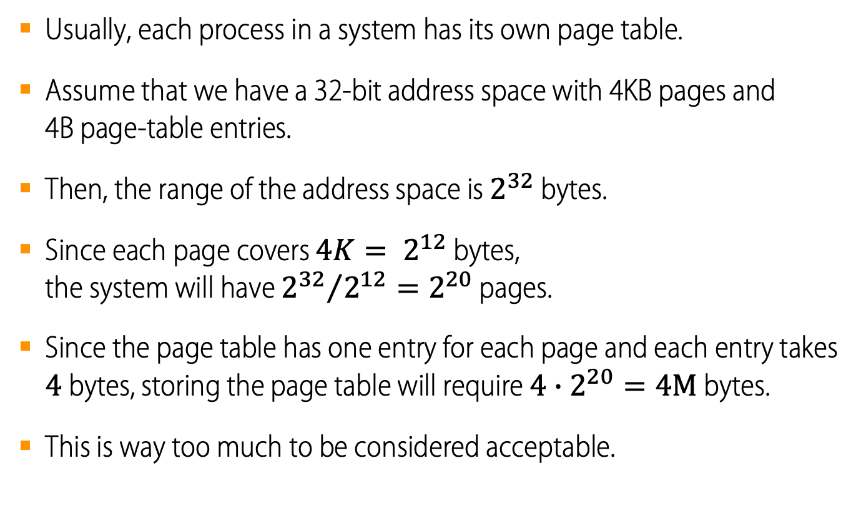
Small Pages lead to Big Page Tables
Usually, each process in a system has its own page table.
Assume that we have a 32-bit address space with 4KB pages and 4B page-table entries.
Then, the range of the address space is $2^{32}$ bytes.
Since each page covers $4K= 2^{12}$ bytes, the system will have ${2^{32}}/{2^{12}=2^{20}}$ pages.
Since the page table has one entry for each page and each entry takes $4$ bytes, storing the page table will require ${4∙2}^{20}=4M$ bytes.
This is way too much to be considered acceptable.

Slide 8
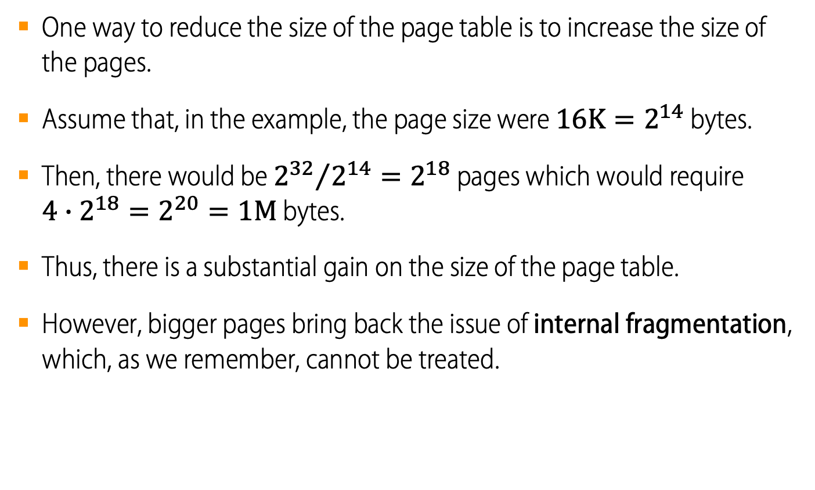
Larger Pages lead to Smaller Page Tables, but…
One way to reduce the size of the page table is to increase the size of the pages.
Assume that, in the example, the page size were $16K=2^{14}$ bytes.
Then, there would be ${2^{32}}/{2^{14}=2^{18}}$ pages which would require $4∙2^{18}=2^{20}=1M$ bytes.
Thus, there is a substantial gain on the size of the page table.
However, bigger pages bring back the issue of internal fragmentation, which, as we remember, cannot be treated.

Slide 9
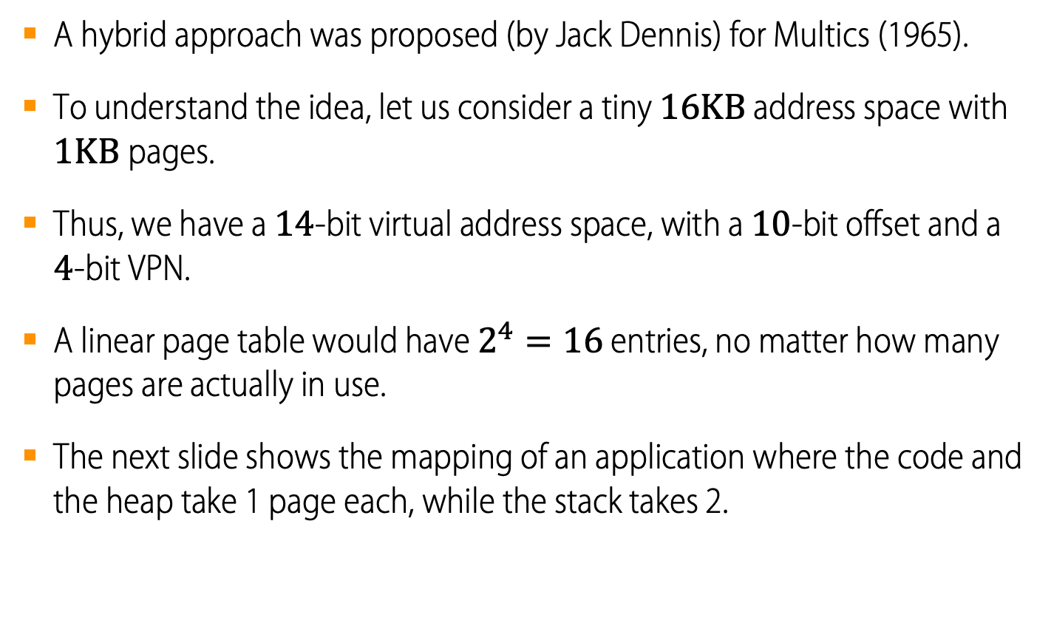
Pages and Segments: a Hybrid Approach
A hybrid approach was proposed (by Jack Dennis) for Multics (1965).
To understand the idea, let us consider a tiny $16KB$ address space with $1KB$pages.
Thus, we have a $14$-bit virtual address space, with a $10$-bit offset and a $4$-bit VPN.
A linear page table would have $2^{4}=16$ entries, no matter how many pages are actually in use.
The next slide shows the mapping of an application where the code and the heap take 1 page each, while the stack takes 2.
A 16KB Address Space with 1KB Pages

Slide 10
The example mapped by a linear page table
Physical memory
 | 0
 | 1
 | 2
 | 3
 | 4
 | 5
 | 6
 | 7
 | 8
 | 9
 | 10
 | 11
 | 12
 | 13
 | 14
 | 15
 | 16
 | 17
 | 18
 | 19
 | 20
 | 21
 | 22
 | 23
 | 24
 | 25
 | 26
 | 27
 | 28
 | 29
 | 30
 | 31
The associated linear page table
VPN | PFN | valid | prot | present | dirty
0 | 10 | 1 | r-x | 1 | 0
1 |  | 0
2 |  | 0
3 |  | 0
4 | 23 | 1 | rw- | 1 | 1
5 |  | 0
6 |  | 0
7 |  | 0
8 |  | 0
9 |  | 0
10 |  | 0
11 |  | 0
12 |  | 0
13 |  | 0
14 | 28 | 1 | rw- | 1 | 1
15 | 4 | 1 | rw- | 1 | 1
Virtual address space
code |  | 0
 |  | 1
 |  | 2
 |  | 3
heap |  | 4
 |  | 5
 |  | 6
 |  | 7
 |  | 8
 |  | 9
 |  | 10
 |  | 11
 |  | 12
 |  | 13
 |  | 14
stack |  | 15
A 16KB Address Space with 1KB Pages

Slide 11
The example mapped by a linear page table
Physical memory
 | 0
 | 1
 | 2
 | 3
 | 4
 | 5
 | 6
 | 7
 | 8
 | 9
 | 10
 | 11
 | 12
 | 13
 | 14
 | 15
 | 16
 | 17
 | 18
 | 19
 | 20
 | 21
 | 22
 | 23
 | 24
 | 25
 | 26
 | 27
 | 28
 | 29
 | 30
 | 31
The associated linear page table
VPN | PFN | valid | prot | present | dirty
0 | 10 | 1 | r-x | 1 | 0
1 |  | 0
2 |  | 0
3 |  | 0
4 | 23 | 1 | rw- | 1 | 1
5 |  | 0
6 |  | 0
7 |  | 0
8 |  | 0
9 |  | 0
10 |  | 0
11 |  | 0
12 |  | 0
13 |  | 0
14 | 28 | 1 | rw- | 1 | 1
15 | 4 | 1 | rw- | 1 | 1
Virtual address space
code |  | 0
 |  | 1
 |  | 2
 |  | 3
heap |  | 4
 |  | 5
 |  | 6
 |  | 7
 |  | 8
 |  | 9
 |  | 10
 |  | 11
 |  | 12
 |  | 13
 |  | 14
stack |  | 15
Most of the page table remains unused, full of invalid entries.
A 16KB Address Space with 1KB Pages

Slide 12
Paged Segmentation: a Hybrid Approach
To conserve space, the idea is to split the address space in a few segments and then use paging to map those segments onto physical memory.
For example, if we assume a 32-bit address space, up to 4 segments and 4KB pages, a virtual address could be interpreted as
Now, how would we map that onto physical memory?
First, let us extract the the virtual address components
SN = (VirtualAddress & SEG_MASK) >> SN_SHIFT
VPN = (VirtualAddress & VPN_MASK) >> VPN_SHIFT
Offset = (VirtualAddress & OFFSET_MASK)
31 | 30 | 29 | 28 | 27 | 26 | 25 | 24 | 23 | 22 | 21 | 20 | 19 | 18 | 17 | 16 | 15 | 14 | 13 | 12 | 11 | 10 | 9 | 8 | 7 | 6 | 5 | 4 | 3 | 2 | 1 | 0
SN
VPN
Offset

Slide 13
Paged Segmentation: a Hybrid Approach
Each segment refers to a particular data section, e.g.
Now let us create an “array” of Base/Bounds registers, so that
Base[SN] is the base address of a linear page table for this segment
Bounds[SN] is the length of the linear page table associated with this segment
This enables us to calculate the address of the page table entry associated to any virtual address
AddressOfPTE = Base[SN] + (VPN * sizeof(PTE))
Actually, this does not work for the stack because it grows upwards, but we’ll take care of that later.
The contents of AddressOfPTE is the PFN of the frame that holds that page.
A possible mapping of the former example is shown on the next slide.
SEG | Content
0 (00₂) | unused
1 (01₂) | code
2 (10₂) | heap
3 (11₂) | stack

Slide 14
The example mapped by a hybrid model
Physical memory
 | 0
 | 1
 | 2
 | 3
 | 4
 | 5
 | 6
 | 7
 | 8
 | 9
 | 10
 | 11
 | 12
 | 13
 | 14
 | 15
 | 16
 | 17
 | 18
 | 19
 | 20
 | 21
 | 22
 | 23
 | 24
 | 25
 | 26
 | 27
 | 28
 | 29
 | 30
 | 31
Virtual address space
The associated linear page tables
Base
 | 0
 | 1
 | 2
 | 3
code |  | 0
 |  | 1
 |  | 2
 |  | 3
heap |  | 4
 |  | 5
 |  | 6
 |  | 7
 |  | 8
 |  | 9
 |  | 10
 |  | 11
 |  | 12
 |  | 13
 |  | 14
stack |  | 15
 | PFN | valid | prot | prsnt | dirty
VPN 0 | 10 | 1 | r-x | 1 | 0
 | PFN | valid | prot | prsnt | dirty
VPN 0 | 23 | 1 | rw- | 1 | 1
Bounds
 | 0
1 | 1
1 | 2
2 | 3
 | PFN | valid | prot | prsnt | dirty
VPN 0 | 28 | 1 | rw- | 1 | 1
1 | 4 | 1 | rw- | 1 | 1
No wasted space in the page table anymore.
But variable space allocation is back again.
A 16KB Address Space with 1KB Pages

Slide 15
Paged Segmentation Implementation using a Segment Table
Physical Memory

Slide 16
Issues with the Hybrid Approach
The hybrid approach is not without issues.
Internal fragmentation
If there is a large but sparsely-used heap, we can still end up with a lot of wasted space inside its page table.
External fragmentation
Since the size of the page tables is variable, they may have to be relocated, which may lead to external fragmentation.
For reasons like these, people continued to look for better ways to implement smaller page tables.
Can we get rid of all those invalid regions in the page table instead of keeping them all in memory?

Slide 17
Looking for Another Page Table Structure
Critical issues in page table design
Page table size
Search efficiency
Common workarounds
Hierarchical Paging
Hashed Page Tables
Inverted Page Tables

Slide 18
Hierarchichal Page Tables
To avoid the variable space issue we change course and will try to page the page table itself.
This approach turns the linear page table into something like a tree that we call a hierarchical or multi-level page table.
Chop up the page table into page-sized units.
If an entire page of page-table entries is invalid, don’t allocate that page of the page table at all.
To track whether a page of the page table is valid, and in this case where it is, use a new structure, called a page directory.
This approach is so effective that many modern systems (e.g. x86) employ it.

Slide 19
Hierarchical Page Tables
Break up the virtual address space into multiple page tables.
A simple technique uses a two-level page table.
page number
p₁
p₂
page offset
d
virtual address

Slide 20
Two-Level Paging Example
On a 32-bit machine with 4KB page size, a virtual address is divided into
a 20-bit page number
a 12-bit page offset
Since the page table is paged, and assuming that a page table entry takes 4 bytes, the page number can be further divided in
a 10-bit outer page number
a 10-bit inner page number
Thus, a virtual address is as follows:
where
p₁ is an index into the outer page table, and
p₂ is the inner page number and gives the offset within the page of the outer page table.
page number |  | page offset
p₁ | p₂ | d
10 bits | 10 bits | 12 bits

Slide 21
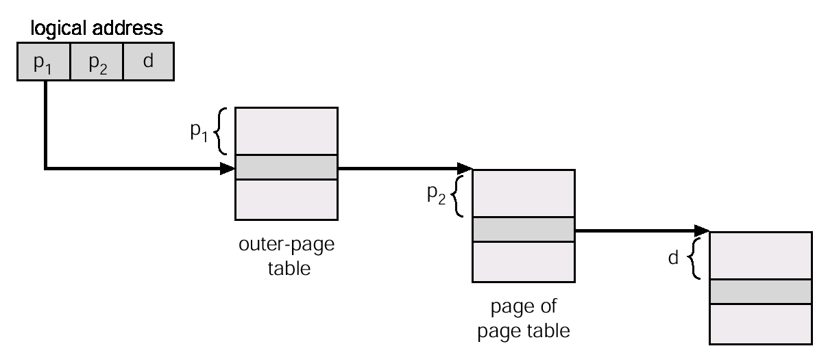
Two-level paging address translation
Address-translation scheme for a two-level 32-bit paging architecture
virtual address

Slide 22
Linear and Multi-Level Page Tables
Linear Page Table
Two-level Page Table
PTBR | 201
PDBR | 200
 | valid | prot | PFN
 | 1 | rx | 12 | PFN 201
 | 1 | rx | 13
 | 0 | — | —
 | 1 | rw | 100
 | 0 | — | — | PFN 202
 | 0 | — | —
 | 0 | — | —
 | 0 | — | —
 | 0 | — | — | PFN 203
 | 0 | — | —
 | 0 | — | —
 | 0 | — | —
 | 0 | — | — | PFN 204
 | 0 | — | —
 | 1 | rw | 86
 | 1 | rw | 15
 | valid | prot | PFN
 | 1 | rx | 12 | PFN 201
 | 1 | rx | 13
 | 0 | — | —
 | 1 | rw | 100
 | valid | PFN
PFN 200 | 1 | 201
 | 0 | —
 | 0 | —
 | 1 | 204
Pages 1 and 2 of PT are not allocated
Page Directory
 | valid | prot | PFN
 | 0 | — | — | PFN 204
 | 0 | — | —
 | 1 | rw | 86
 | 1 | rw | 15

Slide 23
Structure of a Two-level Page Table
The page directory contains one entry per page of the page table.
It consists of a number of page directory entries (PDE).
Each PDE contains a valid bit and a Page Frame Number (PFN).
The valid bit is set to indicate that at least one of the pages of the page table pointed to the PFN has its valid bit set as well.
If the valid bit is not set, a page table has not been allocated and the rest of the PDE is not defined.

Slide 24
Hierachical Page Tables: Pros & Cons
Advantages
Only allocates page-table space in proportion to the amount of address space you are using.
If carefully designed to accommodate each portion of the page table within a page, the OS can grab any free page when it needs to allocate or grow a page table.
Disadvantages
The page directories add at least one level of indirection and a time-penalty on every TLB miss. Thus, multi-level page tables are a small example of a time-space trade-off.
Complexity, since handling the page-table lookup on a TLB miss is clearly more involved than a simple linear page-table lookup.

Slide 25
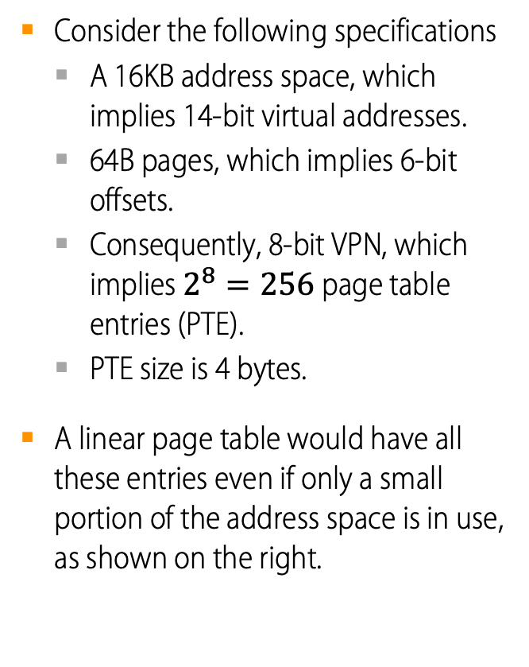
A Detailed Multi-Level Example
Consider the following specifications
A 16KB address space, which implies 14-bit virtual addresses.
64B pages, which implies 6-bit offsets.
Consequently, 8-bit VPN, which implies $2^{8}=256$ page table entries (PTE).
PTE size is 4 bytes.
A linear page table would have all these entries even if only a small portion of the address space is in use, as shown on the right.
0 (0000 0000) | code
1 (0000 0001) | code
2 (0000 0010) | (free)
3 (0000 0011) | (free)
4 (0000 0100) | heap
5 (0000 0101) | heap
6 (0000 0110) | (free)
7 (0000 0111) | (free)
 | … all free …
252 (1111 1100) | (free)
253 (1111 1101) | (free)
254 (1111 1110) | stack
255 (1111 1111) | stack

Slide 26
A Detailed Multi-Level Example: Page Directory Idx
The format of a virtual address in our example is
Page size is 64B and PTE size is 4B. So, a page can hold 16 PTEs, which leads to a 4-bit Inner Page Number.
The remaining top-most 4 bits will give the Page Directory Index.
Each Directory Entry will have an invalid bit which, if set, will cause an exception to be raised if we try to access any of the related inner pages.
13 | 12 | 11 | 10 | 9 | 8 | 7 | 6 | 5 | 4 | 3 | 2 | 1 | 0
VPN
Offset
Page Directory Index
Inner Page Number
13 | 12 | 11 | 10 | 9 | 8 | 7 | 6 | 5 | 4 | 3 | 2 | 1 | 0
VPN
Offset

Slide 27
A Detailed Multi-Level Example: Page Table Idx
If the PDE is valid, we have more work to do to fetch the page table entry (PTE) from the page of the page table pointed to by this page-directory entry.
This page-table index can then be used to index into the page table itself.
Page Directory Index
Page Table Index
13 | 12 | 11 | 10 | 9 | 8 | 7 | 6 | 5 | 4 | 3 | 2 | 1 | 0
VPN
Offset

Slide 28
Hierarchical Page Tables with More than Two Levels
In some cases, a deeper tree is possible…
Flag | Detail
Virtual address | 30 bits
Page size | 512 bytes
Offset | 9 bits
VPN | 21 bits
29 | 28 | 27 | 26 | 25 | 24 | 23 | 22 | 21 | 20 | 19 | 18 | 17 | 16 | 15 | 14 | 13 | 12 | 11 | 10 | 9 | 8 | 7 | 6 | 5 | 4 | 3 | 2 | 1 | 0
VPN
offset

Slide 29

More than Two Levels: Page Table Index
In some cases, a deeper tree is possible.
Flag | Detail
Virtual address | 30 bit
Page size | 512 byte
VPN | 21 bit
Offset | 9 bit
Page entry per page | 128 PTEs
$$\log_{2}{128=7}$$
29 | 28 | 27 | 26 | 25 | 24 | 23 | 22 | 21 | 20 | 19 | 18 | 17 | 16 | 15 | 14 | 13 | 12 | 11 | 10 | 9 | 8 | 7 | 6 | 5 | 4 | 3 | 2 | 1 | 0
Page Directory Index
Page Table Index
VPN
offset

Slide 30
More than Two Levels: Page Directory
If our page directory has $2^{14}$entries, it spans not one page but 128.
To remedy this problem, we build a further level of the tree, by splitting the page directory itself into multiple pages of the page directory.
29 | 28 | 27 | 26 | 25 | 24 | 23 | 22 | 21 | 20 | 19 | 18 | 17 | 16 | 15 | 14 | 13 | 12 | 11 | 10 | 9 | 8 | 7 | 6 | 5 | 4 | 3 | 2 | 1 | 0
PD Index 0
PD Index 1
Page Table Index
VPN
offset

Slide 31
Multilevel Paging Implementation
Physical Memory

Slide 32
Multi-level Page Table Control Flow
01: VPN = (VirtualAddress & VPN_MASK) >> SHIFT
02: (Success,TlbEntry) = TLB_Lookup(VPN)
03: if(Success == True) //TLB Hit
04: if(CanAccess(TlbEntry.ProtectBits) == True)
05: Offset = VirtualAddress & OFFSET_MASK
06: PhysAddr = (TlbEntry.PFN << SHIFT) | Offset
07: Register = AccessMemory(PhysAddr)
08: else RaiseException(PROTECTION_FAULT);
09: else // perform the full multi-level lookup
(1 lines) extract the virtual page number(VPN)
(2 lines) check if the TLB holds the transalation for this VPN
(5-8 lines) extract the page frame number from the relevant TLB entry, and form the desired physical address and access memory

Slide 33
Multi-level Page Table Control Flow
11: else
12: PDIndex = (VPN & PD_MASK) >> PD_SHIFT
13: PDEAddr = PDBR + (PDIndex * sizeof(PDE))
14: PDE = AccessMemory(PDEAddr)
15: if(PDE.Valid == False)
16: RaiseException(SEGMENTATION_FAULT)
17: else // PDE is Valid: now fetch PTE from PT
(11 lines) extract the Page Directory Index(PDIndex)
(13 lines) get Page Directory Entry(PDE)
(15-17 lines) Check PDE valid flag. If valid flag is true, fetch Page Table entry from Page Table

Slide 34
The Translation Process: Remember the TLB
18: PTIndex = (VPN & PT_MASK) >> PT_SHIFT
19: PTEAddr = (PDE.PFN << SHIFT) + (PTIndex * sizeof(PTE))
20: PTE = AccessMemory(PTEAddr)
21: if(PTE.Valid == False)
22: RaiseException(SEGMENTATION_FAULT)
23: else if(CanAccess(PTE.ProtectBits) == False)
24: RaiseException(PROTECTION_FAULT);
25: else
26: TLB_Insert(VPN, PTE.PFN , PTE.ProtectBits)
27: RetryInstruction()

Slide 35
Another Alternative: Hashed Page Tables
Common in address spaces > 32 bits.
Page number is hashed into a page table.
This page table contains a chain of elements hashing to the same location.
Page numbers are compared in this chain searching for a match.
If a match is found, the corresponding frame is extracted.

Slide 36
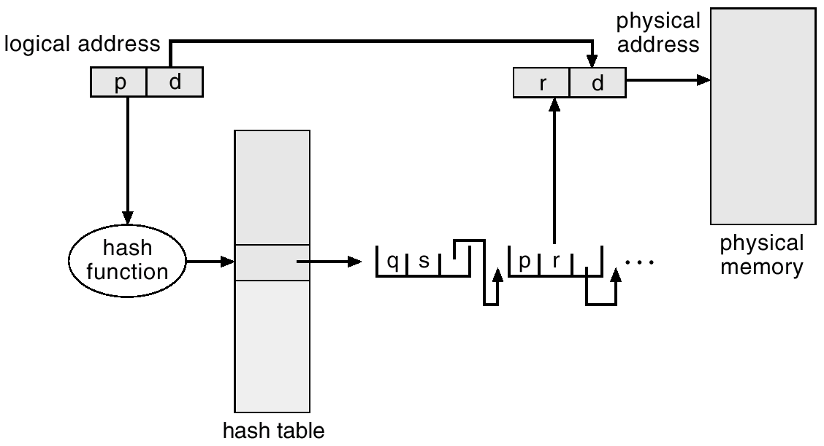
Hashed Page Table

Slide 37
Another Alternative: Inverted Page Table
Keeping a single page table that has an entry for each physical frame of the system memory.
Entry consists of the number of the page stored in that frame plus data about the process that owns that page.
Decreases memory needed to store each page table, but increases time needed to search the table when a page reference occurs.
Use hash table to limit the search to at most a few page-table entries.

Slide 38
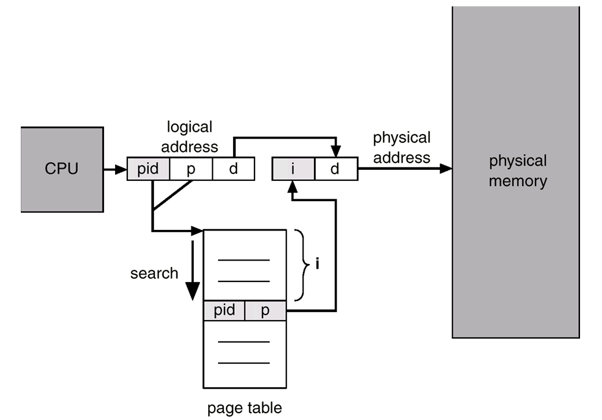
Inverted Page Table Architecture
physical memory
CPU
i

