Slide 1
Beyond Physical Memory Swapping Policies
T15
Ch.22 of Operating Systems: Three Easy Pieces by Remzi and Andrea Arpaci-Dusseau (pages.cs.wisc.edu/~remzi/OSTEP/)
17 de setembro de 2018

Slide 2
Beyond Physical Memory: Policies
Memory pressure forces the OS to start paging out pages to make room for actively-used pages.
Deciding which page to evict is encapsulated within the replacement policy of the OS.

Slide 3
Process Creation: Copy-on-Write
Copy-on-write provides for rapid process creation and minimizes the number of new pages that must be allocated to a new process.
Parent and child processes initially share same pages in memory.
When either process modifies a shared page, that page is copied.
COW allows more efficient process creation as only modified pages are copied.
Free pages are usually allocated by the OS from a pool of zero-filled on-demand pages.

Slide 4
Before Process 1 Modifies Page C
Process 1
Physical memory
Process 2
Page A
Page B
Page C

Slide 5
After Process 1 Modifies Page C
Process 1
Physical memory
Process 2
Page A
Page B
Page C
Copy of Page C

Slide 6
Page Replacement
When the degree of multiprogramming is increased, OS usually over-allocates memory.
What happens when a page fault occurs and there is no free frame?
Find some page in memory, but not really in use, and swap it out.
Page replacement
An algorithm is wanted which will result in minimum number of page faults.
The same page may be brought into memory several times.

Slide 7
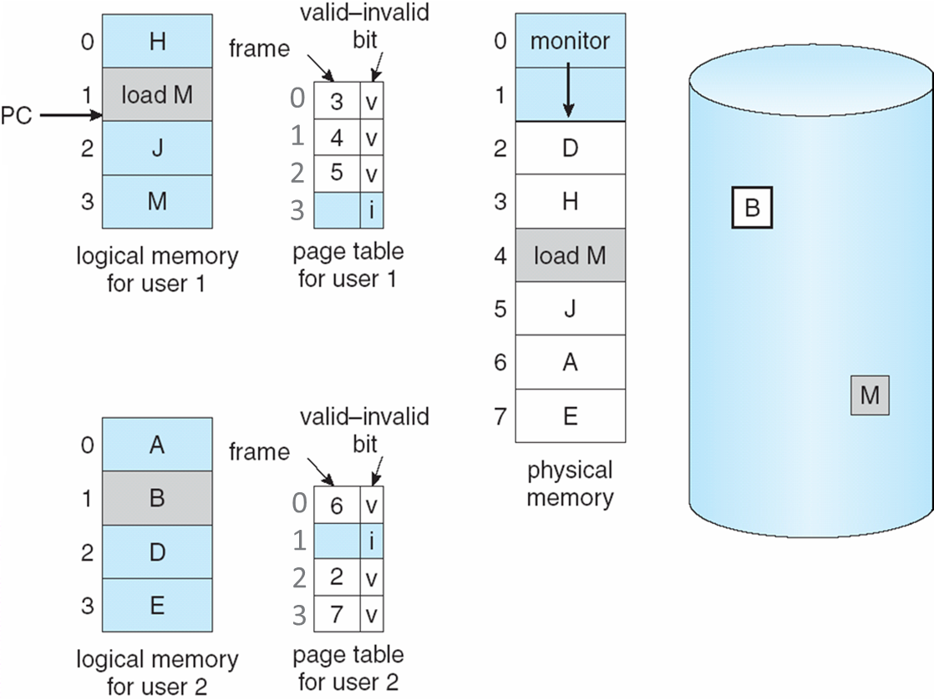
Over-allocation and Need For Page Replacement

Slide 8
Page Replacement
Deal with over-allocation of memory by modifying page-fault service routine to include page replacement.
Page replacement completes separation between logical memory and physical memory
A large virtual memory can be provided on a much smaller physical memory.
When replacing pages in memory a modify bit is used to reduce overhead of page transfers.
Only modified pages are written to disk.

Slide 9
Basic Page Replacement
Find the location of the desired page on disk.
Find a free frame
If there is a free frame, use it.
If there is no free frame, use a page replacement algorithm to select a victim frame.
If the victim frame’s modify bit is set, write it to disk; update the page and frame tables.
Bring the desired page into the free frame; update the page and frame tables.
Restart the process.

Slide 10
Page Replacement
frame
valid-invalid bit
Swap out victim page
2
change v-i bit to invalid
1
p₁
A
A
0
i
B
p₁
f
v
f
Swap desired page in
p₂
B
3
f
v
p₂
0
i
4
reset page table for new page
page table
process image in backing store
physical memory

Slide 11
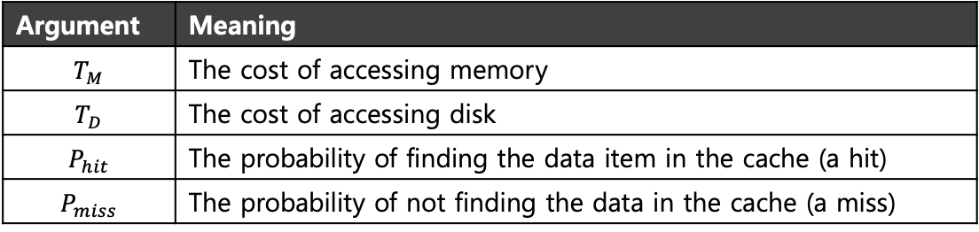

Cache Management
The goal in picking a replacement policy for this cache is to minimize the number of cache misses.
The number of cache hits and misses let us calculate the average memory access time (AMAT).
$$AMAT=\left(P_{hit}∗T_{M}\right)+(P_{miss}∗T_{D})$$
Argument | Meaning
$$T_{M}$$ | The cost of accessing memory
$$T_{D}$$ | The cost of accessing disk
$$P_{hit}$$ | The probability of finding the data item in the cache (a hit)
$$P_{miss}$$ | The probability of not finding the data in the cache (a miss)

Slide 12
The Optimal Replacement Policy…
Leads to the fewest number of misses overall
Replaces the page that will be accessed furthest in the future…
… which would result in the fewest-possible cache misses.
Since we cannot predict the future…
… it serves only as a comparison point, to know how close we are to perfection.

Slide 13
Page Replacement Algorithms
In general, we want the lowest page-fault rate.
A page replacement algorithm can be evaluated by
running it on a particular string of memory references (reference string) and
computing the number of page faults on that string.

Slide 14
Creating Reference Strings
An initial reference string can be created artificially or by tracing a given system and recording the address of each memory reference.
Since we are interested only in page faults, the length of the reference string can be reduced if we take into account that
For each reference, only the page number needs to be considered.
If there is a reference to page p, any immediately following references to p can be dropped, since they will never cause a page fault.

Slide 15
Example: Creating a Reference String
Assume
A 12-bit paged virtual memory with eight 512B-pages.
A process trace which produced the following reference string:
1000, 4032, 1001, 6012, 1002, 1003, 1004, 1001, 5010, 1002, 1003, 1004, 1001, 6010, 1002, 1003, 1004, 1001, 6007, 1002, 1005, 5010
To analyze the page faults, the string can be reduced to
1, 4, 1, 6, 1, 1, 1, 1, 5, 1, 1, 1, 1, 6, 1, 1, 1, 1, 6, 1, 1, 5
And, then, further reduced to
1, 4, 1, 6, 1, 5, 1, 6, 1, 6, 1, 5

Slide 16
Number of Page Faults vs Number of Frames
Assume
A first-in first-out replacement policy
Reference string: 1, 4, 1, 6, 1, 5, 1, 6, 1, 6, 1, 5
For number of frames = 2 | 1 | 4
For number of frames = 2 | 1 | 4 | 6
For number of frames = 2 | 1 | 4 | 6 | 1
For number of frames = 2 | 1 | 4 | 6 | 1 | 5
For number of frames = 2 | 1 | 4 | 6 | 1 | 5 | 6
For number of frames = 2 | 1 | 4 | 6 | 1 | 5 | 6 | 1
For number of frames = 2 | 1 | 4 | 6 | 1 | 5 | 6 | 1 | 5

Slide 17
Classical Page Replacement Algorithms
First-In First-Out
Optimal
Least-Recently-Used
Least-Recently-Used Approximation
Counting-Based
To illustrate the algorithms we will use a memory with 3 frames and the reference string
7, 0, 1, 2, 0, 3, 0, 4, 2, 3, 0, 3, 2, 1, 2, 0, 1, 7, 0, 1

Slide 18
7
0
1
2
0
3
0
4
2
3
0
3
2
1
2
0
1
7
0
1
page frames

Slide 19
FIFO Replacement
7
0
1
2
0
3
0
4
2
3
0
3
2
1
2
0
1
7
0
1
7
7
7
2
2
2
2
4
4
4
0
0
0
0
0
0
0
7
7
7
0
0
0
0
3
3
3
2
2
2
2
2
1
1
1
1
1
0
0
1
1
1
1
0
0
0
3
3
3
3
3
2
2
2
2
2
1
page frames

Slide 20
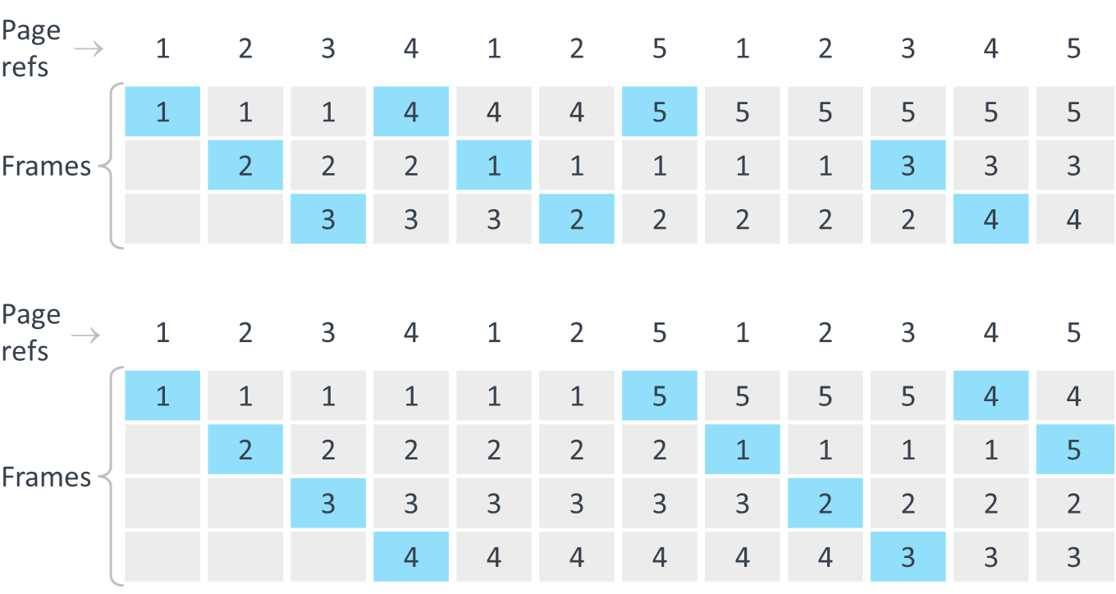
FIFO Replacement: Belady’s Anomaly
Page refs | 1 | 2 | 3 | 4 | 1 | 2 | 5 | 1 | 2 | 3 | 4 | 5
Frames | 1 | 1 | 1 | 4 | 4 | 4 | 5 | 5 | 5 | 5 | 5 | 5
 |  | 2 | 2 | 2 | 1 | 1 | 1 | 1 | 1 | 3 | 3 | 3
 |  |  | 3 | 3 | 3 | 2 | 2 | 2 | 2 | 2 | 4 | 4
Page refs | 1 | 2 | 3 | 4 | 1 | 2 | 5 | 1 | 2 | 3 | 4 | 5
Frames | 1 | 1 | 1 | 1 | 1 | 1 | 5 | 5 | 5 | 5 | 4 | 4
 |  | 2 | 2 | 2 | 2 | 2 | 2 | 1 | 1 | 1 | 1 | 5
 |  |  | 3 | 3 | 3 | 3 | 3 | 3 | 2 | 2 | 2 | 2
 |  |  |  | 4 | 4 | 4 | 4 | 4 | 4 | 3 | 3 | 3
→
→

Slide 21
FIFO Replacement: Belady’s Anomaly
Page refs | 1 | 2 | 3 | 4 | 1 | 2 | 5 | 1 | 2 | 3 | 4 | 5
Frames | 1 | 1 | 1 | 4 | 4 | 4 | 5 | 5 | 5 | 5 | 5 | 5
 |  | 2 | 2 | 2 | 1 | 1 | 1 | 1 | 1 | 3 | 3 | 3
 |  |  | 3 | 3 | 3 | 2 | 2 | 2 | 2 | 2 | 4 | 4
Page refs | 1 | 2 | 3 | 4 | 1 | 2 | 5 | 1 | 2 | 3 | 4 | 5
Frames | 1 | 1 | 1 | 1 | 1 | 1 | 5 | 5 | 5 | 5 | 4 | 4
 |  | 2 | 2 | 2 | 2 | 2 | 2 | 1 | 1 | 1 | 1 | 5
 |  |  | 3 | 3 | 3 | 3 | 3 | 3 | 2 | 2 | 2 | 2
 |  |  |  | 4 | 4 | 4 | 4 | 4 | 4 | 3 | 3 | 3
→
→

Slide 22
Graph of Page Faults vs Number of Frames
Assuming the following reference string
1, 2, 3, 4, 1, 2, 5, 1, 2, 3, 4, 5

Slide 23
Optimal Algorithm
Replace the page that will not be used for longest period of time
What is the purpose of this since we do not know the future?
It is useful for measuring how well our algorithms perform.
7
0
1
2
0
3
0
4
2
3
0
3
2
1
2
0
1
7
0
1
7
7
7
2
2
2
2
2
2
2
2
2
2
2
2
2
2
7
7
7
0
0
0
0
0
0
4
4
4
0
0
0
0
0
0
0
0
0
0
1
1
1
3
3
3
3
3
3
3
3
1
1
1
1
1
1
1
page frames

Slide 24
Least Recently Used (LRU) Algorithm
7
0
1
2
0
3
0
4
2
3
0
3
2
1
2
0
1
7
0
1
7
7
7
2
2
2
2
4
4
4
0
0
0
1
1
1
1
1
1
1
0
0
0
0
0
0
0
0
3
3
3
3
3
3
0
0
0
0
0
1
1
1
3
3
3
2
2
2
2
2
2
2
2
2
7
7
7
page frames

Slide 25
Least Recently Used (LRU) Algorithm
Counter implementation
Every page entry has a counter; every time page is referenced, copy the clock into the counter
When a page needs to be swapped in, look at the counters to determine which page will be swapped out
Stack implementation
Keep a stack of page numbers in a doubly linked list.
When a page is referenced
move it to the top
6 pointers must be updated
No search for replacement page

Slide 26
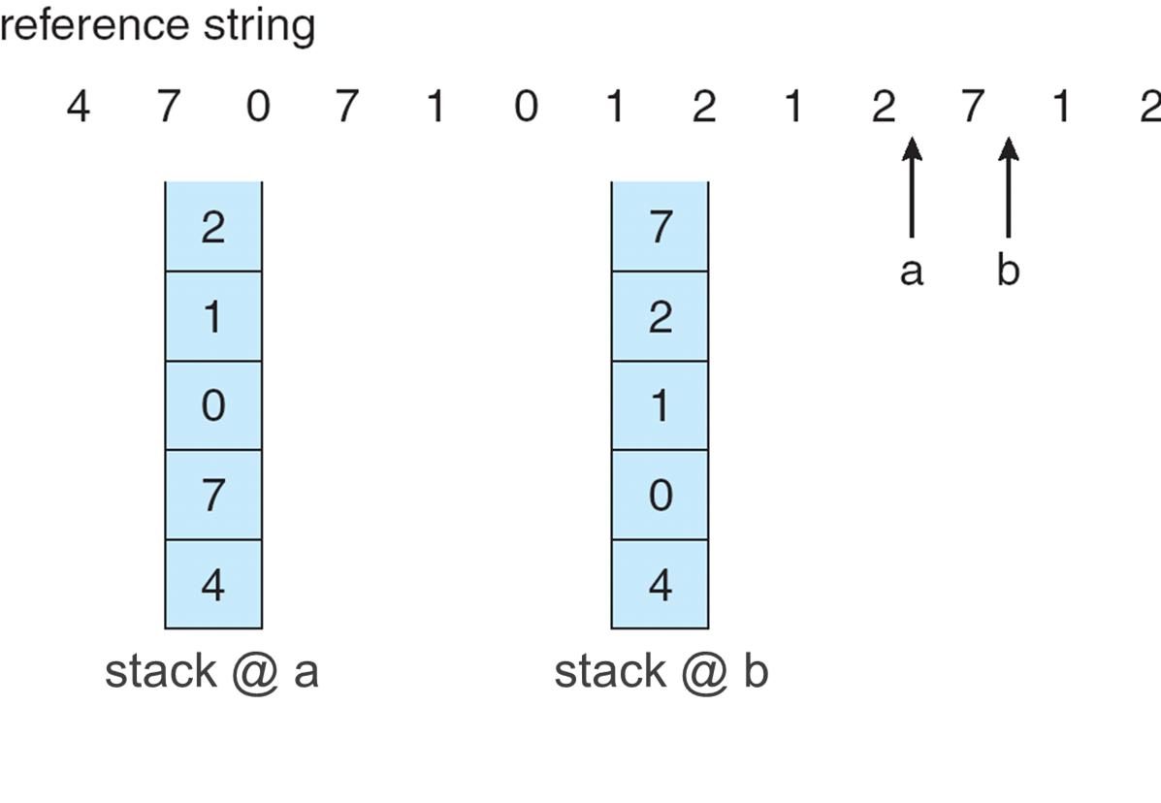
Use of a stack to record the most recent page references in LRU

Slide 27
LRU Approximation Algorithms
To keep track of which pages have been least-and-recently used, the system has to do some accounting work on every memory reference.
Add a little bit of hardware support.
Reference bit
With each page associate a bit, initially = 0
When page is referenced, set bit to 1
Replace a page whose reference bit is 0 (if one exists)
However, the order of the references is not known.

Slide 28
LRU Approximation Algorithms
Additional reference bits
Uses reference bit plus a one byte register for each page in a table in memory.
At regular intervals a timer interrupt transfers control to the OS.
For each page, the OS shifts the register right by one bit and copies the reference bit into the high order bit of the register.
When needed, interpret the registers as unsigned 8-bit integers and replace the page with the lowest one.
If more than one page have the lowest value, we can either swap out all of them or use FIFO.

Slide 29
LRU Approximation Algorithms
Second Chance (Clock)
Uses reference bit
Clock replacement
If page to be replaced (in clock order) has reference bit = 1
set reference bit to 0
leave page in memory
try to replace the next page (in clock order)
victim?
victim?
victim?
Ref bit = 0
Ref bit = 1

Slide 30
LRU Approximation Algorithms
Enhanced Second Chance
Uses reference bit and modify bit as an ordered pair.
These two bits generate four possible cases
(0, 0) = neither recently used nor modified
(0, 1) = not recently used but modified
(1, 0) = recently used but not modified
(1, 1) = recently used and modified
Execution pattern is the same as in the clock algorithm.
We replace the first page encountered in the lowest non-empty class.

Slide 31
Counting-Based Algorithms
Keep a counter of the number of references that have been made to each page
LFU (Least-Frequently Used) Algorithm
Replaces page with smallest count
MFU (Most-Frequently Used) Algorithm
Based on the argument that the page with the smallest count was probably just brought in and has yet to be used

Slide 32
Additional Procedures
Keep a pool of free frames
A victim frame is chosen using any method
The desired page is read into a frame taken from the pool without waiting for the victim to be written out.
When the victim has been written out, its frame is added to the free frames pool.
Pool of free frames with “memory”
Keep a pool of free frames but remember which page was in each frame.
If the page is required again, use it directly.

Slide 33
Additional Procedures
Keep a list of modified pages
Whenever the paging device is idle, write out one page from the list and reset its modify bit.

Slide 34
Thrashing
When a process does not have “enough” pages the page-fault rate can become very high.
This may lead to
Low CPU utilization
OS feels that it needs to increase the degree of multipro-gramming
OS adds another process to the system
A process keeps busy just swapping pages in and out
Inneficiency
Confusion
Overload
Thrashing

Slide 35
Thrashing
Memory is oversubscribed and the memory demands of the set of running processes exceeds the available physical memory.
Decide not to run a subset of processes.
Reduced set of processes working sets fit in memory.
Thrashing
CPU utilization
Degree of multiprogramming

Slide 36
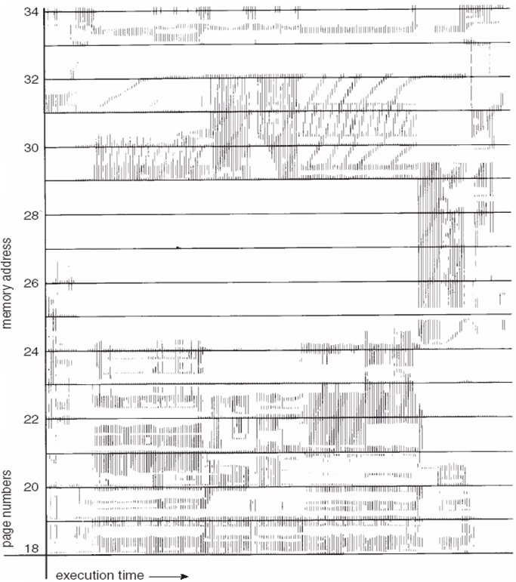
Demand Paging and Thrashing
Why does demand paging work?
Locality model
Process migrates from one locality to another
Localities may overlap
Why does thrashing occur?
Σ (size of localities ) > total memory size

Slide 37
Localities and Page Fault Rates
While a process executes within a locality its page fault rate is low.
Locality span

Slide 38
Working-Set Model
Δ ≡ working-set window ≡ a fixed number of page references Example: 10.000 instructions
WSS_{i} (working set size of process P_{i}) = total number of pages referenced in the most recent Δ (varies in time)
if Δ is too small it will not encompass entire locality
if Δ is too large it may encompass several localities
if Δ = ∞ it will encompass entire program

Slide 39
Working-Set Model
Total demand for frames
D = Σ WSS_{i}
Total number of available frames = m
If D > m, thrashing will occur because some processes will not have enough frames.
Policy
OS monitors the WS of each process and allocates enough frames to each.
If there are extra frames, another process can be started.
If D > m, one of the processes will be suspended.

Slide 40
Working-set model
The difficulty with the model is keeping track of the working-set because its window is a moving one.
Example:

Slide 41
Keeping Track of the Working Set
Approximate with interval timer + a reference bit
Example: Δ = 10,000
Timer interrupts after every 5,000 time units
Keep in memory 2 history bits for each page
Whenever a timer interrupt occurs, for each page, shift the history bits left, add the reference bit and set it to 0.
If (history bits) ≠ 0, the page is considered in the WS.
Why is this not completely accurate?
The uncertainty can be reduced by increasing the number of history bits and the frequency of interrupts.

Slide 42
Page-Fault Frequency Scheme
An alternative to the working-set scheme.
Establish “acceptable” page-fault rates
If actual rate too low, process loses frame
If actual rate too high, process gains frame
page fault rate
increase number of frames
upper bound
OK
lower bound
decrease number of frames
number of frames

Slide 43
Allocation of Frames
System architecture defines a minimum number of frames per process in order to guarantee that it can execute e.g.
Instructions which operate on blocks of memory
Indirect addressing
Two major frame allocation schemes
Fixed allocation
Equal allocation
Proportional allocation
Priority allocation

Slide 44
Fixed Allocation
Equal allocation
Give to each process an equal share of the number of frames available.
Proportional allocation
Allocate available frames proportionally to the size of each process.
A process’ share cannot be lesser than the minimum number of frames per process prescribed by the architecture.

Slide 45
Priority Allocation
Use a proportional allocation scheme using priorities rather than size.
If process P_{i} generates a page fault,
Select for replacement one of its frames or
Select for replacement a frame from a lower-priority process.

Slide 46
Global vs. Local Allocation
Global replacement
Replacement frame is selected from the set of all frames.
One process can get a frame from another.
Processes cannot control their own page-fault rate.
Local replacement
Each process gets frames from only its own set of allocated frames.
Process may be hindered by not having access to other, less used, frames.

Slide 47
Other issues: Non-Uniform Memory Access
In systems with multiple CPUs a given CPU can access some regions of main memory faster than it can access others.
Systems in which memory acccess times vary significantly are known as NUMA (non-uniform memory access) systems.
In such systems, frame allocation algorithms must take into account the “distance” between the frame and the CPU.
This is more complicated when threads are used, because these may be scheduled to CPUs in many different system boards.

Slide 48
Allocating Kernel Memory
Treated differently from user memory.
Often allocated from a free-memory pool
Kernel requests memory for structures of varying sizes.
Some kernel memory needs to be contiguous.
Two main approaches
Buddy-system allocation
Slab allocation

Slide 49
Buddy System Allocation
Allocates memory from a fixed-size region consisting of physically-contiguous pages.
Memory allocated using power-of-2 scheme.
Satisfies requests in units sized as power of 2.
Request rounded up to next highest power of 2.
When smaller allocation needed than is available, current chunk split into two buddies of next-lower power of 2.
Repeat until appropriately sized chunk available.

Slide 50
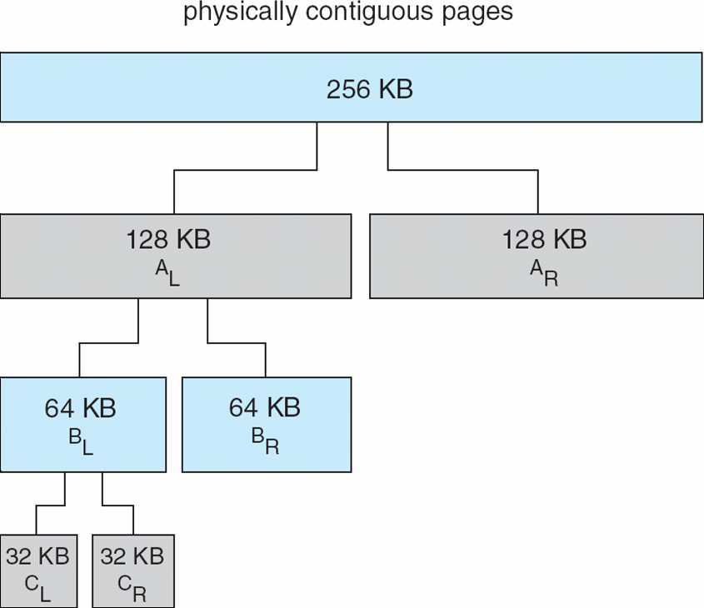
Buddy System Allocation

Slide 51
Slab Allocation
A slab is a set of one or more physically contiguous pages.
A cache consists of one or more slabs.
There is a single cache for each unique kernel data structure.
A cache is filled with objects – instantiations of the data structure.
When a cache is created, it is filled with objects marked as free.
When a new object is needed, a free object from the corresponding cache is assigned and marked as used.
If a slab is full of used objects, a new object will be allocated from an empty slab.
If there are no empty slabs, a new slab allocated.
Benefits include no fragmentation, fast memory request satisfaction.

Slide 52
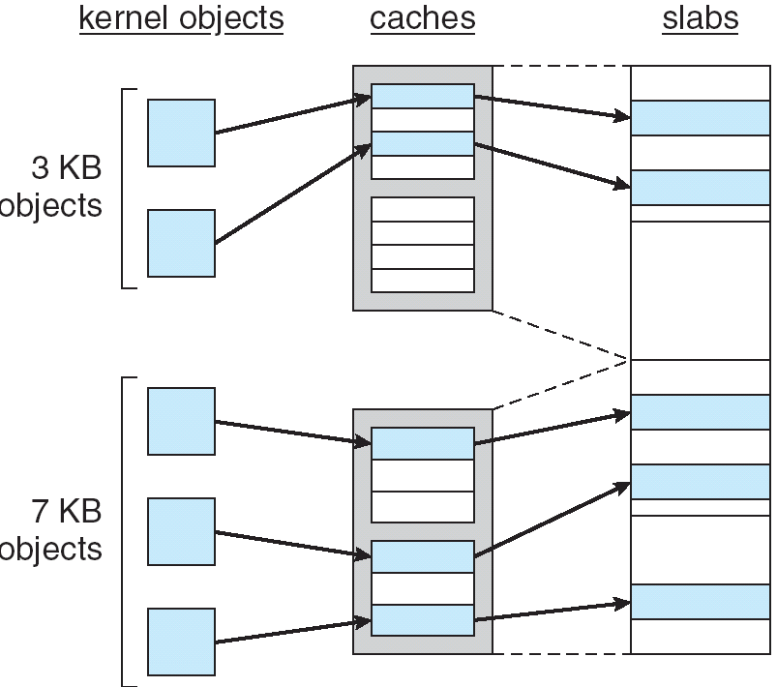
Slab Allocation
physically contiguous pages

Slide 53
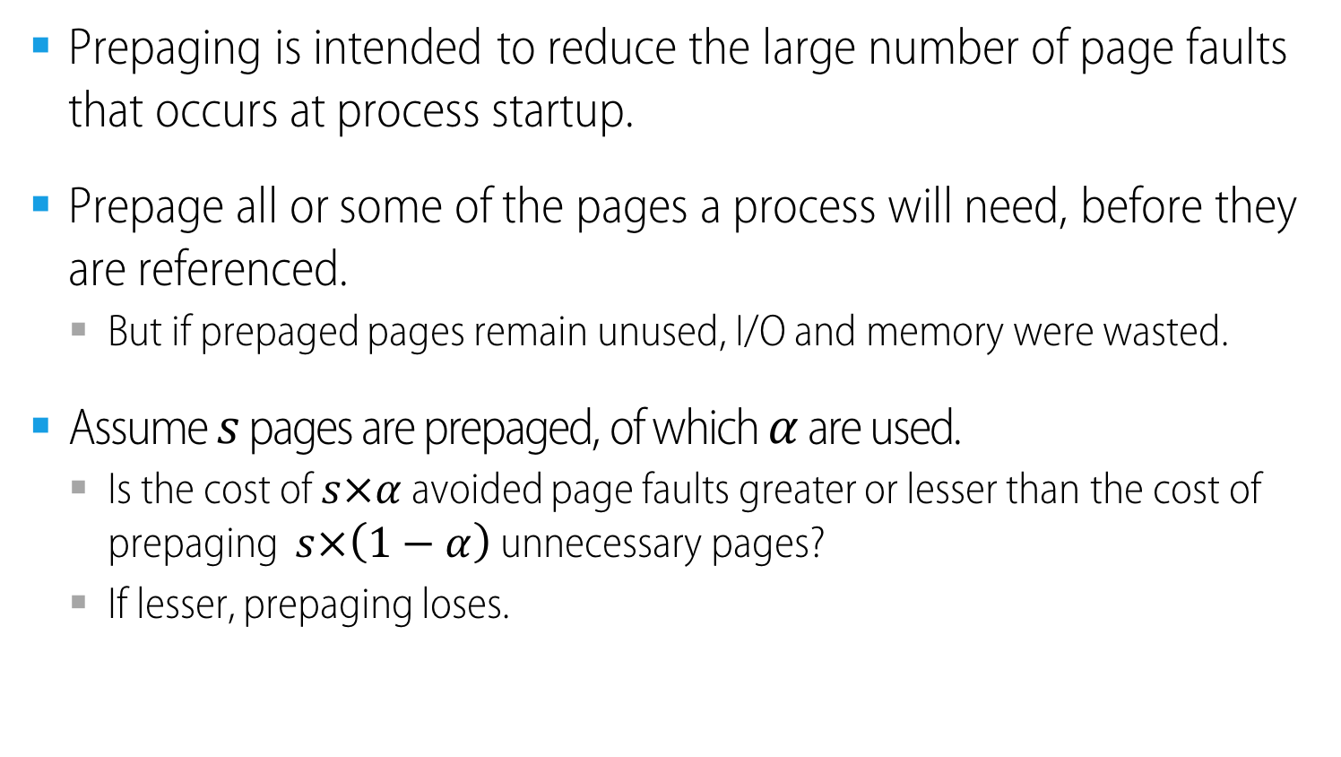
Other Issues: Prepaging
Prepaging is intended to reduce the large number of page faults that occurs at process startup.
Prepage all or some of the pages a process will need, before they are referenced.
But if prepaged pages remain unused, I/O and memory were wasted.
Assume $s$ pages are prepaged, of which $α$ are used.
Is the cost of $s×α$ avoided page faults greater or lesser than the cost of prepaging $s×\left(1−α\right)$ unnecessary pages?
If lesser, prepaging loses.

Slide 54
Prepaging
The OS guesses that a page is about to be used, and thus brings it in ahead of time.
For example, Page 2 is likely to be accessed soon and thus should also be brought into memory.
Page 1 is required
Page 3
…
Physical Memory
Page 4
Page 5
Page n
Page 1
Page 2
Page 3
Page 4
Secondary Storage
…

Slide 55
Clustering, Grouping
Collect a number of pending writes together in memory and write them to disk in one write.
A single large write is more efficient than many small ones.
Pending writes
Page 1
Page 2
Page 3
Page 4
Page 5
…
Page n
Physical Memory
only one single operation
Page 1
Page 2
Page 3
Page 4
Secondary Storage
…

Slide 56
Clustering, Grouping
Collect a number of pending writes together in memory and write them to disk in one write.
A single large write is more efficient than many small ones.

Slide 57
Considering Dirty Pages
The hardware includes a modified bit (aka dirty bit)
Page has been modified and is thus dirty, it must be written back to disk to evict it.
Page has not been modified, the eviction is free.

Slide 58
Other Issues: Page Size
At the time of OS design little can be done about page size. Why?
During the design of a new machine, page size selection must take into consideration
Fragmentation
Table size
I/O overhead
Locality

Slide 59
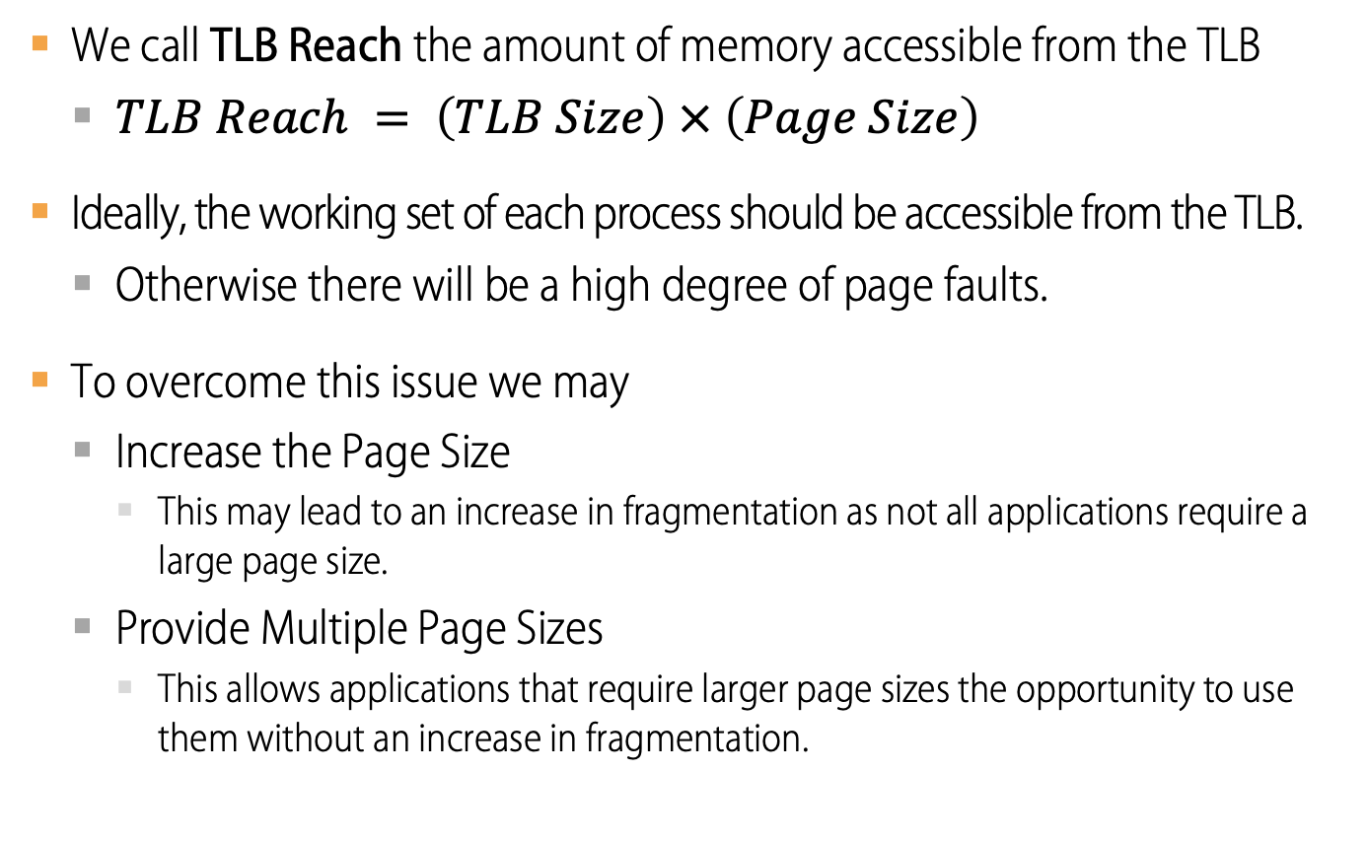
Other Issues: TLB Reach
We call TLB Reach the amount of memory accessible from the TLB
$TLB Reach = \left(TLB Size\right) × \left(Page Size\right)$
Ideally, the working set of each process should be accessible from the TLB.
Otherwise there will be a high degree of page faults.
To overcome this issue we may
Increase the Page Size
This may lead to an increase in fragmentation as not all applications require a large page size.
Provide Multiple Page Sizes
This allows applications that require larger page sizes the opportunity to use them without an increase in fragmentation.

Slide 60
Other Issues: Program Structure
int[128,128] data;
Each row is stored in one 512B page
Program 1 for (i = 0; i <128; i++) for (j = 0; j < 128; j++) data[i,j] = 0;
Program 2 for (j = 0; j < 128; j++) for (i = 0; i < 128; i++) data[i,j] = 0;
128
page faults
128 x 128 i.e.
16.384
page faults

Slide 61
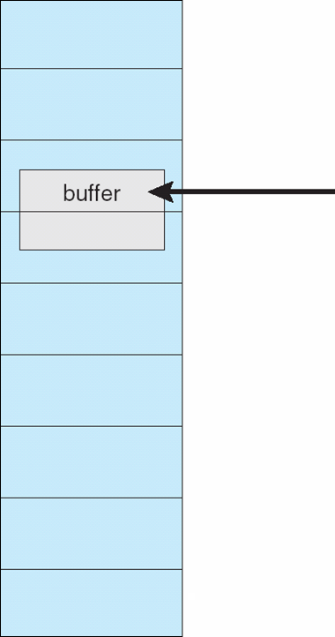
Other Issues: I/O interlock
I/O Interlock
Pages must sometimes be locked into memory.
E.g. I/O pages that are used for copying a file from a device must be locked from being selected for eviction by a page replacement algorithm.
backing store

Slide 62
Parking Lot

Slide 63

Tracing the Optimal Policy
Consider a 3-page cache and the following page reference sequence 0 1 2 0 1 3 0 3 1 2 1
Access | Hit/Miss? | Evict | Resulting Cache State
0 | Miss |  | 0
1 | Miss |  | 0 | 1
2 | Miss |  | 0 | 1 | 2
0 | Hit |  | 0 | 1 | 2
1 | Hit |  | 0 | 1 | 2
3 | Miss | 2 | 0 | 1 | 3
0 | Hit |  | 0 | 1 | 3
3 | Hit |  | 0 | 1 | 3
1 | Hit |  | 0 | 1 | 3
2 | Miss | 3 | 0 | 1 | 2
1 | Hit |  | 0 | 1 | 2
Hit rate is $$\frac{Hits}{Hits+Misses}=54.6\%$$
Future is not known.

Slide 64
A Simple Policy: FIFO
Pages were placed in a queue when they enter the system.
When a replacement occurs, the page on the tail of the queue(the “First-in” pages) is evicted.
It is simple to implement, but can’t determine the importance of blocks.

Slide 65

Tracing the FIFIO Policy
Reference Row
0
1
2
0
1
3
0
3
1
2
1
Access | Hit/Miss? | Evict | Resulting Cache State
0 | Miss |  | 0
1 | Miss |  | 0,1
2 | Miss |  | 0,1,2
0 | Hit |  | 0,1,2
1 | Hit |  | 0,1,2
3 | Miss | 0 | 1,2,3
0 | Miss | 1 | 2,3,0
3 | Hit |  | 2,3,0
1 | Miss |  | 3,0,1
2 | Miss | 3 | 0,1,2
1 | Hit |  | 0,1,2
Hit rate is $\frac{Hits}{Hits+Misses}=36.4\%$
Even though page 0 had been accessed a number of times, FIFO still kicks it out.

Slide 66
BELADY’S ANOMALY
We would expect the cache hit rate to increase when the cache gets larger. But in this case, with FIFO, it gets worse.
Reference Row
1
2
3
4
1
2
5
1
2
3
4
5

Slide 67
Another Simple Policy: Random
Picks a random page to replace under memory pressure.
It doesn’t really try to be too intelligent in picking which blocks to evict.
Random does depends entirely upon how lucky Random gets in its choice.
Access | Hit/Miss? | Evict | Resulting Cache State
0 | Miss |  | 0
1 | Miss |  | 0,1
2 | Miss |  | 0,1,2
0 | Hit |  | 0,1,2
1 | Hit |  | 0,1,2
3 | Miss | 0 | 1,2,3
0 | Miss | 1 | 2,3,0
3 | Hit |  | 2,3,0
1 | Miss | 3 | 2,0,1
2 | Hit |  | 2,0,1
1 | Hit |  | 2,0,1

Slide 68
Random Performance
Sometimes, Random is as good as optimal, achieving 6 hits on the example trace.
Random Performance over 10,000 Trials

Slide 69
Using History
Lean on the past and use history.
Two type of historical information.
Historical Information | Meaning | Algorithms
recency | The more recently a page has been accessed, the more likely it will be accessed again | LRU
frequency | If a page has been accessed many times, It should not be replcaed as it clearly has some value | LFU

Slide 70
Using History : LRU
Replaces the least-recently-used page.
Reference Row
0
1
2
0
1
3
0
3
1
2
1
Access | Hit/Miss? | Evict | Resulting Cache State
0 | Miss |  | 0
1 | Miss |  | 0,1
2 | Miss |  | 0,1,2
0 | Hit |  | 1,2,0
1 | Hit |  | 2,0,1
3 | Miss | 2 | 0,1,3
0 | Hit |  | 1,3,0
3 | Hit |  | 1,0,3
1 | Hit |  | 0,3,1
2 | Miss | 0 | 3,1,2
1 | Hit |  | 3,2,1

Slide 71
Workload Example : The No-Locality Workload
Each reference is to a random page within the set of accessed pages.
Workload accesses 100 unique pages over time.
Choosing the next page to refer to at random
The No-Locality Workload
100%
80%
When the cache is large enough to fit the entire workload,
it also doesn’t matter which policy you use.
60%
Hit Rate
OPT
LRU
40%
FIFO
RAND
20%
20
40
60
80
100
Cache Size (Blocks)

Slide 72
Workload Example : The 80-20 Workload
Exhibits locality: 80% of the reference are made to 20% of the page
The remaining 20% of the reference are made to the remaining 80% of the pages.
The 80-20 Workload
100%
80%
LRU is more likely to
hold onto the hot pages.
60%
Hit Rate
OPT
LRU
40%
FIFO
RAND
20%
20
40
60
80
100
Cache Size (Blocks)

Slide 73
Workload Example : The Looping Sequential
Refer to 50 pages in sequence.
Starting at 0, then 1, … up to page 49, and then we Loop, repeating those accesses, for total of 10,000 accesses to 50 unique pages.
The Looping-Sequential Workload
100%
80%
60%
Hit Rate
OPT
LRU
40%
FIFO
RAND
20%
20
40
60
80
100
Cache Size (Blocks)

Slide 74
Implementing Historical Algorithms
To keep track of which pages have been least-and-recently used, the system has to do some accounting work on every memory reference.
Add a little bit of hardware support.

Slide 75
Approximating LRU
Require some hardware support, in the form of a use bit
Whenever a page is referenced, the use bit is set by hardware to 1.
Hardware never clears the bit, though; that is the responsibility of the OS
Clock Algorithm
All pages of the system arranges in a circular list.
A clock hand points to some particular page to begin with.

Slide 76
Clock Algorithm
The algorithm continues until it finds a use bit that is set to 0.
A
H
B
Use bit | Meaning
0 | Evict the page
1 | Clear Use bit and advance hand
G
C
F
D
E
The Clock page replacement algorithm
When a page fault occurs, the page the hand is pointing to is inspected. The action taken depends on the Use bit

Slide 77
Workload with Clock Algorithm
Clock algorithm doesn’t do as well as perfect LRU, it does better then approach that don’t consider history at all.
The 80-20 Workload
100%
80%
60%
Hit Rate
OPT
LRU
40%
Clock
FIFO
RAND
20%
20
40
60
80
100
Cache Size (Blocks)

Slide 78
Considering Dirty Pages
The hardware include a modified bit (a.k.a dirty bit)
Page has been modified and is thus dirty, it must be written back to disk to evict it.
Page has not been modified, the eviction is free.

Slide 79
Page Selection Policy
The OS has to decide when to bring a page into memory.
Presents the OS with some different options.

Slide 80
Prefetching
The OS guess that a page is about to be used, and thus bring it in ahead of time.
Page 1 is brought into memory
Page 3
Page 4
Page 5
…
Page n
Physical Memory
Page 2
…
Page 1
Page 3
Page 4
Secondary
Storage
Page 2 likely soon be accessed and
thus should be brought into memory too

Slide 81
Clustering, Grouping
Collect a number of pending writes together in memory and write them to disk in one write.
Perform a single large write more efficiently than many small ones.
Pending writes
Page 1
Page 2
Page 3
Page 4
Page 5
…
Page n
Physical Memory
write in one write
Page 2
…
Page 1
Page 3
Page 4
Secondary
Storage

Slide 82
Thrashing
Memory is oversubscribed and the memory demands of the set of running processes exceeds the available physical memory.
Decide not to run a subset of processes.
Reduced set of processes working sets fit in memory.
CPU
Utilization
Trashing
Degree of multiprogramming

Slide 83
Beyond Physical Memory: Policies
Memory pressure forces the OS to start paging out pages to make room for actively-used pages.
Deciding which page to evict is encapsulated within the replacement policy of the OS.

Slide 84


Cache Management
Goal in picking a replacement policy for this cache is to minimize the number of cache misses.
The number of cache hits and misses let us calculate the average memory access time(AMAT).
$$AMAT=\left(P_{Hit}∗T_{M}\right)+(P_{Miss}∗T_{D})$$
Arguement | Meaning
$$T_{M}$$ | The cost of accessing memory
$$T_{D}$$ | The cost of accessing disk
$$P_{Hit}$$ | The probability of finding the data item in the cache(a hit)
$$P_{Miss}$$ | The probability of not finding the data in the cache(a miss)

Slide 85
The Optimal Replacement Policy
Leads to the fewest number of misses overall
Replaces the page that will be accessed furthest in the future
Resulting in the fewest-possible cache misses
Serve only as a comparison point, to know how close we are to perfect

Slide 86
Caching and Demand-Paged Virtual Memory

Slide 87
Definitions
Cache
Copy of data that is faster to access than the original
Hit: if cache has copy
Miss: if cache does not have copy
Cache block
Unit of cache storage (multiple memory locations)
Temporal locality
Programs tend to reference the same memory locations multiple times
Example: instructions in a loop
Spatial locality
Programs tend to reference nearby locations
Example: data in a loop

Slide 88
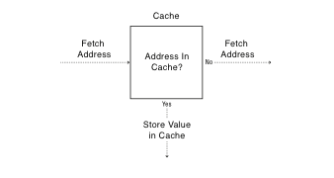
Cache Concept (Read)

Slide 89
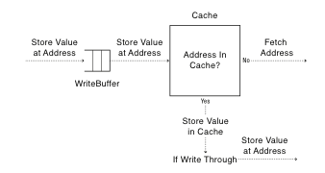
Cache Concept (Write)
Write through: changes sent
immediately to next level of storage
Write back: changes stored in cache until cache block is replaced

Slide 90
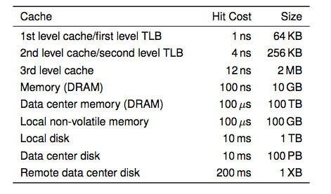
Memory Hierarchy
i7 has 8MB as shared 3rd level cache; 2nd level cache is per-core

Slide 91
Main Points
Can we provide the illusion of near infinite memory in limited physical memory?
Demand-paged virtual memory
Memory-mapped files
How do we choose which page to replace?
FIFO, MIN, LRU, LFU, Clock
What types of workloads does caching work for, and how well?
Spatial/temporal locality vs. Zipf workloads

Slide 92
Hardware address translation is a power tool
Kernel trap on read/write to selected addresses
Copy on write
Fill on reference
Zero on use
Demand paged virtual memory
Memory mapped files
Modified bit emulation
Use bit emulation

Slide 93
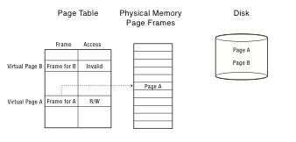
Demand Paging (Before)

Slide 94
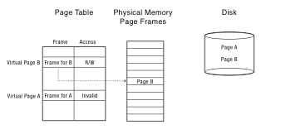
Demand Paging (After)

Slide 95
Demand Paging on MIPS
TLB miss
Trap to kernel
Page table walk
Find page is invalid
Convert virtual address to file + offset
Allocate page frame
Evict page if needed
Initiate disk block read into page frame
Disk interrupt when DMA complete
Mark page as valid
Load TLB entry
Resume process at faulting instruction
Execute instruction

Slide 96
Demand Paging
TLB miss
Page table walk
Page fault (page invalid in page table)
Trap to kernel
Convert virtual address to file + offset
Allocate page frame
Evict page if needed
Initiate disk block read into page frame
Disk interrupt when DMA complete
Mark page as valid
Resume process at faulting instruction
TLB miss
Page table walk to fetch translation
Execute instruction

Slide 97
Allocating a Page Frame
Select old page to evict
Find all page table entries that refer to old page
If page frame is shared
Set each page table entry to invalid
Remove any TLB entries
Copies of now invalid page table entry
Write changes on page back to disk, if necessary

Slide 98
How do we know if page has been modified?
Every page table entry has some bookkeeping
Has page been modified?
Set by hardware on store instruction
In both TLB and page table entry
Has page been recently used?
Set by hardware on in page table entry on every TLB miss
Bookkeeping bits can be reset by the OS kernel
When changes to page are flushed to disk
To track whether page is recently used

Slide 99
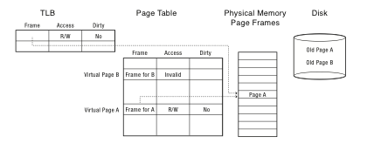
Keeping Track of Page Modifications (Before)

Slide 100
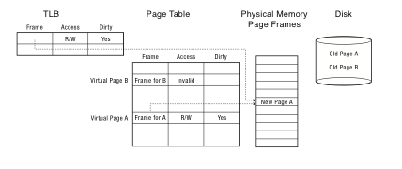
Keeping Track of Page Modifications (After)

Slide 101
Virtual or Physical Dirty/Use Bits
Most machines keep dirty/use bits in the page table entry
Physical page is
Modified if any page table entry that points to it is modified
Recently used if any page table entry that points to it is recently used
On MIPS, simpler to keep dirty/use bits in the core map
Core map: map of physical page frames

Slide 102
Emulating Modified/Use Bits w/ MIPS Software Loaded TLB
MIPS TLB entries have an extra bit: modified/unmodified
Trap to kernel if no entry in TLB, or if write to an unmodified page
On a TLB read miss:
If page is clean, load TLB entry as read-only; if dirty, load as rd/wr
Mark page as recently used
On a TLB write to an unmodified page:
Kernel marks page as modified in its page table
Reset TLB entry to be read-write
Mark page as recently used
On TLB write miss:
Kernel marks page as modified in its page table
Load TLB entry as read-write
Mark page as recently used

Slide 103
Emulating a Modified Bit (Hardware Loaded TLB)
Some processor architectures do not keep a modified bit per page
Extra bookkeeping and complexity
Kernel can emulate a modified bit:
Set all clean pages as read-only
On first write to page, trap into kernel
Kernel sets modified bit, marks page as read-write
Resume execution
Kernel needs to keep track of both
Current page table permission (e.g., read-only)
True page table permission (e.g., writeable, clean)

Slide 104
Emulating a Recently Used Bit (Hardware Loaded TLB)
Some processor architectures do not keep a recently used bit per page
Extra bookkeeping and complexity
Kernel can emulate a recently used bit:
Set all recently unused pages as invalid
On first read/write, trap into kernel
Kernel sets recently used bit
Marks page as read or read/write
Kernel needs to keep track of both
Current page table permission (e.g., invalid)
True page table permission (e.g., read-only, writeable)

Slide 105
Models for Application File I/O
Explicit read/write system calls
Data copied to user process using system call
Application operates on data
Data copied back to kernel using system call
Memory-mapped files
Open file as a memory segment
Program uses load/store instructions on segment memory, implicitly operating on the file
Page fault if portion of file is not yet in memory
Kernel brings missing blocks into memory, restarts process

Slide 106
Advantages to Memory-mapped Files
Programming simplicity, esp for large files
Operate directly on file, instead of copy in/copy out
Zero-copy I/O
Data brought from disk directly into page frame
Pipelining
Process can start working before all the pages are populated
Interprocess communication
Shared memory segment vs. temporary file

Slide 107
From Memory-Mapped Files to Demand-Paged Virtual Memory
Every process segment backed by a file on disk
Code segment -> code portion of executable
Data, heap, stack segments -> temp files
Shared libraries -> code file and temp data file
Memory-mapped files -> memory-mapped files
When process ends, delete temp files
Unified memory management across file buffer and process memory

Slide 108
Cache Replacement Policy
On a cache miss, how do we choose which entry to replace?
Assuming the new entry is more likely to be used in the near future
In direct mapped caches, not an issue!
Policy goal: reduce cache misses
Improve expected case performance
Also: reduce likelihood of very poor performance

Slide 109
A Simple Policy
Random?
Replace a random entry
FIFO?
Replace the entry that has been in the cache the longest time
What could go wrong?

Slide 110
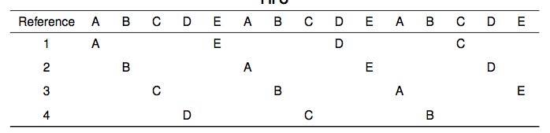
FIFO in Action
Worst case for FIFO is if program strides through memory that is larger than the cache

Slide 111
MIN, LRU, LFU
MIN
Replace the cache entry that will not be used for the longest time into the future
Optimality proof based on exchange: if evict an entry used sooner, that will trigger an earlier cache miss
Least Recently Used (LRU)
Replace the cache entry that has not been used for the longest time in the past
Approximation of MIN
Least Frequently Used (LFU)
Replace the cache entry used the least often (in the recent past)

Slide 112
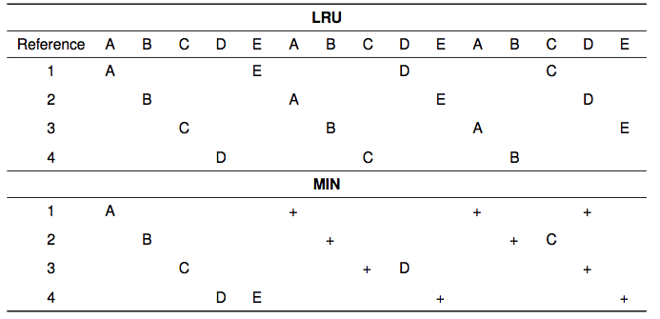
LRU/MIN for Sequential Scan

Slide 113
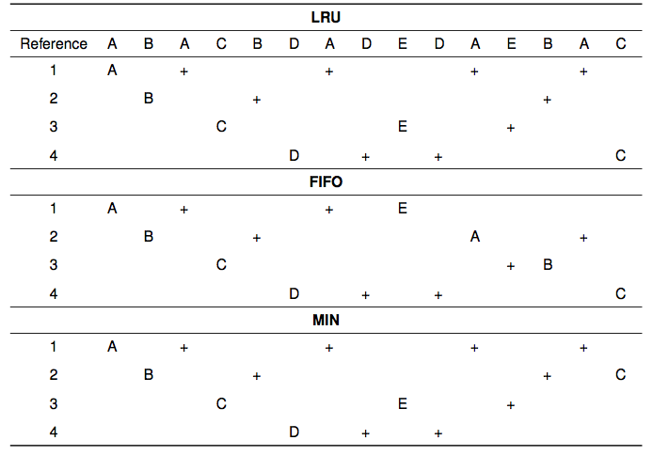

Slide 114
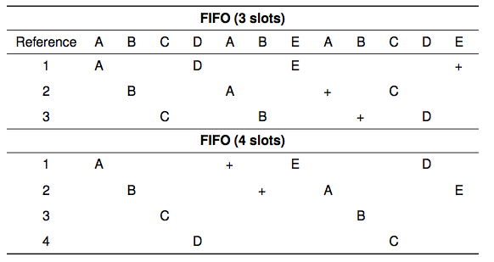
Belady’s Anomaly

Slide 115
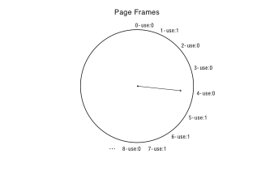
Clock Algorithm: Estimating LRU
Periodically, sweep through all pages
If page is unused, reclaim
If page is used, mark as unused

Slide 116
Nth Chance: Not Recently Used
Instead of one bit per page, keep an integer
notInUseSince: number of sweeps since last use
Periodically sweep through all page frames
if (page is used) {
notInUseSince = 0;
} else if (notInUseSince < N) {
notInUseSince++;
} else {
reclaim page;
}

Slide 117
Implementation Note
Clock and Nth Chance can run synchronously
In page fault handler, run algorithm to find next page to evict
Might require writing changes back to disk first
Or asynchronously
Create a thread to maintain a pool of recently unused, clean pages
Find recently unused dirty pages, write mods back to disk
Find recently unused clean pages, mark as invalid and move to pool
On page fault, check if requested page is in pool!
If not, evict that page

Slide 118
Recap
MIN is optimal
replace the page or cache entry that will be used farthest into the future
LRU is an approximation of MIN
For programs that exhibit spatial and temporal locality
Clock/Nth Chance is an approximation of LRU
Bin pages into sets of “not recently used”

Slide 119
Working Set Model
Working Set: set of memory locations that need to be cached for reasonable cache hit rate
Thrashing: when system has too small a cache

Slide 120
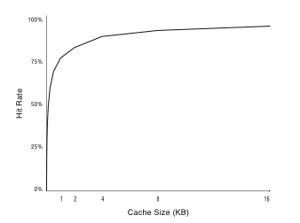
Cache Working Set

Slide 121
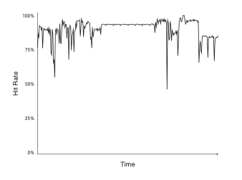
Phase Change Behavior

Slide 122
Question
What happens to system performance as we increase the number of processes?
If the sum of the working sets > physical memory?

Slide 123
Zipf Distribution
Caching behavior of many systems are not well characterized by the working set model
An alternative is the Zipf distribution
Popularity ~ 1/k^c, for kth most popular item, 1 < c < 2

Slide 124
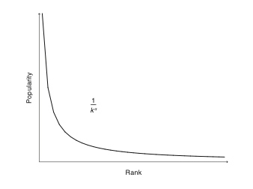
Zipf Distribution

Slide 125
Zipf Examples
Web pages
Movies
Library books
Words in text
Salaries
City population
…
Common thread: popularity is self-reinforcing

Slide 126
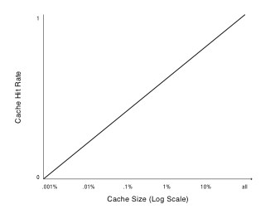
Zipf and Caching

Slide 127
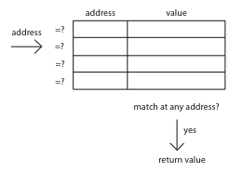
Cache Lookup: Fully Associative

Slide 128
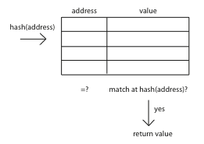
Cache Lookup: Direct Mapped

Slide 129
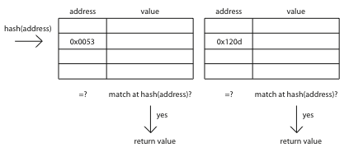
Cache Lookup: Set Associative

Slide 130
Page Coloring
What happens when cache size >> page size?
Direct mapped or set associative
Multiple pages map to the same cache line
OS page assignment matters!
Example: 8MB cache, 4KB pages
1 of every 2K pages lands in same place in cache
What should the OS do?

Slide 131
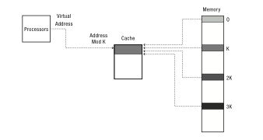
Page Coloring

