Slide 1
Concurrency and Threads
T16
Ch.26 of Operating Systems: Three Easy Pieces by Remzi and Andrea Arpaci-Dusseau (pages.cs.wisc.edu/~remzi/OSTEP/)
17 de setembro de 2018

Slide 2
Introduction to Concurrency
We use the word concurrency to refer to multiple activities that can happen at the same time.
Correctly managing concurrency is a key challenge for operating system developers and, more recently, has also become a concern for many application developers.
From the programmer’s perspective, it is much easier to think sequentially than to keep track of many simultaneous activities.
How can you write a correct program with dozens of events happening at once?
How do you debug such program if each execution is unique?

Slide 3
Concurrency within Applications
We have already studied two abstractions
Virtual CPUs – enabling concurrency between multiple running programs (i.e. processes).
Virtual Memory – defining address spaces which enable each program to feel like having its own private memory.
We will now introduce a new abstraction: threads
Threads behave nearly as separate processes, except for one big difference:
All the threads of a program share the same address space.
Threads enable concurrency within a single process.
A multi-threaded program will have more than one point of execution but only a single address space.

Slide 4
Processes and threads
A traditional (heavyweight) process has a single thread of control
A multi-threaded process can have more than one active task at a time
= instruction trace
one process one thread
one process multiple threads
multiple processes one thread per process
multiple processes multiple threads per process

Slide 5
What’s our goal?
The key idea is to write a concurrent program as a set of sequential streams of execution, or threads, that interact and share results in a very precise way.
Threads let us define a set of sequential tasks that run concurrently.
We will now
define the thread abstraction
show how you can use it
explain how the OS can implement threads on top of a limited number of processors.

Slide 6
Thread Control Blocks (TCBs)
Each thread has its own private set of registers it uses for computation
If there are two threads that are running on a single processor, switching from running one to running the other, requires a context switch.
The context switch between threads is quite similar to the context switch between processes, as the register state of the first must be saved and the register state of the second restored before running it.
For processes, we saved state to a Process Control Block (PCB). For threads, we’ll need one or more Thread Control Blocks (TCBs).

Slide 7

A process may have many threads
code
data
files
code
data
files
registers
stack
registers
registers
registers
stack
stack
stack
thread
threads
Single-threaded process
Multi-threaded process

Slide 8
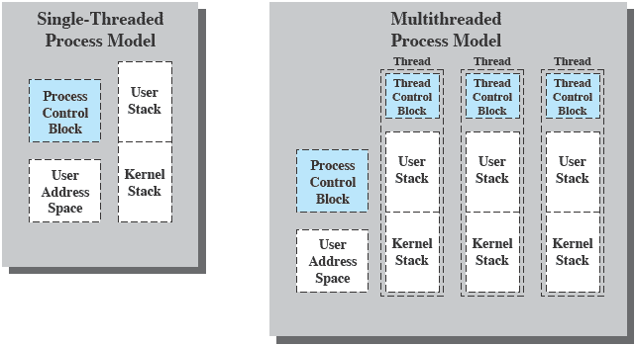
Single-thread and multi-thread process models
Single-thread Process Model
Multi-thread Process Model
User Stack
Thread Control Block
Thread Control Block
Thread Control Block
Process Control Block
User Stack
User Stack
User Stack
Kernel Stack
Process Control Block
User Address Space
Kernel Stack
Kernel Stack
Kernel Stack
User Address Space

Slide 9
Examples of process and thread level items
Per process items
(shared by all threads in a process)
Address space
Global variables
Open files
Child processes
Pending alarms
Signals and signal handlers
Accounting information
Per thread items
(private to each thread)
Program counter
Registers
Stack
State

Slide 10
Processes and threads
An OS can be seen as a manager of
resources
time
Early OSs treated both problems at process level.
Modern OSs use a finer grain for time management:
The unit of dispatching is now a thread or lightweight process.
The unit of resource ownership still is a process or task.

Slide 11
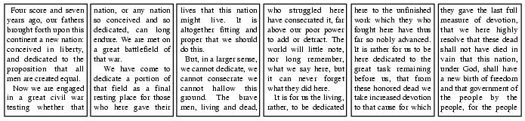

A multithreaded word processor
Word processor
OS kernel

Slide 12
A thread is a single execution sequence that represents a separately executable task.
Single execution sequence
Separately executable task
Each thread executes a sequence of instructions just as in the familiar sequential programming model.
The operating system can run, suspend or resume a thread at any time.

Slide 13
In summary, a thread …
Has an execution state.
Running, ready, etc.
Has an execution stack.
Has some static storage for local variables.
Has its context saved when not running.
Has access to the memory and resources of its process.
These are shared by all threads of the process
Is blocked when its process is blocked.
Is terminated when its process terminates.

Slide 14
Why should you use threads at all?
Exploiting parallelism
E.g. by doing foreground and background work at the same time.
Asynchronous processing
E.g. by implementing asynchronous elements of a program (power failure protection, backup, spell check, etc.) as independent threads.
Speeding execution
E.g. by overlapping record reading and processing.
Modular program structure
Programs involving different activities or data sources and destinations may be easier to design and implement using separate threads.

Slide 15
Thread benefits
Responsiveness
A multithreaded process may run even if part of it is blocked or very busy.
Resource sharing
The threads of a process share memory and files, so intercommunication may not require kernel involvement.
Performance
It is faster to create a new thread than a process, to terminate a thread than a process and to switch between threads than between processes.
Scalability
A multi-threaded process can benefit of a multiprocessor or multicore architecture.

Slide 16
Synchronous RPC in a single thread uniprocessor
Example
Process 1
RPC request
Server
RPC reply
RPC request
Server
RPC reply
time
Running
Blocked, waiting for response to RPC
RPC ≡ Remote Procedure Call

Slide 17
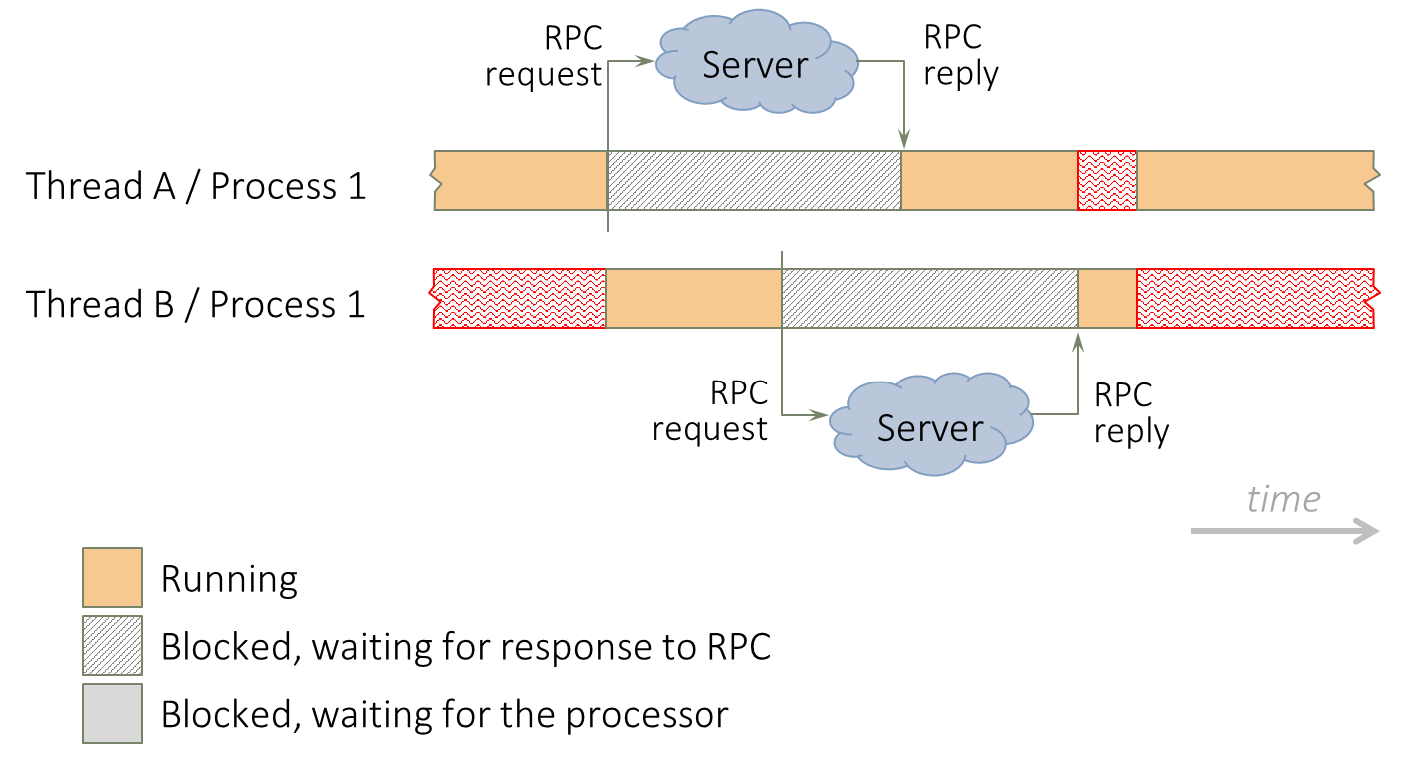
Synchronous RPC in a multi thread uniprocessor
Example
RPC request
Server
RPC reply
Process 1 / Thread A
Process 1 / Thread B
RPC request
RPC reply
Server
time
Running
Blocked, waiting for response to RPC
Blocked, waiting for the processor

Slide 18
Multicore programming challenges
Dividing activities
Finding program blocks that can be run in parallel.
Achieving balance
Adjusting block run duration and value.
Reducing data dependency
Minimizing data dependencies between blocks.
Assuring proper synchronization of the unavoidable dependencies.
Testing and debugging
Process traces are of much lower value than in single-core or single-processor environments due to potential nondeterminism

Slide 19
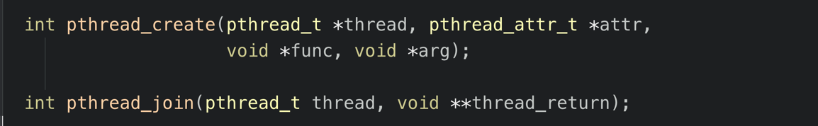
Example: Thread creation
Let’s design a 2-thread application so that one of the threads will print “A” while the other thread will print “B”.
We will use two functions from the pthread API of POSIX
Create a new thread
Wait for the termination of another thread
The POSIX API provides a way to invoke an asynchronous procedure call.
An asynchronous procedure call separates the call from the return.
The caller starts the function and continues executing concurrently with the called function.
Later, the caller can wait for function completion.

Slide 20
Before we go… let’s wrap the pthread functions
If you examine pthread’s specification, you’ll see that some of its functions return a success indicator.
In order to avoid processing the success indicator at each point of call, we’ll define wrapper functions, which will just call their similarly-named counterparts and make sure that they don’t return any funny results.
The “mythreads.h” header file will contain our wrapper functions, which differ from the original ones by having their names starting with a capital “P”.

Slide 21
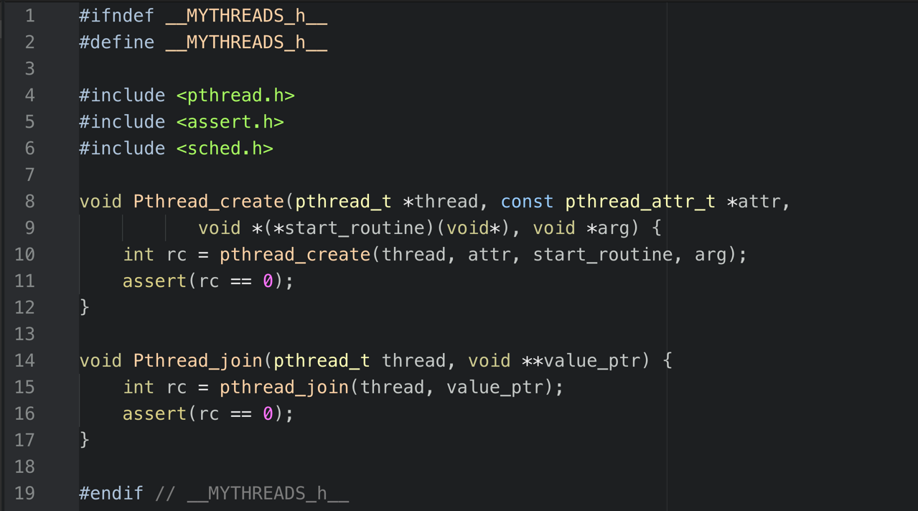
Our wrapper functions

Slide 22
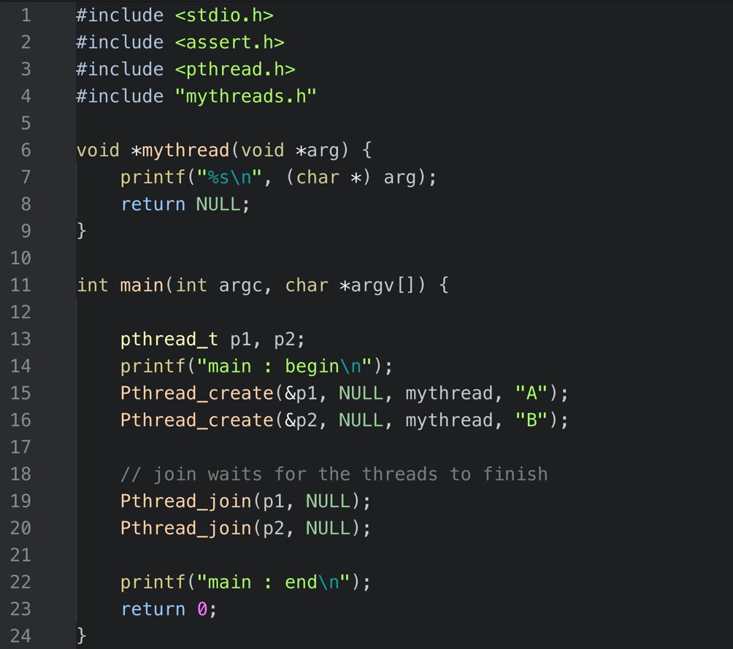

Slide 24
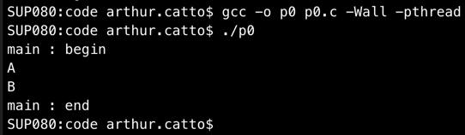
Is this the only possible output we could get?

Slide 25
Making things worse: sharing data
Example(?)
Design a 2-thread application so that
Each thread performs the summation of the sequence of non-negative integers up to a given limit.
The main function prints the accumulated result of the threads’ calculation.

Slide 26
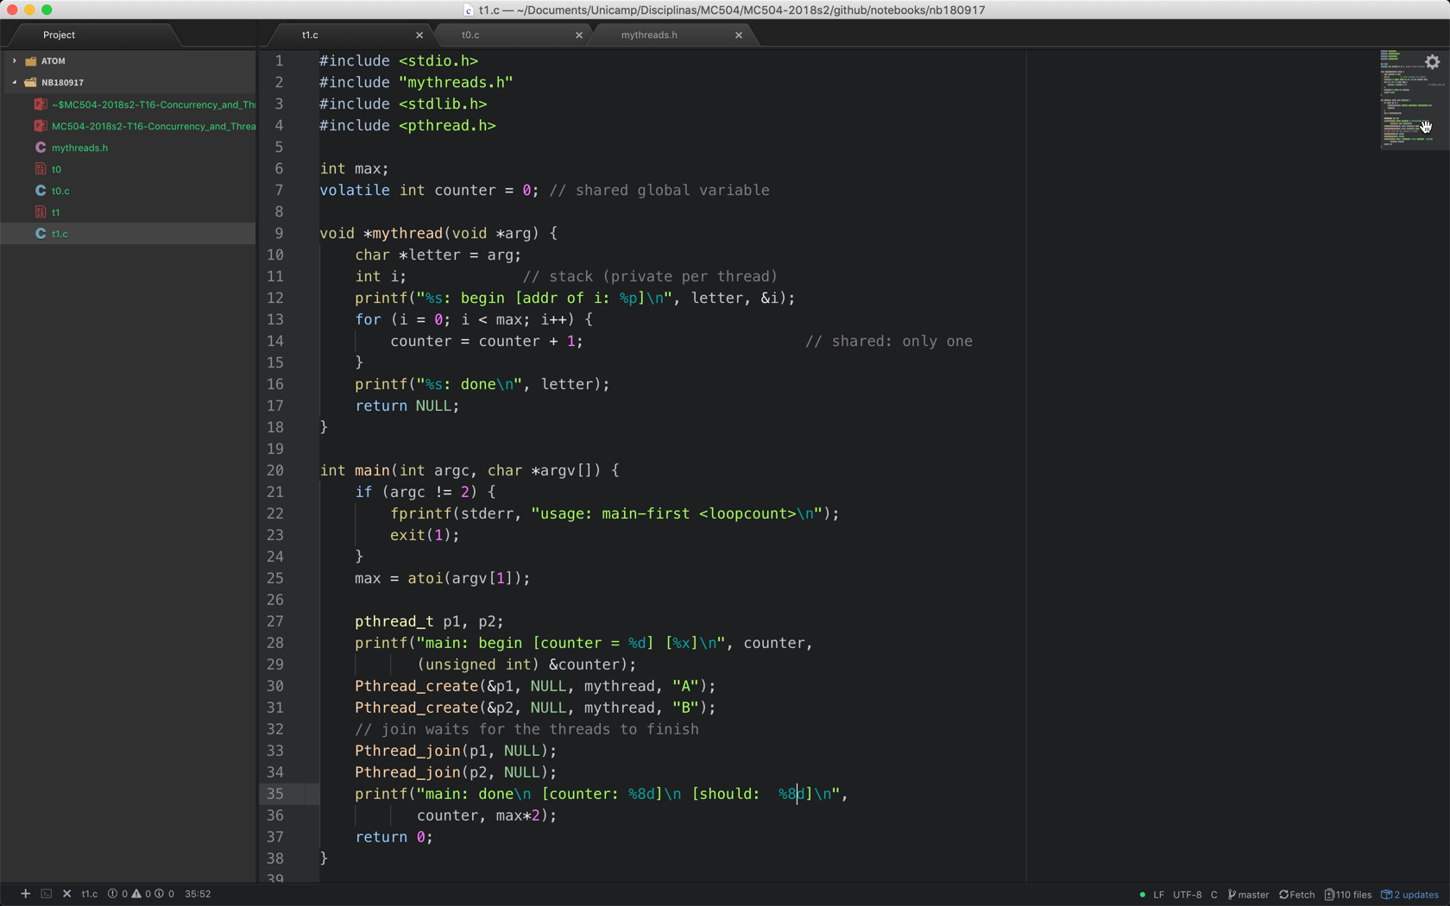

Slide 27
%8d

Slide 28
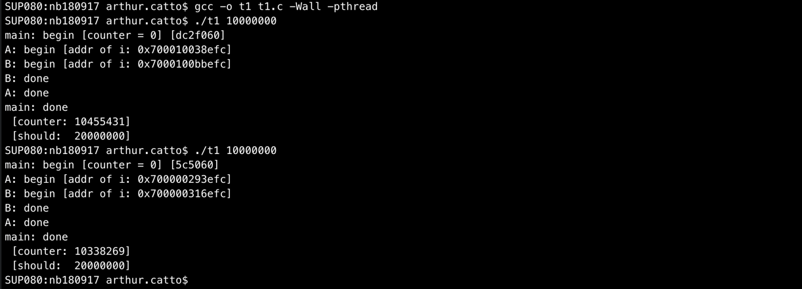
Where is the bug?

Slide 29

Example: Summing a range of integers
Design a proper multithreaded application that performs the summation of the sequence of non-negative integers up to a given limit.
Main idea
Split the sequence into $nt$ ranges.
Create $nt$ threads and let each of them sum one range.
Sum the results of all threads.

Slide 30
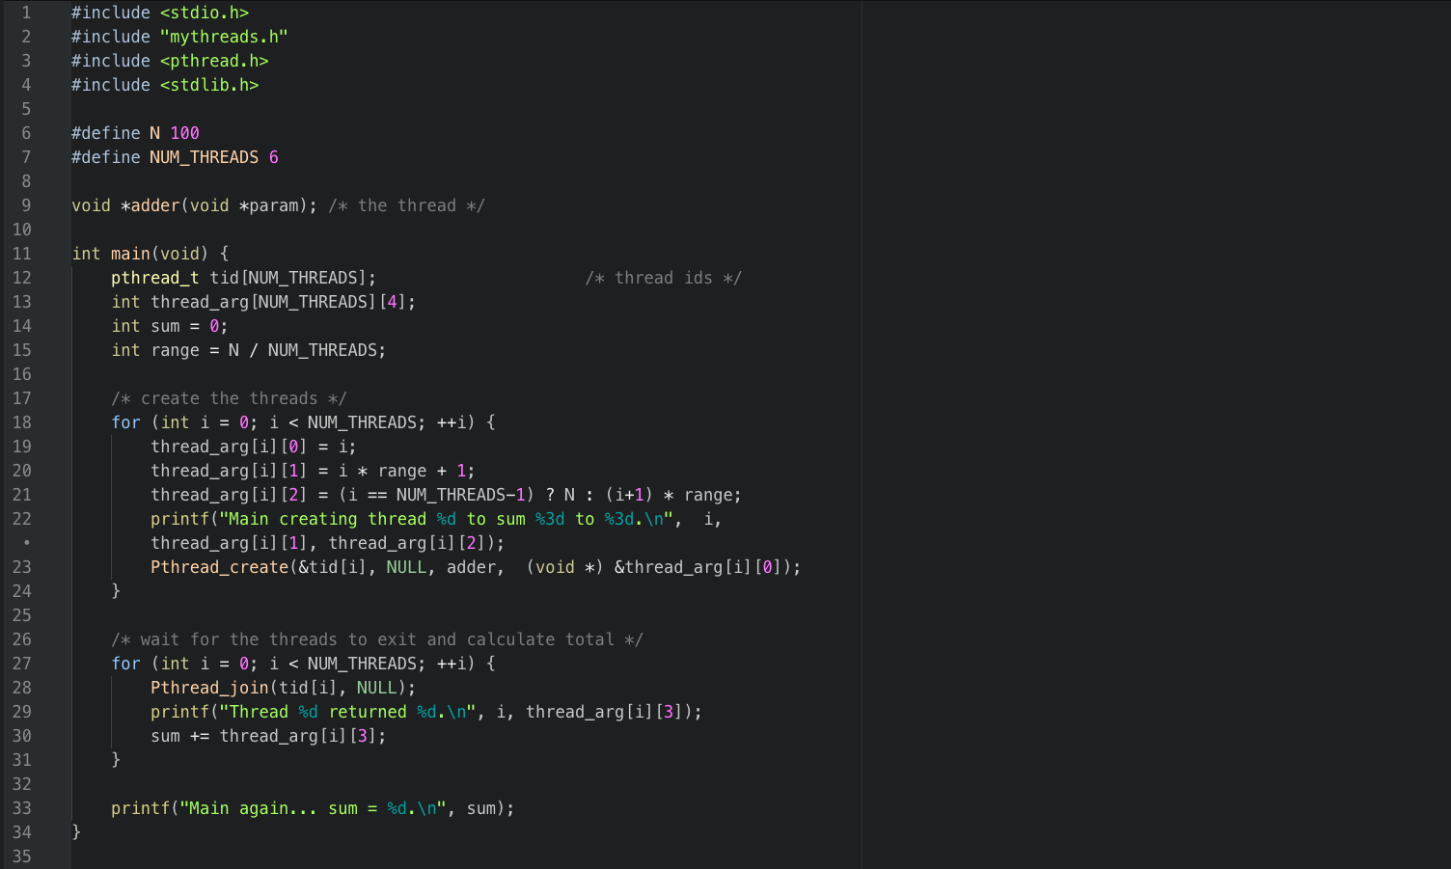
…
…

Slide 32
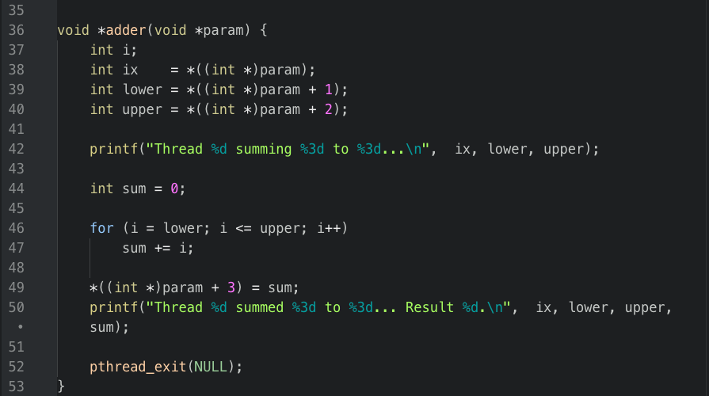

Slide 33
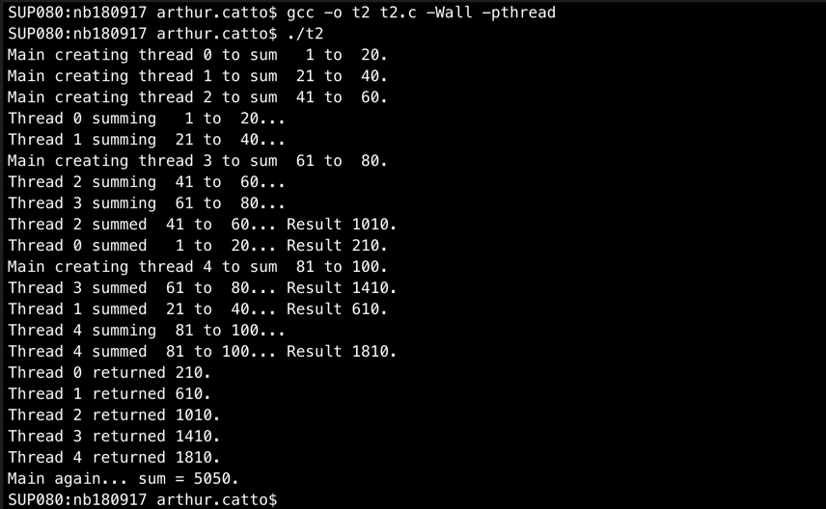
Sample result output
What do the messages tell you about program execution?

