Slide 1
Thread Synchronization 1
T17
28
24 de setembro de 2018

Slide 2
Background

Slide 3
Cooperating threads may affect and be affected by one another...
Independent threads operate on disjoint subsets of memory.
So, reasoning about them differs little from reasoning about a set of independent single-threaded processes.
Most multi-threaded programs have per-thread state (e.g., a thread’s stack and registers) and shared state (shared variables on the heap).
Cooperating threads read and write shared space and, thus, affect or can be affected by other simultaneously running threads.
Concurrent access to shared data may result in data inconsistency.
Thus, maintaining data consistency requires mechanisms to ensure orderly execution of cooperating threads.

Slide 4
Writing correct programs involving multiple cooperating threads is not that easy...
We are used to thinking ”sequentially” when reasoning about programs.
Unfortunately, this does not work for cooperating threads because...
Program execution depends on the possible interleavings of threads’ access to shared state.
Program execution can be nondeterministic.
Compilers and processor hardware can reorder instructions.
Let us have a closer look at each of these situations.

Slide 5

Program execution depends on the possible interleavings of threads’ access to shared state.
Assuming that $x$ is a shared variable on the heap…
What will be the final value of $x$?
Thread A | Thread B
… | …
x = 1; | x = 2;
… | …

Slide 6
Program execution can be nondeterministic.
Different runs of the same program may produce different results, because…
The scheduler may make different scheduling decisions.
The processor may run at a different frequency.
Another concurrent program may affect the cache hit rate.
Debugging techniques may affect the program’s behavior.
Heisenbugs (bugs that disappear or change when examined) are much more difficult to diagnose than Bohrbugs (deterministic bugs).
How can we debug programs whose behavior changes across runs?

Slide 7

Compilers and processor hardware can reorder instructions.
Modern compilers and hardware reorder instructions to improve performance.
This is generally invisible to single-threaded programs but can become visible when multiple threads interact via shared variables.
Can we be sure that $p$has already been initialized when $q$is calculated?
Thread A | Thread B
… | …
p = someComputation(); | while (!pInitialized)
pInitialized = true; | ;
… | q = anotherComputation(p)
 | …

Slide 8
We will study a structured synchronization approach to sharing state in multi-threaded programs.
By a structured synchronization approach we mean…
To structure the program to facilitate reasoning about concurrency.
To use a set of standard synchronization primitives to control access to shared state.
Our goal is to be able to reason about a thread’s behavior while avoiding the danger of having to consider all the possible interleavings that may occur.

Slide 9
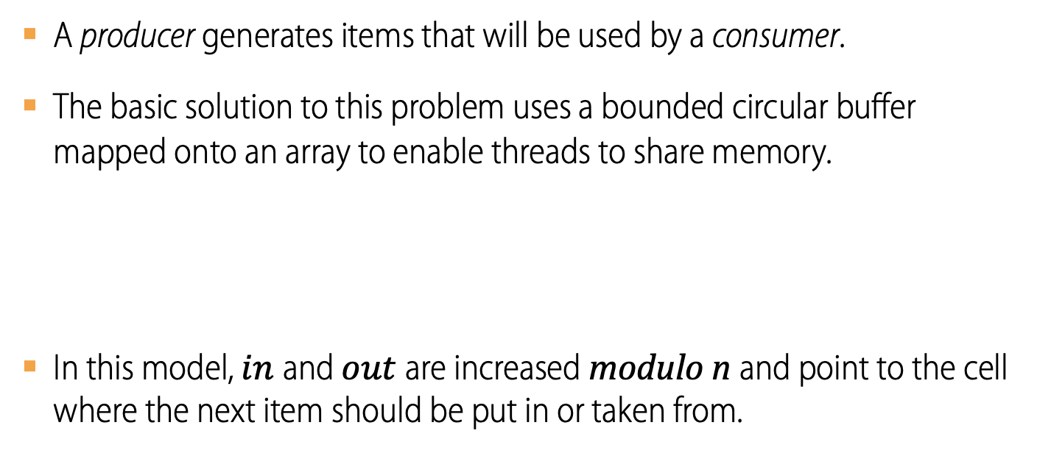
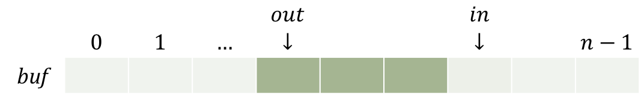
The Producer–Consumer problem
Example
A producer generates items that will be used by a consumer.
The basic solution to this problem uses a bounded circular buffer mapped onto an array to enable threads to share memory.
In this model, $in$and $out$are increased modulo n and point to the cell where the next item should be put in or taken from.
 |  |  |  | $$out$$ |  |  | $$in$$
 | $$0$$ | $$1$$ | $$…$$ | $$↓$$ |  |  | $$↓$$ |  | $$n−1$$
buf
How do the producer and consumer check if the buffer is empty?
How do they check if the buffer is full?

Slide 10
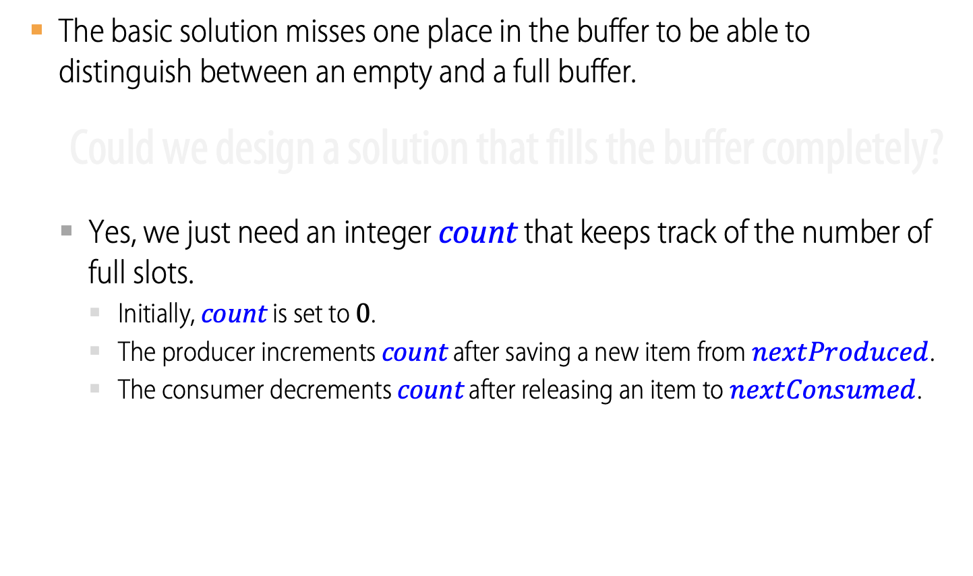
The Producer–Consumer problem
Example
The basic solution misses one place in the buffer to be able to distinguish between an empty and a full buffer.
Could we design a solution that fills the buffer completely?
Yes, we just need an integer count that keeps track of the number of full slots.
Initially, count is set to $0$.
The producer increments count after saving a new item from $nextProduced$.
The consumer decrements count after releasing an item to $nextConsumed$.

Slide 11
Suggested Producer and Consumer Routines
Producer
while (true) {
/* receive an item from nextProduced */
while (count == BUFFER_SIZE)
/* do nothing */ ;
buffer[in] = nextProduced;
in = (in + 1) % BUFFER_SIZE;
count++;
}
Consumer
while (true) {
while (count == 0)
/* do nothing */ ;
nextConsumed = buffer[out];
out = (out + 1) % BUFFER_SIZE;
count--;
/* release an item to nextConsumed */
}

Slide 12
Producer routine
Example
…
while (true) {
/* place a new item in nextProduced */
while (count == BUFFER_SIZE)
/* do nothing */ ;
buffer[in] = nextProduced;
in = (in + 1) % BUFFER_SIZE;
count++;
}
…

Slide 13
Consumer routine
Example
…
while (true) {
while (count == 0)
/* do nothing */ ;
nextConsumed = buffer[out];
out = (out + 1) % BUFFER_SIZE;
count--;
/* consume the item in nextConsumed */
}
…

Slide 14
What may happen if the two threads run simultaneously?
A compiler could have translated count++ into
register1 = count
register1 = register1 + 1
count = register1
… and count−− into
register2 = count
register2 = register2 – 1
count = register2
Producer and consumer may now update count concurrently, and...

Slide 15
… get involved in a race condition over count.
Consider count == 5 and the following instruction interleaving
Could the final value of count be different?
Step | Process | Instruction | count | reg1 | reg2
0 | producer | register1 = count | 5 | 5
1 | producer | register1 = register1 + 1 | 5 | 6
2 | consumer | register2 = count | 5 | 6 | 5
3 | consumer | register2 = register2 - 1 | 5 | 6 | 4
4 | producer | count = register1 | 6 | 6 | 4
5 | consumer | count = register2 | 4 | 6 | 4

Slide 16
We say that there is a race condition when …
Two or more threads share a variable
and
their execution is interleaved in an arbitrary manner
so that
they may leave the shared variable with a final value
which
could not be produced if they were run sequentially, in any possible order.

Slide 17
The Critical-Section Problem

Slide 18
Critical sections are code segments in two or more threads which may get involved in a race condition.
A solution to the critical section problem involves the design of a protocol that such threads could use in order to avoid the creation of race conditions between them.
A proper solution to the critical section problem must
Make no assumption about the threads’ relative speed
Satisfy three additional requirements
Safety (aka mutual exclusion)
Liveness (aka progress)
Bounded waiting (aka starvation-free)

Slide 19
What’s the meaning of those extra requirements?
Safety (aka mutual exclusion)
if a thread is executing in its critical section then no other thread can be executing in its critical section
…
…

Slide 20
Solving the Critical-Section Problem requires...
…
Liveness (aka progress)
if no thread is executing in its critical section and there are threads willing to enter their critical sections then one of these threads will be allowed to enter its critical section within a finite amount of time
…

Slide 21
Solving the Critical-Section Problem requires...
…
…
Bounded Waiting (aka starvation-free)
if a thread has made a request to enter its critical section and such request has not been granted yet then this thread must be allowed to enter its critical section within a finite amount of time

Slide 22
On designing a solution, we will assume that…
The threads will be arbitrarily interleaved.
After entering its critical section, a thread only stays there for a finite amount of time.
Memory fetch and store are atomic (i.e. non-interruptible).
Also, a proper solution should be…
Efficient
It should not consume an unreasonable amount of resources while waiting.
Fair
It should not make some thread wait longer than others without reason.
Simple
It should be easy to understand and use.

Slide 23
The threads use one shared flag to avoid entering the critical section at the same time.
Solution attempt #1:
 | Thread 0 | Thread 1
1. | while (true) { | while (true) {
2. | if (!flag) { | if (!flag) {
3. | flag = true; | flag = true;
4. | /* Critical Section */ | /* Critical Section */
5. | flag = false; | flag = false;
6. | } | }
7. | … | …
8. | } | }
Does this attempt satisfy the requirements that were given?
✘
Safety (mutual exclusion)
Liveness (progress)
Bounded waiting (starvation-free)

Slide 24
The threads use two shared flags to avoid entering the critical section at the same time.
Solution attempt #2:
 | Thread 0 | Thread 1
1. | while (true) { | while (true) {
2. | flag0 = true; | flag1 = true;
3. | if (!flag1) { | if (!flag0) {
4. | /* Critical Section */ | /* Critical Section */
5. | flag0 = false; | flag1 = false;
6. | } | }
7. | … | …
8. | } | }
Does this attempt satisfy the requirements that were given?
✔
✘
Safety (mutual exclusion)
Liveness (progress)
Bounded waiting (starvation-free)

Slide 25
The threads use two shared flags and a turn indicator to avoid entering the critical section at the same time.
Peterson’s algorithm:
 | Thread 0 | Thread 1
1. | while (true) { | while (true) {
2. | flag[0] = true; | flag[1] = true;
3. | turn = 1; | turn = 0;
4. | while (flag[1] && turn == 1) | while (flag[0] && turn == 0)
5. | /* do nothing */ ; | /* do nothing */ ;
6. | /* Critical Section */ | /* Critical Section */
7. | flag[0] = false; | flag[1] = false;
8. | … | …
9. | } | }
Does this attempt satisfy the requirements that were given?
✔
✔
✔
Safety (mutual exclusion)
Liveness (progress)
Bounded waiting (starvation-free)

Slide 26
Analysis of Peterson’s Algorithm for Thread T_{i}
 | Thread i
1. | j = 1 - i;
2. | while (true) {
3. | flag[i] = true;
4. | turn = j;
5. | while (flag[j] && turn == j)
6. | /* do nothing */ ;
7. | /* Critical Section */
8. | flag[i] = false;
9. | …
10. | }
Does it satisfy the safety requirement?
Yes. How? Why?
Does it satisfy the liveness requirement?
Yes. How? Why?
Is it starvation-free as required?
Yes. How? Why?
Are there any problems with it?
Yes. What?

Slide 27
Peterson’s algorithm: what do you say?
Peterson’s algorithm works, but it is unsatisfactory.
Solution is complicated.
Proving correctness is tricky, even for a simple case.
While thread is waiting, it is consuming processor time.
Can we do better? How?
Define higher-level programming abstractions to simplify concurrent programming.
Use hardware features to eliminate busy-waiting or at least reduce it to an absolute minimum.

Slide 28
Locks

Slide 29
Lessons from Producer-Consumer
Solution is complicated…
… so “obvious code” often has bugs.
Modern compilers/architectures reorder instructions…
… thus making reasoning even more difficult.
Generalizing to many threads/processors…
… is even more complex: see Peterson’s algorithm.
Notes:
…

Slide 30
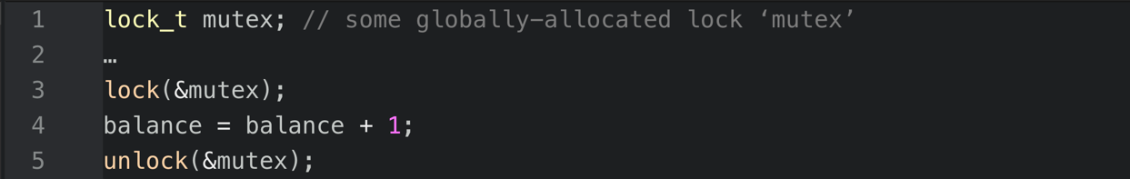

The Basic Idea
We want any critical section to execute as if it were a single atomic instruction.
For example, consider the canonical update of a shared variable
Let us add a lock – i.e. some protective code – around the critical section
Now assume that the lock variable (e.g. mutex) holds the state of the lock.
available (or unlocked or free) $→$ no thread holds the lock.
acquired (or locked or held) $→$ exactly one thread holds the lock and (presumably) is in the critical section protected by that lock.

Slide 31
The semantics of lock() and unlock()
lock()
The thread tries to acquire the lock.
If no other thread holds the lock, the thread will acquire the lock and may enter the critical section.
Otherwise, lock() will not return as long as another thread is holding the lock, thus preventing the thread from entering the critical section.
The thread that holds the lock is said to be the owner of the lock.
unlock()
When the owner of the lock performs this operation, the lock becomes available again.
If there are other threads waiting on lock(), one of them will succeed and acquire the lock. Otherwise, the lock will remain available (or free).

Slide 32
Why only lock and unlock?
Suppose we add another method to ask if a lock is free.
Suppose it returns true.
In this case, would the lock be…
Free?
Busy?
Don’t know?

Slide 33
Locks exhibit three main properties
At most one lock holder at a time (safety).
If no one holding, acquirer gets lock (progress).
If all lock holders finish and there are no higher priority waiters, waiter eventually gets lock (progress).
What about starvation?
Notes:
Bounded waiting

Slide 34
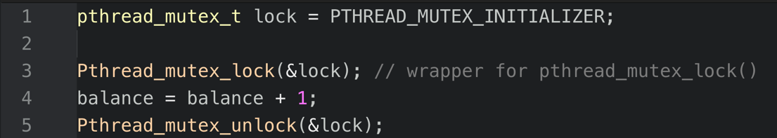
What are mutex variables?
The POSIX library implements mutex locks to provide mutual exclusion between threads.
As before, we will add wrapper functions to our mythreads.h header file to deal with the potential failure of any call.
We may be using different locks to protect different critical sections, thus adopting a more fine-grained approach, to increase the potential for concurrent execution.

Slide 35
Mutual exclusion between threads in POSIX
The POSIX pthreads package uses mutex objects to implement mutual exclusion between threads and prevent race conditions.
mutex variables are one of the primary means for implementing thread synchronization and for protecting shared data when multiple writes occur.
A mutex variable acts like a ”lock” protecting access to a shared data resource.
The basic concept of a mutex as used in pthreads is that only one thread can lock (or own) a mutex variable at any given time.
Thus, even if several threads try to lock a mutex only one thread will succeed.
No other thread can own that mutex until the owning thread unlocks it.
Threads must ”take turns” in order to access protected data.
mutex semantics is similar to lock semantics and both work essentially in the same way.
Notes:
Bounded waiting

Slide 36
Can we build an efficient lock?
Is there any required hardware support?
Any required OS support?

