Slide 1
Thread Synchronization 2
T18
28
26 de setembro de 2018

Slide 2
Can we build an efficient lock?
Is there any required hardware support?
Any required OS support?

Slide 3
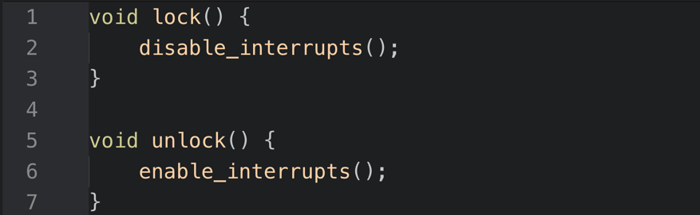
A First Attempt: Controlling Interrupts
Interrupts can be used to control access to critical sections.
This is a simple solution and one of the earliest means to provide mutual exclusion.
It was conceived for single-processor systems.
Would you have any issues with this proposal?

Slide 4
Interrupt Control Raises Many Issues…
It allows a thread to execute a privileged operation.
It is unwise to put too much trust in applications.
Greedy (or malicious) program could monopolize the processor.
It creates a centralized point of control for all critical sections of a program.
It does not work on multiprocessors.
Interrupts may be lost if their control is disabled for long periods of time.
In modern CPUs, instructions that mask or unmask interrupts tend to be slower than others.

Slide 5
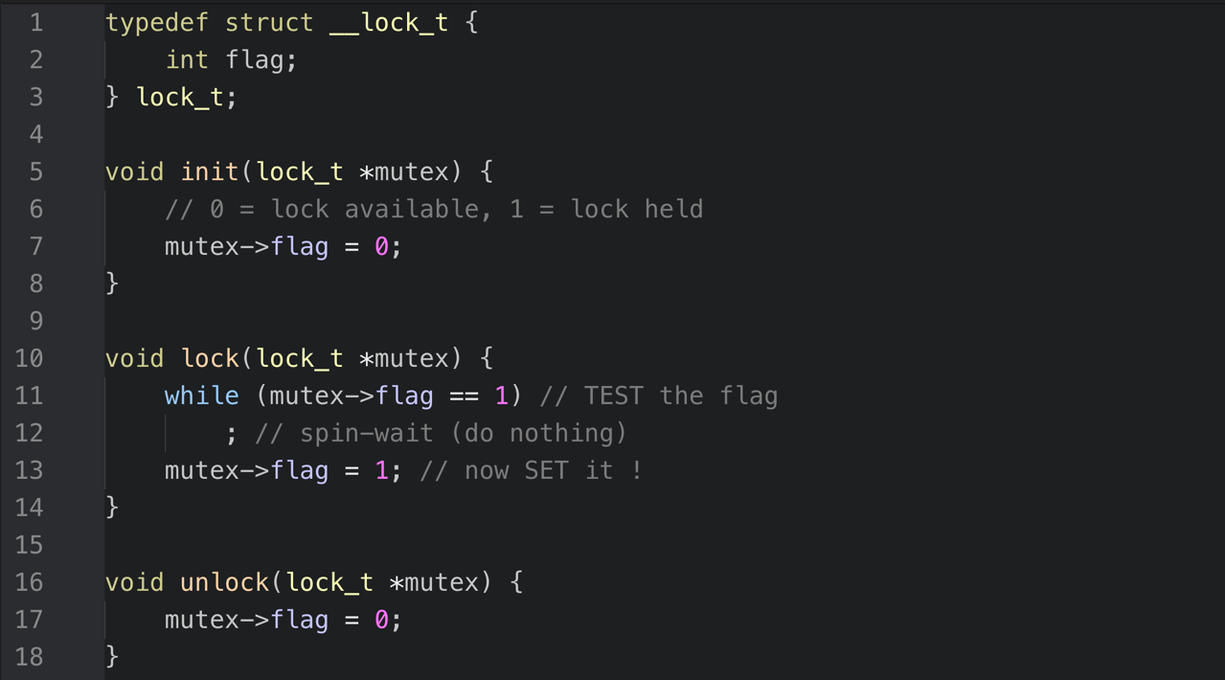
Why do we need hardware support?
Let’s try to use a software flag to indicate whether the lock is held or not.
Do you have any issues with this code?

Slide 6
Our software attempt has two problems…
Correctness: There is no mutual exclusion (assume flag == 0 initially)
Thread 1 Thread 2
call lock()
while (flag == 1)
;
interrupt switch to thread 2
call lock()
while (flag == 1)
;
flag = 1;
interrupt switch to thread 1
flag = 1;
Efficiency: Spin-waiting wastes CPU time just waiting for another thread.

Slide 7
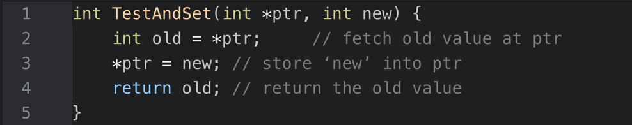
Getting Some Help from Hardware: Test-and-Set
Since disabling interrupts and software flags did not work, system designers started to look for hardware support.
In the early 60’s the Burroughs B5000 provided a simple solution, which is still widely adopted today, even for single CPU systems.
Semantics of an atomic instruction to support the creation of simple locks:
It fetches the value pointed to by ptr, sets that value to new and returns the fetched value.
This sequence of operations is performed atomically.

Slide 8
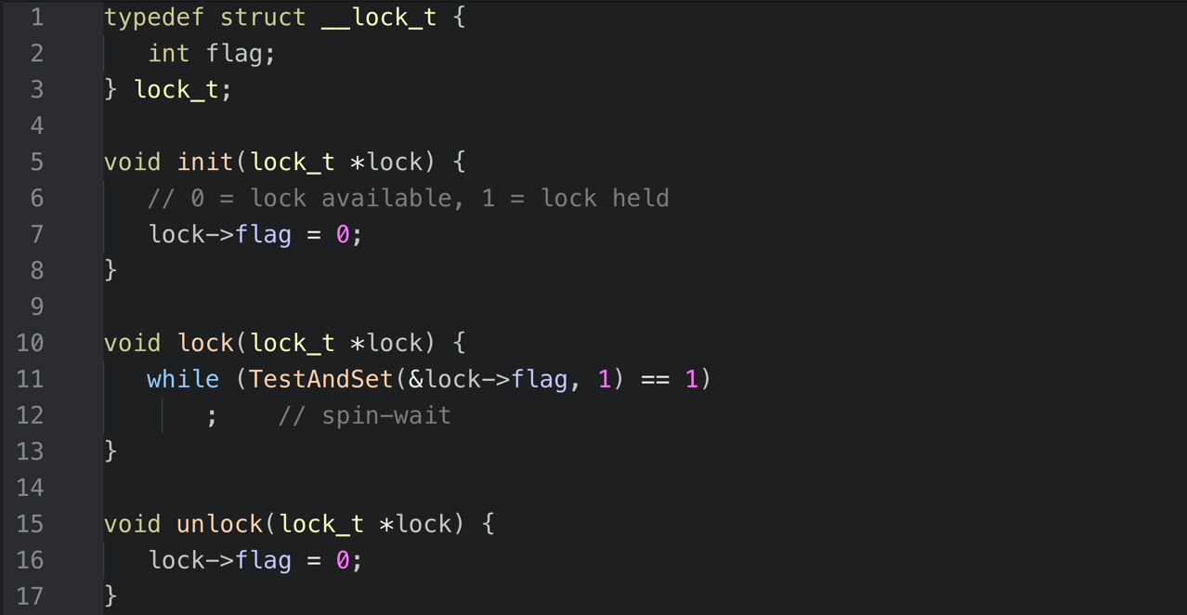
A Working Spin Lock using TestAndSet
To work correctly on a single processor, this solution requires a preemptive scheduler.
Could you schedule the threads in such a way that it would not work?

Slide 9
Evaluating the Basic Spin Lock
✔
Correctness
Correctness
It allows only a single thread to enter the critical section at a time.
Fairness
It does not provide any guarantees of fairness.
Indeed, a spinning thread may spin forever.
Performance
In the single CPU, performance overheads can be quite painful.
If the number of threads roughly equals the number of CPUs, spin locks work reasonably well.
✘
Fairness
Performance
?

Slide 10
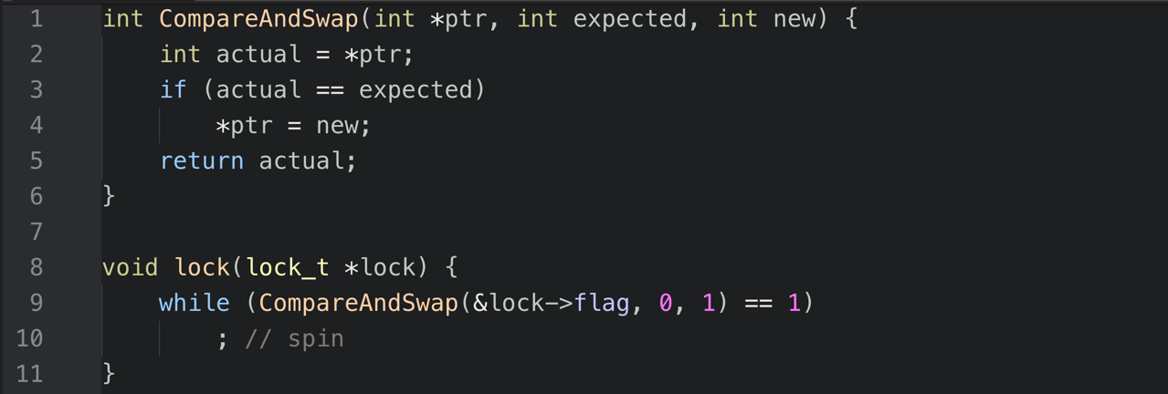
Another Atomic Primitive: Compare-and-Swap
SPARC, x86
Test whether the value at the address ptr is equal to expected.
If so, update the memory location pointed to by ptr with the new value.
In either case, return the actual value at that memory location.
This is enough for us to write a spin lock…

Slide 11

Yet Another: Load-Linked and Store-Conditional
MIPS, Alpha, PowerPC, ARM
int LoadLinked(int *ptr) {
return *ptr;
}
int StoreConditional(int *ptr, int value) {
if (no one has updated *ptr since the LoadLinked to this address) {
*ptr = value;
return 1; // success!
} else {
return 0; // failed to update
}
}
The store-conditional only succeeds if no intermittent store to the address has taken place.
Success $→$ return 1 and update the value at ptr to value.
Fail $→$ the value at ptr is not updated and 0 is returned.

Slide 12
A Lock Using Load-Linked and Store-Conditional
void lock(lock_t *lock) {
while (1) {
while (LoadLinked(&lock->flag) == 1)
; // spin until it’s zero
if (StoreConditional(&lock->flag, 1) == 1)
return; // if set-it-to-1 was a success: all done
// otherwise: try it all over again
}
}
void unlock(lock_t *lock) {
lock->flag = 0;
}

Slide 13
A Shorter Lock Using LoadLinked and StoreConditional
void lock(lock_t *lock) {
while (LoadLinked(&lock->flag) ||
!StoreConditional(&lock->flag, 1))
; // spin
}
void unlock(lock_t *lock) {
lock->flag = 0;
}
Are both solutions equivalent?

Slide 14
And A Last One: Fetch-and-Add
Atomically increment the value pointed to by ptr, while returning the old value.
int FetchAndAdd(int *ptr) {
int old = *ptr;
*ptr = old + 1;
return old;
}
FetchAndAdd allows us to implement a so-called ticket lock (Mellor-Crummey and Scott, 1991), that can guarantee progress for all threads, as we’ll see next.

Slide 15
Ticket Lock: Ensuring progress for all threads
typedef struct __lock_t {
int ticket;
int turn;
} lock_t;
void lock_init(lock_t *lock) {
lock->ticket = 0;
lock->turn = 0;
}
void lock(lock_t *lock) {
int myturn = FetchAndAdd(&lock->ticket);
while (lock->turn != myturn)
; // spin
}
void unlock(lock_t *lock) {
FetchAndAdd(&lock->turn);
}
Do you understand how this solution works?
Can you tell the main difference between this solution and the former ones?

Slide 16
Can All That Spinning Be Avoided?
Hardware-based spin locks are simple and they work.
However, in some cases, such solutions can be quite inefficient.
Can you tell why?
Any time a thread gets caught spinning, it wastes an entire time slice doing nothing but checking a value.
What might happen when there are 𝑛 concurrent threads?
Can we develop a lock that does not needlessly waste time busy waiting on the CPU?

Slide 17
A Simple Approach: Just Yield Control
When you are going to spin, give up the CPU to another thread.
OS system call moves the caller from the running to the ready state.
void init(lock_t *ptr) {
ptr->flag = 0;
}
void lock(lock_t *ptr) {
while (TestAndSet(&ptr->flag, 1) == 1)
yield(); // give up the CPU
}
void unlock(lock_t *ptr) {
ptr->flag = 0;
}
With many threads, context switching can become expensive, while the starvation problem still remains.

Slide 18
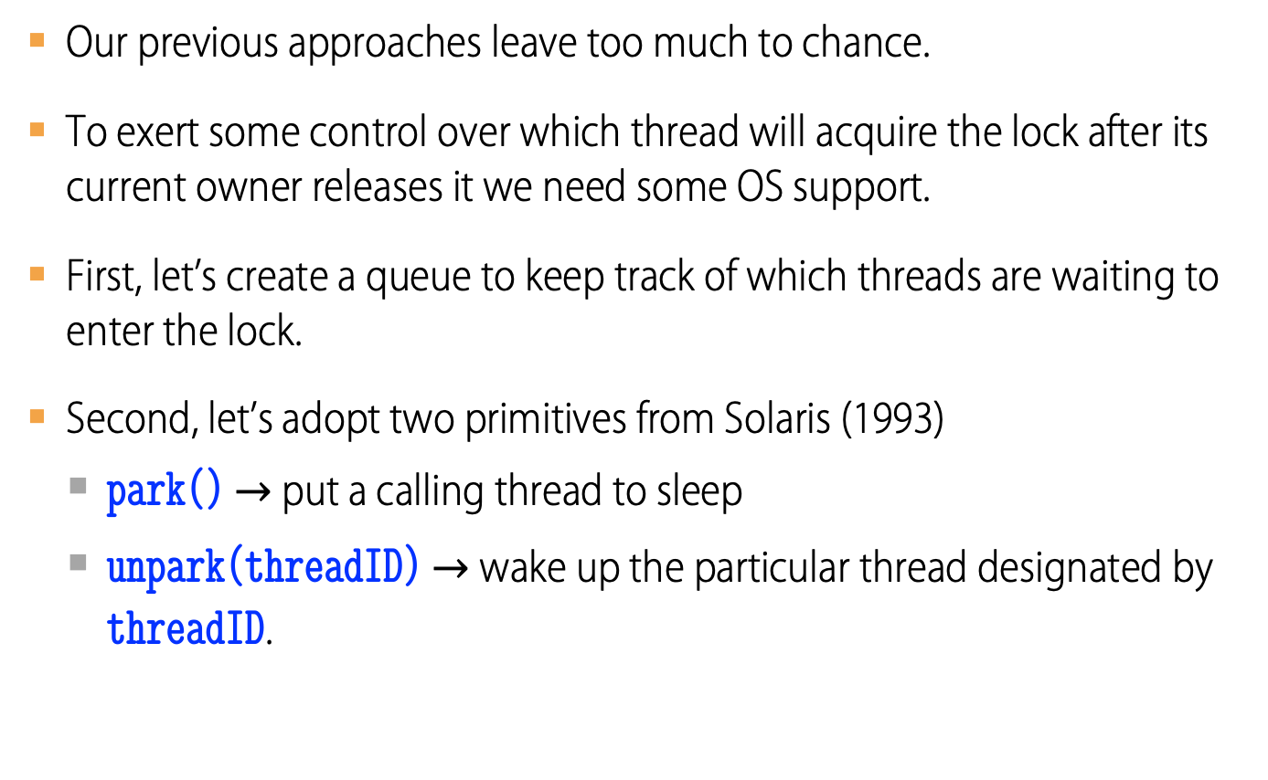
Using Queues: Sleeping Instead of Spinning
Our previous approaches leave too much to chance.
To exert some control over which thread will acquire the lock after its current owner releases it we need some OS support.
First, let’s create a queue to keep track of which threads are waiting to enter the lock.
Second, let’s adopt two primitives from Solaris (1993)
park() $→$ put a calling thread to sleep
unpark(threadID) $→$ wake up the particular thread designated by threadID.

Slide 19
Lock With Queues, Test-and-set, Yield and Wakeup
typedef struct __lock_t {
int flag;
int guard;
queue_t *q; }
lock_t;
void lock_init(lock_t *m) {
m->flag = 0;
m->guard = 0;
queue_init(m->q);
}
...

Slide 20
Lock With Queues, Test-and-set, Yield and Wakeup
void lock(lock_t *m) {
while (TestAndSet(&m->guard, 1) == 1)
; // acquire guard lock by spinning
if (m->flag == 0) {
m->flag = 1; // lock is acquired
m->guard = 0;
} else {
queue_add(m->q, gettid());
m->guard = 0;
park();
}
}
...

Slide 21
Lock With Queues, Test-and-set, Yield and Wakeup
void unlock(lock_t *m) {
while (TestAndSet(&m->guard, 1) == 1)
; // acquire guard lock by spinning
if (queue_empty(m->q))
m->flag = 0; // let go of lock; no one wants it
else
unpark(queue_remove(m->q)); // hold lock (for next thread!)
m->guard = 0;
}

Slide 22
Some interesting things about the queueing model
Why did we combine test-and-set and the waiting queue?
Why did we use a waiting queue at all?
What is the purpose of the guard field in lock_t?
Aren’t there spin-locks in lock() and unlock()? Isn’t that what we were trying to eliminate?
What happens in lock() when a thread cannot acquire the lock?
In lock(), what if the lock release came after park() instead of before?
Look at park() – line 20 – carefully. Can you spot a threat nearby?

Slide 23
An unexpected race condition…
There is a race condition just before the park() call on line 20.
Let’s see what could happen there. Assume that…
There are two threads A and B.
Thread A is running but is descheduled just before calling park().
Control is switched to thread B which is holding the lock.
Thread B releases the lock, finds the queue empty and does nothing more.
Thread A will now sleep forever…
This problem is sometimes called the wakeup/waiting race.

Slide 24
How to cure the wakeup/waiting race
Solaris solved this problem by adding a third system call: setpark().
By calling this routine, a thread indicates it is about to park.
If it happens to be interrupted and another thread calls unpark() before park() is actually called, the subsequent park() returns immediately instead of sleeping.
Only a small change is needed within lock()…
… else {
queue_add(m->q, gettid());
setpark(); // new code
m->guard = 0;
park();
}

Slide 25
Other approaches: Futex
Linux provides a futex which is similar to Solaris’ park and unpark.
futex_wait(address, expected)
Put the calling thread to sleep, if the value at address is equal to expected.
Otherwise, the call returns immediately.
futex_wake(address)
Wake up one thread that is waiting on the queue.
The code snippet of the next slides comes from lowlevellock.h in the nptl library
The high bit of the integer v tracks whether the lock is held or not.
All the other bits give the number of waiters.

Slide 26
Implementing mutex_lock
void mutex_lock(int *mutex) {
int v;
/* Bit 31 was clear, we got the mutex (this is the fastpath) */
if (atomic_bit_test_set(mutex, 31) == 0)
return;
atomic_increment(mutex);
while (1) {
if (atomic_bit_test_set(mutex, 31) == 0) {
atomic_decrement(mutex);
return;
}
/* We have to wait now. First make sure the futex value
we are monitoring is truly negative (i.e. locked). */
v = *mutex;
if (v >= 0)
continue;
futex_wait(mutex, v);
}
}

Slide 27
Implementing mutex_unlock
void mutex_unlock(int *mutex) {
/* Adding 0x80000000 to the counter results in 0 if and only if
there are no other interested threads */
if (atomic_add_zero(mutex, 0x80000000))
return;
/* There are other threads waiting for this mutex,
wake one of them up */
futex_wake(mutex);
}

Slide 28
Two-Phase Locks
A two-phase lock realizes that spinning can be useful if the lock is about to be released.
First phase
The lock spins for a while, hoping that it can acquire the lock.
If the lock is not acquired during the first spin phase, a second phase is entered,
Second phase
The caller is put to sleep.
The caller is only woken up when the lock becomes free later.

Slide 29
Rules for Using Locks
Every lock is initially free.
Always acquire a lock before accessing the shared data structure it protects.
Do it at the beginning of procedure!
Always release a lock after finishing with the protected shared data.
Do it at the end of procedure!
Only the holder can release a lock.
Do not throw a lock for someone else to release.
Never access shared data without a protecting lock.
It is dangerous!

Slide 30
Application Roadmap
Concurrent Applications
Shared Objects
Bounded Buffer |  | Barrier
Synchronization Variables
Locks | Condition Variables |  | Semaphores
Atomic Instructions
Interrupt Disable |  | Test-and-Set
Hardware
Multiple Processors |  | Hardware Interrupts

Slide 31
Lock Example: malloc and free
An unsafe version of malloc and free can be made thread-safe by
Lock heaplock;
char *ts_malloc(int n) {
char *p;
heaplock.acquire();
p = (char *) malloc(...);
heaplock.release();
return p;
}
void ts_free(char *p) {
heaplock.acquire();
free(p);
heaplock.release();
}

Slide 32
Will this code work?
data_t *p;
...
if (p == NULL) {
lock.acquire();
if (p == NULL) {
p = newP();
}
lock.release();
}
... use p->field1 ...
data_t *newP() {
data_t *p;
p = malloc(sizeof(*p));
p->field1 = …;
p->field2 = …;
return p;
}
Notes:
No! p can be written by hardware/compiler before initialization is complete

Slide 33
An attempt at implementing Bounded Buffer
void tryput(int item) { lock.acquire(); if ((tail - front) < MAX) { buf[tail % MAX] = item; tail++; } lock.release(); } | int tryget() { int item = NULL; lock.acquire(); if (front < tail) { item = buf[front % MAX]; front++; } lock.release(); return item; }
MAX is buffer capacity
Initially
front = tail = 0
lock is free
Notes:
For simplicity, assume no wraparound on the integers front and last; I’ll assume you can fix that if you want
Front = total number of items that have ever been removed; tail is total # ever inserted
Locks at beginning of procedure; unlock at end; no access outside of locks
Note that we don’t know when we once we release the lock whether the buffer is still empty – we only know the state of the buffer while holding the lock!

Slide 34
An attempt at implementing Bounded Buffer
What is the underlying data structure?
How many items can be in the buffer at the same time?
How do we know whether the buffer is full?
If tryget returns NULL, do we know the buffer is empty?
How do we know whether the buffer is empty?
What happens if the producer calls tryput and the buffer is full?
What happens if the consumer calls tryget and the buffer is empty?
How should we use tryget to make sure we get an item?
If we poll tryget in a loop, what happens to a thread calling tryput?
Is it a good solution?
Notes:
For simplicity, assume no wraparound on the integers front and last; I’ll assume you can fix that if you want
Front = total number of items that have ever been removed; tail is total # ever inserted
Locks at beginning of procedure; unlock at end; no access outside of locks
Note that we don’t know when we once we release the lock whether the buffer is still empty – we only know the state of the buffer while holding the lock!

Slide 35
We can do better with Condition Variables...
Condition variables provide yet another way for threads to synchronize.
While locks implement synchronization by controlling thread access to data, condition variables allow threads to synchronize based upon the actual value of data.
Without condition variables, threads would have to continually poll (possibly in a critical section), to check if a condition is met.
This can be very resource consuming since the thread would be continuously busy in this activity.
A condition variable is a way to achieve the same goal without polling.
A condition variable is always used in conjunction with a lock and allows a thread to wait inside a critical section

Slide 36
Condition Variables’ methods
CV::wait() blocks the calling thread until the related condition variable is signalled.
A thread should call wait while holding a lock, and will automatically and atomically release the lock to allow another thread to use the shared data while it waits.
After signal is received, the lock will be automatically acquired for use by the waiting thread before it is awaken and control returns to it.
The thread is responsible for releasing the lock after finishing with it.

Slide 37
Condition Variables’ methods
CV::signal() is used to wake up another thread which is waiting on the condition variable.
It should be called after the lock is acquired, and must release it to allow the wait() routine to complete.
CV::broadcast() should be used instead of CV::signal() if more than one thread is in a blocking wait state.
It is a logical error to call CV::signal() before calling CV::wait().

Slide 38
Condition Variables’ Design Pattern
methodThatWaits() { lock.acquire(); /* Read/write shared state */ while (!testSharedState()) { cv.wait(&lock); } /* Read/write shared state */ lock.release(); } | methodThatSignals() { lock.acquire(); /* Read/write shared state */ if (testSharedState()) cv.signal(&lock); /* Read/write shared state */ lock.release(); }
Notes:
For simplicity, assume no wraparound on the integers front and last; I’ll assume you can fix that if you want
Front = total number of items that have ever been removed; tail is total # ever inserted
Locks at beginning of procedure; unlock at end; no access outside of locks
Note that we don’t know when we once we release the lock whether the buffer is still empty – we only know the state of the buffer while holding the lock!

Slide 39
An advice on how to wait for a condition
Using a while loop instead of an if statement to check the waited for condition can help deal with several potential problems, such as:
If several threads are waiting for the same wake up signal, they will take turns acquiring the lock, and any one of them can then modify the condition they all waited for.
If the thread received the signal in error due to a program bug.
The Pthreads library is permitted to issue spurious wake ups to a waiting thread without violating the standard.

Slide 40
A better Bounded Buffer implementation
int get(void) { int item; lock.acquire(); while (tail == front) { empty.wait(&lock); } item = buf[front % MAX]; front++; full.signal(); lock.release(); return item; } | void put(int item) { lock.acquire(); while ((tail - front) == MAX) { full.wait(&lock); } buf[tail % MAX] = item; tail++; empty.signal(); lock.release(); }
Initially front = tail = 0
MAX is buffer capacity
empty and full are condition variables
Notes:
For simplicity, assume no wraparound on the integers front and last; I’ll assume you can fix that if you want
Front = total number of items that have ever been removed; tail is total # ever inserted
Locks at beginning of procedure; unlock at end; no access outside of locks
Note that we don’t know when we once we release the lock whether the buffer is still empty – we only know the state of the buffer while holding the lock!

Slide 41
Producer-Consumer using Bounded Buffer
void *producer(void *par) {
for (int i = 0; i < MAX_ITEMS; ++i) {
put(i);
if (i < MAX_RUN)
sleep(1);
}
return NULL;
}
void *consumer(void *par) {
int x;
for (int i = 0; i < MAX_ITEMS; ++i) {
x = get();
if (i >= 2 * MAX_RUN)
sleep(1);
}
return NULL;
}
#define MAX_BUF 4
#define MAX_RUN 6
#define MAX_ITEMS 3*MAX_RUN
#define NUM_THREADS 2

Slide 42
Producer-Consumer using Bounded Buffer
put: item = 0
get: item = 0
get: buffer empty... waiting
put: item = 1
get: item = 1
get: buffer empty... waiting
put: item = 2
get: item = 2
get: buffer empty... waiting
put: item = 3
get: item = 3
get: buffer empty... waiting
put: item = 4
get: item = 4
get: buffer empty... waiting
put: item = 5
get: item = 5
get: buffer empty... waiting
put: item = 6
put: item = 7
put: item = 8
put: item = 9
put: buffer full... waiting
get: item = 6
get: item = 7
get: item = 8
get: item = 9
get: buffer empty... waiting
put: item = 10
put: item = 11
put: item = 12
put: item = 13
put: buffer full... waiting
get: item = 10
get: item = 11
get: item = 12
put: item = 14
put: item = 15
put: item = 16
put: buffer full... waiting
get: item = 13
put: item = 17
get: item = 14
get: item = 15
get: item = 16
get: item = 17
Main(): Waited and joined with 2 threads. Done.
Program ended with exit code: 0

Slide 43
Pre and Post Conditions help us to reason about a program
What is the state of the bounded buffer at lock acquire?
front <= tail
front + MAX >= tail
These are also true on return from wait
And at lock release
Pre and post conditions allow not only for proofs of correctness but also for the design of correct programs.

Slide 44
Pre/Post Conditions
methodThatWaits() {
lock.acquire();
// Pre-condition:
// State is consistent
// Read/write shared state
while (!testSharedState()) {
cv.wait(&lock);
}
// WARNING:
// shared state may have changed!
// But testSharedState is TRUE
// and pre-condition is true
// Read/write shared state
lock.release();
}
methodThatSignals() {
lock.acquire();
// Pre-condition:
// State is consistent
// Read/write shared state
if (testSharedState())
cv.signal(&lock);
// NO WARNING:
// signal keeps lock
// Read/write shared state
lock.release();
}
Notes:
An efficient way to wait for something to happen. Code that uses CV looks like state is ok, but

Slide 45
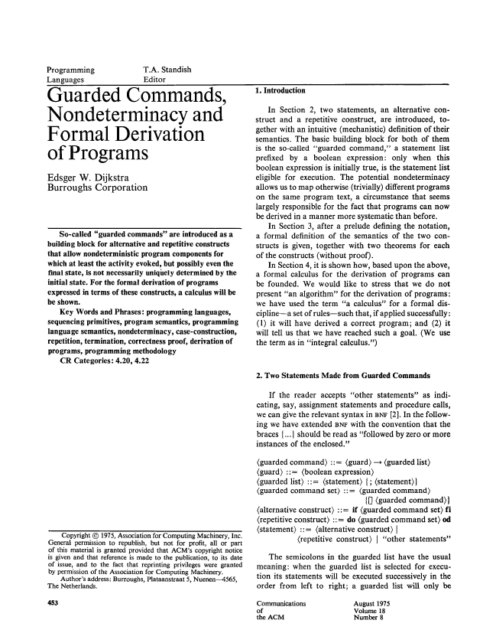
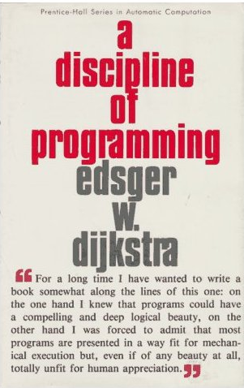

About formal derivation of programs...
Dijkstra, E. W. 1975. Guarded commands, nondeterminacy and formal derivation of programs. Commun. ACM 18, 8 (Aug. 1975), 453-457.

Slide 46
Condition Variables 1/2
ALWAYS hold lock when calling wait, signal or broadcast.
Condition variable allows a thread to wait for a change to shared state.
ALWAYS hold lock when accessing shared state.
Condition variable is memoryless and has no internal state other than a queue of waiting threads.
If signal is called when no one is waiting, nothing happens
If a thread calls wait, it will block until the next signal, regardless of how many times signal has been called in the past.
Wait atomically releases lock
What if wait, then release?
What if release, then wait?

Slide 47
Condition Variables 2/2
When a thread is woken up from wait, it may not run immediately
signal/broadcast puts thread on ready list
When lock is released, anyone might acquire it
wait MUST be in a loop
while (needToWait()) {
condition.wait(lock);
}
When a waiting thread is resumes, it may not run immediately. This behavior simplifies implementation...
Of condition variables and locks
Of code that uses condition variables and locks

Slide 48
wait must happen within a while loop because...
When waiting upon a condition, in some implementations of condition variables, such as in Java, a “spurious wakeup” is permitted to occur, in general, as a concession to the underlying platform semantics.
This has little practical impact on most application programs as a condition should always be waited upon in a loop, testing the state predicate that is being waited for.

Slide 49
Structured Synchronization
Identify objects or data structures that can be accessed by multiple threads concurrently
Add locks to object/module
Grab lock on start to every method/procedure
Release lock on finish
If you need to wait, do it whitin a while
while(needToWait()) { condition.wait(lock); }
Do not assume that you will wake up right after signal.
If do something that might wake someone up…
signal or broadcast
Always leave shared state variables in a consistent state…
When lock is released, or when waiting.

Slide 50
Never forget the rules...
Use consistent structure
Always use locks and condition variables
Always acquire lock at beginning of procedure, release at end
Always hold lock when using a condition variable
Always wait in while loop
Never spin in sleep(...)

