Slide 1
CPU Virtualization The Process API
T02

Slide 2
Essential Questions
Here we discuss process management in Unix systems, in an attempt at answering two questions
What interfaces should the OS present for process creation and control?
How should these interfaces be designed to enable ease of use as well as utility?

Slide 3
Process creation

Slide 4
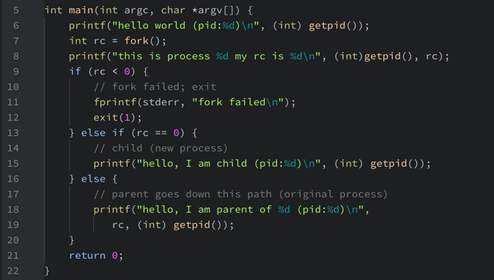
The fork() system call (p1.c)

Slide 5
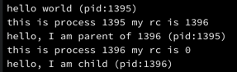
The fork() system call (p1.c)
Read the docs to find out how fork works.
Compile and run p1.c. The snapshot below is the result I got.
Did you get something similar?
Does fork seem to be working as you expected?
Can you write down a trace of p1’s execution?
Is that the only output that p1 might have produced? Could it be longer? Could the lines appear in another sequence?

Slide 6
Waiting for process termination

Slide 7
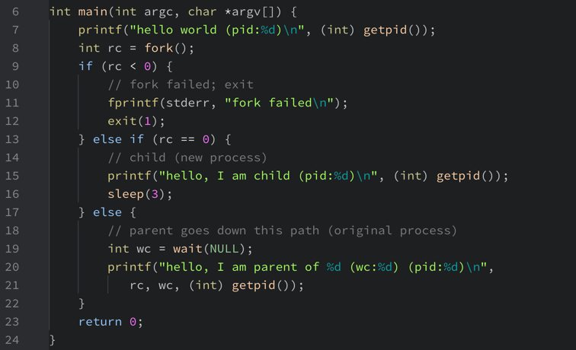
The wait() system call (p2.c)

Slide 8
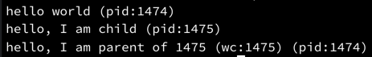
The wait() system call (p2.c)
Read the docs to learn about sleep and wait.
Compile and run p2.c. The snapshot below is what I got as a result.
Did you get something similar?
Do sleep and wait seem to be working as expected?
Can you write down a trace of p2’s execution?
Is that the only output that p2 might have produced? Could it be longer? Could the lines appear in another sequence?

Slide 9
Running an external program

Slide 10
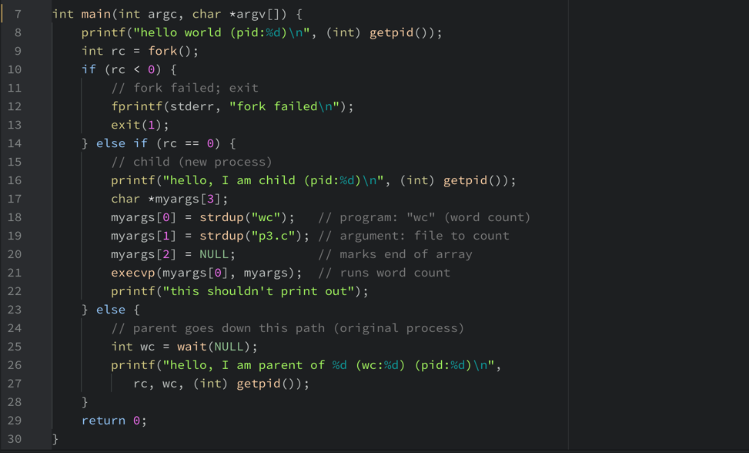
The execvp() system call (p3.c)

Slide 11
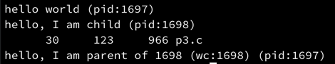
The wait() system call (p3.c)
Read the docs to learn about execvp.
Compile and run p3.c. The snapshot below is what I got as a result.
Did you get something similar?
Does execvp seem to be working as expected?
Can you write down a trace of p3’s execution?
Is that the only output that p3 might have produced? Could it be longer? Could the lines appear in another sequence?

Slide 12
Redirecting the output of a process

Slide 13
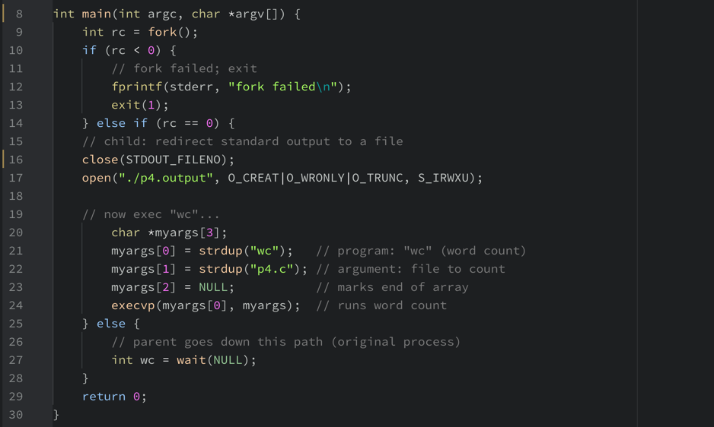
The close() and open() system calls (p4.c)

Slide 14
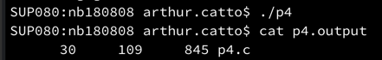
Redirecting program output (p4.c)
Read the docs to learn about close, open and cat.
Compile and run p4.c. The snapshot below is what I got as a result.
Did you get something similar? Where has p4’s output gone?
Does p4 seem to be working as expected?
Now type cat p4.output at the command prompt. This is what I got...
Is that what you would expect? Is that the only possible output?

