Slide 1
CPU Virtualization An Introduction to Scheduling
T04
Ch.7 of Operating Systems: Three Easy Pieces by Remzi and Andrea Arpaci-Dusseau (pages.cs.wisc.edu/~remzi/OSTEP/)
16 de agosto de 2018

Slide 2
Two Components
CPU Virtualization
Dispatcher (Previous lecture)
Low-level mechanism
Performs context-switch
Switch from user mode to kernel mode
Save execution state (registers) of old process in PCB
Insert PCB in ready queue
Load state of next process from PCB to registers
Switch from kernel to user mode
Jump to instruction in new user process
Scheduler (Today)
Applies a policy to determine which process gets CPU when there is a process switch.

Slide 3
State transitions
Review
Ready
Dispatch
Running
Deschedule
Event occurs
Event wait
Blocked
How to transition? (“mechanism”)
When to transition? (“policy”)

Slide 4
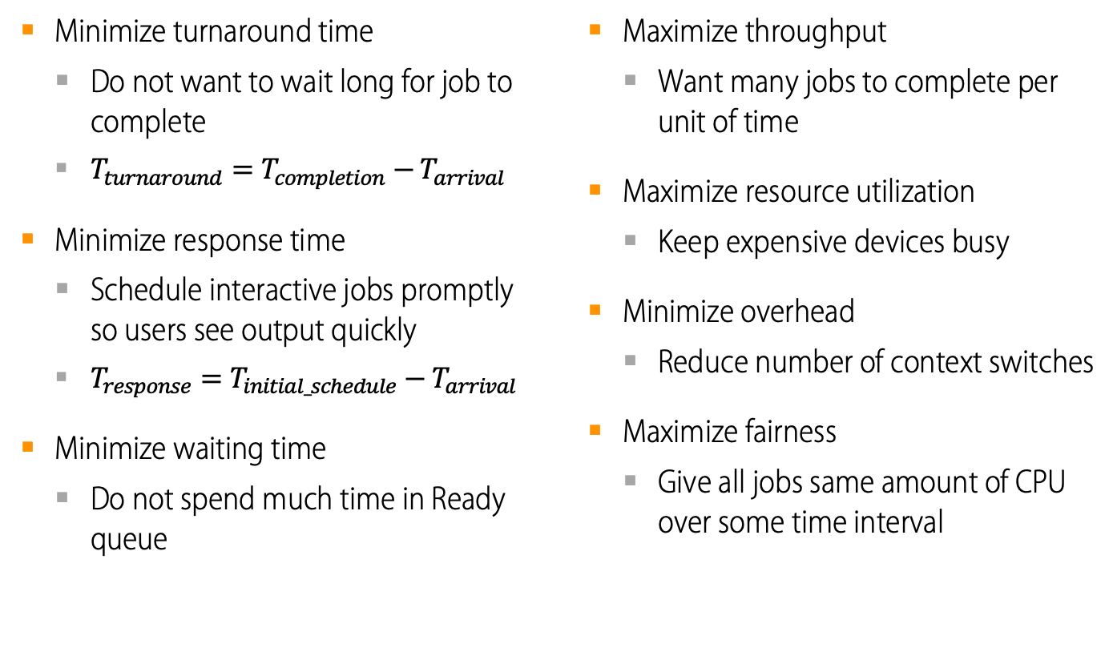
Usual Scheduling Performance Metrics
Minimize turnaround time
Do not want to wait long for job to complete
$T_{turnaround}=T_{completion}−T_{arrival}$
Minimize response time
Schedule interactive jobs promptly so users see output quickly
$T_{response}=T_{initial_schedule}−T_{arrival}$
Minimize waiting time
Do not spend much time in Ready queue
Maximize throughput
Want many jobs to complete per unit of time
Maximize resource utilization
Keep expensive devices busy
Minimize overhead
Reduce number of context switches
Maximize fairness
Give all jobs same amount of CPU over some time interval

Slide 5
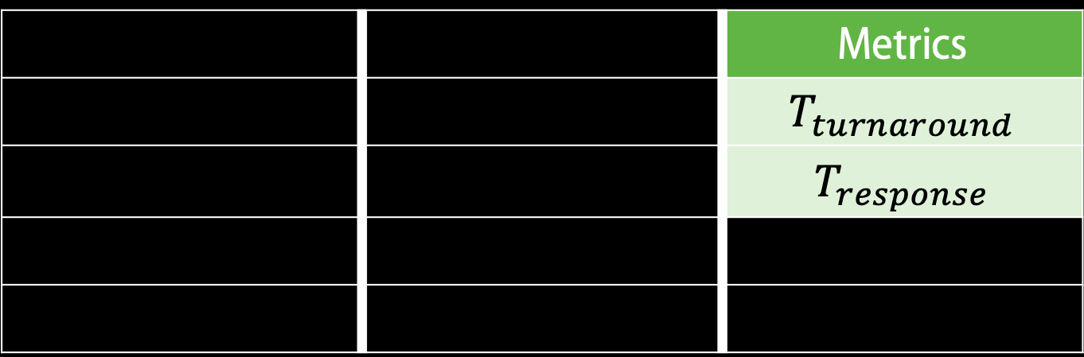
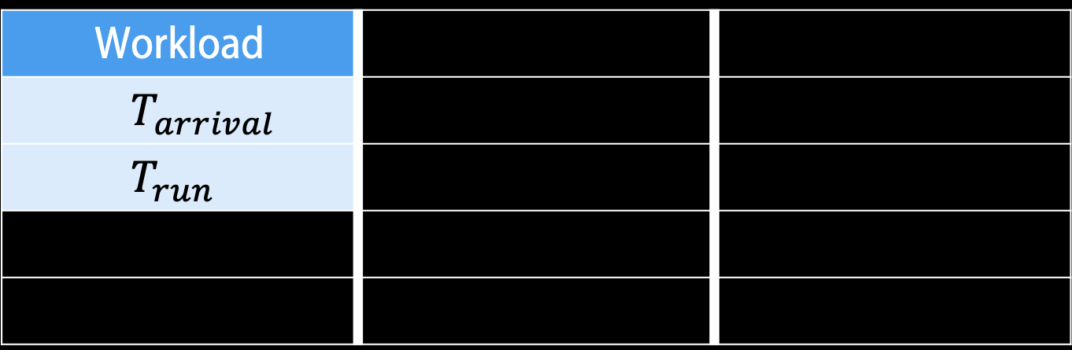
Scheduling basics
Workload
$$T_{arrival}$$
$$T_{run}$$
 | Scheduler
 | FIFO
 | SJF
 | STCF
 | RR
 |  | Metrics
 |  | $$T_{turnaround}$$
 |  | $$T_{response}$$

Slide 6
Workload Assumptions
All jobs run for the same amount of time.
All jobs arrive at the same time.
All jobs only use the CPU (i.e. no I/O).
Run-time of each job is known.

Slide 7
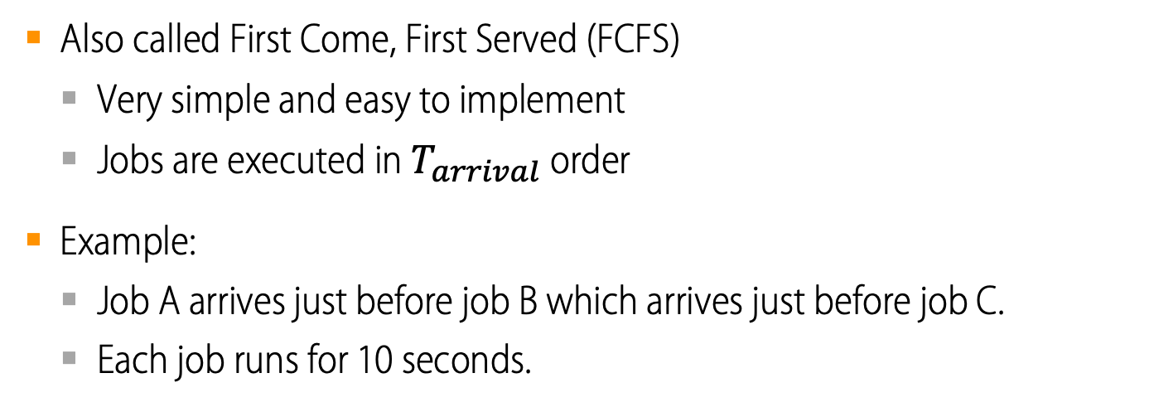
First In, First Out (FIFO)
Also called First Come, First Served (FCFS)
Very simple and easy to implement
Jobs are executed in $T_{arrival}$ order
Example:
Job A arrives just before job B which arrives just before job C.
Each job runs for 10 seconds.
A | B | C
0 |  | 20 |  | 40 |  | 60 |  | 80
A, B and C arrive

Slide 8
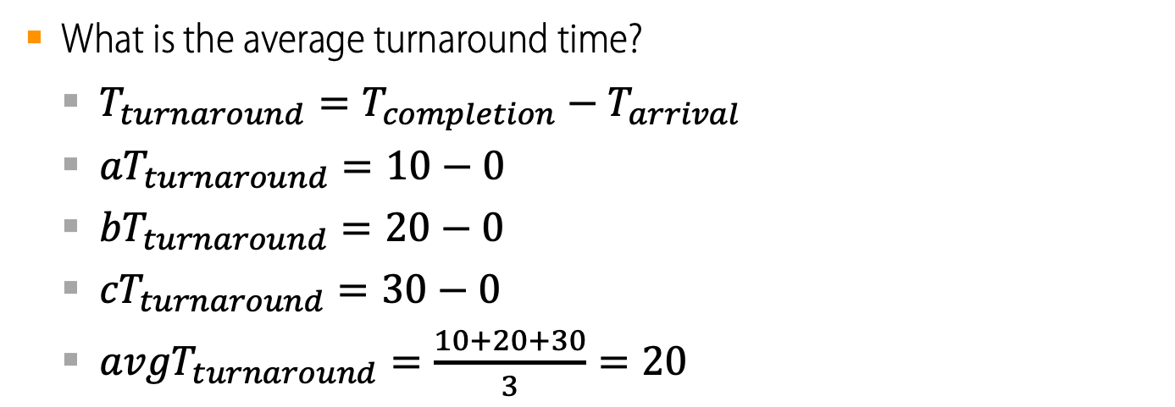
FIFO (identical jobs)
A | B | C
0 |  | 20 |  | 40 |  | 60 |  | 80
A, B and C arrive
What is the average turnaround time?
$T_{turnaround}=T_{completion}−T_{arrival}$
${aT}_{turnaround}=10−0$
${bT}_{turnaround}=20−0$
${cT}_{turnaround}=30−0$
${avgT}_{turnaround}=\frac{10+20+30}{3}=20$

Slide 9
Why wouldn’t FIFO be our solution of choice?

Slide 10
Relaxed Workload Assumptions
All jobs run for the same amount of time.
All jobs arrive at the same time.
All jobs only use the CPU (i.e. no I/O).
Run-time of each job is known.

Slide 11
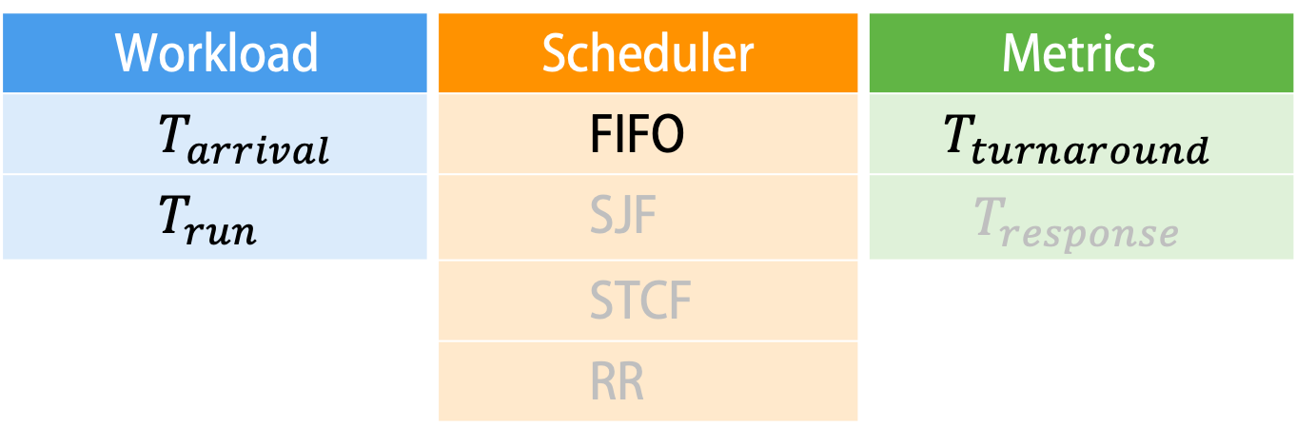
Any problematic workloads for FIFO?
Workload | Scheduler | Metrics
$$T_{arrival}$$ | FIFO | $$T_{turnaround}$$
$$T_{run}$$ | SJF | $$T_{response}$$
 | STCF
 | RR
Think of a really big first job…
What would happen to FIFO’s turnaround time?

Slide 12
FIFO (big first job)
Workload
Job A arrives just before job B which arrives just before job C.
Job A runs for 60 seconds, jobs B and C run for 10 seconds.
A |  |  |  |  |  | B | C
0 |  | 20 |  | 40 |  | 60 |  | 80
A, B and C arrive

Slide 13

FIFO (identical jobs)
A |  |  |  |  |  | B | C
0 |  | 20 |  | 40 |  | 60 |  | 80
A, B and C arrive
What is the average turnaround time?
$T_{turnaround}=T_{completion}−T_{arrival}$
${aT}_{turnaround}=60−0$
${bT}_{turnaround}=70−0$
${cT}_{turnaround}=80−0$
${avgT}_{turnaround}=\frac{60+70+80}{3}=70$

Slide 14
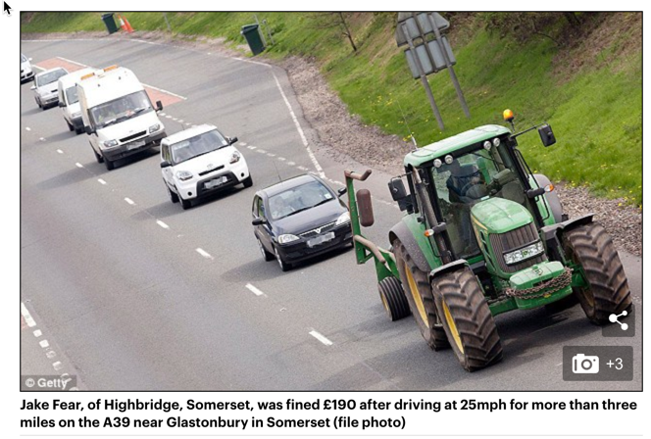
Convoy Effect
The Convoy Effect

Slide 15
Overtaking the tractor
What was the problem with FIFO?
Turnaround time can suffer when short jobs must wait for long jobs
Let’s try a new scheduler: SJF (Shortest Job First)
Choose job with smallest run time

Slide 16
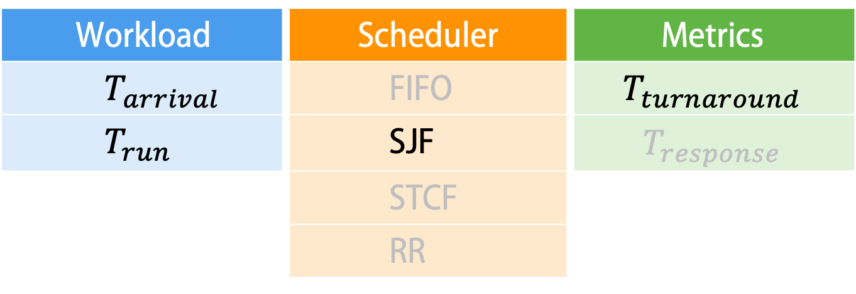
Scheduling basics
Workload | Scheduler | Metrics
$$T_{arrival}$$ | FIFO | $$T_{turnaround}$$
$$T_{run}$$ | SJF | $$T_{response}$$
 | STCF
 | RR

Slide 17
SJF (shortest job first)
Workload
Jobs A, B and C arrive at the same time.
Job A runs for 60 seconds, jobs B and C run for 10 seconds.
B | C | A
0 |  | 20 |  | 40 |  | 60 |  | 80
A, B and C arrive

Slide 18
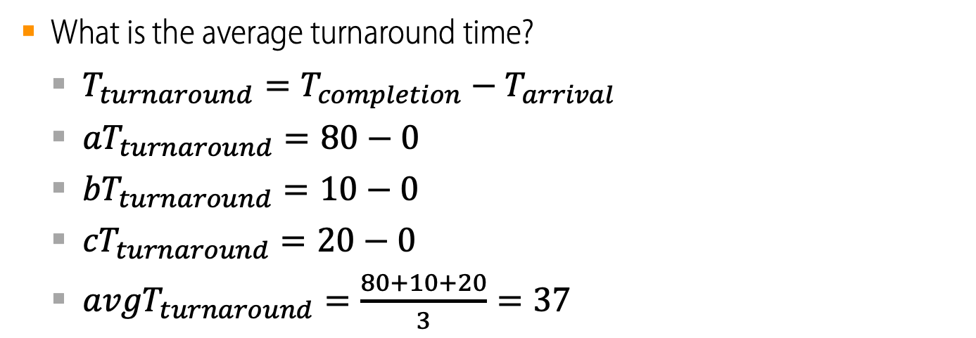
SJF (shortest job first)
B | C | A
0 |  | 20 |  | 40 |  | 60 |  | 80
A, B and C arrive
What is the average turnaround time?
$T_{turnaround}=T_{completion}−T_{arrival}$
${aT}_{turnaround}=80−0$
${bT}_{turnaround}=10−0$
${cT}_{turnaround}=20−0$
${avgT}_{turnaround}=\frac{80+10+20}{3}=37$

Slide 19
SJF (shortest job first)
SJF is provably optimal, for minimizing average turnaround time (with no preemption).
Scheduling a shorter job before a longer job improves the turnaround time of the shorter job more than it harms the turnaround time of the longer job.

Slide 20
Why wouldn’t SJF be our solution of choice?

Slide 21
Relaxed Workload Assumptions
All jobs run for the same amount of time.
All jobs arrive at the same time.
All jobs only use the CPU (i.e. no I/O).
Run-time of each job is known.

Slide 22
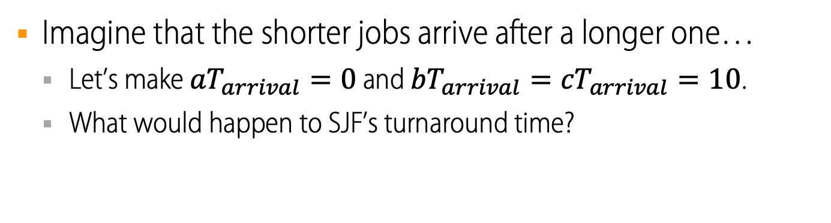
Any problematic workloads for SJF?
Workload | Scheduler | Metrics
$$T_{arrival}$$ | FIFO | $$T_{turnaround}$$
$$T_{run}$$ | SJF | $$T_{response}$$
 | STCF
 | RR
Imagine that the shorter jobs arrive after a longer one…
Let’s make ${aT}_{arrival}=0$ and ${bT}_{arrival}={cT}_{arrival}=10$.
What would happen to SJF’s turnaround time?

Slide 23

Stuck behind a tractor again…
A |  |  |  |  |  | B | C
0 |  | 20 |  | 40 |  | 60 |  | 80
 | B and C arrive
A arrives
What is the average turnaround time?
$T_{turnaround}=T_{completion}−T_{arrival}$
${aT}_{turnaround}=60−0$
${bT}_{turnaround}=70−10$
${cT}_{turnaround}=80−10$
${avgT}_{turnaround}=\frac{60+60+70}{3}=63$

Slide 24
A case for preemptive scheduling
What was the problem with FIFO and SJF?
They are non-preemptive, i.e. they only schedule a new job when the previous job voluntarily relinquishes the CPU (performs I/O or exits)
Let’s try a new scheduler: STCF (Shortest Time-to-Completion First)
Also known as Preemptive Shortest Job First (PSJF) and Shortest Remaining-Time First (SRTF).
Potentially schedule a different job at any point by taking CPU away from running job.
Always run the quickest-to-complete job.

Slide 25
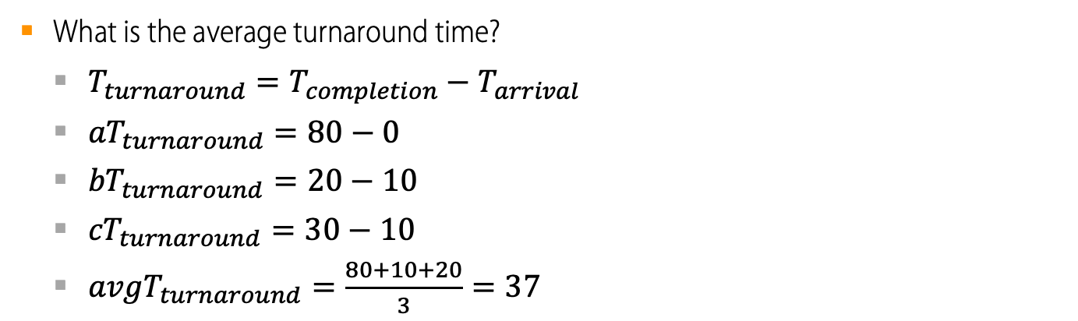
Preemptive STCF: overtaking the tractor again
A | B | C | A
0 |  | 20 |  | 40 |  | 60 |  | 80
 |  |  | A is resumed
 | B and C arrive, A is preempted
A arrives
What is the average turnaround time?
$T_{turnaround}=T_{completion}−T_{arrival}$
${aT}_{turnaround}=80−0$
${bT}_{turnaround}=20−10$
${cT}_{turnaround}=30−10$
${avgT}_{turnaround}=\frac{80+10+20}{3}=37$

Slide 26
Why wouldn’t STCF be our solution of choice?

Slide 27
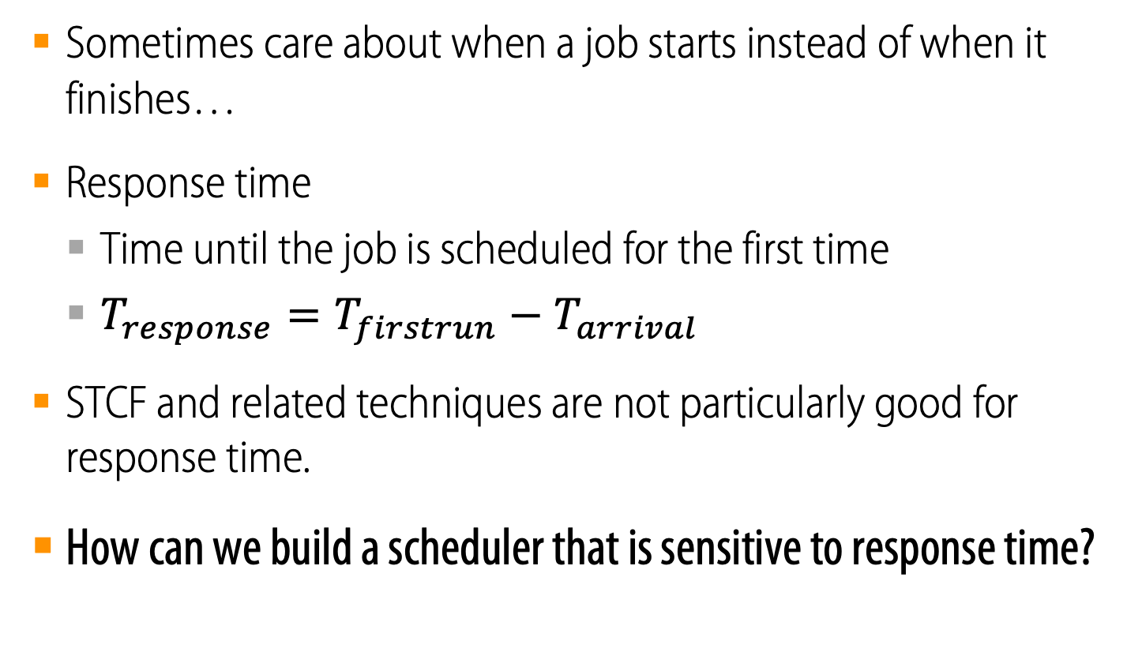
Response time
Sometimes care about when a job starts instead of when it finishes…
Response time
Time until the job is scheduled for the first time
$T_{response}=T_{firstrun}−T_{arrival}$
STCF and related techniques are not particularly good for response time.
How can we build a scheduler that is sensitive to response time?

Slide 28

Response vs. Turnaround
In the non-preemptive example below…
B’s turnaround time is…
$T_{turnaround}=T_{completion}−T_{arrival}=30−10=20$
B’s response time is…
$T_{response}=T_{firstrun}−T_{arrival}=20−10=10$
A |  | B
0 |  | 20 |  | 40 |  | 60 |  | 80
 | B arrives
A arrives

Slide 29
Caring about response time
What was the problem with FIFO, SJF and STCF?
They may show poor response time.
Let’s try a new scheduler: RR (Round Robin)
Run a job for a time slice and then switch to the next job in the ready queue until all jobs are finished.
Time slice is sometimes called a scheduling quantum.
The length of the time slice must be a multiple of the timer-interrupt period.

Slide 30
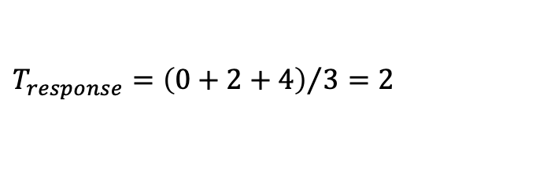
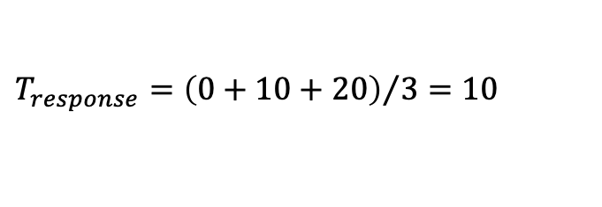
FIFO vs. RR (simultaneous identical jobs)
A | B | C
0 | 10 | 20 | 30
A | B | C | A | B | C | A | B | C | A | B | C | A | B | C
0 |  |  |  |  | 10 |  |  |  |  | 20 |  |  |  |  | 30
$$T_{response}={\left(0+10+20\right)}/3=10$$
$$T_{response}={\left(0+2+4\right)}/3=2$$

Slide 31
Why wouldn’t RR be our solution of choice?

Slide 32
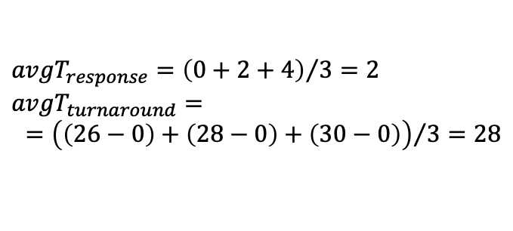
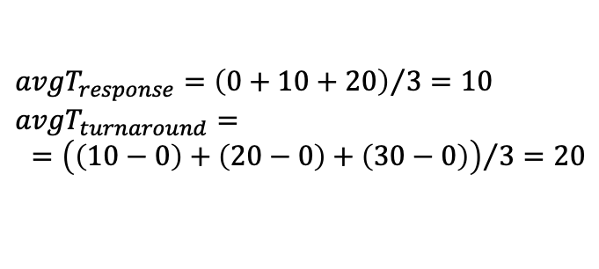
In what ways isn’t RR ideal?
RR is fair, but performs poorly on metrics such as turnaround time.
Let’s calculate the average turnaround time for both options in our last example.
A | B | C
0 | 10 | 20 | 30
A | B | C | A | B | C | A | B | C | A | B | C | A | B | C
0 |  |  |  |  | 10 |  |  |  |  | 20 |  |  |  |  | 30
$${avgT}_{response}={\left(0+10+20\right)}/3=10$$
$${avgT}_{turnaround}=$$
$={\left(\left(10−0\right)+\left(20−0\right)+\left(30−0\right)\right)}/{3=20}$
$${avgT}_{response}={\left(0+2+4\right)}/3=2$$
$${avgT}_{turnaround}=$$
$={\left(\left(26−0\right)+\left(28−0\right)+\left(30−0\right)\right)}/{3=28}$

Slide 33
The length of the time slice is critical
The shorter the time slice …
… the better the response time.
… the higher the relative cost of context switching.
The longer time slice…
… the less noticeable the increase in the cost of switching.
… the worse the response time.

Slide 34
Relaxed Workload Assumptions
All jobs run for the same amount of time.
All jobs arrive at the same time.
All jobs only use the CPU (i.e. no I/O).
Run-time of each job is known.

Slide 35
Incorporating I/O
Let’s relax assumption 3: programs may perform I/O
Example:
Jobs A and B need 50 units of CPU time each.
A runs for 10 units and then issues an I/O request
Each I/O operation takes 10 time units
B simply uses the CPU for 50 time units and performs no I/O
The scheduler runs A first, then B.

Slide 36
What happens when the scheduler isn’t I/O aware?
CPU | A |  | A |  | A | B
Disk |  | A |  | A
 | 0 |  | 20 |  | 40 |  | 60 |  | 80
Resources may be poorly used.
Job A holds on to CPU even while blocked waiting for disk.

Slide 37
Making the scheduler I/O aware
CPU | A | B | A | B | A | B
Disk |  | A |  | A
 | 0 |  | 20 |  | 40 |  | 60 |  | 80
Treat Job A as 3 separate CPU bursts.
When Job A completes I/O, another Job A becomes ready.
Each CPU burst is shorter than Job B, so even with SCTF, Job A preempts Job B.

Slide 38
Making the scheduler I/O aware
When a job initiates an I/O request…
… the job is blocked waiting for I/O completion.
… the scheduler should schedule another job on the CPU.
When the I/O completes…
… an interrupt is raised.
… the OS moves the process from blocked back to ready state.

Slide 39
Can we further relax our Workload Assumptions?
All jobs run for the same amount of time.
All jobs arrive at the same time.
All jobs only use the CPU (i.e. no I/O).
Run-time of each job is known.
Well… that’s a theme for next week.

