Slide 1
CPU Virtualization The Process Abstraction
T01

Slide 2
Essential Question
How can the OS provide the illusion of a nearly endless supply of physical CPUs when there are only a few of them available?

Slide 3
Introduction

Slide 4
The operation of a simple computer
Fetch stage
Execute stage
Fetch next instruction
Execute instruction
START
HALT

Slide 5
Programmed I/O
Simple computer I/O
Issue read command to I/O module
Read status of I/O module
Read word from I/O module
Write word to memory
Ready?
Yes
Done?
Yes
No
No
I/O module performs the action, not the processor
Sets appropriate bits in the I/O status register
Processor checks status until operation is complete before proceeding to the next instruction

Slide 6
Flow of Control in Programmed I/O
User program
① write
④ I/O op
I/O program
② write
⑤ end
③
Flow of control
Flow of time
①
④
Processor wait
⑤
②
④
Processor wait
⑤
③
I/O duration
I/O duration

Slide 7
Memory scheme in a simple batch system
Operating System
User Program Area

Slide 8
Uniprogramming
Processor must wait for I/O instruction to complete before proceeding
Run
Wait
Run
Wait
Program A

Slide 9
I/O devices are too slow
What is the problem with waiting?
Access Time |  |  |  |  |  |  |  |  | Capacity
Volatile | 1 nsec |  |  |  | Registers |  |  |  | Kilobytes
 | 2 nsec |  |  | Cache |  |  |  |  | Megabytes
 | 10 nsec |  | Main memory |  |  |  |  |  | Gigabytes
Non-volatile | 10 msec | Magnetic disk |  |  |  |  |  |  | Terabytes
The numbers are very rough approximations as of today.

Slide 10
Basic instruction cycle with interrupts
To enable the use of idle CPU time during I/O, the I/O module signals the end of the operation by means of an interrupt.
Fetch stage
Execute stage
Interrupt stage
Interrupts disabled
Fetch next instruction
Execute instruction
Interrupt checking and treatment
START
Interrupts enabled
HALT

Slide 11
Interrupt-driven I/O or how to harness slack time
No
Issue read command to I/O module
Read status of I/O module
Read word from I/O module
Write word to memory
Ready?
Yes
Done?
Yes
No
next instruction
do something else
interrupt
error condition
Processor is interrupted when I/O module ready to exchange data
Processor saves context of program executing and begins executing interrupt-handler
No needless waiting
Consumes a lot of processor time because every word read or written passes through the processor

Slide 12
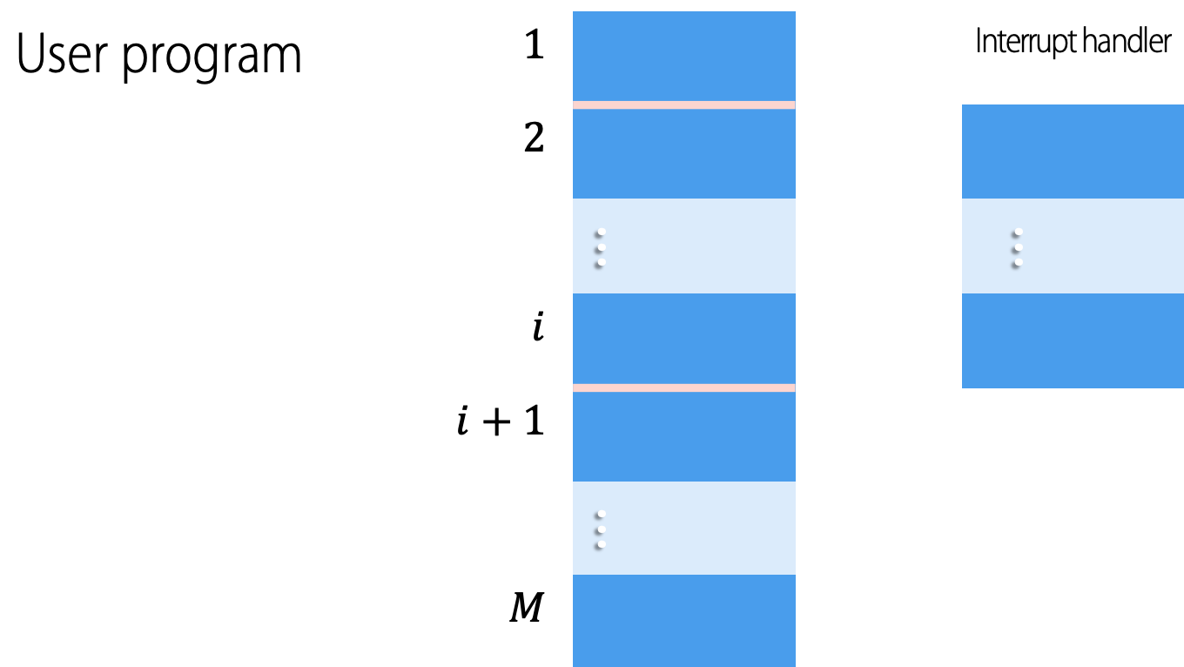
Transfer of control under an interrupt
User program | $$1$$ |  |  |  | Interrupt handler
 | $$2$$
 |  | ... |  |  | ...
 | $$i$$
 | $$i+1$$
 |  | ...
 | $$M$$
Interrupt occurs here

Slide 13
Flow of Control with Short I/O Wait
User program
① write
④ I/O op
I/O program
②
② write
Interrupt occurs here
② write
⑤ end
Interrupt handler
③
③
③
Flow of control
Flow of time
①
④
②
⑤
②
④
③
⑤
③
I/O duration
I/O duration

Slide 14
Flow of Control with Long I/O Wait
User program
① write
④ I/O op
I/O program
② write
Interrupt occurs here
⑤ end
Interrupt handler
③
Flow of control
Flow of time
①
④
②
Processor wait
⑤
④
③
Processor wait
⑤
I/O duration
I/O duration

Slide 15
Multiprogrammed batch systems
Single user cannot keep CPU and I/O devices busy at all times
Multiprogramming organizes jobs (code and data) so CPU always has one to execute
A subset of total jobs in system is kept in memory
One job selected and run via job scheduling
When it has to wait (for I/O for example), OS switches to another job
Operating System
Job 1
Job 2
Job 3
Job 4

Slide 16
Multiprogramming two jobs
When one job needs to wait for I/O, the processor can switch to another job
Program A | Run | Wait |  |  |  | Run | Wait
Program B | Wait | Run | Wait |  |  |  | Run | Wait
Combined | Run A | Run B | Wait |  |  | Run A | Run B | Wait

Slide 17
Multiprogramming three jobs
Program A | Run | Wait |  |  |  | Run
Program B | Wait | Run | Wait |  |  |  | Run | Wait | Run
Program C | Wait |  | Run | Wait |  |  |  | Run
Combined | Run A | Run B | Run C | Wait |  | Run A | Run B | Run C | Run B | Wait

Slide 18
What is required in hw for multiprogramming?
Timer
Dual-mode operation
Interrupts
Memory Protection
Privileged Instructions

Slide 19
Hardware features for multiprogramming
Timer
Enables interrupting a user job after a certain amount of time
Dual-mode operation
Interrupts
Memory Protection
Privileged Instructions

Slide 20
Hardware features for multiprogramming
Timer
Enable switching between jobs while waiting for I/O to complete
Dual-mode operation
Interrupts
Memory Protection
Privileged Instructions

Slide 21
Hardware features for multiprogramming
Timer
User jobs cannot execute certain machine level instructions
Dual-mode operation
Interrupts
Memory Protection
Privileged Instructions

Slide 22
Hardware features for multiprogramming
Timer
A job cannot alter the memory area of the system or of another job
Dual-mode operation
Interrupts
Memory Protection
Privileged Instructions

Slide 23
Hardware features for multiprogramming
Jobs execute in user mode
Privileged instructions may not be executed
OS executes in system (aka kernel) mode
Privileged instructions may be executed
Protected areas of memory may be accessed
Timer
Dual-mode operation
Interrupts
Memory Protection
Privileged Instructions

Slide 24
The Process Abstraction

Slide 25
A process can be understood as …
A program in execution
An instance of a program running on a computer
An entity that can be assigned to and executed on a processor
A unit of activity characterized by
a sequence of program instructions to be executed during its lifetime
an evolving state and
an associated set of required system services

Slide 26
A process …
Consists of three components
An executable program
Associated data needed by the program
Execution context of the program aka process state
All information the operating system needs to manage the process
Needs resources to accomplish its task
CPU, memory, I/O, files
Initialization data
On termination, requires reclaim of any reusable resources

Slide 27
Simple process implementation
Main memory
Processor registers
Process index
i
PC
i
Process
Base
b
list
j
Limit
h
A few concerns…
Does a process need to be wholly loaded in memory?
Can processes be switched in and out of memory?
If so, does a process need to be reloaded to the same memory addresses where it has been before?
Other registers
Context
Process
Data
A
Program
(code)
b
Context
Process
h
Data
B
Program
(code)

Slide 28
How do a process and the OS interact?
Via system calls and dual-mode operation
User process
User mode (mode bit = 1)
user process executing
does system call
continues execution
trap mode bit ← 0
mode bit ← 1 return
Kernel
treats the call
Kernel mode (mode bit = 0)

Slide 29
Virtual Memory
How to isolate one process from another?
Memory is addressed from a logical point of view.
Each process gets a continuous address range which may be larger than that of the actual processor.
Virtual memory addresses are not linked to actual memory addresses.
How can this be achieved?

Slide 30
Virtual Memory Addressing
Virtual address
Real address
Processor
Memory Management Unit
Main memory
Disk address
Details of this operation will be studied in ”Virtualization of Memory”
Secondary memory

Slide 31
Typical structure of a process in memory
max
stack
heap
data
code
program counter
0

Slide 32
What the processes feel...
Code of Process A
Code of Process B
Code of Process C
000 |  | 000 |  | 000
001 |  | 001 |  | 001
002 |  | 002 |  | 002
003 |  | 003 |  | 003
004 |  | 004
005 |  | 005
006 |  | 006
007 |  | 007
008
009
010
011

Slide 33
What the OS does…
Address | Main memory |  | Program counter
0 |  |  |  | 8000
100 | Dispatcher
5000 | Process A
8000 | Process B
12000 | Process C

Slide 34
What actually happens
1 | 5000 |  |  | 17 | 100 |  |  | 35 | 5006
2 | 5001 |  |  | 18 | 101 |  |  | 36 | 5007
3 | 5002 |  |  | 19 | 102 |  |  | 37 | 5008
4 | 5003 |  |  | 20 | 103 |  |  | 38 | 5009
5 | 5004 |  |  | 21 | 104 |  |  | 39 | 5010
6 | 5005 | Time-out |  | 22 | 105 |  |  | 40 | 5011 | Time-out
7 | 100 |  |  | 23 | 12000 |  |  | 41 | 100
8 | 101 |  |  | 24 | 12001 |  |  | 42 | 101
9 | 102 |  |  | 25 | 12002 |  |  | 43 | 102
10 | 103 |  |  | 26 | 12003 |  |  | 44 | 103
11 | 104 |  |  | 27 | 12000 |  |  | 45 | 104
12 | 105 |  |  | 28 | 12001 | Time-out |  | 46 | 105
13 | 8000 |  |  | 29 | 100 |  |  | 47 | 12002
14 | 8001 |  |  | 30 | 101 |  |  | 48 | 12003
15 | 8002 |  |  | 31 | 102 |  |  | 49 | 12000
16 | 8003 | I/O req |  | 32 | 103 |  |  | 50 | 12001
 |  |  |  | 33 | 104 |  |  | 51 | 12002
 |  |  |  | 34 | 105 |  |  | 52 | 12003 | Time-out
100 = dispatcher initial address
Gray areas correspond to execution of the dispatcher process
Column #1 counts instruction cycles
Column #2 gives the address of the instruction being executed

Slide 35
What the processes feel
Trace of Process A
Trace of Process B
Trace of Process C
000 |  | 000 |  | 000
001 |  | 001 |  | 001
002 |  | 002 |  | 002
003 |  | 003 |  | 003
004 |  |  |  | 000
005 |  |  |  | 001
006 |  |  |  | 002
007 |  |  |  | 003
008 |  |  |  | 000
009 |  |  |  | 001
010 |  |  |  | 002
011 |  |  |  | 003

Slide 36
Process States

Slide 37
Two-state process model
A process may be in one of two states
Running
Not-running
Dispatch
Enter
Not Running
Running
Exit
Pause

Slide 38
Queuing diagram for the 2-state model
What’s wrong with this model?
Queue
Enter
Dispatch
Processor
Exit
Pause

Slide 39
Process life-cycle in the 5-state model
Ready: The process is waiting to be assigned to a processor
Final: The process has finished execution
Running: Instructions are being executed
Initial
Ready
Dispatch
Running
Final
Admit
Release
Timeout
Initial: The process has been created
Event Occurs
Event Wait
Blocked
Blocked: The process is waiting for some event to occur

Slide 40
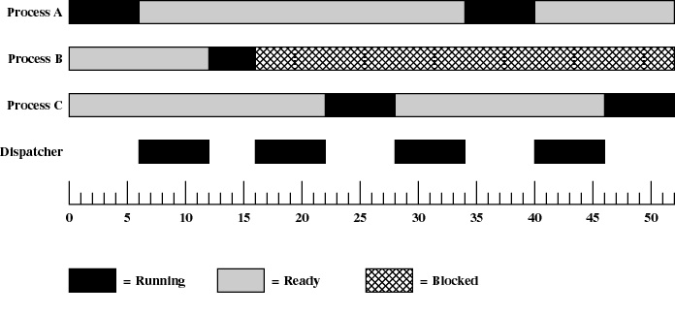

States of the example processes

Slide 41
Queuing diagram for the 5-state model
Ready Queue
Admit
Dispatch
Processor
Release
Timeout
Blocked Queue
Event wait
Event occurs

Slide 42
Implementation of priorities
When scheduling is based on process priority it makes sense to create several “ready” queues, one for each priority level.
In this way, the OS can easily locate the highest priority “ready” process that has been waiting for the longest time.

Slide 43
5-state model with several blocked queues
Ready Queue
Admit
Dispatch
Processor
Release
Timeout
Event 1 Queue
Event 1 occurs
Event 1 wait
Event n Queue
Event n occurs
Event n wait

Slide 44
Process suspension
Processor is faster than I/O so all processes could be waiting for I/O
The OS can swap these blocked processes to disk to free up more memory
Blocked state becomes suspend state when process has been swapped to disk

Slide 45
A 6-state process life-cycle model
Dispatch
Initial
Admit
Ready
Running
Release
Final
Timeout
Activate
Event Occurs
Event Wait
Suspend
Blocked
Suspend

Slide 46
A model with 2 “suspend” states
There are two independent concepts
A process may be ready or blocked
A process may be suspended or not
Four states are required to model such 2×2 arrangement
Ready
Blocked
Ready/Suspended
Blocked/Suspended

Slide 47
A 7-state process life-cycle model
Initial
Admit
Admit
Suspend
Ready / Suspend
Activate
Ready
Dispatch
Running
Final
Release
Suspend
Timeout
Event occurs
Event occurs
Event wait
Blocked / Suspend
Activate
Blocked
Suspend

Slide 48
Suspended process characteristics
It is not available for immediate execution
It may be waiting for an event
In this case, the blocked condition is independent from the suspend condition
It may have been suspended by an agent and now its state can only be changed by that agent.

Slide 49
Process Description

Slide 50
Operating system control structures
Information about the current status of each process and resource
Tables are constructed for each entity managed by the operating system
Memory
I/O
Files
Processes
Such tables must be linked somehow.
To create the tables, the OS must know the details of the executing environment.

Slide 51
General structure of OS control tables
Memory Tables
I/O Tables
File Tables
Process Image
Process 1
Process Image
Process n
Memory
Devices
Files
Processes
Primary Process Table
 | Process 1
 | Process 2
 | Process 3
 | …
 | Process n

Slide 52
Memory Tables
Allocation of main memory to processes
Allocation of secondary memory to processes
Protection attributes for access to shared memory regions
Information needed to manage virtual memory

Slide 53
I/O Tables
I/O device is available or assigned
Status of I/O operation
Location in main memory being used as the source or destination of the I/O transfer

Slide 54
File Tables
Existence of file
Location of file on secondary memory
Current file status
File attributes
Often this information is maintained by a file management system

Slide 55
Process Table
Where process is located
Attributes in the process control block
Program
Data
Stack

Slide 56
Typical elements of a process image
User data
The modifiable part of the user space.
User program
The code of the program to be executed.
System stacks
Used as temporary storage for parameters, intermediate results and return addresses for procedure and system calls.
PCB Process Control Block
Data needed by the OS to control the process, such as process id, processor state, etc.
May include program data, a user stack area and programs that may be modified.

Slide 57
User processes in virtual memory
Process Identification |  | Process Identification |  | Process Identification
Processor State Information |  | Processor State Information |  | Processor State Information
Process Control Information |  | Process Control Information |  | Process Control Information
User Stack |  | User Stack |  | User Stack
Private User Address Space (Programs, Data) |  | Private User Address Space (Programs, Data) |  | Private User Address Space (Programs, Data)
Shared Address Space |  | Shared Address Space |  | Shared Address Space
Process 1 |  | Process 2 |  | Process n
Process
Control
Block

Slide 58
Process Control Block
Process identification
Identifiers
Identifier of this process
Identifier of the process that created this process (parent process)
User identifier
Etc.
Process Identification
Processor State Information | Process Control Block
Process Control Information
User Stack
Private User Address Space (Programs, Data)
Shared Address Space

Slide 59
Process Control Block
Processor State Information
User-Visible Registers
A user-visible register is one that may be referenced by means of the machine language that the processor executes while in user mode.
Typically, there are from 8 to 32 of these registers, although some RISC implementations have over 100.
Process Identification
Processor State Information | Process Control Block
Process Control Information
User Stack
Private User Address Space (Programs, Data)
Shared Address Space

Slide 60
Process Control Block
Processor State Information
Program Status Word (PSW)
A variety of processor registers that are employed to control the operation of the processor, e.g.
Program counter
Condition codes
Status information
Process Identification
Processor State Information | Process Control Block
Process Control Information
User Stack
Private User Address Space (Programs, Data)
Shared Address Space

Slide 61
Process Control Block
Processor State Information
Stack Pointers
Each process has one or more last-in-first-out (LIFO) system stacks associated with it.
A stack is used to store parameters and calling addresses for procedure and system calls.
The stack pointer points to the top of the stack.
Process Identification
Processor State Information | Process Control Block
Process Control Information
User Stack
Private User Address Space (Programs, Data)
Shared Address Space

Slide 62
Process Control Block
Process Control Information
Scheduling and State Information
Information needed by the OS to perform its scheduling function, e.g.
Process state
Priority
Scheduling-related information
Event
Process Identification
Processor State Information | Process Control Block
Process Control Information
User Stack
Private User Address Space (Programs, Data)
Shared Address Space

Slide 63
Process Control Block
Process Control Information
Data Structuring
A process may be linked to another process in a queue, ring, or some other structure.
For example, all processes in a waiting state for a particular priority level may be linked in a queue.
A process may exhibit a parent-child (creator-created) relationship with another process.
The PCB may contain pointers to other processes to support these structures.
Process Identification
Processor State Information | Process Control Block
Process Control Information
User Stack
Private User Address Space (Programs, Data)
Shared Address Space

Slide 64
Process Control Block
Process Control Information
Interprocess Communication
Various flags, signals, and messages may be associated with communication between two independent processes and kept in the PCB.
Process Privileges
Processes may be granted privileges in terms of the memory that may be accessed, the types of instructions that may be executed and the use of system utilities and services.
Process Identification
Processor State Information | Process Control Block
Process Control Information
User Stack
Private User Address Space (Programs, Data)
Shared Address Space

Slide 65
Process Control Block
Process Control Information
Memory Management
This section may include pointers to segment and/or page tables that describe the virtual memory assigned to this process.
Resource Ownership and Utilization
Resources controlled by the process may be indicated, e.g. opened files.
A history of utilization of the processor or other resources may also be included.
This information may be needed by the scheduler.
Process Identification
Processor State Information | Process Control Block
Process Control Information
User Stack
Private User Address Space (Programs, Data)
Shared Address Space

Slide 66
Process List Structures
Running
PCB
Ready
PCB
PCB
PCB
Blocked
PCB
PCB
PCB
PCB

Slide 67
User and Kernel Stacks
Most operating systems allocate a kernel interrupt stack for each user-level process.
Process state | Running |  | Ready to Run |  | Waiting for I/O
User Stack | … |  | …
 |  |  |  |  | Syscall
 | Proc2 |  | Proc2 |  | Proc2
 | Proc1 |  | Proc1 |  | Proc1
 | Main |  | Main |  | Main
Kernel Stack
 |  |  |  |  | I/O Driver Top Half
 |  |  |  |  | Syscall Handler
 |  |  | User CPU State |  | User CPU State

Slide 68
xv6, a simple Unix-like teaching operating system
xv6 is a teaching operating system developed in the summer of 2006 for MIT's operating systems course, 6.828: Operating System Engineering, which will be cited in several examples during our course.
A detailed description of xv6 and additional material can be found at https://pdos.csail.mit.edu/6.828/2017/xv6.html
The latest xv6 source (licensed under the traditional MIT license) is available via git clone git://github.com/mit-pdos/xv6-public.git
A booklet giving the sources with line numbers is available at https://pdos.csail.mit.edu/6.828/2017/xv6/xv6-rev10.pdf.
A 100-page textbook that may help you to read through xv6 and learn about the main ideas in operating systems is also available at https://pdos.csail.mit.edu/6.828/2017/xv6/book-rev10.pdf.
The line numbers in this book refer to the above source booklet.

Slide 69
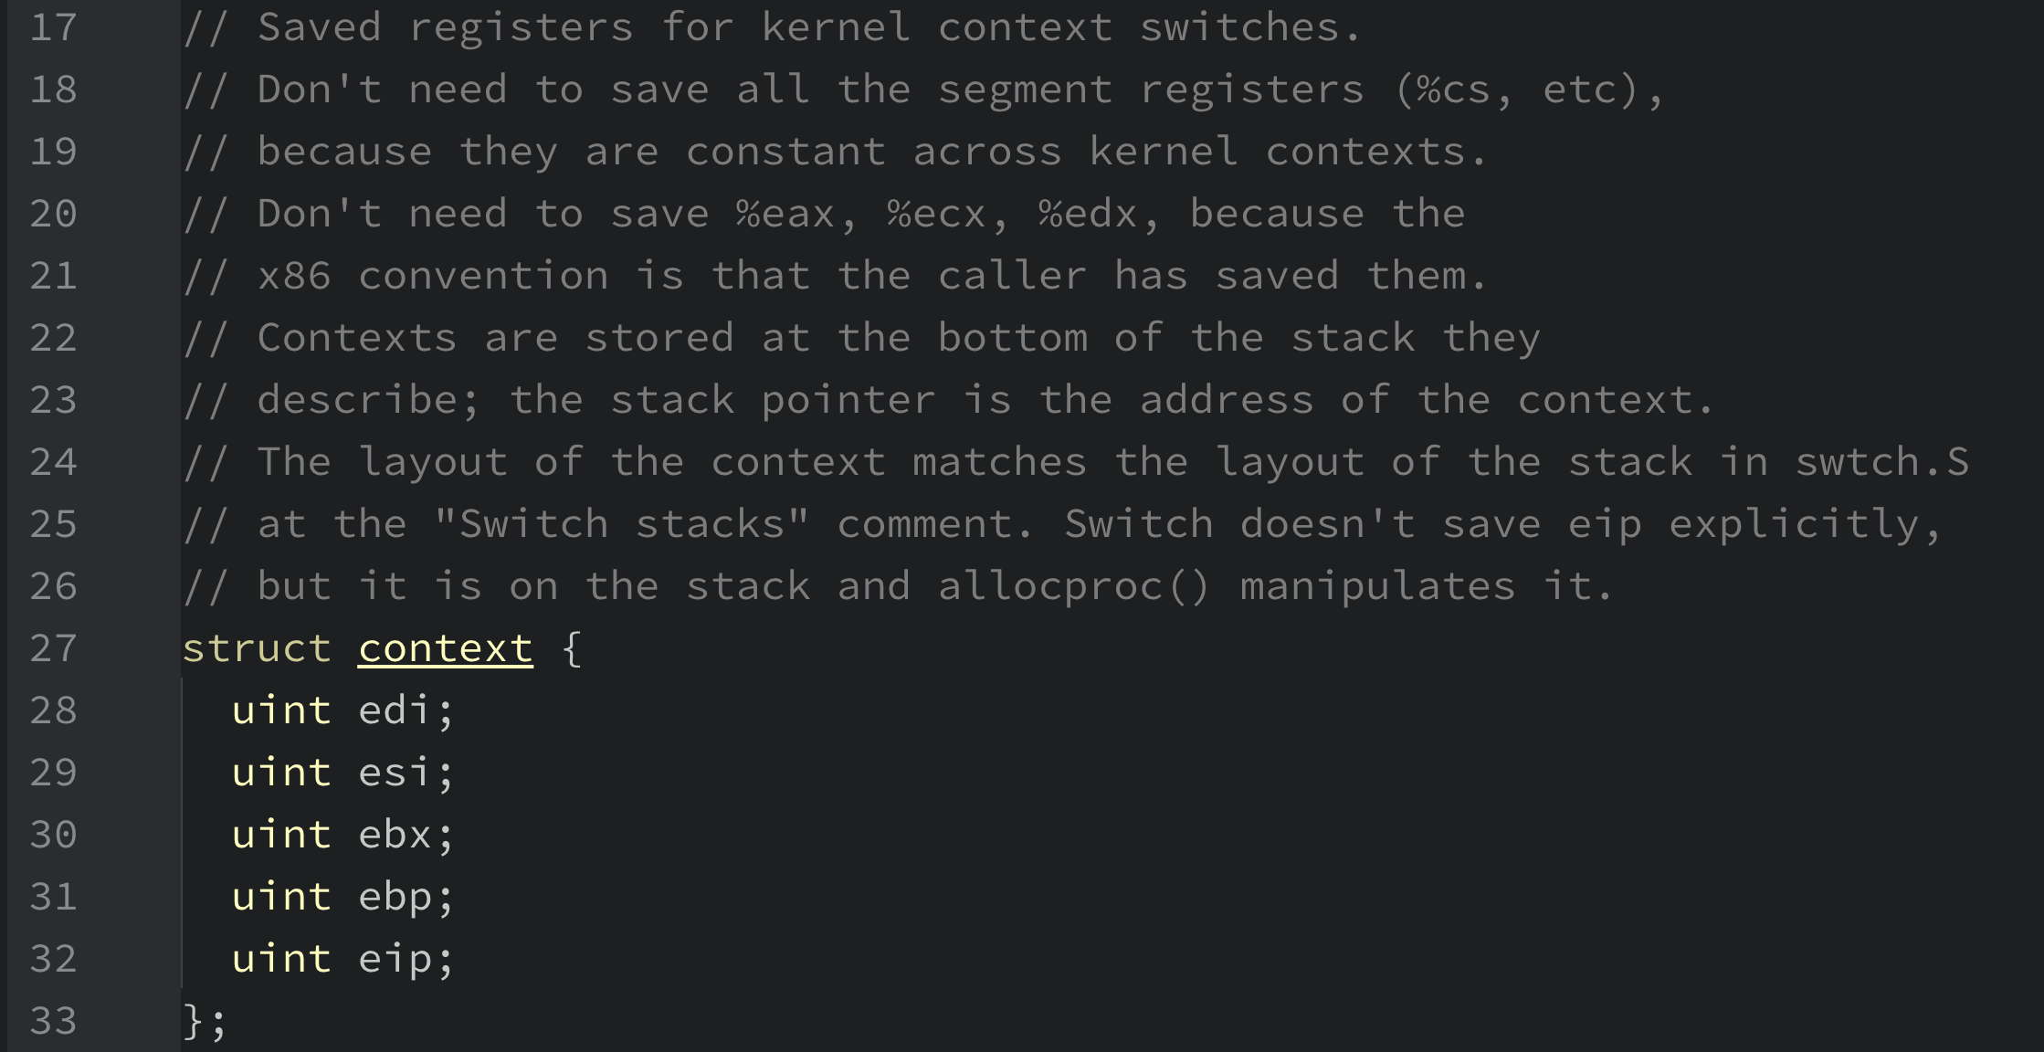
xv6: saved registers for kernel control switches

Slide 70
xv6: the different states a process can be in

Slide 71
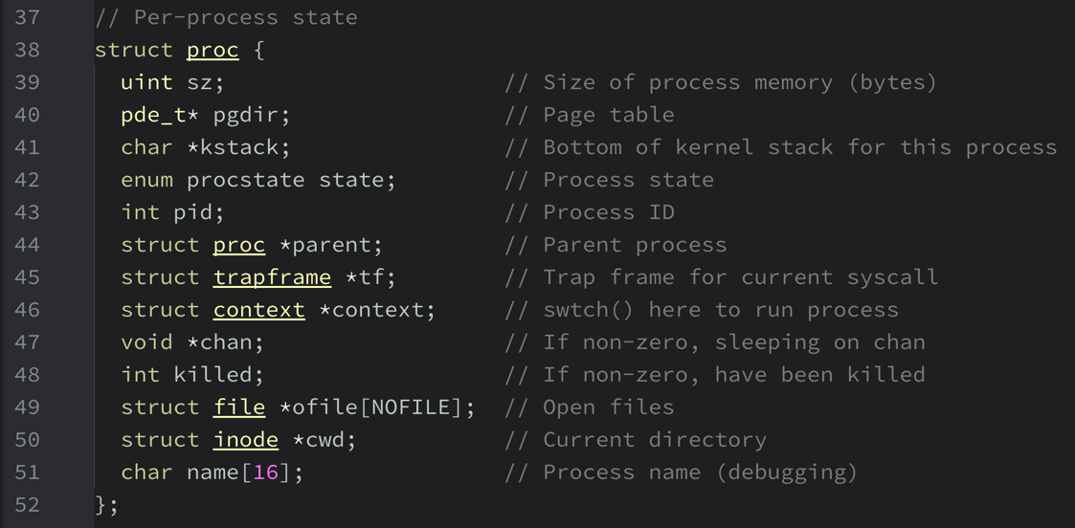
xv6: information tracked about each process

Slide 72
Simulation homeworks
At the end of many chapters of the textbook you will find simulation homeworks, which come in the form of simulators you run to make sure you understand some piece of the material.
The simulators are generally python programs that enable you both to generate different problems (using different random seeds) as well as to have the program solve the problem for you (with the -c flag) so that you can check your answers.
Running any simulator with a -h or --help flag will provide with more information as to all the options the simulator gives you.
The README provided with each simulator gives more detail as to how to run it. Each flag is described in some detail therein.

Slide 73
Process control

Slide 74
To start a new process the kernel must…
Assign a unique process identifier
Allocate and initialize the Process Control Block
Allocate memory space for the process
Copy the program from disk into the newly allocated memory
Allocate a user-level stack for user-level execution
Allocate a kernel-level stack for handling system calls, interrupts and exceptions
Set up appropriate linkages
Ex: add the new process to the scheduling queue
Create or expand other data structures
Ex: maintain an accounting file

Slide 75
Modes of Execution
User mode
Less-privileged mode
User programs typically execute in this mode
Each instruction is checked before being executed to make sure that it can be performed by that process
System mode, control mode, or kernel mode
More-privileged mode
The kernel of the OS executes in this mode with protection checks turned of

Slide 76
Reasons for switching from User to Kernel Mode
Interrupts
Clock interrupt
Process has executed for the maximum allowable time slice
I/O interrupt
Processor exceptions
Memory fault
Memory address is not loaded so it must be brought into main memory
Executing a prohibited or faulty instruction
System call
Such as file open, to request the system to perform an operation on the process’ behalf.
Trap
Term used to refer to
Processor exceptions and system calls or
Any transfer of control from a less privileged to a more privileged level

Slide 77
Reasons for switching from Kernel to User Mode
New process
Resume after an interrupt, processor exception or system call
Switch to another process
User-level upcall
Preemptive user-level threads
Asynchronous I/O notification
Interprocess communication
User-level exception handling
User-level resource allocation

Slide 78
Swapping processes P₀ and P₁
P₀
OS
P₁
save state into PCB₀
reload state from PCB₁
save state into PCB₁
reload state from PCB₀
time

Slide 79
Change of Process State
Save the context of processor including program counter and other registers
Update the PCB of the process that is currently in the Running state
Move that PCB to appropriate queue
Select another process for execution
Update the PCB of the selected process
Update memory-management data structures
Restore context of the selected process

Slide 80
Queueing diagram view of process scheduling
ready queue
CPU
I/O
I/O queue
I/O request
time slice expired
child executes
fork a child
interrupt occurs
event queue
wait for an interrupt

Slide 81
Schedulers
Short term scheduler (CPU scheduler)
Selects a new process to be executed next and allocates the CPU to it
Frequently activated (milliseconds)
Must be very fast
Long term scheduler (job scheduler)
Selects processes which should be brought to the ready queue
Infrequently activated (seconds or minutes)
Can be slow
Controls the degree of multiprogramming

Slide 82
Process behavior during execution
I/O-bound process
Spends more of its time doing I/O than calculating
Many short CPU bursts
CPU-bound process
Spends more of its time doing calculations than doing I/O
Few long CPU bursts
Long term scheduler must select a good mix of I/O-bound and CPU-bound processes

Slide 83
Addition of medium-term scheduling
swap-in
partially executed swapped-out processes
swap-out
ready queue
CPU
I/O
I/O waiting queues

Slide 84
Execution of the Operating System
If the OS is just a collection of programs which are run by the processor just like any other programs, is the OS a process?
If so, how is it controlled?

Slide 85
Relationship between OS and user processes
Non-process Kernel
Execute kernel outside of any process
Operating system code is executed as a separate entity which runs in privileged mode
P₁
P₂
P₃
…
P_{n}
kernel
Separate kernel

Slide 86
Relationship between OS and user processes
Execution Within User Processes
Operating system software included within the context of a user process
Process executes in privileged mode when executing operating system code
P₁
P₂
P₃
…
P_{n}
OS func tion
OS func tion
OS func tion
OS func tion
process switching functions
OS functions executing within user processes

Slide 87
Relationship between OS and user processes
Process-based Operating System
OS implemented as a collection of system processes.
Noncritical OS functions are implemented as separate processes under dispatcher control.
Useful in multiprocessor or multicomputer environments, where some OS services may be assigned to dedicated processors to improve performance.
P₁
P₂
…
P_{n}
OS₁
…
OS_{k}
process switching functions
OS functions executing as separate processes

Slide 88
Interprocess communication

Slide 89
Communication models
Message passing |  |  | Shared memory
process A |  |  | process A
 | M
 |  |  | shared
process B
 |  |  | process B
 | M
kernel |  |  | kernel
 | M

Slide 90
Concerns in message-passing systems
Naming
Direct communication
Indirect communication
Synchronization
Blocking and non-blocking message passing
Buffering
Zero capacity
Bounded capacity
Unbounded capacity

Slide 91
Remote Procedure Call (RPC)
Marshalling the parameters
Semantics of a call
At most once
Exactly once
Binding of names

Slide 92
Conventional Procedure Call
Parameter passing in a local procedure call
The stack before and during a read(fd, buf, bytes) call
caller’s local variables
caller’s local variables
bytes
buf
fd
return address
caller’s local variables
bytes
buf
fd
return address
read’s local variables
stack pointer
stack pointer
stack pointer

Slide 93
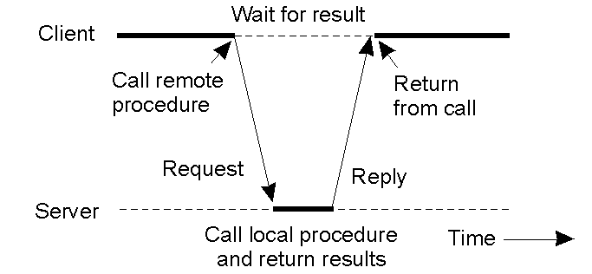
Synchronous Remote Procedure Call
RPC between a client and a server program
call remote procedure
return from call
Client
wait for result
reply
request
Server
call local procedure and return results

Slide 94
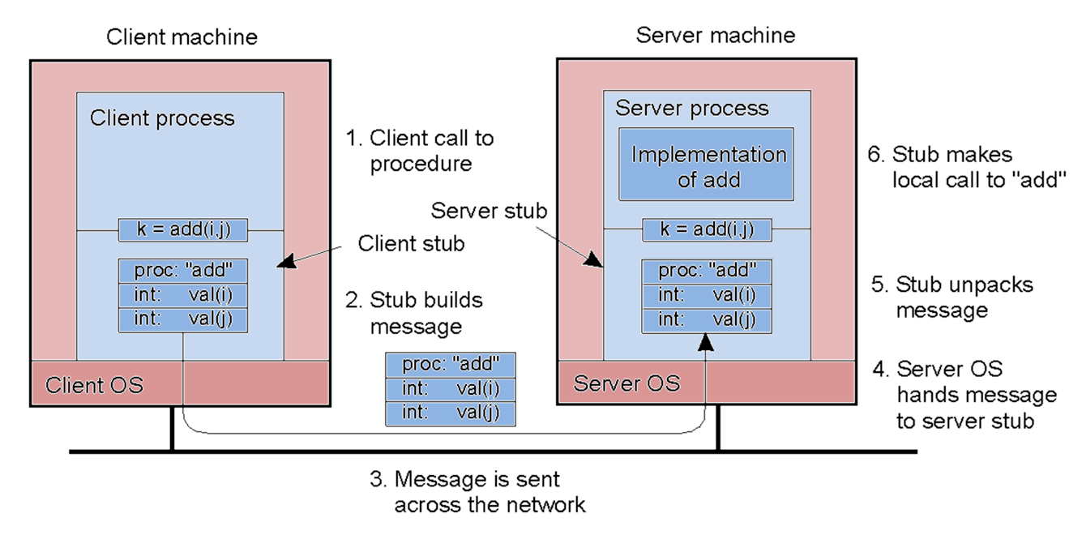
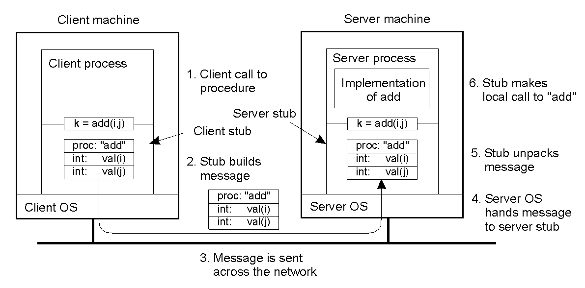

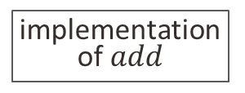


Steps and stubs in remote computation via RPC
proc | “add”
int | 10
int | 20
proc | “add”
int | 10
int | 20
Client process
Server process
6. Stub makes local call to $$add$$
$$\begin{matrix}i≔10;j≔20; \\ k≔add\left(i,j\right)\end{matrix}$$
1. Client call to procedure
implementation of $add$
Client stub
Server stub
5. Stub unpacks message
2. Stub builds message
$$z=add\left(10, 20\right)$$
proc | “add”
int | 10
int | 20
4. Server OS hands message to server stub
3. Message is sent across the network
Client OS
Server OS

Slide 95
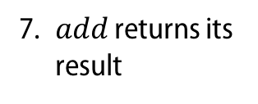
Steps and stubs in remote computation via RPC
proc | “add”
int | 10
int | 20
proc | “add”
int | 10
int | 20
Client process
Server process
7. $add$ returns its result
$$\begin{matrix}i≔10;j≔20; \\ k≔add\left(i,j\right)\end{matrix}$$
12. Client gets the result
implementation of $add$
Client stub
Server stub
8. Stub builds message
11. Stub unpacks message
$$z=add\left(10, 20\right)$$
int | 30
9. Message is sent across the network
10. Server OS hands message to server stub
Client OS
Server OS

Slide 96
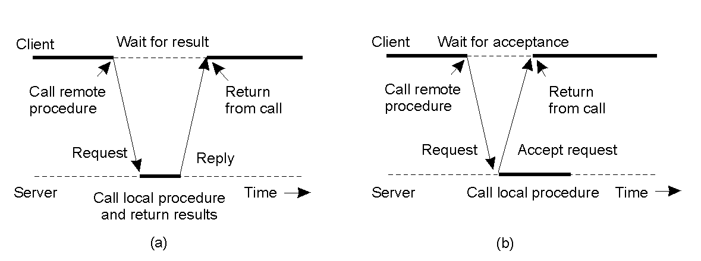
Asynchronous RPCs
call remote procedure
return from call
Client
wait for acceptance
accept
request
The interaction between client and server in a synchronous RPC
The interaction between client and server in an asynchronous RPC
Server
call local procedure

Slide 97
Using multiple asynchronous RPCs
call server with asynchronous RPC
return from call
interrupt client
Client
accept
acknowledge
request
result
The interaction between client and server in a synchronous RPC
The interaction between client and server in an asynchronous RPC
Server
call local procedure
upcall client

Slide 98
Execution of an RPC
Client
Messages
Server
user calls kernel to send RPC message to procedure X
kernel sends message to matchmaker to find port number
From: client Port: kernel To: server Port: matchmaker Re: address for RPC
matchmaker receives message, looks up answer
kernel places port P in user RPC message
From: server Port: matchmaker To: client Port: kernel Re: RPC X port P
matchmaker replies to client with port P
kernel sends RPC
From: client Port: kernel To: server Port: P <contents>
daemon listening to port P receives message
kernel receives reply, passes it to user
From: server Port: P To: client Port: kernel <output>
daemon processes request and sends output

Slide 99
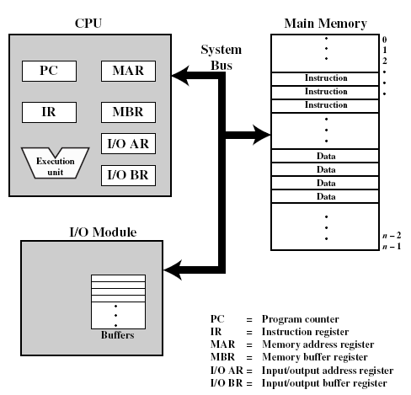
Top-level view of the main computer components
What is a computer?
Processor
Main Memory
Basic elements
System Bus
PC
MAR
Control and state registers
IR
MBR
User accessible registers
I/O AR
Execution unit
I/O BR
PC = Program counter
IR = Instruction register
MAR = Memory address register
MBR = Memory buffer register
I/O AR = Input/output address register
I/O BR = Input/output buffer register
I/O Module

Slide 100
Serial processing
What could be done with a simple computer like that?
No operating system
Machines run from a console with display lights, toggle switches, input device and printer
Setup included
Loading a compiler
Loading source program
Saving compiled program
Loading and linking executable program

Slide 101
Simple Batch Processing
What could be done with a simple computer like that?
Monitors
Software that controls the sequence of events
Batch jobs together
Program branches back to monitor when finished
Job Control Language (JCL)
Special type of programming language
Provides instruction to the monitor
What compiler to use
What data to use

Slide 102
Simple Interrupt Processing
Device controller or other system hardware issues an interrupt
Processor pushes PSW and PC onto control stack
Save remainder of process state information
Processor finishes execution of current instruction
Processor loads new PC value based on interrupt
Process the interrupt
Processor signals acknowledgement of interrupt
Restore process state information
Restore old PSW and PC
Hardware
Software

Slide 103
Classes of Interrupts
Program | Generated by a condition that occurs as a result of an instruction execution, such as arithmetic overflow, division by zero, attempt to execute an illegal instruction or reference outside a user's allowed memory space.
Timer | Generated by a timer within the processor. This allows the operating system to perform certain functions on a regular basis.
I/O | Generated by an I/O controller, to signal normal completion of an operation or an error condition.
Hardware failure | Generated by a failure, such as power failure or memory parity error.

Slide 104
Key elements of an OS for Multiprogramming
Operating System
Service call from Process
Service call handler (code)
Interrupt from Process
Interrupt handler (code)
Long- term queue
Short- term queue
I/O queues
Interrupt from I/O
Long-term Scheduler (code)
Short-term Scheduler (code)
Pass control to process

Slide 105
Traditional UNIX layered system structure
(the users)
shells and commands compilers and interpreters system libraries
system-call interface to the kernel
signals terminal handling character I/O system terminal drivers | file system swapping block I/O system disk and tape drivers | CPU scheduling page replacement demand paging virtual memory
kernel interface to the hardware
terminal controllers terminals | device controllers disks and tapes | memory controllers physical memory
kernel
hw

Slide 106
Virtual Machine Concept
Applications and processes |  | Applications and processes | … | Applications and processes
Virtual machine 1 |  | Virtual machine 2 | … | Virtual machine n
Virtual machine monitor
Host operating system
Shared hardware

Slide 107
E.g. Paging
How to implement virtual memory?
Virtual memory is divided into a number of fixed-size blocks called pages.
Virtual address is given by a page number and an offset within the page.
Actual memory is divided into a number of fixed-size blocks called frames.
A page can be placed in any available frame.
For each process, a page table gives the number of the frame where each page has been loaded.
Real address or physical address refers to main memory and is given by that frame number and the same offset of the logical address in the corresponding page.

Slide 108
Virtual Memory
A.1
A.0
A.2
A.5
0
0
1
1
Main memory
Divided into a number of fixed-length frames, the same size of pages.
For a program to execute at least one of its pages must be loaded in a frame in main memory.
Disk
Secondary memory can hold many fixed-length pages.
A user program consists of some number of pages.
Pages for all programs (including OS) are on disk.
B.0
B.1
B.2
B.3
2
2
3
3
4
4
5
5
A.7
6
6
A.9
7
User
8
program
9
B
A.8
10
User
program
A
B.5
B.6
Main Memory
Disk

Slide 109
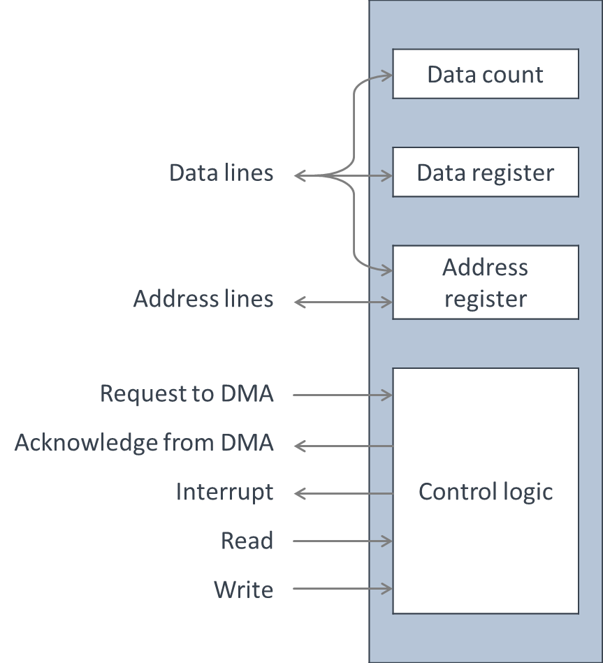
Direct Memory Access
Can I/O operation speed be improved?
 |  |  | Data count
Data lines |  |  | Data register
Address lines |  |  | Address register
Request to DMA |  |  | Control logic
Acknowledge from DMA
Interrupt
Read
Write
Performed by a separate module on the system bus or an I/O module.
Transfers a block of data directly to or from memory.
An interrupt is sent when the transfer is complete.
Meanwhile, processor continues with other work.

Slide 110
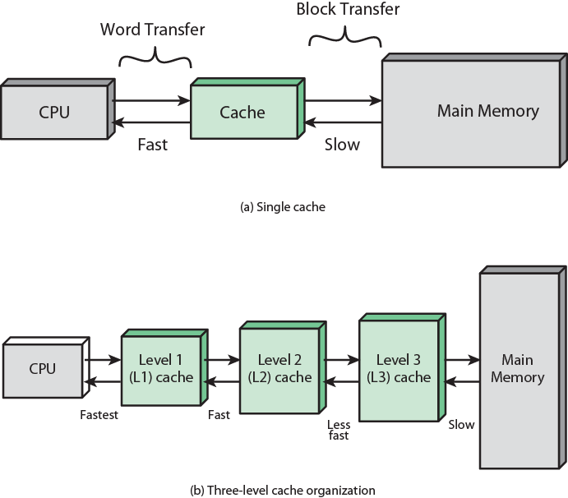
Cache and Main Memory: Single cache
Can memory access speed be improved?

Slide 111
Cache and Main Memory: Three-level cache
Can memory access speed be improved?

Slide 112
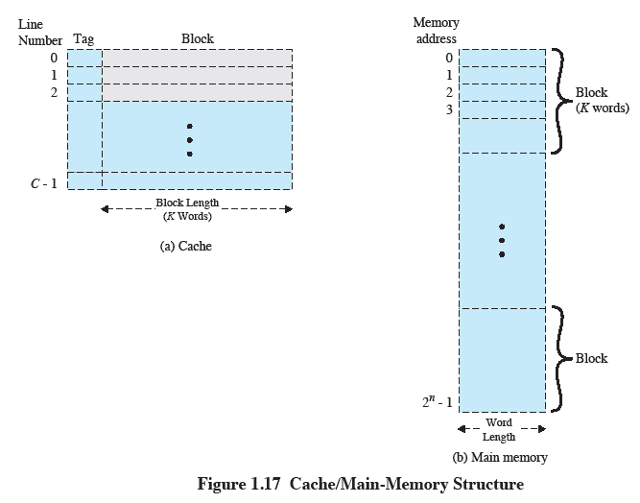
Cache / Main-memory Structure
Can memory access speed be improved?

Slide 113

Locality of reference
Locality of reference is key to limiting the number of pages that must be present in memory at any time, thus enabling an efficient implementation of virtual memory and the process concept.

Slide 114
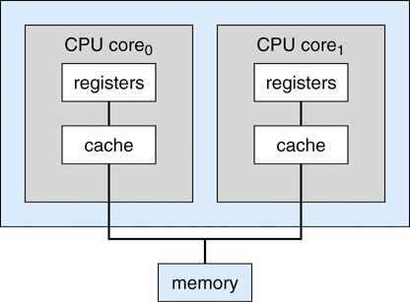
Model of a dual-core processor
Can processor speed be improved?
CPU core₀
CPU core₁
registers
registers
cache
cache
memory

Slide 115
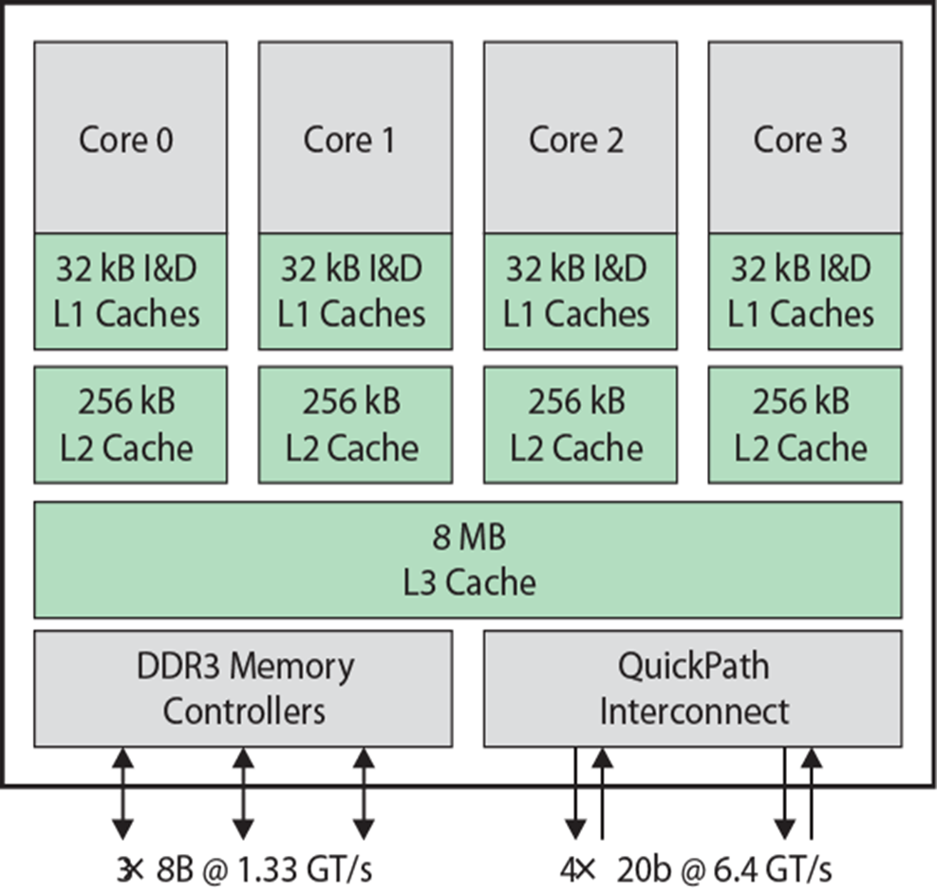
Intel Core i7 Block Diagram
Can processor speed be improved?

Slide 116
Main reasons for process creation
New batch job | The OS is provided with a batch job control stream, usually on tape or disk. When the OS is prepared to take on new work, it reads the next sequence of job control commands.
Interactive logon | A user at a terminal logs on to the system.
Created by OS to provide a service | The OS can create a process to perform a function on behalf of a user program, without the user having to wait (e.g.: a process to control printing).
Spawned by an existing process | For purposes of modularity or to exploit parallelism, a user program can dictate the creation of a number of processes.

Slide 117
Main reasons for process termination (1/4)
Formal completion | The process executes an OS service call to indicate that it has completed running.
Time limit exceeded | The process has run longer than the specified time limit. Time can be measured in many ways: total elapsed time (“wall clock time”), amount of time spent executing, the amount of time since the user last provided any input, etc.
Resources unavailable | The process requires more resources than the system can provide.

Slide 118
Main reasons for process termination (2/4)
Bounds violation | The process tries to access a memory location that it is not allowed to access.
Protection error | The process tries to use a resource such as a file that it is not allowed to use, or to use it in an improper way, such as writing to a read-only file.
Arithmetic error | The process tries a prohibited computation, such as division by zero, or tries to store numbers larger than the hardware can accommodate.
Time overrun | The process has waited longer than a specified maximum for a certain event to occur.

Slide 119
Main reasons for process termination (3/4)
I/O failure | An error occurs during input or output, such as inability to find a file: failure to read or write after a specified maximum number of tries (when: for example, a defective area is encountered on a tape) or invalid operation (such as reading from the line printer).
Invalid instruction | The process attempts to execute a nonexistent instruction (often a result of branching into a data area and attempting to execute the data).
Privileged instruction | The process attempts to use an instruction reserved for the operating system.

Slide 120
Main reasons for process termination (4/4)
Data misuse | A piece of data is of the wrong type or is not initialized.
Operator or OS intervention | For some reason, the operator or the operating system has terminated the process (for example, if a deadlock exists).
Parent termination | When a parent terminates, the operating system may automatically terminate all of the offspring of that parent.
Parent request | A parent process typically has the authority to terminate any of its offspring.

Slide 121
A process model with 5 states
In order to overcome the problem with the queue
New
The process has been created
Ready
The process is waiting to be assigned to a processor
Running
Instructions are being executed
Blocked
The process is waiting for some event to occur
Exit
The process has finished execution

Slide 122
Main reasons for process suspension
Swapping
Other OS reason
Interactive user request
Timing
Parent process request

Slide 123
Main reasons for process suspension
Swapping
Other OS reason
Interactive user request
Timing
Parent process request
The OS needs to release sufficient main memory to bring in a process that is ready to execute.

Slide 124
Main reasons for process suspension
Swapping
Other OS reason
Interactive user request
Timing
Parent process request
The OS may suspend a background or utility process or a process that is suspected of causing a problem.

Slide 125
Main reasons for process suspension
Swapping
Other OS reason
Interactive user request
Timing
Parent process request
A user may wish to suspend execution of a program for purposes of debugging or in connection with the use of a resource.

Slide 126
Main reasons for process suspension
Swapping
Other OS reason
Interactive user request
Timing
Parent process request
A parent process may wish to suspend execution of a descendant to examine or modify the suspended process, or to coordinate the activity of various descendants.

Slide 127
Main reasons for process suspension
Swapping
Other OS reason
Interactive user request
Timing
Parent process request
A process may be executed periodically (e.g.. an accounting or system monitoring process) and may be suspended while waiting for the next time interval.

Slide 128
Processes and Resources
P₁
P₂
P_{n}
Virtual Memory
Computer Resources
Processor
I/O
I/O
I/O
Main Memory

