Slide 1
CPU Virtualization The Process API
T02

Slide 2
Essential Questions
Here we discuss process creation in Unix systems, in an attempt at answering two questions
What interfaces should the OS present for process creation and control?
How should these interfaces be designed to enable ease of use as well as utility?

Slide 3
Process creation

Slide 4
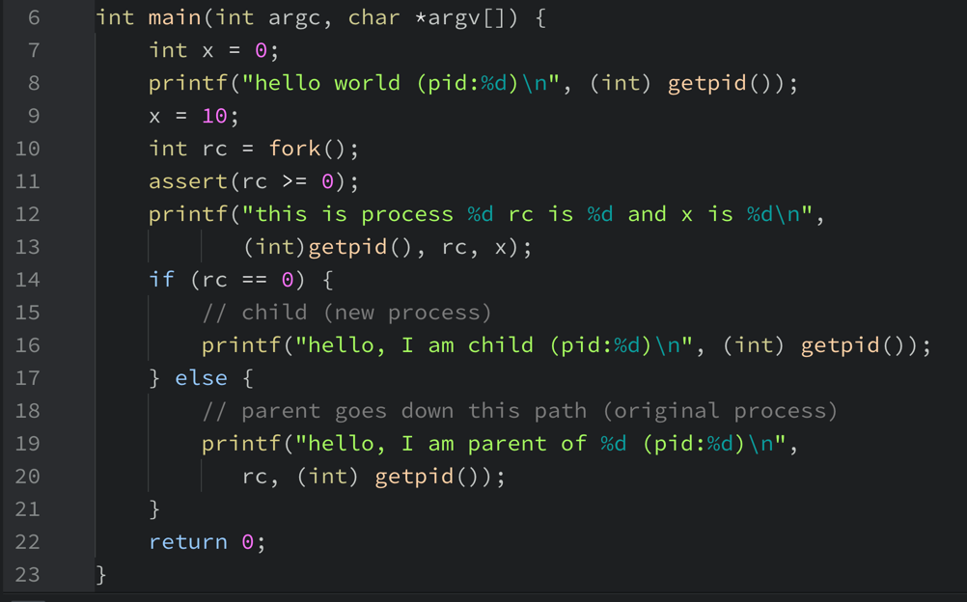
The fork() system call
The fork() system call is used by a process to create a new one.

Slide 5
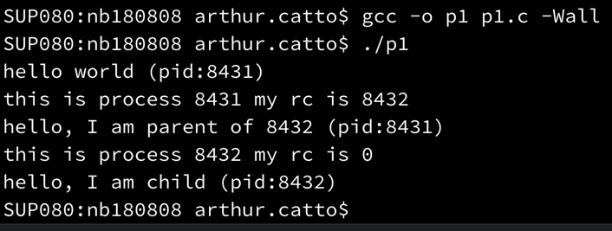
p1’s result… is it what you expected?
Is it what you expected?
Can you guess how fork() works?

Slide 6
How fork() works
When a process (the parent process) calls fork(), an exact copy of it is created, which includes the address space (i.e. all code and variables) and the program counter.
So, the new process (the child process) starts to execute at the fork() point of return.
To distinguish parent and child, fork() returns the child’s pid to the parent and 0 to the child.
This enables us to write code that handles parent and child differently.

