Slide 1
Memory Virtualization Segmentation
T10
Ch.16 of Operating Systems: Three Easy Pieces by Remzi and Andrea Arpaci-Dusseau (pages.cs.wisc.edu/~remzi/OSTEP/)
29 de agosto de 2018

Slide 2
Inefficiency of the Base and Bound Approach
0KB
Program Code
1KB
2KB
Big chunk of “free” space
“Free” space takes up physical memory.
Hard to run when an address space does not fit into physical memory
3KB
4KB
5KB
Heap
6KB
(free)
14KB
15KB
Stack
16KB

Slide 3
Segmentation
Memory-management scheme that supports user view of memory.
A program is a collection of segments.
A segment is a virtual unit such as:
main program
procedure
function
method
object
local variables
global variables
common block
stack
symbol table

Slide 4
Segmentation
A segment is just a contiguous portion of the address space of particular length.
Logically-different segments: code, stack, heap
Each segment can be placed in a different part of physical memory.
Base and bound are defined for each segment.

Slide 5
Logical View of Segmentation
1400 | sgmt 0
2400
3200 | sgmt 3
4300 | sgmt 2
4700 | sgmt 4
5700
6300 | sgmt 1
6700
physical memory
virtual address space
0
3
 | base | bound
0 | 1400 | 1000
1 | 6300 | 400
2 | 43000 | 400
3 | 3200 | 1100
4 | 4700 | 1000
segment table
subprogram
stack
4
symbol table
1
sqrt
2
main program

Slide 6
Segmentation
Segmentation provides a virtual view of main memory.
The segments of a program may have different lengths.
There is a maximum segment length.
Since segments are not equal, segmentation resembles dynamic partitioning.

Slide 7
Segmentation
Segment is a contiguous region of virtual memory
Segment can be located anywhere in physical memory
Each segment has: start, length, access permission
Processes can share segments
Same start, length, same/different access permissions

Slide 8
Segmentation Architecture
Virtual address consists of a pair: <segment-number, offset>
Each process has a segment table (in hardware)
Segment number → entry in table
A segment table maps a two-dimensional virtual address onto a one-dimensional physical address.
Each entry in a segment table has at least two fields
Base: the segment’s starting physical address in memory.
Bound: the length of the segment.

Slide 9
Segmentation Architecture
Protection
With each entry in segment table associate
validation bit (if zero ⇒ illegal segment)
privilege bits (read/write/execute)
Protection bits associated with segments
Code sharing occurs at segment level.
Since segments vary in length, memory allocation is a dynamic storage allocation problem.

Slide 10
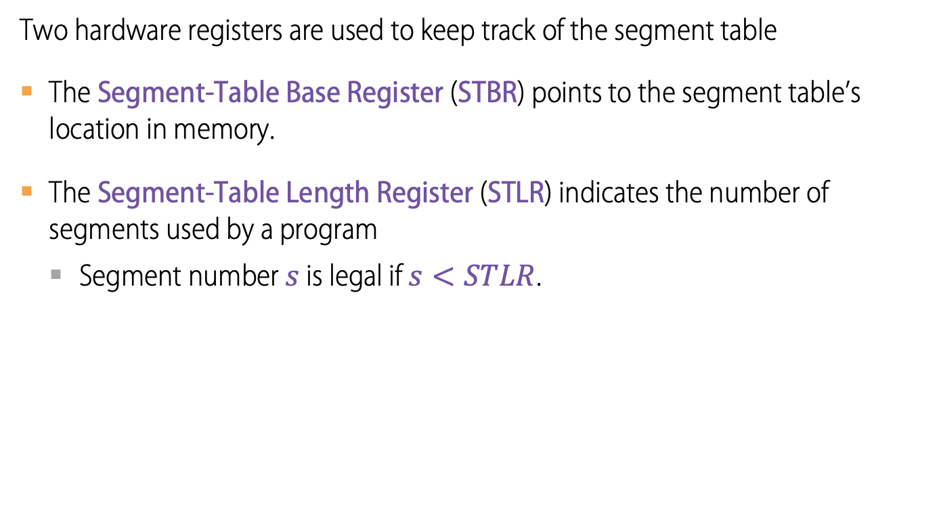
Segmentation Architecture
Two hardware registers are used to keep track of the segment table
The Segment-Table Base Register (STBR) points to the segment table’s location in memory.
The Segment-Table Length Register (STLR) indicates the number of segments used by a program
Segment number $s$ is legal if $s<STLR$.

Slide 11
Fine-Grained and Coarse-Grained Segmentation
Coarse-Grained means segmentation in small numbers.
e.g., code, heap, stack.
Fine-Grained segmentation allows a more flexible address space.
To support many segments, hardware support with a segment table is required.

Slide 12
Segmentation
Stack
Code
Data
Code
Heap
Data
Stack
Heap
Notes:
This should seem a bit strange: the virtual address space has gaps in it! Each segment gets mapped to contiguous locations in physical memory, but may be gaps between segments.
This is a little like walking around in the dark, and there are huge pits in the ground where you die if you step in the pit.
But! of course, a correct program will never step off into a pit, so ok.
A correct program will never address gaps; if it does, trap to kernel and then core dump. Minor exception: stack, heap can grow. In UNIX, sbrk() increases size of heap segment. For stack, just take fault, system automatically increases size of stack.
Detail: Protection mode in segmentation table entries. For example, code segment would be read-only (only execution and loads are allowed). Data and stack segment would be read-write (stores allowed).
What must be saved/restored on context switch? Typically, segment table stored in CPU, not in memory, because it’s small.
Contents must be saved/restored.

Slide 13
Segmentation
Pros?
Can share code/data segments between processes
Can protect code segment from being overwritten
Can transparently grow stack/heap as needed
Can detect if need to copy-on-write or zero-on-reference
Cons?
Complex memory management
Need to find chunk of a particular size
May need to rearrange memory from time to time to make room for new segment or growing segment
External fragmentation: wasted space between chunks

Slide 14
UNIX fork and Copy on Write
UNIX fork
Makes a complete copy of a process
Segments allow a more efficient implementation
Copy segment table into child
Mark parent and child segments as read-only
Start child process; return to parent
If child or parent writes to a segment (ex: stack, heap)
trap into kernel
make a copy of the segment and resume

Slide 15
Processor
Code
Processor
Data
P1’s Segment Table
Heap
Stack
Processor
Code
Processor
Data
P2’s Segment Table
Heap
Stack

Slide 16
Zero-on-Reference
How much physical memory is needed for the stack or heap?
Only what is currently in use
When program uses memory beyond end of stack
Segmentation fault into OS kernel
Kernel allocates some memory
How much?
Clears the allocated memory
Avoid accidentally leaking information!
Modify segment table
Resume process

Slide 17
A point to ponder
With segmentation, what is saved/restored on a process context switch?
Notes:
Only the OS gets to change the base and bounds! Clearly, user program can't, or else lose protection.
With base&bounds system, what gets saved/restored on a context switch?
contents of base and bounds register; or maybe even contents of memory

Slide 18
Placing Segments In Physical Memory
0KB
Program Code
0KB
Operating System
Segment | Base | Size
Code | 32K | 2K
Heap | 34K | 2K
Stack | 28K | 2K
2KB
4KB
Heap
16KB
6KB
(not in use)
(free)
28KB
Stack
(not in use)
32KB
34KB
Code
Heap
(not in use)
48KB
14KB
Stack
16KB
64KB
Space Address
Physical Memory

Slide 19
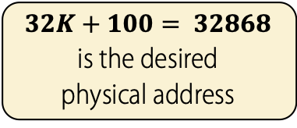

Address Translation on Segmentation
Example
The code segment starts at virtual address $0$ in address space.
The offset of virtual address $100$ is $100$.
physical address = base + offset
Segment | Base | Size
Code | 32K | 2K
Heap | 34K | 2K
Stack | 28K | 2K
16KB
(not in use)
0KB
32KB
$32K+100= 32868$ is the desired physical address
100
Program Code
Code
instruction
2KB
34KB
Heap
4KB
(not in use)
Address Space
Physical Memory

Slide 20
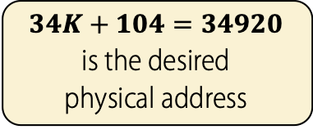
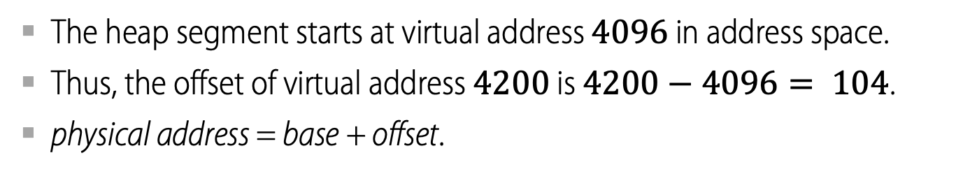
Address Translation on Segmentation
Example
The heap segment starts at virtual address $4096$ in address space.
Thus, the offset of virtual address $4200$ is $4200−4096= 104$.
physical address = base + offset.
Segment | Base | Size
Code | 32K | 2K
Heap | 34K | 2K
Stack | 28K | 2K
(not in use)
32KB
Code
4KB
34KB
$34K+104=34920$ is the desired physical address
4200
Heap
Heap
data
6KB
36KB
(not in use)
Address Space
Physical Memory

Slide 21
Segmentation Fault or Violation
If an illegal address such as 7KB which is beyond the end of heap is referenced, the OS incurs a segmentation fault.
The hardware detects that address is out of bounds.
Segment | Base | Size
Code | 32K | 2K
Heap | 34K | 2K
Stack | 28K | 2K
4KB
Heap
6KB
7KB
(not in use)
8KB
Address Space

Slide 22
Which Segment Are We Referring To?
OS support
The hardware uses segment registers during address translation. How does it know the offset into a segment, and to which segment an address refers?
One possible approach is to chop up the address space into segments based on the top few bits of the virtual address.
For example, if the OS requires three segments, the top two bits of the virtual address could be used to represent the segment number.
Assuming an address space of 16KB, the remaining 12 bits will be used to represent the offset into the segment, which leaves us with a maximum segment size of 4KB.
0KB
Program Code
2KB
4KB
Heap
6KB
(free)
14KB
13 | 12 | 11 | 10 | 9 | 8 | 7 | 6 | 5 | 4 | 3 | 2 | 1 | 0
Stack
16KB
Address Space
Segment
Offset

Slide 23
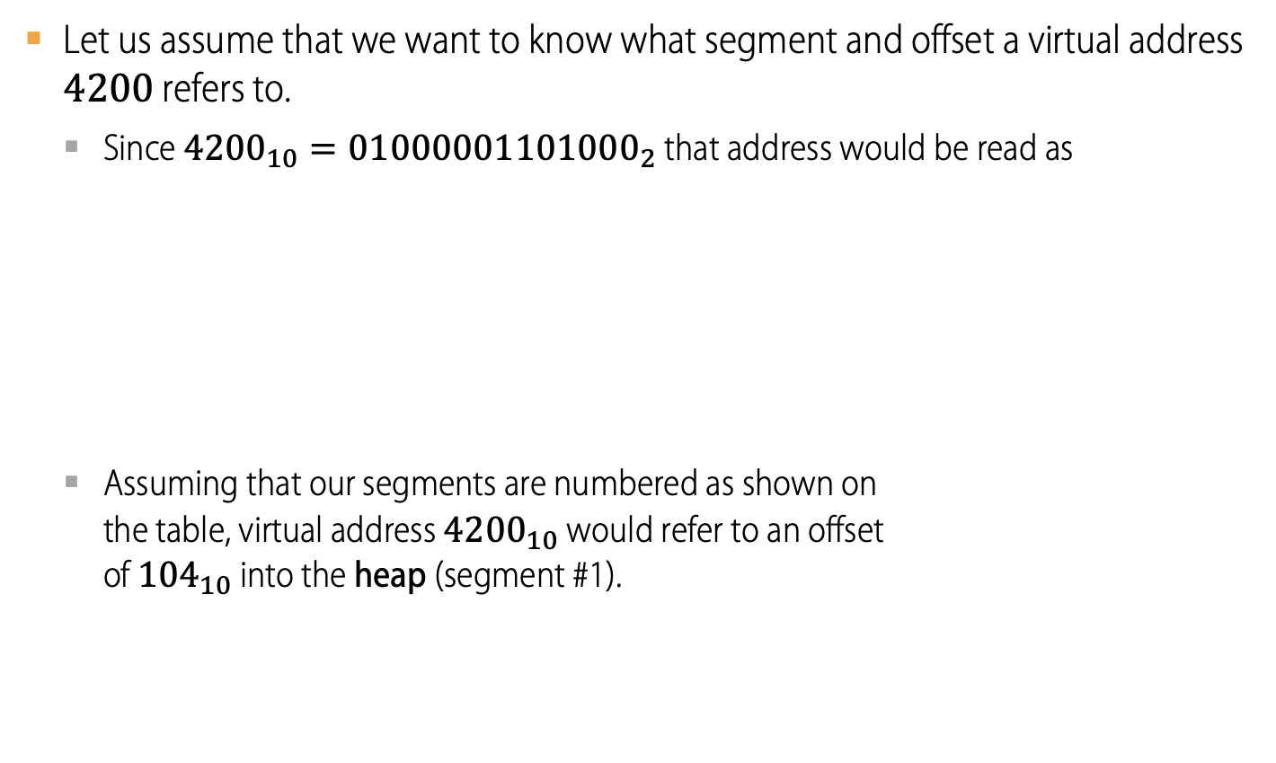
Referring to a Segment
Example
Let us assume that we want to know what segment and offset a virtual address $4200$ refers to.
Since ${4200}_{10}={01000001101000}_{2}$ that address would be read as
Assuming that our segments are numbered as shown on the table, virtual address ${4200}_{10}$ would refer to an offset of ${104}_{10}$ into the heap (segment #1).
13 | 12 | 11 | 10 | 9 | 8 | 7 | 6 | 5 | 4 | 3 | 2 | 1 | 0
0 | 1 | 0 | 0 | 0 | 0 | 0 | 1 | 1 | 0 | 1 | 0 | 0 | 0
Segment = 1
Offset = 64 + 32 + 8 = 104
Segment | bits
Code | 00
Heap | 01
Stack | 10
(unused) | 11

Slide 24
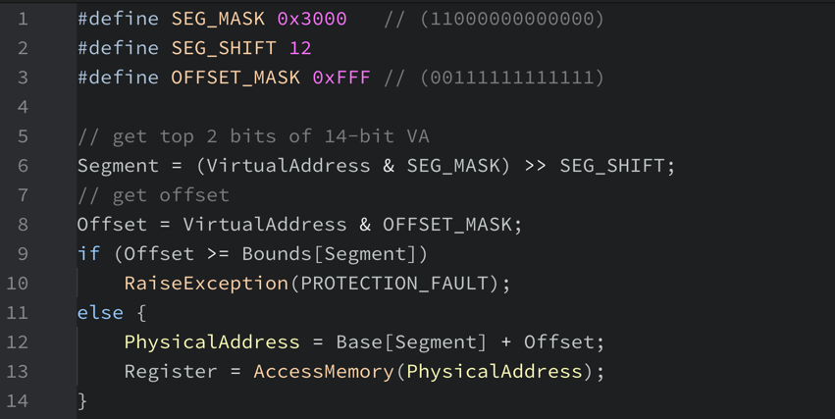
Referring to a Segment
OS support
Assuming that base and bounds were arrays indexed by segment number, to translate a virtual address into a physical one, the hardware would be doing something like…

Slide 25
Referring to the Stack Segment
OS support
Remember that the stack grows backwards.
Extra hardware support is needed.
The hardware must check which way a segment grows.
Let us use a bit for that: 1 = positive direction, 0 = negative direction
(not in use)
Segment Registers with Support for Negative-Growth
Segment | Base | Size | Positive-Growth?
Code | 32K | 2K | 1
Heap | 34K | 2K | 1
Stack | 28K | 2K | 0
26KB
Stack
28KB
(not in use)
Physical Memory

Slide 26

Referring to an Address within the Stack
Example
Let us assume that we want to know what segment and offset a virtual address $15K$ refers to.
Since $15K={11110000000000}_{2}$ that address would be read as
Assuming that our segments are numbered as shown on the table, virtual address ${4200}_{10}$ would refer to an offset of ${104}_{10}$ into the heap (segment #1).
13
12
11
10
9
8
7
6
5
4
3
2
1
0
1
1
1
1
0
0
0
0
0
0
0
0
0
0
Segment = 1
Offset = 64 + 32 + 8 = 104
Segment | bits
Code | 00
Heap | 01
Stack | 10
(unused) | 11

Slide 27
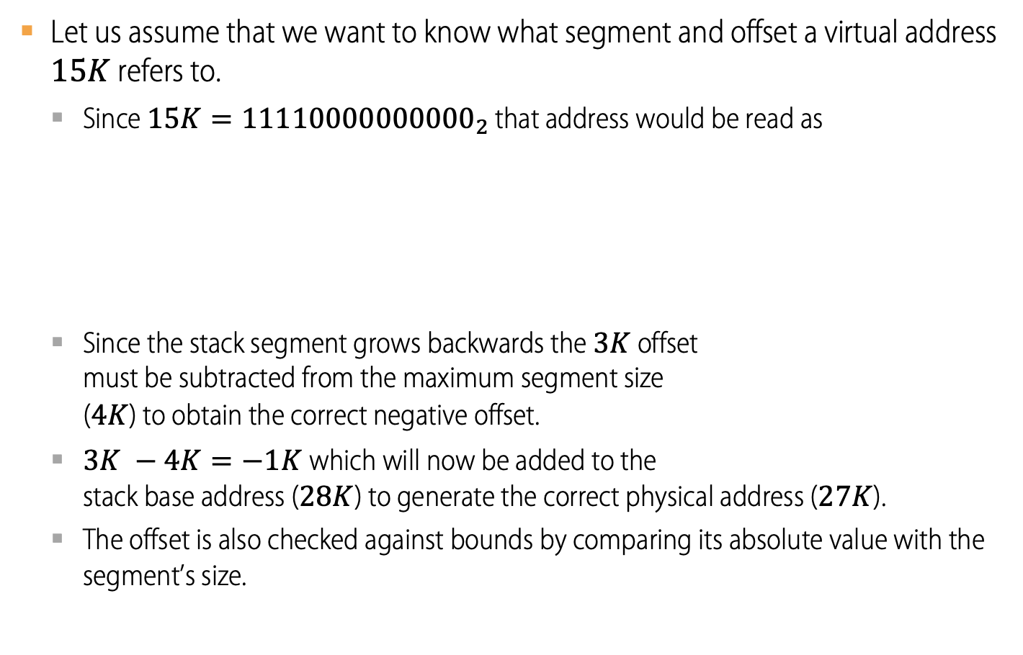
Referring to an Address within the Stack
Example
Let us assume that we want to know what segment and offset a virtual address $15K$ refers to.
Since $15K={11110000000000}_{2}$ that address would be read as
Since the stack segment grows backwards the $3K$ offset must be subtracted from the maximum segment size ($4K$) to obtain the correct negative offset.
$3K −4K=−1K$which will now be added to the stack base address ($28K$) to generate the correct physical address ($27K$).
The offset is also checked against bounds by comparing its absolute value with the segment’s size.
13 | 12 | 11 | 10 | 9 | 8 | 7 | 6 | 5 | 4 | 3 | 2 | 1 | 0
1 | 1 | 1 | 1 | 0 | 0 | 0 | 0 | 0 | 0 | 0 | 0 | 0 | 0
Segment = 3
Offset = 3K = 2048 + 1024 = 3072
Segment | Base | Size | Positive-Growth?
Code | 32K | 2K | 1
Heap | 34K | 2K | 1
Stack | 28K | 2K | 0

Slide 28
Sharing
OS support
Segments can also be shared among address spaces.
Code sharing, for example, is common and still used in systems today.
Segment sharing requires extra hardware support in the form of protection bits.
A few more bits are added to the segment registers or to the sgment table to indicate permission to read, write and/or execute.
Segment Registers with Support for Negative-Growth and Sharing
Segment | Base | Size | Positive-Growth? | Protection
Code | 32K | 2K | 1 | Read-Execute
Heap | 34K | 2K | 1 | Read-Write
Stack | 28K | 2K | 0 | Read-Write

Slide 29
Fragmentation
OS support
External Fragmentation
Holes of free space in physical memory that make it difficult to allocate new segments.
There are 24KB free, but not in one contiguous segment.
The OS cannot satisfy a 20KB request.
Compaction
Rearranging the existing segments in physical memory, but this is expensive.
Stop running processes.
Copy data to somewhere.
Change segment base register value.

Slide 30
Memory Compaction
BEFORE
AFTER
0KB
Operating System
0KB
Operating System
8KB
8KB
16KB
16KB
(not in use)
Allocated
24KB
24KB
Allocated
32KB
32KB
(not in use)
40KB
Allocated
40KB
(not in use)
48KB
(not in use)
48KB
56KB
56KB
Allocated
64KB
64KB

