Slide 1
Memory Virtualization Paging
T11
Ch.18 of Operating Systems: Three Easy Pieces by Remzi and Andrea Arpaci-Dusseau (pages.cs.wisc.edu/~remzi/OSTEP/)
03 de setembro de 2018

Slide 2
Partitioning Issues
We have seen that
With fixed partitioning, any program, no matter how small, occupies an entire partition.
This sort of memory waste is called internal fragmentation.
With variable partitioning, due to the process allocation policy, holes of various sizes may appear and be scattered throughout memory.
This sort of memory waste is called external fragmentation.

Slide 3
Noncontiguous allocation
One way to fight external fragmentation is to make the physical address space of a process noncontiguous.
The idea is to make all the available physical memory accessible to any running process.
We have already studied segmentation, an early noncontiguous allocation concept, which reminds us of the pros and cons of variable partitioning.
Paging is another early noncontiguous allocation concept, which takes a different approach.
It was designed at the University of Manchester and implemented in the Atlas Computer, which was commissioned in 1962.

Slide 4
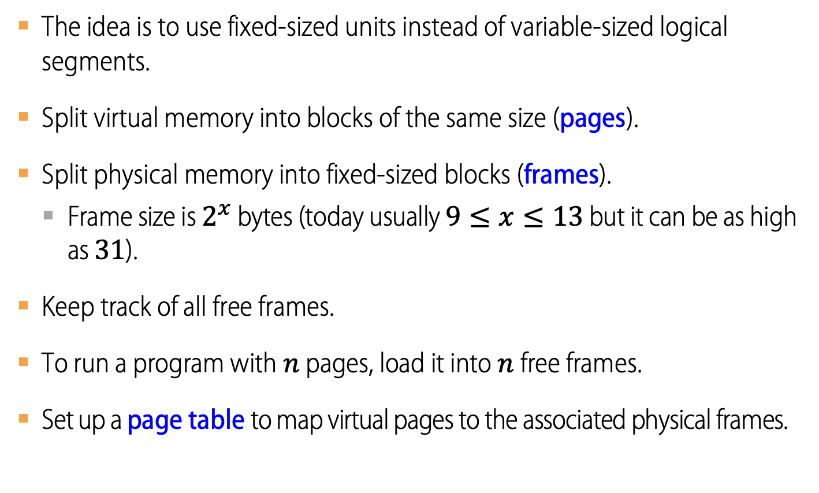
The Paging Approach
The idea is to use fixed-sized units instead of variable-sized logical segments.
Split virtual memory into blocks of the same size (pages).
Split physical memory into fixed-sized blocks (frames).
Frame size is $2^{x}$ bytes (today usually $9≤x≤13$ but it can be as high as 31).
Keep track of all free frames.
To run a program with $n$ pages, load it into $n$ free frames.
Set up a page table to map virtual pages to the associated physical frames.

Slide 5
Points to ponder
How can we virtualize memory with pages, so as to avoid the problems of segmentation?
What are the basic techniques?
How do we make those techniques work well, with minimal space and time overheads?
Is this strategy prone to…
Internal fragmentation? Why?
External fragmentation? Why?

Slide 6
Advantages Of Paging
Flexibility
It supports the abstraction of an address space effectively.
E.g. there will be no assumptions about how heap and stack grow and are used.
Simplicity
Managing the page table requires only two hardware registers
Page-table base register (PTBR) points to page table.
Page-table length register (PTLR) indicates the size of the page table.
It is easy to manage the free-space.
The pages in the address space and the frames in the physical memory are the same size.
It is easy to allocate and keep a free list, e.g. by using a bitmap like 0011111100000001100, where each bit represents one physical page frame.

Slide 7
A Simple Paging System
Example
Consider
A tiny 64B address space with four 16B pages
A small 128B physical memory with eight 16B page frames.
0
frame 0 of physical memory
reserved for OS
16
(unused)
frame 1
32
page 3 of AS
frame 2
48
page 0 of AS
frame 3
64
0
(unused)
frame 4
(page 0)
16
80
page 2 of AS
frame 5
(page 1)
32
96
(page 2)
(unused)
frame 6
48
112
(page 3)
page 1 of AS
frame 7
64
128
A Simple 64B Address Space
The Address Space Placed In Physical Memory

Slide 8
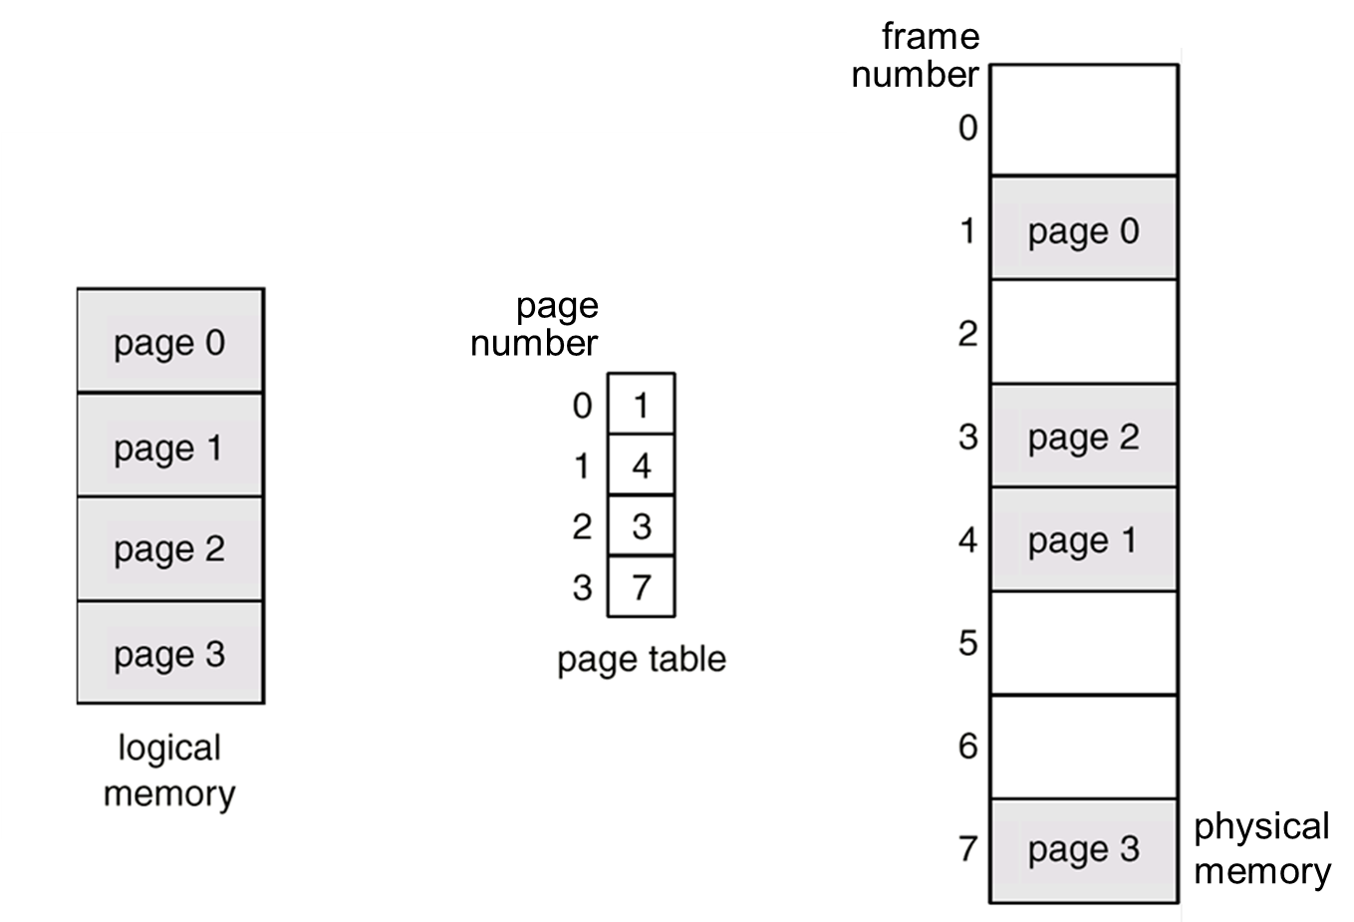
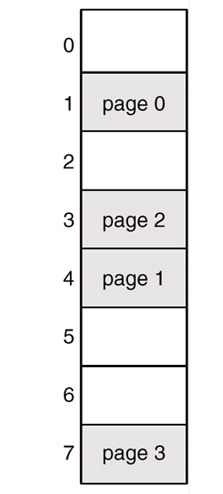
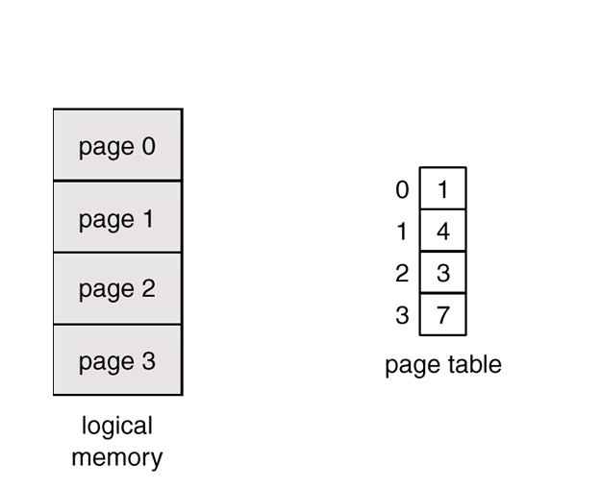
A Simple Paging System
Example
frame number
page 3
page 0
page 2
page 1
page 0
page 1
page 2
page 3
page number
3
7
5
2
virtual memory
physical memory

Slide 9
Paged Translation (Abstract)

Slide 10
Paged Translation (Abstract)

Slide 11
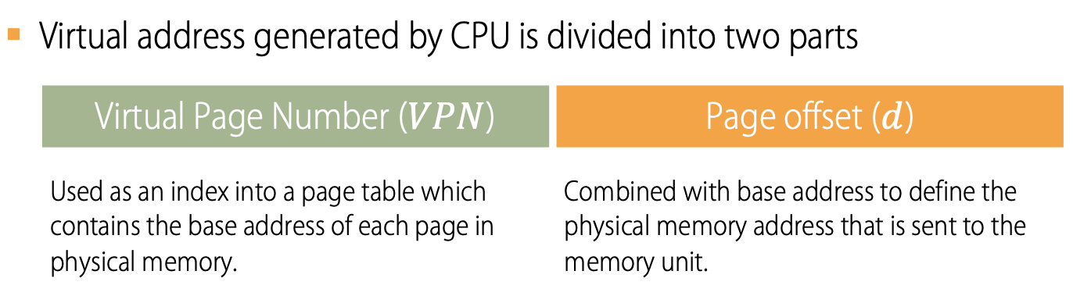
Address Translation Scheme
Virtual address generated by CPU is divided into two parts
 | Virtual Page Number ($VPN$) | Page offset ($d$)
 | Used as an index into a page table which contains the base address of each page in physical memory. | Combined with base address to define the physical memory address that is sent to the memory unit.
In our simple paging example, 6 bits will be required to cover the address space.
There are 4 pages, so the VPN will take 2 bits
The size of each page is 16B, so the offset will require 4 bits.
VPN
offset
Va5
Va4
Va3
Va2
Va1
Va0

Slide 12
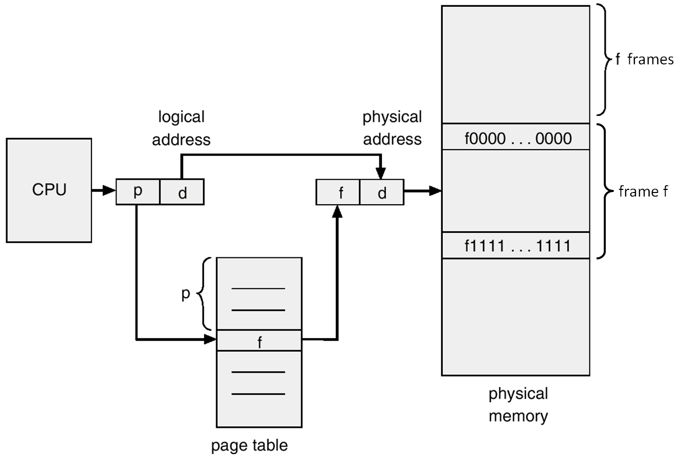
Address Translation Scheme
f0…000
f1…111
CPU
VPN | d
PFN | d
PFN
VPN

Slide 13
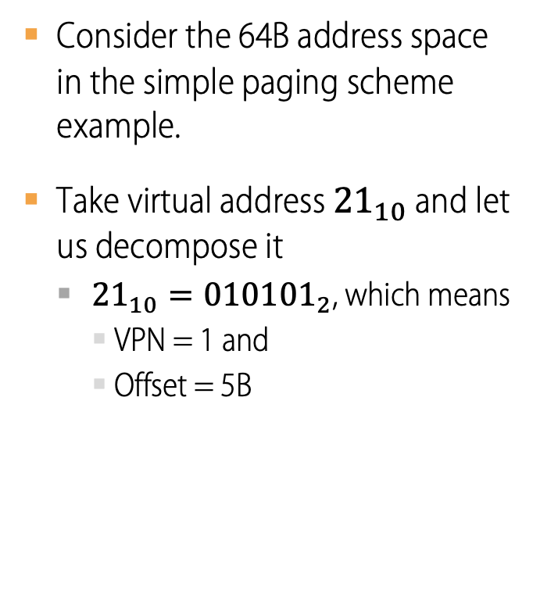
Address Translation
Example
Consider the 64B address space in the simple paging scheme example.
Take virtual address ${21}_{10}$ and let us decompose it
${21}_{10}={010101}_{2}$, which means
VPN = 1 and
Offset = 5B
VPN
offset
0
1
0
1
0
1

Slide 14

Address Translation
Example
Assume now that, in our simple system, Virtual Pages are mapped onto Physical Frames according to the table on the left.
Virtual address ${21}_{10 }$would be mapped onto memory address ${117}_{10}$ as shown by the diagram on the right.
VPN
offset
Virtual
Address
0
1
0
1
0
1
Address Translation
VPN | PFN
0 | 3
1 | 7
2 | 5
3 | 2
Physical
Address
1
1
1
0
1
0
1
PFN
offset

Slide 15
Paging Example (4B pages, 32B mem)
VA₁₀ | VA₄ | Value |  | Page Table |  |  | PA₄ | PA₁₀ | Value |  | PA₄ | PA₁₀ | Value
0 | 00 | A |  | 0 | 5 |  | 00 | 0 |  |  | 100 | 16
1 | 01 | B |  | 1 | 6 |  | 01 | 1 |  |  | 101 | 17
2 | 02 | C |  | 2 | 3 |  | 02 | 2 |  |  | 102 | 18
3 | 03 | D |  | 3 | 1 |  | 03 | 3 |  |  | 103 | 19
4 | 10 | E |  | 4 |  |  | 10 | 4 | M |  | 110 | 20 | A
5 | 11 | F |  | 5 |  |  | 11 | 5 | N |  | 111 | 21 | B
6 | 12 | G |  | 6 |  |  | 12 | 6 | O |  | 112 | 22 | C
7 | 13 | H |  | 7 |  |  | 13 | 7 | P |  | 113 | 23 | D
8 | 20 | I |  |  |  |  | 20 | 8 |  |  | 120 | 24 | E
9 | 21 | J |  |  |  |  | 21 | 9 |  |  | 121 | 25 | F
10 | 22 | K |  |  |  |  | 22 | 10 |  |  | 122 | 26 | G
11 | 23 | L |  |  |  |  | 23 | 11 |  |  | 123 | 27 | H
12 | 30 | M |  |  |  |  | 30 | 12 | I |  | 130 | 28
13 | 31 | N |  |  |  |  | 31 | 13 | J |  | 131 | 29
14 | 32 | O |  |  |  |  | 32 | 14 | K |  | 132 | 30
15 | 33 | P |  |  |  |  | 33 | 15 | L |  | 133 | 31

Slide 16
Free Frame Allocation
BEFORE
AFTER
free-frame list
14
13
18
20
15
memory
13
14
15
16
17
18
19
20
21
free-frame list
15
memory
13 | page 1
14 | page 0
15
16
17
18 | page 2
19
20 | page 3
21
new-process page table
0 | 14
1 | 13
2 | 18
3 | 20
page 0 page 1 page 2 page 3
page 0 page 1 page 2 page 3
new process
new process

Slide 17
Points to ponder…
How big can page tables be?
Where are page tables stored?
What are the typical contents of a page table?
Does paging make the system (too) slow?

Slide 18
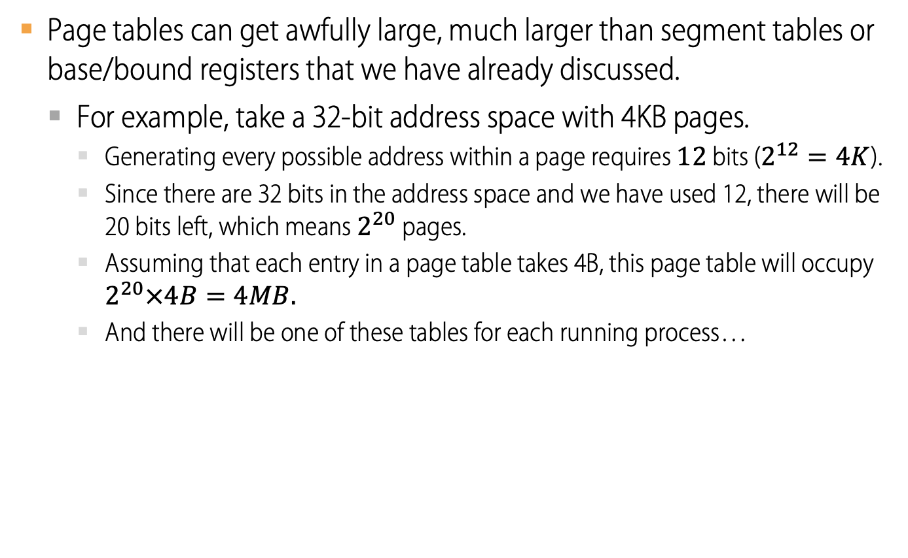
How Big Are Page Tables?
Page tables can get awfully large, much larger than segment tables or base/bound registers that we have already discussed.
For example, take a 32-bit address space with 4KB pages.
Generating every possible address within a page requires $12$ bits ($2^{12}=4K$).
Since there are 32 bits in the address space and we have used 12, there will be 20 bits left, which means $2^{20}$ pages.
Assuming that each entry in a page table takes 4B, this page table will occupy $2^{20}×4B=4MB.$
And there will be one of these tables for each running process…

Slide 19
Where Are Page Tables Stored?
Because page tables are so big, they cannot fit into any special on-chip hardware.
Instead, they are kept in the kernel physical memory.

Slide 20
What Is In The Page Table?
The page table is just a data structure that is used to map a virtual address to a physical address, and in its simplest form is just an array.
The OS indexes the PT by VPN to get the Physical Frame Number and some flags, e.g.
Valid (V): whether the frame is valid.
Read/Write (R/W): whether the page can be read from or written to
Present (P): whether the page is in physical memory or on disk
Dirty (D): whether the page has been modified since it was read
Accessed (A): whether the page has been accessed
31 | 30 | 29 | 28 | 27 | 26 | 25 | 24 | 23 | 22 | 21 | 20 | 19 | 18 | 17 | 16 | 15 | 14 | 13 | 12 | 11 | 10 | 9 | 8 | 7 | 6 | 5 | 4 | 3 | 2 | 1 | 0
Physical Frame Number (PFN)
G
PAT
D
A
PCD
PWT
U/S
R/W
P
Example: An x86 Page Table Entry (PTE)

Slide 21
Paging: Also Too Slow
We have seen that in order to translate a virtual address, we need to access the Page Table to get the corresponding Physical Frame Number.
Since the Page Table is stored in memory, this implies that, for every memory reference, paging requires the OS to perform one extra memory reference.
An abstract protocol for what happens on each memory reference is shown on the next slide.

Slide 22
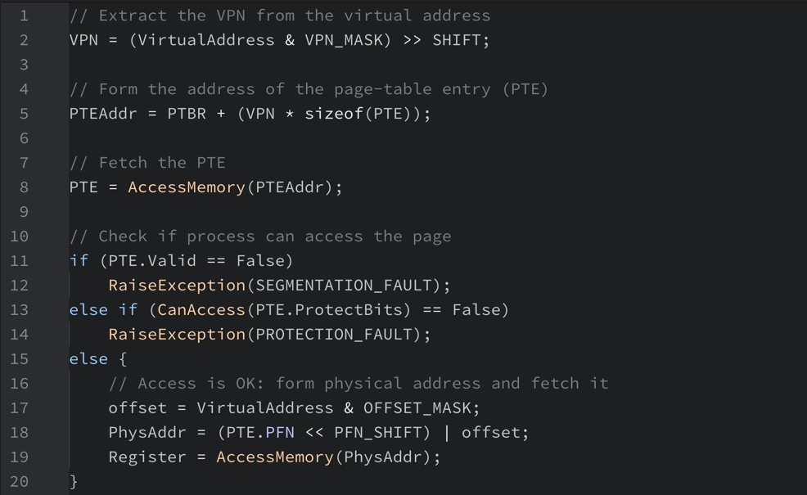
Accessing Memory With Paging

Slide 23
Paged Translation (Implementation)

Slide 24

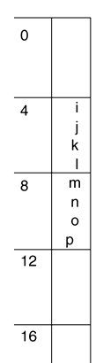
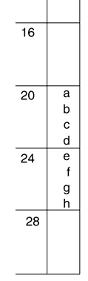
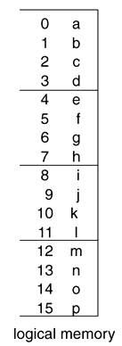

Paging Example
Page size = 4B
Physical memory = 32B

Slide 25
Points to Ponder…
With paging, what is saved or restored on a process context switch? | What if the page size is very small? | What if the page size is very large?
Pointer to page table, size of page table | Page table may become too large. | Internal fragmentation, if we don’t need all of the space inside a fixed size chunk.
Page table itself is in main memory
Notes:
Means lots of space taken up with page table entries.

Slide 26
Paging and Copy on Write
Can we share memory between processes?
Set entries in both page tables to point to same page frames
Need core map of page frames to track which processes are pointing to which page frames (e.g., reference count)
UNIX fork with copy on write
Copy page table of parent into child process
Mark all pages (in new and old page tables) as read-only
Trap into kernel on write (in child or parent)
Copy page
Mark both as writeable
Resume execution

Slide 27
Fill On Demand
Can I start running a program before its code is in physical memory?
Set all page table entries to invalid
When a page is referenced for first time, kernel trap
Kernel brings page in from disk
Resume execution
Remaining pages can be transferred in the background while program is running
Notes:
On windows, the compiler reorganizes where procedures are in the executable, to put the initialization code in a few pages right at the beginning

Slide 28
Sparse Address Spaces
Might want many separate dynamic modules
Per-processor heaps
Per-thread stacks
Memory-mapped files
Dynamically linked libraries
What if virtual address space is large?
32-bits, 4KB pages ➜ 500K page table entries
64-bits, 4KB pages ➜ 4 quadrillion page table entries
32-bits, 4KB pages ➜ 500K page table entries
64-bits, 4KB pages ➜ 4 quadrillion page table entries
Notes:
Is there a solution that allows simple memory allocation, easy to share memory, and is efficient for sparse address spaces?

