Slide 1
Common Concurrency Problems
T23a
32
17 de outubro de 2018

Slide 2
Common Concurrency Problems
More recent work focuses on studying other types of common concurrency bugs.
Non-deadlock bugs make up 70% of concurrency bugs:
Atomicity violation
Order violation
Deadlocks account for 30% of all bugs.
70% Atomicity violation +
Order violation
30% Deadlock

Slide 3
Atomicity-Violation Bugs
In this sort of error, critical sections may not be executed atomically.
This is a simple example found in MySQL:
Thread1::
if(thd->proc_info){
...
fputs(thd->proc_info, ...);
...
}
Thread2::
thd->proc_info = NULL;
What is the problem here?
Tread1 and Thread2 may access field proc_info in struct thd non-atomically .

Slide 4
Atomicity-Violation Bugs
How can we solve that problem?
In this case it is rather straightforward: just protect the critical sections with locks.
mutex_t lock = PTHREAD_MUTEX_INITIALIZER;
Thread1::
mutex_lock(&lock);
if(thd->proc_info) {
...
fputs(thd->proc_info, ...);
...
}
mutex_unlock(&lock);
Thread2::
mutex_lock(&lock);
thd->proc_info = NULL;
mutex_unlock(&lock);

Slide 5
Order-Violation Bugs
In this sort of error, instructions in different threads may be executed out of the expected order.
Thread1::
void init(){
mThread = PR_CreateThread(mMain, …);
}
Thread2::
void mMain(…){
mState = mThread->State
}
What is the problem here?
The code in Thread2 seems to assume that the variable mThread has already been initialized (and is not NULL), but this may not be true.

Slide 6
Order-Violation Bugs
How can we solve that problem?
In this case, we can use a condition variable to enforce order of execution.
mutex_t mtLock = PTHREAD_MUTEX_INITIALIZER;
cond_t mtCond = PTHREAD_COND_INITIALIZER;
int mtInit = 0;
Thread 1::
void init(){
...
mThread = PR_CreateThread(mMain,…);
// signal that the thread has been created.
mutex_lock(&mtLock);
mtInit = 1;
cond_signal(&mtCond);
mutex_unlock(&mtLock);
...
}
Thread2::
void mMain(…){
...
// wait for the thread to be initialized …
mutex_lock(&mtLock);
while(mtInit == 0)
cond_wait(&mtCond, &mtLock);
mutex_unlock(&mtLock);
mState = mThread->State;
...
}

Slide 7
Deadlocks

Slide 8
Deadlocks…
Are permanent blockings of two or more processes or threads that either
compete for system resources or
communicate with each other.
Involve conflicting needs for resources by two or more processes or threads.
Have no efficient solution.

Slide 9
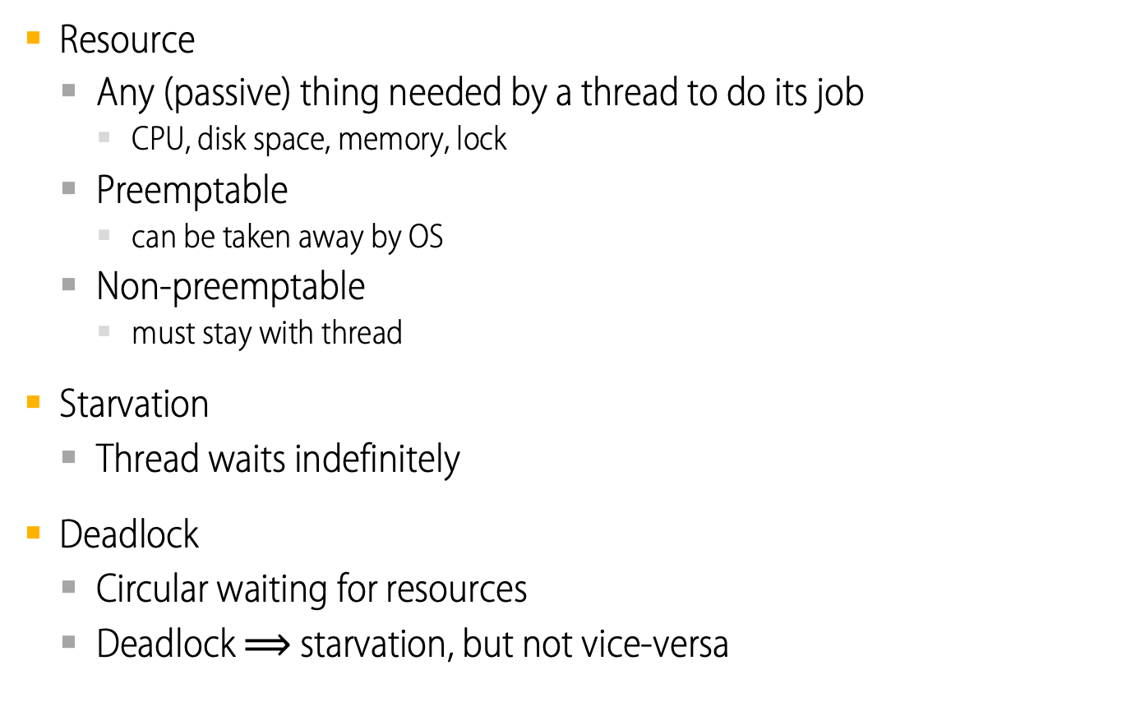
Deadlock Definition
Resource
Any (passive) thing needed by a thread to do its job
CPU, disk space, memory, lock
Preemptable
can be taken away by OS
Non-preemptable
must stay with thread
Starvation
Thread waits indefinitely
Deadlock
Circular waiting for resources
Deadlock $⟹$ starvation, but not vice-versa
Notes:
(disk space -- what would you think if I took space for your files?)
(mutual exclusion is a weird kind of resource!)

Slide 10


Bridge Crossing
Deadlock Example
Bridge with a single lane of traffic.
Each section of the bridge can be viewed as a resource.
If a deadlock occurs, it can be resolved if one car backs up (preempt resources and rollback).
Several cars may have to be backed up if a deadlock occurs.
Starvation is possible.

Slide 11
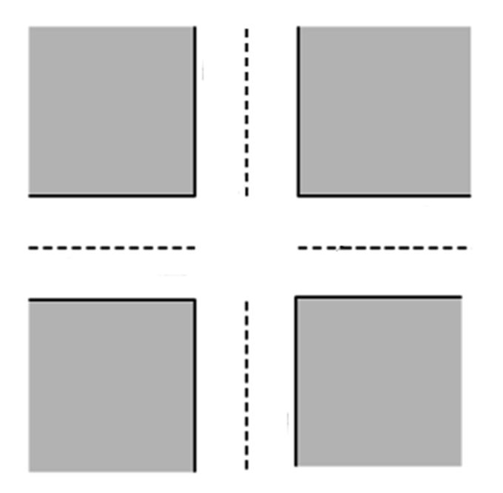
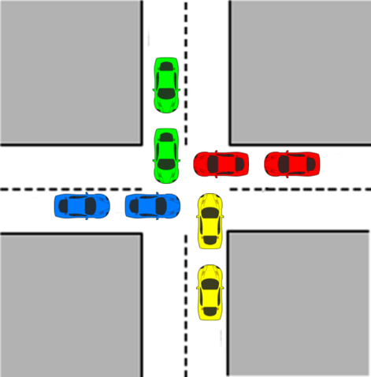




Crossroads
Deadlock Example
c
b
d
a
Deadlock is possible
Deadlock has occurred

Slide 12
Two locks
Deadlock Example
Thread A | Thread B
lock1.acquire(); | lock2.acquire();
lock2.acquire(); | lock1.acquire();
lock2.release(); | lock1.release();
lock1.release(); | lock2.release();
Can deadlock happen?
Will deadlock happen?
Notes:
Deadlock won't always happen with this code, but it might.
So you release a piece of software, and you tested it, there it is, controlling the nuclear power plant, and whamo! deadlock!

Slide 13
Two locks and a condition variable
Deadlock Example
Thread A | Thread B
lock1.acquire(); | lock1.acquire();
... | ...
lock2.acquire(); | lock2.acquire();
while (needToWait()) { | ...
condition.wait(lock2); | condition.signal(lock2);
} | ...
lock2.release(); | lock2.release();
... | ...
lock1.release(); | lock1.release();
What happens here?

Slide 14
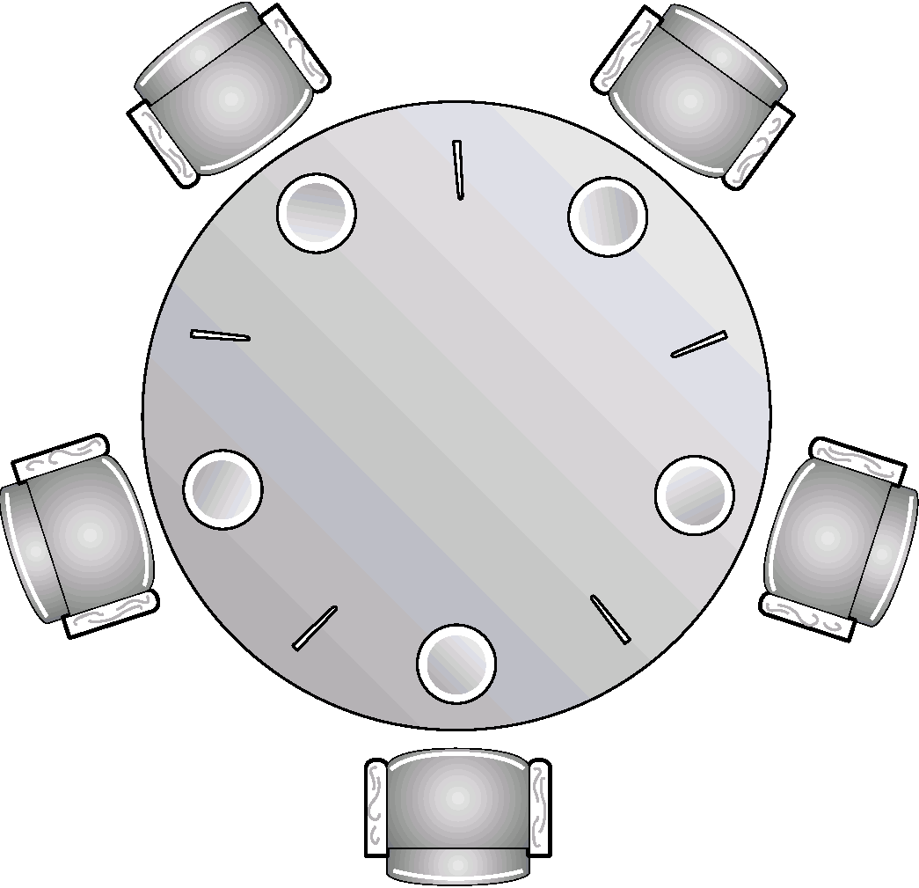
Dining Philosophers
Deadlock example
Problem
5 people sit around a table and alternate between talking and eating from an infinite sushi tray placed at the center of the table.
There are 5 plates and 5 chopsticks as shown in the picture.
To eat, both chopsticks next to a plate are required.
Chopsticks are returned to their positions whenever a person stops or is not able to start eating.
Can deadlock happen?
If so, does it always happen?
Can a person starve?

Slide 15
Deadlocks
The Deadlock Problem
System Model
Deadlock Characterization
Methods for Handling Deadlocks
Deadlock Prevention
Deadlock Avoidance
Deadlock Detection
Recovery from Deadlock

Slide 16
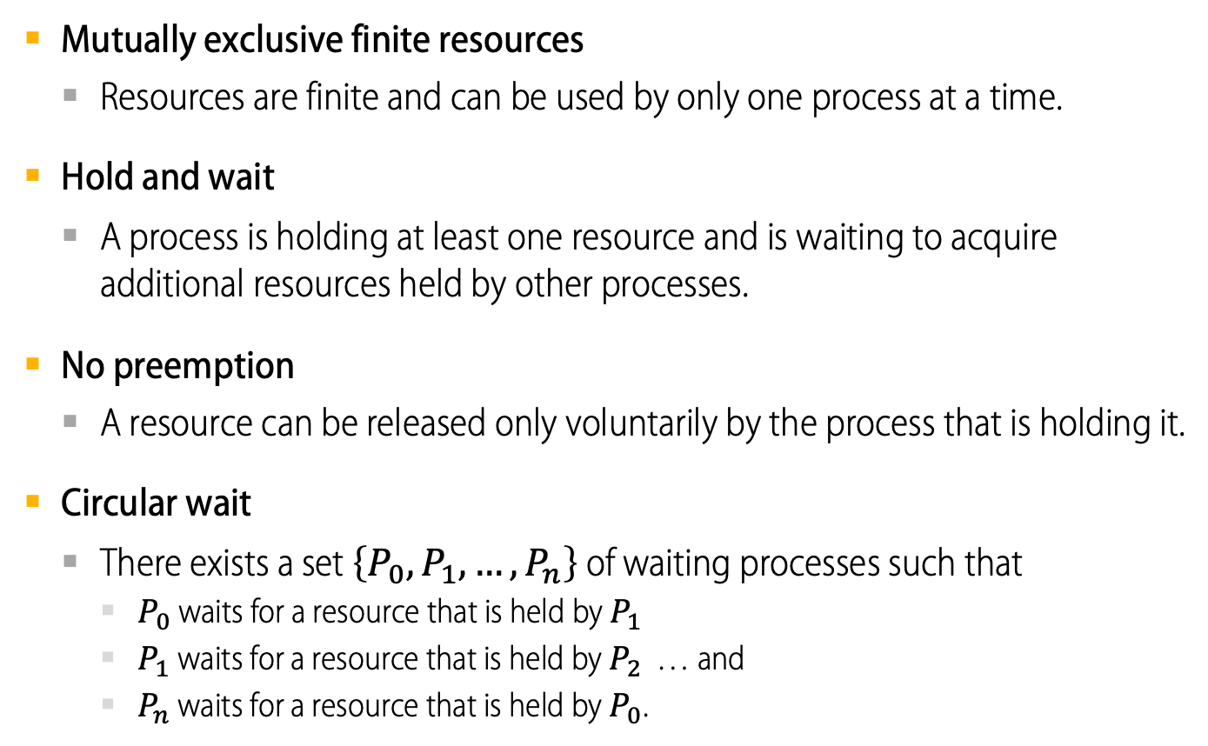
Deadlock can arise only if 4 conditions hold simultaneously
Deadlock Characterization
Mutually exclusive finite resources
Resources are finite and can be used by only one process at a time.
Hold and wait
A process is holding at least one resource and is waiting to acquire additional resources held by other processes.
No preemption
A resource can be released only voluntarily by the process that is holding it.
Circular wait
There exists a set $\left\{P_{0}, P_{1}, …, P_{n}\right\}$ of waiting processes such that
$P_{0}$ waits for a resource that is held by $P_{1}$
$P_{1}$ waits for a resource that is held by $P_{2}$ … and
$P_{n}$ waits for a resource that is held by $P_{0}$.

Slide 17
A question about the Dining Philosophers
How does the Dining Philosophers problem meet the necessary conditions for deadlock?
Mutually exclusive finite resources
Hold and wait
No preemption
Circular wait
Can Dining Philosophers be modified to prevent deadlock?
Notes:
Limited access: an infinite pool of chopsticks
No preemption: take a chopstick away from a lawyer if they are in deadlock
Wait while holding: grab both chopsticks at once or neither
Circular chain: one left handed lawyer

Slide 18
Methods for Handling Deadlocks

Slide 19
Methods for Handling Deadlocks
Prevention
Restrain requests to ensure that at least one necessary condition cannot hold so that the system can never enter a deadlock state.
Avoidance
Delay granting requests that would take the system to a state where a deadlock might occur.
Detection
Allow the system to enter a deadlock state and then recover.
Ignore the problem and pretend that deadlocks never occur
Known as the “ostrich algorithm” and used by most operating systems, including UNIX and Windows.

Slide 20
Deadlock Prevention: ensure that at least one necessary condition cannot hold
Mutual Exclusion
Not required for sharable resources.
Must hold for non-sharable resources.
Hold and Wait
Prevent a process from requesting a resource if it is already holding any other resources.
Require a process to request and receive all the resources it needs before it begins execution or allow process to request resources only when it has none.
Low resource utilization; starvation possible.

Slide 21
Deadlock Prevention: ensure that at least one necessary condition cannot hold
No Preemption
If a process that is holding some resources requests another resource that cannot be immediately allocated to it, then all resources currently being held are released.
Preempted resources are added to the list of resources for which the process is waiting.
Process will be restarted only when it can regain its old resources, as well as the new ones that it is requesting.
Circular Wait
Impose a total ordering of all resource types and require that each process requests resources in an increasing order of enumeration.

Slide 22
Preventing Deadlock
Exploit or limit program behavior
Limit program from doing anything that might lead to deadlock
Predict the future
If we know what program will do, we can tell if granting a resource might lead to deadlock
Detect and recover
If we can rollback a thread, we can fix a deadlock once it occurs

Slide 23
Exploit or Limit Behavior
Provide enough resources
How many chopsticks are enough?
Eliminate wait while holding
Release lock when calling out of module
Telephone circuit setup
Eliminate circular waiting
Lock ordering: always acquire locks in a fixed order
Example: move file from one directory to another
Notes:
One additional chopstick anywhere on the table is enough!
Acquire both chopsticks at once?
Can we apply lock ordering to dining lawyers?

Slide 24
Example
Thread 1
Acquire A
Acquire C
If (maybe) Wait for B
Thread 2
Acquire B
Wait for A
How can we make sure to avoid deadlock?
Notes:
Have to stall at step 2 – after that, doomed. Preventing deadlock means waiting even when the resource you are asking for is available, if some of the resources you will (or may) need are not available.

Slide 25
Deadlock Avoidance
In order to avoid a deadlock, the system must have some additional a priori information available.
Simplest and most useful model requires that each process declare the maximum number of resources of each type that it may need.
The deadlock-avoidance algorithm dynamically examines the resource-allocation state to ensure that there can never be a circular-wait condition.
Resource-allocation state is defined by the number of available and allocated resources, and the maximum demands of the processes.

Slide 26
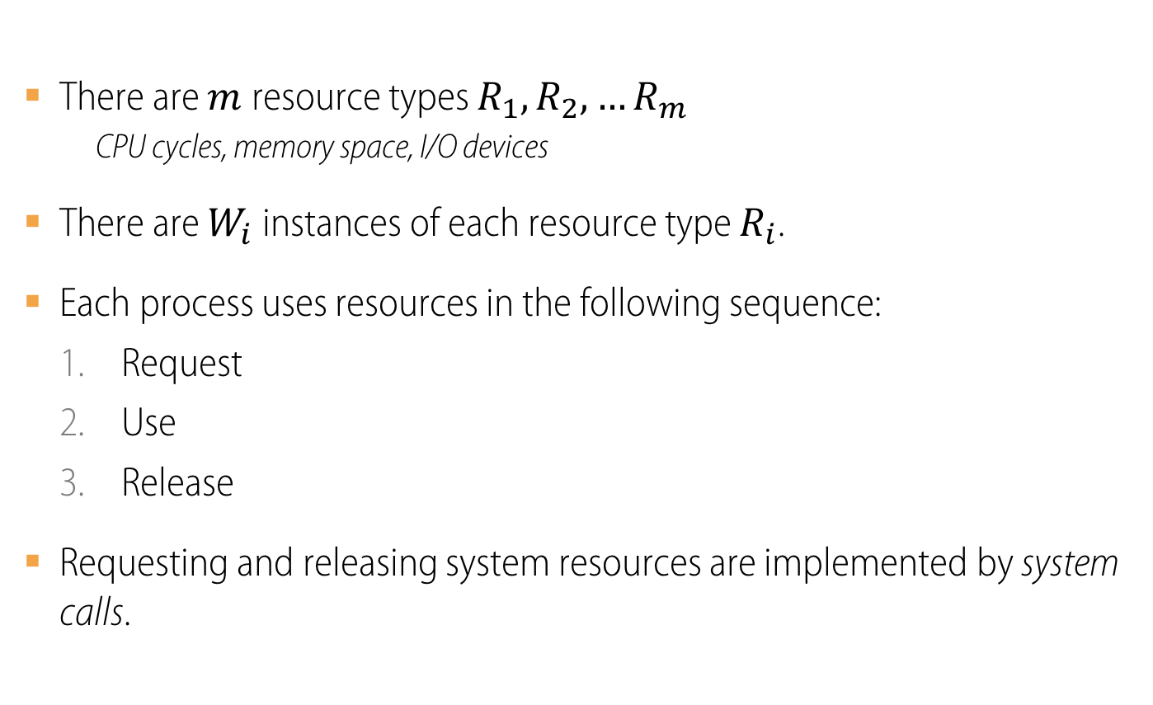
System Model
There are $m$resource types $R_{1},R_{2},…R_{m}$
CPU cycles, memory space, I/O devices
There are $W_{i}$ instances of each resource type $R_{i}$.
Each process uses resources in the following sequence:
Request
Use
Release
Requesting and releasing system resources are implemented by system calls.

Slide 27
Analysis of potential for deadlock (2 processes, 2 resources)
Process P
… get A;
… get B;
… rel A;
… rel B;
…
Process Q
… get B;
… get A;
… rel B;
… rel A;
…
Progress of Q
rel A
A required
rel B
get A
B required
get B
get A
get B
rel A
rel B
Progress of P
A required
B required

Slide 28
Analysis of potential for deadlock (2 processes, 2 resources)
Progress of Q
rel A
P and Q want A
A required
rel B
P and Q want both
get A
B required
P and Q want B
get B
get A
get B
rel A
rel B
Progress of P
A required
B required

Slide 29
Analysis of potential for deadlock (2 processes, 2 resources)
Progress of Q
rel A
P and Q want A
A required
rel B
P and Q want both
get A
B required
Deadlock inevitable
P and Q want B
get B
Q running; P waiting
P running; Q waiting
get A
get B
rel A
rel B
Progress of P
A required
B required

Slide 30
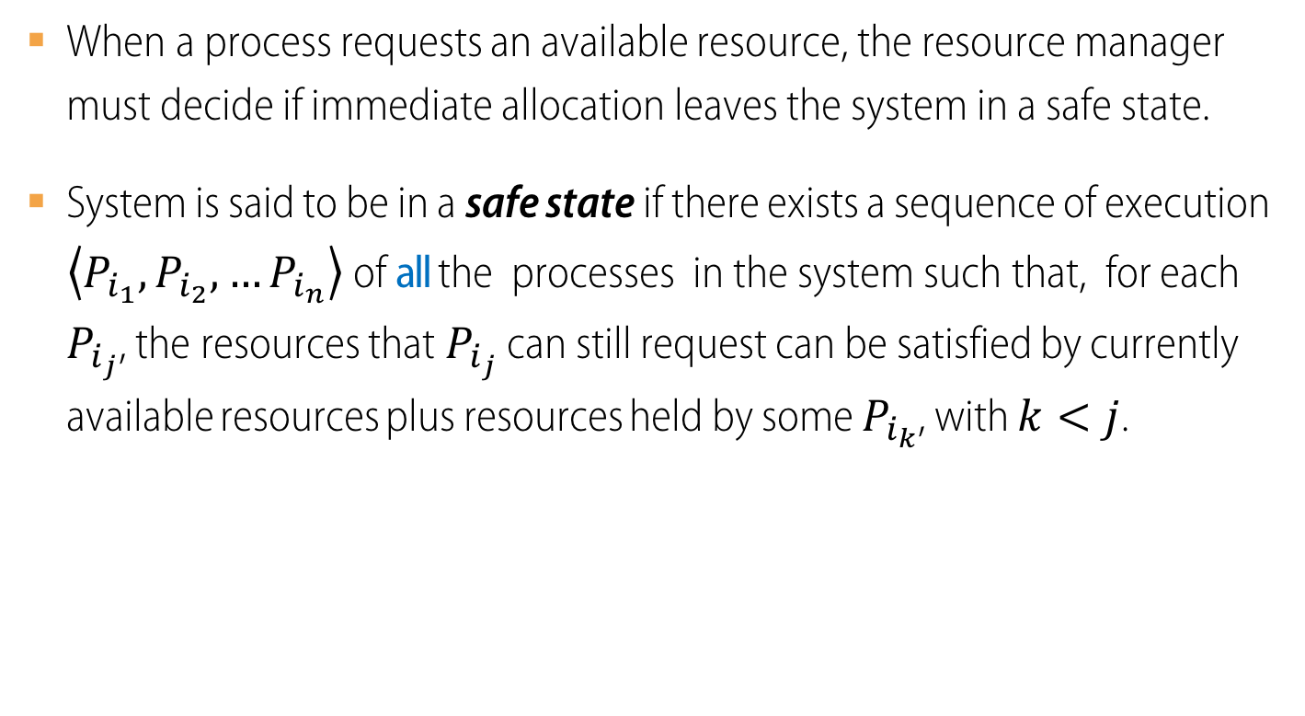
Deadlock avoidance: the Safe State concept
When a process requests an available resource, the resource manager must decide if immediate allocation leaves the system in a safe state.
System is said to be in a safe state if there exists a sequence of execution $\left\langle P_{i_{1}},P_{i_{2}},…P_{i_{n}}\right\rangle$ of all the processes in the system such that, for each $P_{i_{j}}$, the resources that $P_{i_{j}}$ can still request can be satisfied by currently available resources plus resources held by some $P_{i_{k}}$, with $k<j$.

Slide 31
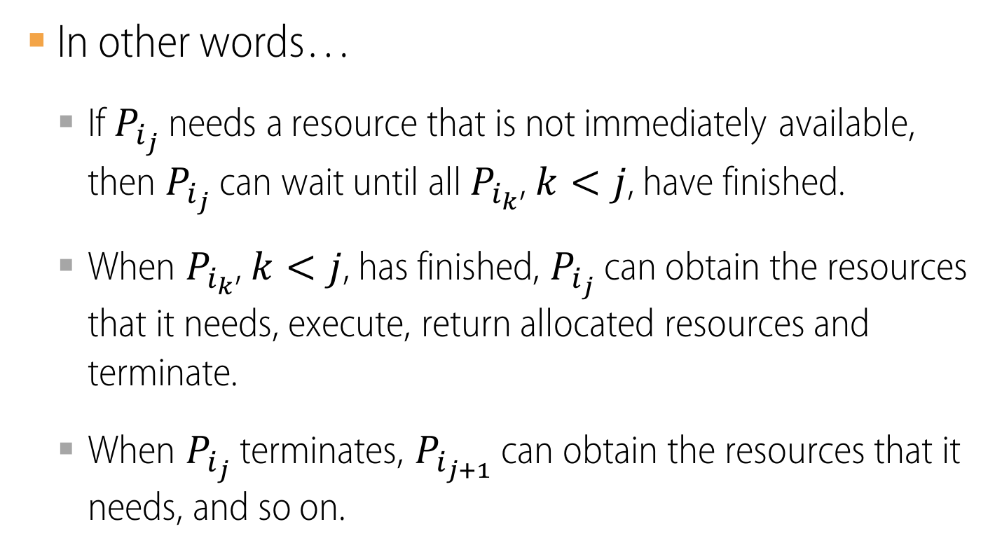
Safe State
In other words…
If $P_{i_{j}}$ needs a resource that is not immediately available, then $P_{i_{j}}$ can wait until all $P_{i_{k}}$, $k<j$, have finished.
When $P_{i_{k}}$, $k<j$, has finished, $P_{i_{j}}$ can obtain the resources that it needs, execute, return allocated resources and terminate.
When $P_{i_{j}}$ terminates, $P_{i_{j+1}}$ can obtain the resources that it needs, and so on.

Slide 32
Basic Facts about Safe and Unsafe States
System is in a safe state
No deadlocks.
System is in an unsafe state
Possibility of deadlock.
To avoid deadlocks
Ensure that the system will never enter an unsafe state.
unsafe
deadlock
safe
System states

Slide 33
Deadlock Dynamics
Safe state
For any possible sequence of future resource requests, it is possible to eventually grant all requests
May require waiting even when resources are available!
Unsafe state
Some sequence of resource requests can result in deadlock
Doomed state
All possible computations lead to deadlock

Slide 34
Food for thought...
What are the doomed states for Dining Philosophers?
What are the unsafe states?
What are the safe states?

