Slide 1
Common
Concurrency Problems
T23b
32
22 de outubro de 2018

Slide 2
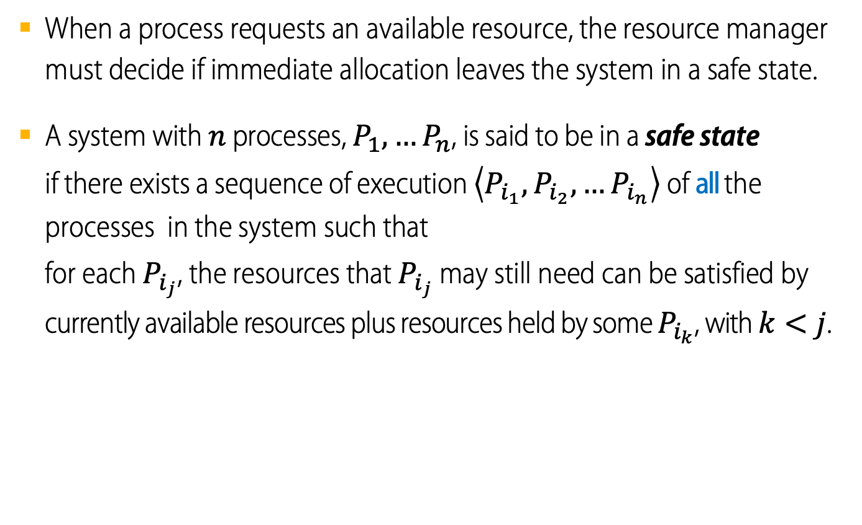
Deadlock avoidance: the Safe State concept
When a process requests an available resource, the resource manager must decide if immediate allocation leaves the system in a safe state.
A system with $n$ processes, $P_{1},…P_{n}$, is said to be in a safe state
if there exists a sequence of execution $\left\langle P_{i_{1}},P_{i_{2}},…P_{i_{n}}\right\rangle$ of all the processes in the system such that
for each $P_{i_{j}}$, the resources that $P_{i_{j}}$ may still need can be satisfied by currently available resources plus resources held by some $P_{i_{k}}$, with $k<j$.

Slide 3
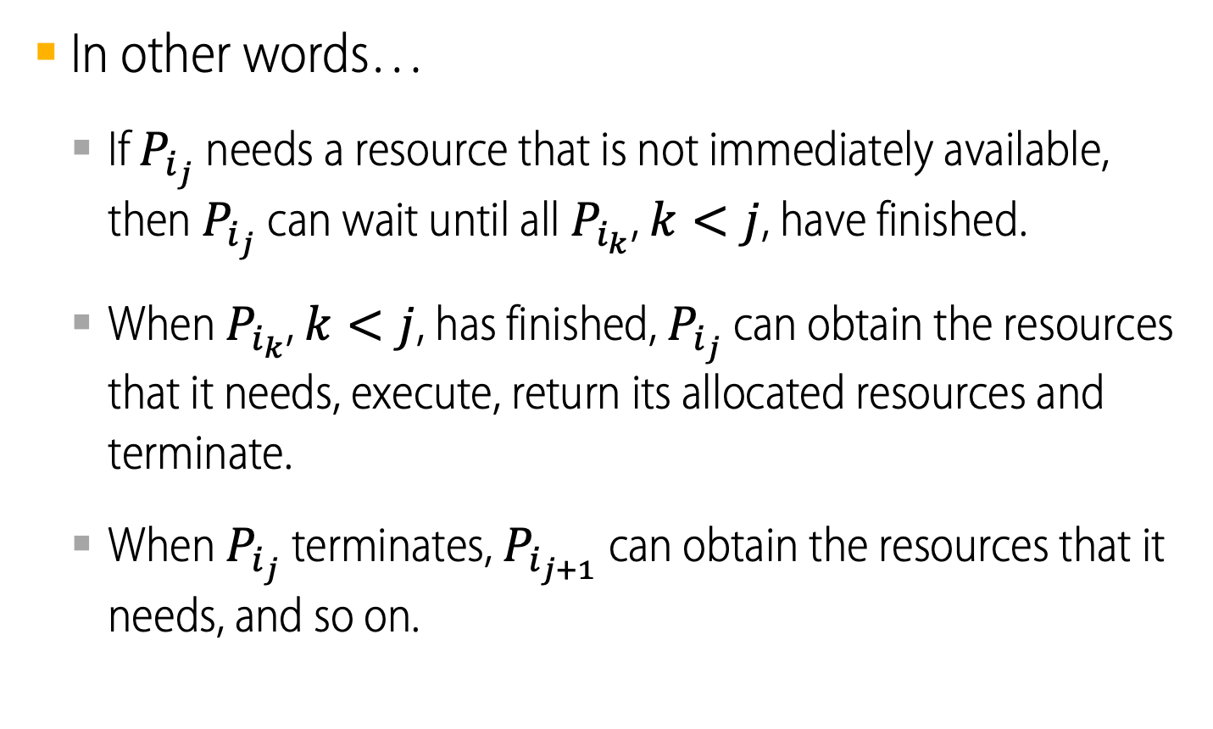
Safe State
In other words…
  If $P_{i_{j}}$ needs a resource that is not immediately available, then $P_{i_{j}}$ can wait until all $P_{i_{k}}$, $k<j$, have finished.
  When $P_{i_{k}}$, $k<j$, has finished, $P_{i_{j}}$ can obtain the resources that it needs, execute, return its allocated resources and terminate.
  When $P_{i_{j}}$ terminates, $P_{i_{j+1}}$ can obtain the resources that it needs, and so on.

Slide 4
Basic Facts about Safe and Unsafe States
System is in a safe state
  No deadlocks.
System is in an unsafe state
  Possibility of deadlock.
To avoid deadlocks
  Ensure that the system will never enter an unsafe state.
unsafe
deadlock
safe
System states

Slide 5
Deadlock Dynamics
Safe state
  For any possible sequence of future resource requests, it is possible to eventually grant all requests.
  May require waiting even when resources are available!
Unsafe state
  Some sequence of resource requests can result in deadlock.
Doomed state
  All possible computations lead to deadlock.

Slide 6
Food for thought...
What are the doomed states for Dining Philosophers?
What are the unsafe states?
What are the safe states?

Slide 7
Deadlock Avoidance algorithms
Single instance of a resource type
Use a resource-allocation graph scheme.
Multiple instances of a resource type
Use the banker’s algorithm.

Slide 8


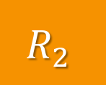
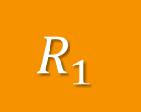
Resource-Allocation Graph Scheme
Deadlock avoidance with single instance of each resource type
Create a resource allocation graph.
$$R_{1}$$
$${ P}_{1}$$
$${ P}_{2}$$
$$R_{2}$$

Slide 9
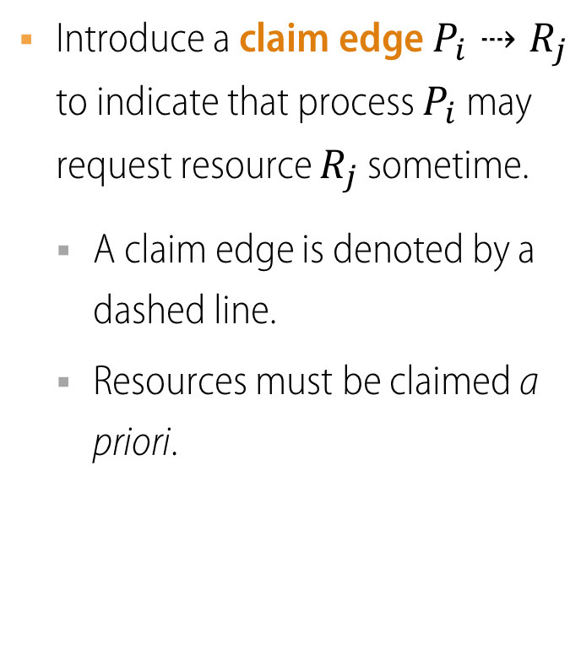
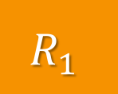
Resource-Allocation Graph Scheme
Deadlock avoidance with single instance of each resource type
Introduce a claim edge $P_{i}⇢R_{j}$ to indicate that process $P_{i}$ may request resource $R_{j}$ sometime.
  A claim edge is denoted by a dashed line.
  Resources must be claimed a priori.
$$R_{1}$$
$${ P}_{1}$$
$${ P}_{2}$$
$$R_{2}$$

Slide 10
Resource-Allocation Graph Scheme
Deadlock avoidance with single instance of each resource type
A claim edge is converted to a request edge when a process requests a resource.
A request edge is converted to an assignment edge when the resource is allocated to the process.
When a resource is released by a process, assignment edge reconverts to a claim edge.
$$R_{1}$$
$${ P}_{1}$$
$${ P}_{2}$$
$$R_{2}$$

Slide 11
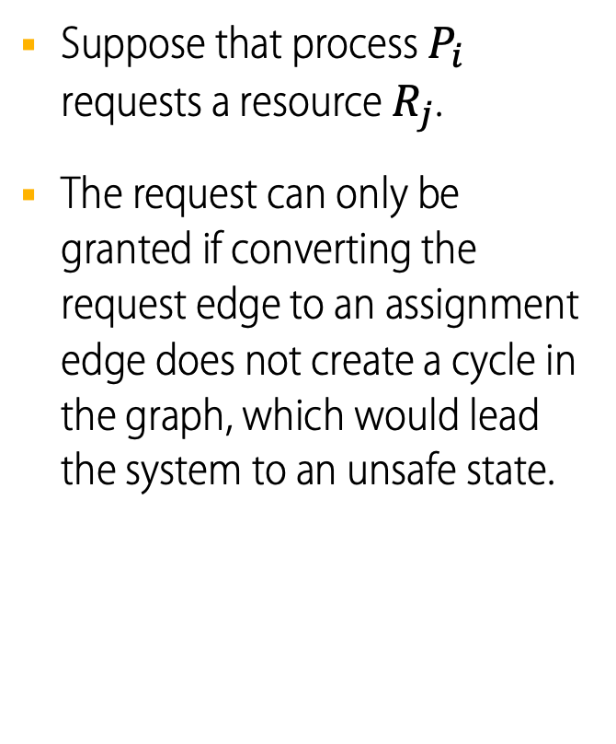
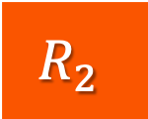
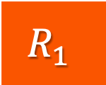
Resource-Allocation Graph Scheme
Deadlock avoidance with single instance of each resource type
Suppose that process $P_{i}$ requests a resource $R_{j}$.
The request can only be granted if converting the request edge to an assignment edge does not create a cycle in the graph, which would lead the system to an unsafe state.
$$R_{1}$$
$${ P}_{1}$$
$${ P}_{2}$$
$$R_{2}$$

Slide 12
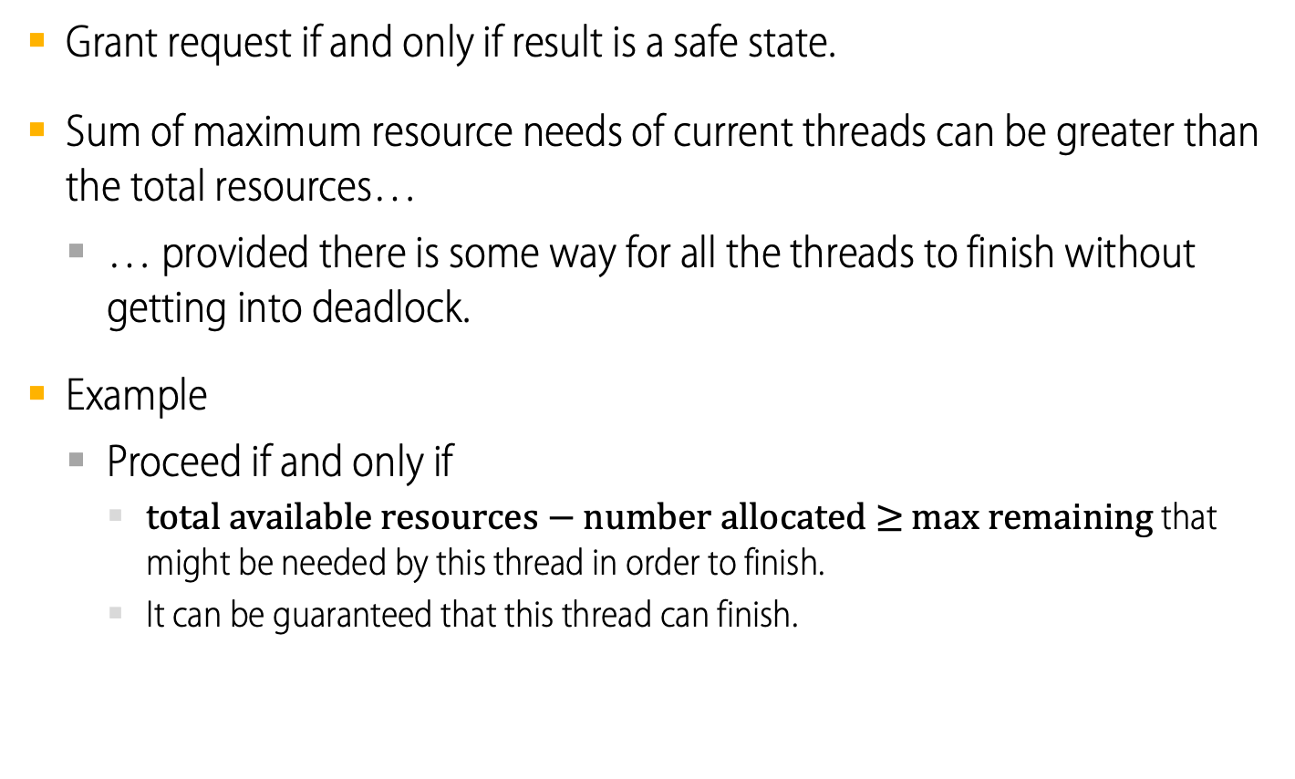
Predict the Future: Banker’s Algorithm
Deadlock avoidance with multiple instances of each resource type
Grant request if and only if result is a safe state.
Sum of maximum resource needs of current threads can be greater than the total resources…
  … provided there is some way for all the threads to finish without getting into deadlock.
Example
  Proceed if and only if
    total available resources $−$ number allocated $≥$ max remaining that might be needed by this thread in order to finish.
    It can be guaranteed that this thread can finish.
Notes:
Gas crisis -- sum of gas tanks in cars bigger than
storage capacity of tanks. Usually ok!

Slide 13
Banker’s Algorithm
Deadlock avoidance with multiple instances of each resource type
Can deal with multiple instances of resources.
Each process must claim maximum use a priori.
When a process requests a resource it may have to wait.
When a process gets all its resources it must return them in a finite amount of time.

Slide 14
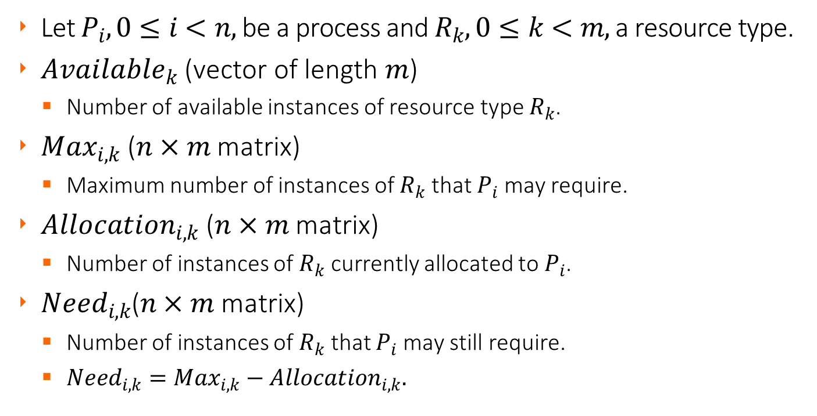
Data Structures
Banker’s Algorithm
Let $P_{i}, 0≤i<n,$ be a process and $R_{k}, 0≤k<m,$ a resource type.
${Available}_{k}$ (vector of length $m$)
  Number of available instances of resource type $R_{k}$.
${Max}_{i,k}$($n×m$ matrix)
  Maximum number of instances of $R_{k}$ that $P_{i}$ may require.
${Allocation}_{i,k}$ ($n×m$ matrix)
  Number of instances of $R_{k}$ currently allocated to $P_{i}$.
${Need}_{i,k}$($n×m$ matrix)
  Number of instances of $R_{k}$ that $P_{i}$ may still require.
  ${Need}_{i,k}={Max}_{i,k}−{Allocation}_{i,k}.$

Slide 15
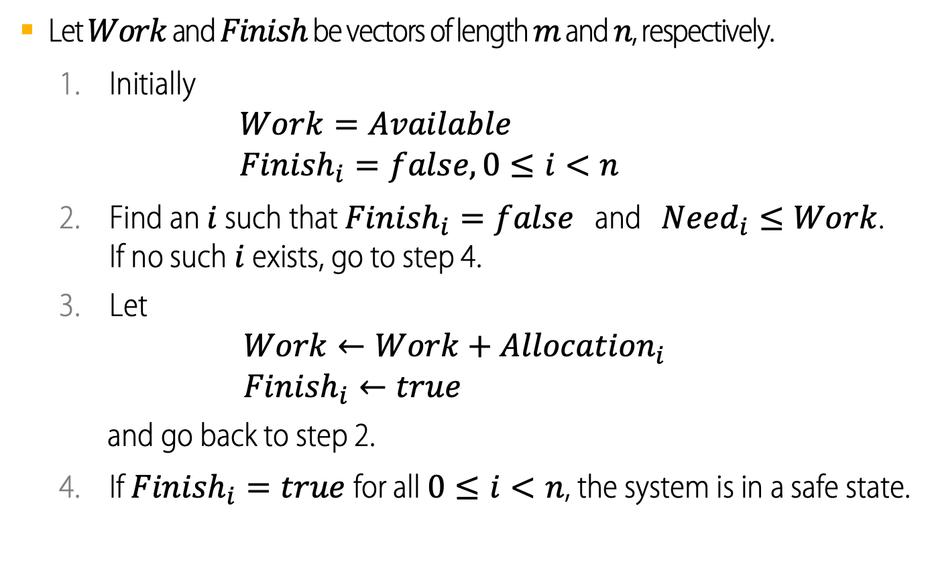
Safety Algorithm
Banker’s Algorithm
Let $Work$ and $Finish$ be vectors of length $m$ and $n$, respectively.
  Initially
  $Work=Available$
  ${Finish}_{i}=false,0≤i<n$
  Find an $i$ such that ${Finish}_{i}=false$ and ${Need}_{i}≤Work$.
  If no such $i$ exists, go to step 4.
  Let
  $Work←Work+{Allocation}_{i}$
  ${Finish}_{i}←true$
  and go back to step 2.
  If ${Finish}_{i}=true$for all $0≤i<n$, the system is in a safe state.

Slide 16




Resource-Request Algorithm for Process $P_{i}$
Banker’s Algorithm
Let $Request$ be the request vector for process $P_{i}$.
  ${Request}_{k}=x$, means that $P_{i}$ wants $x$ instances more of resource $R_{k}$.
If $Request>{Need}_{i}$, raise error condition, since $P_{i}$ has exceeded its maximum claim.
If $Request>Available$, $P_{i}$ must wait, since resources are not immediately available.
…
Let $Request$ be the request vector for process $P_{i}$.
  ${Request}_{k}=x$, means that $P_{i}$ wants $x$ instances more of resource $R_{k}$.
If $Request>{Need}_{i}$, raise error condition, since $P_{i}$ has exceeded its maximum claim.
If $Request>Available$, $P_{i}$ must wait, since resources are not immediately available.
…
Let $Request$ be the request vector for process $P_{i}$.
  ${Request}_{k}=x$, means that $P_{i}$ wants $x$ instances more of resource $R_{k}$.
If $Request>{Need}_{i}$, raise error condition, since $P_{i}$ has exceeded its maximum claim.
If $Request>Available$, $P_{i}$ must wait, since resources are not immediately available.
…

Slide 17
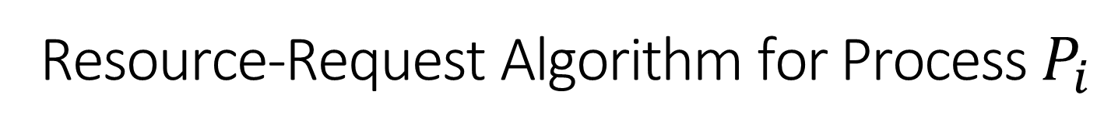
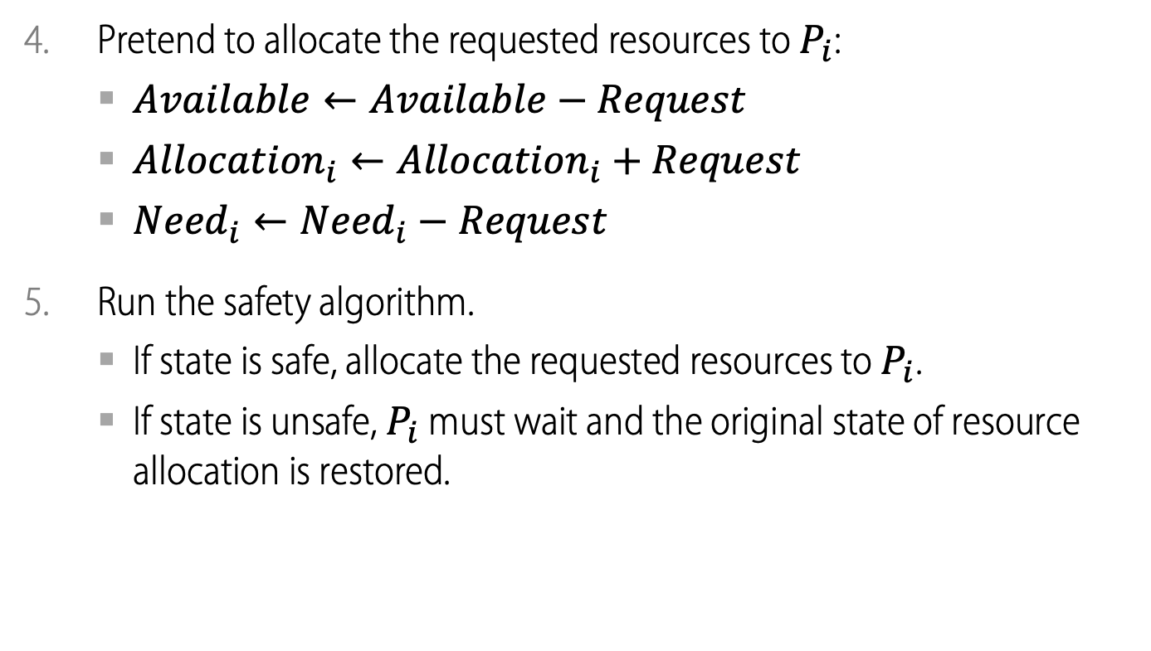
Resource-Request Algorithm for Process $P_{i}$
Banker’s Algorithm
Pretend to allocate the requested resources to $P_{i}$:
  $Available←Available−Request$
  ${Allocation}_{i}←{Allocation}_{i}+Request$
  ${Need}_{i}←{Need}_{i}−Request$
Run the safety algorithm.
  If state is safe, allocate the requested resources to $P_{i}$.
  If state is unsafe, $P_{i}$ must wait and the original state of resource allocation is restored.

Slide 18
Example of Banker’s Algorithm
5 processes P₀ through P₄
3 resource types,
A (10 instances), B (5), C (7).
Total
A | B | C
10 | 5 | 7
System snapshot at time T₀
 | Max |  |  |  | Allocation |  |  |  | Need |  |  |  | Available
 | A | B | C |  | A | B | C |  | A | B | C |  | A | B | C
P₀ | 7 | 5 | 3
P₁ | 3 | 2 | 2
P₂ | 9 | 0 | 2
P₃ | 2 | 2 | 2
P₄ | 4 | 3 | 3

Slide 19
Example of Banker’s Algorithm
5 processes P₀ through P₄
3 resource types,
A (10 instances), B (5), C (7).
Total
A | B | C
10 | 5 | 7
System snapshot at time T₀
 | Max |  |  |  | Allocation |  |  |  | Need |  |  |  | Available
 | A | B | C |  | A | B | C |  | A | B | C |  | A | B | C
P₀ | 7 | 5 | 3 |  | 0 | 1 | 0
P₁ | 3 | 2 | 2 |  | 2 | 0 | 0
P₂ | 9 | 0 | 2 |  | 3 | 0 | 2
P₃ | 2 | 2 | 2 |  | 2 | 1 | 1
P₄ | 4 | 3 | 3 |  | 0 | 0 | 2

Slide 20
Example of Banker’s Algorithm
5 processes P₀ through P₄
3 resource types,
A (10 instances), B (5), C (7).
Total
A | B | C
10 | 5 | 7
System snapshot at time T₀
 | Max |  |  |  | Allocation |  |  |  | Need |  |  |  | Available
 | A | B | C |  | A | B | C |  | A | B | C |  | A | B | C
P₀ | 7 | 5 | 3 |  | 0 | 1 | 0 |  |  |  |  |  | 3 | 3 | 2
P₁ | 3 | 2 | 2 |  | 2 | 0 | 0
P₂ | 9 | 0 | 2 |  | 3 | 0 | 2
P₃ | 2 | 2 | 2 |  | 2 | 1 | 1
P₄ | 4 | 3 | 3 |  | 0 | 0 | 2

Slide 21
Example of Banker’s Algorithm
5 processes P₀ through P₄
3 resource types,
A (10 instances), B (5), C (7).
Total
A | B | C
10 | 5 | 7
System snapshot at time T₀
 | Max |  |  |  | Allocation |  |  |  | Need |  |  |  | Available
 | A | B | C |  | A | B | C |  | A | B | C |  | A | B | C
P₀ | 7 | 5 | 3 |  | 0 | 1 | 0 |  | 7 | 4 | 3 |  | 3 | 3 | 2
P₁ | 3 | 2 | 2 |  | 2 | 0 | 0
P₂ | 9 | 0 | 2 |  | 3 | 0 | 2
P₃ | 2 | 2 | 2 |  | 2 | 1 | 1
P₄ | 4 | 3 | 3 |  | 0 | 0 | 2

Slide 22
Example of Banker’s Algorithm
5 processes P₀ through P₄
3 resource types,
A (10 instances), B (5), C (7).
Total
A | B | C
10 | 5 | 7
System snapshot at time T₀
 | Max |  |  |  | Allocation |  |  |  | Need |  |  |  | Available
 | A | B | C |  | A | B | C |  | A | B | C |  | A | B | C
P₀ | 7 | 5 | 3 |  | 0 | 1 | 0 |  | 7 | 4 | 3 |  | 3 | 3 | 2
P₁ | 3 | 2 | 2 |  | 2 | 0 | 0 |  | 1 | 2 | 2
P₂ | 9 | 0 | 2 |  | 3 | 0 | 2
P₃ | 2 | 2 | 2 |  | 2 | 1 | 1
P₄ | 4 | 3 | 3 |  | 0 | 0 | 2

Slide 23
Example of Banker’s Algorithm
5 processes P₀ through P₄
3 resource types,
A (10 instances), B (5), C (7).
Total
A | B | C
10 | 5 | 7
System snapshot at time T₀
 | Max |  |  |  | Allocation |  |  |  | Need |  |  |  | Available
 | A | B | C |  | A | B | C |  | A | B | C |  | A | B | C
P₀ | 7 | 5 | 3 |  | 0 | 1 | 0 |  | 7 | 4 | 3 |  | 3 | 3 | 2
P₁ | 3 | 2 | 2 |  | 2 | 0 | 0 |  | 1 | 2 | 2
P₂ | 9 | 0 | 2 |  | 3 | 0 | 2 |  | 6 | 0 | 0
P₃ | 2 | 2 | 2 |  | 2 | 1 | 1 |  | 0 | 1 | 1
P₄ | 4 | 3 | 3 |  | 0 | 0 | 2 |  | 4 | 3 | 1

Slide 24
Example of Banker’s Algorithm
Is the system state at time T₀ safe?
  To find the answer we must run the safety algorithm.
 | Max |  |  |  | Allocation |  |  |  | Need |  |  |  | Finish |  | Available
 | A | B | C |  | A | B | C |  | A | B | C |  |  |  | A | B | C
P₀ | 7 | 5 | 3 |  | 0 | 1 | 0 |  | 7 | 4 | 3 |  |  |  | 3 | 3 | 2
P₁ | 3 | 2 | 2 |  | 2 | 0 | 0 |  | 1 | 2 | 2
P₂ | 9 | 0 | 2 |  | 3 | 0 | 2 |  | 6 | 0 | 0 |  |  |  | Work
P₃ | 2 | 2 | 2 |  | 2 | 1 | 1 |  | 0 | 1 | 1 |  |  |  | A | B | C
P₄ | 4 | 3 | 3 |  | 0 | 0 | 2 |  | 4 | 3 | 1

Slide 25
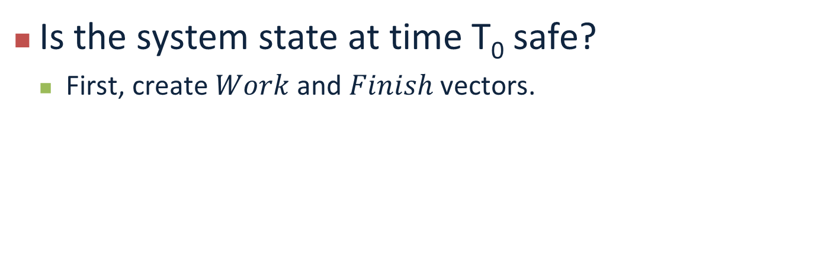
Example of Banker’s Algorithm
Is the system state at time T₀ safe?
  First, create $Work$ and $Finish$ vectors.
 | Max |  |  |  | Allocation |  |  |  | Need |  |  |  | Finish |  | Available
 | A | B | C |  | A | B | C |  | A | B | C |  |  |  | A | B | C
P₀ | 7 | 5 | 3 |  | 0 | 1 | 0 |  | 7 | 4 | 3 |  |  |  | 3 | 3 | 2
P₁ | 3 | 2 | 2 |  | 2 | 0 | 0 |  | 1 | 2 | 2
P₂ | 9 | 0 | 2 |  | 3 | 0 | 2 |  | 6 | 0 | 0 |  |  |  | Work
P₃ | 2 | 2 | 2 |  | 2 | 1 | 1 |  | 0 | 1 | 1 |  |  |  | A | B | C
P₄ | 4 | 3 | 3 |  | 0 | 0 | 2 |  | 4 | 3 | 1 |  |  |  | 3 | 3 | 2

Slide 26
Example of Banker’s Algorithm
Is the system state at time T₀ safe?
  Can any process terminate?
    Yes. P₁ can. Retrieve the resources that it holds.
 | Max |  |  |  | Allocation |  |  |  | Need |  |  |  | Finish |  | Available
 | A | B | C |  | A | B | C |  | A | B | C |  |  |  | A | B | C
P₀ | 7 | 5 | 3 |  | 0 | 1 | 0 |  | 7 | 4 | 3 |  |  |  | 3 | 3 | 2
P₁ | 3 | 2 | 2 |  | 2 | 0 | 0 |  | 1 | 2 | 2
P₂ | 9 | 0 | 2 |  | 3 | 0 | 2 |  | 6 | 0 | 0 |  |  |  | Work
P₃ | 2 | 2 | 2 |  | 2 | 1 | 1 |  | 0 | 1 | 1 |  |  |  | A | B | C
P₄ | 4 | 3 | 3 |  | 0 | 0 | 2 |  | 4 | 3 | 1 |  |  |  | 3 | 3 | 2
 | Max |  |  |  | Allocation |  |  |  | Need |  |  |  | Finish |  | Available
 | A | B | C |  | A | B | C |  | A | B | C |  |  |  | A | B | C
P₀ | 7 | 5 | 3 |  | 0 | 1 | 0 |  | 7 | 4 | 3 |  |  |  | 3 | 3 | 2
P₁ | 3 | 2 | 2 |  | 2 | 0 | 0 |  | 1 | 2 | 2 |  | T
P₂ | 9 | 0 | 2 |  | 3 | 0 | 2 |  | 6 | 0 | 0 |  |  |  | Work
P₃ | 2 | 2 | 2 |  | 2 | 1 | 1 |  | 0 | 1 | 1 |  |  |  | A | B | C
P₄ | 4 | 3 | 3 |  | 0 | 0 | 2 |  | 4 | 3 | 1 |  |  |  | 5 | 3 | 2

Slide 27
Example of Banker’s Algorithm
Is the system state at time T₀ safe?
  Can another process terminate?
    Yes. P₃ can. Retrieve the resources that it holds.
 | Max |  |  |  | Allocation |  |  |  | Need |  |  |  | Finish |  | Available
 | A | B | C |  | A | B | C |  | A | B | C |  |  |  | A | B | C
P₀ | 7 | 5 | 3 |  | 0 | 1 | 0 |  | 7 | 4 | 3 |  |  |  | 3 | 3 | 2
P₁ | 3 | 2 | 2 |  | 2 | 0 | 0 |  | 1 | 2 | 2 |  | T
P₂ | 9 | 0 | 2 |  | 3 | 0 | 2 |  | 6 | 0 | 0 |  |  |  | Work
P₃ | 2 | 2 | 2 |  | 2 | 1 | 1 |  | 0 | 1 | 1 |  |  |  | A | B | C
P₄ | 4 | 3 | 3 |  | 0 | 0 | 2 |  | 4 | 3 | 1 |  |  |  | 5 | 3 | 2
 | Max |  |  |  | Allocation |  |  |  | Need |  |  |  | Finish |  | Available
 | A | B | C |  | A | B | C |  | A | B | C |  |  |  | A | B | C
P₀ | 7 | 5 | 3 |  | 0 | 1 | 0 |  | 7 | 4 | 3 |  |  |  | 3 | 3 | 2
P₁ | 3 | 2 | 2 |  | 2 | 0 | 0 |  | 1 | 2 | 2 |  | T
P₂ | 9 | 0 | 2 |  | 3 | 0 | 2 |  | 6 | 0 | 0 |  |  |  | Work
P₃ | 2 | 2 | 2 |  | 2 | 1 | 1 |  | 0 | 1 | 1 |  | T |  | A | B | C
P₄ | 4 | 3 | 3 |  | 0 | 0 | 2 |  | 4 | 3 | 1 |  |  |  | 7 | 4 | 3

Slide 28
Example of Banker’s Algorithm
Is the system state at time T₀ safe?
  Now, P₀ can terminate. Let’s retrieve its resources.
 | Max |  |  |  | Allocation |  |  |  | Need |  |  |  | Finish |  | Available
 | A | B | C |  | A | B | C |  | A | B | C |  |  |  | A | B | C
P₀ | 7 | 5 | 3 |  | 0 | 1 | 0 |  | 7 | 4 | 3 |  |  |  | 3 | 3 | 2
P₁ | 3 | 2 | 2 |  | 2 | 0 | 0 |  | 1 | 2 | 2 |  | T
P₂ | 9 | 0 | 2 |  | 3 | 0 | 2 |  | 6 | 0 | 0 |  |  |  | Work
P₃ | 2 | 2 | 2 |  | 2 | 1 | 1 |  | 0 | 1 | 1 |  | T |  | A | B | C
P₄ | 4 | 3 | 3 |  | 0 | 0 | 2 |  | 4 | 3 | 1 |  |  |  | 7 | 4 | 3
 | Max |  |  |  | Allocation |  |  |  | Need |  |  |  | Finish |  | Available
 | A | B | C |  | A | B | C |  | A | B | C |  |  |  | A | B | C
P₀ | 7 | 5 | 3 |  | 0 | 1 | 0 |  | 7 | 4 | 3 |  | T |  | 3 | 3 | 2
P₁ | 3 | 2 | 2 |  | 2 | 0 | 0 |  | 1 | 2 | 2 |  | T
P₂ | 9 | 0 | 2 |  | 3 | 0 | 2 |  | 6 | 0 | 0 |  |  |  | Work
P₃ | 2 | 2 | 2 |  | 2 | 1 | 1 |  | 0 | 1 | 1 |  | T |  | A | B | C
P₄ | 4 | 3 | 3 |  | 0 | 0 | 2 |  | 4 | 3 | 1 |  |  |  | 7 | 5 | 3

Slide 29
Example of Banker’s Algorithm
Is the system state at time T₀ safe?
  Now, P₂ can terminate.
 | Max |  |  |  | Allocation |  |  |  | Need |  |  |  | Finish |  | Available
 | A | B | C |  | A | B | C |  | A | B | C |  |  |  | A | B | C
P₀ | 7 | 5 | 3 |  | 0 | 1 | 0 |  | 7 | 4 | 3 |  | T |  | 3 | 3 | 2
P₁ | 3 | 2 | 2 |  | 2 | 0 | 0 |  | 1 | 2 | 2 |  | T
P₂ | 9 | 0 | 2 |  | 3 | 0 | 2 |  | 6 | 0 | 0 |  | T |  | Work
P₃ | 2 | 2 | 2 |  | 2 | 1 | 1 |  | 0 | 1 | 1 |  | T |  | A | B | C
P₄ | 4 | 3 | 3 |  | 0 | 0 | 2 |  | 4 | 3 | 1 |  |  |  | 10 | 5 | 5

Slide 30
Example of Banker’s Algorithm
Is the system state at time T₀ safe?
  And finally P₄ can terminate.
  YES!
 | Max |  |  |  | Allocation |  |  |  | Need |  |  |  | Finish |  | Available
 | A | B | C |  | A | B | C |  | A | B | C |  |  |  | A | B | C
P₀ | 7 | 5 | 3 |  | 0 | 1 | 0 |  | 7 | 4 | 3 |  | T |  | 3 | 3 | 2
P₁ | 3 | 2 | 2 |  | 2 | 0 | 0 |  | 1 | 2 | 2 |  | T
P₂ | 9 | 0 | 2 |  | 3 | 0 | 2 |  | 6 | 0 | 0 |  | T |  | Work
P₃ | 2 | 2 | 2 |  | 2 | 1 | 1 |  | 0 | 1 | 1 |  | T |  | A | B | C
P₄ | 4 | 3 | 3 |  | 0 | 0 | 2 |  | 4 | 3 | 1 |  | T |  | 10 | 5 | 7

Slide 31
Example of Banker’s Algorithm
Can a (1, 0, 2) request by P₁ be granted at T₀?
  Pretend to grant the request
 | Max |  |  |  | Allocation |  |  |  | Need |  |  |  | Finish |  | Available
 | A | B | C |  | A | B | C |  | A | B | C |  |  |  | A | B | C
P₀ | 7 | 5 | 3 |  | 0 | 1 | 0 |  | 7 | 4 | 3 |  |  |  | 3 | 3 | 2
P₁ | 3 | 2 | 2 |  | 2 | 0 | 0 |  | 1 | 2 | 2
P₂ | 9 | 0 | 2 |  | 3 | 0 | 2 |  | 6 | 0 | 0 |  |  |  | Work
P₃ | 2 | 2 | 2 |  | 2 | 1 | 1 |  | 0 | 1 | 1 |  |  |  | A | B | C
P₄ | 4 | 3 | 3 |  | 0 | 0 | 2 |  | 4 | 3 | 1

Slide 32
Example of Banker’s Algorithm
At T₀ can a (1, 0, 2) request by P₁ be granted?
  Pretend to grant the request
  Run the safety algorithm
 | Max |  |  |  | Allocation |  |  |  | Need |  |  |  | Finish |  | Available
 | A | B | C |  | A | B | C |  | A | B | C |  |  |  | A | B | C
P₀ | 7 | 5 | 3 |  | 0 | 1 | 0 |  | 7 | 4 | 3 |  |  |  | 2 | 3 | 0
P₁ | 3 | 2 | 2 |  | 3 | 0 | 2 |  | 0 | 2 | 0
P₂ | 9 | 0 | 2 |  | 3 | 0 | 2 |  | 6 | 0 | 0 |  |  |  | Work
P₃ | 2 | 2 | 2 |  | 2 | 1 | 1 |  | 0 | 1 | 1 |  |  |  | A | B | C
P₄ | 4 | 3 | 3 |  | 0 | 0 | 2 |  | 4 | 3 | 1

Slide 33
Example of Banker’s Algorithm
At T₀ can a (1, 0, 2) request by P₁ be granted?
  Pretend to grant the request
  Run the safety algorithm
 | Max |  |  |  | Allocation |  |  |  | Need |  |  |  | Finish |  | Available
 | A | B | C |  | A | B | C |  | A | B | C |  |  |  | A | B | C
P₀ | 7 | 5 | 3 |  | 0 | 1 | 0 |  | 7 | 4 | 3 |  |  |  | 2 | 3 | 0
P₁ | 3 | 2 | 2 |  | 3 | 0 | 2 |  | 0 | 2 | 0
P₂ | 9 | 0 | 2 |  | 3 | 0 | 2 |  | 6 | 0 | 0 |  |  |  | Work
P₃ | 2 | 2 | 2 |  | 2 | 1 | 1 |  | 0 | 1 | 1 |  |  |  | A | B | C
P₄ | 4 | 3 | 3 |  | 0 | 0 | 2 |  | 4 | 3 | 1 |  |  |  | 2 | 3 | 0

Slide 34
Example of Banker’s Algorithm
At T₀ can a (1, 0, 2) request by P₁ be granted?
  Pretend to grant the request
  Run the safety algorithm
 | Max |  |  |  | Allocation |  |  |  | Need |  |  |  | Finish |  | Available
 | A | B | C |  | A | B | C |  | A | B | C |  |  |  | A | B | C
P₀ | 7 | 5 | 3 |  | 0 | 1 | 0 |  | 7 | 4 | 3 |  |  |  | 2 | 3 | 0
P₁ | 3 | 2 | 2 |  | 3 | 0 | 2 |  | 0 | 2 | 0 |  | T
P₂ | 9 | 0 | 2 |  | 3 | 0 | 2 |  | 6 | 0 | 0 |  |  |  | Work
P₃ | 2 | 2 | 2 |  | 2 | 1 | 1 |  | 0 | 1 | 1 |  |  |  | A | B | C
P₄ | 4 | 3 | 3 |  | 0 | 0 | 2 |  | 4 | 3 | 1 |  |  |  | 5 | 3 | 2

Slide 35
Example of Banker’s Algorithm
At T₀ can a (1, 0, 2) request by P₁ be granted?
  Pretend to grant the request
  Run the safety algorithm
 | Max |  |  |  | Allocation |  |  |  | Need |  |  |  | Finish |  | Available
 | A | B | C |  | A | B | C |  | A | B | C |  |  |  | A | B | C
P₀ | 7 | 5 | 3 |  | 0 | 1 | 0 |  | 7 | 4 | 3 |  |  |  | 2 | 3 | 0
P₁ | 3 | 2 | 2 |  | 3 | 0 | 2 |  | 0 | 2 | 0 |  | T
P₂ | 9 | 0 | 2 |  | 3 | 0 | 2 |  | 6 | 0 | 0 |  |  |  | Work
P₃ | 2 | 2 | 2 |  | 2 | 1 | 1 |  | 0 | 1 | 1 |  | T |  | A | B | C
P₄ | 4 | 3 | 3 |  | 0 | 0 | 2 |  | 4 | 3 | 1 |  |  |  | 7 | 4 | 3

Slide 36
Example of Banker’s Algorithm
At T₀ can a (1, 0, 2) request by P₁ be granted?
  Pretend to grant the request
  Run the safety algorithm
 | Max |  |  |  | Allocation |  |  |  | Need |  |  |  | Finish |  | Available
 | A | B | C |  | A | B | C |  | A | B | C |  |  |  | A | B | C
P₀ | 7 | 5 | 3 |  | 0 | 1 | 0 |  | 7 | 4 | 3 |  | T |  | 2 | 3 | 0
P₁ | 3 | 2 | 2 |  | 3 | 0 | 2 |  | 0 | 2 | 0 |  | T
P₂ | 9 | 0 | 2 |  | 3 | 0 | 2 |  | 6 | 0 | 0 |  |  |  | Work
P₃ | 2 | 2 | 2 |  | 2 | 1 | 1 |  | 0 | 1 | 1 |  | T |  | A | B | C
P₄ | 4 | 3 | 3 |  | 0 | 0 | 2 |  | 4 | 3 | 1 |  |  |  | 7 | 5 | 3

Slide 37
Example of Banker’s Algorithm
At T₀ can a (1, 0, 2) request by P₁ be granted?
  Pretend to grant the request
  Run the safety algorithm
 | Max |  |  |  | Allocation |  |  |  | Need |  |  |  | Finish |  | Available
 | A | B | C |  | A | B | C |  | A | B | C |  |  |  | A | B | C
P₀ | 7 | 5 | 3 |  | 0 | 1 | 0 |  | 7 | 4 | 3 |  | T |  | 2 | 3 | 0
P₁ | 3 | 2 | 2 |  | 3 | 0 | 2 |  | 0 | 2 | 0 |  | T
P₂ | 9 | 0 | 2 |  | 3 | 0 | 2 |  | 6 | 0 | 0 |  | T |  | Work
P₃ | 2 | 2 | 2 |  | 2 | 1 | 1 |  | 0 | 1 | 1 |  | T |  | A | B | C
P₄ | 4 | 3 | 3 |  | 0 | 0 | 2 |  | 4 | 3 | 1 |  |  |  | 10 | 5 | 5

Slide 38
Example of Banker’s Algorithm
At T₀ can a (1, 0, 2) request by P₁ be granted?
  Pretend to grant the request
  Run the safety algorithm
 | Max |  |  |  | Allocation |  |  |  | Need |  |  |  | Finish |  | Available
 | A | B | C |  | A | B | C |  | A | B | C |  |  |  | A | B | C
P₀ | 7 | 5 | 3 |  | 0 | 1 | 0 |  | 7 | 4 | 3 |  | T |  | 2 | 3 | 0
P₁ | 3 | 2 | 2 |  | 3 | 0 | 2 |  | 0 | 2 | 0 |  | T
P₂ | 9 | 0 | 2 |  | 3 | 0 | 2 |  | 6 | 0 | 0 |  | T |  | Work
P₃ | 2 | 2 | 2 |  | 2 | 1 | 1 |  | 0 | 1 | 1 |  | T |  | A | B | C
P₄ | 4 | 3 | 3 |  | 0 | 0 | 2 |  | 4 | 3 | 1 |  | T |  | 10 | 5 | 7

Slide 39
Example of Banker’s Algorithm
At T₀ can a (1, 0, 2) request by P₁ be granted?
  Pretend to grant the request
  Run the safety algorithm
 Yes!
 | Max |  |  |  | Allocation |  |  |  | Need |  |  |  | Finish |  | Available
 | A | B | C |  | A | B | C |  | A | B | C |  |  |  | A | B | C
P₀ | 7 | 5 | 3 |  | 0 | 1 | 0 |  | 7 | 4 | 3 |  | T |  | 2 | 3 | 0
P₁ | 3 | 2 | 2 |  | 3 | 0 | 2 |  | 0 | 2 | 0 |  | T
P₂ | 9 | 0 | 2 |  | 3 | 0 | 2 |  | 6 | 0 | 0 |  | T |  | Work
P₃ | 2 | 2 | 2 |  | 2 | 1 | 1 |  | 0 | 1 | 1 |  | T |  | A | B | C
P₄ | 4 | 3 | 3 |  | 0 | 0 | 2 |  | 4 | 3 | 1 |  | T |  | 10 | 5 | 7

Slide 40
Example of Banker’s Algorithm
At T₀ can a (3, 3, 0) request by P₄ be granted?
  Pretend to grant the request
 | Max |  |  |  | Allocation |  |  |  | Need |  |  |  | Finish |  | Available
 | A | B | C |  | A | B | C |  | A | B | C |  |  |  | A | B | C
P₀ | 7 | 5 | 3 |  | 0 | 1 | 0 |  | 7 | 4 | 3 |  |  |  | 3 | 3 | 2
P₁ | 3 | 2 | 2 |  | 2 | 0 | 0 |  | 1 | 2 | 2
P₂ | 9 | 0 | 2 |  | 3 | 0 | 2 |  | 6 | 0 | 0 |  |  |  | Work
P₃ | 2 | 2 | 2 |  | 2 | 1 | 1 |  | 0 | 1 | 1 |  |  |  | A | B | C
P₄ | 4 | 3 | 3 |  | 0 | 0 | 2 |  | 4 | 3 | 1 |  |  |  | 3 | 3 | 2

Slide 41
Example of Banker’s Algorithm
At T₀ can a (3, 3, 0) request by P₄ be granted?
  Pretend to grant the request
 | Max |  |  |  | Allocation |  |  |  | Need |  |  |  | Finish |  | Available
 | A | B | C |  | A | B | C |  | A | B | C |  |  |  | A | B | C
P₀ | 7 | 5 | 3 |  | 0 | 1 | 0 |  | 7 | 4 | 3 |  |  |  | 0 | 0 | 2
P₁ | 3 | 2 | 2 |  | 2 | 0 | 0 |  | 1 | 2 | 2
P₂ | 9 | 0 | 2 |  | 3 | 0 | 2 |  | 6 | 0 | 0 |  |  |  | Work
P₃ | 2 | 2 | 2 |  | 2 | 1 | 1 |  | 0 | 1 | 1 |  |  |  | A | B | C
P₄ | 4 | 3 | 3 |  | 3 | 3 | 2 |  | 1 | 0 | 1 |  |  |  | 0 | 0 | 2

Slide 42
Example of Banker’s Algorithm
At T₀ can a (3, 3, 0) request by P₄ be granted?
  Pretend to grant the request
  Run the safety algorithm
 No!
 | Max |  |  |  | Allocation |  |  |  | Need |  |  |  | Finish |  | Available
 | A | B | C |  | A | B | C |  | A | B | C |  |  |  | A | B | C
P₀ | 7 | 5 | 3 |  | 0 | 1 | 0 |  | 7 | 4 | 3 |  |  |  | 0 | 0 | 2
P₁ | 3 | 2 | 2 |  | 2 | 0 | 0 |  | 1 | 2 | 2
P₂ | 9 | 0 | 2 |  | 3 | 0 | 2 |  | 6 | 0 | 0 |  |  |  | Work
P₃ | 2 | 2 | 2 |  | 2 | 1 | 1 |  | 0 | 1 | 1 |  |  |  | A | B | C
P₄ | 4 | 3 | 3 |  | 3 | 3 | 2 |  | 1 | 0 | 1 |  |  |  | 0 | 0 | 2

Slide 43
Example of Banker’s Algorithm
At T₀ can a (0, 2, 0) request by P₀ be granted?
 | Max |  |  |  | Allocation |  |  |  | Need |  |  |  | Finish |  | Available
 | A | B | C |  | A | B | C |  | A | B | C |  |  |  | A | B | C
P₀ | 7 | 5 | 3 |  | 0 | 1 | 0 |  | 7 | 4 | 3 |  |  |  | 3 | 3 | 2
P₁ | 3 | 2 | 2 |  | 2 | 0 | 0 |  | 1 | 2 | 2
P₂ | 9 | 0 | 2 |  | 3 | 0 | 2 |  | 6 | 0 | 0 |  |  |  | Work
P₃ | 2 | 2 | 2 |  | 2 | 1 | 1 |  | 0 | 1 | 1 |  |  |  | A | B | C
P₄ | 4 | 3 | 3 |  | 0 | 0 | 2 |  | 4 | 3 | 1

Slide 44
Example of Banker’s Algorithm
At T₀ can a (0, 2, 0) request by P₀ be granted?
  Pretend to grant the request
 | Max |  |  |  | Allocation |  |  |  | Need |  |  |  | Finish |  | Available
 | A | B | C |  | A | B | C |  | A | B | C |  |  |  | A | B | C
P₀ | 7 | 5 | 3 |  | 0 | 1 | 0 |  | 7 | 4 | 3 |  |  |  | 3 | 3 | 2
P₁ | 3 | 2 | 2 |  | 2 | 0 | 0 |  | 1 | 2 | 2
P₂ | 9 | 0 | 2 |  | 3 | 0 | 2 |  | 6 | 0 | 0 |  |  |  | Work
P₃ | 2 | 2 | 2 |  | 2 | 1 | 1 |  | 0 | 1 | 1 |  |  |  | A | B | C
P₄ | 4 | 3 | 3 |  | 0 | 0 | 2 |  | 4 | 3 | 1

Slide 45
Example of Banker’s Algorithm
At T₀ can a (0, 2, 0) request by P₀ be granted?
  Pretend to grant the request
 | Max |  |  |  | Allocation |  |  |  | Need |  |  |  | Finish |  | Available
 | A | B | C |  | A | B | C |  | A | B | C |  |  |  | A | B | C
P₀ | 7 | 5 | 3 |  | 0 | 3 | 0 |  | 7 | 2 | 3 |  |  |  | 3 | 1 | 2
P₁ | 3 | 2 | 2 |  | 2 | 0 | 0 |  | 1 | 2 | 2
P₂ | 9 | 0 | 2 |  | 3 | 0 | 2 |  | 6 | 0 | 0 |  |  |  | Work
P₃ | 2 | 2 | 2 |  | 2 | 1 | 1 |  | 0 | 1 | 1 |  |  |  | A | B | C
P₄ | 4 | 3 | 3 |  | 0 | 0 | 2 |  | 4 | 3 | 1

Slide 46
Example of Banker’s Algorithm
At T₀ can a (0, 2, 0) request by P₀ be granted?
  Pretend to grant the request
  Run the safety algorithm
 | Max |  |  |  | Allocation |  |  |  | Need |  |  |  | Finish |  | Available
 | A | B | C |  | A | B | C |  | A | B | C |  |  |  | A | B | C
P₀ | 7 | 5 | 3 |  | 0 | 3 | 0 |  | 7 | 2 | 3 |  |  |  | 3 | 1 | 2
P₁ | 3 | 2 | 2 |  | 2 | 0 | 0 |  | 1 | 2 | 2
P₂ | 9 | 0 | 2 |  | 3 | 0 | 2 |  | 6 | 0 | 0 |  |  |  | Work
P₃ | 2 | 2 | 2 |  | 2 | 1 | 1 |  | 0 | 1 | 1 |  |  |  | A | B | C
P₄ | 4 | 3 | 3 |  | 0 | 0 | 2 |  | 4 | 3 | 1 |  |  |  | 3 | 1 | 2

Slide 47
Example of Banker’s Algorithm
At T₀ can a (0, 2, 0) request by P₀ be granted?
  Pretend to grant the request
  Run the safety algorithm
 | Max |  |  |  | Allocation |  |  |  | Need |  |  |  | Finish |  | Available
 | A | B | C |  | A | B | C |  | A | B | C |  |  |  | A | B | C
P₀ | 7 | 5 | 3 |  | 0 | 3 | 0 |  | 7 | 2 | 3 |  |  |  | 3 | 1 | 2
P₁ | 3 | 2 | 2 |  | 2 | 0 | 0 |  | 1 | 2 | 2
P₂ | 9 | 0 | 2 |  | 3 | 0 | 2 |  | 6 | 0 | 0 |  |  |  | Work
P₃ | 2 | 2 | 2 |  | 2 | 1 | 1 |  | 0 | 1 | 1 |  | T |  | A | B | C
P₄ | 4 | 3 | 3 |  | 0 | 0 | 2 |  | 4 | 3 | 1 |  |  |  | 5 | 2 | 3

Slide 48
Example of Banker’s Algorithm
At T₀ can a (0, 2, 0) request by P₀ be granted?
  Pretend to grant the request
  Run the safety algorithm
 | Max |  |  |  | Allocation |  |  |  | Need |  |  |  | Finish |  | Available
 | A | B | C |  | A | B | C |  | A | B | C |  |  |  | A | B | C
P₀ | 7 | 5 | 3 |  | 0 | 3 | 0 |  | 7 | 2 | 3 |  |  |  | 3 | 1 | 2
P₁ | 3 | 2 | 2 |  | 2 | 0 | 0 |  | 1 | 2 | 2 |  | T
P₂ | 9 | 0 | 2 |  | 3 | 0 | 2 |  | 6 | 0 | 0 |  |  |  | Work
P₃ | 2 | 2 | 2 |  | 2 | 1 | 1 |  | 0 | 1 | 1 |  | T |  | A | B | C
P₄ | 4 | 3 | 3 |  | 0 | 0 | 2 |  | 4 | 3 | 1 |  |  |  | 7 | 2 | 3

Slide 49
Example of Banker’s Algorithm
At T₀ can a (0, 2, 0) request by P₀ be granted?
  Pretend to grant the request
  Run the safety algorithm
 | Max |  |  |  | Allocation |  |  |  | Need |  |  |  | Finish |  | Available
 | A | B | C |  | A | B | C |  | A | B | C |  |  |  | A | B | C
P₀ | 7 | 5 | 3 |  | 0 | 3 | 0 |  | 7 | 2 | 3 |  | T |  | 3 | 1 | 2
P₁ | 3 | 2 | 2 |  | 2 | 0 | 0 |  | 1 | 2 | 2 |  | T
P₂ | 9 | 0 | 2 |  | 3 | 0 | 2 |  | 6 | 0 | 0 |  |  |  | Work
P₃ | 2 | 2 | 2 |  | 2 | 1 | 1 |  | 0 | 1 | 1 |  | T |  | A | B | C
P₄ | 4 | 3 | 3 |  | 0 | 0 | 2 |  | 4 | 3 | 1 |  |  |  | 7 | 5 | 3

Slide 50
Example of Banker’s Algorithm
At T₀ can a (0, 2, 0) request by P₀ be granted?
  Pretend to grant the request
  Run the safety algorithm
 | Max |  |  |  | Allocation |  |  |  | Need |  |  |  | Finish |  | Available
 | A | B | C |  | A | B | C |  | A | B | C |  |  |  | A | B | C
P₀ | 7 | 5 | 3 |  | 0 | 3 | 0 |  | 7 | 2 | 3 |  | T |  | 3 | 1 | 2
P₁ | 3 | 2 | 2 |  | 2 | 0 | 0 |  | 1 | 2 | 2 |  | T
P₂ | 9 | 0 | 2 |  | 3 | 0 | 2 |  | 6 | 0 | 0 |  | T |  | Work
P₃ | 2 | 2 | 2 |  | 2 | 1 | 1 |  | 0 | 1 | 1 |  | T |  | A | B | C
P₄ | 4 | 3 | 3 |  | 0 | 0 | 2 |  | 4 | 3 | 1 |  |  |  | 10 | 5 | 5

Slide 51
Example of Banker’s Algorithm
At T₀ can a (0, 2, 0) request by P₀ be granted?
  Pretend to grant the request
  Run the safety algorithm
 Yes!
 | Max |  |  |  | Allocation |  |  |  | Need |  |  |  | Finish |  | Available
 | A | B | C |  | A | B | C |  | A | B | C |  |  |  | A | B | C
P₀ | 7 | 5 | 3 |  | 0 | 3 | 0 |  | 7 | 2 | 3 |  | T |  | 3 | 1 | 2
P₁ | 3 | 2 | 2 |  | 2 | 0 | 0 |  | 1 | 2 | 2 |  | T
P₂ | 9 | 0 | 2 |  | 3 | 0 | 2 |  | 6 | 0 | 0 |  | T |  | Work
P₃ | 2 | 2 | 2 |  | 2 | 1 | 1 |  | 0 | 1 | 1 |  | T |  | A | B | C
P₄ | 4 | 3 | 3 |  | 0 | 0 | 2 |  | 4 | 3 | 1 |  | T |  | 10 | 5 | 7

Slide 52
Deadlock Detection
Allow system to enter deadlock state
Run a detection algorithm
  Resource allocation graphs are used to detect the existence or possibility of deadlock.
Apply a recovery scheme

Slide 53
Detect and Repair
Algorithm
  Scan wait-for graph
  Detect cycles
  Fix cycles
Proceed without the resource
  Requires robust exception handling code
Roll back and retry
  Transaction: all operations are provisional until have all required resources to complete operation
Notes:
a) Shoot thread, force it to give up resources.
In traffic example, Godzilla -- picks up a car, hurls it into the east river. Other three cars can go!
Shoot a dining lawyer. A feature. Of course, what's going to happen, the lawyer's going to fall face first into the spaghetti, still clutching the fork. So the other lawyers will rush over and pry the fork out of his fingers. Maybe better to shoot all the dining lawyers.
This isn't always possible -- for instance, with a mutex, can't shoot a thread and leave world in a consistent state, unless the exception handling code is very carefully written.
b) Continue even though you don’t have the resource you need --- e.g., Amazon will say you can have a book, if the inventory subsystem doesn’t reply quickly enough (wrong answer quickly is better than the right answer slowly)
c) Roll back actions of deadlocked threads (transactions)
Common technique in databases.
Hit the reverse button on the VCR. Pretend the last few minutes didn't happen.
Transactions -- allow you to do this rollback, to beginning of transaction. How many of you have seen Groundhog Day? Screenwriter must have taken 451!
Common technique in databases. Of course, if restart in exactly the same way, might still get deadlock. So roll only one car back.

Slide 54
Detecting Deadlock

Slide 55
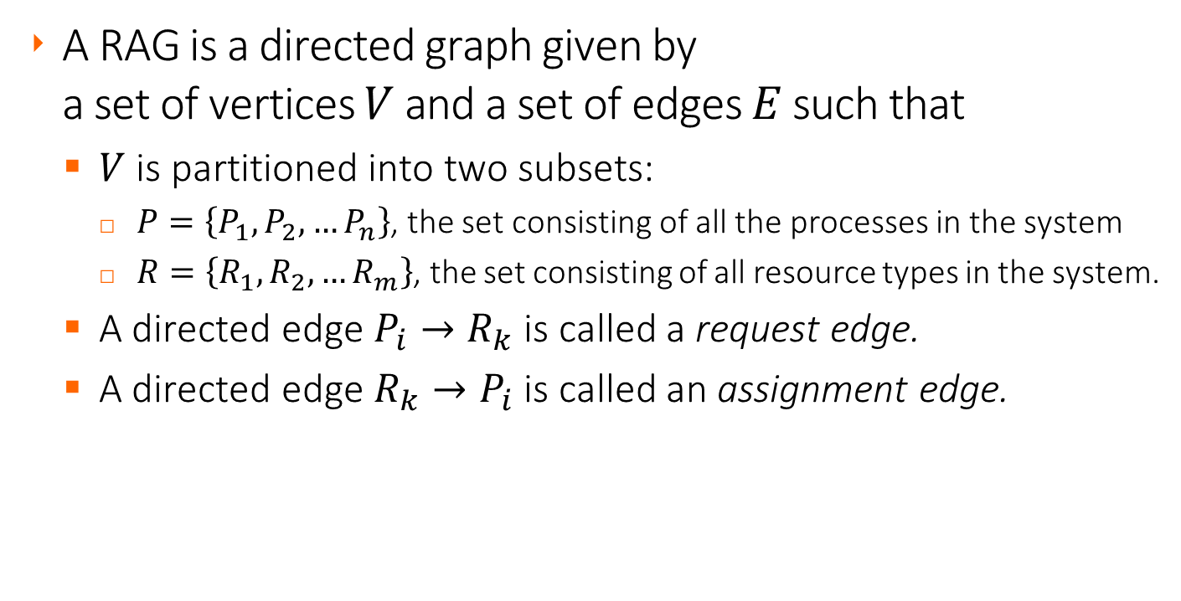
Resource-Allocation Graph (RAG)
Deadlock Detection
A RAG is a directed graph given by
a set of vertices $V$ and a set of edges $E$ such that
  $V$ is partitioned into two subsets:
    $P=\left\{P_{1},P_{2},…P_{n}\right\}$, the set consisting of all the processes in the system
    $R=\left\{R_{1},R_{2},…R_{m}\right\}$, the set consisting of all resource types in the system.
  A directed edge $P_{i}→R_{k}$ is called a request edge.
  A directed edge $R_{k}→P_{i}$ is called an assignment edge.

Slide 56














Resource-Allocation Graphs
Deadlock Detection
Process $P_{i}$
Resource Type $R_{k}$ with 4 instances
$P_{i}$requests an instance of $R_{k}$
$P_{i}$ holds an instance of $R_{k}$
$$P_{i}$$
$$R_{1}$$
$$R_{2}$$
●
●
● | ●
● | ●
$$R_{k}$$
$${ P}_{1}$$
$${ P}_{2}$$
$${ P}_{3}$$
$$P_{i}$$
● | ●
● | ●
● | ●
● | ●
● | ●
$$R_{k}$$
$$R_{3}$$
$$R_{4}$$
$$P_{i}$$
● | ●
● | ●
$$R_{k}$$

Slide 57













Do these Resource Allocation Graphs show deadlocks?
Deadlock Detection
$${ P}_{2}$$
$$R_{1}$$
$$R_{2}$$
$$R_{1}$$
●
●
● | ●
$${ P}_{1}$$
$${ P}_{2}$$
$${ P}_{3}$$
$${ P}_{1}$$
$${ P}_{3}$$
● | ●
● | ●
● | ●
● | ●
$$R_{3}$$
$$R_{4}$$
$$R_{3}$$
$${ P}_{4}$$

Slide 58
Basic facts about a Resource Allocation Graph
Deadlock Detection
If the graph contains no cycles, there is no deadlock.
If the graph contains a cycle, then
  If there is only one instance per resource type,
  there is a deadlock.
  If there are several instances per resource type,
  there is a possibility of deadlock.

Slide 59















Single Instance of Each Resource Type
Deadlock Detection
$${ P}_{5}$$
$$R_{1}$$
$$R_{3}$$
$$R_{4}$$
$${ P}_{5}$$
$${ P}_{1}$$
$${ P}_{2}$$
$${ P}_{3}$$
$${ P}_{1}$$
$${ P}_{2}$$
$${ P}_{3}$$
$$R_{2}$$
$${ P}_{4}$$
$$R_{5}$$
$${ P}_{4}$$
Resource-Allocation Graph
Corresponding wait-for graph

Slide 60
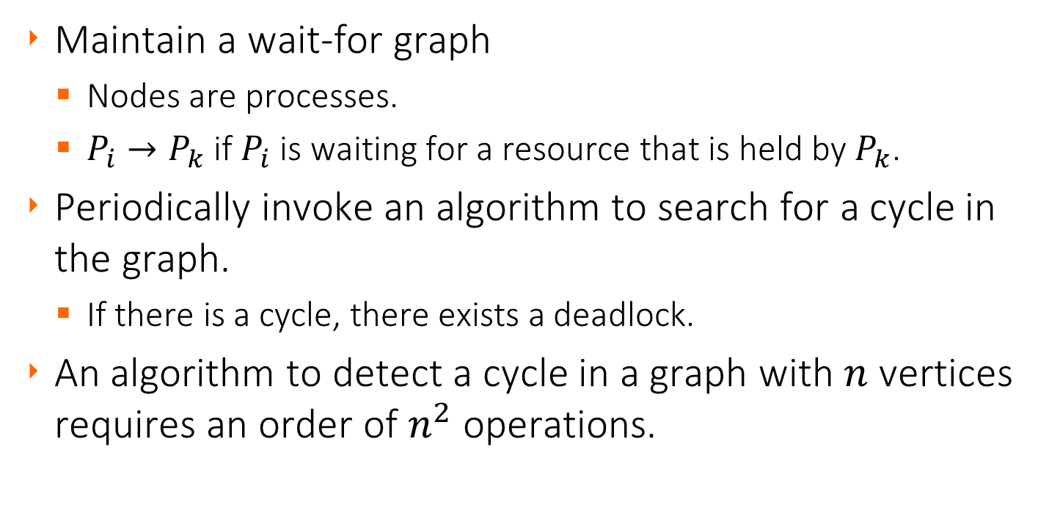
Single Instance of Each Resource Type
Deadlock Detection
Maintain a wait-for graph
  Nodes are processes.
  $P_{i}→P_{k}$ if $P_{i}$ is waiting for a resource that is held by $P_{k}$.
Periodically invoke an algorithm to search for a cycle in the graph.
  If there is a cycle, there exists a deadlock.
An algorithm to detect a cycle in a graph with $n$ vertices requires an order of $n^{2}$ operations.

Slide 61
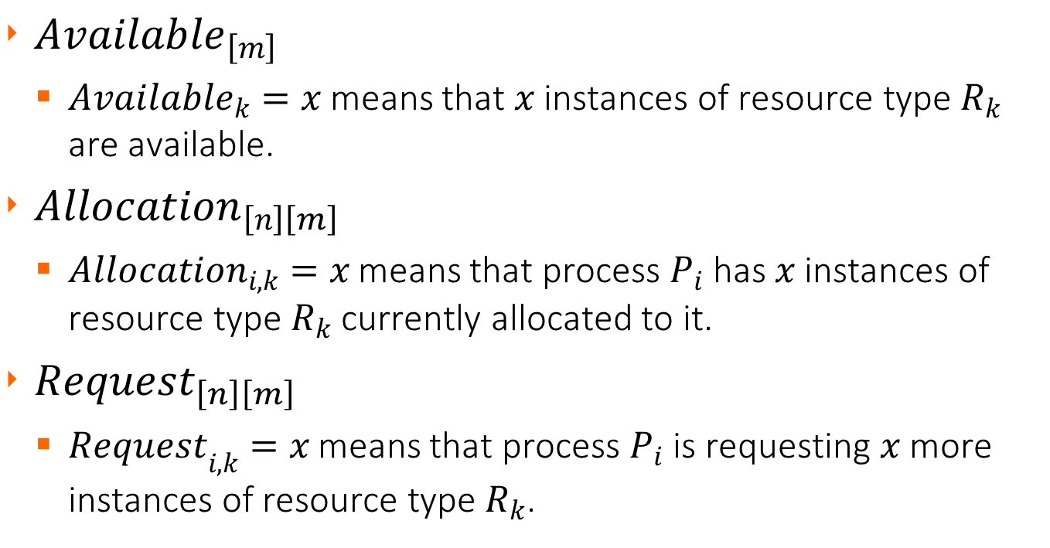
Solution for multiple instances of a resource type
Deadlock Detection
${Available}_{\left[m\right]}$
  ${Available}_{k}=x$ means that $x$ instances of resource type $R_{k}$ are available.
${Allocation}_{\left[n\right]\left[m\right]}$
  ${Allocation}_{i, k}=x$ means that process $P_{i}$ has $x$ instances of resource type $R_{k}$ currently allocated to it.
${Request}_{\left[n\right]\left[m\right]}$
  ${Request}_{i,k}=x$ means that process $P_{i}$ is requesting $x$more instances of resource type $R_{k}$.

Slide 62
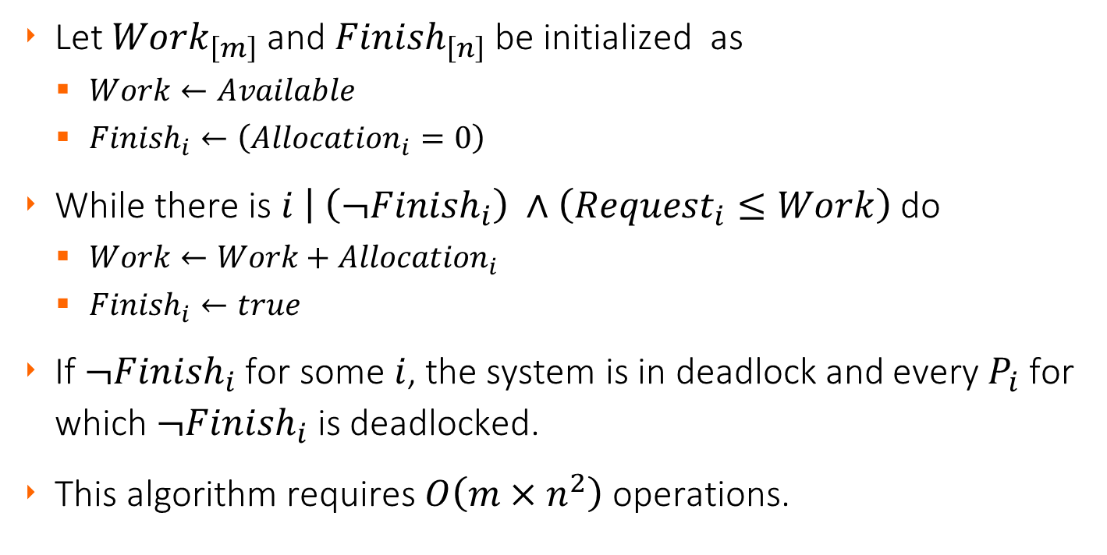
Detection Algorithm
Deadlock Detection
Let ${Work}_{\left[m\right]}$ and ${Finish}_{\left[n\right]}$be initialized as
  $Work←Available$
  ${Finish}_{i}←\left({Allocation}_{i}=0\right)$
While there is $i \left| \left(¬{Finish}_{i}\right) ∧\left({Request}_{i}≤Work\right)\right.$ do
  $Work←{Work+Allocation}_{i}$
  ${Finish}_{i}←true$
If ${¬Finish}_{i}$ for some $i$, the system is in deadlock and every $P_{i}$ for which ${¬Finish}_{i}$ is deadlocked.
This algorithm requires $O\left(m×n^{2}\right)$ operations.

Slide 63
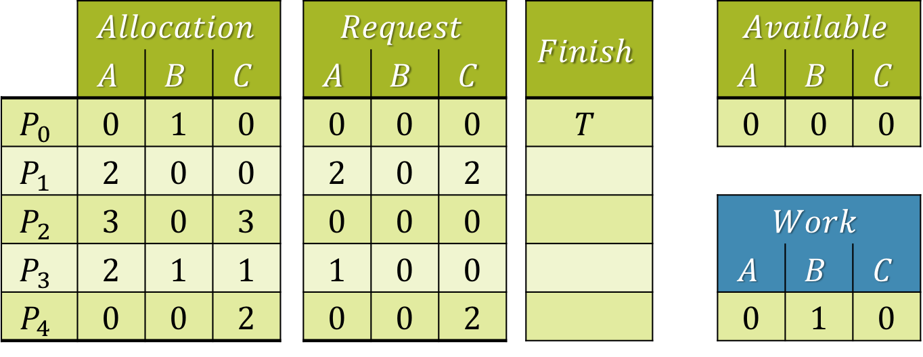

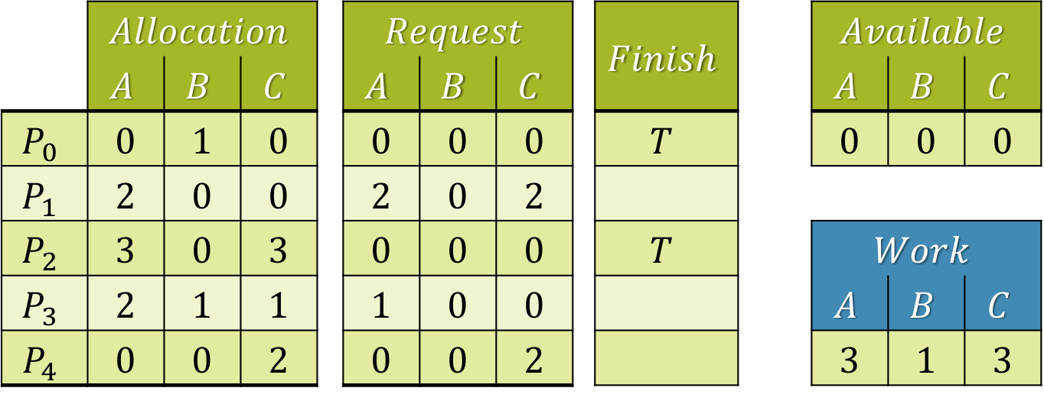

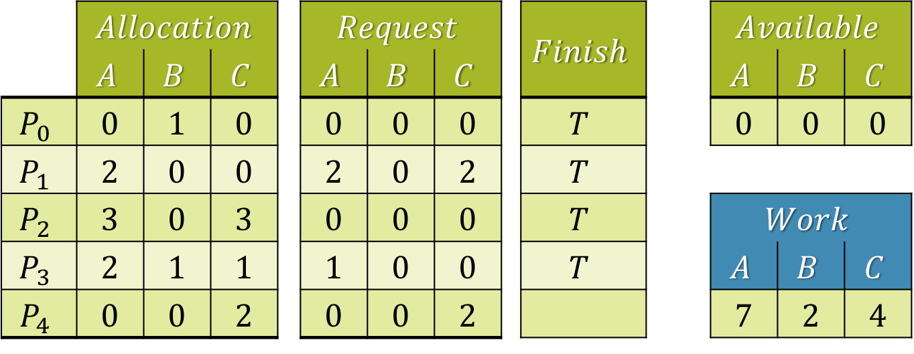
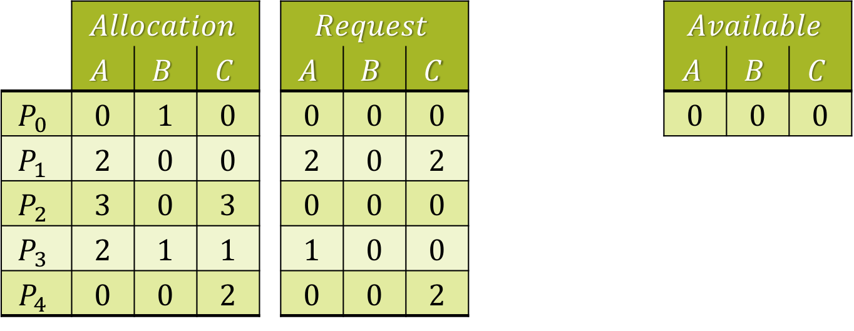


Example of Detection Algorithm
Deadlock Detection
Five processes $P_{0}$ through $P_{4}$
Three resource types: $A \left(7 \text{instances}\right)$, $B\left(2\right) \text{and} C\left(6\right).$
Snapshot at time $t_{0}$:
No deadlock, because sequence $\left\langle P_{0},P_{2},P_{1},P_{3},P_{4}\right\rangle$ results in ${Finish}_{i}$ being true for all $i$.
 | $$Allocation$$ |  |  |  | $$Request$$ |  |  |  | $$Finish$$ |  | $$Available$$
 | $$A$$ | $$B$$ | $$C$$ |  | $$A$$ | $$B$$ | $$C$$ |  |  |  | $$A$$ | $$B$$ | $$C$$
$$P_{0}$$ | 0 | 1 | 0 |  | 0 | 0 | 0 |  | $$T$$ |  | 0 | 0 | 0
$$P_{1}$$ | 2 | 0 | 0 |  | 2 | 0 | 2
$$P_{2}$$ | 3 | 0 | 3 |  | 0 | 0 | 0 |  |  |  | $$Work$$
$$P_{3}$$ | 2 | 1 | 1 |  | 1 | 0 | 0 |  |  |  | $$A$$ | $$B$$ | $$C$$
$$P_{4}$$ | 0 | 0 | 2 |  | 0 | 0 | 2 |  |  |  | 0 | 1 | 0
 | $$Allocation$$ |  |  |  | $$Request$$ |  |  |  | $$Finish$$ |  | $$Available$$
 | $$A$$ | $$B$$ | $$C$$ |  | $$A$$ | $$B$$ | $$C$$ |  |  |  | $$A$$ | $$B$$ | $$C$$
$$P_{0}$$ | 0 | 1 | 0 |  | 0 | 0 | 0 |  | $$T$$ |  | 0 | 0 | 0
$$P_{1}$$ | 2 | 0 | 0 |  | 2 | 0 | 2 |  | $$T$$
$$P_{2}$$ | 3 | 0 | 3 |  | 0 | 0 | 0 |  | $$T$$ |  | $$Work$$
$$P_{3}$$ | 2 | 1 | 1 |  | 1 | 0 | 0 |  | $$T$$ |  | $$A$$ | $$B$$ | $$C$$
$$P_{4}$$ | 0 | 0 | 2 |  | 0 | 0 | 2 |  | $$T$$ |  | 7 | 2 | 6
 | $$Allocation$$ |  |  |  | $$Request$$ |  |  |  | $$Finish$$ |  | $$Available$$
 | $$A$$ | $$B$$ | $$C$$ |  | $$A$$ | $$B$$ | $$C$$ |  |  |  | $$A$$ | $$B$$ | $$C$$
$$P_{0}$$ | 0 | 1 | 0 |  | 0 | 0 | 0 |  | $$T$$ |  | 0 | 0 | 0
$$P_{1}$$ | 2 | 0 | 0 |  | 2 | 0 | 2 |  | $$T$$
$$P_{2}$$ | 3 | 0 | 3 |  | 0 | 0 | 0 |  | $$T$$ |  | $$Work$$
$$P_{3}$$ | 2 | 1 | 1 |  | 1 | 0 | 0 |  | $$T$$ |  | $$A$$ | $$B$$ | $$C$$
$$P_{4}$$ | 0 | 0 | 2 |  | 0 | 0 | 2 |  |  |  | 7 | 2 | 4
 | $$Allocation$$ |  |  |  | $$Request$$ |  |  |  | $$Finish$$ |  | $$Available$$
 | $$A$$ | $$B$$ | $$C$$ |  | $$A$$ | $$B$$ | $$C$$ |  |  |  | $$A$$ | $$B$$ | $$C$$
$$P_{0}$$ | 0 | 1 | 0 |  | 0 | 0 | 0 |  | $$T$$ |  | 0 | 0 | 0
$$P_{1}$$ | 2 | 0 | 0 |  | 2 | 0 | 2 |  | $$T$$
$$P_{2}$$ | 3 | 0 | 3 |  | 0 | 0 | 0 |  | $$T$$ |  | $$Work$$
$$P_{3}$$ | 2 | 1 | 1 |  | 1 | 0 | 0 |  |  |  | $$A$$ | $$B$$ | $$C$$
$$P_{4}$$ | 0 | 0 | 2 |  | 0 | 0 | 2 |  |  |  | 5 | 1 | 3
 | $$Allocation$$ |  |  |  | $$Request$$ |  |  |  | $$Finish$$ |  | $$Available$$
 | $$A$$ | $$B$$ | $$C$$ |  | $$A$$ | $$B$$ | $$C$$ |  |  |  | $$A$$ | $$B$$ | $$C$$
$$P_{0}$$ | 0 | 1 | 0 |  | 0 | 0 | 0 |  | $$T$$ |  | 0 | 0 | 0
$$P_{1}$$ | 2 | 0 | 0 |  | 2 | 0 | 2
$$P_{2}$$ | 3 | 0 | 3 |  | 0 | 0 | 0 |  | $$T$$ |  | $$Work$$
$$P_{3}$$ | 2 | 1 | 1 |  | 1 | 0 | 0 |  |  |  | $$A$$ | $$B$$ | $$C$$
$$P_{4}$$ | 0 | 0 | 2 |  | 0 | 0 | 2 |  |  |  | 3 | 1 | 3
 | $$Allocation$$ |  |  |  | $$Request$$ |  |  |  | $$Finish$$ |  | $$Available$$
 | $$A$$ | $$B$$ | $$C$$ |  | $$A$$ | $$B$$ | $$C$$ |  |  |  | $$A$$ | $$B$$ | $$C$$
$$P_{0}$$ | 0 | 1 | 0 |  | 0 | 0 | 0 |  |  |  | 0 | 0 | 0
$$P_{1}$$ | 2 | 0 | 0 |  | 2 | 0 | 2
$$P_{2}$$ | 3 | 0 | 3 |  | 0 | 0 | 0 |  |  |  | $$Work$$
$$P_{3}$$ | 2 | 1 | 1 |  | 1 | 0 | 0 |  |  |  | $$A$$ | $$B$$ | $$C$$
$$P_{4}$$ | 0 | 0 | 2 |  | 0 | 0 | 2 |  |  |  | 0 | 0 | 0
 | $$Allocation$$ |  |  |  | $$Request$$ |  |  |  |  |  | $$Available$$
 | $$A$$ | $$B$$ | $$C$$ |  | $$A$$ | $$B$$ | $$C$$ |  |  |  | $$A$$ | $$B$$ | $$C$$
$$P_{0}$$ | 0 | 1 | 0 |  | 0 | 0 | 0 |  |  |  | 0 | 0 | 0
$$P_{1}$$ | 2 | 0 | 0 |  | 2 | 0 | 2
$$P_{2}$$ | 3 | 0 | 3 |  | 0 | 0 | 0 |  |  |  | $$Work$$
$$P_{3}$$ | 2 | 1 | 1 |  | 1 | 0 | 0 |  |  |  | $$A$$ | $$B$$ | $$C$$
$$P_{4}$$ | 0 | 0 | 2 |  | 0 | 0 | 2

Slide 64

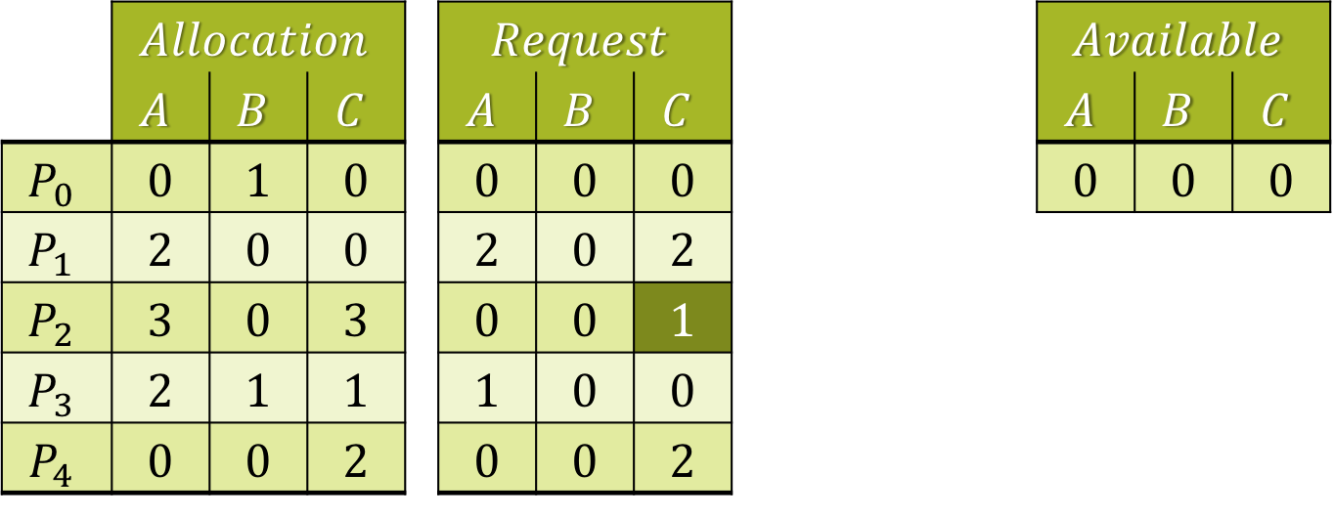
Example of Detection Algorithm
Deadlock Detection
Same problem, but $P_{2}$ now requests one additional instance of resource type $C$.
Snapshot at time $t_{0}$:
 | $$Allocation$$ |  |  |  | $$Request$$ |  |  |  |  |  | $$Available$$
 | $$A$$ | $$B$$ | $$C$$ |  | $$A$$ | $$B$$ | $$C$$ |  |  |  | $$A$$ | $$B$$ | $$C$$
$$P_{0}$$ | 0 | 1 | 0 |  | 0 | 0 | 0 |  |  |  | 0 | 0 | 0
$$P_{1}$$ | 2 | 0 | 0 |  | 2 | 0 | 2
$$P_{2}$$ | 3 | 0 | 3 |  | 0 | 0 | 1 |  |  |  | $$Work$$
$$P_{3}$$ | 2 | 1 | 1 |  | 1 | 0 | 0 |  |  |  | $$A$$ | $$B$$ | $$C$$
$$P_{4}$$ | 0 | 0 | 2 |  | 0 | 0 | 2

Slide 65

Example of Detection Algorithm
Deadlock Detection
Same problem, but $P_{2}$ now requests one additional instance of resource type $C$.
Snapshot at time $t_{0}$:
 | $$Allocation$$ |  |  |  | $$Request$$ |  |  |  | $$Finish$$ |  | $$Available$$
 | $$A$$ | $$B$$ | $$C$$ |  | $$A$$ | $$B$$ | $$C$$ |  |  |  | $$A$$ | $$B$$ | $$C$$
$$P_{0}$$ | 0 | 1 | 0 |  | 0 | 0 | 0 |  |  |  | 0 | 0 | 0
$$P_{1}$$ | 2 | 0 | 0 |  | 2 | 0 | 2
$$P_{2}$$ | 3 | 0 | 3 |  | 0 | 0 | 1 |  |  |  | $$Work$$
$$P_{3}$$ | 2 | 1 | 1 |  | 1 | 0 | 0 |  |  |  | $$A$$ | $$B$$ | $$C$$
$$P_{4}$$ | 0 | 0 | 2 |  | 0 | 0 | 2 |  |  |  | 0 | 0 | 0

Slide 66


Example of Detection Algorithm
Deadlock Detection
Same problem, but $P_{2}$ now requests one additional instance of resource type $C$.
Snapshot at time $t_{0}$:
The system is now in a deadlock involving processes $P_{1},P_{2},P_{3} \text{and} P_{4}$.
 | $$Allocation$$ |  |  |  | $$Request$$ |  |  |  | $$Finish$$ |  | $$Available$$
 | $$A$$ | $$B$$ | $$C$$ |  | $$A$$ | $$B$$ | $$C$$ |  |  |  | $$A$$ | $$B$$ | $$C$$
$$P_{0}$$ | 0 | 1 | 0 |  | 0 | 0 | 0 |  | $$T$$ |  | 0 | 0 | 0
$$P_{1}$$ | 2 | 0 | 0 |  | 2 | 0 | 2
$$P_{2}$$ | 3 | 0 | 3 |  | 0 | 0 | 1 |  |  |  | $$Work$$
$$P_{3}$$ | 2 | 1 | 1 |  | 1 | 0 | 0 |  |  |  | $$A$$ | $$B$$ | $$C$$
$$P_{4}$$ | 0 | 0 | 2 |  | 0 | 0 | 2 |  |  |  | 0 | 1 | 0

Slide 67
Detection-Algorithm Usage
Deadlock Detection
When, and how often, to invoke depends on:
  How often a deadlock is likely to occur?
  How many processes will need to be rolled back?
    One for each disjoint cycle
If the detection algorithm is invoked arbitrarily,
there may be many cycles in the resource graph.
  It may be difficult or even impossible to tell which of the many deadlocked processes “caused” the deadlock.

Slide 68
Recovery from Deadlock: Process Termination
Deadlock Detection
There are two options
  Abort all deadlocked processes
  Abort one process at a time until the deadlock ends.
In which order should we choose to abort?
  Priority of the process.
  How long the process has run, and how long it will run.
  Resources that the process has used.
  Resources that the process needs to complete.
  How many processes will have to be terminated.
  Is the process interactive or batch?

Slide 69
Recovery from Deadlock: Resource Preemption
Deadlock Detection
Selecting a victim
  Minimize cost.
Rollback
  Return to some safe state, restart process from there.
Starvation
  Same process may always be picked as victim, so it is a good idea to include number of rollbacks in cost factor.

