Slide 1
Event-Based Concurrency
T24
33
24 de outubro de 2018

Slide 2
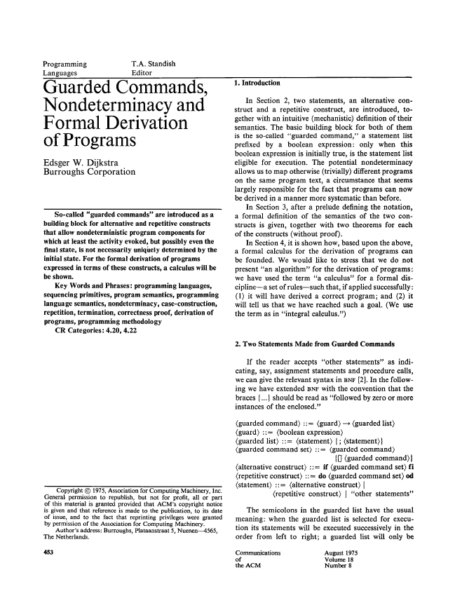
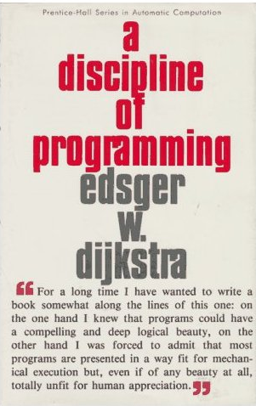

Modelos alternativos já eram assunto há 40 anos…
Dijkstra, E. W. 1975. Guarded commands, nondeterminacy and formal derivation of programs. Commun. ACM 18, 8 (Aug. 1975), 453-457.

Slide 3
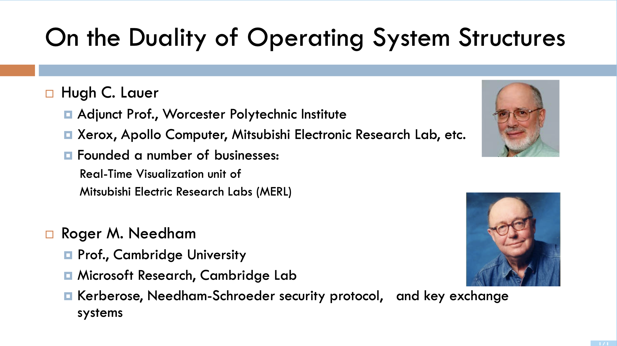
Modelos alternativos já eram assunto há 40 anos…

Slide 4
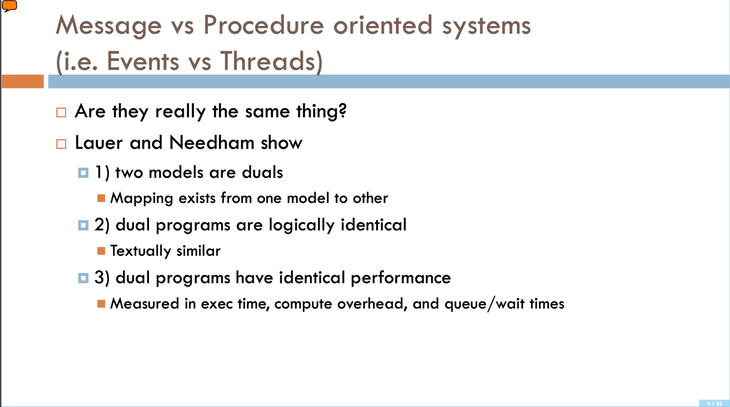
Modelos alternativos já eram assunto há 40 anos…

Slide 5
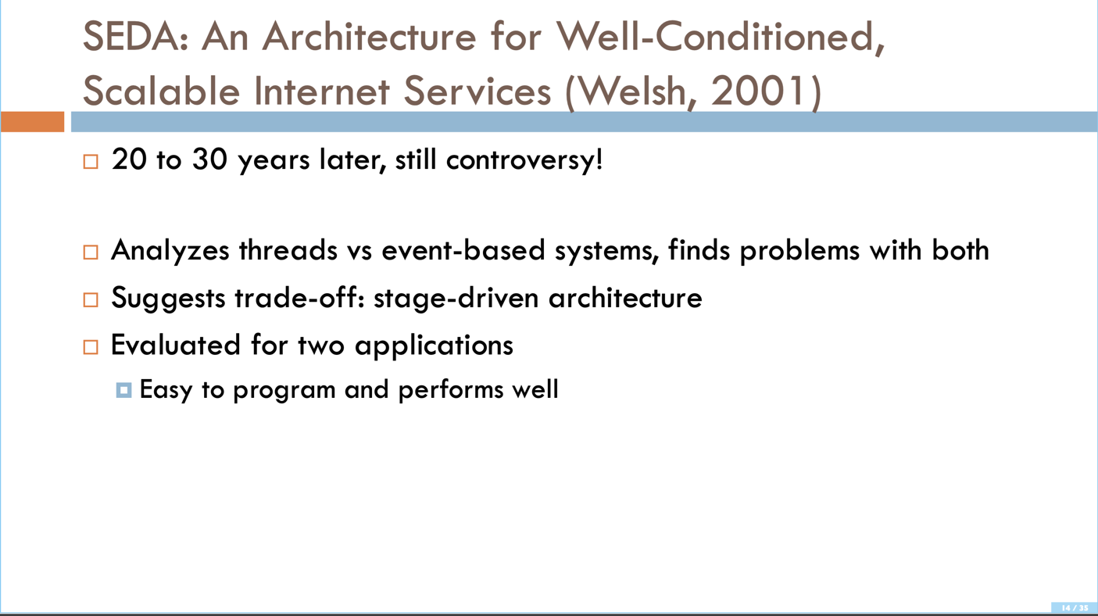
Modelos alternativos já eram assunto há 40 anos…

Slide 6
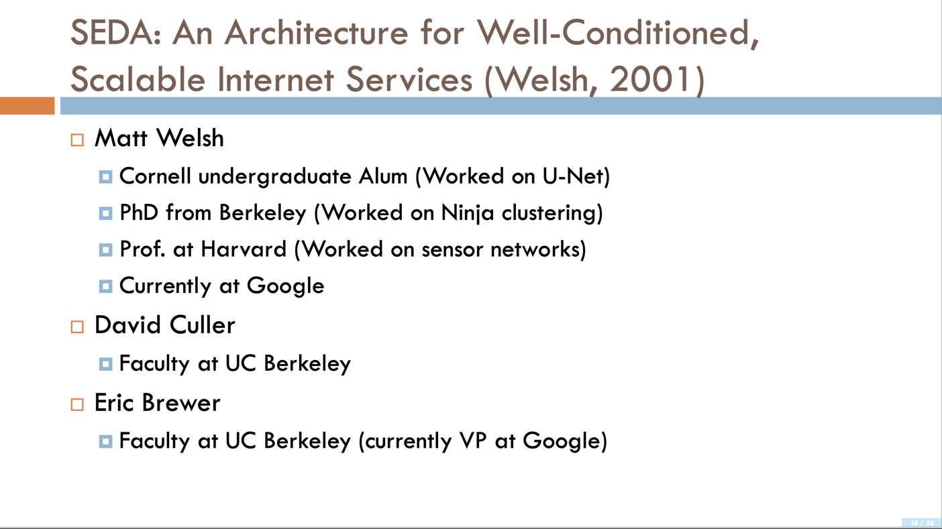
Modelos alternativos já eram assunto há 40 anos…

Slide 7
Event-Based Concurrency
As we have seen, it is not easy to generate a thread-safe concurrent application using the traditional procedural programming style.
For example, missing locks, deadlocks and other problems can easily arise.
Event-based concurrency is another style of concurrent programming which has become popular in some modern systems.
For example, it is used in GUI-based applications, some types of internet servers, and server-side frameworks like node.js.
The idea is to replace the complexities of multi-threading with a deterministic, sequential model that is easier to understand and debug, while giving the developer greater control over what is scheduled at a given moment in time.

Slide 8
Can we build concurrent systems without threads?
We would like to allow a single-threaded program to cope with high-latency I/ O devices by overlapping I/ O with processing and other I/ O.
Thus,
Retaining control over concurrency
Avoiding some of the problems common to multi-threaded applications
How could we build a concurrent server like that?

Slide 9
The Basic Idea: An Event Loop
The basic approach is called event-based concurrency:
Wait for something (i.e., an “event”) to occur.
When it does, check what type of event it is.
Do the small amount of work it requires.
Example:
while (1) {
events = getEvents();
for (e in events)
processEvent(e);
}
While the event handler processes an event, this is the only activity taking place in the system.
How can an event handler tell whether a message has arrived for it?
event handler

Slide 10
How to detect the occurrence of events
Most systems provide a basic API, including select() or poll() system calls.
They check whether there are incoming I/O requests to be serviced.
They enable the developer to build a non-blocking event loop, which checks for incoming packets and reads from sockets with messages and replies as needed.
With a single CPU and an event-based application, the problems found in concurrent programs are no longer present.
Since the event-based server cannot be interrupted by another thread, there is no need to acquire or release locks.
Thus, concurrency bugs common in multithreaded programs do not appear in the basic event-based approach.

Slide 11
Simple code using select()
int main(void) {
// open and set up a bunch of sockets (not shown)
// main loop
while (1) {
// initialize the fd_set to all zero
fd_set readFDs;
FD_ZERO(&readFDs);
// now set the bits for the descriptors
// this server is interested in
// (for simplicity, all of them from min to max)
for (int fd = minFD; fd < maxFD; fd++)
FD_SET(fd, &readFDs);
// do the select
int rc = select(maxFD + 1, &readFDs, NULL, NULL, NULL);
// check which actually have data using FD_ISSET()
for (int fd = minFD; fd < maxFD; fd++)
if (FD_ISSET(fd, &readFDs))
processFD(fd);
}
}

Slide 12
What if an event leads to a system call that might block?
In a thread-based server, while the thread issuing the blocking I/O request suspends (waiting for the I/O to complete), other threads can run.
This natural overlap of I/O and other operations is what makes thread-based programming quite natural and straightforward.
With an event-based approach, however, there are no other threads to run: just the main event loop.
This implies that if an event handler issues a call that blocks, the entire server will also block until the call completes.
When the event loop blocks, the system sits idle, and thus is a huge potential waste of resources.
We thus have a rule that must be obeyed in event-based systems: no blocking calls are allowed.

Slide 13
Why Simpler? No Locks Needed
The event-based server cannot be interrupted by another thread.
With a single CPU and an event-based application.
It is decidedly single threaded.
Thus, concurrency bugs common in threaded programs do not manifest in the basic event-based approach.

Slide 14
A Problem: Blocking System Calls
What if an event requires that you issue a system call that might block?
There are no other threads to run: just the main event loop
The entire server will do just that: block until the call completes.
Huge potential waste of resources
In event-based systems no blocking calls are allowed.

Slide 15
A Solution: Asynchronous I/O
Enable an application to issue an I/O request and return control immediately to the caller, before the I/O has completed.
Example:
An Interface provided on macOS
The APIs revolve around a basic structure, the struct aiocb or AIO control block in common terminology.
struct aiocb {
int aio_fildes; /* File descriptor */
off_t aio_offset; /* File offset */
volatile void *aio_buf; /* Location of buffer */
size_t aio_nbytes; /* Length of transfer */
};

Slide 16
A Solution: Asynchronous I/O (Cont.)
Asynchronous API:
To issue an asynchronous read to a file
If successful, it returns right away and the application can continue with its work.
Checks whether the request referred to by aiocbp has completed.
An application can periodically pool the system via aio_error().
If it has completed, returns success.
If not, EINPROGRESS is returned.
int aio_read(struct aiocb *aiocbp);
int aio_error(const struct aiocb *aiocbp);

Slide 17
A Solution: Asynchronous I/O (Cont.)
Interrupt
Remedy the overhead to check whether an I/O has completed
Using UNIX signals to inform applications when an asynchronous I/O completes.
Removing the need to repeatedly ask the system.

Slide 18
Another Problem: State Management
The code of event-based approach is generally more complicated to write than traditional thread-based code.
It must package up some program state for the next event handler to use when the I/O completes.
The state the program needs is on the stack of the thread. → manual stack management

Slide 19
Another Problem: State Management (Cont.)
Example (an event-based system):
First issue the read asynchronously.
Then, periodically check for completion of the read.
That call informs us that the read is complete.
How does the event-based server know what to do?
int rc = read(fd, buffer, size);
rc = write(sd, buffer, size);

Slide 20
Another Problem: State Management (Cont.)
Solution: continuation
Record the needed information to finish processing this event in some data structure.
When the event happens (i.e., when the disk I/O completes), look up the needed information and process the event.

Slide 21
What is still difficult with Events.
Systems moved from a single CPU to multiple CPUs.
Some of the simplicity of the event-based approach disappeared.
It does not integrate well with certain kinds of systems activity.
Ex. Paging: A server will not make progress until page fault completes (implicit blocking).
Hard to manage overtime: The exact semantics of various routines changes.
Asynchronous disk I/O never quite integrates with asynchronous network I/O in as simple and uniform a manner as you might think.

Slide 22
ASIDE: Unix Signals
Provide a way to communicate with a process.
HUP (hang up), INT(interrupt), SEGV(segmentation violation), and etc.
Example: When your program encounters a segmentation violation, the OS sends it a SIGSEGV.
#include <stdio.h>
#include <signal.h>
void handle(int arg) {
printf("stop wakin’ me up...\n");
}
int main(int argc, char *argv[]) {
signal(SIGHUP, handle);
while (1)
; // doin’ nothin’ except catchin’ some sigs
return 0;
}
A simple program that goes into an infinite loop

Slide 23
ASIDE: Unix Signals (Cont.)
You can send signals to it with the kill command line tool.
Doing so will interrupt the main while loop in the program and run the handler code handle().
prompt> ./main &
[3] 36705
prompt> kill -HUP 36705
stop wakin’ me up...
prompt> kill -HUP 36705
stop wakin’ me up...
prompt> kill -HUP 36705
stop wakin’ me up...

