Slide 1
Hard Disk Drives
T26
37
29 de outubro de 2018

Slide 2
Hard disk drives have been the main form of persistent data storage in computer systems for decades…
How do modern hard disks store data?
What is their interface?
How is data actually laid out and accessed?
How does disk scheduling affect performance?

Slide 3
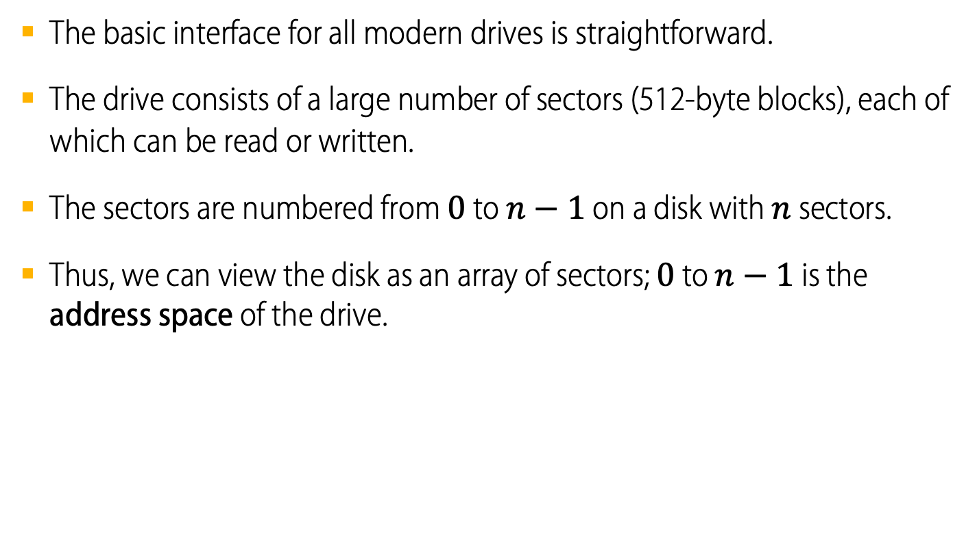
The hard-disk drive interface
The basic interface for all modern drives is straightforward.
The drive consists of a large number of sectors (512-byte blocks), each of which can be read or written.
The sectors are numbered from $0$ to $n−1$ on a disk with $n$ sectors.
Thus, we can view the disk as an array of sectors; $0$ to $n−1$ is the address space of the drive.

Slide 4
The hard-disk drive interface
Multi-sector operations are possible.
Many file systems will read or write 4KB or more at a time.
However, the only guarantee is that a single 512- byte write is atomic (i.e., it will either complete in its entirety or it won’t complete at all).
Thus, if an untimely power loss occurs, only a portion of a larger write may complete (sometimes called a torn write).
There are some assumptions most clients of disk drives make, but that are not specified directly in the interface (an unwritten contract):
Accessing two blocks that are near one-another within the drive’s address space is faster than accessing two blocks that are far apart.
Accessing blocks in a contiguous chunk (i.e., a sequential read or write) is the fastest access mode, much faster than any random access pattern.

Slide 5
The basic geometry of a hard disk
10
9
0
1
2
4
5
7
8
3
6
11
spindle

Slide 6
The basic geometry of a hard disk
Platter
A circular hard surface (aluminum coated with a thin magnetic layer)
Data is stored persistently by inducing magnetic changes to it.
Each platter has 2 sides, each of which is called a surface.
Spindle
Spindle is connected to a motor that spins the platters around.
The rate of rotation today is typically 7,200 to 15,000 RPM.
At 10,000 RPM a full rotation takes about 6 ms.
Track
Concentric circles of sectors
Data is encoded on each surface in a track.
A single surface contains many thousands and thousands of tracks.
spindle
A Disk with Just One Single Track (12 sectors)

Slide 7
The basic geometry of a hard disk
Disk head
There is one head per surface of the drive
It is responsible for reading and writing the disk.
It is attached to a single disk arm, which moves across the surface.
Rotates this way
head
spindle
arm
A Single Track Plus A Head

Slide 8
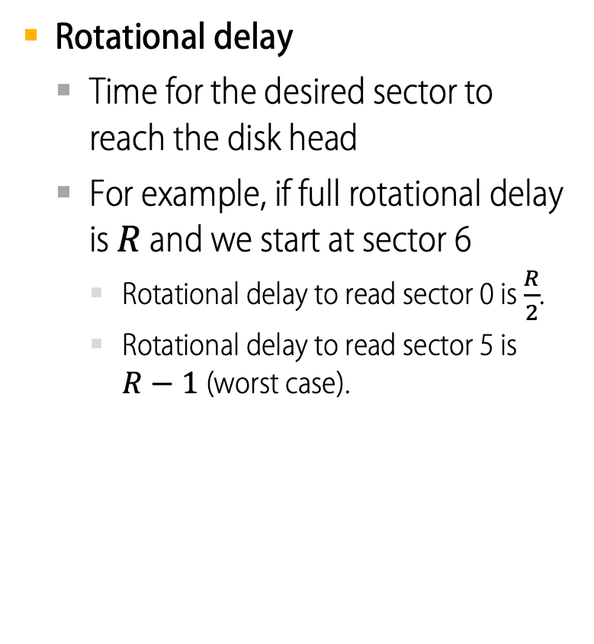
Single track latency: Rotational Delay
Rotational delay
Time for the desired sector to reach the disk head
For example, if full rotational delay is $R$ and we start at sector 6
Rotational delay to read sector 0 is $\frac{R}{2}$.
Rotational delay to read sector 5 is $R−1$ (worst case).
Rotates this way
head
spindle
arm
A Single Track Plus A Head

Slide 9
Multiple Tracks: Seek Time
Rotates this way
Rotates this way
Three Tracks Plus A Head (Right: With Seek)
(e.g., read to sector 11)
Remaining rotation
seek
spindle
spindle
Seek
Move the disk arm to the correct track
The time to move head to the track containing the desired sector is called seek time.
It is one of the most costly disk operations.

Slide 10
Phases of Seek
Acceleration → Coasting → Deceleration → Settling
Acceleration: The disk arm gets moving.
Coasting: The arm is moving at full speed.
Deceleration: The arm slows down.
Settling: The head is carefully positioned over the correct track.
The settling time is often quite significant, e.g., 0.5 to 2ms.

Slide 11
Phases of I/O
Seek → Rotational delay → Transfer
Transfer: The final phase of I/O
Data is either actually read from or written to the surface.

Slide 12
Track Skew
Rotates this way
Used in some hard disks to make sure that sequential reads can be properly serviced even when crossing track boundaries.
Without track skew, the head would be moved to the next track but the desired next block might have already rotated under the head.
9
8
19
10
18
20
7
28
29
30
11
17
21
27
31
Spindle
6
16
26
32
22
0
25
33
5
15
24
34
23
35
1
14
12
4
13
2
3
Three Tracks: Track Skew Of 2

Slide 13
Cache or Track Buffer
The cache holds data read from or written to the disk.
Allows the drive to quickly respond to requests.
Small amount of memory (usually around 8 or 16 MB)

Slide 14
Write on cache
Writeback (immediate reporting)
Acknowledge that a write has completed when it has put the data in its memory.
Faster but dangerous.
Write through
Acknowledge that a write has completed only after the data has actually been written to disk.

Slide 15

I/O Time: Doing The Math
I/O time
$T_{I/O}=T_{seek}+T_{rotation}+T_{transfer}$
Rate of I/O
$R_{I/O}=\frac{{Size}_{Transfer}}{T_{I/O}}$
Disk Drive Specs: SCSI Versus SATA
 | Cheetah 15K.5 | Barracuda
Capacity | 300 GB | 1 TB
RPM | 15,000 | 7,200
Average Seek | 4 ms | 9 ms
Max Transfer | 125 MB/s | 105 MB/s
Platters | 4 | 4
Cache | 16 MB | 16/32 MB
Connects Via | SCSI | SATA

Slide 16
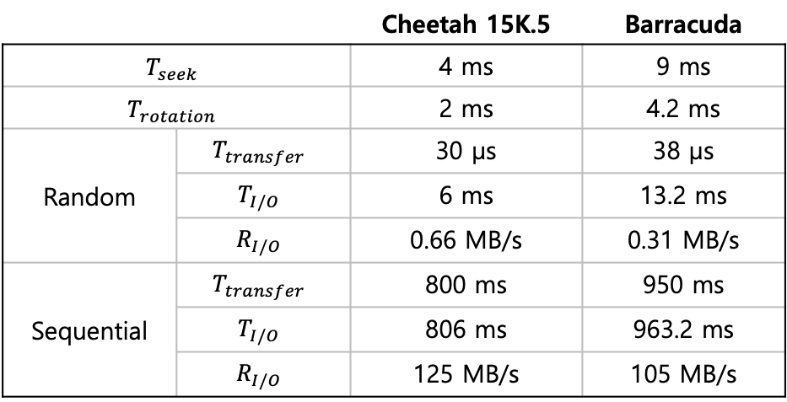
I/O Time: Doing The Math
Random workload: Issue 4KB read to random locations on the disk
Sequential workload: Read 100MB consecutively from the disk
Disk Drive Performance: SCSI vs SATA, Random vs Sequential
 |  | Cheetah 15K.5 | Barracuda
$$T_{seek}$$ |  | 4 ms | 9 ms
$$T_{rotation}$$ |  | 2 ms | 4.2 ms
Random | $$T_{transfer}$$ | 30 µs | 38 µs
 | $$T_{I/O}$$ | 6 ms | 13.2 ms
 | $$R_{I/O}$$ | 0.66 MB/s | 0.31 MB/s
Sequential | $$T_{transfer}$$ | 800 ms | 950 ms
 | $$T_{I/O}$$ | 806 ms | 963.2 ms
 | $$R_{I/O}$$ | 125 MB/s | 105 MB/s

Slide 17
Disk Scheduling
Disk Scheduler decides which I/O request to schedule next.
SSTF (Shortest Seek Time First)
Order the queue of I/O request by track
Pick requests on the nearest track to complete first
Rotates this way
9
8
21
10
20
22
7
32
33
34
11
19
23
SSTF: Scheduling Request 21 and 2
Issue the request to 21 → issue the request to 2
31
35
Spindle
6
18
30
24
12
0
29
25
5
17
28
26
13
27
1
16
14
4
15
2
3

Slide 18
SSTF is not a panacea.
Problem 1: The drive geometry is not available to the host OS
Solution: OS can simply implement Nearest-block-first (NBF)
Problem 2: Starvation
If there were a steady stream of request to the inner track, request to other tracks would then be ignored completely.

Slide 19
Elevator (a.k.a. SCAN or C-SCAN)
Move across the disk servicing requests in order across the tracks.
Sweep: A single pass across the disk
If a request comes for a block on a track that has already been services on this sweep of the disk, it is queued until the next sweep.
F-SCAN
Freeze the queue to be serviced when it is doing a sweep
Avoid starvation of far-away requests
C-SCAN (Circular SCAN)
Sweep from outer-to-inner, and then inner-to-outer, etc.

Slide 20
How to account for Disk rotation costs?
Rotates this way
If rotation is faster than seek : request 16 → request 8
If seek is faster than rotation : request 8 → request 16
9
8
21
10
20
22
7
32
33
34
11
19
23
31
35
Spindle
6
18
30
24
12
0
29
25
5
17
28
26
13
27
1
16
14
4
15
2
3
SSTF: Sometimes Not Good Enough
On modern drives, both seek and rotation are roughly equivalent:
Thus, SPTF (Shortest Positioning Time First) is useful.

Slide 21
I/O merging
Reduce the number of request sent to the disk and lowers overhead
E.g., read blocks 33, then 8, then 34:
The scheduler merge the request for blocks 33 and 34 into a single two-block request.

