Slide 1
Hard Disk Scheduling
T27
37
29 de outubro de 2018

Slide 2
To use disk drives efficiently the OS must find
Fast access time
Large disk bandwidth
Bandwidth is the quotient of the total number of bytes transferred by the total time between the first request for service and the completion of the last transfer.
Access time has two major components
Seek time
Rotational latency

Slide 3
To read or write, the disk head must be positioned at the desired track and at the beginning of the desired sector.
Seek time
Time taken to position the head at the desired track
Rotational delay or rotational latency
Time until the beginning of the desired sector reaches the head
Data transfer occurs as the sector moves under the head.

Slide 4
Seek time is the main reason for differences in performance.
For a single disk there will be a number of pending I/O requests.
If requests are selected randomly, we will achieve poor performance.
Wait for Device | Wait for Channel | Seek Delay | Rotational Delay | Data Transfer
device busy and allocated to the process

Slide 5
There are many types of disk scheduling algorithms
Sequential
Priority-based
...
In the following examples we will consider
A 200-cylinder disk
Read/write head initially on cylinder 53
The following request queue (required track numbers)
98, 183, 37, 122, 14, 124, 65, 67

Slide 6
First-in, first-out (FIFO)
Processes requests sequentially
Fair to all processes
Approaches random scheduling in performance if there are many processes

Slide 7
First-in, first-out (FIFO)
Queue = 98, 183, 37, 122, 14, 124, 65, 67
Head initially parked at cylinder 53
Total seek length
640 cylinders

Slide 8
Last-in, first-out
Good for transaction processing systems
The device is given to the most recent user so there should be little arm movement
Possibility of starvation since a job may never regain the head of the line

Slide 9
Priority-based scheduling
Goal is not to optimize disk use but to meet other objectives
Short batch jobs may have higher priority
Can provide good interactive response time

Slide 10
Shortest Service Time First
Select the disk I/O request that requires the least movement of the disk arm from its current position
Always chooses the minimum seek time

Slide 11
Shortest Service Time First
Queue = 98, 183, 37, 122, 14, 124, 65, 67
Head initially parked at cylinder 53
Total seek length
236 cylinders

Slide 12
SSTF is not a panacea
Problem 1: The drive geometry is not available to the host OS
Solution: OS can simply implement nearest-block-first (NBF)
Problem 2: Starvation
If there were a steady stream of requests to the inner track, requests to other tracks would then be ignored completely.

Slide 13
SCAN
Arm moves in one direction only, satisfying all outstanding requests until it reaches the last track in that direction
Direction is then reversed

Slide 14
SCAN
Disk Scheduling Policies
Queue = 98, 183, 37, 122, 14, 124, 65, 67
Head initially parked at cylinder 53
Total seek length
208 cylinders

Slide 15
C-SCAN
Restricts scanning to one direction only
When the last track has been visited in one direction, the arm is returned to the opposite end of the disk and the scan begins again

Slide 16
C-SCAN
Disk Scheduling Policies
Queue = 98, 183, 37, 122, 14, 124, 65, 67
Head initially at cylinder 53, moving forward
Total seek length
197 cylinders + retraction

Slide 17
C-LOOK
Similar to C-SCAN
The arm moves only up to the last request in each direction
After that it changes direction without moving up to the disk border

Slide 18
C-LOOK
Disk Scheduling Policies
Queue = 98, 183, 37, 122, 14, 124, 65, 67
Head initially parked at cylinder 53
Total seek length
167 cylinders + retraction

Slide 19
N-step-SCAN and FSCAN
Disk Scheduling Policies
N-step-SCAN
Segments the disk request queue into sub-queues of length N
Sub-queues are processed one at a time, using SCAN
New requests added to other queue when queue is processed
FSCAN
Two queues
One queue is empty for new requests

Slide 20
Choosing a disk scheduling algorithm...
SSTF is common and faster than FCFS.
SCAN and C-SCAN work better with heavy disk load.
Performance depends on number and types of requests.
Service requests are affected by file allocation policies.
Disk scheduling may be written as a separate (easily replaceble) OS module.
SSTF and LOOK are suitable choices for the default algorithm.

Slide 21
Swap-Space Management
Usage of swap-space depends on the memory management algorithm adopted.
Entire process images.
Pages that have been pushed out of memory.
Swapping severely impacts system performance.
It is safer to overestimate the need for swap space.
Lack may lead to process abortions and system crashes.
Some systems allow the use of multiple swap areas, usually on separate disks.

Slide 22
Swap-Space Management
Swap space may reside
Within the normal file system
Implementation is easy but inneficient.
To improve performance OSs attempt to make the swap space contiguous and unmovable.
In a separate (raw) disk partition
Algorithms are designed for speed rather than for storage efficiency.

Slide 23
Disk Cache
Buffer in main memory for disk blocks
Contains a copy of some of the blocks on the disk
Requires a policy for block replacement

Slide 24
Least Recently Used
Disk cache replacement policies
The block that has been in the cache the longest with no reference to it is replaced
The cache consists of a stack of blocks
Most recently referenced block is on the top of the stack
When a block is referenced or brought into the cache, it is placed on the top of the stack
The block on the bottom of the stack is removed when a new block is brought in
Blocks don’t actually move around in main memory
A stack of pointers is used

Slide 25
Least Frequently Used
Disk cache replacement policies
The block that has experienced the fewest references is replaced
A counter is associated with each block
Counter is initialized to 1 when a block is brought in and incremented each time the block is accessed
When needed, the block with smallest count is selected for replacement
Because of locality some blocks may be referenced many times in a short period of time but infrequently overall
Thus the reference count can be misleading

Slide 26
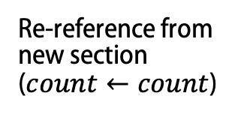

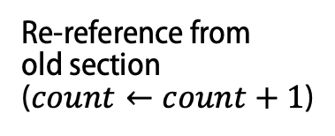
Frequency-Based Replacement 1
Disk cache replacement policies
New block brought in ($count←1$)
…
…
Re-reference from new section ($count←count$)
Block with smallest count in old section is replaced
In case of draw, the block with the oldest reference (the one closer to the bottom of the stack) is replaced
Performance slightly better than LRU or LFU
New section
Re-reference from old section ($count←count+1$)
Old section

Slide 27
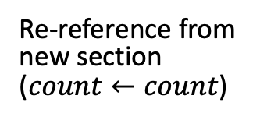
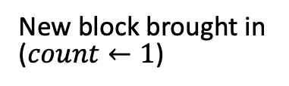

Frequency-Based Replacement 2
Disk cache replacement policies
New block brought in ($count←1$)
…
…
…
Re-reference from new section ($count←count$)
New section
Block with smallest count in old section is replaced
In case of draw, the block with the oldest reference (the one closer to the bottom of the stack) is replaced
Blocks in middle section have a chance to improve count
Performance better than LRU and LFU
Re-reference from middle or old section ($count←count+1$)
Middle section
Old section

Slide 28
Hamming Code

Slide 29

Code for detecting a single error
Consider $m$ data bits $d_{m}…d_{3}d_{2}d_{1}$
Adding $1$ parity bit we create a code which uses $m+1$ bits and can detect one single error.

Slide 30
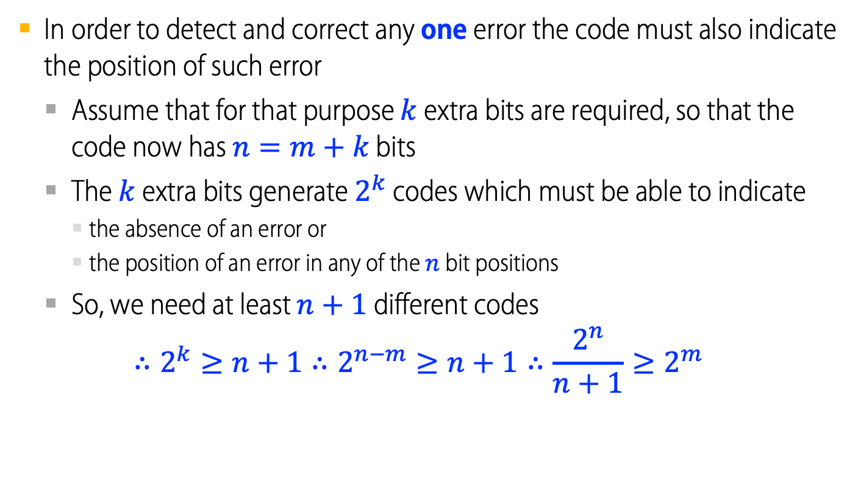
Detecting and correcting a single error
In order to detect and correct any one error the code must also indicate the position of such error
Assume that for that purpose $k$ extra bits are required, so that the code now has $n=m+k$ bits
The $k$ extra bits generate $2^{k}$ codes which must be able to indicate
the absence of an error or
the position of an error in any of the $n$ bit positions
So, we need at least $n+1$ different codes $∴2^{k}≥n+1∴2^{n−m}≥n+1∴\frac{2^{n}}{n+1}≥2^{m}$
$$∴2^{k}≥n+1∴2^{n−m}≥n+1∴\frac{2^{n}}{n+1}≥2^{m}$$

Slide 31
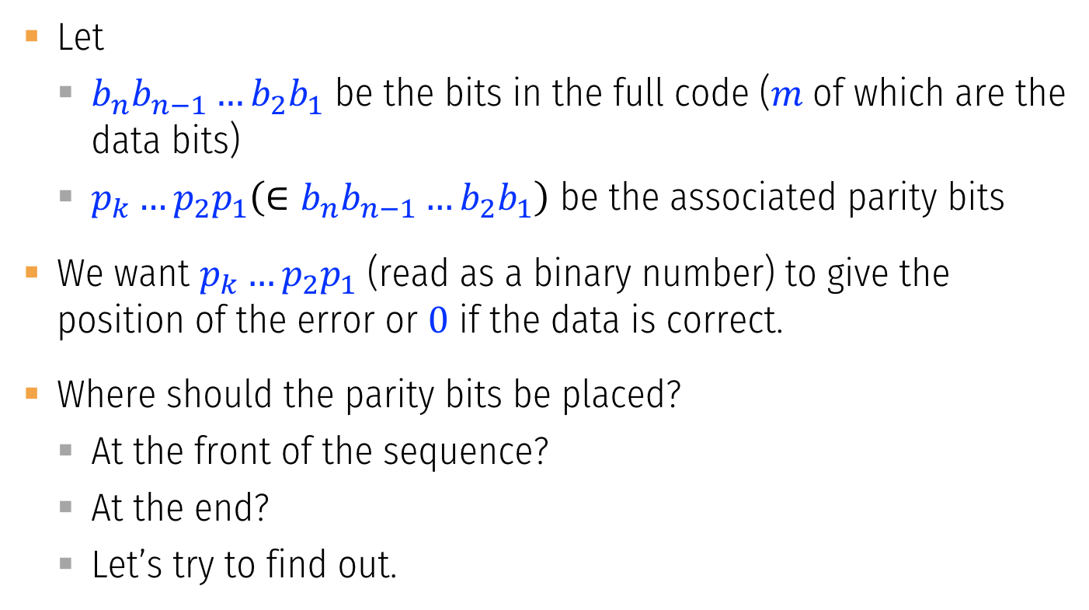
Hamming code for detecting and correcting a single error
Let
$b_{n}b_{n−1}…b_{2}b_{1}$ be the bits in the full code ($m$of which are the data bits)
$p_{k}…p_{2}p_{1}\left(∈b_{n}b_{n−1}…b_{2}b_{1}\right)$ be the associated parity bits
We want $p_{k}…p_{2}p_{1}$ (read as a binary number) to give the position of the error or $0$ if the data is correct.
Where should the parity bits be placed?
At the front of the sequence?
At the end?
Let’s try to find out.

Slide 32

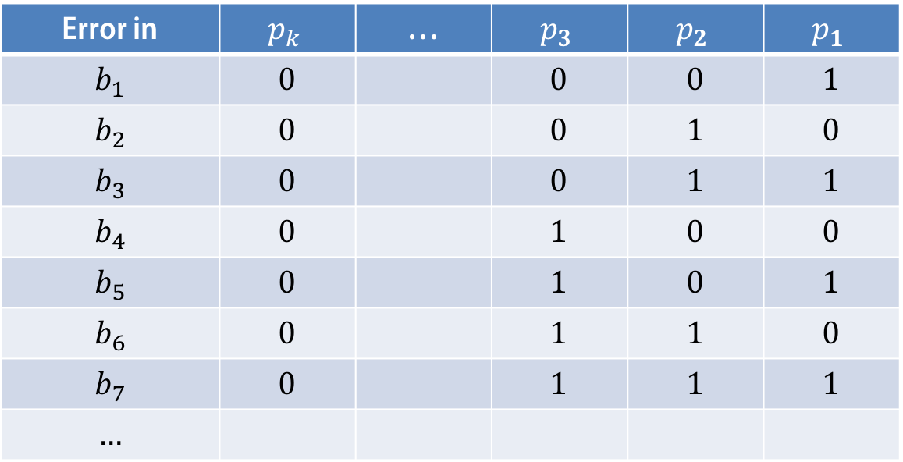
Hamming code for detecting and correcting a single error
We want $p_{k}…p_{2}p_{1}$ (read as a binary number) to give the position of the error or $0$ if the data is correct.
Error in | $$p_{k}$$ | … | $$p_{3}$$ | $$p_{2}$$ | $$p_{1}$$
$$b_{1}$$ | $$0$$ |  | $$0$$ | $$0$$ | $$1$$
$$b_{2}$$ | $$0$$ |  | $$0$$ | $$1$$ | $$0$$
$$b_{3}$$ | $$0$$ |  | $$0$$ | $$1$$ | $$1$$
$$b_{4}$$ | $$0$$ |  | $$1$$ | $$0$$ | $$0$$
$$b_{5}$$ | $$0$$ |  | $$1$$ | $$0$$ | $$1$$
$$b_{6}$$ | $$0$$ |  | $$1$$ | $$1$$ | $$0$$
$$b_{7}$$ | $$0$$ |  | $$1$$ | $$1$$ | $$1$$
$$…$$

Slide 33

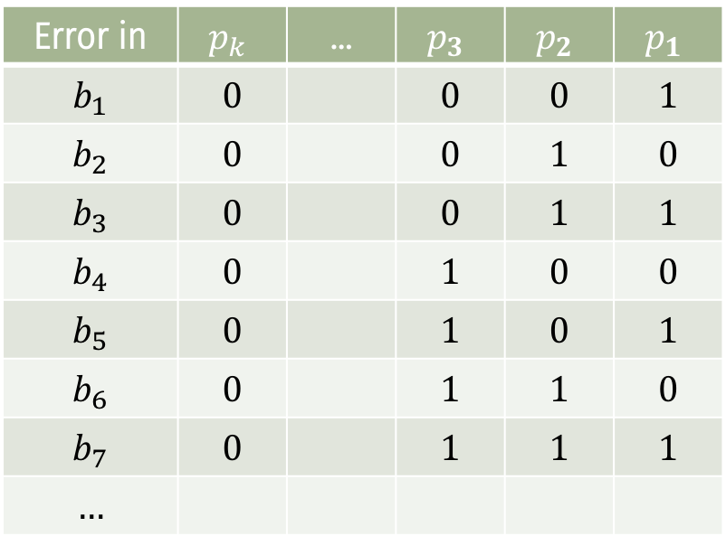
Hamming code for detecting and correcting a single error
Error in | $$p_{k}$$ | … | $$p_{3}$$ | $$p_{2}$$ | $$p_{1}$$
$$b_{1}$$ | $$0$$ |  | $$0$$ | $$0$$ | $$1$$
$$b_{2}$$ | $$0$$ |  | $$0$$ | $$1$$ | $$0$$
$$b_{3}$$ | $$0$$ |  | $$0$$ | $$1$$ | $$1$$
$$b_{4}$$ | $$0$$ |  | $$1$$ | $$0$$ | $$0$$
$$b_{5}$$ | $$0$$ |  | $$1$$ | $$0$$ | $$1$$
$$b_{6}$$ | $$0$$ |  | $$1$$ | $$1$$ | $$0$$
$$b_{7}$$ | $$0$$ |  | $$1$$ | $$1$$ | $$1$$
$$…$$
Now analyze the contribution of each bit $b_{i}$ to the code bits $p_{j}$.
Every $b_{i}$ contributes to several $p_{j}$ with the exception of $b_{1},b_{2},b_{4},…$ which contribute to exactly only one.
So, if we use positions $1, 2, 4, …$ for the parity bits, they will be independent of each other.
●

Slide 34
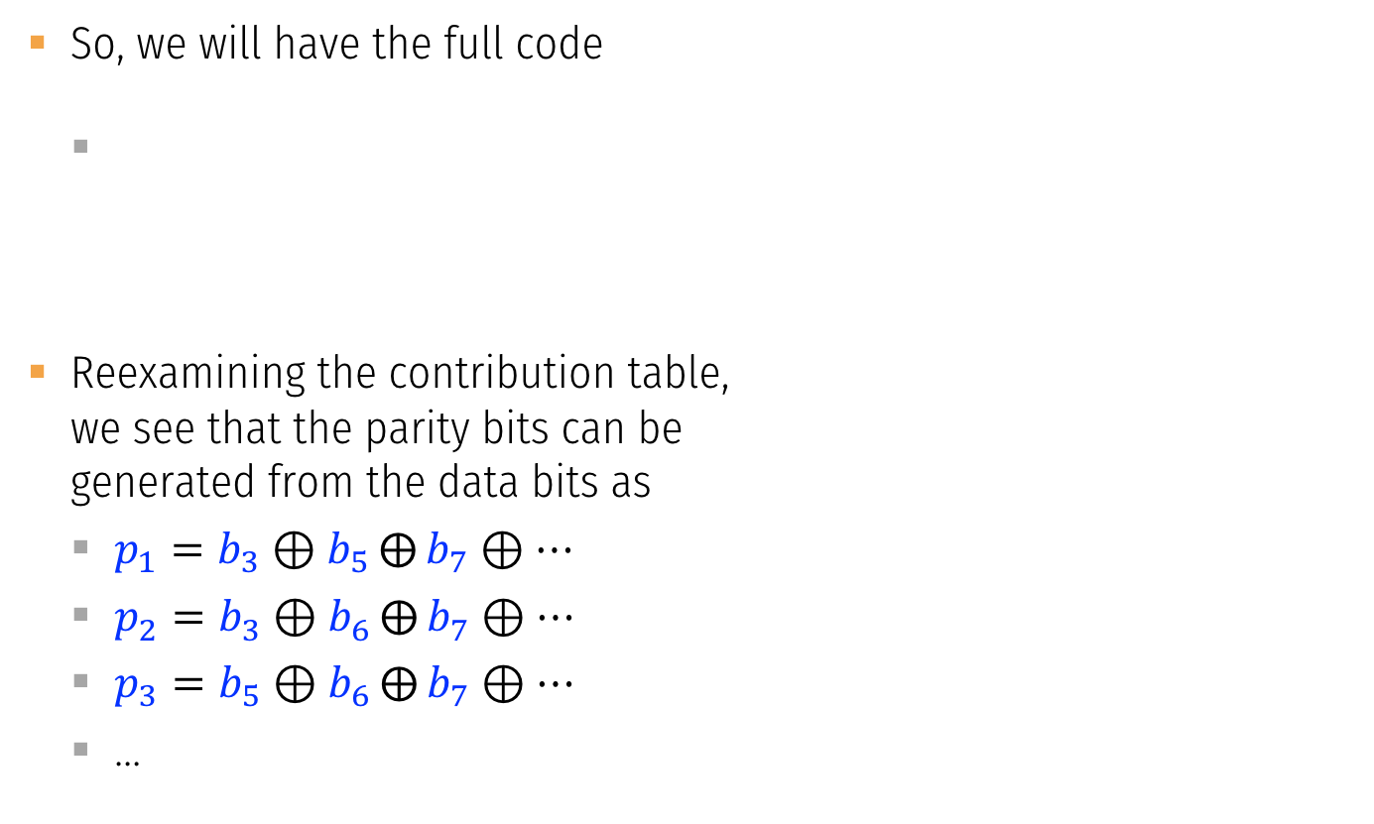
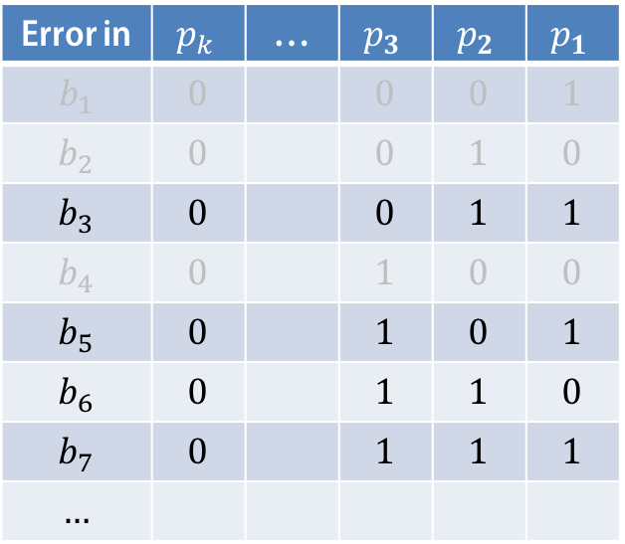
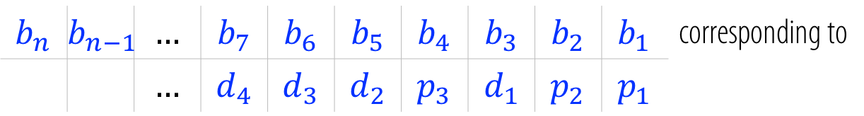
Hamming code for detecting and correcting a single error
So, we will have the full code
Reexamining the contribution table, we see that the parity bits can be generated from the data bits as
$p_{1}=b_{3}⊕b_{5}⨁{b_{7}}⊕…$
$p_{2}=b_{3}⊕b_{6}⨁{b_{7}}⊕…$
$p_{3}=b_{5}⊕b_{6}⨁{b_{7}}⊕…$
…
$$b_{n}$$ | $$b_{n−1}$$ | $$…$$ | $$b_{7}$$ | $$b_{6}$$ | $$b_{5}$$ | $$b_{4}$$ | $$b_{3}$$ | $$b_{2}$$ | $$b_{1}$$ | corresponding to
 |  | $$…$$ | $$d_{4}$$ | $$d_{3}$$ | $$d_{2}$$ | $$p_{3}$$ | $$d_{1}$$ | $$p_{2}$$ | $$p_{1}$$
Error in | $$p_{k}$$ | … | $$p_{3}$$ | $$p_{2}$$ | $$p_{1}$$
$$b_{1}$$ | $$0$$ |  | $$0$$ | $$0$$ | $$1$$
$$b_{2}$$ | $$0$$ |  | $$0$$ | $$1$$ | $$0$$
$$b_{3}$$ | $$0$$ |  | $$0$$ | $$1$$ | $$1$$
$$b_{4}$$ | $$0$$ |  | $$1$$ | $$0$$ | $$0$$
$$b_{5}$$ | $$0$$ |  | $$1$$ | $$0$$ | $$1$$
$$b_{6}$$ | $$0$$ |  | $$1$$ | $$1$$ | $$0$$
$$b_{7}$$ | $$0$$ |  | $$1$$ | $$1$$ | $$1$$
$$…$$

Slide 35
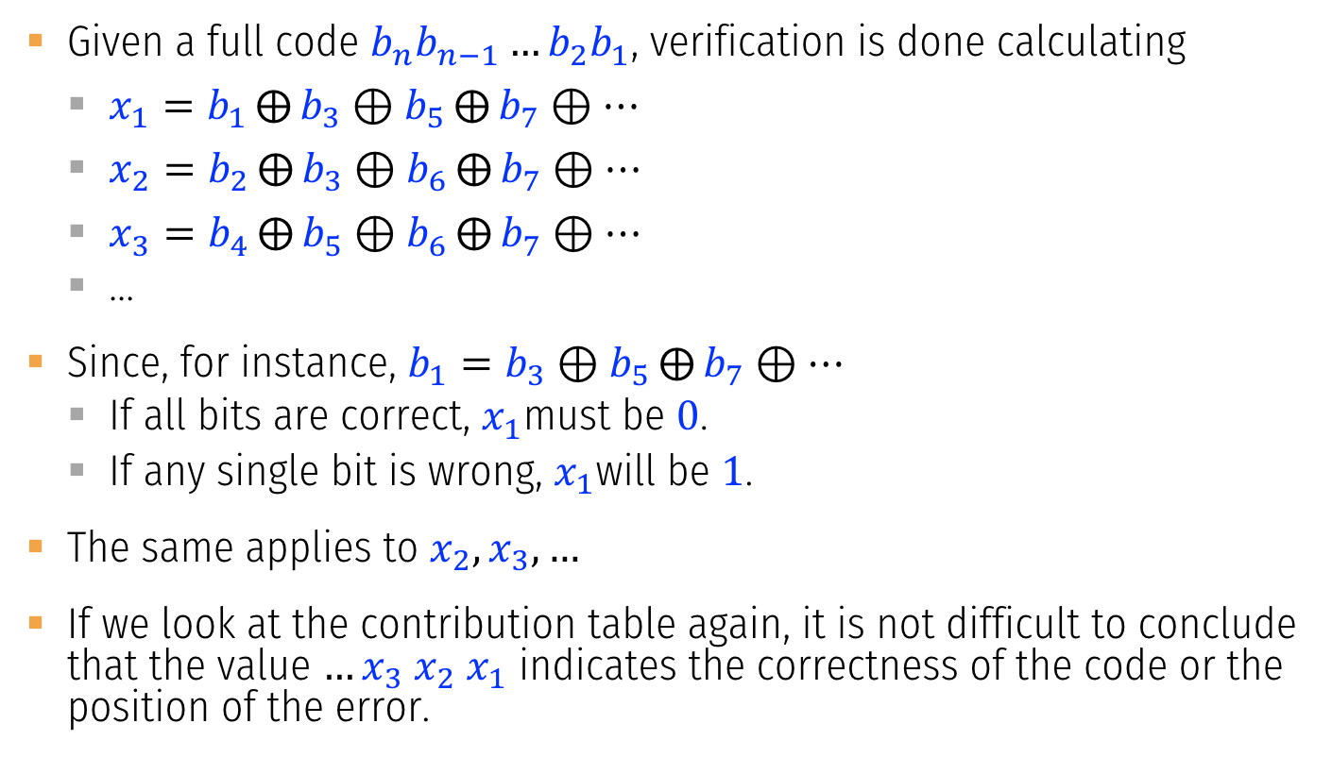
Hamming code for detecting and correcting a single error
Given a full code $b_{n}b_{n−1}…b_{2}b_{1}$, verification is done calculating
$x_{1}=b_{1}⨁{b_{3}}⊕b_{5}⨁{b_{7}}⊕…$
$x_{2}=b_{2}⨁{b_{3}}⊕b_{6}⨁{b_{7}}⊕…$
$x_{3}=b_{4}⨁{b_{5}}⊕b_{6}⨁{b_{7}}⊕…$
…
Since, for instance, $b_{1}=b_{3}⊕b_{5}⨁{b_{7}}⊕…$
If all bits are correct, $x_{1}$must be $0$.
If any single bit is wrong, $x_{1}$will be $1$.
The same applies to $x_{2},x_{3},…$
If we look at the contribution table again, it is not difficult to conclude that the value $…x_{3} x_{2} x_{1}$ indicates the correctness of the code or the position of the error.

Slide 36
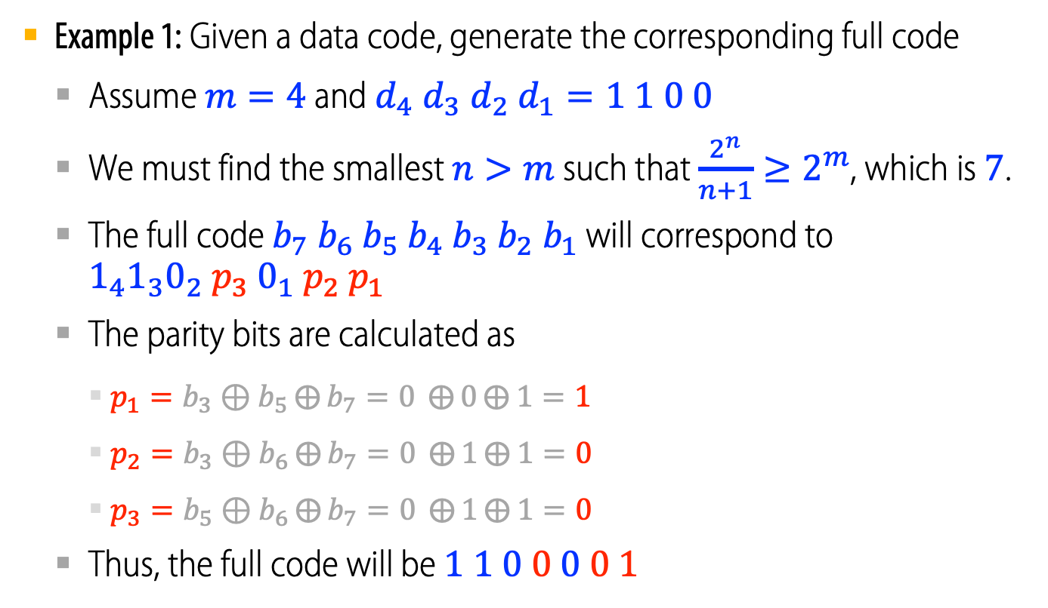
Hamming code for detecting and correcting a single error
Example 1: Given a data code, generate the corresponding full code
Assume $m=4$ and $d_{4} d_{3} d_{2} d_{1}=1 1 0 0$
We must find the smallest $n>m$ such that $\frac{2^{n}}{n+1}≥2^{m}$, which is $7$.
The full code $b_{7}{ b}_{6} b_{5} b_{4} b_{3}{ b}_{2}{ b}_{1}$ will correspond to $1_{4}1_{3}0_{2}{ p}_{3} 0_{1} p_{2} p_{1}$
The parity bits are calculated as
$p_{1}=b_{3}⊕b_{5}⨁{b_{7}}=0 ⨁{0}⨁{1}=1$
$p_{2}=b_{3}⊕b_{6}⨁{b_{7}}=0 ⨁{1}⨁{1}=0$
$p_{3}=b_{5}⊕b_{6}⨁{b_{7}}=0 ⨁{1}⨁{1}=0$
Thus, the full code will be $1 1 0 0 0 0 1$

Slide 37
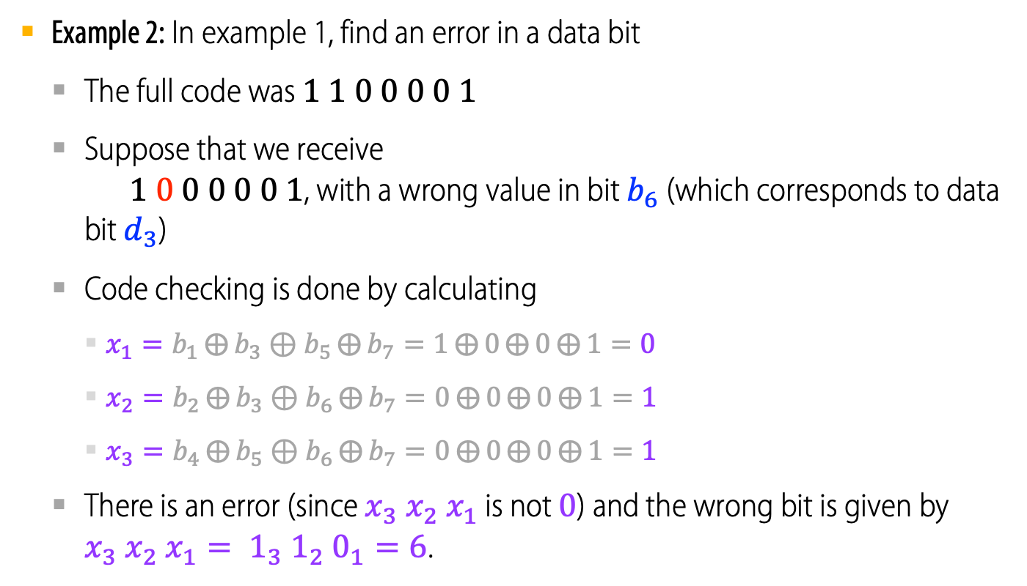
Hamming code for detecting and correcting a single error
Example 2: In example 1, find an error in a data bit
The full code was $1 1 0 0 0 0 1$
Suppose that we receive $1 0 0 0 0 0 1$, with a wrong value in bit $b_{6}$ (which corresponds to data bit $d_{3}$)
Code checking is done by calculating
$x_{1}=b_{1}⨁{b_{3}}⊕b_{5}⨁{b_{7}}=1⨁{0}⨁{0}⨁{1}=0$
$x_{2}=b_{2}⨁{b_{3}}⊕b_{6}⨁{b_{7}}=0⨁{0}⨁{0}⨁{1}=1$
$x_{3}=b_{4}⨁{b_{5}}⊕b_{6}⨁{b_{7}}=0⨁{0}⨁{0}⨁{1}=1$
There is an error (since $x_{3} x_{2} x_{1}$ is not $0$) and the wrong bit is given by $x_{3} x_{2} x_{1}= 1_{3} 1_{2} 0_{1}=6$.
●

Slide 38
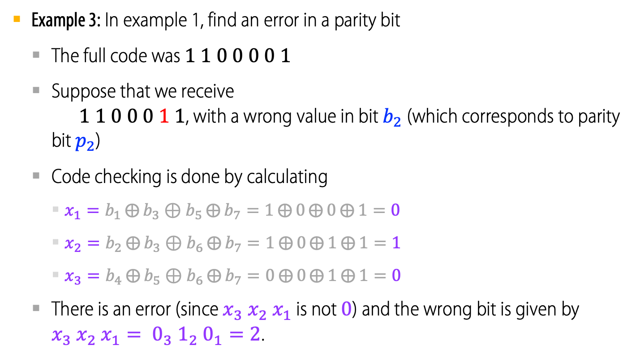
Hamming code for detecting and correcting a single error
Example 3: In example 1, find an error in a parity bit
The full code was $1 1 0 0 0 0 1$
Suppose that we receive $1 1 0 0 0 1 1$, with a wrong value in bit $b_{2}$ (which corresponds to parity bit $p_{2}$)
Code checking is done by calculating
$x_{1}=b_{1}⨁{b_{3}}⊕b_{5}⨁{b_{7}}=1⨁{0}⨁{0}⨁{1}=0$
$x_{2}=b_{2}⨁{b_{3}}⊕b_{6}⨁{b_{7}}=1⨁{0}⨁{1}⨁{1}=1$
$x_{3}=b_{4}⨁{b_{5}}⊕b_{6}⨁{b_{7}}=0⨁{0}⨁{1}⨁{1}=0$
There is an error (since $x_{3} x_{2} x_{1}$ is not $0$) and the wrong bit is given by $x_{3} x_{2} x_{1}= 0_{3} 1_{2} 0_{1}=2$.
●

