Slide 1
File System Implementation
T30
40
14 de novembro de 2018

Slide 2
How to implement a simple file system
How can we build a simple file system?
What structures are needed on the disk?
What do they need to track?
How are they accessed?

Slide 3
The Way To Think
To implement a file system, there are two main aspects to think about
Data structures
What types of on-disk structures does the file system need to organize its data and metadata?
Access methods
How does a file system map the calls made by a process, such as open(), read(), write(), etc., onto its structures?
Which structures are read during the execution of a particular system call?
Which structures are written?
How do such operations affect the performance of an application?

Slide 4
Overall Organization
Let’s develop the overall on-disk organization of a very simple file system’s data structures.
Assume we have a very small disk with only 256KB.
Let’s divide it into 4KB blocks.
In this case, there will be 64 blocks, numbered from 0 to 63.
0 |  |  |  |  |  |  | 7 |  | 8 |  |  |  |  |  |  | 15 |  | 16 |  |  |  |  |  |  | 23 |  | 24 |  |  |  |  |  |  | 31
32 |  |  |  |  |  |  | 39 |  | 40 |  |  |  |  |  |  | 47 |  | 48 |  |  |  |  |  |  | 55 |  | 56 |  |  |  |  |  |  | 63

Slide 5
Data region in the file system
A large fixed region of the disk should be reserved to store user data.
Let’s use the last 56 of the 64 blocks for that.
What do we need next?
The file system must track which data blocks belong to a file, the size of the file, its owner and their access rights, last access and modify times, etc.
Such information is usually stored on a structure called an inode.
Data Region
0 |  |  |  |  |  |  | 7 |  | 8 |  |  |  |  |  |  | 15 |  | 16 |  |  |  |  |  |  | 23 |  | 24 |  |  |  |  |  |  | 31
32 |  |  |  |  |  |  | 39 |  | 40 |  |  |  |  |  |  | 47 |  | 48 |  |  |  |  |  |  | 55 |  | 56 |  |  |  |  |  |  | 63
 |  |  |  |  |  |  |  |  | D | D | D | D | D | D | D | D |  | D | D | D | D | D | D | D | D |  | D | D | D | D | D | D | D | D
0 |  |  |  |  |  |  | 7 |  | 8 |  |  |  |  |  |  | 15 |  | 16 |  |  |  |  |  |  | 23 |  | 24 |  |  |  |  |  |  | 31
D | D | D | D | D | D | D | D |  | D | D | D | D | D | D | D | D |  | D | D | D | D | D | D | D | D |  | D | D | D | D | D | D | D | D
32 |  |  |  |  |  |  | 39 |  | 40 |  |  |  |  |  |  | 47 |  | 48 |  |  |  |  |  |  | 55 |  | 56 |  |  |  |  |  |  | 63
Data Region

Slide 6
Inode table in the file system
Let’s assume an inode occupies 256B and reserve some space for an inode table, which will hold an array of on-disk inodes.
Let’s use 5 blocks (say 3 to 7) for the inode table.
Since a 4KB block can hold 16 inodes, the file system may contain up to 80 files.
Is there anything still missing in our design?
inodes
Data Region
 |  |  |  |  |  |  |  |  | D | D | D | D | D | D | D | D |  | D | D | D | D | D | D | D | D |  | D | D | D | D | D | D | D | D
0 |  |  |  |  |  |  | 7 |  | 8 |  |  |  |  |  |  | 15 |  | 16 |  |  |  |  |  |  | 23 |  | 24 |  |  |  |  |  |  | 31
D | D | D | D | D | D | D | D |  | D | D | D | D | D | D | D | D |  | D | D | D | D | D | D | D | D |  | D | D | D | D | D | D | D | D
32 |  |  |  |  |  |  | 39 |  | 40 |  |  |  |  |  |  | 47 |  | 48 |  |  |  |  |  |  | 55 |  | 56 |  |  |  |  |  |  | 63
 |  |  | I | I | I | I | I |  | D | D | D | D | D | D | D | D |  | D | D | D | D | D | D | D | D |  | D | D | D | D | D | D | D | D
0 |  |  |  |  |  |  | 7 |  | 8 |  |  |  |  |  |  | 15 |  | 16 |  |  |  |  |  |  | 23 |  | 24 |  |  |  |  |  |  | 31
D | D | D | D | D | D | D | D |  | D | D | D | D | D | D | D | D |  | D | D | D | D | D | D | D | D |  | D | D | D | D | D | D | D | D
32 |  |  |  |  |  |  | 39 |  | 40 |  |  |  |  |  |  | 47 |  | 48 |  |  |  |  |  |  | 55 |  | 56 |  |  |  |  |  |  | 63
Data Region

Slide 7
Allocation structures
We need some allocation structures to track whether inodes or data blocks are free or allocated.
Of course, there are many possible allocation-tracking methods, e.g.
A free list that points to the first free block, which then points to the next free block, and so forth.
A simple structure called a bitmap, where each bit is used to indicate whether the corresponding object/block is free (0) or in-use (1).
In our example, we will take the bitmap approach.

Slide 8
Allocation structures
Let’s use two bitmaps, one for the inodes (i) and another for the data (d).
We will reserve one block for each.
What do you think about the size of our bitmaps?
Is there anything still missing in our design?
inodes
Data Region
 |  |  | I | I | I | I | I |  | D | D | D | D | D | D | D | D |  | D | D | D | D | D | D | D | D |  | D | D | D | D | D | D | D | D
0 |  |  |  |  |  |  | 7 |  | 8 |  |  |  |  |  |  | 15 |  | 16 |  |  |  |  |  |  | 23 |  | 24 |  |  |  |  |  |  | 31
D | D | D | D | D | D | D | D |  | D | D | D | D | D | D | D | D |  | D | D | D | D | D | D | D | D |  | D | D | D | D | D | D | D | D
32 |  |  |  |  |  |  | 39 |  | 40 |  |  |  |  |  |  | 47 |  | 48 |  |  |  |  |  |  | 55 |  | 56 |  |  |  |  |  |  | 63
 | i | d | I | I | I | I | I |  | D | D | D | D | D | D | D | D |  | D | D | D | D | D | D | D | D |  | D | D | D | D | D | D | D | D
0 |  |  |  |  |  |  | 7 |  | 8 |  |  |  |  |  |  | 15 |  | 16 |  |  |  |  |  |  | 23 |  | 24 |  |  |  |  |  |  | 31
D | D | D | D | D | D | D | D |  | D | D | D | D | D | D | D | D |  | D | D | D | D | D | D | D | D |  | D | D | D | D | D | D | D | D
32 |  |  |  |  |  |  | 39 |  | 40 |  |  |  |  |  |  | 47 |  | 48 |  |  |  |  |  |  | 55 |  | 56 |  |  |  |  |  |  | 63
Data Region

Slide 9
The superblock
We still need a superblock containing information about the file system, including the number of inodes and data blocks, the location of the inode table and the data region, etc.
When mounting a file system, the OS will read the superblock first to initialize various parameters before attaching the volume to the file-system tree.
This completes the design of the layout of our very simple file system.
inodes
Data Region
S | i | d | I | I | I | I | I |  | D | D | D | D | D | D | D | D |  | D | D | D | D | D | D | D | D |  | D | D | D | D | D | D | D | D
0 |  |  |  |  |  |  | 7 |  | 8 |  |  |  |  |  |  | 15 |  | 16 |  |  |  |  |  |  | 23 |  | 24 |  |  |  |  |  |  | 31
D | D | D | D | D | D | D | D |  | D | D | D | D | D | D | D | D |  | D | D | D | D | D | D | D | D |  | D | D | D | D | D | D | D | D
32 |  |  |  |  |  |  | 39 |  | 40 |  |  |  |  |  |  | 47 |  | 48 |  |  |  |  |  |  | 55 |  | 56 |  |  |  |  |  |  | 63
Data Region

Slide 10
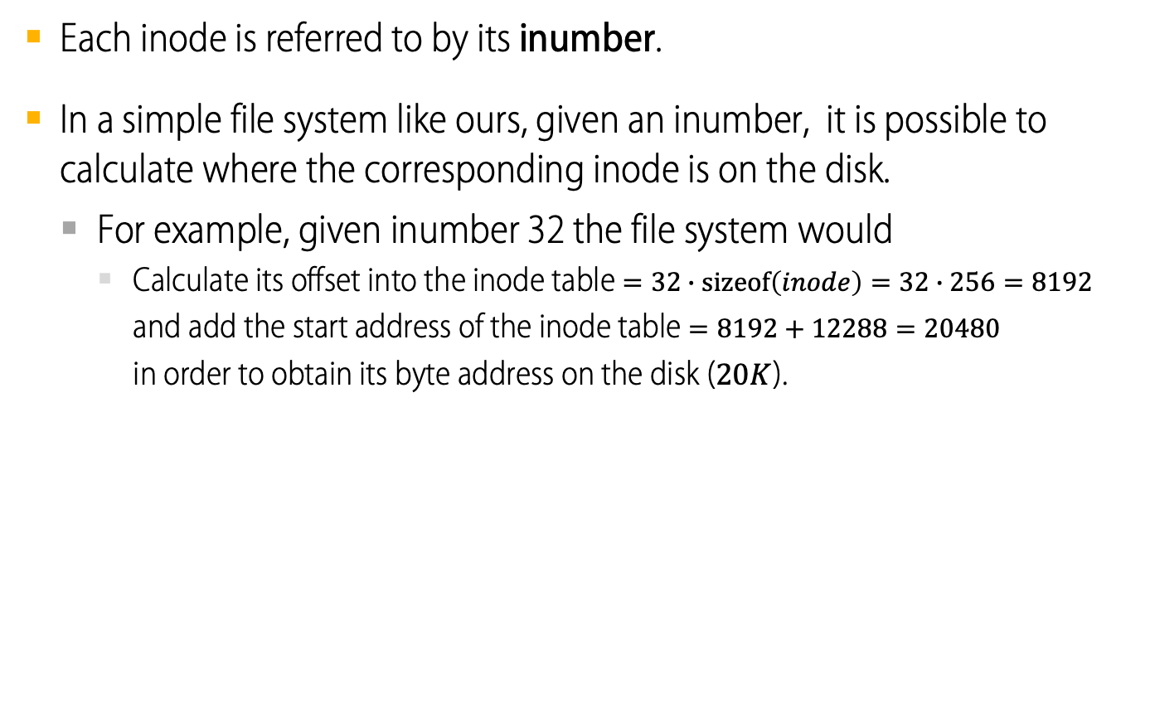
File Organization: inodes
Each inode is referred to by its inumber.
In a simple file system like ours, given an inumber, it is possible to calculate where the corresponding inode is on the disk.
For example, given inumber 32 the file system would
Calculate its offset into the inode table $=32∙\text{sizeof}\left(inode\right)=32∙256=8192$
and add the start address of the inode table $=8192+12288=20480$
in order to obtain its byte address on the disk ($20K$).
0KB | 4KB | 8KB | 12KB |  |  |  | 16KB |  |  |  | 20KB |  |  |  | 24KB |  |  |  | 28KB
superblock | inode bitmap | data bitmap | 0 | 1 | 2 | 3 | 16 | 17 | 18 | 19 | 32 | 33 | 34 | 35 | 48 | 49 | 50 | 51 | 64 | 65 | 66 | 67
 |  |  | 4 | 5 | 6 | 7 | 20 | 21 | 22 | 23 | 36 | 37 | 38 | 39 | 52 | 53 | 54 | 55 | 68 | 69 | 70 | 71
 |  |  | 8 | 9 | 10 | 11 | 24 | 25 | 26 | 27 | 40 | 41 | 42 | 43 | 56 | 57 | 58 | 59 | 72 | 73 | 74 | 75
 |  |  | 12 | 13 | 14 | 15 | 28 | 29 | 30 | 31 | 44 | 45 | 46 | 47 | 60 | 61 | 62 | 63 | 76 | 77 | 78 | 79
 |  |  | iblock 0 |  |  |  | iblock 1 |  |  |  | iblock 2 |  |  |  | iblock 3 |  |  |  | iblock 4

Slide 11
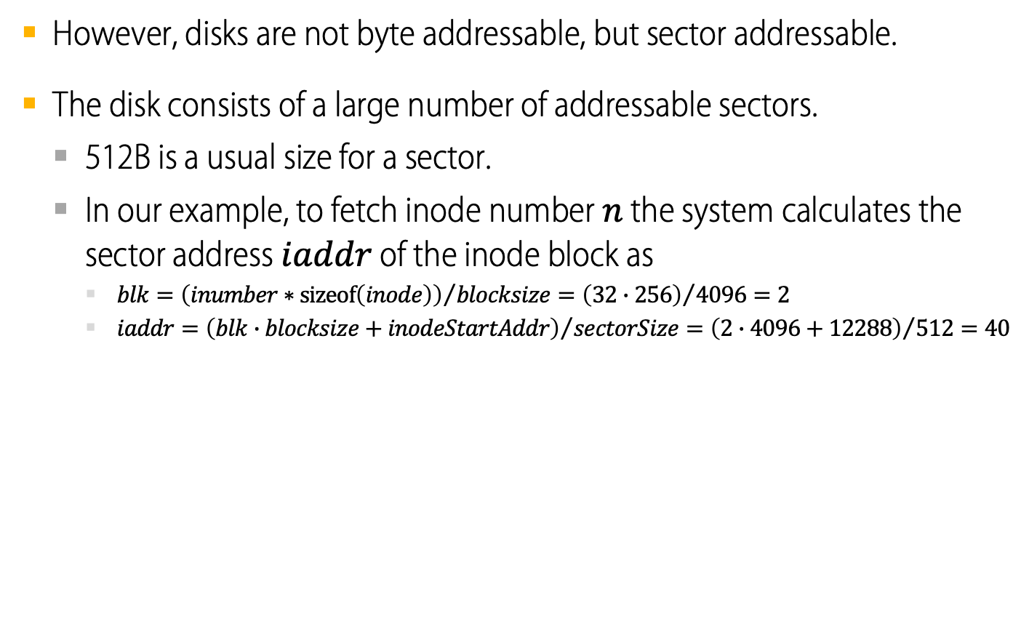
File Organization: inodes
However, disks are not byte addressable, but sector addressable.
The disk consists of a large number of addressable sectors.
512B is a usual size for a sector.
In our example, to fetch inode number $n$ the system calculates the sector address $iaddr$ of the inode block as
$blk={\left(inumber∗\operatorname{sizeof}\left(inode\right)\right)}/{blocksize}={\left(32∙256\right)}/{4096}=2$
$iaddr={\left(blk∙blocksize+inodeStartAddr\right)}/{sectorSize}={\left(2∙4096+12288\right)}/{512=40}$
0KB | 4KB | 8KB | 12KB |  |  |  | 16KB |  |  |  | 20KB |  |  |  | 24KB |  |  |  | 28KB
superblock | inode bitmap | data bitmap | 0 | 1 | 2 | 3 | 16 | 17 | 18 | 19 | 32 | 33 | 34 | 35 | 48 | 49 | 50 | 51 | 64 | 65 | 66 | 67
 |  |  | 4 | 5 | 6 | 7 | 20 | 21 | 22 | 23 | 36 | 37 | 38 | 39 | 52 | 53 | 54 | 55 | 68 | 69 | 70 | 71
 |  |  | 8 | 9 | 10 | 11 | 24 | 25 | 26 | 27 | 40 | 41 | 42 | 43 | 56 | 57 | 58 | 59 | 72 | 73 | 74 | 75
 |  |  | 12 | 13 | 14 | 15 | 28 | 29 | 30 | 31 | 44 | 45 | 46 | 47 | 60 | 61 | 62 | 63 | 76 | 77 | 78 | 79
 |  |  | iblock 0 |  |  |  | iblock 1 |  |  |  | iblock 2 |  |  |  | iblock 3 |  |  |  | iblock 4

Slide 12
File Organization: The inode
The inode has all the information about a file
File type (regular file, directory, etc)
Size and the number of blocks allocated to it
Protection information (who owns the file, who can access, etc)
Time information
Etc

Slide 13
File Organization: The inode (Cont.)
Size Name What is this inode field for?
2 mode can this file be read/written/executed?
2 uid who owns this file?
4 size how many bytes are in this file?
4 time what time was this file last accessed?
4 ctime what time was this file created?
4 mtime what time was this file last modified?
4 dtime what time was this inode deleted?
4 gid which group does this file belong to?
2 links_count how many hard links are there to this file?
2 blocks how many blocks have been allocated to this file?
4 flags how should ext2 use this inode?
4 osd1 an OS-dependent field
60 block a set of disk pointers (15 total)
4 generation file version (used by NFS)
4 file_acl a new permissions model beyond mode bits
4 dir_acl called access control lists
4 faddr an unsupported field
12 i_osd2 another OS-dependent field
The EXT2 Inode

Slide 14
The inode
Size | Name | What is this inode field for?
2 | mode | can this file be read/written/executed?
2 | uid | who owns this file?
4 | size | how many bytes are in this file?
4 | time | what time was this file last accessed?
4 | ctime | what time was this file created?
4 | mtime | what time was this file last modified?
4 | dtime | what time was this inode deleted?
4 | gid | which group does this file belong to?
2 | links_count | how many hard links are there to this file?
2 | blocks | how many blocks have been allocated to this file?
4 | flags | how should ext2 use this inode?
4 | osd1 | an OS-dependent field
60 | block | a set of disk pointers (15 total)
4 | generation | file version (used by NFS)
4 | file_acl | a new permissions model beyond mode bits
4 | dir_acl | called access control lists
4 | faddr | an unsupported field
12 | i_osd2 | another OS-dependent field
The inode holds virtually all the information you need about a file.
The table on the left shows the structure of a simplified Ext2 inode.
Look at the highlighted row.
What can you do with it?
What files can you address with 60 blocks?

Slide 15
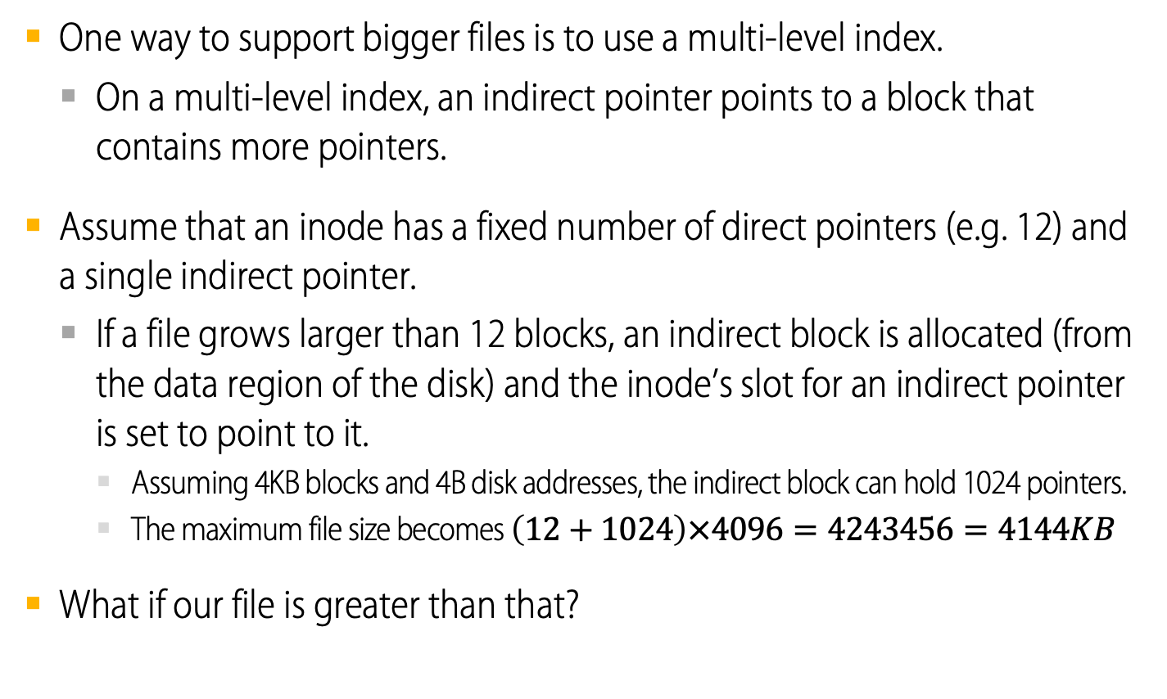
Multi-Level Index
One way to support bigger files is to use a multi-level index.
On a multi-level index, an indirect pointer points to a block that contains more pointers.
Assume that an inode has a fixed number of direct pointers (e.g. 12) and a single indirect pointer.
If a file grows larger than 12 blocks, an indirect block is allocated (from the data region of the disk) and the inode’s slot for an indirect pointer is set to point to it.
Assuming 4KB blocks and 4B disk addresses, the indirect block can hold 1024 pointers.
The maximum file size becomes $\left(12+1024\right)×4096=4243456=4144KB$
What if our file is greater than that?

Slide 16
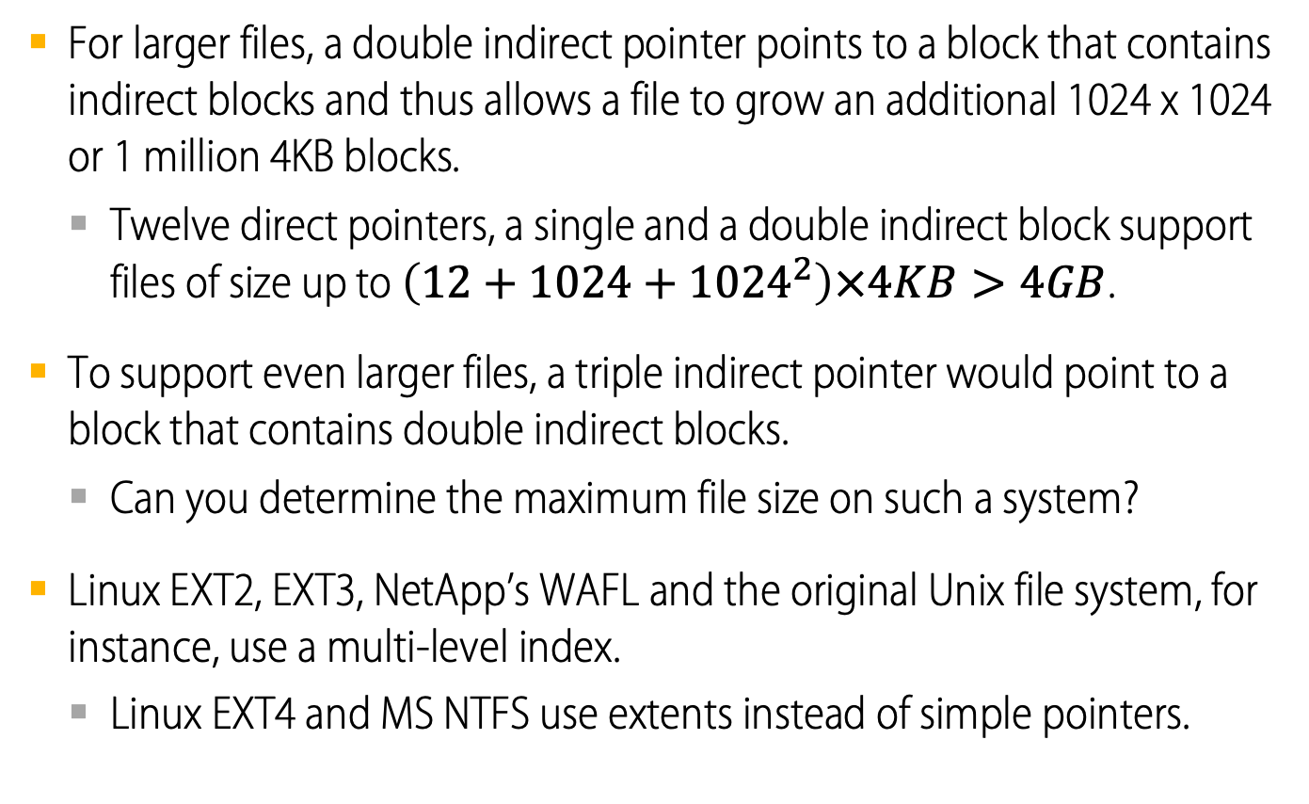
Multi-Level Index
For larger files, a double indirect pointer points to a block that contains indirect blocks and thus allows a file to grow an additional 1024 x 1024 or 1 million 4KB blocks.
Twelve direct pointers, a single and a double indirect block support files of size up to $\left(12+1024+{1024}^{2}\right)×4KB>4GB$.
To support even larger files, a triple indirect pointer would point to a block that contains double indirect blocks.
Can you determine the maximum file size on such a system?
Linux EXT2, EXT3, NetApp’s WAFL and the original Unix file system, for instance, use a multi-level index.
Linux EXT4 and MS NTFS use extents instead of simple pointers.

Slide 17
Multi-Level Index

Slide 18
What are extents?
An extent is simply a disk pointer plus a length (in blocks).
Instead of a pointer for each block, only a pointer and a length are needed to specify the on-disk location of a file.
Just one single extent is limiting, because it may be difficult to find a large-enough contiguous chunk of on-disk free space when allocating a file.
To give the file system more freedom during file allocation, extent-based file systems often allow for more than one extent.
In comparing the two models…
Pointer-based approaches are the most flexible but use a large amount of metadata per file (particularly for large files).
Extent-based approaches are less flexible but more compact.
They work particularly well when there is enough free space on the disk and files can be laid out contiguously.

Slide 19
NTFS index structure

Slide 20
NTFS index structure

Slide 21
NTFS index structure

Slide 22
NTFS index structure

Slide 23
The Multi-Level Index
Why use such an imbalanced tree? Why not a different approach?
Most files are small, so it makes sense to optimize for this case. Look at the table below.
However, many other possibilities exist; after all, the inode is just a data structure...
Microsoft, for instance, has been working on a proprietary Resilient File System (ReFS), codenamed "Protogon", with the intent of becoming the "next generation" file system after NTFS for quite some time.
Agrawal’s File System Measurement Summary (2007)
Most files are small | Roughly 2K is the most common size
Average file size is growing | Almost 200K is the average
Most bytes are stored in large files | A few big files use most of the space
File systems contains lots of files | Almost 100K on average
File systems are roughly half full | Even as disks grow, file system remain -50% full
Directories are typically small | Many have few entries; most have 20 or fewer

Slide 24
Directory Organization
Directory contains a list of (entry name, inode number) pairs.
Each directory has two extra files “.” (dot) for the current directory and “..” (dot-dot) for the parent directory.
For example, assume a directory dir (inode number 5) with three files in it (foo, bar, and foobar, with inode numbers 12, 13, and 24, respectively).
The on-disk data for dir might look like this, where each entry shows the inode number (inum), record length (reclen, the total bytes for the name plus any left-over space), string length (strlen, the actual length of the name), and finally the name of the entry (name).
inum | reclen | strlen | name
5 | 4 | 2 | .
2 | 4 | 3 | ..
12 | 4 | 4 | foo
13 | 4 | 4 | bar
24 | 8 | 7 | foobar

Slide 25
Where are directories stored?
Directories are often treated as a special type of file.
For exemple, a directory may have an inode, somewhere in the inode table, with the type field of the inode marked as “directory” instead of “regular file”.
The directory has data blocks pointed to by the inode (and perhaps, indirect blocks) which live in the data block region of our simple file system.
Our on-disk structure thus remains unchanged.
A simple linear list of entries is not the only way to store directory information.
For example, XFS stores directories in B-tree form, making file create operations faster than in systems with simple lists that must be scanned in their entirety.

Slide 26
How to manage free space?
The file system must track whether inodes and data blocks are free.
There are many ways to manage free space.
Some early file systems used linked lists of free blocks.
Modern file systems use more sophisticated data structures, e.g. B-trees.
In our example, we have used two simple bitmaps.
When creating a file, the file system will search the bitmap for a free inode, allocate it to the file; mark it as used and update the on-disk bitmap.
A similar sequence of activities takes place when a data block is allocated.
Allocating data blocks for a new file also brings other concerns.
For example, some Linux file systems, such as ext2 and ext3, will look for a sequence of blocks (say 8) that are free when a new file is created.
This guarantees that at least a portion of the file will be contiguous on the disk, thus improving performance.
Such a pre-allocation policy is a commonly-used heuristic when allocating space for data blocks.

Slide 27
Access Paths: Reading a File From Disk
Issue an open(“/foo/bar”, O_RDONLY),
Traverse the pathname and thus locate the desired indoe.
Begin at the root of the file system (/)
In most Unix file systems, the root inode number is 2
Filesystem reads in the block that contains inode number 2.
Look inside of it to find pointer to data blocks (contents of the root).
By reading in one or more directory data blocks, It will find “foo” directory.
Traverse recursively the path name until the desired inode (“bar”)
Check finale permissions, allocate a file descriptor for this process and returns file descriptor to user.

Slide 28
Access paths
Now that we have an idea of how files and directories are stored on disk, we can discuss the flow of operations while reading or writing a file.
For the following examples, let us assume that
The file system has been mounted and thus the superblock is already in memory.
Everything else (i.e., inodes, directories) is still on the disk.
The file reading example also assumes that a file /foo/bar (just 12KB in size, i.e., 3 blocks) must be opened, read and then closed.
The file writing example will go through the steps needed to create that file.

Slide 29
Reading a File Timeline
 | data bitmap | inode bitmap | root inode | foo inode | bar inode | root data | foo data | bar data[0] | bar data[1] | bar data[2]
open(bar) |  |  | read
 |  |  |  |  |  | read
 |  |  |  | read
 |  |  |  |  |  |  | read
 |  |  |  |  | read
read() |  |  |  |  | read
 |  |  |  |  |  |  |  | read
 |  |  |  |  | write
read() |  |  |  |  | read
 |  |  |  |  |  |  |  |  | read
 |  |  |  |  | write
read() |  |  |  |  | read
 |  |  |  |  |  |  |  |  |  | read
 |  |  |  |  | write
read
read
read
read
read
read
read
write
read
read
write
read
read
write
time

Slide 30
Opening the file
Reading a File From Disk
Issue an open(“/foo/bar”, O_RDONLY)
The system must traverse the pathname and locate the desired inode.
It begins at the root of the file system (/)
In most Unix file systems, the root inode number is 2
File system reads in the block that contains inode number 2.
It looks inside it to find pointer to data blocks (contents of the root).
By reading one or more directory data blocks, it will find “foo” directory.
Traverse recursively the path name until the desired inode (“bar”)
Read bar’s inode into memory, check permissions, allocate a file descriptor for this process and returns the file descriptor to the user.

Slide 31
Reading and closing the file
Reading a File From Disk
Issue read() to read from the file.
Read in the first block of the file, consulting the inode to find the location of such a block.
Update the inode with a new last-accessed time.
Update in-memory open file table for file descriptor, the file offset.
When file is closed…
File descriptor should be deallocated, and that is all the file system really needs to do.
No disk I/Os take place.

Slide 32
Reading a File Timeline
 | data bitmap | inode bitmap | root inode | foo inode | bar inode | root data | foo data | bar data[0] | bar data[1] | bar data[2]
open(bar) |  |  | read
 |  |  |  |  |  | read
 |  |  |  | read
 |  |  |  |  |  |  | read
 |  |  |  |  | read
read() |  |  |  |  | read
 |  |  |  |  |  |  |  | read
 |  |  |  |  | write
read() |  |  |  |  | read
 |  |  |  |  |  |  |  |  | read
 |  |  |  |  | write
read() |  |  |  |  | read
 |  |  |  |  |  |  |  |  |  | read
 |  |  |  |  | write
read
read
read
read
read
read
read
write
read
read
write
read
read
write
time

Slide 33
Writing to file timeline
 | data bitmap | inode bitmap | root inode | foo inode | bar inode | root data | foo data | bar data[0] | bar data[1] | bar data[2]
create (/foo/bar) |  |  | read
 |  |  |  |  |  | read
 |  |  |  | read
 |  |  |  |  |  |  | read
 |  | read
 |  | write
 |  |  |  |  |  |  | write
 |  |  |  |  | read
 |  |  |  |  | write
 |  |  |  | write
write() |  |  |  |  | read
 | read
 | write
 |  |  |  |  |  |  |  | write
 |  |  |  |  | write
write() |  |  |  |  | read
 | read
 | write
 |  |  |  |  |  |  |  |  | write
 |  |  |  |  | write
write() |  |  |  |  | read
 | read
 | write
 |  |  |  |  |  |  |  |  |  | write
 |  |  |  |  | write
read
read
read
read
read
write
write
read
write
write
read
read
write
write
write
read
read
write
write
write
read
read
write
time
write
write
Notes:
write

Slide 34
Writing to Disk
Issue write() to update the file with new contents.
File may allocate a block (unless the block is being overwritten).
Need to update data block, data bitmap.
It generates five I/Os:
one to read the data bitmap
one to write the bitmap (to reflect its new state to disk)
two more to read and then write the inode
one to write the actual block itself.
To create a file, it also allocates space for the directory, causing high I/O traffic.

Slide 35
Writing to file timeline
 | data bitmap | inode bitmap | root inode | foo inode | bar inode | root data | foo data | bar data[0] | bar data[1] | bar data[2]
create (/foo/bar) |  |  | read
 |  |  |  |  |  | read
 |  |  |  | read
 |  |  |  |  |  |  | read
 |  | read
 |  | write
 |  |  |  |  |  |  | write
 |  |  |  |  | read
 |  |  |  |  | write
 |  |  |  | write
write() |  |  |  |  | read
 | read
 | write
 |  |  |  |  |  |  |  | write
 |  |  |  |  | write
write() |  |  |  |  | read
 | read
 | write
 |  |  |  |  |  |  |  |  | write
 |  |  |  |  | write
write() |  |  |  |  | read
 | read
 | write
 |  |  |  |  |  |  |  |  |  | write
 |  |  |  |  | write
read
read
read
read
read
write
write
read
write
write
read
read
write
write
write
read
read
write
write
write
read
read
write
time
write
write
Notes:
write

Slide 36
Caching and Buffering
Reading and writing files are expensive, incurring many I/Os.
For example, long pathname (/1/2/3/…./100/file.txt)
One to read the inode of the directory and at least one read its data.
Literally perform hundreds of reads just to open the file.
In order to reduce I/O traffic, file systems aggressively use system memory (DRAM) to cache.
Early file systems used fixed-size cache to hold popular blocks.
Static partitioning of memory can be wasteful.
Modem systems use dynamic partitioning approach, unified page cache.
Excessive read I/O can be avoided by large cache.

Slide 37
Caching and Buffering
Write traffic has to go to disk for persistency and cannot be reduced by caching.
File systems use write buffering for write performance benefits.
Delaying writes (file system batches some updates into a smaller set of I/Os).
By buffering several writes in memory, the file system can then schedule subsequent I/Os and thus increase performance.
By avoiding writes.
Some applications force data flushing to disk by calling fsync() or doing direct I/O.

