Slide 1
CPU Virtualization: Scheduling Proportional Share
T06
Ch.9 of Operating Systems: Three Easy Pieces by Remzi and Andrea Arpaci-Dusseau (pages.cs.wisc.edu/~remzi/OSTEP/)
20 de agosto de 2018

Slide 2
Proportional Share Scheduler
Also referred to as a fair-share scheduler
Tries to guarantee that each job obtains a certain percentage of CPU time.
Is not optimized for turnaround or response time.
We will discuss two implementations
Lottery scheduling
Stride scheduling

Slide 3
How can we design a scheduler to share the CPU in a proportional manner?
What are the key mechanisms for doing so?
How effective are they?

Slide 4
Basic Concept
Tickets are the basic concept underlying proportional-share scheduling:
Indicate the relative amount of a resource that a process should receive.
The percent of tickets that a process holds represents its share of the system resource in question.
Example
There are two processes, A and B, in a system with 40 tickets.
Process A has 30 tickets → it is supposed to receive 75% of the CPU
Process B has 10 tickets → it is supposed to receive 25% of the CPU
Lottery scheduling achieves this probabilistically (but not deterministically) by holding a lottery every so often (say, every time slice).

Slide 5
Lottery scheduling
The scheduler knows how many tickets are in the system.
The scheduler picks a winning ticket, loads the state of that winning process and runs it.
Example
There are 100 tickets
Process A has 75 tickets (0 → 74) and Process B has 25 tickets (75 → 99).
Randomness leads to probabilistic correctness but no guarantee.
In the example, B got 20% of CPU time instead of desired 25%.
Winning tickets | 63 | 85 | 70 | 39 | 76 | 17 | 29 | 41 | 36 | 39 | 10 | 99 | 68 | 83 | 63 | 62 | 43 | 0 | 49 | 49
Resulting schedule | A |  | A | A |  | A | A | A | A | A | A |  | A |  | A | A | A | A | A | A
 |  | B |  |  | B |  |  |  |  |  |  | B |  | B

Slide 6
Ticket Mechanisms
Ticket currency
Users allocate tickets among their own jobs in whatever currency they would like.
The system converts user’s currency into a meaningful global value.
Example
The system will share 200 tickets equally among users A and B.
User A runs two jobs A1 and A2 and has given 30 tickets to A1 and 20 to A2 (A’s currency).
User B is running only one job B1 and has given it 10 tickets (B’s currency).

Slide 7
Ticket Mechanisms (Cont.)
Ticket transfer
A process can temporarily hand off its tickets to another process.
Especially useful in a client/server setting, where a client can transfer its tickets to a server to increase its share of CPU time while it does some work on the client’s behalf.
Ticket inflation
This makes sense only in a cooperative scenario, where processes trust one another.
A process can temporarily raise or lower the number of tickets it owns.
If any one process needs more CPU time, it can boost its tickets and get its share increased without any communication with other processes.

Slide 8
Implementation
Requirements
Good random number generator to pick the winning tickets
A data structure to track the processes in the system
The total number of tickets
Example:
There are three processes, A, B, and C, kept in a list.
To make a decision, the scheduler picks a random number (the winner) from the total number of tickets (400, in this example).
Then, it traverses the list, using a simple counter to find the winner, as shown by the code in the next slide.
Job:A
Tkts:100
Job:B
Tkts:50
Job:C
Tkts:250
head
NULL

Slide 9
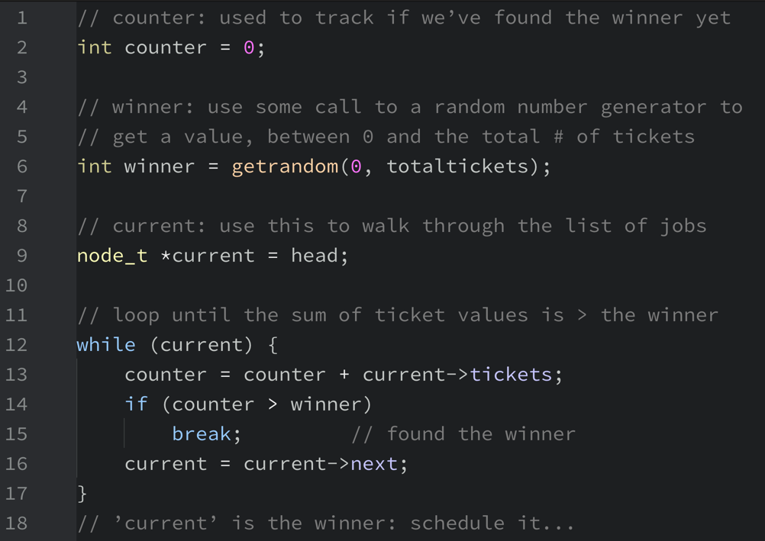
Lottery scheduling decision code

Slide 10
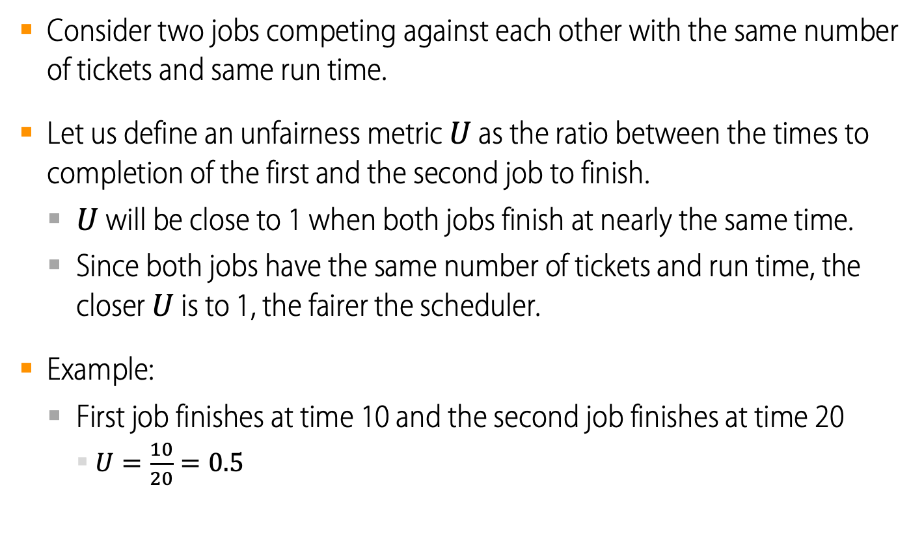
Brief study of lottery fairness
Consider two jobs competing against each other with the same number of tickets and same run time.
Let us define an unfairness metric $U$ as the ratio between the times to completion of the first and the second job to finish.
$U$ will be close to 1 when both jobs finish at nearly the same time.
Since both jobs have the same number of tickets and run time, the closer $U$ is to 1, the fairer the scheduler.
Example:
First job finishes at time 10 and the second job finishes at time 20
$U=\frac{10}{20}=0.5$

Slide 11
Brief study of lottery fairness
Two jobs with the same number of tickets
Job duration varying from 1 to 1000 with step = 10
10 simulation runs for each job duration
For short job durations, unfairness can be quite severe.
Unfairness (average)
Job Duration

Slide 12
Stride Scheduling
The behavior of lottery scheduling is non-deterministic and only probabilistically correct.
Stride scheduling is an also straightforward deterministic fair-share method.
Each job in a system has a stride which is inversely proportional to its number of tickets.
The more tickets a job has, the smaller its stride.
Each job also has a pass, which is an indicator of its progress.
Every time a job runs, its pass is incremented by its stride.
Every time the scheduler needs a process, it picks the one with the lowest pass value.

Slide 13
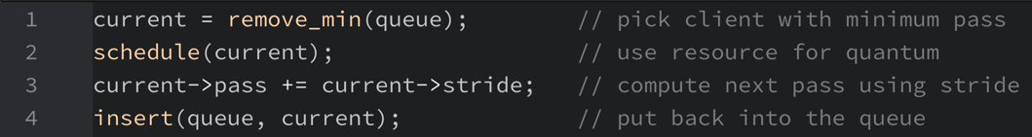
An example of stride scheduling
Consider processes A, B and C with stride values of 100, 200 and 40, all with pass values initially at 0, and the following scheduling algorithm
The behavior of the scheduler over time could be as shown in the table.
Can you demonstrate that the allocation was precise?
Time slice | Pass(A) | Pass(B) | Pass(C) | Who runs?
0 | 0 | 0 | 0 | A
1 | 100 | 0 | 0 | B
2 | 100 | 200 | 0 | C
3 | 100 | 200 | 40 | C
4 | 100 | 200 | 80 | C
5 | 100 | 200 | 120 | A
6 | 200 | 200 | 120 | C
7 | 200 | 200 | 160 | C
8 | 200 | 200 | 200 | …

Slide 14
Summary
Although lottery and stride scheduling are conceptually interesting and straightforward to implement, they have not achieved widespread adoption as CPU schedulers for a number of reasons, e.g.
They do not address I/O
They leave open the hard problem of ticket assignment.
General-purpose schedulers such as MLFQ do better and thus are more widely adopted.
On the other hand, proportional-share schedulers are more useful in virtualized scenarios (e.g. VMWare) where fair-sharing of resources is important and some of these problems are relatively less impacting.

