Slide 1
Locality and The Fast File System
T31
41
21 de novembro de 2018

Slide 2
Unix operating system
Original Unix data structures on disk
The good thing about the old file system
Simple and supported the basic abstractions, i.e. files and directories
Easy to use
A step-forward from earlier approaches
The Problem
Terrible performance
Started off bad and got worse over time
S | Inodes | Data

Slide 3
Issues of the old Unix file system
Treated the disk as a random-access memory
Data was spread all over the disk without regard to positioning time
File system easily fragmented due to uncareful free space management
The policy was simply to take the next free block
For example, consider 4 files A, B, C and D, each with 2 blocks.
If B and D are deleted, the layout becomes
Now, if we create a 4-block file E we get
And E is spread across the disk.
A1 | A2 | B1 | B2 | C1 | C2 | D1 | D2
A1 | A2 |  |  | C1 | C2
A1 | A2 | E1 | E2 | C1 | C2 | E3 | E4

Slide 4
Issues of the old Unix file system
The original block size was too small (512 bytes)
Good because it reduced internal fragmentation
Bad because disk transfer was inefficient.

Slide 5
How to organize on-disk data to improve performance?
What types of allocation policies are required?
How do we make the file system “disk aware”?

Slide 6
Fast File System
FFS was designed by a group at Berkeley in the early 80’s.
FFS structures and allocation policies were designed to be “disk aware” and improve performance.
It kept same API (open(), read(), write(), etc)
The internal implementation was heavily changed.

Slide 7
Organizing Structure: The Cylinder Group
FFS divides the disk into a bunch of groups. (Cylinder Group)
Modern file system call cylinder group as block group.
These groups are uses to improve seek performance.
By placing two files within the same group.
Accessing one after the other will not be long seeks across the disk.
FFS needs to allocate files and directories within each of these groups.
G0 | G1 | G2 | G3 | G4 | G5 | G6 | G7 | G8 | G9

Slide 8
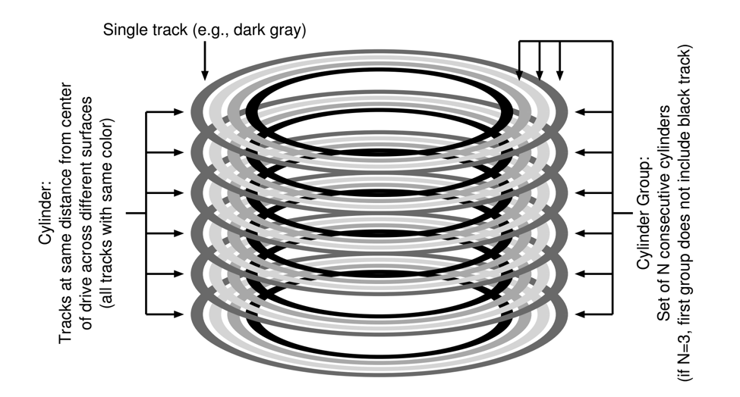

Cylinder Groups
Organizing Structure
FFS divides the disk into groups of $N$ consecutive cylinders.
Modern drives do not show such details about their geometry.
Instead, they export a logical address space of blocks and current file systems organize the drive into groups of consecutive blocks.

Slide 9
Block Groups
Organizing Structure
By placing two files within the same group, FFS ensures that accessing one after the other will not involve long seeks across the disk.
To be able to place and manage files and directories into a group, FFS includes in it all the structures of a file system.
Data structures for each block group
A copy of the super block(S) for reliability reasons
inode bitmap(ib) and data bitmap(db) to track free inodes and data blocks
inodes and data blocks are like those in the very-simple file system (VSFS)
Group 0 |  |  |  |  |  |  |  | Group 1 |  |  |  |  |  |  |  | Group 2
S | ib | db | Inodes | Data

Slide 10
How To Allocate Files and Directories?
Policy is “keep related stuff together”
But… what does “related” mean?
The placement of directories…
Find a block group with a low number of allocated directories and a high number of free inodes.
Put the directory data and inode in that group.
The placement of files…
Allocate data blocks of a file in the same block group of its inode
Place all files in the same block group as their directory

Slide 11
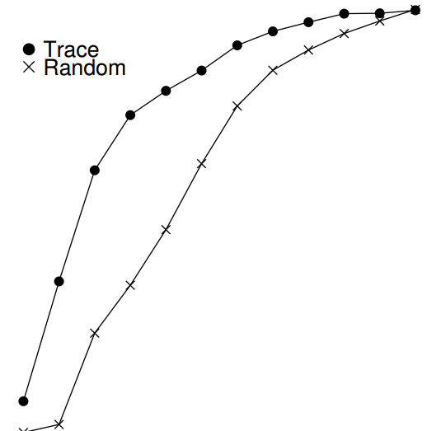
Measuring file locality
How “far away” file accesses were from one another in the directory tree.
7% of file accesses to the same file
Nearly 40% of file accesses in the same directory
25% of file accesses were two distances
proc/src/foo.c
proc/src/bar.c
the distance of two file access is 1
proc/src/foo.c
proc/obj/foo.o
the distance of two file access is 2
100%
80%
60%
Cumulative Frequency
40%
Trace
20%
x
Random
0%
0
2
4
6
8
10
Path Difference

Slide 12
The Large-File Exception
G0 | G1 | G2 | G3 | G4 | G5 | G6 | G7 | G8 | G9
9 0
0 1
2 3
4 5
6 7
If the general policy of file placement is applied, a large file might
Entirely fill the block group it is first placed within
Prevent subsequent “related” files from being placed within this group and, thus, hurt file-access locality
For large files, chunks are spread across the disk
Hurts performance, but this can be addressed by choosing chunk size
Amortization: reducing overhead by doing more work
Group 0 | Group 1 | Group 2 | Group 3 | Group 4 | Group 5 | Group 6 | Group 7 | Group 8 | Group 9
 |  | 0 1 2 3 4 5 6 7 8 9
Group 0 | Group 1 | Group 2 | Group 3 | Group 4 | Group 5 | Group 6 | Group 7 | Group 8 | Group 9
6 7 |  | 0 1 |  | 4 5 |  | 2 3 |  |  | 8 9

Slide 13
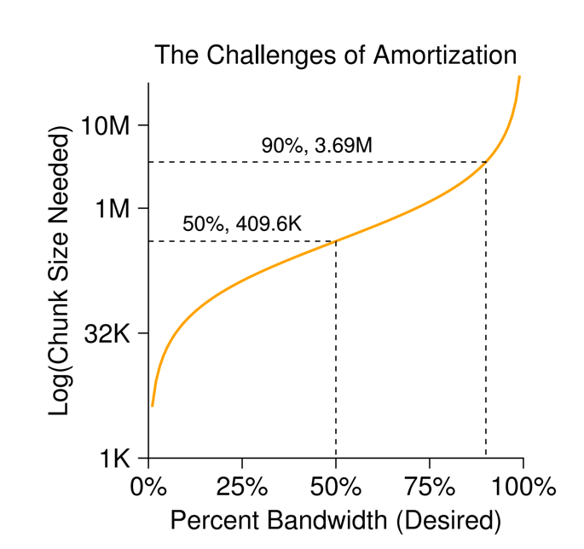
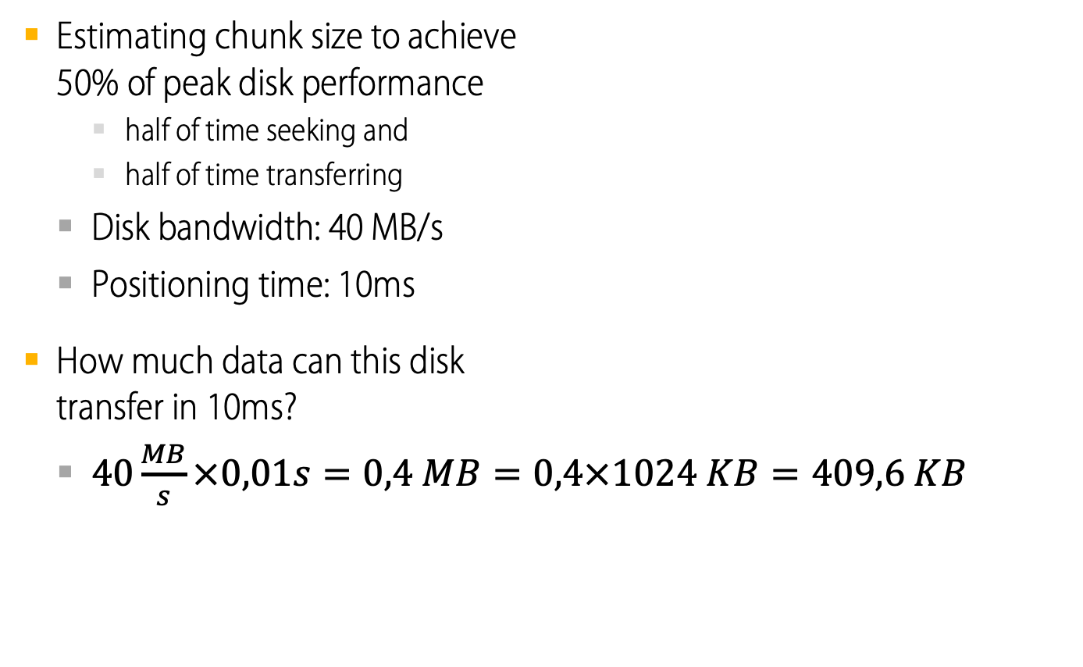
Amortization: How Big Do Chunks Have To Be?
Estimating chunk size to achieve 50% of peak disk performance
half of time seeking and
half of time transferring
Disk bandwidth: 40 MB/s
Positioning time: 10ms
How much data can this disk transfer in 10ms?
$40\frac{MB}{s}×0,01s=0,4 MB=0,4×1024 KB=409,6 KB$

Slide 14
The Large-File Exception in FSS
For large files, FFS took a simpler approach based on the inode structure
The first 12 direct blocks were placed in the same group as the inode
Each subsequent indirect block, and all the blocks it pointed to, were placed in a different block group.
With 4KB-blocks and 32-bit addresses, every 1024 blocks (4MB) of the file were in separate groups
S | ib | db | Inodes | Data
....
12 direct blocks
indirect blocks
inode
....
S | ib | db | Inodes | Data

Slide 15
A few other things about FFS
Internal fragmentation due to large (at that time!) block size
Solution: 512-byte sub-blocks
E.g. to create a file with 1 KB, use two sub-blocks, not an entire 4-KB block
Parameterization
Track buffers
Long file names
Enabling more expressive names in the file system
Symbolic links

