Slide 1
Address Translation
T09a
Referências principais
Ch.15 of Operating Systems: Three Easy Pieces by Remzi and Andrea Arpaci-Dusseau (pages.cs.wisc.edu/~remzi/OSTEP/) and Ch.8 of Operating Systems Principles & Practice (Vol.III: Memory Management) by Thomas Anderson and Mike Dahlin.
Discutido em classe em 27 de agosto de 2018

Slide 2
This module is intended to…
Provide a detailed description of various ways of organizing memory hardware.
Discuss various techniques for memory management, including paging and segmentation.

Slide 3
Main Points
Address Translation Concept
How do we convert a virtual address to a physical address?
Flexible Address Translation
Base and bound
Segmentation
Paging
Multilevel translation
Efficient Address Translation
Translation Lookaside Buffers
Virtually and physically addressed caches

Slide 4
Memory Management is …
… subdividing main memory in order to accommodate multiple processes.
… allocating memory subdivisions to such processes to ensure a reasonable supply of ready processes to consume available processor time.
… especially dependent on the hardware design of the underlying computer system.

Slide 5
Background
Main memory and registers are the only storage that the CPU can access directly.
Register access can be made in at most one CPU clock cycle.
Main memory access can take many cycles.
To accommodate such difference, systems provide a high speed memory buffer called cache.

Slide 6
Background
Programs must be brought into memory and placed within a process in order to be run.
Before being run, programs go through several steps.
Normally, there are always processes ready to run their programs.
Processes sharing memory, must be protected against unwanted mutual interference.

Slide 7
A user program has to go a long way before it runs…
COMPILE TIME
LOAD TIME
source program
object module
other object modules
load module
system library
compiler or assembler
linkage editor
loader
RUN TIME
object module
load module
dinamically loaded system library
In-memory binary memory image

Slide 8
Binding of instructions and data to memory can be performed at …
Compile time
If memory location is known a priori.
Code must be recompiled if starting location changes.
Load time
If location will not change during execution.
Code must be relocatable if memory location is not known at compile time.
Execution time
If during execution the process may be moved from one place in memory to another.
Needs hardware support for address maps (e.g., base and limit registers).

Slide 9
Dynamic Loading
Routine is not loaded until it is called.
Better memory-space utilization.
Any unused routines are never loaded.
Useful when large amounts of code are needed to handle infrequently occurring cases.
No special support from the OS is required.
Implemented through program design.

Slide 10
Dynamic Linking
Linking postponed until execution time.
Small piece of code (stub) used to locate the appropriate memory-resident library routine.
Stub replaces itself with the address of the routine, and executes the routine.
Operating system needed to check if routine is in processes’ memory address.
Particularly useful for libraries.

Slide 11
About address translation…
Address translation is performed by the hardware to transform a virtual address into a physical address.
The desired data is actually stored in a physical address.
The OS must be involved at key points to set up the hardware.
In order to do it properly, the OS must also be responsible for memory management.

Slide 12
Virtual vs. Physical Address Spaces
The concept of a virtual address space that is bound to a separate physical address space is central to proper memory management.
Virtual address
Is generated by the CPU.
Is also referred to as a logical address.
Physical address
Is the address actually seen by the memory unit.

Slide 13
Virtual vs. Physical Address Spaces
Virtual and physical addresses are the same in compile-time and load-time address-binding schemes.
Logical and physical addresses differ in execution-time (or run-time) address-binding scheme.

Slide 14
Mapping virtual to physical addresses requires a dedicated device
Memory-Management Unit (MMU)
Hardware device that maps virtual to physical addresses.
In an MMU scheme, the value in the relocation register is added to every address generated by a user process at the time such address is sent to memory.
Thus, the user program deals only with virtual addresses.
It never sees the real physical addresses.

Slide 15
Address Translation Concept
Processor
Memory Management Unit
Virtual Address
Raise Exception
Invalid
Valid
Physical Memory
Physical Address
Data
Data

Slide 16
Address Translation Goals
Protection
Sharing
Sparse Addresses
Efficiency
Portability

Slide 17
Protection
A process should not be able to reference memory locations in another process without permission.
Since it is impossible to check absolute addresses at compile time, this must be done at run time.
The memory protection requirement must be satisfied by the processor (hardware) rather than by the operating system (software).
The operating system cannot anticipate all the memory references a process will make.

Slide 18
Sharing
Allow several processes to access the same portion of memory.
Shared libraries
Process intercommunication
It is usually better to allow each child process to access the same copy of their parent’s program rather than have their own separate copy.

Slide 19
Sparse addresses
Programs are written in modules, involving multiple regions of dynamic allocation (heaps/stacks).
Modules can be written and compiled independently.
Different degrees of protection are given to modules.
Read-only, execute-only, etc.
Modules can be shared among processes.

Slide 20
Efficiency
Memory available for a program plus its data may be insufficient.
Overlaying allows various modules to be assigned the same region of memory, which is inefficient as we’ll discuss later.
Programmer does not know how much space will be available at run time.
Run time lookup takes time.
Translation tables take space.

Slide 21
Portability
Programmer does not know where the program will be placed in memory when it is executed.
It should be possible to relocate a program (i.e. return it to main memory at a different location), after having swapped it to disk.
Thus, the translation of memory references in the code to actual physical memory addresses can only happen at run time.

Slide 22
Bonus Features
What can you do if you can (selectively) gain control whenever a program reads or writes a particular virtual memory location?
Examples:
Copy-on-write
Zero-on-reference
Fill-on-demand
Demand paging
Memory mapped files
…

Slide 23
Basic Hardware Support
Virtual address
Reference to a memory location independently of the actual assignment of data to memory.
Must be translated to a physical address.
Relative address
Address expressed as a location relative to some known point.
Physical address
Absolute address or actual location of a virtual address in main memory.

Slide 24
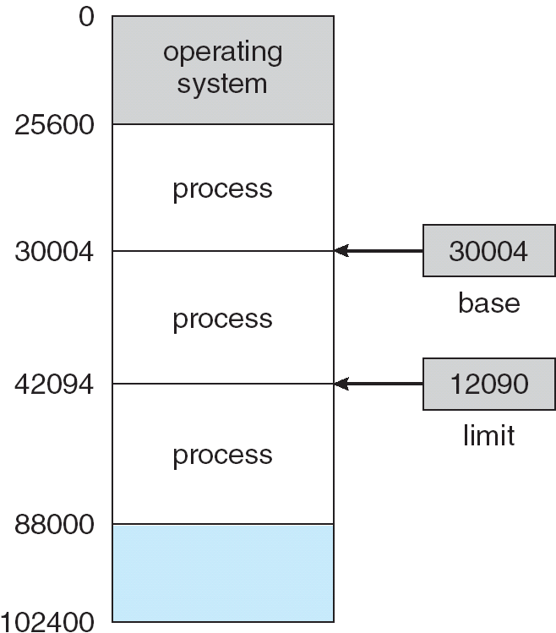
Basic Hardware Support
Memory protection is provided via base and bounds (or base and limit) registers, which define the address space of a process.
Base holds the smallest legal address
Bounds specifies the size of the range.
process
base
bounds

Slide 25
Virtually Addressed Base and Bounds
Base register
Starting address for the process
Bounds (or Limit) register
Ending location of the process or
Maximum allowed offset from the base address
These values are set when the process is loaded or when the process is swapped in.

Slide 26
Virtually Addressed Base and Bounds
The CPU hardware checks each address generated in user mode against the base-limit registers of the running process.

Slide 27
Question
With virtually addressed base and bounds, what is saved/restored on a process context switch?
Notes:
Only the OS gets to change the base and bounds! Clearly, user program can't, or else lose protection.
With base&bounds system, what gets saved/restored on a context switch?
contents of base and bounds register; or maybe even contents of memory

Slide 28
Virtually Addressed Base and Bounds
PROS?
Simple
Fast
Safe
Can relocate in physical memory without changing process
CONS?
Can’t keep program from accidentally overwriting its own code
Can’t share code/data with other processes
Can’t grow stack/heap as needed
2 registers, adder, comparator
Notes:
Provides level of indirection: OS can move bits around behind the program's back, for instance, if program needs to grow beyond its bounds, or if need to coalesce fragments of memory. Stop program, copy bits, change base and bounds registers, restart.
Because OS manages the translation, we control the vertical, we control the horizontal.
Hardware cost:
2 registers
adder, comparator
Plus, slows down hardware because need to take time to do add/compare on every memory reference.
In 60's, thought to be too expensive!
But get better use of memory, and you get protection. These are really important. CPU speed (especially now) is the easy part.

Slide 29
Address translation schemes
Overlays
Swapping
Contiguous allocation
Paging
Segmentation
Multi-level Translation

Slide 30
Overlays
The earliest address translation scheme.
Used when process is larger than the amount of memory allocated to it.
Keep in memory only those instructions and data that are needed at any given time.
Implemented by the user
No special support needed from operating system.
Programming design of overlay structure is complex.

Slide 31
Overlays for a Two-Pass Assembler
pass 1
symbol table | 20K
common routines | 30K
overlay driver | 10K
free memory | 80K
pass 1 | 60k
pass 2 | 70k
pass 2

Slide 32
Swapping
Used when the existing processes wouldn’t fit into the available memory at the same time.
A process can be swapped temporarily out of memory to a backing store, and then brought back into memory for continued execution.
Backing store
Fast disk large enough to accommodate copies of all memory images for all users.
Must provide direct access to memory images.

Slide 33
Swapping
Roll out, roll in
Swapping variant used for priority-based scheduling algorithms.
Lower-priority process is swapped out so higher-priority process can be loaded and executed.
Major part of swap time is transfer time
Total transfer time is directly proportional to the amount of memory swapped.
Modified (and more efficient) versions of swapping are found in most actual systems.

Slide 34
Contiguous Allocation
Main memory broken into two regions:
Resident operating system (usually in low memory).
User processes (usually in high memory).
Base-and-bounds register scheme used to protect user processes from each other, and from changing operating-system code and data.
Base register contains smallest physical address.
Bounds register contains range of virtual addresses.
Each virtual address must be less than the limit register.

Slide 35
Partitioning techniques in continuous allocation
User region further divided into either
Fixed-size partitions
Equal-size partitions
Unequal-size partitions
Variable-size partitions

Slide 36
Examples of fixed partitioning
8M (OS) | 8M |  |  | 8M |  | 8M |  | 8M |  | 8M | 8M | 8M
Equal-size partitions
8M (OS) | 2M | 4M | 6M |  | 8M |  | 8M |  | 12M |  | 16M
Unequal-size partitions
8M (OS) | 8M | 8M | 8M | 8M | 8M | 8M | 8M
Equal-size partitions

Slide 37
Fixed Partitioning
Each partition may contain exactly one process.
Degree of multiprogramming bound by the number of partitions.
When a partition is free one process is selected by the long-term scheduler from the input queue and loaded into it.
When a process terminates, its partition becomes free and available to another process.

Slide 38
Fixed Partitioning
Equal-size partitions
Any process whose size is less than or equal to the size of an available partition can be loaded into it.
If all partitions are full, the operating system can swap a process out of a partition.
A program may not fit in any partition.
The programmer must design the program with overlays.

Slide 39
Fixed Partitioning Placement Algorithms
Equal-size partitions
Since all partitions are of equal size, it does not matter which partition is used.
Unequal-size partitions
Can assign each process to the smallest partition in which it will fit.
Queue for each partition.
Processes are assigned in such a way as to minimize wasted memory within a partition.

Slide 40
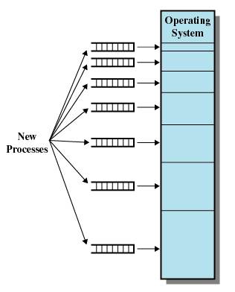
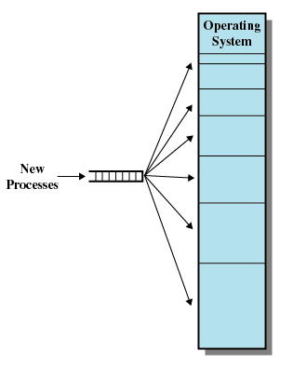
Memory Assigment in Unequal-size Fixed Partitioning
One process queue per partition
A single process queue

Slide 41
Fixed Partitioning Issues
Main memory use is inefficient.
Any program, no matter how small, occupies an entire partition.
This sort of memory waste is called internal fragmentation.

Slide 42
Variable Partitioning
Partitions are of variable length and number.
Operating system maintains information about
Allocated partitions
Free partitions, i.e. blocks of available memory, called holes.
When a process arrives, it is allocated exactly as much memory as required from a hole large enough to accommodate it.
The unused part of the selected hole becomes another (smaller) hole.

Slide 43
The Effect of Variable Partitioning
Due to the process allocation policy, holes of various sizes may appear and be scattered throughout memory.
Compaction algorithm must be used to shift processes so they are contiguous and all free memory is in one block.
This sort of memory waste is called external fragmentation.
Contrary to internal fragmentation, external fragmentation can be treated.

Slide 44
The Effect of Variable Partitioning
operating system | 8M
 | 56M
operating system | 8M
Process 1 | 20M
 | 36M
operating system | 8M
Process 1 | 20M
Process 2 | 14M
 | 22M
operating system | 8M
Process 1 | 20M
Process 2 | 14M
Process 3 | 18M
 | 4M
4M

Slide 45
The Effect of Variable Partitioning
operating system | 8M
Process 1 | 20M
 | 14M
Process 3 | 18M
 | 4M
operating system | 8M
Process 1 | 20M
Process 4 | 8M
 | 6M
Process 3 | 18M
 | 4M
operating system | 8M
 | 20M
Process 4 | 8M
 | 6M
Process 3 | 18M
 | 4M
operating system | 8M
Process 2 | 14M
 | 6M
Process 4 | 8M
 | 6M
Process 3 | 18M
 | 4M

Slide 46
Variable Partitioning Placement Strategies
Operating system must decide which hole a process will be allocated to.
Some common strategies for selecting a hole from the set of available holes are
Best-fit
First-fit
Next-fit

Slide 47
Best-fit
Variable Partitioning Placement Strategies
Chooses the block that is closest in size to the request.
Since smallest block is found for process, the smallest amount of fragmentation is left.
Memory compaction must be done more often.
Worst performer overall.

Slide 48
First-fit
Variable Partitioning Placement Strategies
Scans memory form the beginning and chooses the first available block that is large enough.
May have many process loaded in the front end of memory that must be searched over when trying to find a free block.
Fastest.

Slide 49
Next-fit
Variable Partitioning Placement Strategies
Scans memory from the location of the last placement.
More often allocates a block of memory at the end of memory where the largest block is found.
The largest block of memory is broken up into smaller blocks.
Compaction is required to obtain a large block at the end of memory.

Slide 50
Memory configuration before and after the allocation of a 16MB block
8M |  |  | 8M
12M |  |  | 12M
22M |  |  | 22M
18M |  |  | 18M
8M |  |  | 8M
6M |  |  | 6M
14M |  |  | 14M
36M |  |  | 36M
6M
First Fit
16M
2M
Best Fit
16M
Most recently allocated block
20M
Next Fit
16M

Slide 51
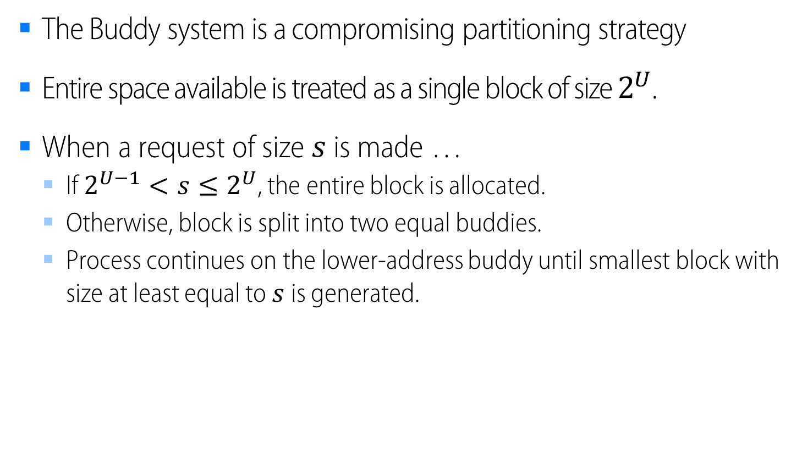
Buddy System
The Buddy system is a compromising partitioning strategy
Entire space available is treated as a single block of size $2^{U}$.
When a request of size $s$ is made …
If $2^{U−1}<s≤2^{U}$, the entire block is allocated.
Otherwise, block is split into two equal buddies.
Process continues on the lower-address buddy until smallest block with size at least equal to $s$is generated.

Slide 52
Buddy System: Example
1 Gbyte block | 1G
Request 100M | A = 128M |  | 128M |  | 256M |  |  |  | 512M
Request 240M | A = 128M |  | 128M |  | B = 256M |  |  |  | 512M
Request 64M | A = 128M |  | C = 64M | 64M | B = 256M |  |  |  | 512M
Request 256M | A = 128M |  | C = 64M | 64M | B = 256M |  |  |  | D = 256M |  |  |  | 256M
Release B | A = 128M |  | C = 64M | 64M | 256M |  |  |  | D = 256M |  |  |  | 256M
Release A | 128M |  | C = 64M | 64M | 256M |  |  |  | D = 256M |  |  |  | 256M
Request 75M | E = 128M |  | C = 64M | 64M | 256M |  |  |  | D = 256M |  |  |  | 256M
Release C | E = 128M |  | 128M |  | 256M |  |  |  | D = 256M |  |  |  | 256M
Release E | 512M |  |  |  |  |  |  |  | D = 256M |  |  |  | 256M
Release D | 1G

Slide 53
Tree Representation of a Buddy System
1 Gbyte block
1000
Request 100M
Request 240M
512
512
Request 64M
Request 256M
256
256
256
256
Release B
Release A
128
128
Request 75M
64
64
Release C
Release E
Release D

Slide 54
Memory Fragmentation Issues and (Possible) Solutions
External fragmentation
Internal fragmentation
Memory is enough to satisfy a request, but it is not contiguous.
Can be reduced by compaction
Shuffle memory contents to put all free space in a single block.
Compaction is possible only if address translation is dynamic and done at execution time.
To avoid the I/O problem
Latch job in memory while it is involved in I/O.
Do I/O only into OS buffers.
Allocated memory may be larger than requested memory.
This excessive memory is internal to a partition and cannot be used.

