Slide 1
Translation Lookaside Buffers
T12
Ch.19 of Operating Systems: Three Easy Pieces by Remzi and Andrea Arpaci-Dusseau (pages.cs.wisc.edu/~remzi/OSTEP/)
05 de setembro de 2018

Slide 2
Background
The requirement that instructions must be in physical memory to be executed may limit the size of a program to the size of main memory.
In many cases, parts of the program are not needed or, at least, not at the same time, e.g.
Code to handle unusual error conditions.
Data structures that are dimensioned in excess of actual need.
Rarely used options and features.

Slide 3
Background
The ability to execute a program which is only partially loaded in memory has many benefits
The size of the program would no longer be constrained by the physical memory that is available.
Since programs would require less memory, the degree of multiprogramming could be increased.
Loading or swapping user programs into memory would require less I/O.
Being able to run a program that is not entirely in memory would benefit both user and system.

Slide 4
Background
Virtual memory allows us to program using virtual addresses that will only be translated to physical addresses when accessed.
To implement the virtual memory model, we can view a program as a collection of segments, e.g. user code, stack, heap, libraries, etc.
On their turn, each segment will be mapped onto a number of pages.

Slide 5
Background
Additional benefits of virtual memory are
System libraries can be shared by several processes through mapping of the shared object onto a virtual address space.
Processes can share part of their virtual address spaces, by mapping them onto actually shared memory pages.
Parent and child processes may share pages, thus speeding up process creation.

Slide 6
Background
To enable access to a virtual address during execution, the page that contains it must be loaded in a frame in physical memory.
Since the number of pages in a program may exceed the number of frames in the target machine’s memory, pages may have to be loaded and unloaded on-the-fly, as execution progresses.
To avoid the slowdown caused by dynamically loading and unloading pages, due to references to addresses that are not present in memory when needed, we make extensive use of caches.

Slide 7
What is a cache?
A cache is a copy of data or code that is faster to access than the original.
Cache memory is allocated in units called blocks, comprising multiple memory locations.
The result of a search for an address in a cache will be
a hit, if the cache has a copy of that address, or
a miss, if the cache does not have a copy of that address.
Cache efficiency is measured by its hit rate and is heavily dependent on
Temporal locality
Programs tend to reference the same memory locations multiple times, e.g. by executing instructions in a loop.
Spatial locality
Programs tend to reference nearby locations, e.g. examining array data in a loop

Slide 8
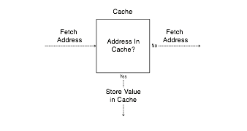
Cache Concept (Read)
Get Value from Cache

Slide 9
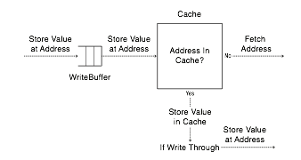
Cache Concept (Write)
Write through: changes sent immediately to next level of storage.
Write back: changes stored in cache until cache block is replaced.

Slide 10
Memory hierarchy example
Cache | Hit Cost | Size
1st level cache/first level TLB | 1 ns | 64 KB
2nd level cache/second level TLB | 4 ns | 256 KB
3rd level cache | 12 ns | 2 MB
Memory (DRAM) | 100 ns | 10 GB
Data center memory (DRAM) | 100 µs | 100 TB
Local non-volatile memory | 100 µs | 100 GB
Local disk | 10 ms | 1 TB
Data center disk | 10 ms | 100 PB
Remote data center disk | 200 ms | 1 EB
i7 has 8MB as shared 3rd level cache; 2nd level cache is per-core

Slide 11
Memory hierarchy example
i7 has 8MB as shared 3rd level cache; 2nd level cache is per-core

Slide 12
TLB
Part of the hardware memory-management unit (MMU).
A hardware cache of popular virtual-to-physical address translations.
TLB
Lookup
MMU
Logical
Address
TLB Hit
Physical
Address
TLB
popular v to p
TLB Miss
CPU
Page Table
all v to p entries
Frame 0
Frame 1
Frame 2
…
Frame n
Address Translation with MMU
Physical Memory
Notes:
말그대로 파풀러한 애들을 캐시해주는 거니까 그림이 잘못됬음.

Slide 13
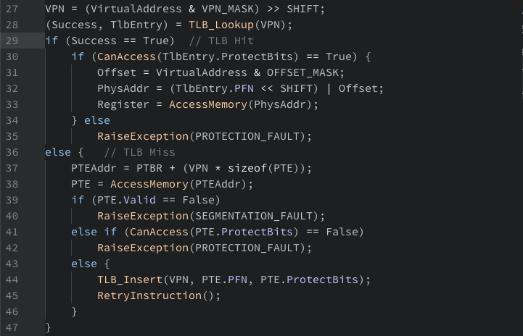
TLB Basic Algorithms

Slide 14
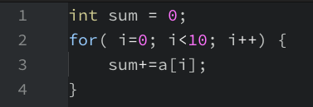
Example: Accessing An Array
How a TLB improves paging performance…
3 misses and 7 hits.
Thus TLB hit rate is 70%.
OFFSET 00 04 08 12 16
VPN = 00
VPN = 01
VPN = 03
VPN = 04
VPN = 05
VPN = 06 |  | a[0] | a[1] | a[2]
VPN = 07 | a[3] | a[4] | a[5] | a[6]
VPN = 08 | a[7] | a[8] | a[9]
VPN = 09
VPN = 10
VPN = 11
VPN = 12
VPN = 13
VPN = 14
VPN = 15
The TLB improves performance
due to spatial locality

Slide 15
Locality
Temporal Locality
An instruction or data item that has been recently accessed will likely be re-accessed soon in the future.
Spatial Locality
If a program accesses memory at address x, it will likely soon access memory near x.
1st access is page1.
2nd access is also page1.
Page 6
…
Page 1
Page 7
Page 2
Page 3
Page 4
Page 5
Page n
Virtual Memory
1st access is page1.
2nd access is near by page1.
Page 1
Page 2
Page 3
Page 4
Page 5
…
Page n
Virtual Memory

Slide 16
Who Handles The TLB Miss?
Hardware handle the TLB miss entirely on CISC.
The hardware has to know exactly where the page tables are located in memory.
The hardware would “walk” the page table, find the correct page-table entry and extract the desired translation, update and retry the instruction.
This is called hardware-managed TLB.

Slide 17
Who Handles The TLB Miss?
RISC have what is known as a software-managed TLB.
On a TLB miss, the hardware raises exception( trap handler ).
Trap handler is code within the OS that is written with the express purpose of handling TLB miss.

Slide 18
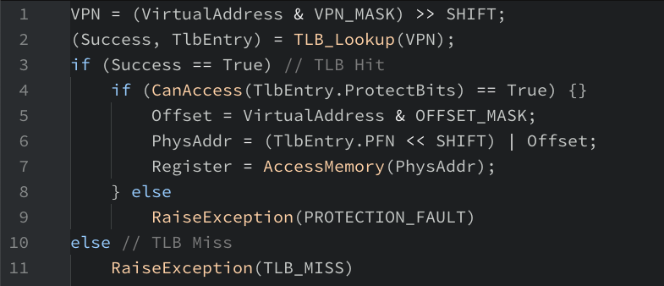
TLB Control Flow algorithm (OS Handled)

Slide 19
TLB entry
TLB is managed by Full Associative method.
A typical TLB might have 32, 64, or 128 entries.
Hardware search the entire TLB in parallel to find the desired translation.
Other bits: valid bits , protection bits, address-space identifier, dirty bit
VPN
PFN
other bits
Typical TLB entry look like this

Slide 20
TLB Issue: Context Switching
Page 0
Page 1
Process A
Page 2
Insert TLB Entry
access VPN10
…
Page n
TLB Table
Virtual Memory
VPN | PFN | valid | prot
10 | 100 | 1 | rwx
- | - | - | -
- | - | - | -
- | - | - | -
Page 0
Process B
Page 1
Page 2
…
Page n
Virtual Memory
Notes:
현재 프로세스 A, B의 주소공간을 가상공간으로 변경 예정

Slide 21
TLB Issue: Context Switching
Page 0
Page 1
Process A
Page 2
…
Page n
TLB Table
Virtual Memory
VPN | PFN | valid | prot
10 | 100 | 1 | rwx
- | - | - | -
10 | 170 | 1 | rwx
- | - | - | -
Context
Switching
Page 0
Process B
access VPN10
Page 1
Page 2
Insert TLB Entry
…
Page n
Virtual Memory
Notes:
현재 프로세스 A, B의 주소공간을 가상공간으로 변경 예정

Slide 22
TLB Issue: Context Switching
Page 0
Page 1
Process A
Page 2
…
Page n
TLB Table
Virtual Memory
VPN | PFN | valid | prot
10 | 100 | 1 | rwx
- | - | - | -
10 | 170 | 1 | rwx
- | - | - | -
Page 0
Process B
Page 1
Page 2
…
Can’t Distinguish which entry is
meant for which process
Page n
Virtual Memory
Notes:
현재 프로세스 A, B의 주소공간을 가상공간으로 변경 예정

Slide 23
To Solve Problem
Provide an address space identifier(ASID) field in the TLB.
Page 0
Page 1
Process A
Page 2
…
TLB Table
Page n
VPN | PFN | valid | prot | ASID
10 | 100 | 1 | rwx | 1
- | - | - | - | -
10 | 170 | 1 | rwx | 2
- | - | - | - | -
Virtual Memory
Page 0
Process B
Page 1
Page 2
…
Page n
Virtual Memory

Slide 24
Another Case
Two processes share a page.
Process 1 is sharing physical page 101 with Process2.
P1 maps this page into the 10th page of its address space.
P2 maps this page to the 50th page of its address space.
VPN | PFN | valid | prot | ASID
10 | 101 | 1 | rwx | 1
- | - | - | - | -
50 | 101 | 1 | rwx | 2
- | - | - | - | -
Sharing of pages is useful as it reduces the number of physical pages in use.

Slide 25
TLB Replacement Policy
LRU(Least Recently Used)
Evict an entry that has not recently been used.
Take advantage of locality in the memory-reference stream.
Reference Row
7
0
1
2
0
3
0
4
2
3
0
3
2
1
2
0
1
7
7
7
2
7
4
7
7
0
1
1
Page Frame:
0
0
0
0
0
0
3
3
3
0
1
1
3
3
2
2
2
2
2
Total 11 TLB misses

Slide 26
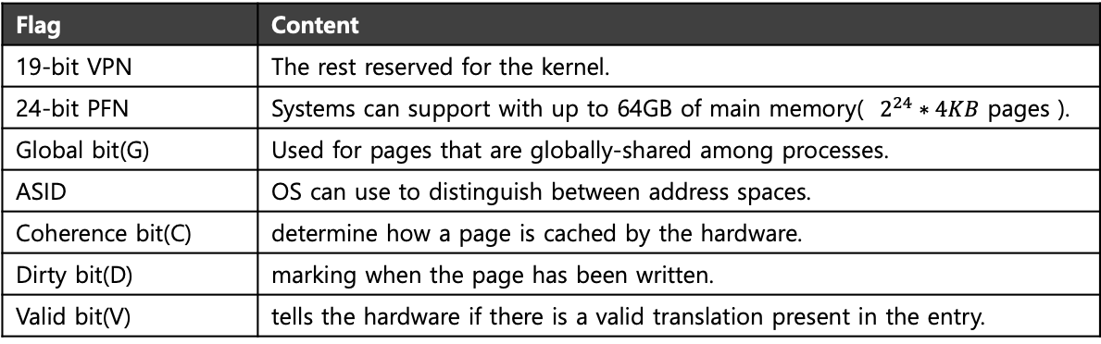
A Real TLB Entry
All 64 bits of this TLB entry(example of MIPS R4000)
0 1 2 3 4 5 6 7 8 9
10 11 … 19 … 31
VPN
G
ASID
PFN
C
D
V
Flag | Content
19-bit VPN | The rest reserved for the kernel.
24-bit PFN | Systems can support with up to 64GB of main memory( $2^{24}∗4KB$ pages ).
Global bit(G) | Used for pages that are globally-shared among processes.
ASID | OS can use to distinguish between address spaces.
Coherence bit(C) | determine how a page is cached by the hardware.
Dirty bit(D) | marking when the page has been written.
Valid bit(V) | tells the hardware if there is a valid translation present in the entry.

