Slide 1
Image Colorization Using U-Net+Conditional DCGAN

Slide 2
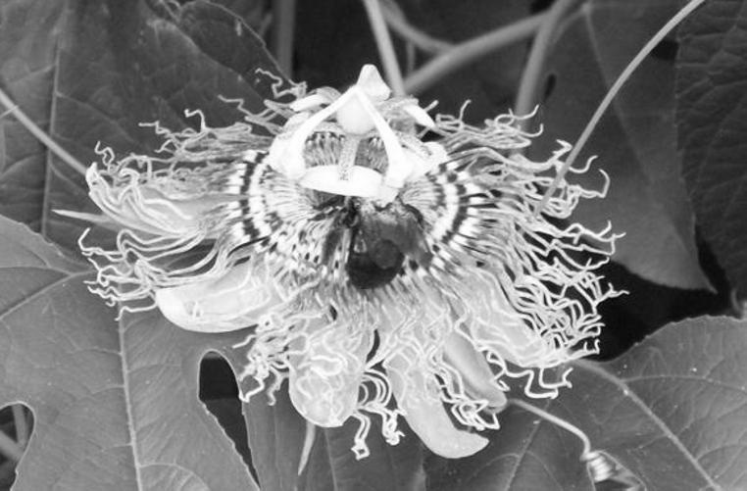
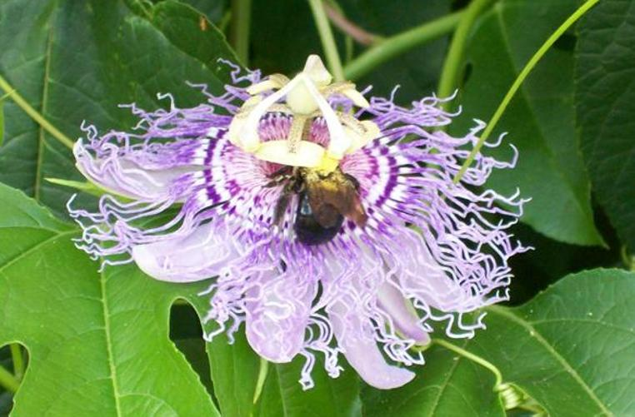
The Problem
We want to be able to turn a grayscale image into a colored image.
We focused on coloring a Flower dataset in our experiment.

Slide 3
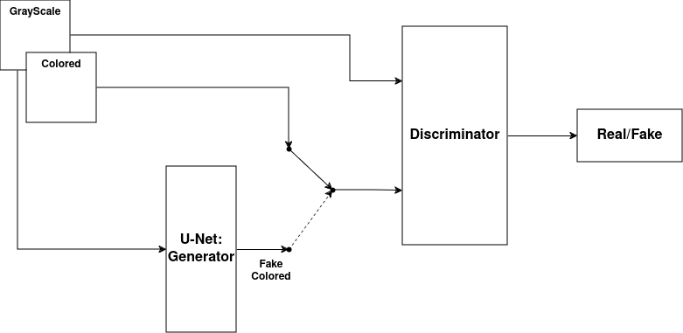
The Model
We first investigated a simple U-Net model and then added a Conditional DCGAN to improve the results.
We tested multiple options for the architecture of each

Slide 4
Generator Architecture
The generator model is based on the models introduced in Colorful Image Colorization[1] and Image-to-Image Translation with Conditional Adversarial Networks[2] and consists of downscaling and upscaling convolutions and “convlution blocks”

Slide 5
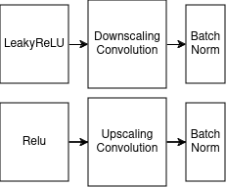
Generator Architecture
The convlution blocks introduced by Image-to-Image Translation with Conditional Adversarial Networks:

Slide 6
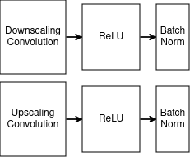
Generator Architecture
The convlution blocks introduced by Colorful Image Colorization:

Slide 7


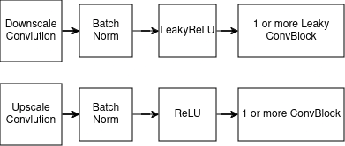
Generator Architecture
Our blocks:
ConvBlock:
Scaling Blocks:

Slide 8
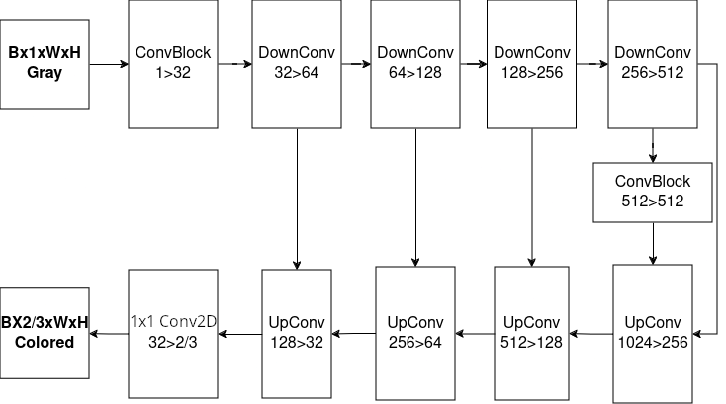
Generator Architecture
Full Architecture:

Slide 9
Discriminator Architecture
We investigated 3 different discriminator architectures, all 3 conditional on the grayscale input:
Convlutional network+Dense Layers for final single scalar
Convlutional network for per patch scalar
U-Net Discriminator

Slide 10
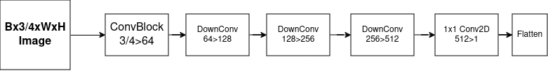

Discriminator Architecture
Both the normal convolutional and the patch concolutional use the same convlutional layers:
The normal convolutional added the dense layers:

Slide 11
Discriminator Architecture
The U-Net discriminator used the same architecture as the generator without the final sigmoid layer(added as neccesary with a fused BinaryCrossEntropy loss function)

Slide 12
Colorspace
We tested learning in RGB, HSV and YCbCr colorspaces(also LAB but the support is very limited in torchvision so we dropped it)

Slide 13
Data Preprocessing
We preprocessed the dataset from 8 bit int RGB images in various resolutions to 0-1 float16 images in each of the colorspaces in a static resolution of 128x128.
We randomized 2% of the dataset for testing(taking the last 2% doesn’t work because the images tend to be grouped by flower types).
Each training batch randomized the order again.
No further augmantation was done.

Slide 14
Learning
For the discriminator we tested both Cross Entropy loss and Wasserstein loss
For the generator we combined the L1 loss from the expected output and the loss of the discriminator, with a weight on L1 to balance the scaling between them.

Slide 15
Measurement
The evalution metric we chose is FID(Fréchet Inception Distance) using the torcheval implementation.
FID measures both the similarity of the generator output to the expected output, and the variety of the images in the batch.
A low variety indicates the generator learned a specific coloring that fools the discriminator instead of learning the true way to color the images.

Slide 16
Choosing the best parameter and architecture

