Slide 1
J2EE与中间件技术
——Enterprise Bean

Slide 2
Enterprise Bean
Written in the Java programming language, an enterprise bean is a server-side component that encapsulates the business logic of an application.
The business logic is the code that fulfills the purpose of the application.
  In an inventory control application, for example, the enterprise beans might implement the business logic in methods called checkInventoryLevel and orderProduct.
  By invoking these methods, clients can access the inventory services provided by the application.

Slide 3
Benefits of Enterprise Beans
For several reasons, enterprise beans simplify the development of large, distributed applications.
First, because the EJB container provides system-level services to enterprise beans, the bean developer can concentrate on solving business problems. The EJB container, rather than the bean developer, is responsible for system-level services, such as transaction management and security authorization.

Slide 4
Second, because the beans rather than the clients contain the application’s business logic, the client developer can focus on the presentation of the client. The client developer does not have to code the routines that implement business rules or access databases. As a result, the clients are thinner, a benefit that is particularly important for clients that run on small devices.
Third, because enterprise beans are portable components, the application assembler can build new applications from existing beans. Provided that they use the standard APIs, these applications can run on any compliant Java EE server.

Slide 5
When to Use Enterprise Beans
The application must be scalable. To accommodate a growing number of users, you may need to distribute an application’s components across multiple machines. Not only can the enterprise beans of an application run on different machines, but also their location will remain transparent to the clients.
Transactions must ensure data integrity. Enterprise beans support transactions, the mechanisms that manage the concurrent access of shared objects.
The application will have a variety of clients. With only a few lines of code, remote clients can easily locate enterprise beans. These clients can be thin, various, and numerous.

Slide 6
Types of Enterprise Beans
Session, Performs a task for a client; optionally, may implement a web service;
Message-driven, Acts as a listener for a particular messaging type, such as the Java Message Service API.

Slide 7
What Is a Session Bean?
A session bean encapsulates business logic that can be invoked programmatically by a client over local, remote, or web service client views.
To access an application that is deployed on the server, the client invokes the session bean’s methods. The session bean performs work for its client, shielding it from complexity by executing business tasks inside the server.
A session bean is not persistent. (That is, its data is not saved to a database.)

Slide 8
Types of Session Beans
Session beans are of three types: stateful, stateless, and singleton(EJB 3.1).

Slide 9
Stateful Session Beans
The state of an object consists of the values of its instance variables. In a stateful session bean, the instance variables represent the state of a unique client/bean session. Because the client interacts (“talks”) with its bean, this state is often called the conversational state.
As its name suggests, a session bean is similar to an interactive session. A session bean is not shared; it can have only one client, in the same way that an interactive session can have only one user. When the client terminates, its session bean appears to terminate and is no longer associated with the client.
The state is retained for the duration of the client/bean session. If the client removes the bean, the session ends and the state disappears.

Slide 10
When to Use
The bean’s state represents the interaction between the bean and a specific client.
The bean needs to hold information about the client across method invocations.
The bean mediates between the client and the other components of the application, presenting a simplified view to the client.
Behind the scenes, the bean manages the work flow of several enterprise beans.

Slide 11
Stateless Session Beans
A stateless session bean does not maintain a conversational state with the client.
When a client invokes the methods of a stateless bean, the bean’s instance variables may contain a state specific to that client but only for the duration of the invocation. When the method is finished, the client-specific state should not be retained.
A stateless session bean can implement a web service, but a stateful session bean cannot.

Slide 12
When to Use
The bean’s state has no data for a specific client.
In a single method invocation, the bean performs a generic task for all clients. For example, you might use a stateless session bean to send an email that confirms an online order.
The bean implements a web service.

Slide 13
Singleton Session Beans
A singleton session bean is instantiated once per application and exists for the lifecycle of the application.
Singleton session beans are designed for circumstances in which a single enterprise bean instance is shared across and concurrently accessed by clients.
Like stateless session beans, singleton session beans can implement web service endpoints.
Applications that use a singleton session bean may specify that the singleton should be instantiated upon application startup, which allows the singleton to perform initialization tasks for the application. The singleton may perform cleanup tasks on application shutdown as well, because the singleton will operate throughout the lifecycle of the application.

Slide 14
What Is a Message-Driven Bean?
A message-driven bean is an enterprise bean that allows Java EE applications to process messages asynchronously.
This type of bean normally acts as a JMS message listener, which is similar to an event listener but receives JMS messages instead of events.
The messages can be sent by any Java EE component (an application client, another enterprise bean, or a web component) or by a JMS application or system that does not use Java EE technology.
Message-driven beans can process JMS messages or other kinds of messages.

Slide 15
When to Use
Session beans allow you to send JMS messages and to receive them synchronously but not asynchronously.
To avoid tying up server resources, do not to use blocking synchronous receives in a server-side component; in general, JMS messages should not be sent or received synchronously.
To receive messages asynchronously, use a message-driven bean.

Slide 16
Accessing Enterprise Beans (session beans)
Clients access enterprise beans either through a no-interface view or through a business interface.
  A no-interface view of an enterprise bean exposes the public methods of the enterprise bean implementation class to clients. Clients using the no-interface view of an enterprise bean may invoke any public methods in the enterprise bean implementation class or any superclasses of the implementation class.
  A business interface is a standard Java programming language interface that contains the business methods of the enterprise bean.

Slide 17
Using Enterprise Beans in Clients
The client of an enterprise bean obtains a reference to an instance of an enterprise bean through either dependency injection, using Java programming language annotations, or JNDI lookup, using the JavaNaming and Directory Interface syntax to find the enterprise bean instance.

Slide 18
Dependency Injection
Dependency injection is the simplest way of obtaining an enterprise bean reference.
Clients that run within a Java EE server-managed environment, JavaServer Faces web applications, JAX-RS web services, other enterprise beans, or Java EE application clients, support dependency injection using the javax.ejb.EJB annotation.

Slide 19
JNDI Lookup
Applications that run outside a Java EE server-managed environment, such as Java SE applications, must perform an explicit lookup.
JNDI supports a global syntax for identifying Java EE components to simplify this explicit lookup.

Slide 20
Deciding on Remote or Local Access
When you design a Java EE application, one of the first decisions you make is the type of client access allowed by the enterprise beans:
  Remote
  Local
  web service

Slide 21
Local Clients
A local client has these characteristics:
  It must run in the same application as the enterprise bean it accesses.
  It can be a web component or another enterprise bean.
  To the local client, the location of the enterprise bean it accesses is not transparent.

Slide 22
no-interface view
The no-interface view of an enterprise bean is a local view.
The public methods of the enterprise bean implementation class are exposed to local clients that access the no-interface view of the enterprise bean.
Enterprise beans that use the no-interface view do not implement a business interface.

Slide 23
Accessing Local Enterprise Beans Using the No-Interface View
Client access to an enterprise bean that exposes a local, no-interface view is accomplished through either dependency injection or JNDI lookup.
Clients do not use the new operator to obtain a new instance of an enterprise bean that uses a no-interface view.

Slide 24
Accessing Local Enterprise Beans That Implement Business Interfaces
Client access to enterprise beans that implement local business interfaces is accomplished through either dependency injection or JNDI lookup.

Slide 25
Remote Clients
A remote client of an enterprise bean has the following traits:
  It can run on a different machine and a different JVM from the enterprise bean it accesses.
  It can be a web component, an application client, or another enterprise bean.
  To a remote client, the location of the enterprise bean is transparent.
  The enterprise bean must implement a business interface. That is, remote clients may not access an enterprise bean through a no-interface view.

Slide 26
The Contents of an Enterprise Bean
Enterprise bean class:
  Implements the business methods of the enterprise bean and any lifecycle callback methods.
Business interfaces:
  Define the business methods implemented by the enterprise bean class.
  A business interface is not required if the enterprise bean exposes a local, no-interface view.
Helper classes:
  Other classes needed by the enterprise bean class, such as exception and utility classes.

Slide 27
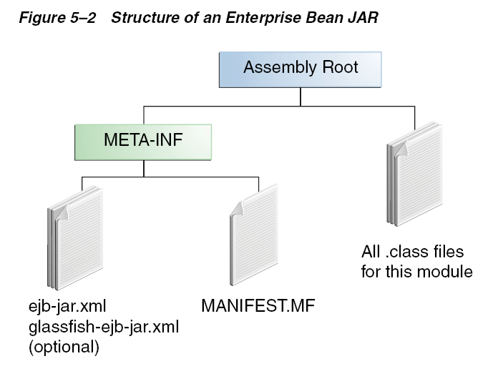
Packaging Enterprise Beans in EJB JAR Modules

Slide 28
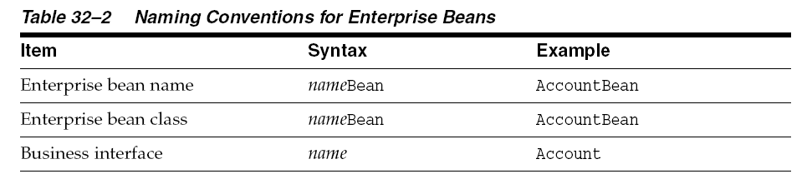
Naming Conventions for Enterprise Beans

