Slide 1
J2EE与中间件技术
——JSP技术

Slide 2
Custom Tags in JSP Pages
JSP technology also provides a mechanism for encapsulating other types of dynamic functionality in custom tags, which are extensions to the JSP language.
Some examples of tasks that can be performed by custom tags include operating on implicit objects, processing forms, accessing databases and other enterprise services such as email and directories, and implementing flow control.
Custom tags increase productivity because they can be reused in more than one application.

Slide 3
Using Custom Tags
Custom tags are user-defined JSP language elements that encapsulate recurring tasks. Custom tags are distributed in a tag library, which defines a set of related custom tags and contains the objects that implement the tags.
The object that implements a custom tag is called a tag handler.
When a JSP page containing a custom tag is translated into a servlet, the tag is converted to operations on a tag handler. The web container then invokes those operations when the JSP page’s servlet is executed.

Slide 4
Using Custom Tags
Custom tags have the syntax
  <prefix:tag attr1="value" ... attrN="value" />
or
  <prefix:tag attr1="value" ... attrN="value" >
    Body
  </prefix:tag>
where prefix distinguishes tags for a library, tag is the tag identifier, and attr1 ... attrN are attributes that modify the behavior of the tag.
Attributes customize the behavior of a custom tag just as parameters customize the behavior of a method.

Slide 5
Using Custom Tags
To use a custom tag in a JSP page, you must
  Declare the tag library containing the tag
  Make the tag library implementation available to the web application

Slide 6
Declaring Tag Libraries
To declare that a JSP page will use tags defined in a tag library, you include a taglib directive in the page before any custom tag from that tag library is used.
  <%@ taglib prefix="tt" [tagdir=/WEB-INF/tags/dir | uri=URI ] %>
The prefix attribute defines the prefix that distinguishes tags defined by a given tag library from those provided by other tag libraries.
If the tag library is defined with tag files, you supply the tagdir attribute to identify the location of the files. The value of the attribute must start with /WEB-INF/tags/.

Slide 7
Declaring Tag Libraries
The uri attribute refers to a URI that uniquely identifies the tag library descriptor (TLD), a document that describes the tag library.
  Tag library descriptor file names must have the extension .tld. TLD files are stored in the WEB-INF directory or subdirectory of the WAR file, or in the META-INF directory or subdirectory of a tag library packaged in a JAR.
  You can reference a TLD directly or indirectly.
  The following taglib directive directly references a TLD file name:
    <%@ taglib prefix="tlt" uri="/WEB-INF/iterator.tld"%>
  This taglib directive uses a short logical name to indirectly reference the TLD:
    <%@ taglib prefix="tlt" uri="/tlt"%>

Slide 8
main.jsp
<%@ taglib uri="/WEB-INF/tlds/stockPrice.tld" prefix="stock" %>
<html>
  <body>
    <h1>Today's Stock Price</h1>
    <p> <stock:stockPrice tickerSymbol="PRAS" /> </p>
    <p> <stock:stockPrice tickerSymbol="GIRD" /> </p>
  </body>
</html>

Slide 9
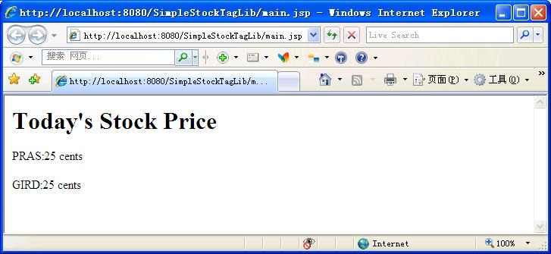

Slide 10
Tag library descriptor
If you want to redistribute your tag files or implement your custom tags with tag handlers written in Java, you must declare the tags in a tag library descriptor (TLD).
A tag library descriptor is an XML document that contains information about a library as a whole and about each tag contained in the library.
TLDs are used by a web container to validate the tags.

Slide 11
Declaring Tag Handlers
When tags are implemented with tag handlers written in Java, each tag in the library must be declared in the TLD with a tag element.
The tag element contains the tag name, the class of its tag handler, information on the tag’s attributes, and information on the variables created by the tag.
Each attribute declaration contains an indication of whether the attribute is required, whether its value can be determined by request-time expressions, the type of the attribute…...

Slide 12
stockPrice.tld
<?xml version="1.0" encoding="UTF-8"?>
<!DOCTYPE taglib PUBLIC "-//Sun Microsystems, Inc.//DTD JSP Tag Library 1.2//EN" "http://java.sun.com/dtd/web-jsptaglibrary_1_2.dtd" >
<taglib>
  <tlib-version>1.2</tlib-version>
  <jsp-version>2.0</jsp-version>
  <short-name>stock</short-name>

Slide 13
stockPrice.tld (cont.)
本例只有一个，用于处理<stock:stockPrice tickerSymbol="PRAS" />
  <tag>
  <name>stockPrice</name>
    <tag-class>tag.StockPriceHandler</tag-class>
    <body-content>empty</body-content>
    <attribute>
      <name>tickerSymbol</name>
      <required>true</required>
      <rtexprvalue>true</rtexprvalue> <type>java.lang.String</type>
    </attribute>
  </tag>
</taglib>
处理标签的类
处理程序的属性，是作为参数发送给处理程序的值
（本例中为"PRAS" ）
可以接受一个表达式作为值

Slide 14
Programming Simple Tag Handlers
The classes and interfaces used to implement simple tag handlers are contained in the javax.servlet.jsp.tagext package. Simple tag handlers implement the SimpleTag interface. For most newly created handlers, you would use the SimpleTagSupport classes as a base class.
The heart of a simple tag handler is a single method, doTag, which is invoked when the end element of the tag is encountered.
  public void doTag() throws JspException, IOException

Slide 15
Tag Handlers for Tags with Attributes
For each tag attribute, you must define a set method in the tag handler that conforms to the JavaBeans architecture conventions.

Slide 16
Programming Simple Tag Handlers
A tag handler has access to an API that allows it to communicate with the JSP page. The entry point to the API is the JSP context object (javax.servlet.jsp.JspContext).
The JspContext object provides access to implicit objects. PageContext extends JspContext with servlet-specific behavior. Through these objects, a tag handler can retrieve all the other implicit objects (request, session, and application) that are accessible from a JSP page.

Slide 17
StockPriceHandler.java
package tag;
import java.io.*;
import javax.servlet.jsp.*;
import javax.servlet.jsp.tagext.*;
public class StockPriceHandler extends SimpleTagSupport {
  private String myTickerSymbol;
  private String price = "25 cents";
  //根据myTickerSymbol，从数据库取数据price

Slide 18
StockPriceHandler.java
  public void setTickerSymbol(String ts) {
    myTickerSymbol = ts;
  }
  public void doTag() throws JspException,IOException{
    try {
      JspWriter out = getJspContext().getOut();
      out.println(myTickerSymbol + ":" + price);
    } catch (Exception e) {
      e.printStackTrace();
      throw new JspException(e.getMessage());
    }
  }
}

Slide 19
部署
StockTagLib
——main.jsp
——WEB-INF
————classes
——————tags
————————StockPriceHandler.class
————tlds
——————stockPrice.tld

Slide 20
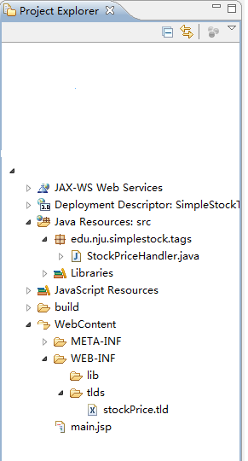
Eclipse

Slide 21
自定义/定制标签库
在简单的JSP标签后面隐藏复杂的功能
将复杂的功能封装在HTML风格的标签中：
  处理格式化任务
  访问外部资源

Slide 22
listStock.jsp
……
<%@ taglib prefix="stock" uri="/WEB-INF/tlds/stockPrice.tld" %>
……
<jsp:useBean id="listStock"
type="edu.nju.onlinestock.action.business.StockListBean"
scope="session"></jsp:useBean>
……
<TABLE>
<TBODY>

Slide 23
<TR>
  <TH width="20%">id</TH>
  <TH width="20%">companyName</TH>
  <TH width="20%">type</TH>
  <TH width="20%">price</TH>
  <TH width="20%">date</TH>
</TR>
<stock:stockPrice/>
</TBODY>
</TABLE>
……

Slide 24
stockPrice.tld
……
<tag>
  <name>stockPrice</name>
  <tag-class>edu.nju.onlinestock.tag.StockPriceHandler</tag-class>
  <body-content>empty</body-content>
  <attribute>
    <name>tickerSymbol</name>
    <required>false</required>
    <rtexprvalue>true</rtexprvalue>
    <type>java.lang.String</type>
  </attribute>
</tag>
</taglib>

Slide 25
StockPriceHandler.java
……
public class StockPriceHandler extends SimpleTagSupport {
  public void doTag() throws JspException, IOException {
    try {
      StockListBean listStock = (StockListBean) getJspContext().findAttribute("listStock");
      JspWriter out = getJspContext().getOut();
      for (int i = 0; i < listStock.getStockList().size(); i++) {
        out.println("<tr><TD align='center'>"+ listStock.getStockList(i).getId()+"</TD>");
        out.println("<TD align='center'>"+ listStock.getStockList(i).getCompanyName()+"</TD>");
        out.println("<TD align='center'>"+ listStock.getStockList(i).getType()+"</TD>");
        out.println("<TD align='center'>"+ listStock.getStockList(i).getPrice()+"</TD>");
        out.println("<TD align='center'>"+ listStock.getStockList(i).getDate()+"</TD></tr>");
      }
    } catch (Exception e) {
      e.printStackTrace();
      throw new JspException(e.getMessage());
    }
  }
}

Slide 26
自定义/定制标签库
在一定程度上实现了模块化
JSP程序员把程序的基本功能用自定义的标签库来实现；美工人员使用这些标签，专注于数据的表达

Slide 27
示例
验证用户状态
  已登录用户可访问，未登录用户转向登录页面
    用户通过URL直接访问XXXServlet或XXX.JSP时

Slide 28
XXXServlet常规解决方案—— doGet()/doPost()
HttpSession session = req.getSession(false);
if(session==null){
  String loginValue = req.getParameter("login");
  boolean isLoginAction = (null == loginValue) ? false : true;
  if (isLoginAction) { // User is logging in
    session = req.getSession(true);
    session.setAttribute("login",loginValue);
    ……
    resp.sendRedirect("/XXX/x.jsp");
  }else{
    resp.sendRedirect("/XXX/Login");
  }
}else{
  String loginValue = session.getAttribute("login").toString();
  ……
  resp.sendRedirect("/XXX/x.jsp");
}

Slide 29
*.jsp
<MyTag:checkSession />
扩展BodyTagSupport类

Slide 30
TagSupport与BodyTagSupport
二者区别
  标签处理类是否需要与标签体交互
doStartTag(),doEndTag()，doAfterBody()方法
  doStartTag()，遇到标签开始时调用，返回值
    EVAL_BODY_INCLUDE，显示标签间的文字，即标签体
    SKIP_BODY,不显示标签间的文字
  doEndTag()，遇到标签结束时调用，返回值
    EVAL_PAGE，处理完标签后继续执行以下的JSP页面
    SKIP_PAGE，不处理接下来的JSP页面
  doAfterBody()，显示完标签间文字之后调用，返回值
    EVAL_BODY_AGAIN，再显示一次标签间的文字
    SKIP_BODY，继续执行标签处理的下一步

Slide 31
Unified Expression Language
The primary new feature of JSP 2.1 is the unified expression language (unified EL), which represents a union of the expression language offered by JSP 2.0 and the expression language created for JavaServer Faces technology version 1.0.
The expression language introduced in JSP 2.0 allows page authors to use simple expressions to dynamically read data from JavaBeans components.
JavaServer Faces technology introduced its own expression language.

Slide 32
JSP 2.0 expression language
All expressions using the ${} syntax are evaluated immediately. These expressions can only be used within template text or as the value of a JSP tag attribute that can accept runtime expressions.
<fmt:formatNumber value="${sessionScope.cart.total}"/>
  The JSP engine evaluates the expression, ${sessionScope.cart.total}, converts it, and passes the returned value to the tag handler.
  Immediate evaluation expressions are always read-only value expressions. The expression shown above can only get the total price from the cart bean; it cannot set the total price.

Slide 33
Value and Method Expressions
The unified EL defines two kinds of expressions: value expressions and method expressions.
  All expressions that are evaluated immediately use the ${} delimiters and are always rvalue expressions.
  Method expressions primarily benefit JavaServer Faces technology.

Slide 34
Referencing Objects Using Value Expressions
Value expressions can refer to the following objects and their properties or attributes:
  JavaBeans components
  Collections
  Java SE enumerated types
  Implicit objects
To refer to these objects, you write an expression using a variable name with which you created the object. The following expression references a JavaBeans component called customer.
  ${customer}
The web container evaluates a variable that appears in an expression by looking up its value according to the behavior of PageContext.findAttribute(String), where the String argument is the name of the variable.
  For example, when evaluating the expression ${customer}, the container will look for customer in the page, request, session, and application scopes and will return its value. If customer is not found, null is returned.

Slide 35
Referring to Object Properties Using Value Expressions
To refer to properties of a bean or an Enum instance, items of a collection, or attributes of an implicit object, you use the . or [] notation.
  if you wanted to reference the name property of the customer bean, you could use either the expression ${customer.name} or the expression ${customer["name"]}.
  A property must at least have an accessor method called get<Property> (where <Property> is the name of the property) so that an expression can reference it.

Slide 36
A value expression also refers directly to values that are not objects, such as the result of arithmetic operations and literal values, as shown by these examples:
  ${"literal"}
  ${customer.age + 20}
  ${true}
  ${57}
The unified expression language defines the following literals:
  Boolean: true and false
  Integer: as in Java
  Floating point: as in Java
  String: with single and double quotes; " is escaped as \", ’ is escaped as \’, and \ is escaped as \\
  Null: null

Slide 37
Where Value Expressions Can Be Used
Value expressions using the ${} delimiters can be used in the following places:
  In static text
  In any standard or custom tag attribute that can accept an expression
The value of an expression in static text is computed and inserted into the current output. Here is an example of an expression embedded in static text:
  <some:tag>
    some text ${expr} some text
  </some:tag>

Slide 38
There are three ways to set a tag attribute value:
  With a single expression construct:
    <some:tag value="${expr}"/>
  With one or more expressions separated or surrounded by text:
    <some:tag value="some${expr}${expr}text${expr}"/>
  With text only:
    <some:tag value="sometext"/>

Slide 39
Defining a Tag Attribute Type
If you plan to create custom tags, you need to specify for each tag in the TLD what kind of expression it accepts.
  <rtexprvalue>true</rtexprvalue>
  You can use ${} syntax for a dynamic attribute, meaning an attribute that accepts dynamically-calculated values at runtime.

Slide 40
Implicit Objects
The JSP expression language defines a set of implicit objects:
  pageContext: The context for the JSP page. Provides access to various objects including:
    servletContext
    session
    request
    response
  param, paramValues, header, headerValues, cookie, initParam
  pageScope, requestScope, sessionScope, applicationScope

Slide 41
form.jsp——填充表单
<%@ page session="false" %>
<html>
<head>
  <title>Form Content</title>
</head>
<body>
  <h3>Fill-out-form</h3>
  <p><form action="form.jsp" method="GET">
    Name = <input type="text" name="myname" value="${ param['myname']}">
    <input type="submit" value="Submit Name">
    </form>
  <p>The Name is ${param.myname}
</body>
</html>

Slide 42
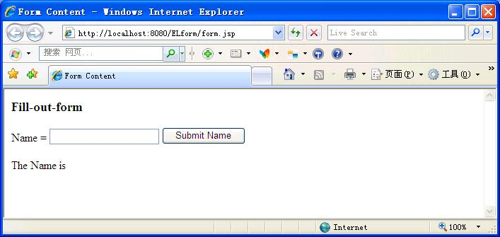

Slide 43
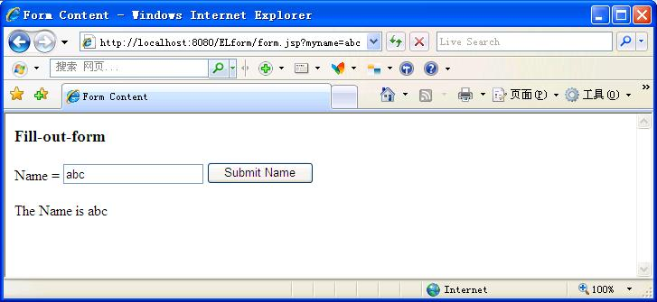

Slide 44
Functions
The JSP expression language allows you to define a function that can be invoked in an expression.
Functions can appear in static text and tag attribute values.
Functions are defined using the same mechanisms as custom tags.
To use a function in a JSP page, you use a taglib directive to import the tag library containing the function.
  <%@ taglib prefix="f" uri="/functions"%>

Slide 45
Defining Functions
To define a function, program it as a public static method in a public class.
Then map the function name as used in the EL expression to the defining class and function signature in a TLD.

Slide 46
compute.java
package mypkg;
import java.util.*;
public class compute{
  public static int add(String x, String y) {
    int a=0;
    int b=0;
    try{
      a=Integer.parseInt(x);
      b=Integer.parseInt(y);
    }catch(Exception e){
    }
    return a+b;
  }
}

Slide 47
computeAdd.tld
<taglib xsi:schemaLocation=http://java.sun.com/xml/ns/javaee webjsptaglibrary_2_1.xsd xmlns="http://java.sun.com/xml/ns/javaee" xmlns:xsi="http://www.w3.org/2001/XMLSchema-instance" version="2.1">
  <tlib-version>2.1</tlib-version>
  <jsp-version>2.0</jsp-version>
  <short-name>ELfunction</short-name>
  <function>
    <name>add</name>
    <function-class>mypkg.compute</function-class>
    <function-signature>int add( java.lang.String,
    java.lang.String )</function-signature>
  </function>
</taglib>

Slide 48
math.jsp
<%@ taglib prefix="my" uri="/WEB-INF/tlds/computeAdd.tld" %>
<html>
<body>
  <h3>Add Numbers</h3>
  <p>
  <form action="math.jsp" method="GET">
    X = <input type="text" name="x" value="${ param["x"]}">
    <br>
    Y = <input type="text" name="y" value="${ param["y"]}">
    <input type="submit" value="Add Numbers">
  </form>
  <p>The sum is: ${my:add(param["x"],param["y"])}
</body>
</html>

Slide 49
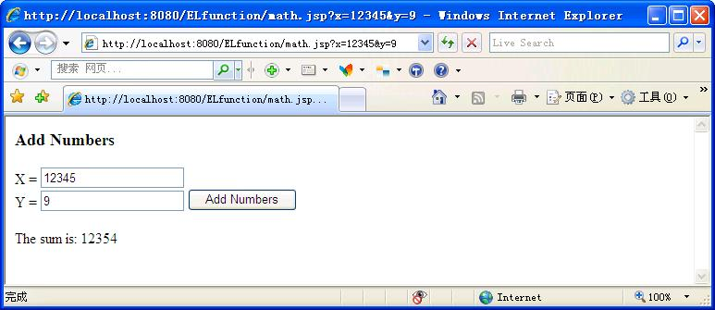

Slide 50
Tag File
A tag file is a source file containing a reusable fragment of JSP code that is translated into a simple tag handler by the web container.
Tag files allow you to create custom tags using JSP syntax. Just as a JSP page gets translated into a servlet class and then compiled, a tag file gets translated into a tag handler and then compiled.
The recommended file extension for a tag file is .tag.

Slide 51
Tag File Directives
Directives are used to control aspects of tag file translation to a tag handler, and to specify aspects of the tag, attributes of the tag, and variables exposed by the tag.
  The tag directive is similar to the JSP page’s page directive but applies to tag files.
    <%@ tag display-name= "stockPrice" %>
    display-name: A short name, Defaults to the name of the tag file without the extension .tag.
  To declare the attributes of a custom tag defined in a tag file, you use the attribute directive.
    <%@ attribute name="tickerSymbol" required="true" %>

Slide 52
stockPrice.tag
<%@attribute name="tickerSymbol"%>
${tickerSymbol} : 25 cents

Slide 53
StockTagLibTagFile
——mainTag.jsp
——WEB-INF
————tags
——————stockPrice.tag

Slide 54
mainTag.jsp
<%@ taglib prefix="stock" tagdir="/WEB-INF/tags" %>
<html>
  <body>
    <h1>Today's Stock Price</h1>
    <p> <stock:stockPrice tickerSymbol="PRAS" /> </p>
    <p> <stock:stockPrice tickerSymbol="GIRD" /> </p>
  </body>
</html>

Slide 55
Tags with Bodies
A simple tag can contain custom and core tags, HTML text, and tag-dependent body content between the start tag and the end tag.
  <prefix:tag attr1="value" ... attrN="value" >
    Body
  </prefix:tag>

Slide 56
Tag File
Tag File Directives
  tag directive
  <%@ tag bodycontent="empty | scriptless | tagdependent" %>
<jsp:doBody> action

Slide 57
body-content Attribute
You must declare the body content of tags that do not accept a body as empty.
Body content containing custom and standard tags and HTML text is specified as scriptless.
All other types of body content (for example, SQL statements passed to the query tag) is specified as tagdependent.
If no attribute is specified, the default is scriptless.

Slide 58
<jsp:doBody>
<jsp:doBody> action
告诉容器去处理body，并且将处理结果添加到response中

Slide 59
例子: display.tag
<%@attribute name="color"%>
<%@attribute name="bgcolor"%>
<%@attribute name="title"%>
<table border="0" bgcolor="${color}">
  <tr>
    <td><b>${title}</b></td>
  </tr>
  <td bgcolor="${bgcolor}"> <jsp:doBody/> </td>
  </tr>
</table>

Slide 60
newsportal.jsp
<%@ taglib prefix="tags" tagdir="/WEB-INF/tags" %>
<html>
<body>
  <table border="0">
    <tr valign="top">
    <td>
    <tags:display color="#ff0000" bgcolor="#ffc0c0" title="Travel">
      Last French Concorde Arrives in NY
      <br/>Another Travel Headline
      <br/>Yet Another Travel Headline
      <br/>
    </tags:display>
    </td>

Slide 61
newsportal.jsp
    <td>
    <tags:display color="#00fc00" bgcolor="#c0ffc0" title="Technology">
      Java for in-flight entertainment
      <br>Another Technology Headline
      <br>Yet Another Technology Headline
      <br>
    </tags:display>
    </td>
    <td>
    <tags:display color="#ffcc11" bgcolor="#ffffcc" title="Sports">
      American Football
      <br/>NBA
      <br/>Soccer
      <br/>
    </tags:display>
    </td>
    </tr>
  </table>
</body>
</html>

Slide 62
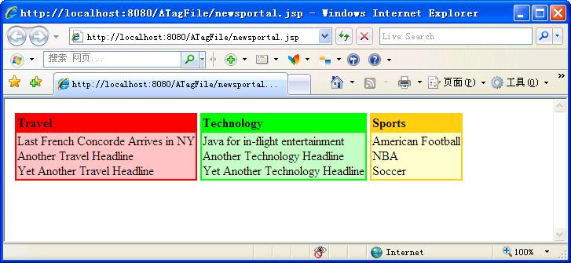

Slide 63
JavaServer Pages Standard Tag Library
The JavaServer Pages Standard Tag Library (JSTL) encapsulates core functionality common to many JSP applications.
JSTL has tags such as iterators and conditionals for handling flow control, tags for manipulating XML documents, internationalization tags, tags for accessing databases using SQL, and commonly used functions.

Slide 64
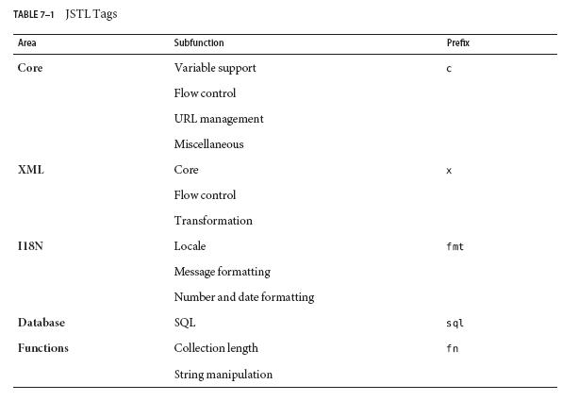
JSTL

Slide 65
Core Tag Library
Variable Support Tags
Flow control tags: eliminate the need for scriptlets
  Conditional Tags
  Iterator Tags

Slide 66
Variable Support Tags
The set tag sets the value of an EL variable or the property of an EL variable in any of the JSP scopes (page, request, session, or application). If the variable does not already exist, it is created.
  <c:set var="foo" scope="session" value="..."/>
To remove an EL variable, you use the remove tag.
  <c:remove var="cart" scope="session"/>

Slide 67
Conditional Tags
The if tag allows the conditional execution of its body according to the value of the test attribute.
  <c:if test="${!empty param.Add}">
    ……
  </c:if>
The choose, when, and otherwise tags can be used to construct an if-then-else statement as follows:
  <c:choose>
    <c:when test="${count == 0}" >
    No records matched your selection.
    </c:when>
    <c:otherwise>
    ${count} records matched your selection.
    </c:otherwise>
  </c:choose>

Slide 68
Iterator Tags
The forEach tag allows you to iterate over a collection of objects. You specify the collection using the items attribute, and the current item is available through a variable named by the var attribute.
  <c:forEach var="item" items="${sessionScope.cart.items}">
    ...
    <tr>
    <td align="right" bgcolor="#ffffff">
    ${item.quantity}
    </td>
    ...
  </c:forEach>

Slide 69
URL Tags
The import tag is the simple, generic way to access URL-based resources, whose content can then be included and or processed within the JSP page.
  <c:import url="/books.xml" var="xml" />
The url tag takes param subtags to include parameters in the returned URL.
The redirect tag sends an HTTP redirect to the client.

Slide 70
Miscellaneous Tags
The catch tag provides a complement to the JSP error page mechanism.
The out tag evaluates an expression and outputs the result of the evaluation to the current JspWriter object.

Slide 71
XML Tag Library
Core Tags
  provide basic functionality to easily parse and access XML data.
Flow Control Tags
Transformation Tags
  The transform tag applies a transformation, specified by an XSLT stylesheet set by the attribute xslt, to an XML document, specified by the attribute doc.

Slide 72
Core Tags
The parse tag parses an XML document and saves the resulting object in the EL variable specified by attribute var.
The set tag evaluates an XPath expression and sets the result into a JSP EL variable specified by attribute var.
The out tag evaluates an XPath expression on the current context node and outputs the result of the evaluation to the current JspWriter object.

Slide 73
Internationalization Tag Library
Setting the Locale
  The setLocale tag is used to override the client-specified locale for a page.
Messaging Tags
  You can set the resource bundle at runtime with the JSTL fmt:setBundle and fmt:bundle tags
  The message tag is used to output localized strings.
Formatting Tags
  The formatNumber tag is used to output localized numbers

Slide 74
SQL Tag Library
The JSTL SQL tags for accessing databases are designed for quick prototyping and simple applications.
  The setDataSource tag allows you to set data source information for the database.
  The query tag performs an SQL query that returns a result set.
  The update tag is used to update a database row.
For production applications, database operations are normally encapsulated in JavaBeans components.

Slide 75
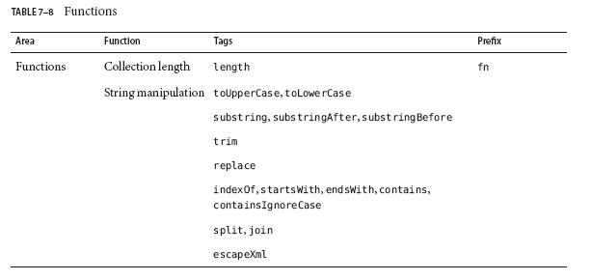
JSTL Functions

Slide 76
示例：Tomcat配置JSTL
http://archive.apache.org/dist/jakarta/taglibs/standard/binaries/
jakarta-taglib-standard-1.1.2.zip
解压
  文件夹：lib、tld、doc、javadoc
  文件： license, notice, readme和standard-doc.war, standard-examples.war
将lib下的standard.jar和jstl.jar复制到<Tomcat_home>\libs下;
将tld下的*.tld复制到<webapp_home>\WEB-INF下。

Slide 77
示例
stockPriceJSTL.tag
  <%@attribute name="tickerSymbol"%>
  <%@ taglib prefix="c" uri="http://java.sun.com/jsp/jstl/core" %>
  <c:set var="price" value="25 cents"/>
  ${tickerSymbol} : ${price}

Slide 78
mainTagJSTL.jsp
<%@ taglib prefix="stock" tagdir="/WEB-INF/tags" %>
……
<h1>Today's Stock Price</h1>
<p> <stock:stockPriceJSTL tickerSymbol="PRAS" /> </p>
<p> <stock:stockPriceJSTL tickerSymbol="GIRD" /> </p>
</body>
</html>

Slide 79
StockJSTL
——mainTagJSTL.jsp
——WEB-INF
————tags
——————stockPriceJSTL.tag
————c.tld

Slide 80
JSTL
The URIs for the libraries are as follows:
  Core: http://java.sun.com/jsp/jstl/core
  XML: http://java.sun.com/jsp/jstl/xml
  Internationalization: http://java.sun.com/jsp/jstl/fmt
  SQL: http://java.sun.com/jsp/jstl/sql
  Functions: http://java.sun.com/jsp/jstl/functions

Slide 81
JSF
JavaServer Faces technology is a server-side component framework for building Java technology-based web applications.
JavaServer Faces technology provides a well-defined programming model and various tag libraries.

Slide 82
Developing a simple JavaServer Faces application
typically requires the following tasks:
  Developing managed beans
  Creating web pages using component tags
  Mapping the FacesServlet instance

Slide 83
Hello World_Developing the Managed Bean
a managed bean is a lightweight container
  package edu.nju.hellojsf.mbeans;
  import javax.faces.bean.ManagedBean;
  @ManagedBean
  public class Hello {
    final String world = "Hello World!";
    public String getworld() {
      return world;
    }
  }

Slide 84
The @ManagedBean annotation registers the managed bean as a resource with the JavaServer Faces implementation.

Slide 85
Creating the Web Page
In a typical Facelets application, web pages are created in XHTML.
  beanhello.xhtml
<html lang="en" xmlns=http://www.w3.org/1999/xhtml xmlns:h=http://java.sun.com/jsf/html >
<h:head>
  <title>Facelets Hello World</title>
</h:head>
<h:body>
  #{hello.world}
</h:body>
</html>

Slide 86
The web page connects to the managed bean through the Expression Language (EL) value expression #{hello.world}, which retrieves the value of the world property from the managed bean Hello.
Note the use of hello to reference the managed bean Hello.
  If no name is specified in the @ManagedBean annotation, the managed bean is always accessed with the first letter of the class name in lowercase.

Slide 87
Facelets vs JSP
The term Facelets refers to the view declaration language for JavaServer Faces technology.
JSP technology, does not support all the new features available in JavaServer Faces in the Java EE 7 platform.

Slide 88
Facelets
Facelets is a powerful but lightweight page declaration language that is used to build JavaServer Faces views using HTML style templates and to build component trees.
  Use of XHTML for creating web pages
  Support for Facelets tag libraries in addition to JavaServer Faces and JSTL tag libraries
  Support for the Expression Language
  Templating for components and pages

Slide 89
#{hello.world}
1、在常规的JSP应用中，请求处理模型只有一个阶段即页面渲染，所以表达式可以立即求值返回给响应response即可。而且表达式只需要从后台对象中取值显示。JSP中表达式语言以“$”开头。
2、在JSF中请求处理模型分解成了6个阶段，每个阶段都有可能用到表达式，所以要求表达式支持延期求值。即在不同的阶段都可以通过表达式语言访问特定的对象。用户在界面输入内容后在postback期间要赋给服务器端的对象，所以需要表达式有赋值功能。另外在验证数据和处理事件，需要后台托管bean的方法，所以表达式需要支持方法调用。JSF表达式语言以“#”开头。

Slide 90
Mapping the FacesServlet Instance
web.xml
<servlet>
  <servlet-name>Faces Servlet</servlet-name>
  <servlet-class>javax.faces.webapp.FacesServlet</servlet-class>
  <load-on-startup>1</load-on-startup>
</servlet>
<servlet-mapping>
  <servlet-name>Faces Servlet</servlet-name>
  <url-pattern>/faces/*</url-pattern>
</servlet-mapping>

Slide 91
The Lifecycle of the hello Application
1. When the hello application is built and deployed on the Server, the application is in an uninitiated state.
2. When a client makes an initial request for the beanhello.xhtml web page, the hello Facelets application is compiled.
3. The compiled Facelets application is executed, and a new component tree is constructed for the hello application and is placed in a FacesContext.

Slide 92
4. The component tree is populated with the component and the managed bean property associated with it, represented by the EL expression hello.world.
5. A new view is built, based on the component tree.
6. The view is rendered to the requesting client as a response.
7. The component tree is destroyed automatically.
8. On subsequent (postback) requests, the component tree is rebuilt, and the saved state is applied.

Slide 93
Eclipse+JSF
创建动态Web项目过程中，在配置中
  选择JSF2.0
  下载Lib，选择Apache

Slide 94
